Slide 1
Relation between the newly derived ECR criterion and the QUENCH LOCA test results
H.G. Sonnenburg, GRS
19th International QUENCH Workshop
Karlsruhe Institute of Technology
Campus North, H.-von-Helmholtz-Platz 1, 76344 Egg.-Leopoldshafen
November 19-21, 2013

Slide 2
Overview
  Phenomena During LOCA Transient
  Development of a New ECR-Criterion
  KIT QUENCH LOCA Tests for Safety Assessment

Slide 3

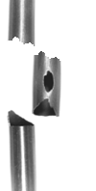
Phenomena during LOCA
Oxidation
secondary Hydriding
Temperature
at burst
~800°C
Temperature
Thermal shock
Quenching fluid shakes the broken fuel rod
135°C
Time
Depletion of ~ 0.1 m fuel if:
a) cladding burst
b) high burn-up
Depletion of ~ 1.5 m fuel if:
a) cladding is already burst
b) no residual ductility left
c) high burn-up
Depletion phenomenon seen in
HALDEN and STUDSVIK
Depletion phenomenon seen in
STUDSVIK by shaking the rod

Slide 4
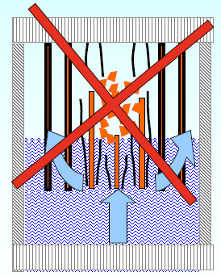
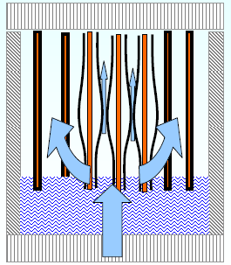
Present Regulatory Limit for LOCA (international)
Maintain coolable geometry
Keep fuel inside cladding
Prevent breaking cladding
Maintain residual ductility in cladding
Limit oxidation
(Limit hydriding - not considered yet)
  Oxidation limits
    Keep equivalent cladding reacted below 17% → ECR < 17%
    Keep oxidation temperature below 1200°C → PCT < 1200°C
    Keep hydriding below ??? → ECR=ECR(H)

Slide 5
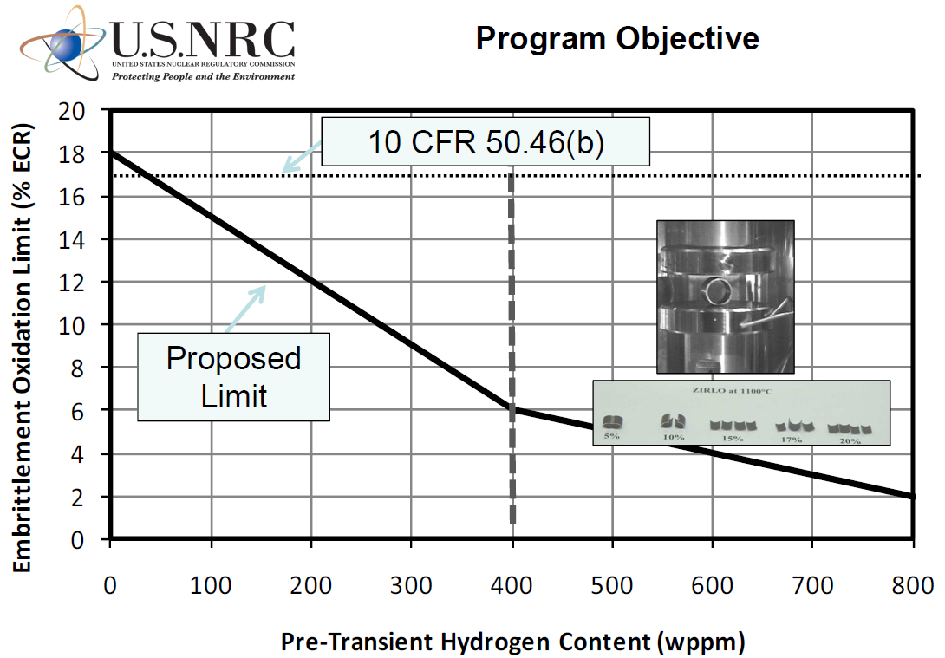
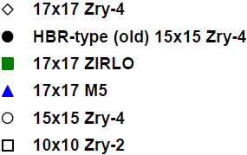
Need for new ECR Criterion
Proposal from U.S.NRC derived from Ring Compression Tests (offset strain >2%)
Proposed criterion relies on a few tests
which fall close to zero ductility
17% ECR
Secondary
Hydriding
during
LOCA ?

Slide 6
Alternative Approach to Derive the ECR Criterion

Slide 7
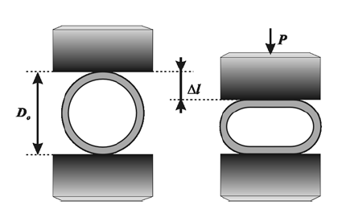
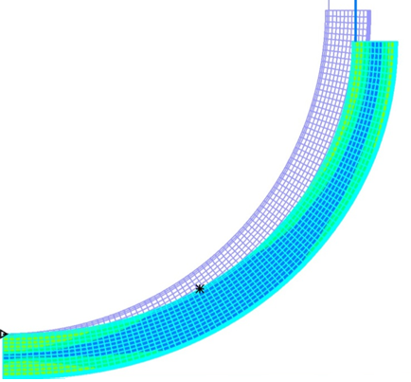
Finite Element Method
  ECR → total O-up-take
  Leistikov → ZrO-, ZrO2-layers → O in prior-b-layer
  MATPRO → E(O), n(O), K(O) → σYield(Ο)
  Finite Element (ADINA): localization of maximum equivalent stress → σBurst(ε)
Load (N)
700
600
ADINA
σBurst(ε)
500
400
300
Ring Compression Test (ANL)
200
100
0
0
1
2
3
4
Displacement (mm)

Slide 8
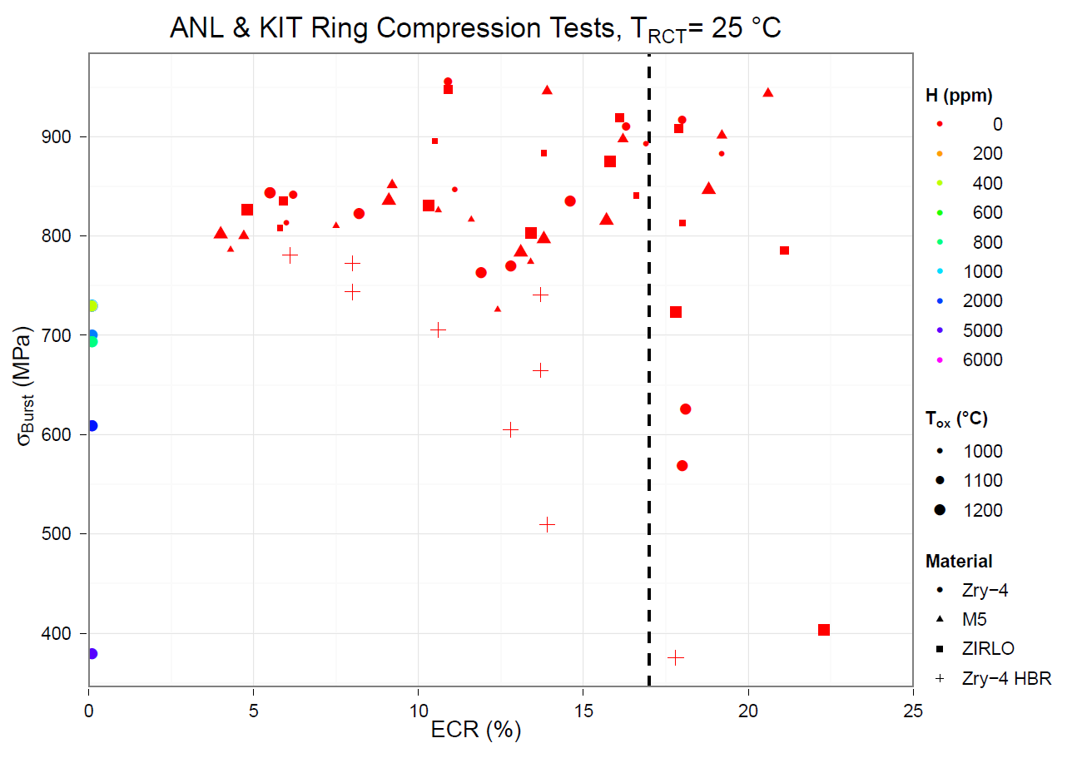
Burst Stresses from 65 RCTs (room temperature) out of 102 RCTs

Slide 9
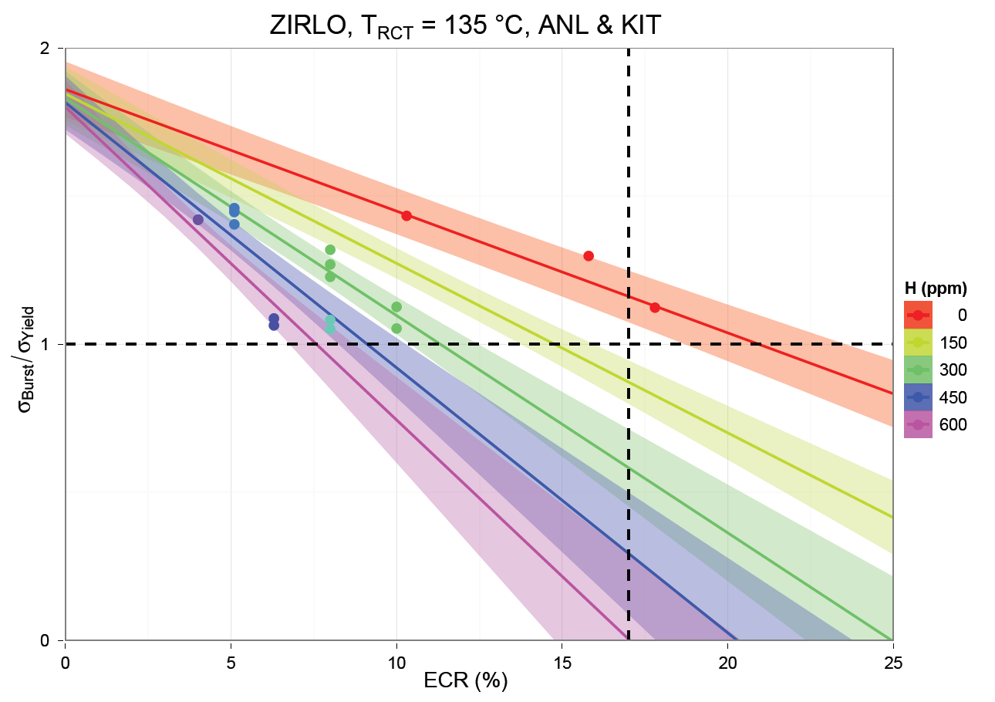
Stress Ratio R = Function (Material, T_{RCT}, ECR, ppm H)
Zero-ductility: R = 1
ECR = 17%

Slide 10
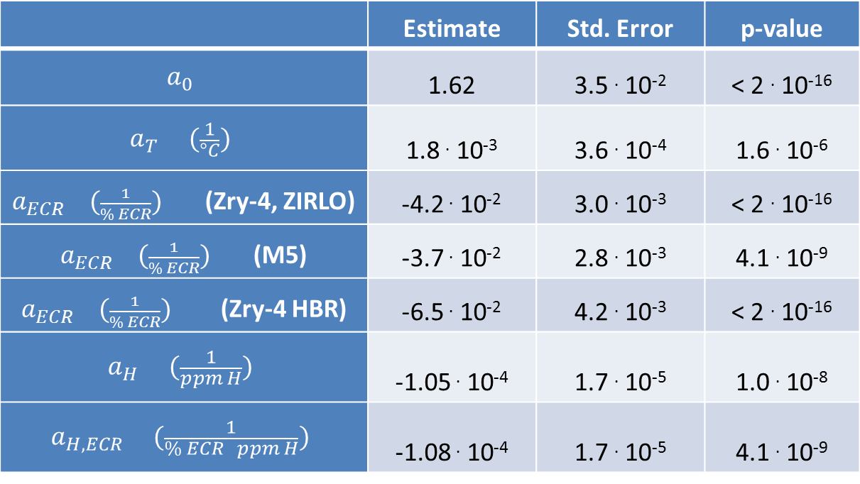
Linear Regression for Stress Ratio R
$$R=\frac{σ_{burst}}{σ_{yield}}=a_{0}+\left(a_{ECR}{+a}_{H,ECR}c\left(H\right)\right)ECR+a_{T}T{+a}_{H}c\left(H\right)$$
based on 102 RCTs
 | Estimate | Std. Error | p-value
$$a_{0}$$ | 1.62 | 3.5 . 10⁻² | < 2 . 10⁻¹⁶
$$a_{T} (\frac{1}{°C})$$ | 1.8 . 10⁻³ | 3.6 . 10⁻⁴ | 1.6 . 10⁻⁶
$a_{ECR} (\frac{1}{\% ECR})$ (Zry-4, ZIRLO) | -4.2 . 10⁻² | 3.0 . 10⁻³ | < 2 . 10⁻¹⁶
$a_{ECR} (\frac{1}{\% ECR})$ (M5) | -3.7 . 10⁻² | 2.8 . 10⁻³ | 4.1 . 10⁻⁹
$a_{ECR} (\frac{1}{\% ECR})$ (Zry-4 HBR) | -6.5 . 10⁻² | 4.2 . 10⁻³ | < 2 . 10⁻¹⁶
$$a_{H} (\frac{1}{ppm H})$$ | -1.05 . 10⁻⁴ | 1.7 . 10⁻⁵ | 1.0 . 10⁻⁸
$$a_{H,ECR} (\frac{1}{\% ECR ppm H})$$ | -1.08 . 10⁻⁴ | 1.7 . 10⁻⁵ | 4.1 . 10⁻⁹

Slide 11
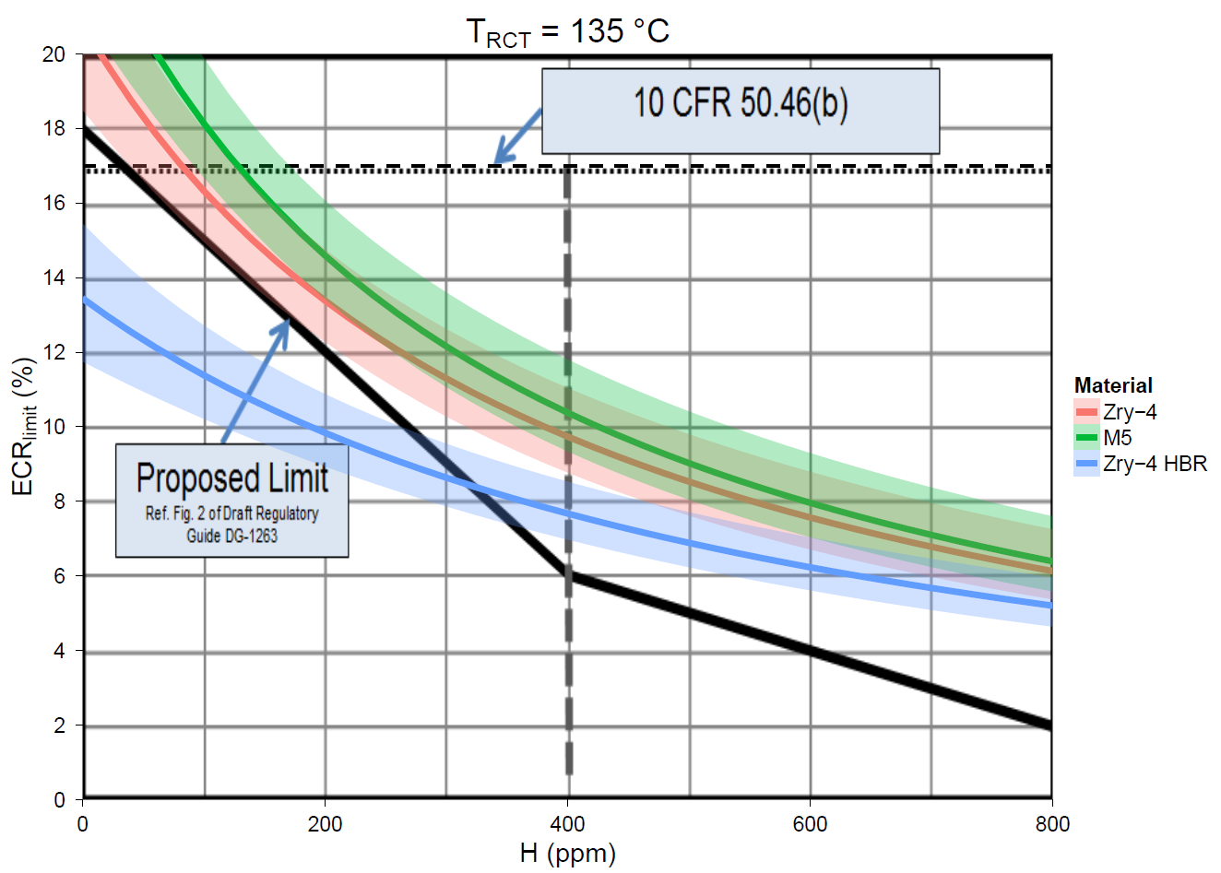

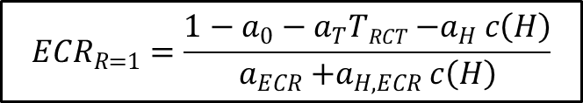
Zero-Ductility
$${ECR}_{R=1}$$
$${ECR}_{R=1}=\frac{1−a_{0}−a_{T}TRCT{−a}_{H}c\left(H\right)}{a_{ECR}{+a}_{H,ECR}c\left(H\right)}$$
ECR in %
secondary
hydriding
during
LOCA ?
H in wppm

Slide 12
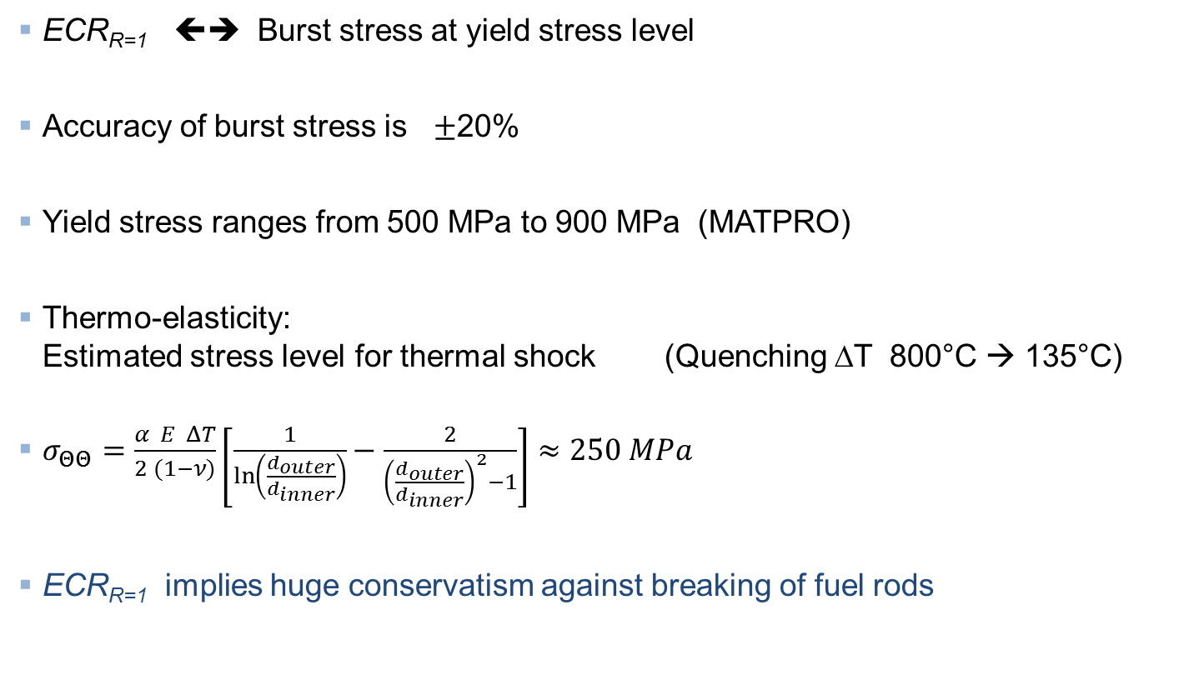
Conservatism of ECR_{R=1}
  ECR_{R=1} ⬅➔ Burst stress at yield stress level
  Accuracy of burst stress is $±$20%
  Yield stress ranges from 500 MPa to 900 MPa (MATPRO)
  Thermo-elasticity:
  Estimated stress level for thermal shock (Quenching ΔT 800°C → 135°C)
  $σ_{ΘΘ}=\frac{α E ΔT}{2 (1−ν)}\left[\frac{1}{ln⁡\left(\frac{d_{outer}}{d_{inner}}\right)}−\frac{2}{{\left(\frac{d_{outer}}{d_{inner}}\right)}^{2}−1}\right]≈250 MPa$
  ECR_{R=1} implies huge conservatism against breaking of fuel rods

Slide 13
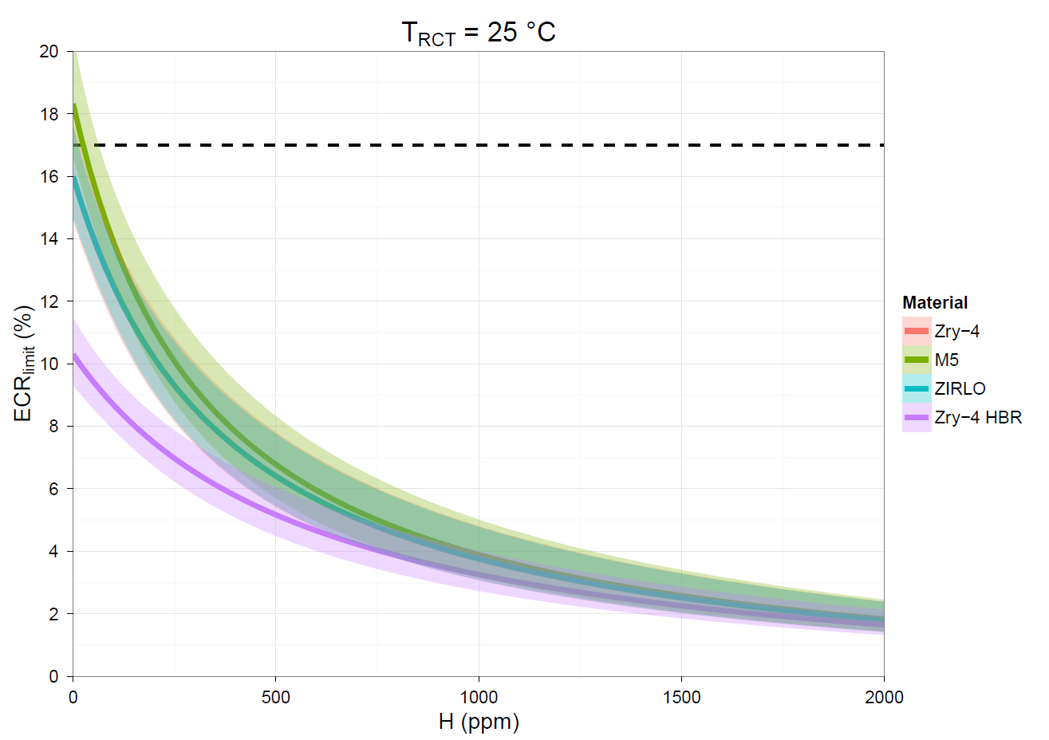
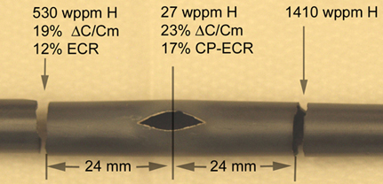
Prototypic Fuel Rod Bundle Tests for Safety Assessment
obsolete 17% ECR limit
Oxidation/Hydriding inacceptable
ECR (%)
ECR_{R<1}
OCZL#19
ECR_{R=1}
Expected Prototypic Bundle Tests at KIT
ECR_{R>1}
Oxidation/Hydriding acceptable

Slide 14
Conclusion
  Fuel rod behaviour under LOCA can be assessed
  including hydriding / oxidation near burst opening
  even at high H content
  New criterion: ECR_{R=1} prevents
  KIT bundle tests (QUENCH LOCA test) provide
  combination of hydriding and oxidation near burst opening
  Safety assessment → Comparison between H / ECR and ECR_{R=1}

