Slide 1
Neutron and X-ray imaging investigations concerning the QUENCH program
M. Grosse, R. Nshimirimana¹, M. Steinbrück, C. Rössger, C. Grünzweig², A. Kaestner², N. Kardjilov³, Y. Onel⁴
¹ NECSA Pretoria (SA), ² PSI Villigen (CH), ³ Helmholtz-Zentrum Berlin, ⁴ BAM Berlin

Slide 2
Outline
Introduction
High Energy X-ray Tomography of the QUENCH-DEBRIS bundle
Separate Effect Tests
- Reaction of oxygen stabilized α-Zry-4 in nitrogen atmosphere
- Investigations of quenched SiC tubes
Neutron Tomography of QUENCH-L1 specimens
Neutron Radiography of QUENCH-L2 specimens
Summary and Conclusions

Slide 3
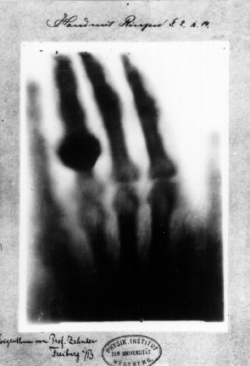
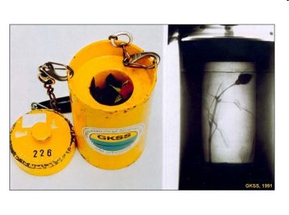
Introduction
X-ray radiography
neutron radiography
GKSS Geesthacht 1991
Mirco Grosse

Slide 4
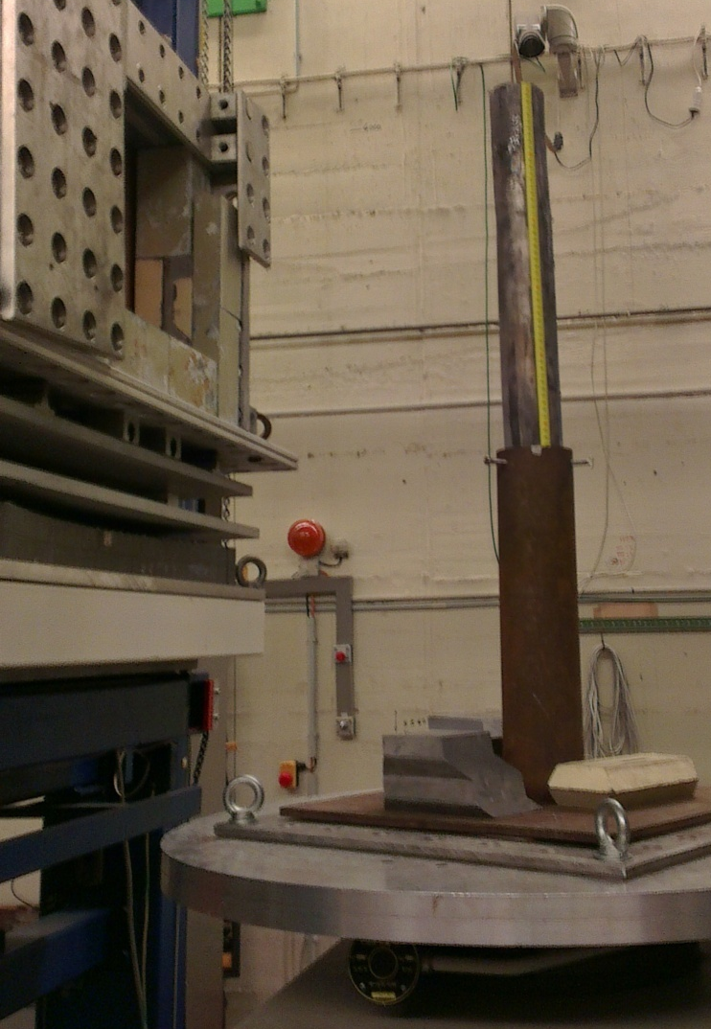
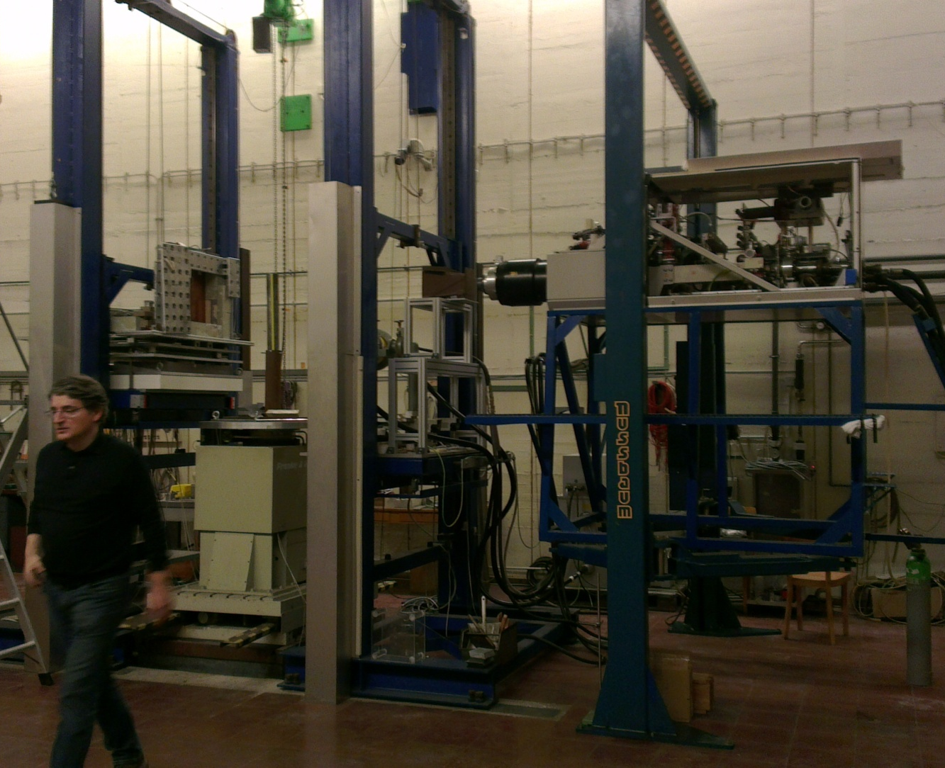
High Energy X-ray Tomography of the QUENCH-DEBRIS bundle
High energy X-ray tomography facility at the „Bundesanstalt für Materialforschung und –prüfung“ in Berlin

Slide 5
High Energy X-ray Tomography of the QUENCH-DEBRIS bundle
Experiment parameters:
Maximal X-ray energy: 12 MeV
Pixel size: 0.29 mm
Scintillator material: CsJ
Spatial resolution: ~1.5 mm
Number of projections: 720
Illumination time: 2 s/ frame
Reconstruction software: OCTOPUS

Slide 6
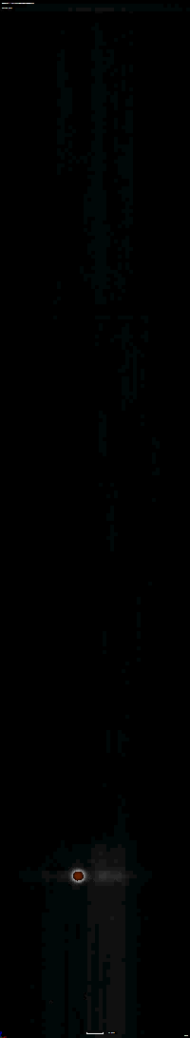
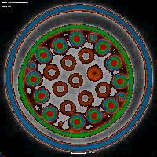
High Energy X-ray Tomography of the QUENCH-DEBRIS bundle
Two debris clusters are formed
Open volumes can be detected
Debris consist of larger segments of broken claddings and smaller pellet fragments
W
Hf
Zr, ZrO₂
Steel

Slide 7
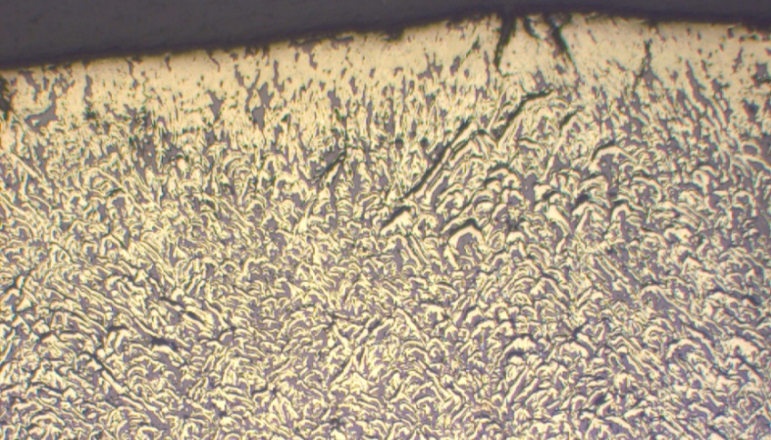
Separate-Effect Tests
Wavelength dependend in-situ neutron radiography investigations of the reaction of oxygen stabilized α-Zry-4 in nitrogen atmosphere at 1373 K
Goal: Answer the question: Are ZrO₂ and ZrN immediately formed at temperature or is Zr(O,N)_{x} formed at reaction temperature and decomposes into ZrO₂ and ZrN during cool down?
Investigation method: wavelength dispersed neutron radiography
Background: Neutron attenuation depends on absorption and scattering

Slide 8
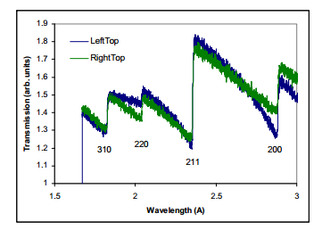
Separate-Effect Tests
Example: Strain and texture in a steel weld
Bragg edges at wave-lengths where a reflection is not longer possible
(A. Tremsin at ORNL User Meeting 2013)

Slide 9
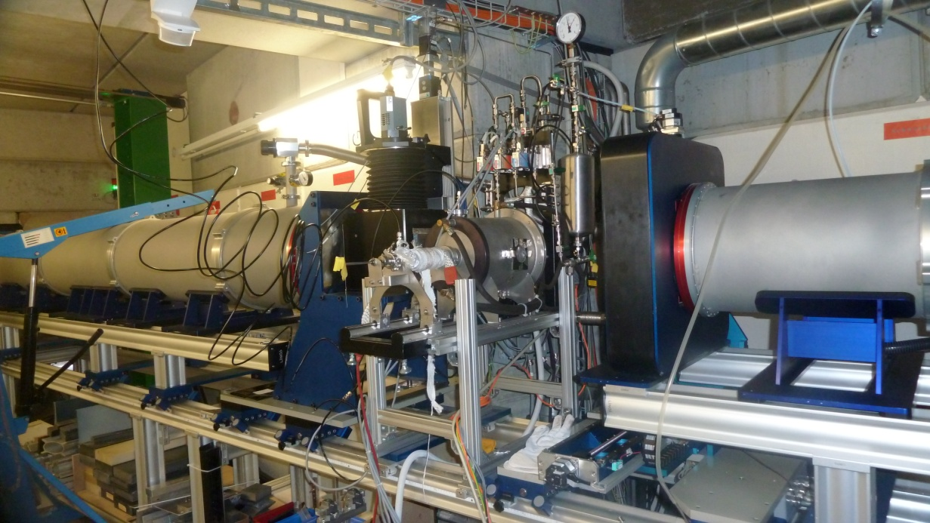
Separate Effect Tests
Temperature: 1373 , 1273, 1073, 873 and 373 K
Wavelength: 4.2 .. 7.1 step 0.1
Wavelength resolution: Δλ/λ ~ 15 %

Slide 10
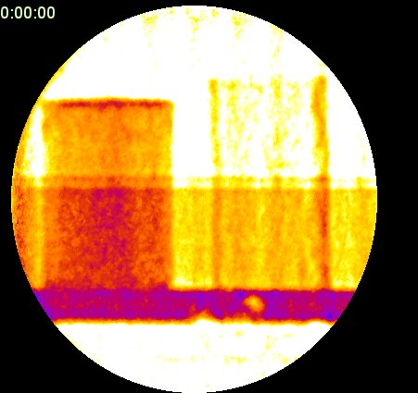
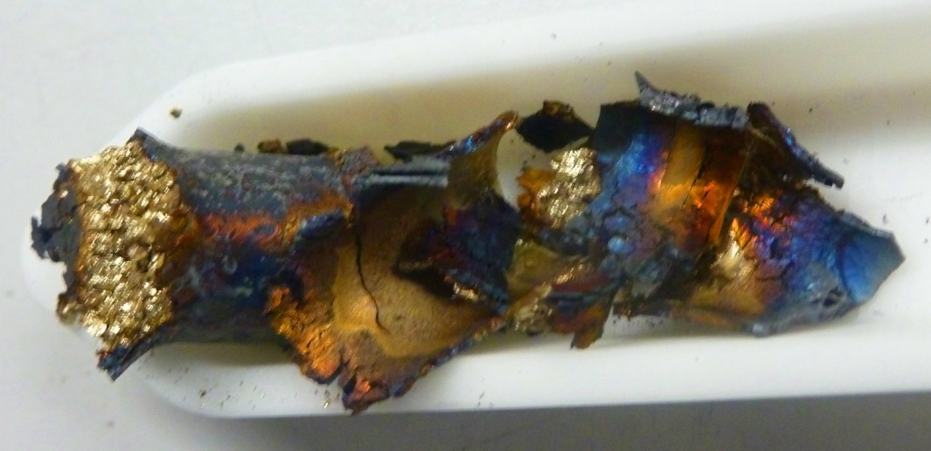
Separate Effect Tests

Slide 11
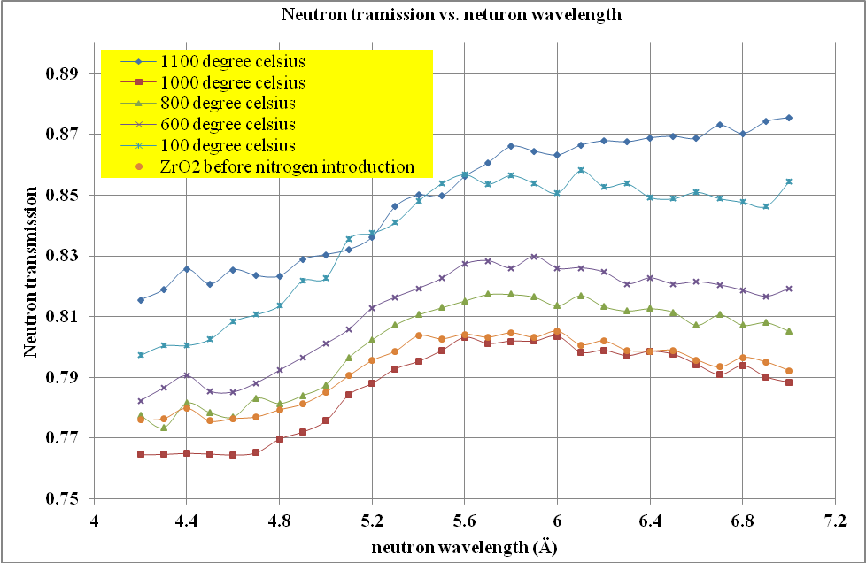
Separate-Effect Tests
No clear Bragg edges were detected

Slide 12
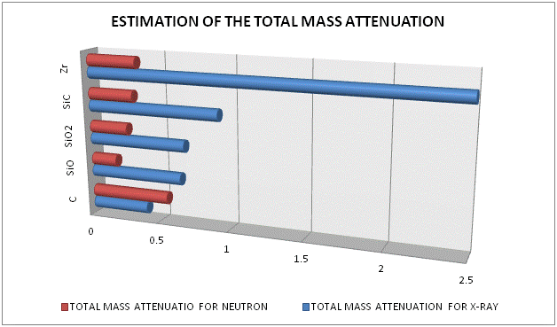
Separate-Effect Tests
X-ray (KIT) and Neutron (BENSC) Tomography Investigations at quenched SiC Samples

Slide 13
Separate-Effect Tests

Slide 14
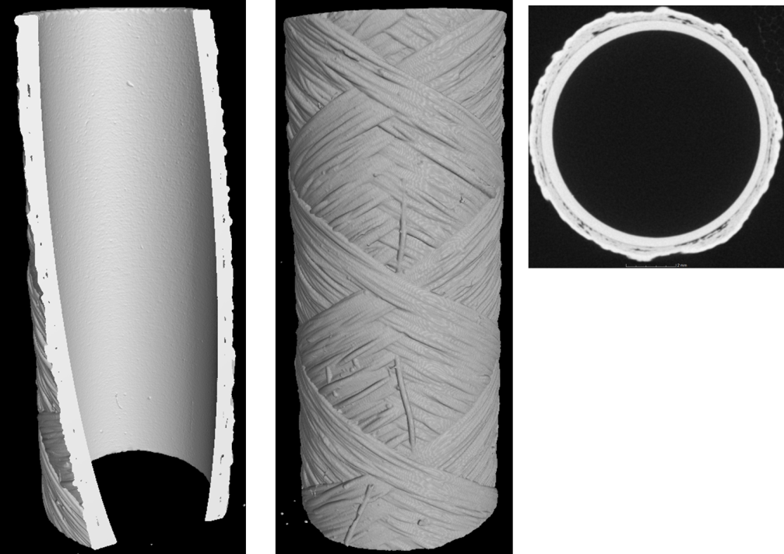
Separate-Effect Tests
As-received state (reference, delivered by CTP)
Consist of SiC fiber layers and monoblock SiC
SiC fibers are not compact empty spaces between fibers and monoblock layer
X-ray tomography

Slide 15
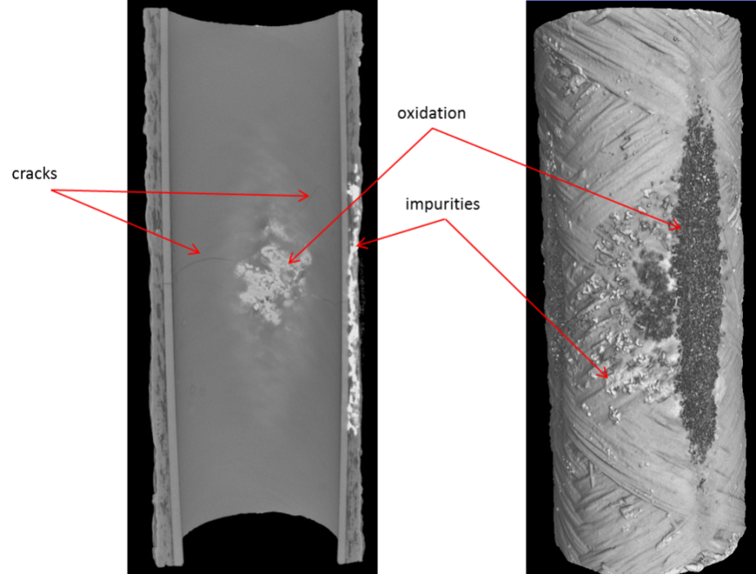
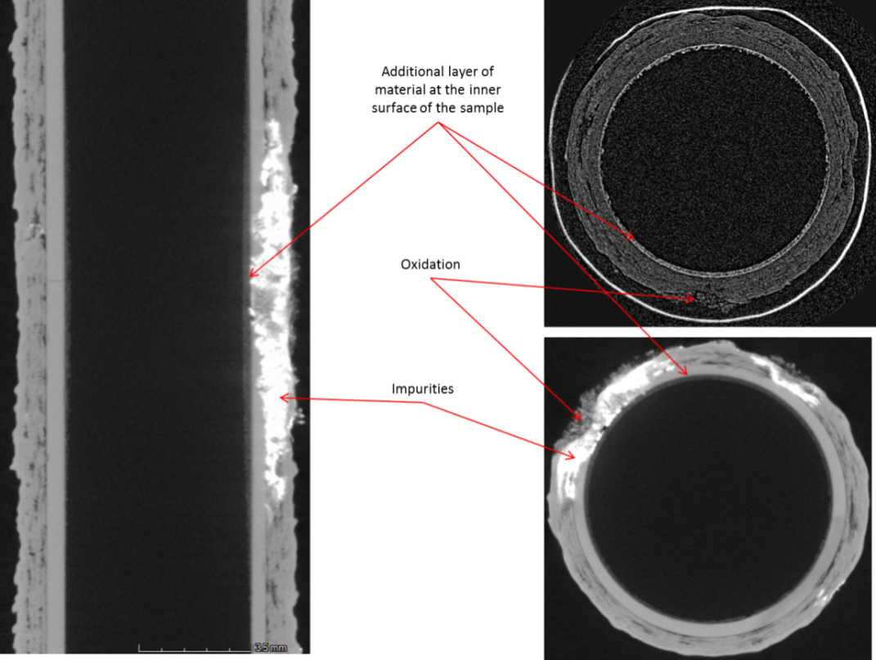
Separate-Effect Tests
Heat-up in inert atmosphere and quenching
Inhomogeneous oxidation and formation of cracks in the monoblock layer

Slide 16
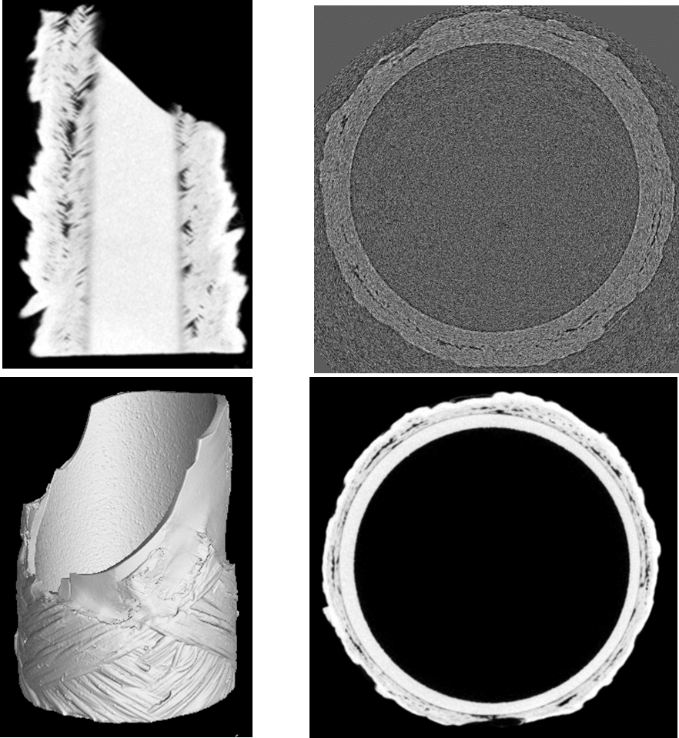
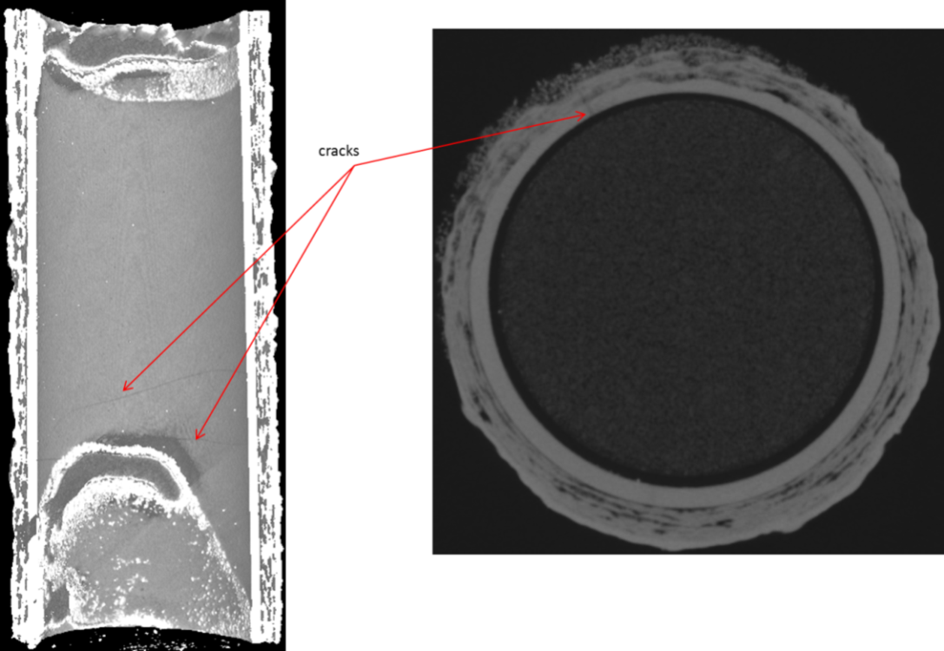
Separate-Effect Tests
Heating up in inert atmosphere until 1400°C, then in steam to 2000°C, quenching
One sample was brocken and also in the other samples cracks are formed

Slide 17
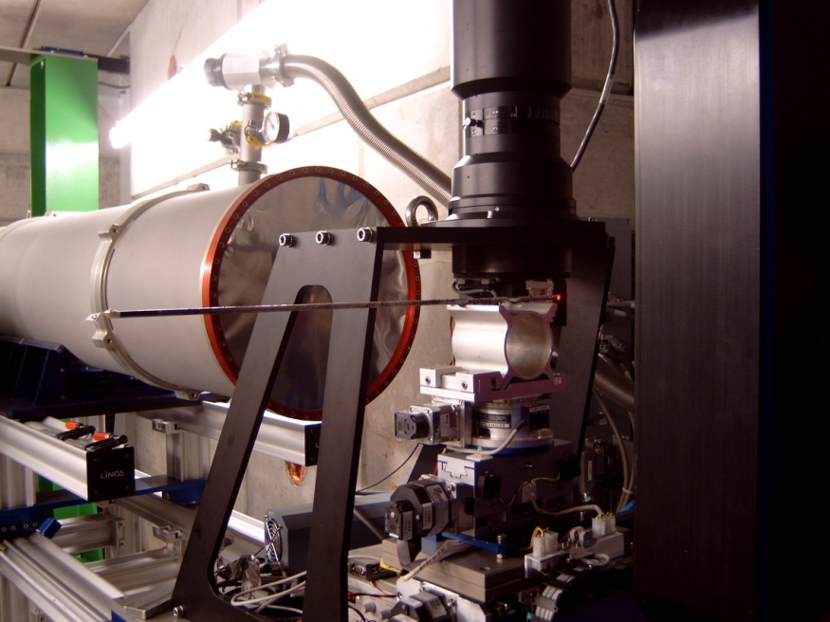
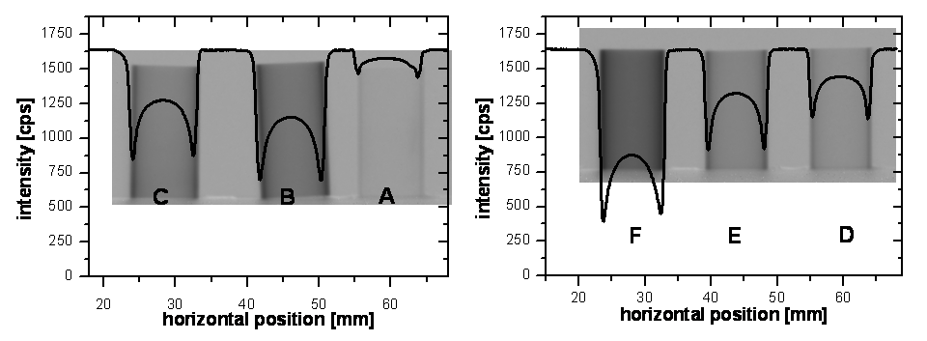
Neutron Radiography and Tomography of QUENCH-LOCA specimens
Neutron tomography investigations were performed at the ConRad facility at the Berlin Neutron Scattering Center in June 18 – 21 2013
Neutron radiography measurements were performed at Nov. 1 2013 at the ICON facility at the SINQ neutron source at the Paul Scherrer Institute Villigen, Switzerland

Slide 18
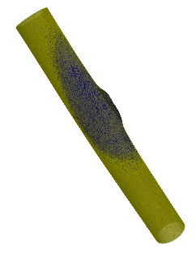
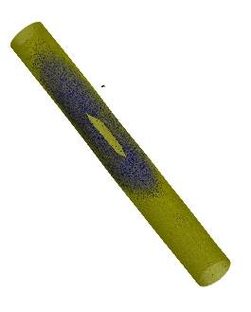
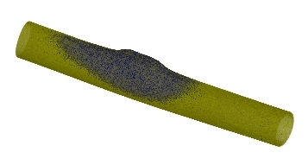
Neutron Tomography of QUENCH-L1 specimens
Maximal hydrogen concentrations, wt.ppm
#02 1690
#03 880
#07 540
#08 970
#09 1270
less than the values found for QUENCH-L0 claddings (max. 2660 wt.ppm)

Slide 19
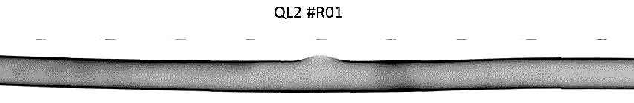


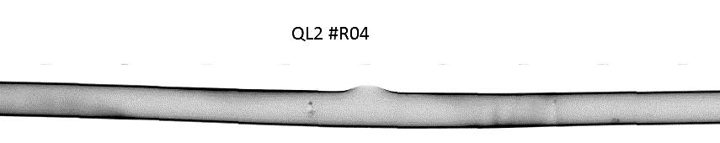
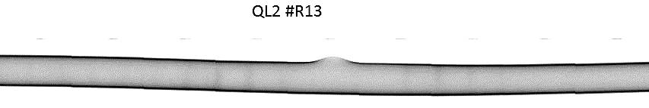
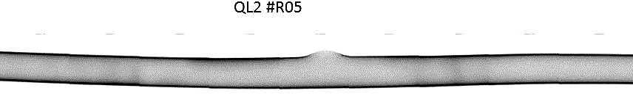
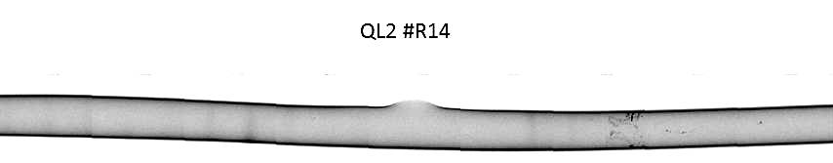
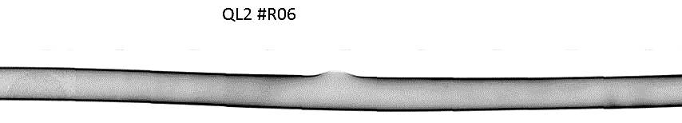
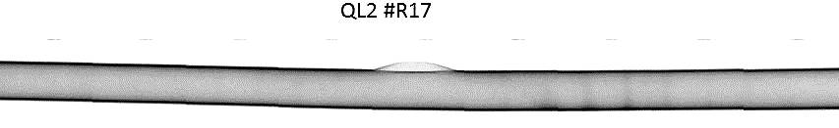
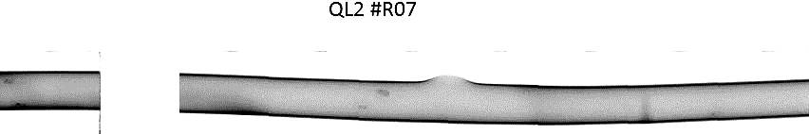
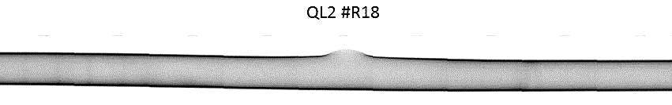
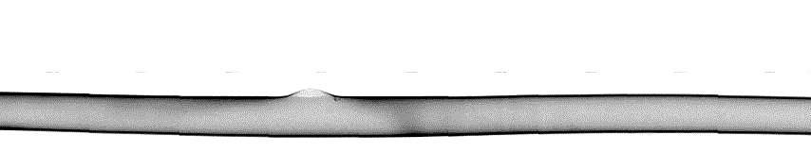
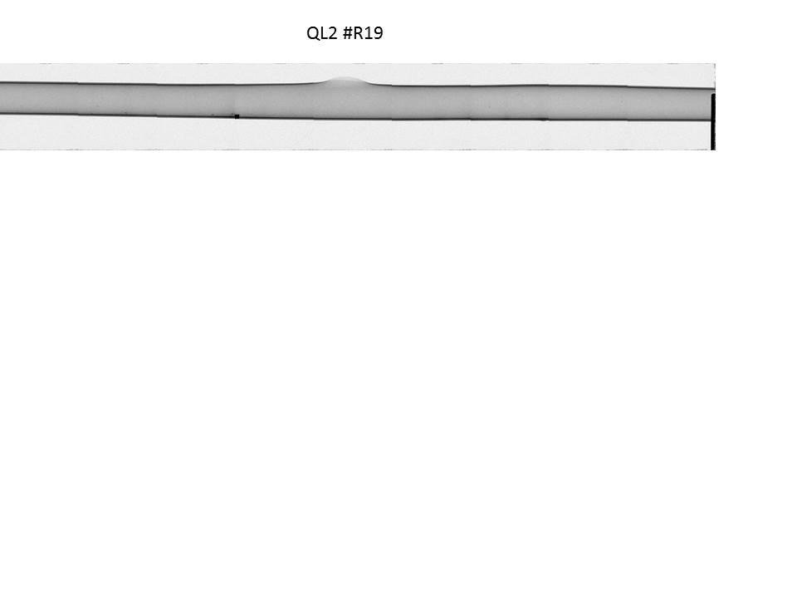
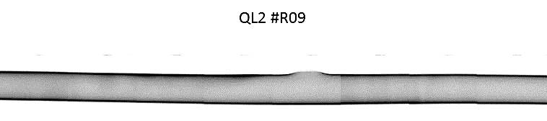
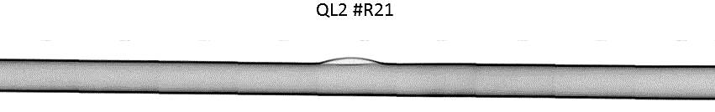
Neutron Radiography of QUENCH-L2 specimens
#01
#02
#04
#05
#06
#07
#08
#09
#10
#12
#13
#14
#17
#18
#19
#21

Slide 20
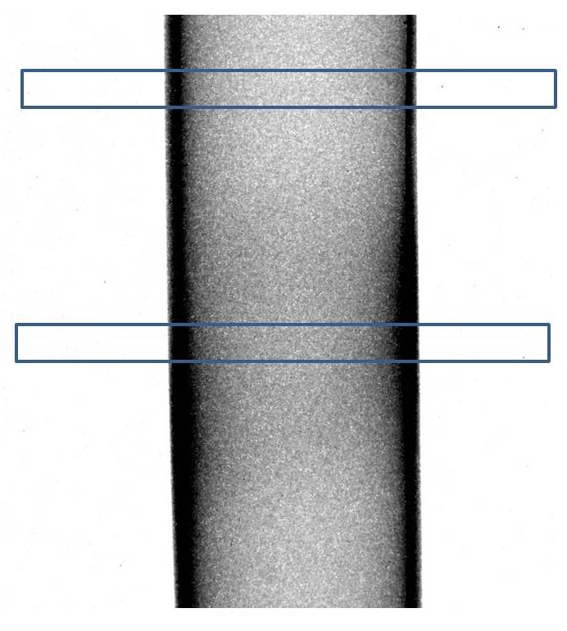
Neutron Radiography of QUENCH-L2 specimens
440 wt.ppm
Neutron tomography will be performed at the ANTARES facility of FRM2 in Garching at Dec. 9 – 12 2013

Slide 21
Summary and Conclusions
Radiography and Tomography investigations provide important information about material distribution, oxidation, crack formation and hydrogen concentration and distribution.
For different objectives different types of radiation has to be applied depending on the attenuation contrasts of the interesting materials.
The debris distribution in the QUENCH-DEBRIS bundle was determined.
The nitriding of oxygen stabilized α-Zry-4 was studied in-situ by neutron radiography. The determination of the phase composition by detection of the wavelength dependence of the neutron attenuation was not yet successful.
SiC tube segments were investigated by means of X-ray and neutron tomography after oxidation and quenching from 2000°C. Inhomogeneous oxidation and the formation of cracks in the inner layer was detected.
Hydrogen concentrations and distribution in QUENCH-LOCA specimens were investigated by means of neutron radiography and tomography. Differences between the claddings applied in the QUENCH-L1 and –L2 were found.

Slide 22
Thanks
KIT (Germany):
the QUENCH team in particular V. Avincola (now at MIT Cambridge, USA till end of this month), J. Stuckert, J. Moch, U. Stegmaier and U. Peters
A. Maier for the X-ray investigations
BAM, BENSC and PSI
all technical and administrative support during the experiments
Thank you for your attention

