Slide 1
First Results of Neutron Radiography and Tomography of QUENCH-L0 cladding tubes
Mirco Grosse, Camille Goulet

Slide 2
Content
Neutron radiography
Secondary hydriding
Experiments
Results
- Radiography
- Tomography
Conclusions

Slide 3
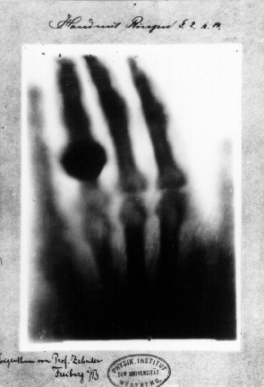
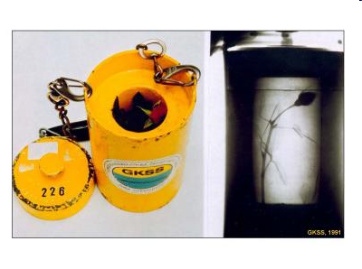
Neutron radiography
GKSS Geesthacht 1991
X-ray radiography
neutron radiography

Slide 4
Neutron radiography
Neutron transmission:
Total macroscopic neutron cross section:
N: number density of the isotope
σ: microscopic neutron cross section

Slide 5
Neutron radiography
System Zr - H

Slide 6
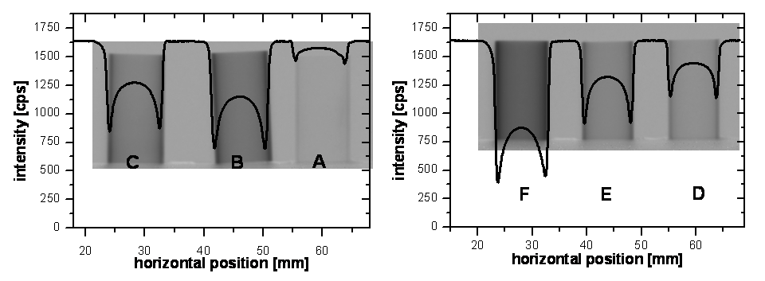
Neutron radiography
Calibration

Slide 7
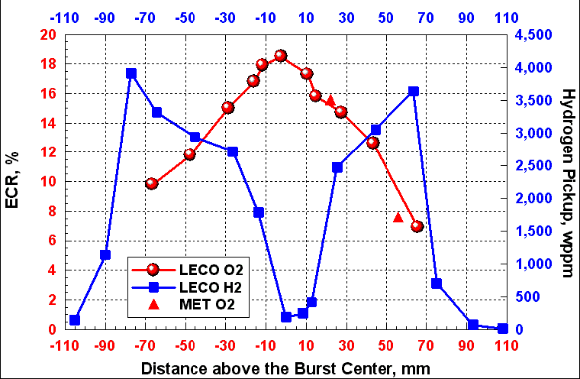
Secondary hydriding
M. Billone et al. NUREG/CR-6967/ANL-07/04

Slide 8
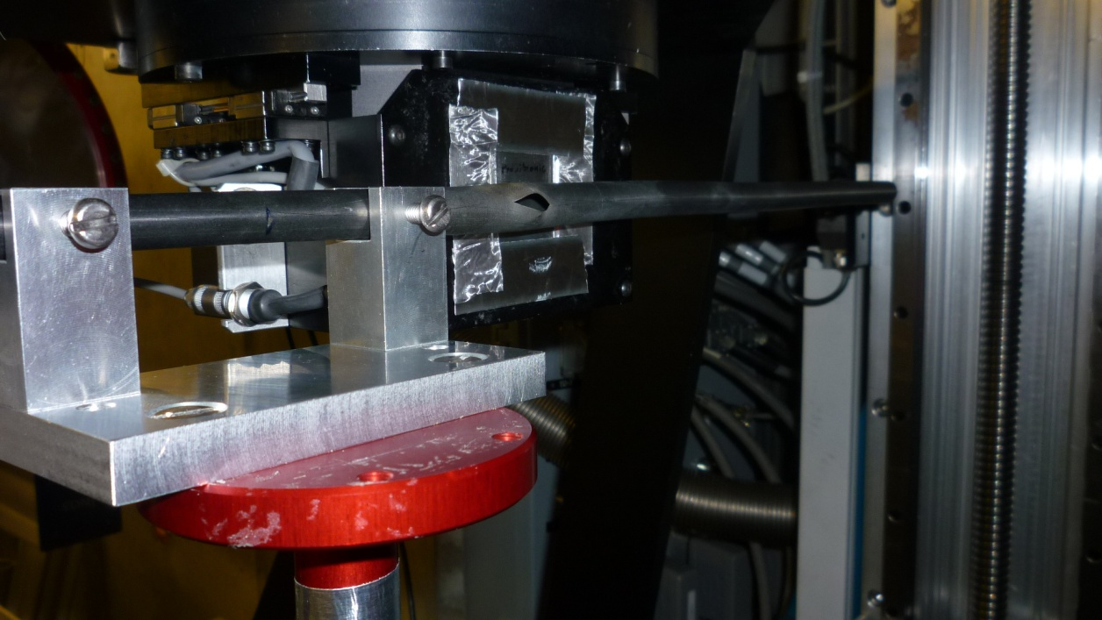
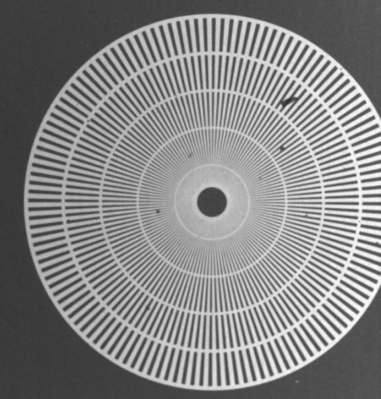

Experiments
ICON facility (SINQ, PSI Villigen, CH)
13.-16.08.2010 (radiography)
09.-17.09.2010 (tomography)
Illumination time per image: 300 s (radiography)
625 x 90 s (tomography)
Spatial resolution: ~ 23 µm

Slide 9
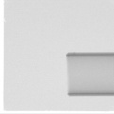
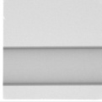
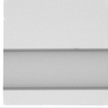


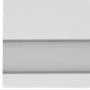

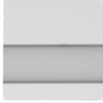
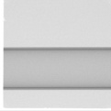
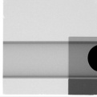
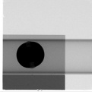
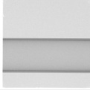
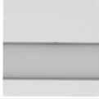
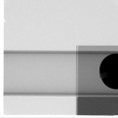

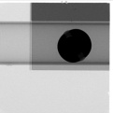
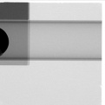




Radiography, rod 15 (p_{i} = 3 bar)
Z=700mm
Z=1120mm
Σ = 0.215,
Is in the range measured for not- oxidized Zry-4
(Σ = 0.197 .. 0.216)

Slide 10
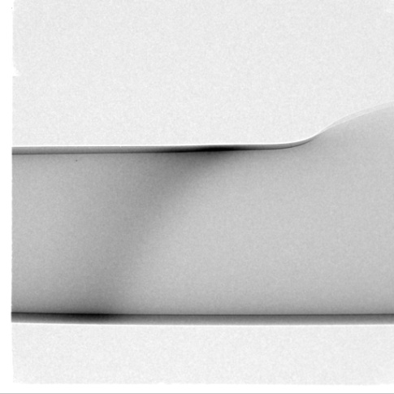
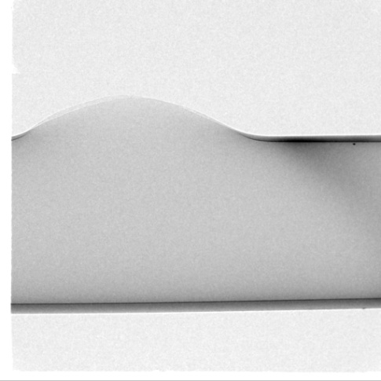
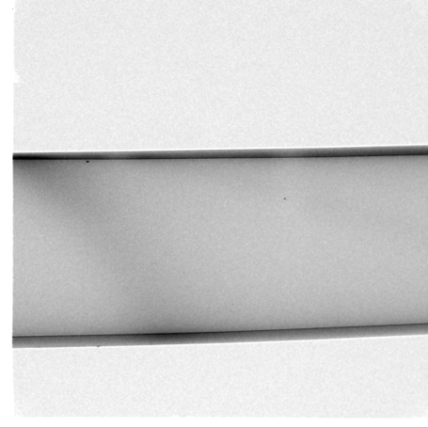
Radiography, rod 03 (p_{i} = 55 bar, Δt = 104 s)

Slide 11
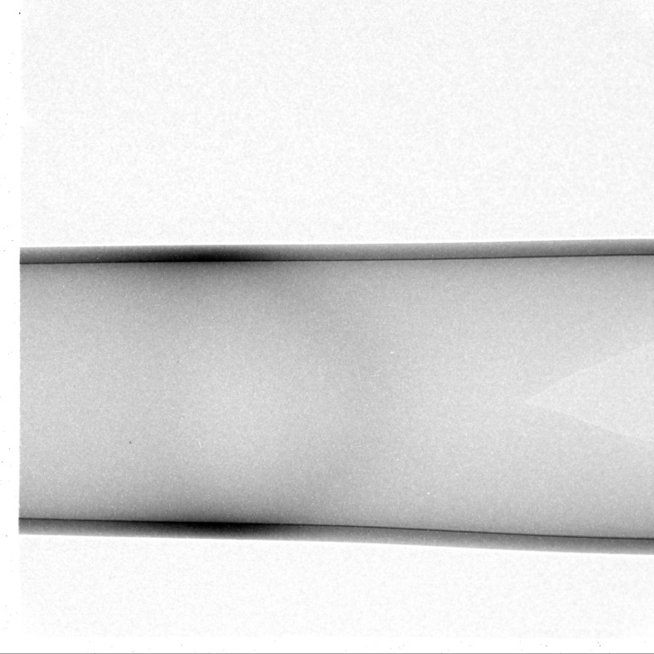
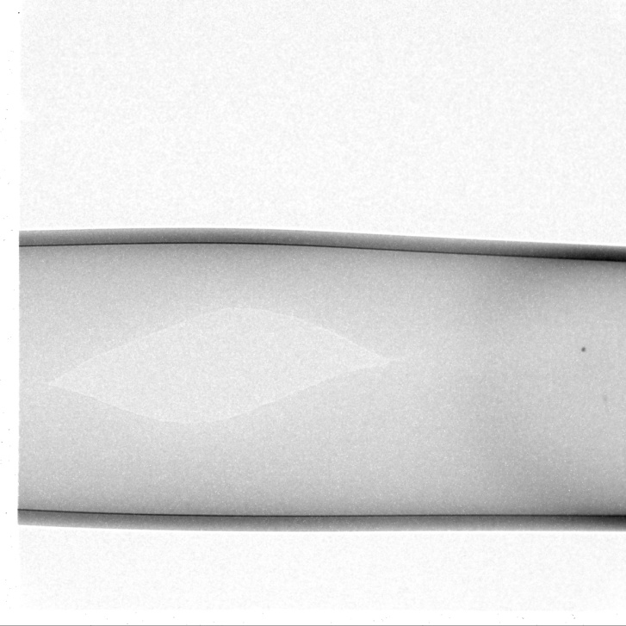
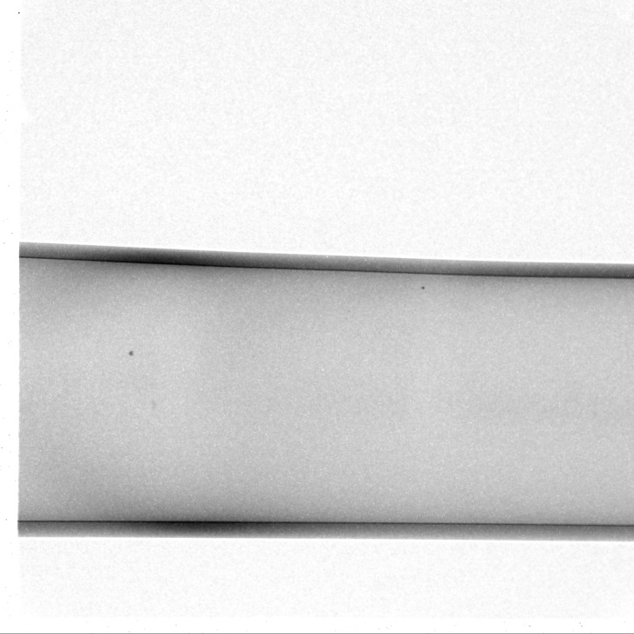
Radiography, rod 03 (p_{i} = 55 bar, Δt = 104 s)
rod rotated by 90°

Slide 12
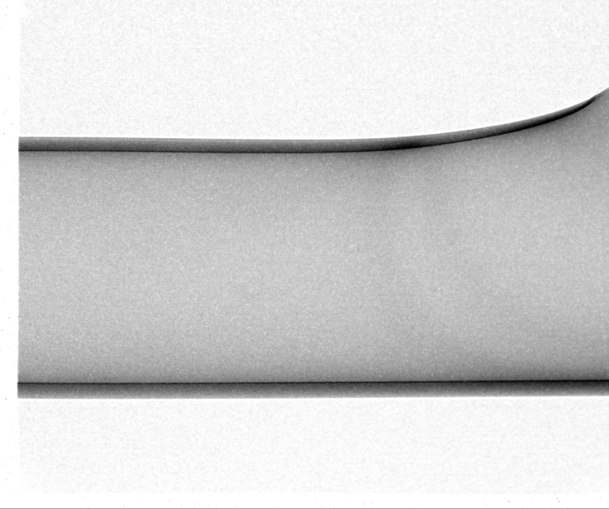
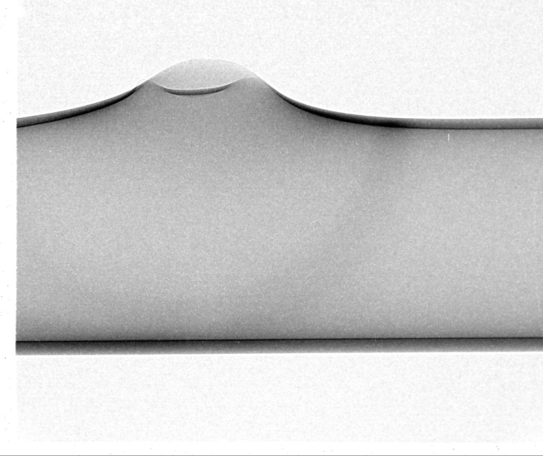
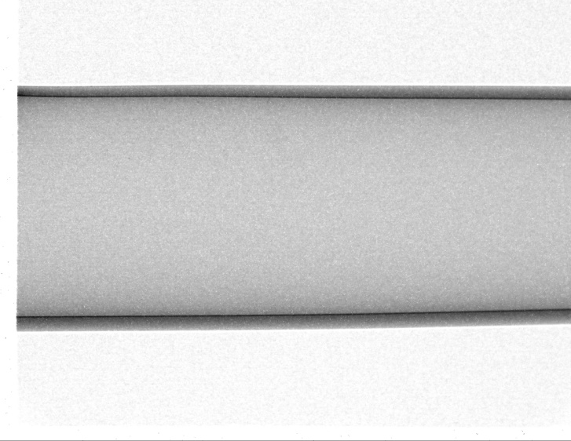
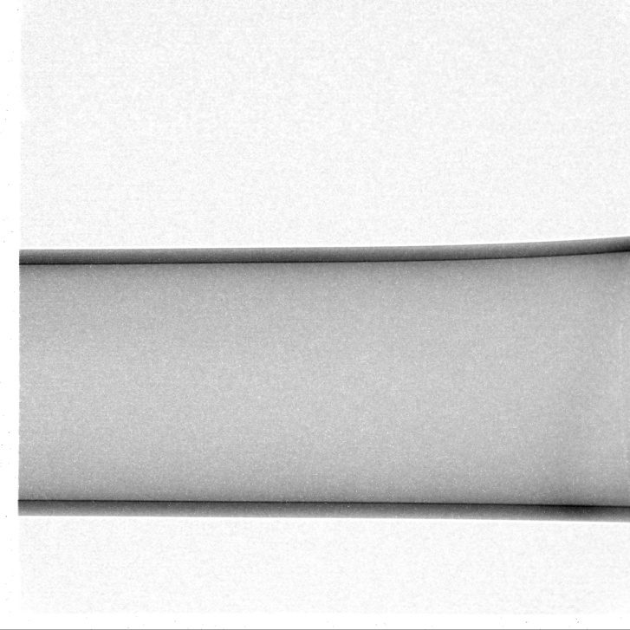
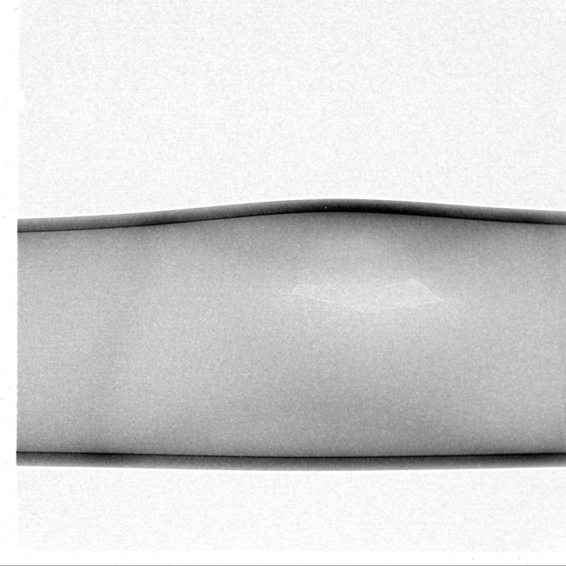
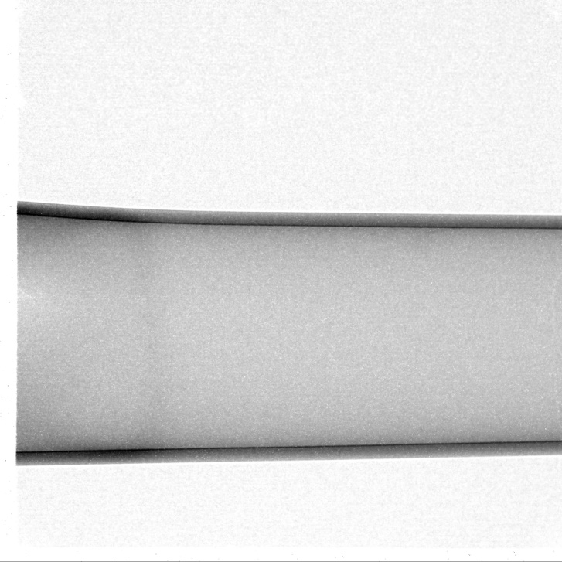
Radiography, rod 06 (p_{i} = 35 bar, Δt = 93 s)

Slide 13
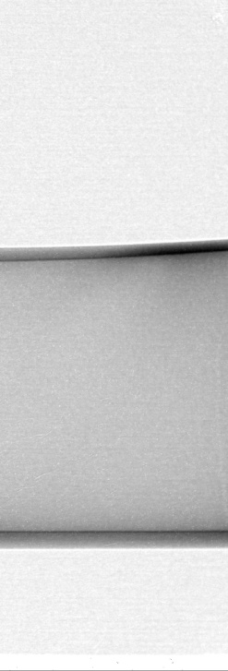
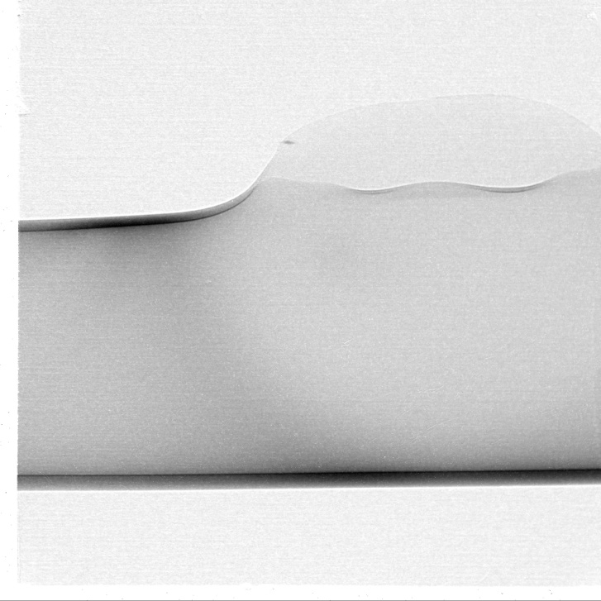
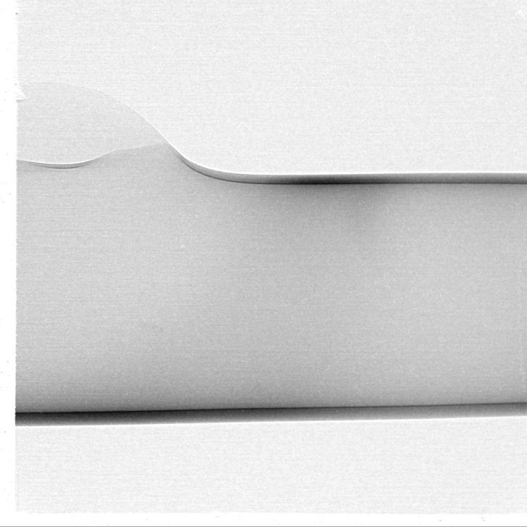
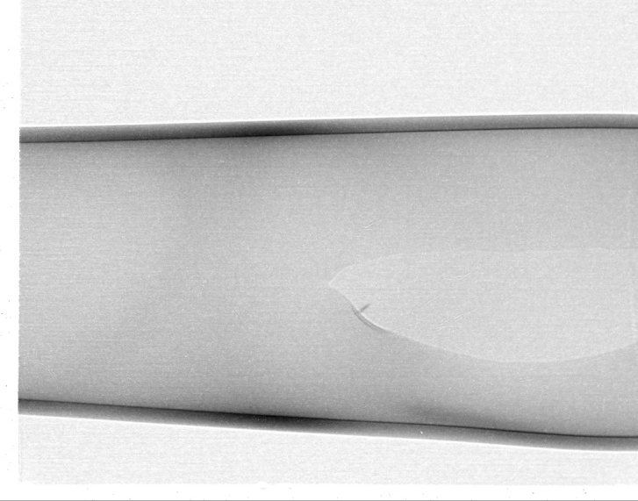
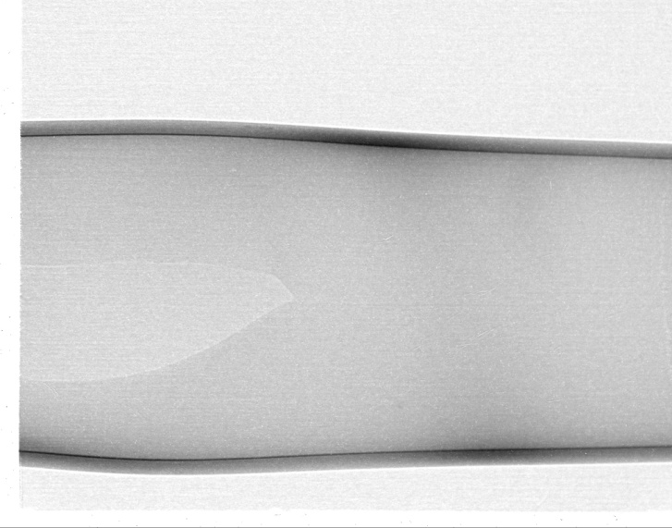
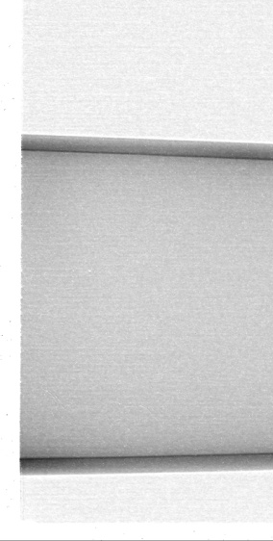
Radiography, rod 08 (p_{i} = 50 bar, Δt = 101 s)

Slide 14
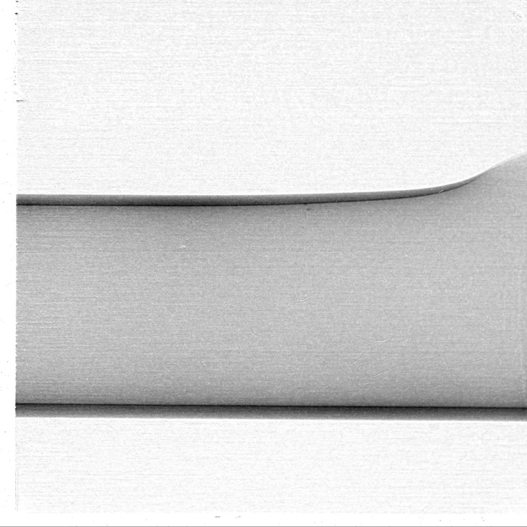
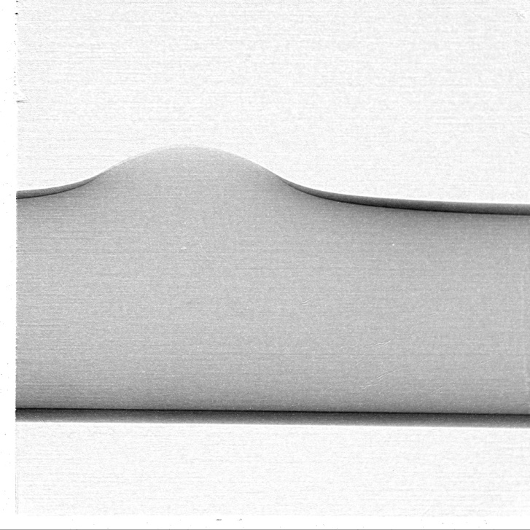
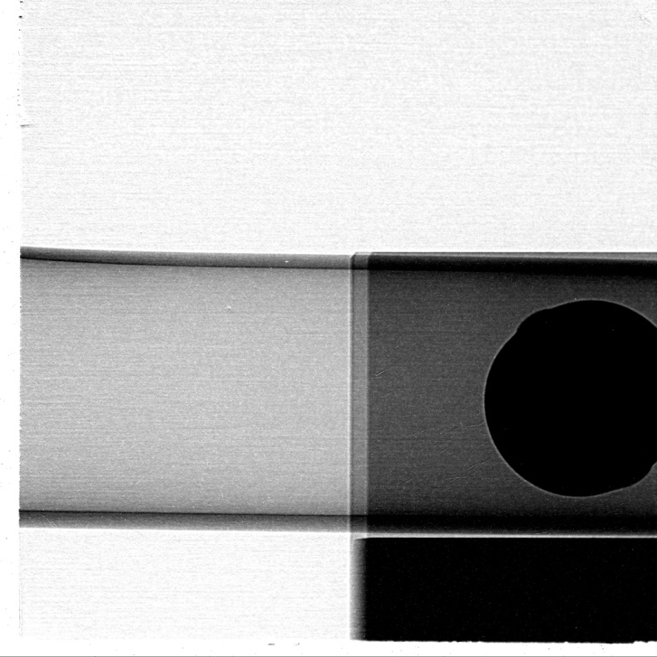
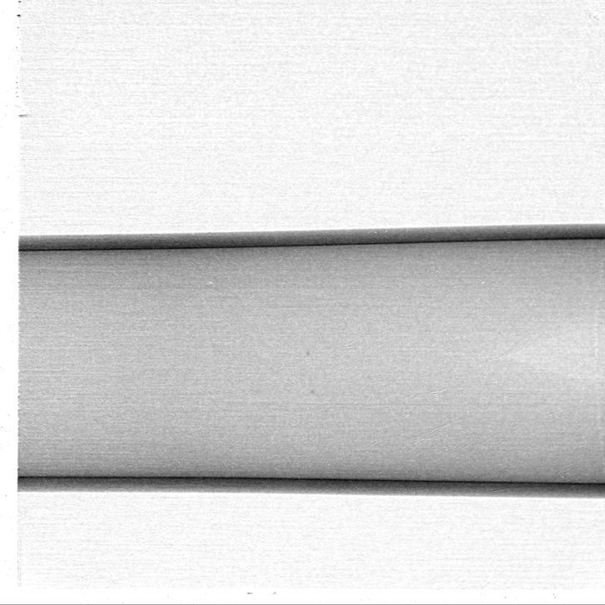
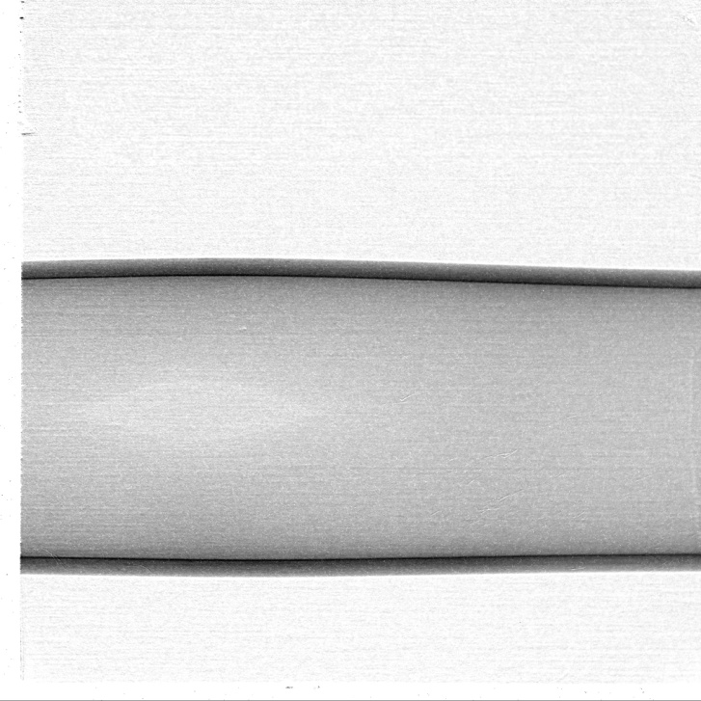

Radiography, rod 10 (p_{i} = 45 bar, Δt = 49 s)

Slide 15
Radiography, rod 17 (p_{i} = 40 bar, Δt = 71 s)

Slide 16
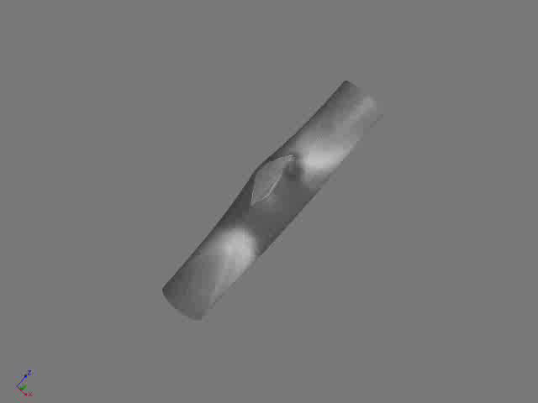
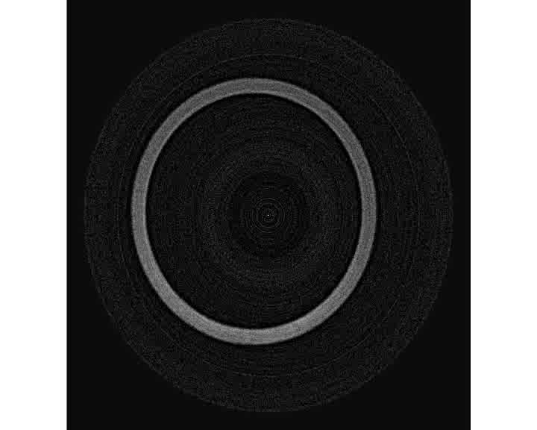
Tomography, rod 01 (p_{i} = 50 bar, Δt = 112 s)
x_{H} = 1330 wppm

Slide 17
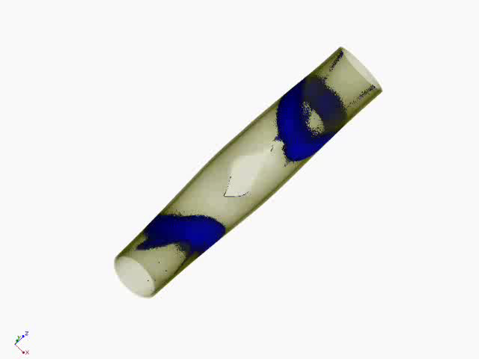
Tomography, rod 01 (p_{i} = 50 bar, Δt = 112 s)

Slide 18
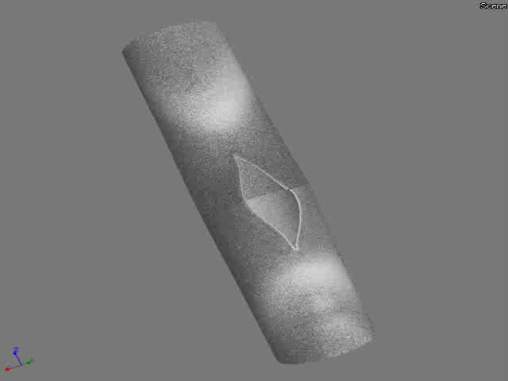
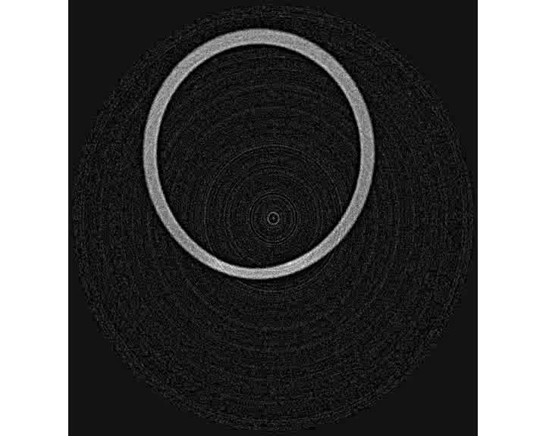
Tomography, rod 03 (p_{i} = 55 bar, Δt = 104 s)
x_{H} = 1300 wppm

Slide 19
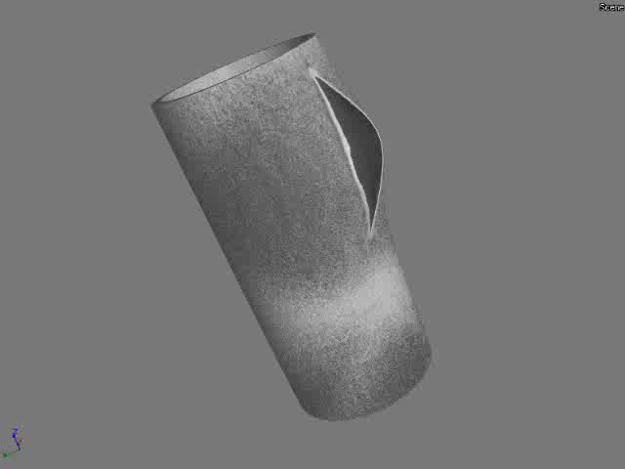
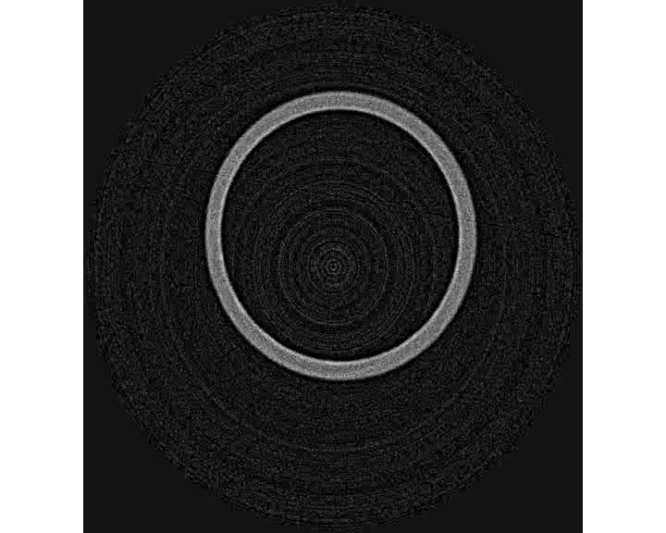
Tomography, rod 05 (p_{i} = 40 bar, Δt = 93 s)
x_{H} = 1060 wppm

Slide 20
Summary and Conclusions
Secondary hydriding was investigated by means of neutron radiography and tomography.
The hydrogen distribution is not symmetric.
The extension of the hydrided zone seems to depend on the time between bursting and quenching.
Maximal hydrogen concentrations of ~1300 ppm was determined (preliminary results).
No influence of inner pressure or crack length is obvious.

Slide 21
Thanks
The QUENCH-LOCA tests and pre-test investigations are sponsored by VGB
KIT:
The QUENCH team, particularly J. Moch und C. Roessger
PSI:
A. Kaestner
Thanks for your attention,
questions?

