Slide 1

First results of the QUENCH-LOCA program
J. Stuckert, M. Große, C. Rössger, M. Steinbrück, M. Walter
Brennelemente, KTG-Fachtag, KA 2014

Slide 2
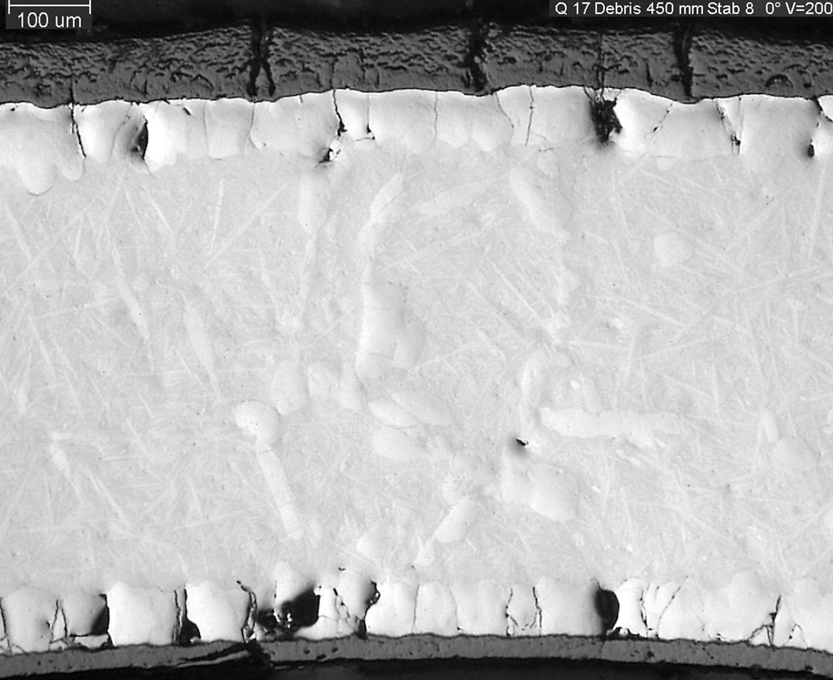
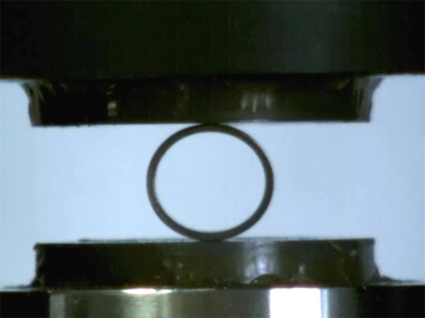
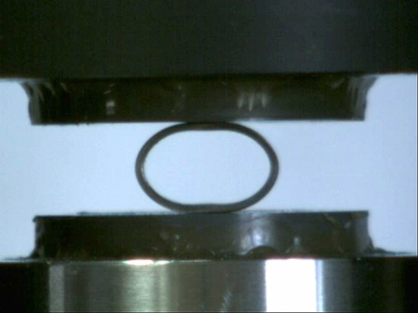
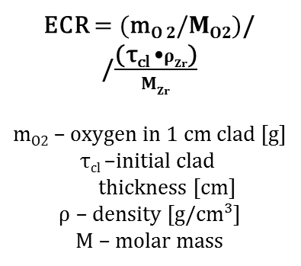
Embrittlement due to oxidation
Equivalent Cladding Reacted
ECR $=$ $(\text{m}\text{O} 2/MO2)$/
/$\frac{\text{(}\text{τ}\text{cl}\text{ ⦁}ρZr\text{)}}{MZr}$
m_{O2} – oxygen in 1 cm clad [g]
τ_{cl} –initial clad
thickness [cm]
$ρ$ – density [g/cm³]
$M$ – molar mass
1250 K
outer ZrO₂ 100 µm; α-Zr(O) 70 µm;
inner ZrO₂ 30 µm; α-Zr(O) 80 µm
Cathcart - Pawel kinetics
D
δ
ANL ring compression tests: Embrittlement occurs when permanent plastic deformation (offset strain) δ/D < 2%
US NRC, 1973: ECR ≤ 17%
and peak cladding T<1200°C

Slide 3
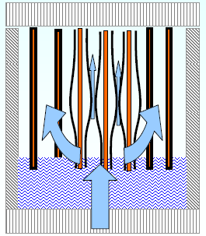
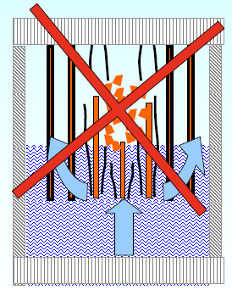
Present Regulatory Limit
for LOCA (international)
Maintain coolable geometry
Keep fuel inside cladding
Prevent breaking cladding
Maintain residual ductility in cladding
Limit oxidation
(Limit hydriding - under consideration)
  Oxidation limits
    Keep equivalent cladding reacted below 17% → ECR < 17%
    Keep oxidation temperature below 1200°C → PCT < 1200°C
    Keep hydriding below ? → ECR = ECR(H)
GRS
GRS

Slide 4
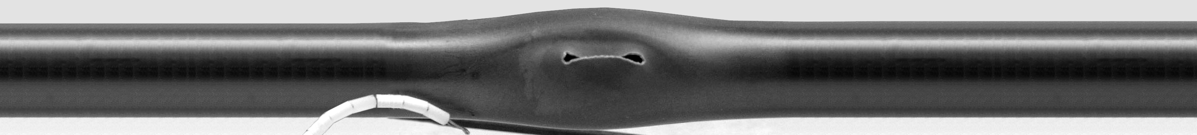
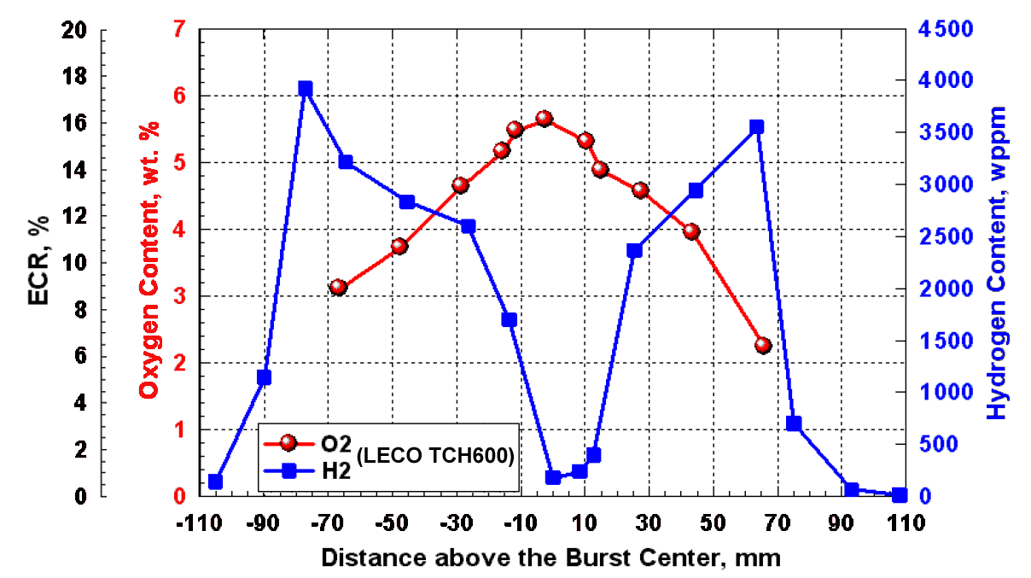
Secondary hydriding:
Hydrogen peaks above and below burst openings
1981, JAERI*: first observation of cladding hydriding by steam ingress through the burst opening
2008, ANL: strong hydriding up to 4000 wppm
Uetsuka et al., Journal of NUCLEAR SCIENCE and TECHNOLOGY, 18[9], pp. 705~717 (September 1981).
NUREG-6967 (Billone et al.): unirradeated pressurised sample OCL11 (Zry-2) ramped in steam from 300ºC to 1204ºC at 5 K/s, held at 1204ºC for 300 s, cooled at 3 K/s to 800ºC, and cooled from 800ºC to RT

Slide 5
Objective for new LOCA bundle tests
Higher burn-up: increased oxidation during normal operation and pertaining hydrogen uptake
Secondary hydriding of cladding after burst
Application of new cladding alloys
Evidence of core coolability
Contribution to modification of current LOCA embrittlement criteria (1200°C, 17% ECR) with consideration of cladding hydrogenation

Slide 6
LOCA program at KIT on secondary hydrogenation of cladding and its influence on cladding embrittlement
Sequence of phenomena:
cladding ballooning and burst, relief of inner rod pressure
steam penetration through the burst opening, steam propagation in decreasing gap between cladding and pellet
oxidation of inner cladding surface with hydrogen release
absorption of hydrogen by cladding at the boundary of inner oxidised area
local embrittlement of cladding near to burst opening
Kr (He)
band of hydrogen absorbed in Zr
oxidation
of inner
cladding
surface
Zr+2H₂O=
ZrO₂+2H₂↑
steam

Slide 7
Cross-section of the QUENCH-L1 bundle
all rods filled with Kr at p = 55 bar
and Tpct = 800 K

Slide 8
Comparison of cladding temperatures at
hottest bundle elevation of 950 mm for QUENCH-L0 and -L1
5.7 K/s
2.5 K/s
enhancements for QUENCH-L1:
1) prototypical high heating rate; 2) prototypical cool-down phase

Slide 9
Progress and boundary conditions of the QUENCH-L1 test
steam 190°C, 2 g/s
Ar 190°C, 6 g/s
maximal reached power:
QUENCH-L1 (Ta-heaters, Ø 6 mm): 58.5 kW,
QUENCH-L0 (W-heaters; Ø 6 mm): 43 kW

Slide 10
Comparison of maximal cladding temperatures at
different elevations for QUENCH-L0 and -L1
LOCA-0
LOCA-1

Slide 11
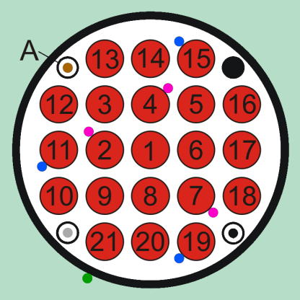
Axial and radial temperature distributions at first burst for QUENCH-L0 (111 s, rod #1) and -L1 (55 s, rod #4)
LOCA-0
LOCA-1

Slide 12
Rod pressure evolution during heating phase for QUENCH-L0 and -L1: burst time indication (coincided with MS results on Kr release)
ballooning
burst
LOCA-0
LOCA-1
internal
rod group
internal
rod group
external
rod group
external
rod group
duration of decrease of the inner pressure to the system pressure: τ₀ ≈ 38 s

Slide 13
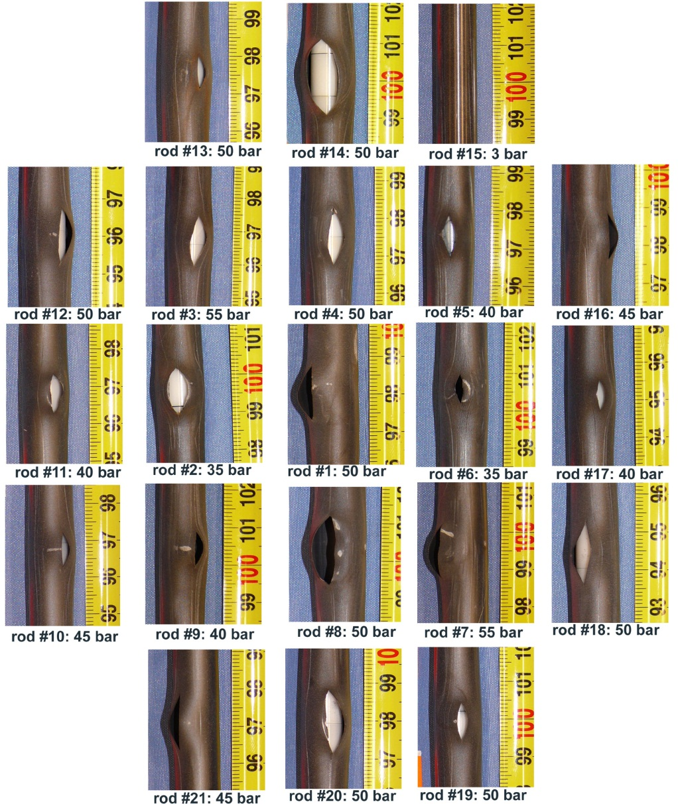
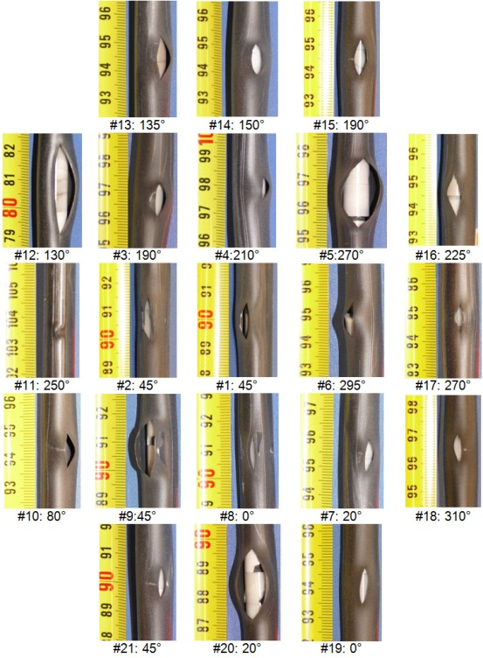
Overview of burst openings
LOCA-0
LOCA-1

Slide 14
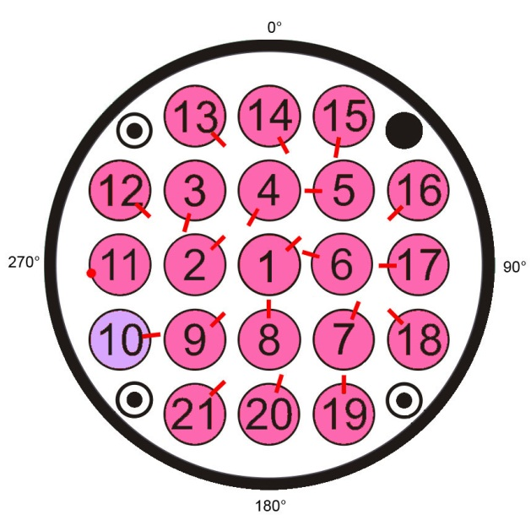
Circumferential positions of burst openings
LOCA-0:
openings oriented
to bundle center
due to strong radial T gradient
LOCA-1:
less pronounced orientation
to bundle center

Slide 15
Length and axial position of burst openings
LOCA-0
LOCA-1

Slide 16
Burst-Parameters
LOCA-0 (transient ca. 220 s)
LOCA-1 (transient ca. 80 s)
Rod group | Rod # | Burst time, s | Burst temperature, interpolated, °C
Center | 1 | 111.2 | 914
 | 7 | 114.2 | 888
 | 4 | 114.6 | 867
 | 3 | 119.2 | 881
 | 8 | 122.0 | 880
 | 5 | 129.6 | 911
 | 6 | 130.4 | 910
 | 9 | 136.2 | 939
 | 2 | 136.8 | 940
Periphery | 12 | 150.0 | 891
 | 18 | 151.2 | 907
 | 17 | 152.0 | 933
 | 20 | 153.2 | 849 (Min)
 | 14 | 153.4 | 898
 | 16 | 155.0 | 894
 | 19 | 159.6 | 929
 | 13 | 162.5 | 880
 | 11 | 167.2 | 948 (Max)
 | 21 | 170.6 | 870
 | 10 | 174.4 | 865
Rod group | Rod # | Burst time, s | Burst temperature, interpolated, °C
Zentralstäbe | 4 | 55.2 | 881
 | 6 | 55.2 | 837
 | 1 | 55.6 | 896 (Max)
 | 5 | 57.2 | 831
 | 2 | 57.2 | 859
 | 8 | 58.6 | 859
 | 3 | 59.0 | 845
 | 7 | 59.8 | 801 (Min)
 | 9 | 62.6 | 889
Peripheriestäbe | 15 | 64.4 | 886
 | 17 | 67.6 | 831
 | 11 | 67.6 | 783
 | 14 | 68.6 | 881
 | 16 | 68.8 | 883
 | 18 | 72.6 | 808
 | 13 | 73.6 | 874
 | 20 | 76.0 | 832
 | 12 | 76.8 | 819
 | 21 | 80.6 | 867
 | 19 | 83.6 | 890
 | 10 | 87.6 | 870

Slide 17
Cooling channel blockage
for LOCA-0 and LOCA-1

Slide 18
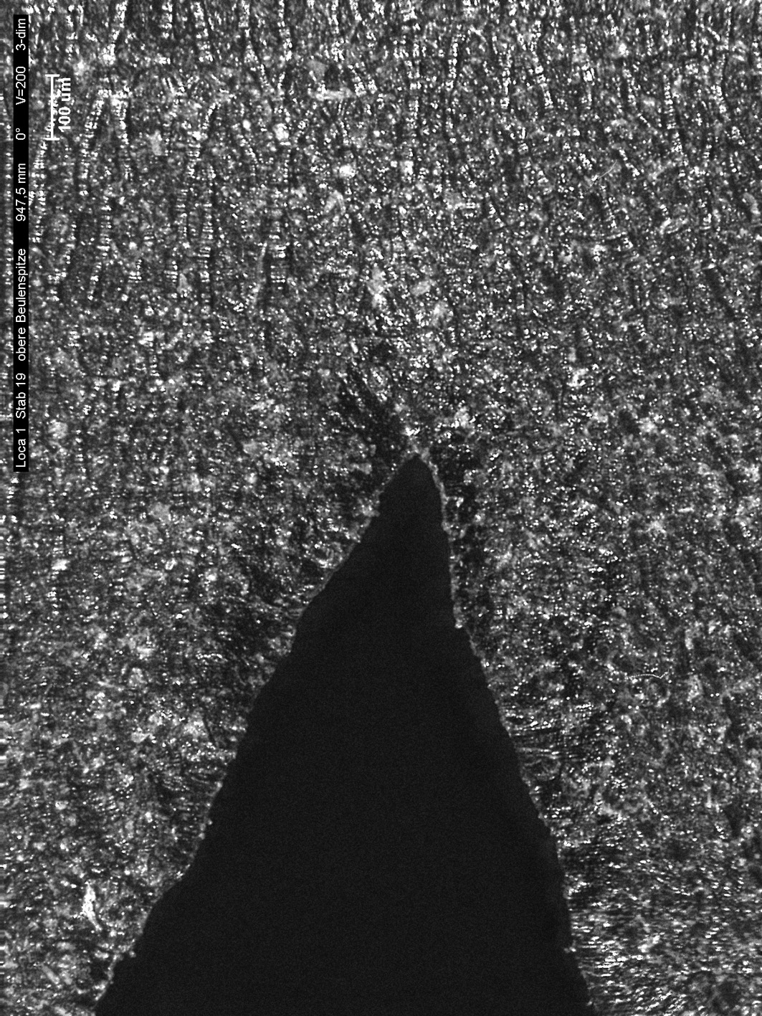
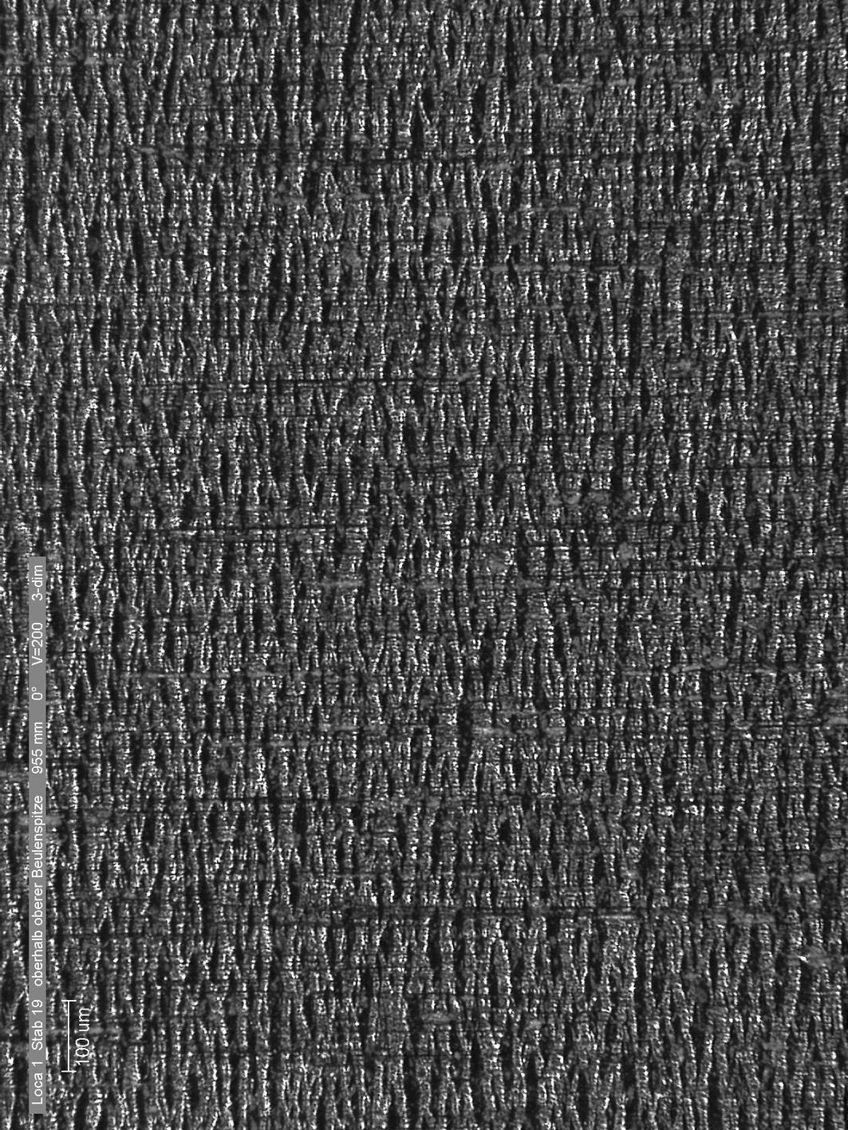
LOCA-1, oxidised outer surface of ballooning region (rod #19):
typical tree bark structure with strain-induced formation
of micro cracks in the oxide during ballooning
100 µm
940 mm
955 mm

Slide 19
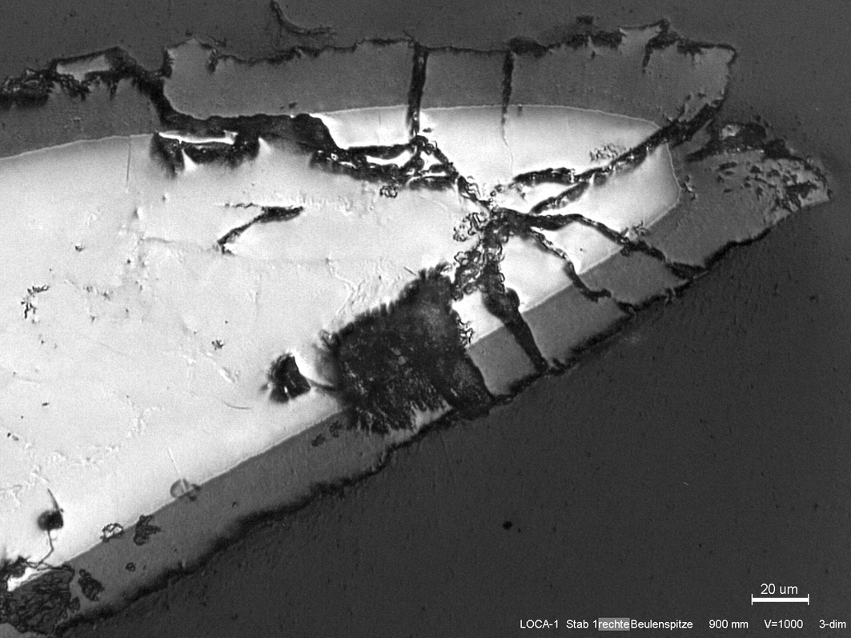
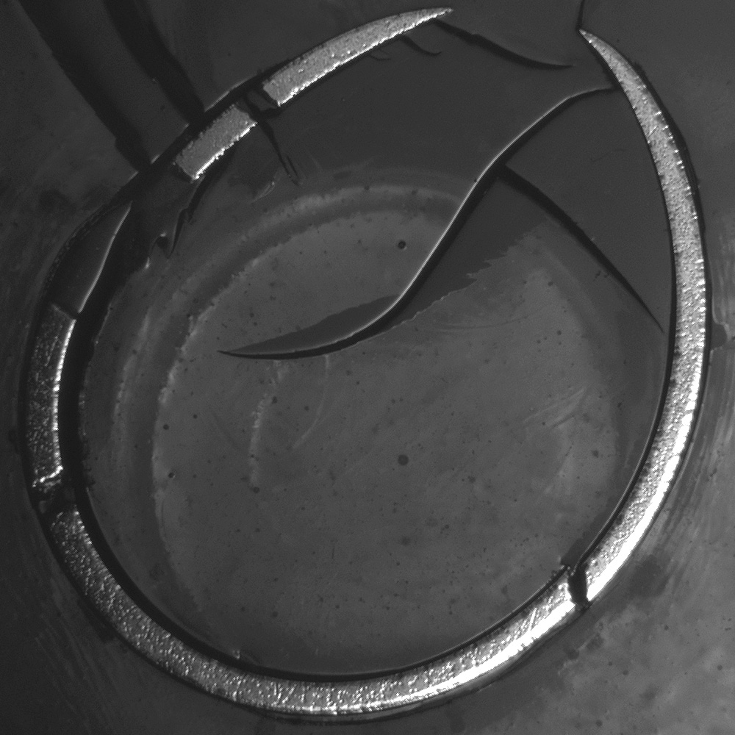
Outer and inner cladding oxidation
at 900 mm for LOCA-1, rod #1
inner and outer oxide
layer thickness:
20 µm
inner oxide:
layer thickness:
20 µm

Slide 20
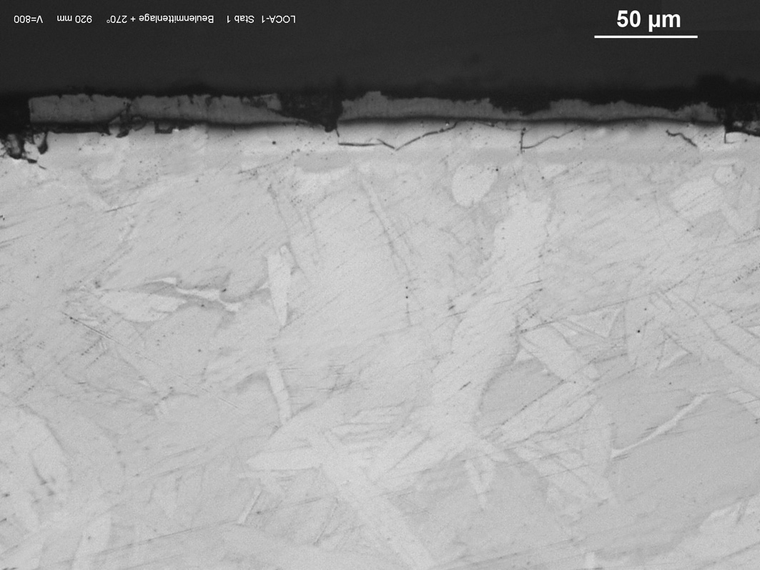
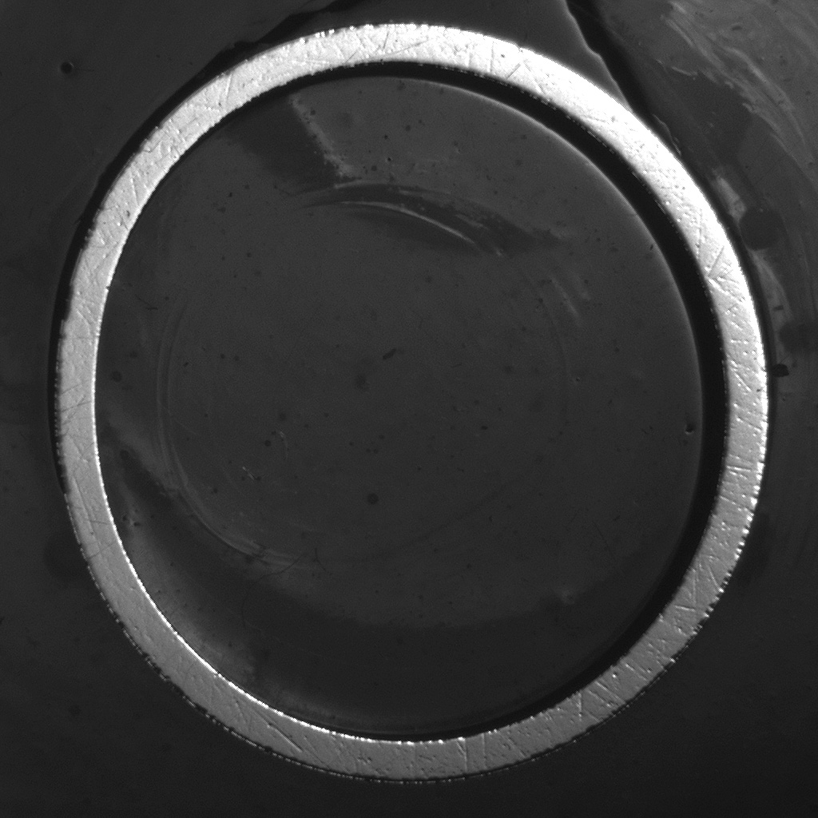
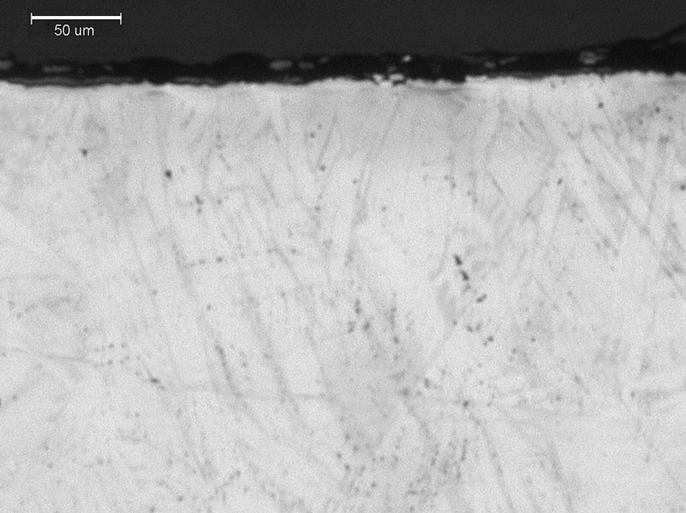
Outer and inner cladding oxidation
at 920 mm of LOCA-1, rod #1
outer oxide
layer thickness:
12 µm
inner oxide
layer thickness:
4 µm

Slide 21
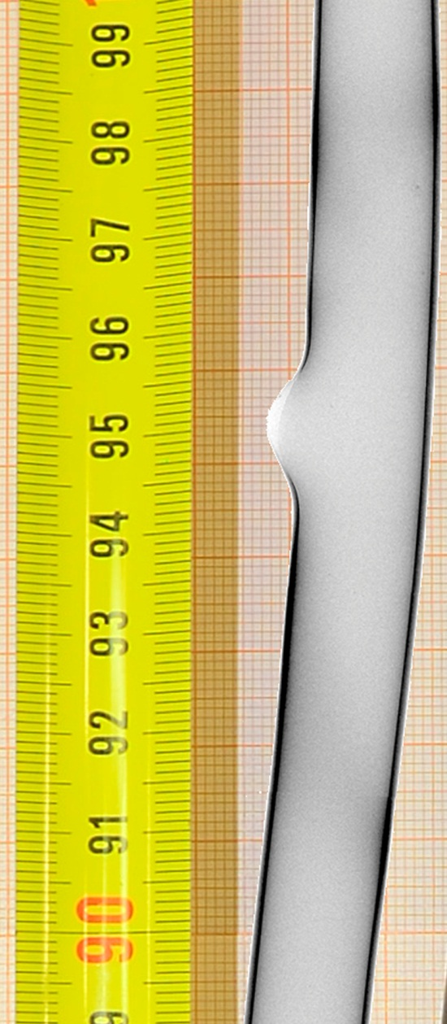
QL1, rod #6: axial distribution of inner oxidation in region of secondary hydrogenation
metallographic
measurements along longitudinal cut:

Slide 22
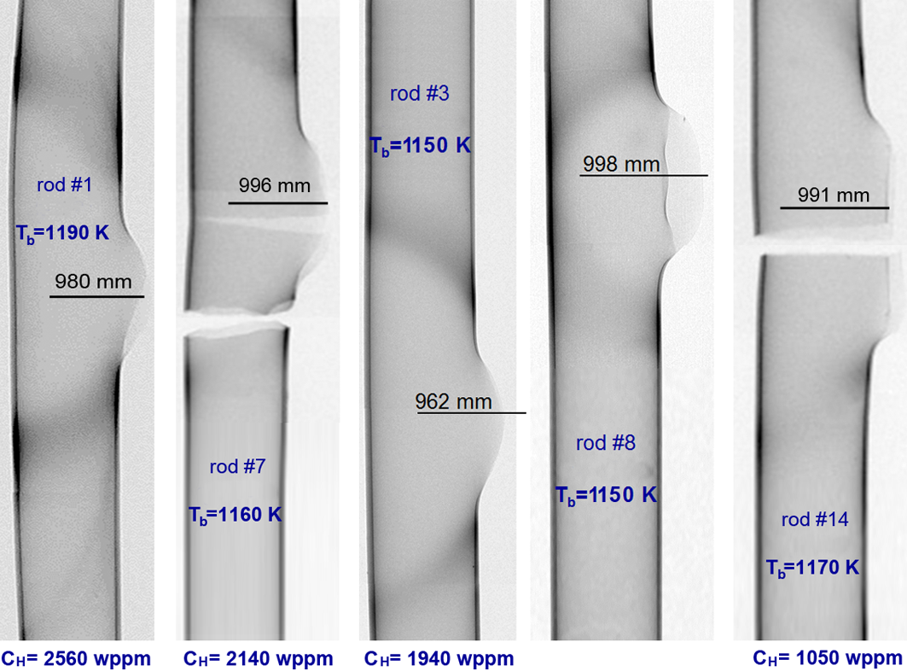
Secondary hydriding QL0:
hydrogen bands around burst location
(with quantitative results of n⁰-tomography)
rods #7 and #14:
tube ruptures during
tensile testing
at room temperature

Slide 23
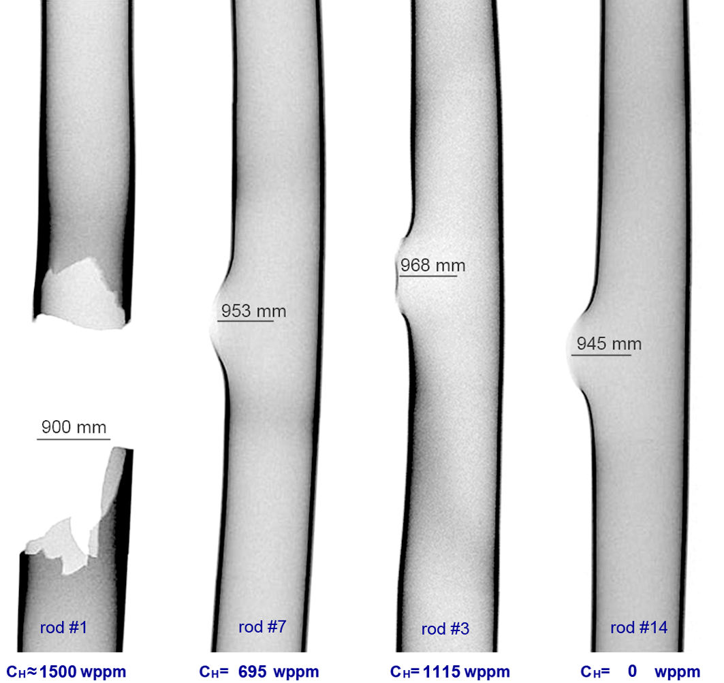
Secondary hydriding QL1:
hydrogen bands around burst location
(with quantitative results of n⁰-tomography)
rod #1:
tube failure during
dismantling of the bundle
at room temperature

Slide 24
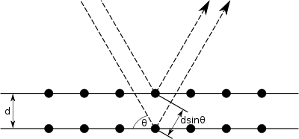
QL1, results of X-ray (λ=154 pm) diffractometry:
no evidence of hydrides with sizes more than 10 nm

Slide 25
QL1, shift of X-ray diffraction peaks:
increase of lattice parameters due to dissolved hydrogen
ΔΘ
ΔΘ = -0.07° → C_{H} ≈ 260 wppm
ΔΘ = -0.02° → C_{H} ≈ 75 wppm
ΔΘ = -0.04° → C_{H} ≈ 150 wppm
ΔΘ = -0.05° → C_{H} ≈ 190 wppm

Slide 26
Micro hardness (Vickers) of hydrated samples:
dependence on hydrogen content and temperature

Slide 27
QL0: microhardness peaks at hydrogen bands
rod #3; t_{burst}=119 s; T_{burst}=820°C; A_{burst}=40 mm²
rod #8; t_{burst}=122 s; T_{burst}=820°C; A_{burst}=60 mm²

Slide 28
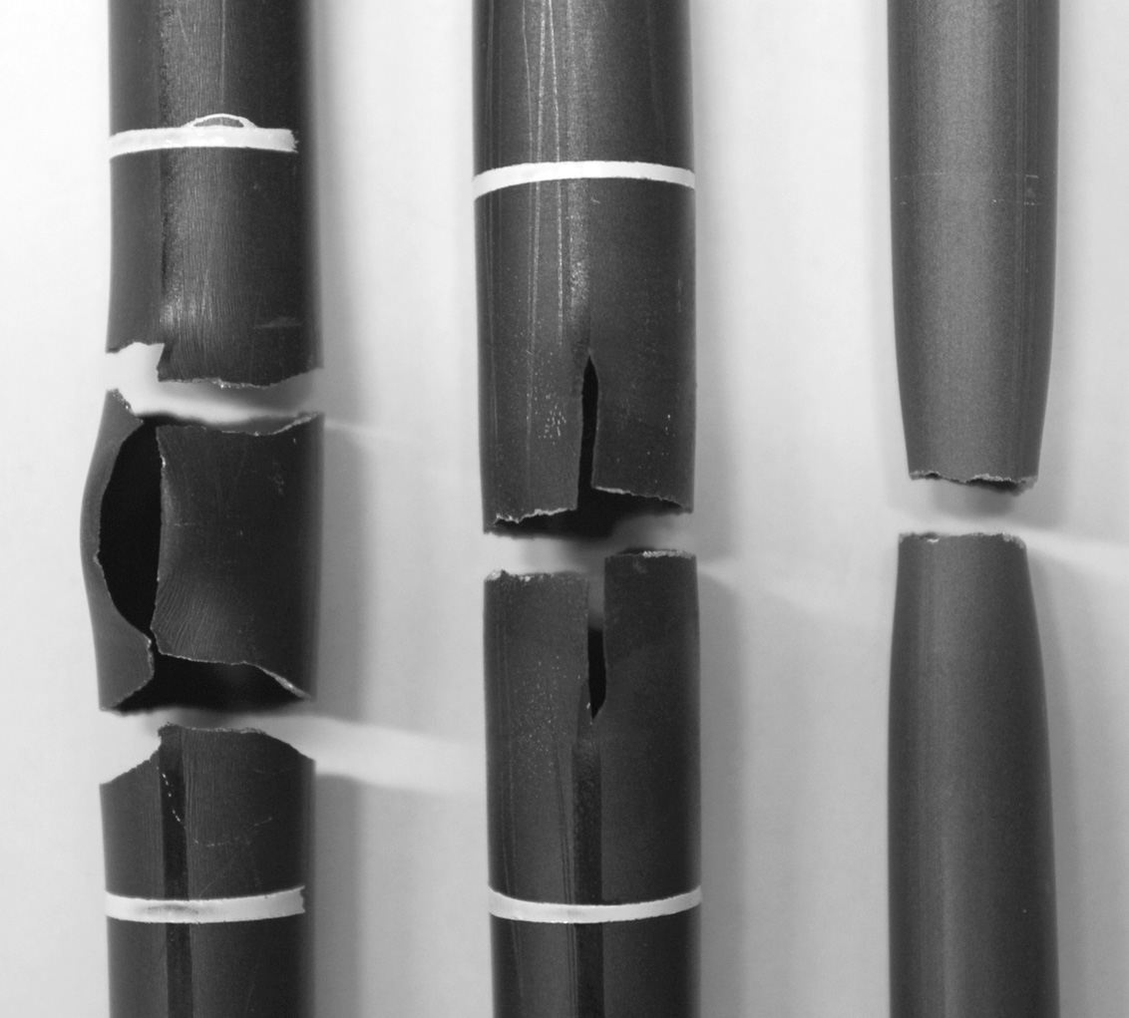
Failure behavior during tensile tests at room temperature
QL0: 3 types
QL1: only stress concentration
(excepted rod #1 brittle ruptured during handling)
hydrogen
embrittlement
(inner rods with C_{H} > 1500 wppm)
stress
concentration
(outer rods with C_{H} > 1000 wppm)
necking
(outer rods)
rod #4
C_{H} = 730 wppm
rod #6
C_{H} = 795 wppm
rod #9
C_{H} = 1270 wppm

Slide 29
Tensile tests for inner rods
QL0 sample length 500 mm or 250 mm*
QL1 sample length 1000 mm or 250 mm*
all failures: pre-crack

Slide 30
Results of tensile tests
QL0
QL1
rod l0=500 mm *l0=250 mm | ultimate tensile strength [MPa] | fracture stress [MPa] | elongation at fracture [%] | rupture based on:
01* | 254 | 254 | 0.38 | hydrogen embrittlement
02 | 408 | 408 | 0.99 | hydrogen embrittlement
04* | 276 | 276 | 0.40 | hydrogen embrittlement
05* | 274 | 274 | 0.37 | hydrogen embrittlement
06 | 148 | 148 | 0.16 | stress concentration
07* | 222 | 222 | 0.29 | hydrogen embrittlement
09 | 518 | 433 | 8.10 | necking
10 | 512 | 507 | 10.12 | necking
11 | 509 | 391 | 11.67 | necking
12 | 502 | 499 | 6.44 | stress concentration
13 | 504 | 504 | 9.18 | stress concentration
14 | 430 | 430 | 1.97 | stress concentration
15 | 505 | 450 | 11.70 | necking
16 | 512 | 389 | 10.95 | necking
17 | 501 | 497 | 3.83 | failure at stuck pellet
18 | 513 | 458 | 10.19 | necking
19 | 489 | 368 | 11.80 | necking
20 | 452 | 447 | 2.20 | stress concentration
21 | 506 | 498 | 8.11 | stress concentration
rod l0=1000 mm *l0 = 250 mm | ultimate tensile strength [MPa] | fracture stress [MPa] | elongation at fracture (graded) [%] | rupture based on:
04* | 416 | 414 | 0.75 (0.68) | stress concentration
06* | 499 | 481 | 1.70 (1.68) | stress concentration
07* | 436 | 425 | 1.03 (0.81) | stress concentration
09 | 307 | 307 | 0.59 (0.09) | stress concentration
12 | 464 | 464 | 5.50 (5.27) | stress concentration
13 | 518 | 515 | 5.13 (5.03) | stress concentration
14 | 471 | 471 | 3.96 (3.80) | stress concentration
16 | 462 | 456 | 4.31 (4.10) | stress concentration
17* | 333 | 327 | 0.33 (0.33) | stress concentration
18* | 270 | 263 | 0.19 (0.19) | stress concentration
20* | 367 | 356 | 1.13 (1.06) | stress concentration

Slide 31
Summary
Two out-of-pile bundle tests, QUENCH-L0 and QUENCH-L1, with the same bundle geometry and the same cladding material (Zircaloy-4) were performed under LOCA conditions to investigate the phenomenon of the so-called cladding secondary hydriding. The tests differed in (1) heat-up rate during the first transient (max 2.5 K/s for QL0 and max 7.5 K/s for QL1); (2) absence (QL0) and presence (QL1) of a cool-down phase before quenching.
The cladding burst occurred at temperatures between 1123 and 1223 K for QL0 and between 1073 and 1173 K for QL1 (i.e. in both cases the burst temperatures were inside the temperature region corresponding the α → α + β → β phase transition of the Zircaloy-4 alloy).

Slide 32
Summary (cont.)
Post-burst duration of inner cladding oxidation at high temperatures was shorter in case of the more prototypical test QL1. Therefore the amount of hydrogen absorbed by claddings close to their burst openings was lower for the QL1 (less than 1700 wppm) than for QL0 (less than 2600 wppm).
Tensile tests at room temperature with claddings of both bundles showed that claddings with hydrogen contents less than 1500 wppm ruptured inside the burst opening due to stress concentration, whereas claddings with hydrogen contents more than 1500 wppm fractured along the hydrogen bands.

Slide 33
Acknowledgment
The QUENCH-LOCA experiments are supported and partly sponsored by VGB PowerTech e.V., Essen, Germany, European technical association for power and heat generation.
The authors would like to thank Mr. J. Moch, Dr. H. Leiste, Mrs. J. Laier and Mrs. U. Peters for intensive work during test preparation and post-test investigations
Thank you for your attention
https://www.iam.kit.edu/wpt/loca/
http://www.iam.kit.edu/wpt/471.php
http://quench.forschung.kit.edu/

