Slide 1

Microstructure and mechanical properties of Zircaloy-4 claddings hydrogenated at temperatures typical for LOCA conditions
A. Pshenichnikov, J. Stuckert
QWS19, Karlsruhe 2013

Slide 2
Objectives
Structure assessment of annealed and hydrogenated specimens
Fracture surface investigation
Zirconium hydrides detection
Progress in understanding the mechanism of embrittlement of Zirconium alloys
Application to the results of QUENCH-LOCA test

Slide 3
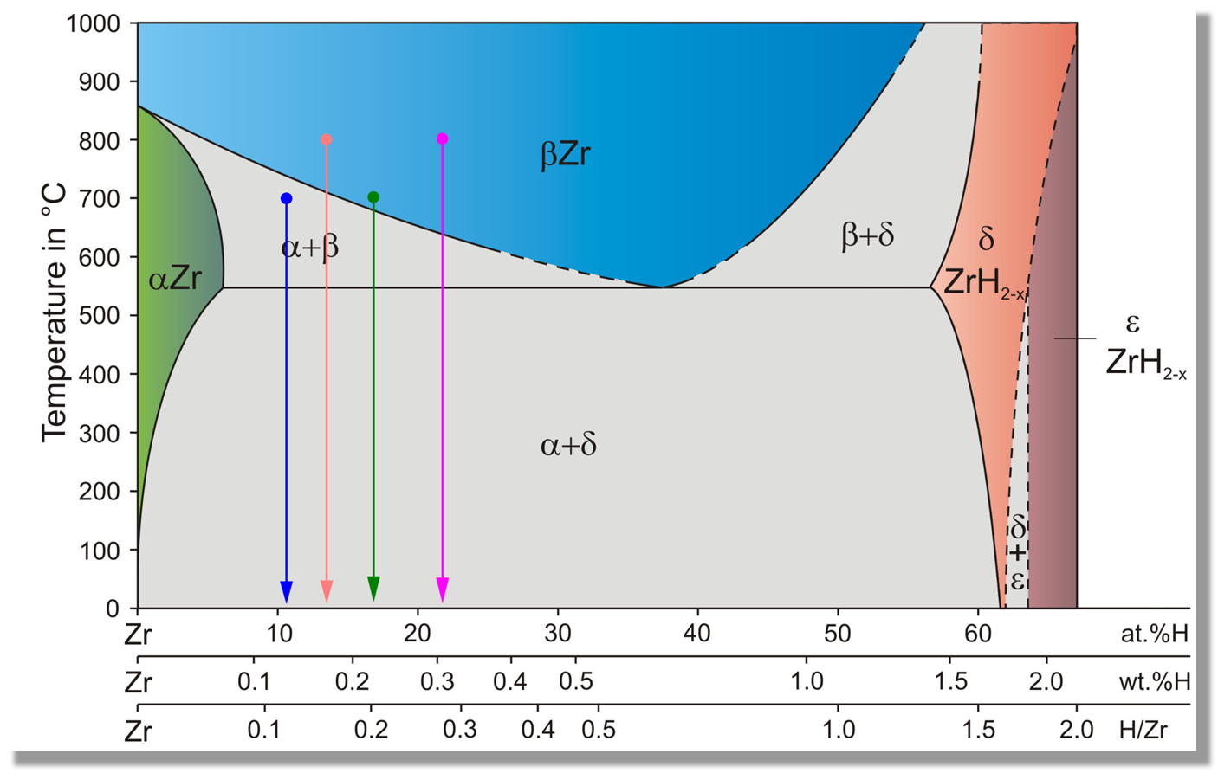
Equilibrium phase diagram of Zr-H system*
selected examples of our tests
Region of interest is LOCA conditions
Cooling in air
700 wppm H
9500 wppm H
* According to E. Zuzek et al., Bull. Alloy Phase Diagr. (1990), 385

Slide 4


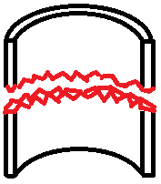
Material and methods of investigation
Material: Conventional Zircaloy-4 cladding tube
ICP-OES measurement of Zircaloy-4 chemical composition (by weight):
Sn: 1.33±0.02%, Fe: 0.23±0.002%, Cr: 0.12±0.0003%, O: 0.116±0.003%, Zr balance
Methods of investigation:
Hydrogenation in Ar+H₂ gas mixture in LORA-furnace
Metallographic investigations and microhardness tests of the tube section
X-Ray diffraction analysis in the cladding tube wall middle
Scanning electron microscopy of polished and etched as well as fractured surfaces

Slide 5
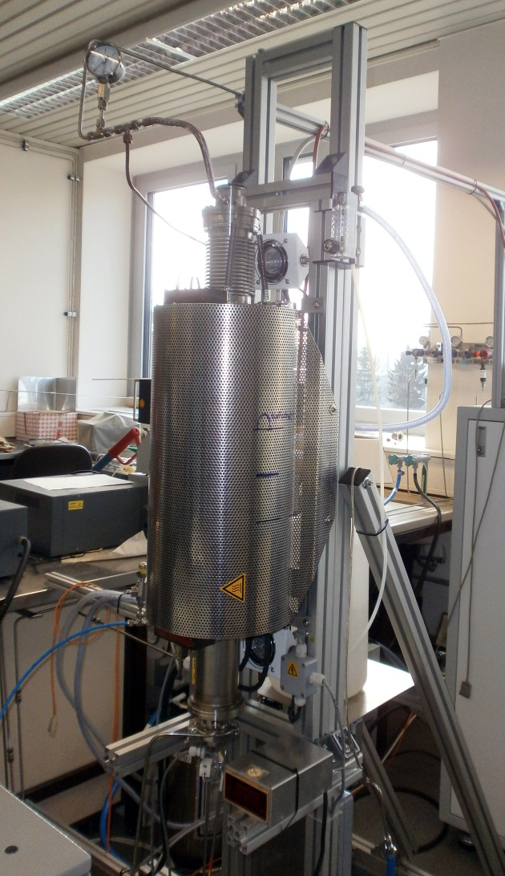
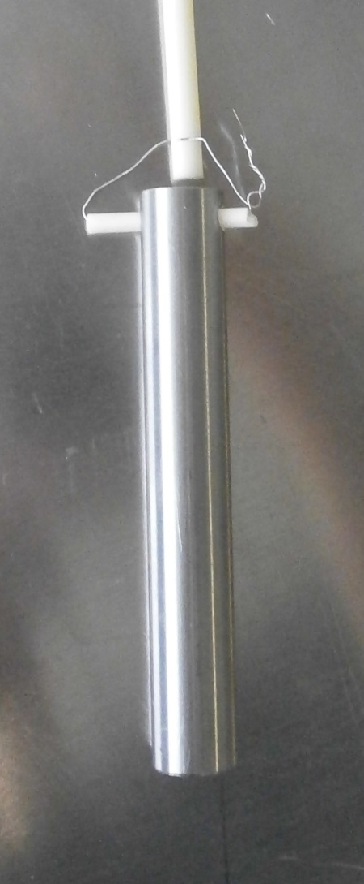
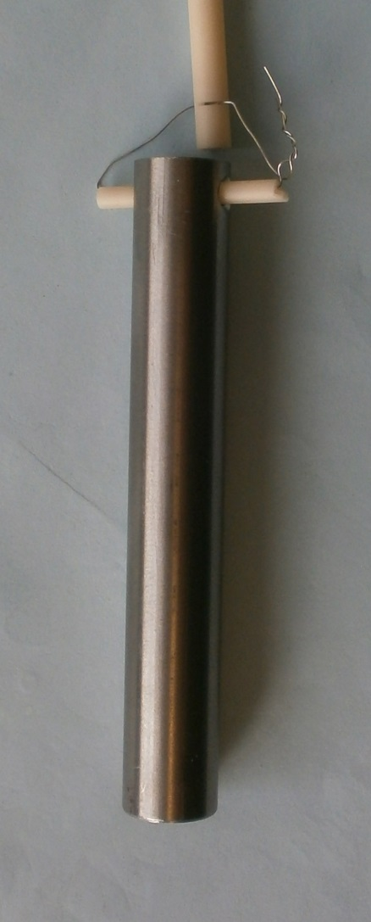
Experimental procedure
Hydrogenation facility
LORA furnace
Specimen before hydrogenation
Specimen withdrawal in air after hydrogenation
Cooled specimen after hydrogenation
Hydrogen gas partial pressure was 0.1 bar
Estimated cooling rate was 5 K/s
H₂ duration was
2 to 12 minutes

Slide 6
Results of metallographic observations

Slide 7
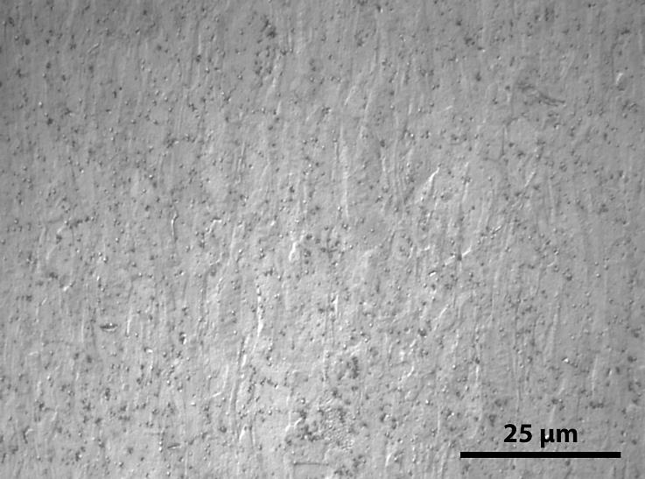
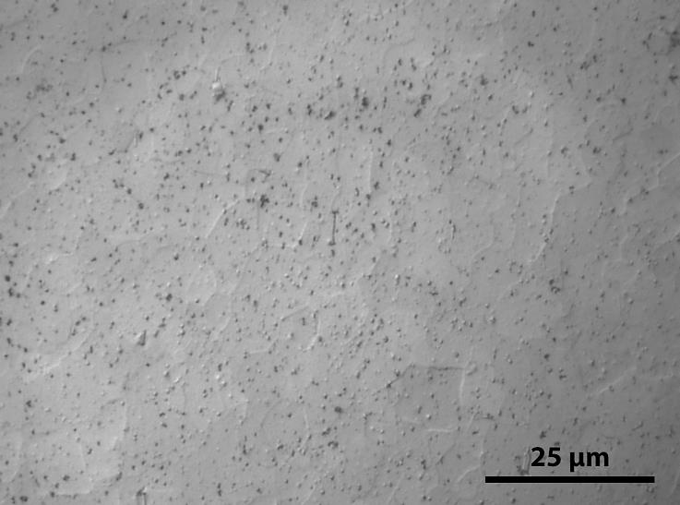
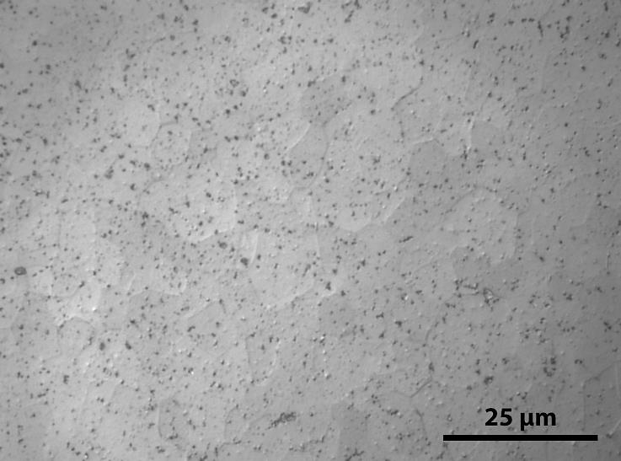
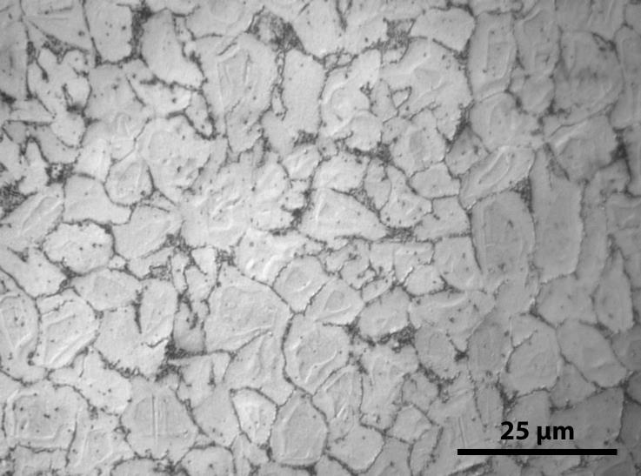
Optical metallography of annealed Zircaloy-4
Annealing of Zircaloy-4 cladding at various temperatures during 8 minutes and fast cooling in air
As-received
700 °C
800 °C
At 810 °C starts
α → β phase transformation
900 °C

Slide 8
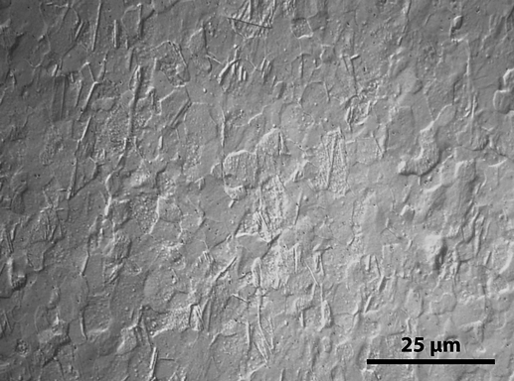
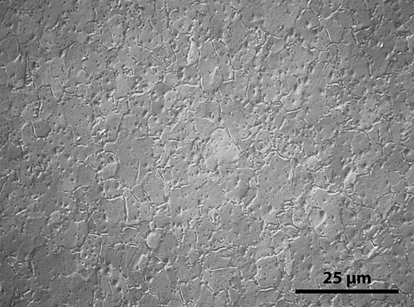
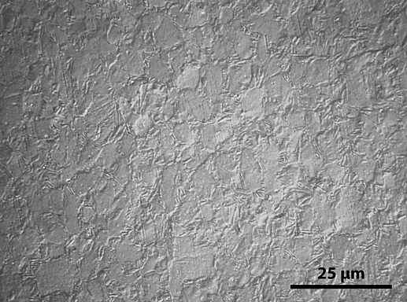
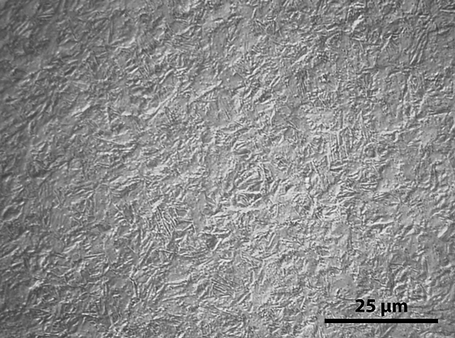
Optical metallography of hydrogenated Zircaloy-4
Hydrogenation of Zircaloy-4 cladding at 600 °C in Ar+H₂ mixture and fast cooling in air
780 wppm H
1400 wppm H
2000 wppm H
3490 wppm H

Slide 9
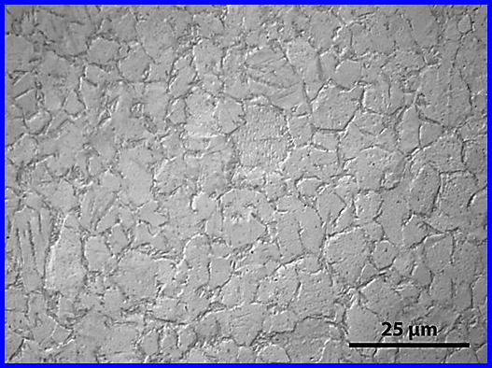
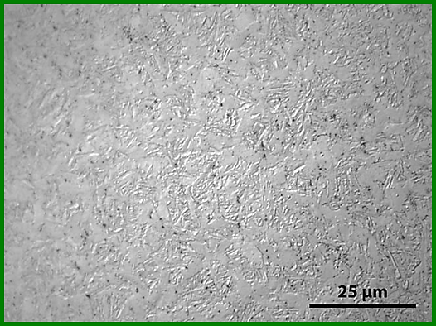
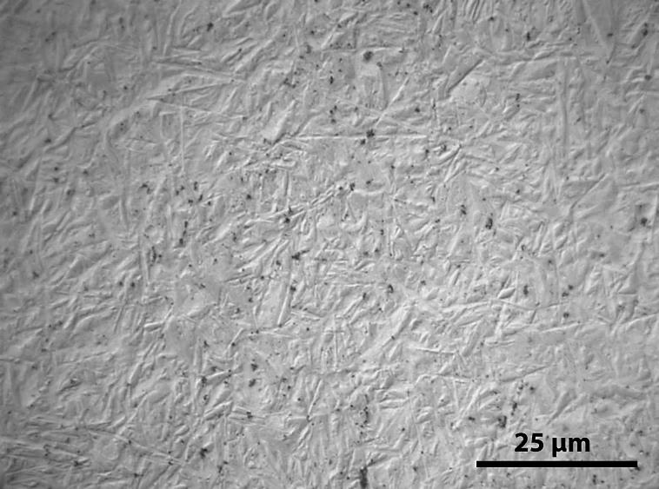
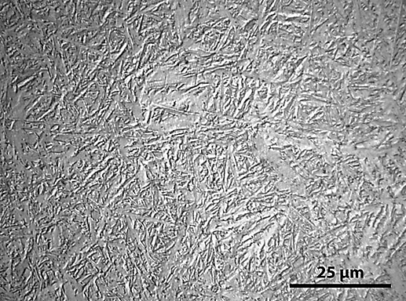
Optical metallography of hydrogenated Zircaloy-4
Hydrogenation of Zircaloy-4 cladding at 700 °C in Ar+H2 mixture and fast cooling in air
1330 wppm H
2250 wppm H
α - Zr
„islands“
4000 wppm H
4760 wppm H

Slide 10
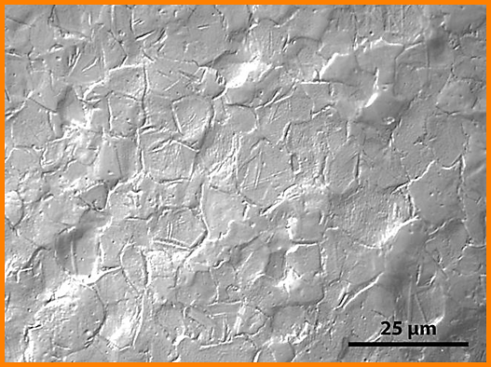
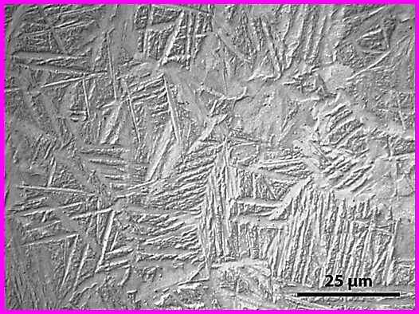
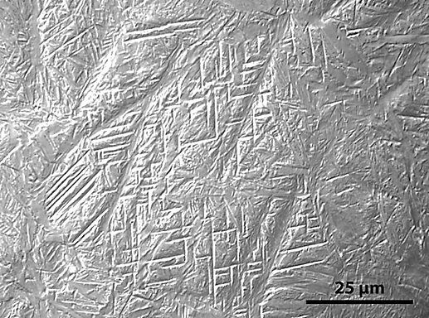
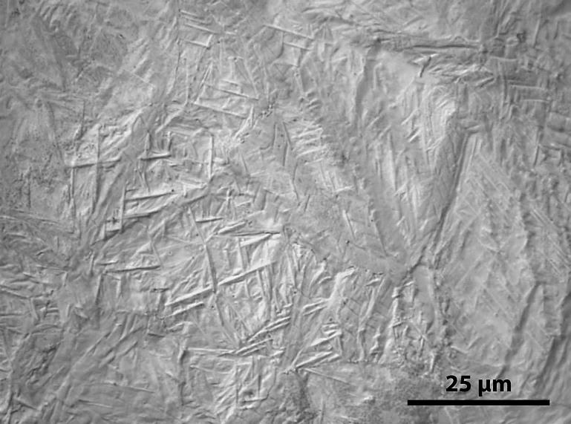
Optical metallography of hydrogenated Zircaloy-4
Hydrogenation of Zircaloy-4 cladding at 800 °C in Ar+H2 mixture and fast cooling in air
1790 wppm H
3060 wppm H
8600 wppm H
9550 wppm H

Slide 11
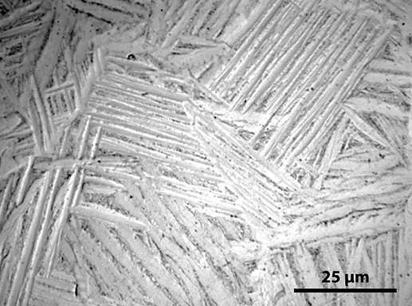
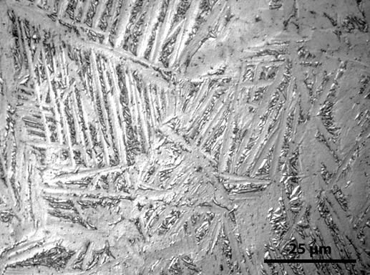
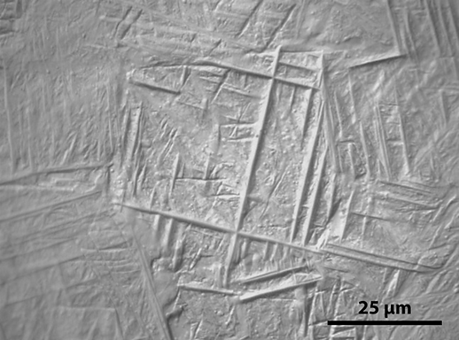
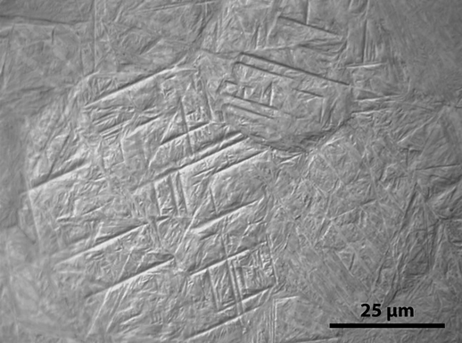
Optical metallography of hydrogenated Zircaloy-4
Hydrogenation of Zircaloy-4 cladding at 900 °C in Ar+H2 mixture and fast cooling in air
880 wppm H
1500 wppm H
2000 wppm H
6700 wppm H

Slide 12
Scanning Electron Microscopy
polished and etched specimens

Slide 13
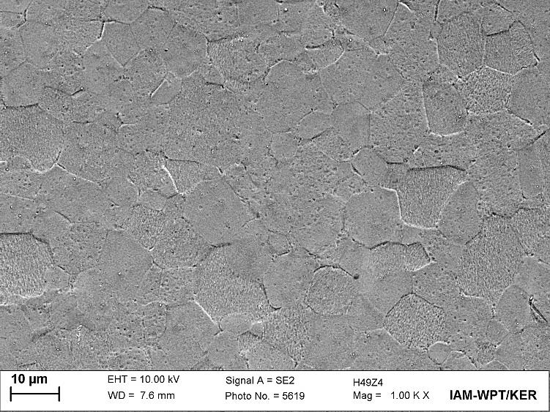
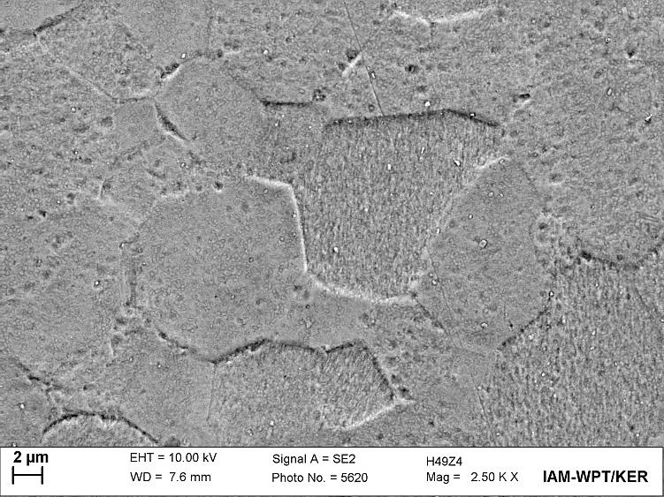
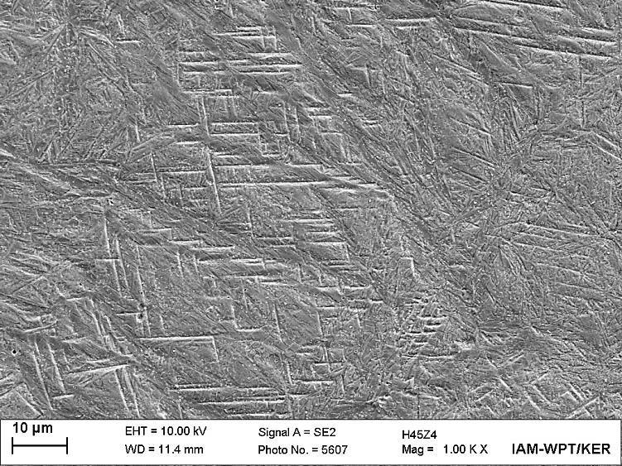
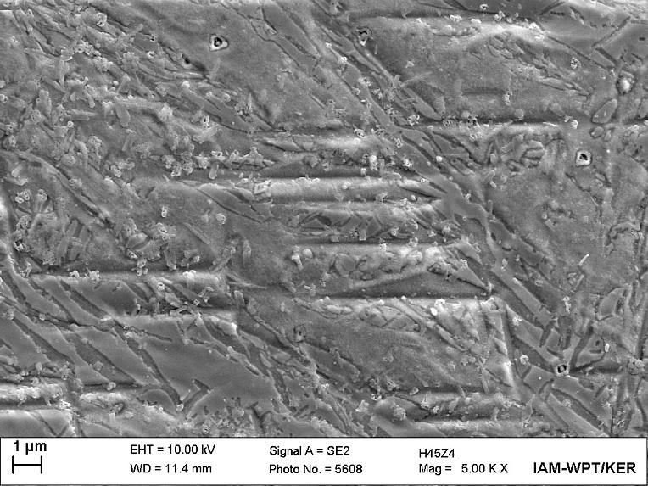
Scanning electron microscopy
of annealed and hydrogenated Zircaloy-4
After polishing and etching
0 wppm H
8600 wppm H

Slide 14
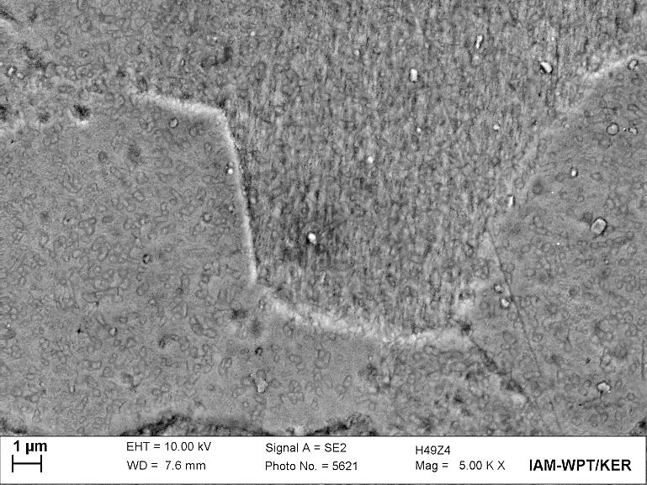
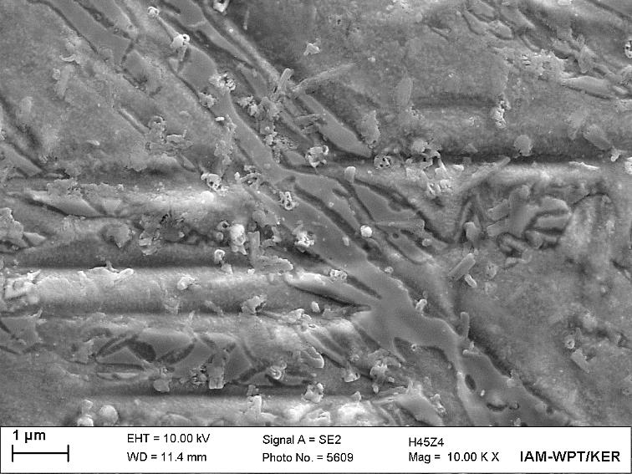
Scanning electron microscopy
of annealed and hydrogenated Zircaloy-4
After polishing and etching
0 wppm H
8600 wppm H

Slide 15
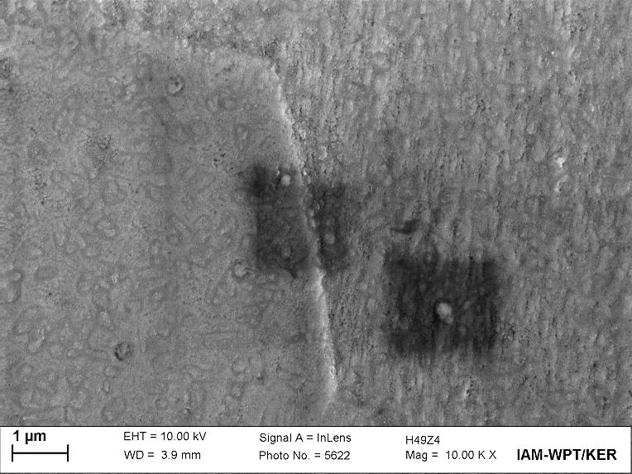
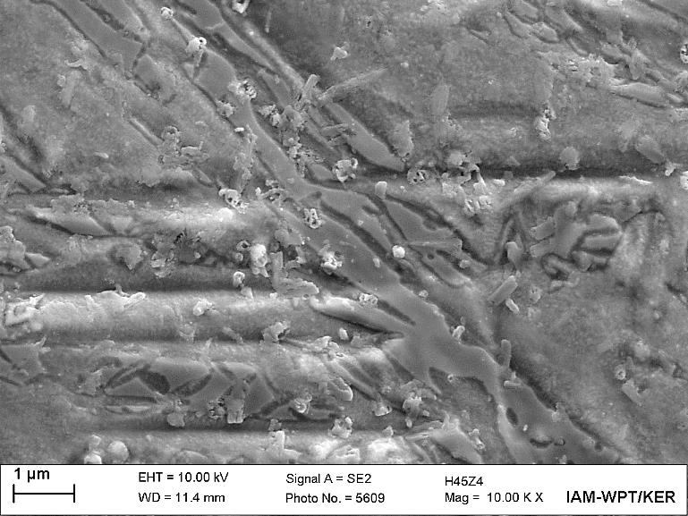
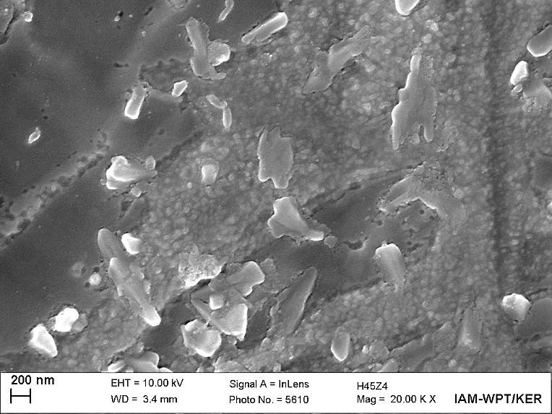
Scanning electron microscopy
of annealed and hydrogenated Zircaloy-4
After polishing and etching
0 wppm H
α-Zr(O)?
α-Zr (prior β phase)?
8600 wppm H
γ- Zr hydrides?
δ- Zr hydrides?

Slide 16
Scanning Electron Microscopy
fracture surface

Slide 17
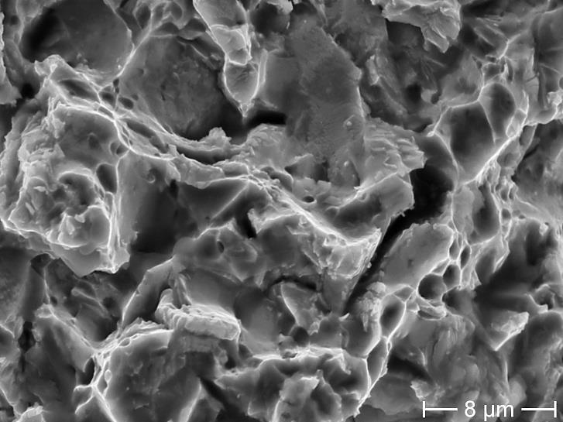
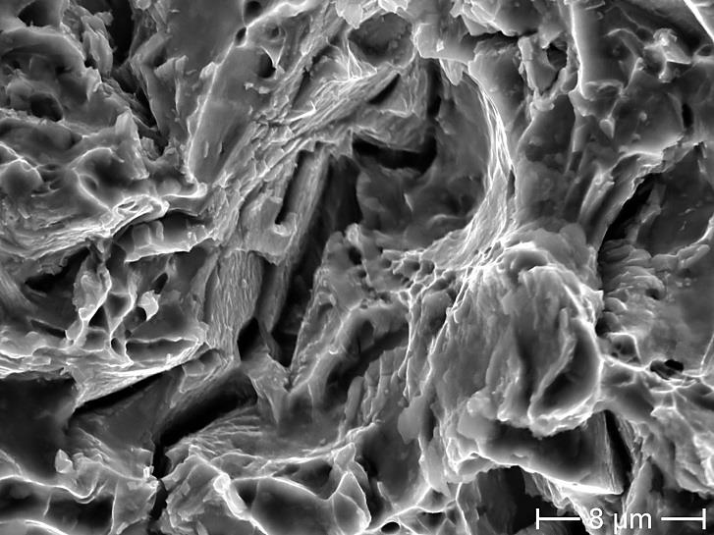
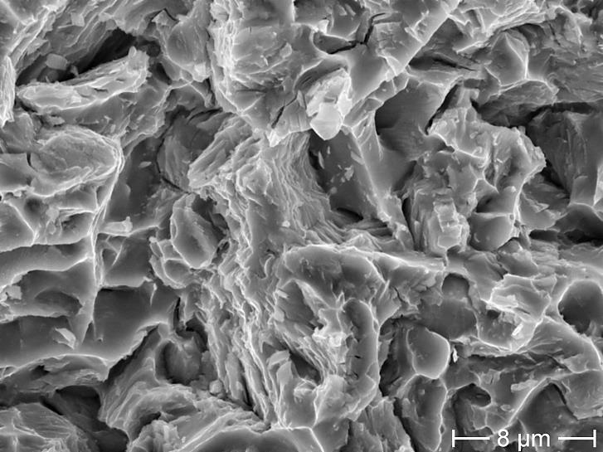
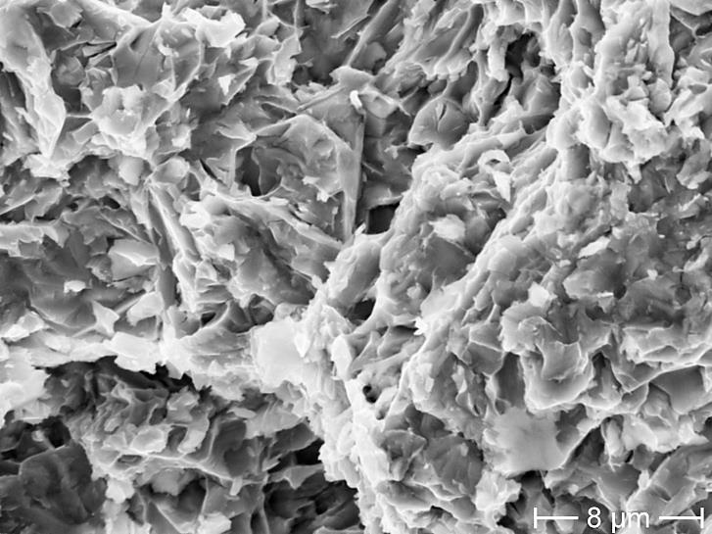
Scanning electron microscopy
of fracture surfaces of hydrogenated Zircaloy-4
700 °C
720 wppm H
1860 wppm H
2790 wppm H
4850 wppm H

Slide 18
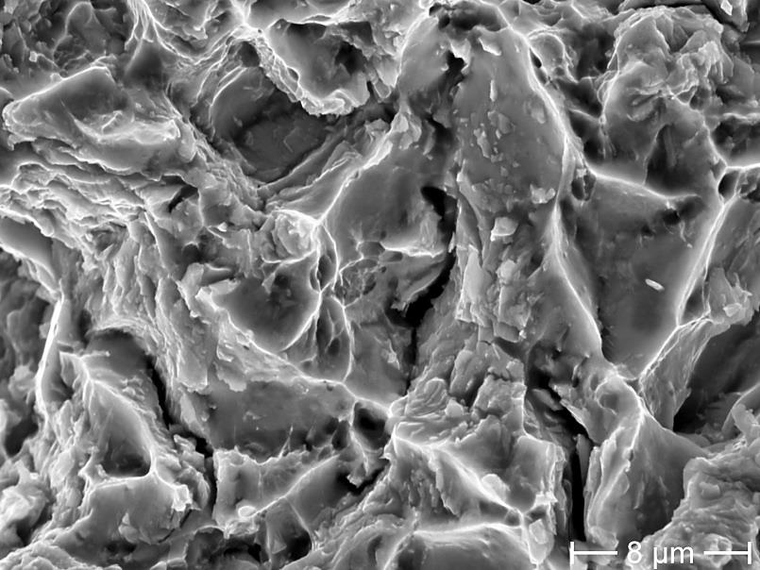
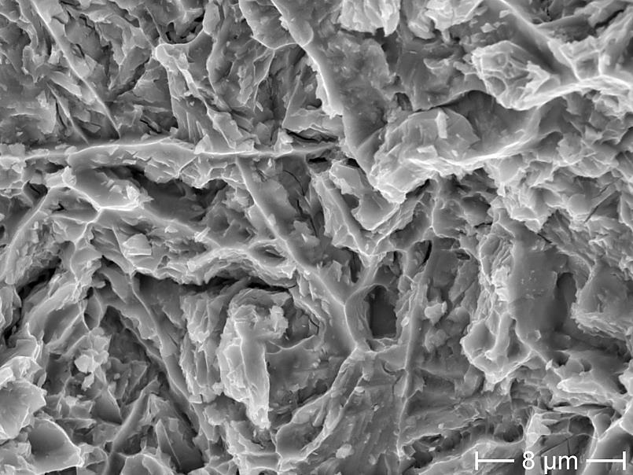
Scanning electron microscopy
of fracture surfaces of hydrogenated Zircaloy-4
800 °C
1110 wppm H
3070 wppm H

Slide 19
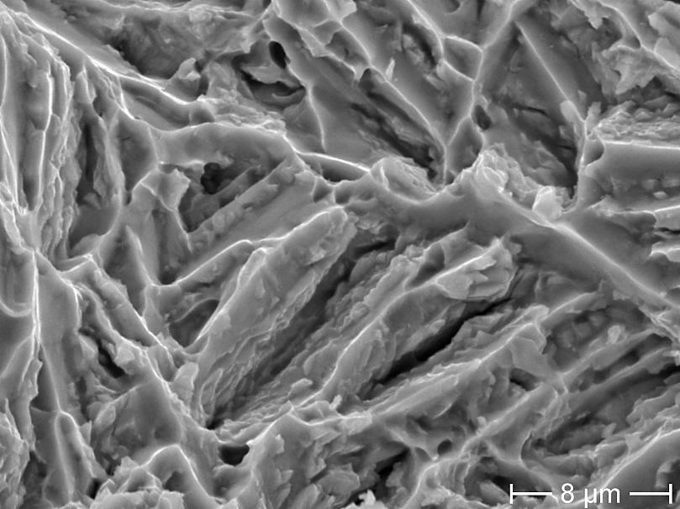
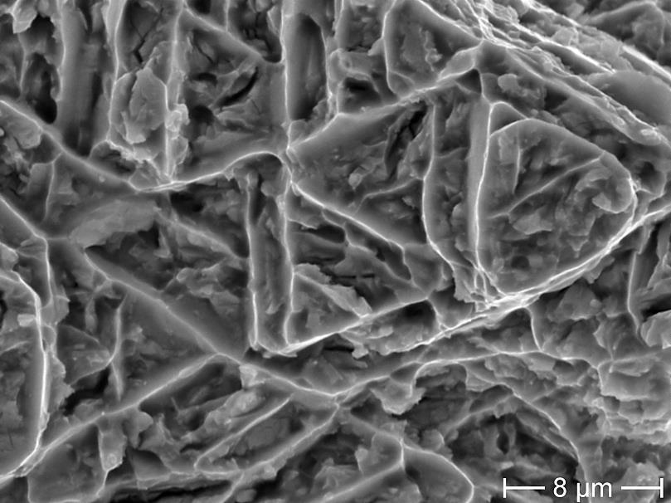
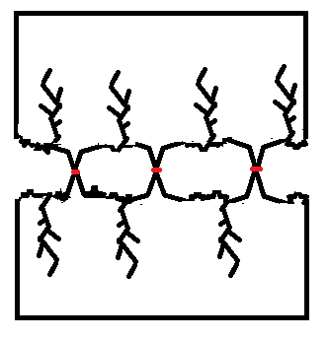
Scanning electron microscopy
of fracture surfaces of hydrogenated Zircaloy-4
900 °C
1170 wppm H
1640 wppm H
Brittle fracture
Ductile fracture on needles of α-Zr(O)

Slide 20
Microhardness tests

Slide 21
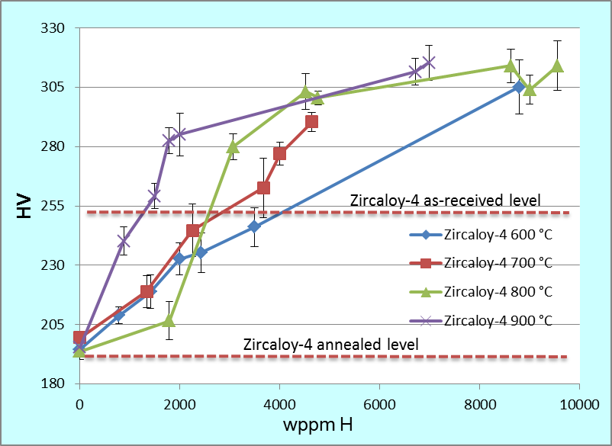
Microhardness of annealed and hydrogenated
Zircaloy-4
hydrogen + T impact
at 900 °C
hydrogen impact
at 600 °C
The diagonal length of resulting indented square was about 10 µm.

Slide 22
X-Ray diffraction analysis

Slide 23
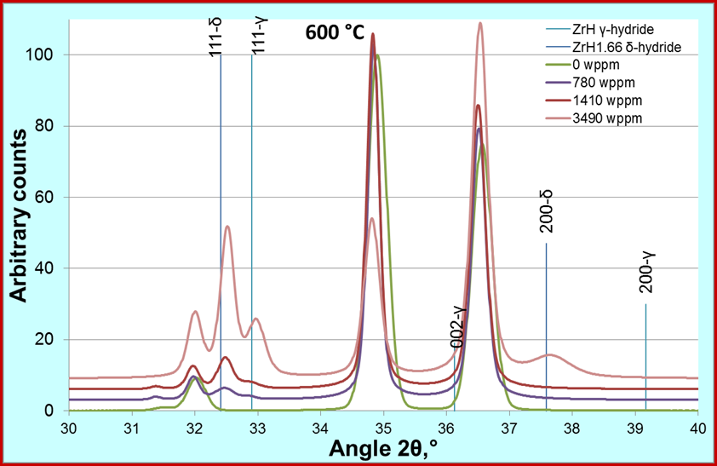
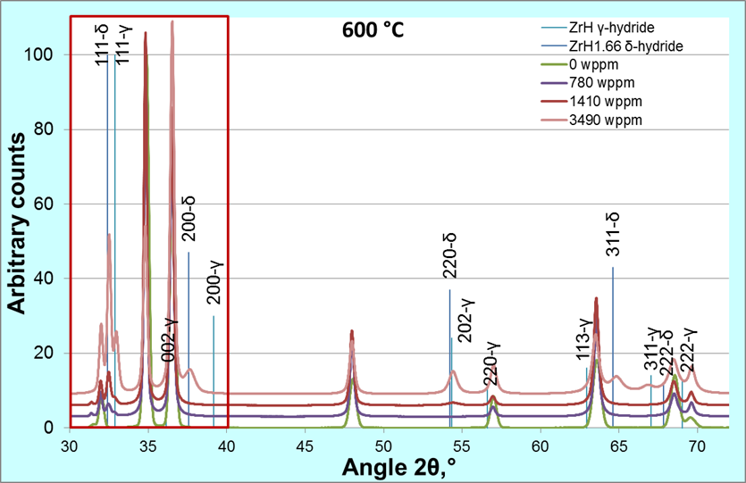
X-Ray profiles of Zircaloy-4 samples
hydrogenated at 600 °C
Hydrides
are compressed with 0.5% of local strain

Slide 24
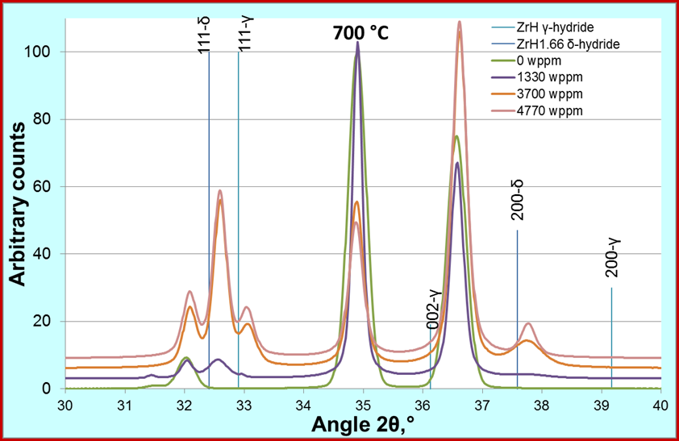
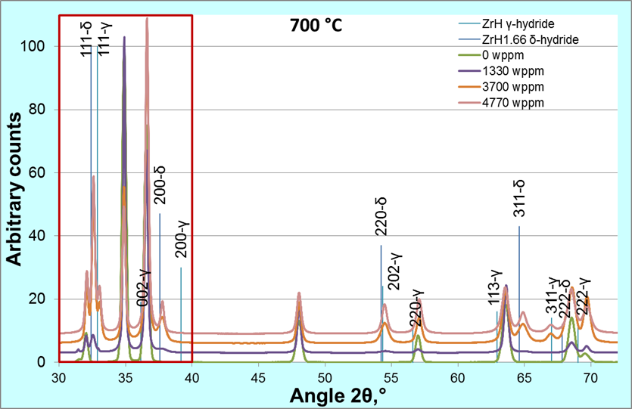
X-Ray profiles of Zircaloy-4 samples
hydrogenated at 700 °C

Slide 25
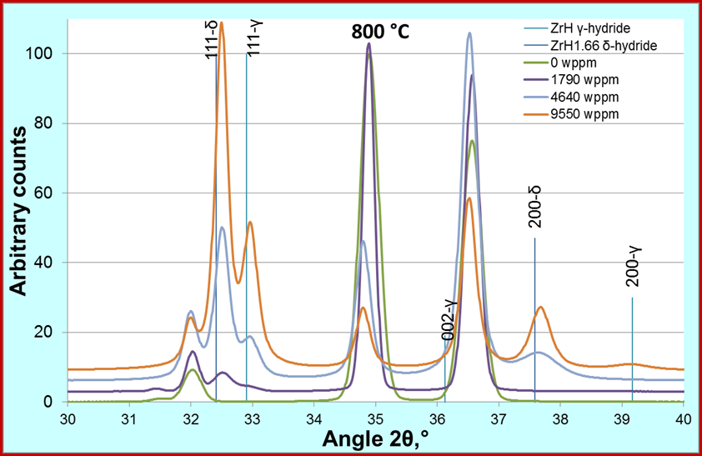
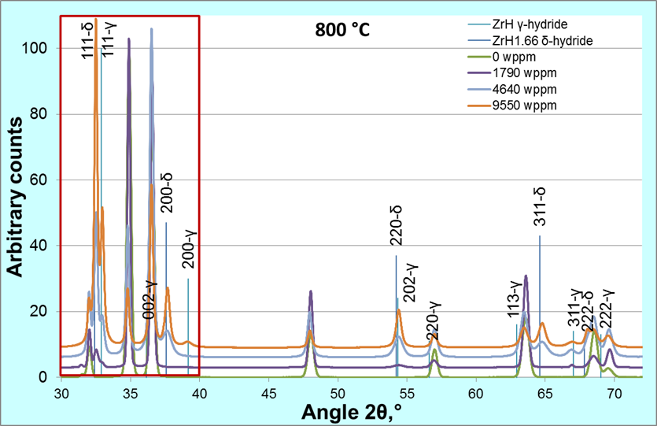

X-Ray profiles of Zircaloy-4 samples
hydrogenated at 800 °C

Slide 26




Change of lattice parameters after hydrogenation
of Zircaloy-4 samples
a
γ – hydride ZrH scheme
δ – hydride ZrH_{1,66} scheme
c
c
a
2D projection of HCP-lattice
without hydrogen
With hydrogen
3D model of
HCP-lattice
Scheme of decohesion mechanism, accompanied by hydride formation

Slide 27
Conclusion
No “macroscopic” hydrides were detected by means of optical microscopy, only high magnification SEM observations reveal presumable submicroscale hydrides.
Microhardness tests showed a relationship between hydrogen content hardening, annealing softening and hardening due to β → α transformation during cooling phase.
The XRD-analysis showed the presence of γ-, δ-phases of zirconium hydrides in all of performed experiments. With the increase of hydrogen content the hydride peak intensity was also increased. Simultaneously the hydrogen should be partially dissolved in the lattice which is indicated by increase of the lattice parameter “c”.
Because carried out observations have proved only the presence of hydrides and gave not enough information on the hydride structure and distribution, further detailed EBSD and TEM investigations should be performed in order to determine the location, morphology and orientation of nano-scaled hydrides and to separate hydrides from other structural features.
The performed experiments can explain the absence of macroscopic hydrides in QUENCH-LOCA experiments. The increased brittleness of some zirconium claddings after QUENCH-LOCA tests could be caused by nano-scaled hydrides which are distributed in the bulk of material. The fact of the growth of the lattice parameter “c” allows to suggest that the decohesion mechanism accompanied by hydride formation could be responsible for cladding destruction.

Slide 28
Aknowledgements
The authors would like to thank the following KIT colleagues:
Dr. Mario Walter for fruitful discussions
Mrs. Ursula Peters for her technical assistance with the hydrogenation tests
Ms. Julia Lorenz for the help during preparation of the specimens for metallographic observations
Dr. Harald Leiste for carrying out of X-Ray diffraction measurements
Dr. Marcus Müller for carrying out of FEG-SEM observations

Slide 29
Thank you for your attention!
anton.pshenichnikov@kit.edu
juri.stuckert@kit.edu
http://www.iam.kit.edu/wpt/471.php

