Slide 1

First results of the bundle test QUENCH-L2 with M5® claddings
J. Stuckert, M. Große, J. Moch, C. Rössger, M. Steinbrück, M. Walter
QWS19, Karlsruhe 2013

Slide 2
LOCA program at KIT on secondary hydrogenation of cladding and its influence on cladding embrittlement
Sequence of phenomena:
cladding ballooning and burst, relief of inner rod pressure
steam penetration through the burst opening, steam propagation in decreasing gap between cladding and pellet
oxidation of inner cladding surface with hydrogen release
absorption of hydrogen by cladding at the boundary of inner oxidised area at temperatures higher of the phase transition α → (α+β) in Zr alloy
local embrittlement of cladding near to burst opening
Kr (He)
band of hydrogen absorbed in Zr
oxidation
of inner
cladding
surface
Zr+2H₂O=
ZrO₂+2H₂↑
steam

Slide 3
Cross-section of the QUENCH-L2 bundle
The use of tungsten heaters with smaller diameter (4.6 mm) instead tungsten heaters (QUENCH-L0) or tantalum heaters (QUENCH-L1) with diameter of 6 mm has allowed to reach a higher heat rate.
All rods are filled with Kr with p=55 bar at Tpct=800 K (similar to QUENCH-L1).

Slide 4
Maximal cladding temperatures of internal rods
in hottest region of QUENCH-L0, -L1 and -L2 bundles
8 K/s
7 K/s
2.5 K/s
similar temperature histories for QUENCH-L1 (reference, Zry-4) and -L2 (M5®)

Slide 5
Scenario of the QUENCH-L2 test
steam 190°C, 2 g/s
Ar 190°C, 6 g/s
maximal reached power:
QUENCH-L1 (Ta-heaters, Ø 6 mm): 58.5 kW,
QUENCH-L2 (W-heaters; Ø 4.6 mm): 60.5 kW

Slide 6
QL2: circumferential temperature gradient
for rod #7 at hottest elevations 850 mm (7/12) and 950 mm (7/13)
≈70 K during burst

Slide 7
QL2: circumferential oxidation gradient
(post-test eddy current measurements)
0°
270°
90°
180°

Slide 8
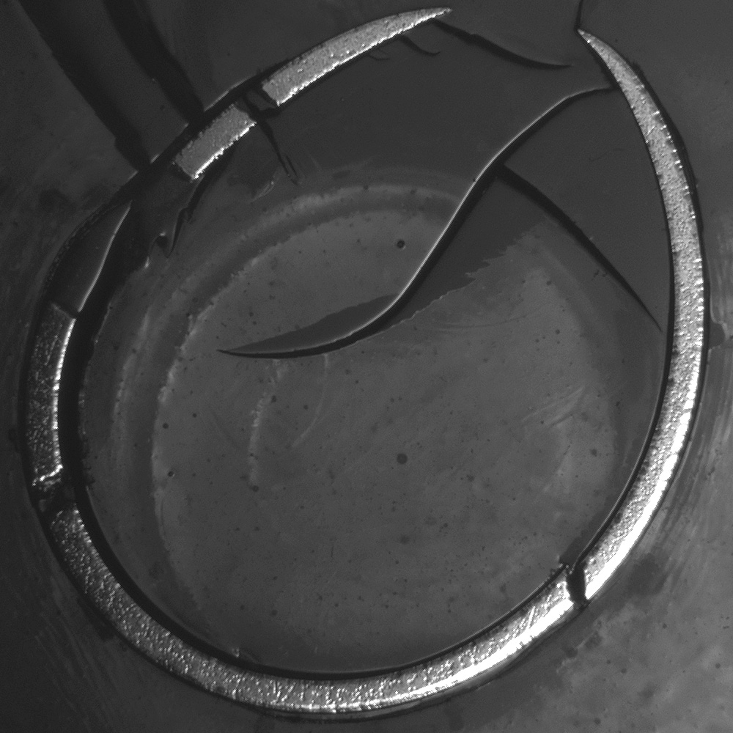
Cladding oxidation degree:
total thickness of outer ZrO₂ and α-Zr(O) layers
(tangential average of eddy-current measurements)
ZrO₂
α-Zr(O)
β-Zr
(QUENCH-L1; rod #1)

Slide 9
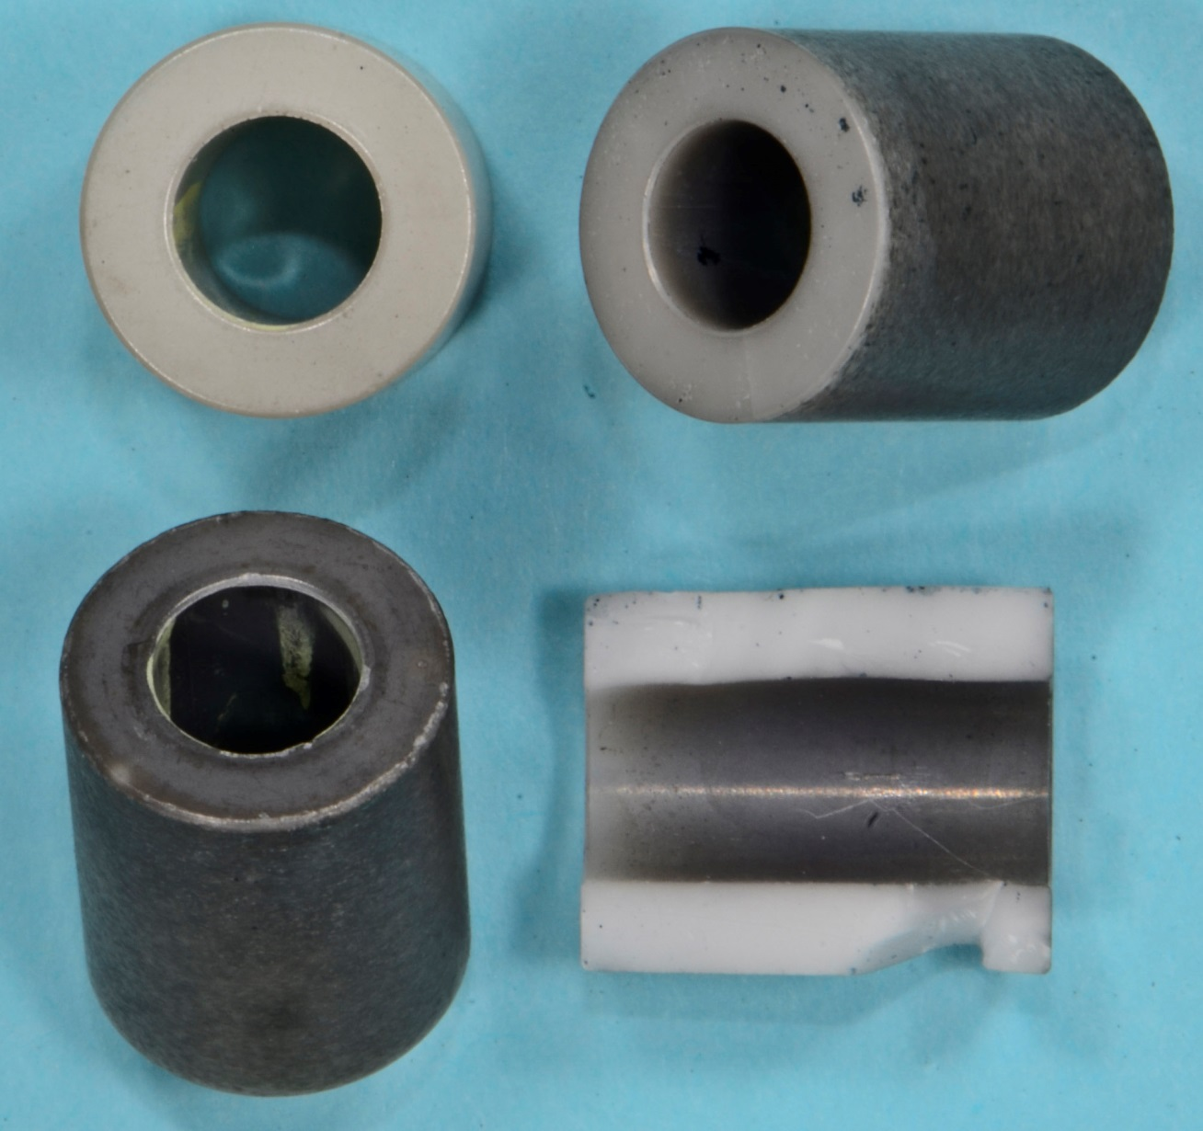
Metal-vapour-phase deposition
on the pellet surface
post-test ZrO₂ pellet
good contacted with
adjacent pellet:
negligible coating
of frontal surface
original ZrO₂ pellet
post-test ZrO₂ pellet
with large gap to
adjacent pellet:
significant coating
of frontal surface
(deposition
of W and Zr)
deposition of W
at inner surface
of cracked pellet
deposition of Zr

Slide 10
Rod pressure evolution during heating phase for QUENCH-L1 and -L2: burst time indication (coincided with MS results on Kr release)
LOCA-1
ballooning
LOCA-2
burst
internal
rod group
internal
rod group
external
rod group
external
rod group
duration of decrease of the inner pressure to the system pressure: τ₀ ≈ 30 s

Slide 11
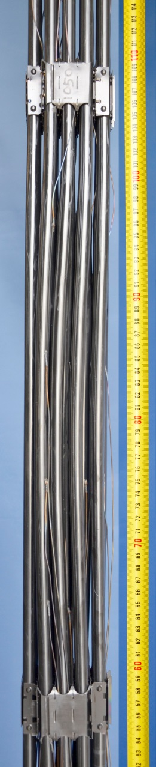
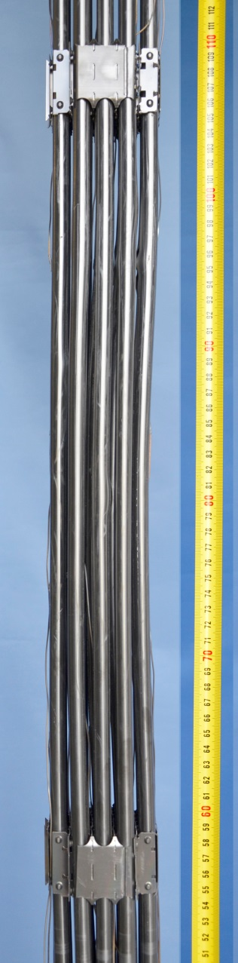
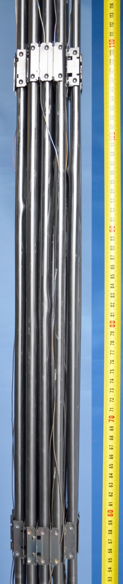
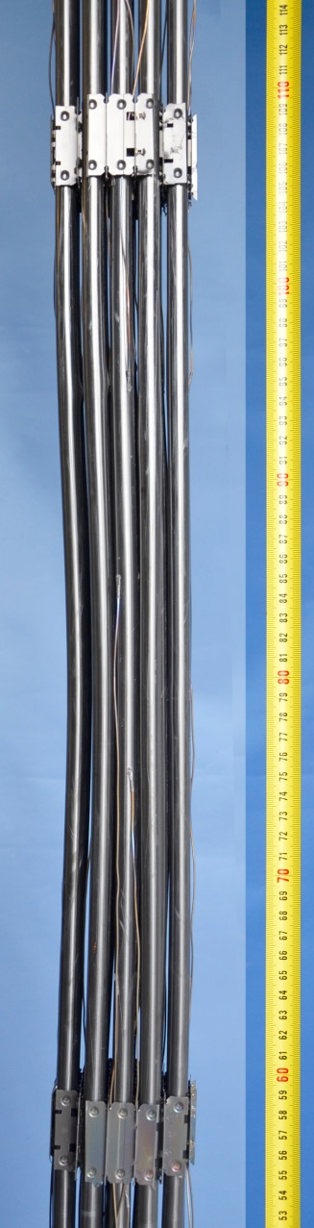
Post-test QL2 bundle view between GS3 and GS4: rod bending
0° | 90° | 180° | 270°

Slide 12
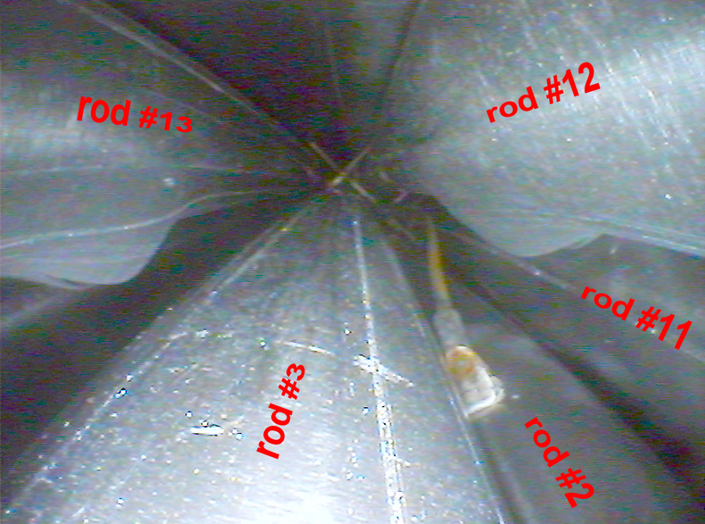
QL2: videoscope observations
ballooning and burst of cladding tubes at elevation 950 mm

Slide 13
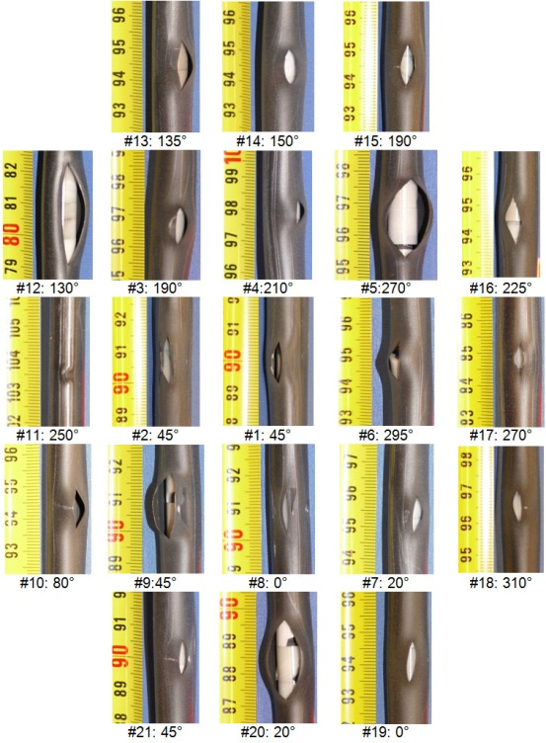
Overview of burst openings
LOCA-1
LOCA-2

Slide 14
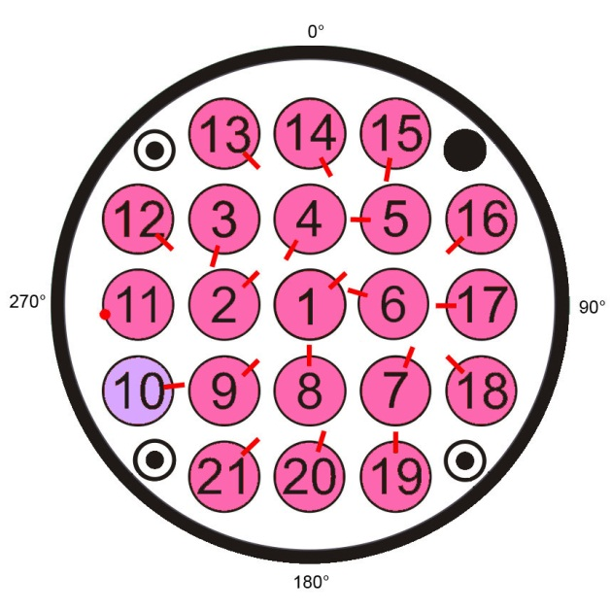
Circumferential position of burst openings
LOCA-0:
openings oriented
to bundle center
due to strong radial T gradient
LOCA-1:
not strong orientation
to bundle center
LOCA-2:
similar to LOCA-1
excluding adjacent rods
7, 8, 20

Slide 15
Length and axial position of burst openings
LOCA-0
LOCA-1
LOCA-2

Slide 16
Burst-Parameters
LOCA-1
LOCA-2
Rod group | Rod # | Burst time, s | Burst temperature, interpolated, K
Inner rods | 4 | 55.2 | 1154
 | 6 | 55.2 | 1110
 | 1 | 55.6 | 1169 (Max)
 | 5 | 57.2 | 1104
 | 2 | 57.2 | 1132
 | 8 | 58.6 | 1132
 | 3 | 59.0 | 1118
 | 7 | 59.8 | 1074 (Min)
 | 9 | 62.6 | 1162
Outer rods | 15 | 64.4 | 1159
 | 17 | 67.6 | 1104
 | 11 | 67.6 | 1056
 | 14 | 68.6 | 1154
 | 16 | 68.8 | 1156
 | 18 | 72.6 | 1081
 | 13 | 73.6 | 1147
 | 20 | 76.0 | 1105
 | 12 | 76.8 | 1092
 | 21 | 80.6 | 1140
 | 19 | 83.6 | 1163
 | 10 | 87.6 | 1143
Rod group | Rod # | Burst time, s | Burst temperature, interpolated, K
Inner rods | 8 | 48.4 | 1113
 | 6 | 49.8 | 1121
 | 1 | 50.4 | 1135
 | 4 | 52.4 | 1167
 | 2 | 52.6 | 1167
 | 9 | 52.7 | 1162
 | 3 | 52.7 | 1168
 | 7 | 52.9 | 1136
 | 5 | 53.1 | 1163
Outer rods | 15 | 57.2 | 1124
 | 17 | 62 | 1102
 | 20 | 62.8 | 1110
 | 16 | 64 | 1143
 | 18 | 65 | 1139
 | 11 | 65 | 1145
 | 21 | 65.8 | 1050 (Min)
 | 10 | 66.2 | 1125
 | 14 | 66.2 | 1167
 | 13 | 67.4 | 1178
 | 19 | 67.4 | 1093
 | 12 | 67.8 | 1195 (Max)

Slide 17
Cooling channel blockage
for LOCA-0, LOCA-1 and LOCA-2

Slide 18
Summary
Test QUENCH-LOCA-2 test was performed according to a temperature/time-scenario typical for a LBLOCA in a German PWR with maximal heat-up rate 8 K/s, cooling phase lasted 120 s and terminated with 3.3 g/s/rod water flooding.
The maximum temperature of 1400 K was reached on the end of the heat-up phase at elevation 850 mm. Tangential temperature gradient across a rod was up to 70 K on the burst onset.
Due to low ballooning degree the maximum blockage ratio of cooling channel (15% at 960 mm) was lower in comparison to QUENCH-L0 and -L1 (about 23%). Due to moderate blockage a good bundle coolability was kept for all three bundles.
The cladding burst occurred at temperatures between 1050 and 1195 K (similar to QUENCH-L1). The inner rod pressure relief to the system pressure during about 35 s (similar to QUENCH-L0 and -L1).
During quenching, following the high-temperature phase, no fragmentation of claddings was observed (residual ductility is sufficient).
The first two experiments (QUENCH-L0 and -L1) show that formation of hydrogen-containing bands is expected first above 930°C. The corresponding studies for QUENCH-L2 are in progress.

Slide 19
Acknowledgment
The QUENCH-LOCA experiments are supported and partly sponsored by the association of the German utilities (VGB).
The authors would like to thank Mrs. J. Laier and Mrs. U. Peters for intensive work during test preparation and post-test investigations.
Thank you for your attention
https://www.iam.kit.edu/wpt/loca/
http://www.iam.kit.edu/wpt/471.php
http://quench.forschung.kit.edu/

