Slide 1
Overview of LOCA tests performed at KIT during last 30 years
J. Stuckert
QWS19, Karlsruhe 2013

Slide 2
OUTLINE
Out-of-pile single tube isothermal tests TUBA
Out-of-pile single rod transient tests FABIOLA
FR2 in-pile single rod tests with nuclear and electrical heating
Out-of-pile bundle tests FEBA on investigation of coolability of bundle with ballooning simulators
Out-of-pile bundle tests SEFLEX on influence of clad-fuel gaps and coolability of bundles blocked by pre-ballooned clads
Out-of-pile REBEKA bundle tests on Zry-4 clad behaviour under LOCA conditions

Slide 3
Out-of-pile KfK single tube isothermal tests TUBA
between 600°C and 1200°C: investigation of creep rupture time
P. Hofmann, S. Raff. KfK 3168, Juli 1981
60 tests
samples: as received Zry-4 tubes (without pellets) with length of 60 mm;
pressure-less heating to work T in He;
filling of sample with Ar during 1 s
to overpressures 2…200 bar;
one TC at sample bottom;
axial T difference between sample middle and sample end-plugs (pre-test): 25 K;
azimuthal ΔT: < 3 K;
strain measurement on cross projection with video camera.
He
scheme of TUBA rig (TUbe Burst Apparatus)

Slide 4
Single tube isothermal TUBA tests: dependence of burst strain
and rod bending on temperature
650°C
100 bar
80% strain
800°C
23 bar
80% strain
950°C
16 bar
80% strain
1050°C
5 bar
70% strain
1) two minimums of the burst strain:
at 900°C (α+β region) and 1050°C (β region);
2) significant rod bending at temperatures before phase transition (α region);
absence of rod bending at temperatures during and after phase transition;
3) axial contraction in α region due to anisotropy.
max burst strain vs. temperaure

Slide 5
Single tube isothermal TUBA tests: criterion of creep rupture time
(dependence of burst time on temperature and pressure)
*
pressure
strain
pressure
strain
pressure p_{i}
hoop stress, σ_{HSO}
Zry-4 samples
after burst
at 850°C
Zry-4 samples
after burst
at 900°C
stress rupture life
*burst strain expressed as a percentage

Slide 6
KfK single rod transient tests FABIOLA
L. Schmidt, H. Lehning, K. Müller, D. Piel, H. Schleger. KfK 3250, Juni 1982
> 100 tests
samples: as received Zry-4 tubes
with length of 200 mm, filled with Al₂O₃ or UO₂ pellets (no influence of pellet material was detected);
filling of sample with He during 1 s
to overpressures 40…125 bar at 600°C;
transient heating in steam with rates 2…11 K/s until clad burst;
temperature measurements: 3 pyrometers along axial direction (75 mm interval), 3 thermocouples at burst position (only few samples; 120° interval);
axial T gradient between sample middle and sample end-plugs: 0.2 K/mm;
azimuthal ΔT: 15 K;
strain measurement on longitudinal projection with X-ray camera.
steam 1 m/s
shroud
(heated)
pressure tube
X-ray picture of FABIOLA rig

Slide 7
Single rod transient tests FABIOLA: dependence of burst time and burst strain on pressure
122 bar
68 bar
burst at 866°C (α+β-region)
burst at 766°C (α-region)
strain 39%
strain 52%

Slide 8
Out-of-pile single rod transient tests FABIOLA: dependence of burst strain on temperature
α+β-region: 810…980°C
minimum of burst strain lies in α+β-region at 900°C - similar to isotherm tests

Slide 9
FR2 in-pile single rod tests with electrical heating
M. Prüßmann, E. H. Karb, L. Sepold. KfK 3255, September 1982
8 reference tests with rod simulators inside FR2 reactor channel
(reactor out of order)
samples: as received Zry-4 tubes
filled with Al₂O₃;
Internal Inconel heater 50 W/cm;
filling of sample with He during to overpressures 20…110 bar at 370°C;
transient heat up with rate 12 K/s until desired T of 820…1000°C;
temperature measurements: 6 surface TC along axial direction;
axial ΔT between sample middle and sample end-plugs: > 50 K;
azimuthal ΔT: < 60 K;
tests performed without reflood.
electrically heated rod BSS
FR2 test channel

Slide 10
FR2 in-pile single rod tests with electrical heating:
axial changes of circumferential strain
(sample BSS 23:
Tburst=810°C
Pburst=85 bar)

Slide 11
FR2 in-pile single rod tests
E. H. Karb, M. Prüßmann, L. Sepold, P. Hofmann, G. Schanz. KfK 3346, March 1983
The same test scenario as for electrically heated rods (BSS),
but with nuclear heating.
Tests performed without reflood.
pre-irradiation history of rods
with burnup
20 GWd/tU
Type of Tests | Test series | Number of irradeated rods | Number of tests | Burnup (MWd/tU) | Range of internal pressure at steady state temperature (bar)
Calibration, Scoping | A | 0 | 5 | 0 | 25 -100
Unirradiated rods (Main parameter: Internal pressure) | B | 0 | 9 | 0 | 55 - 90
Irradiated rods (Main parameter: Burnup) | C | 6 | 5 | 2500 | 25 - 110
 | E | 6 | 5 | 8000 | 25 - 120
 | F | 6 | 5 | 20000 | 45 - 85
 | G1 | 6 | 5 | 35000 | 50 - 90
 | G2/3 | 6 | 5 | 35000 | 60 - 125
Electrically heated fuel rod simulators (Main parameter: Internal pressure) | BSS | 0 | 8 | 0 | 20 - 110
test rod
design

Slide 12
FR2 in-pile single rod tests:
cladding oxidation close to the burst opening
No influence of irradiation on the oxide growth was indicated (up to 35 GWd/tU)
Close to the burst opening, the thickness of the inner oxide layer was similar to outer oxide
Essentially no oxide was found on the inner surface more than about 100 mm from the burst location
The observed oxidation did not influence the circumferential strain

Slide 13
FR2 in-pile single rod tests:
no influence of irradiation (<35 GWd/tU) on burst parameters

Slide 14
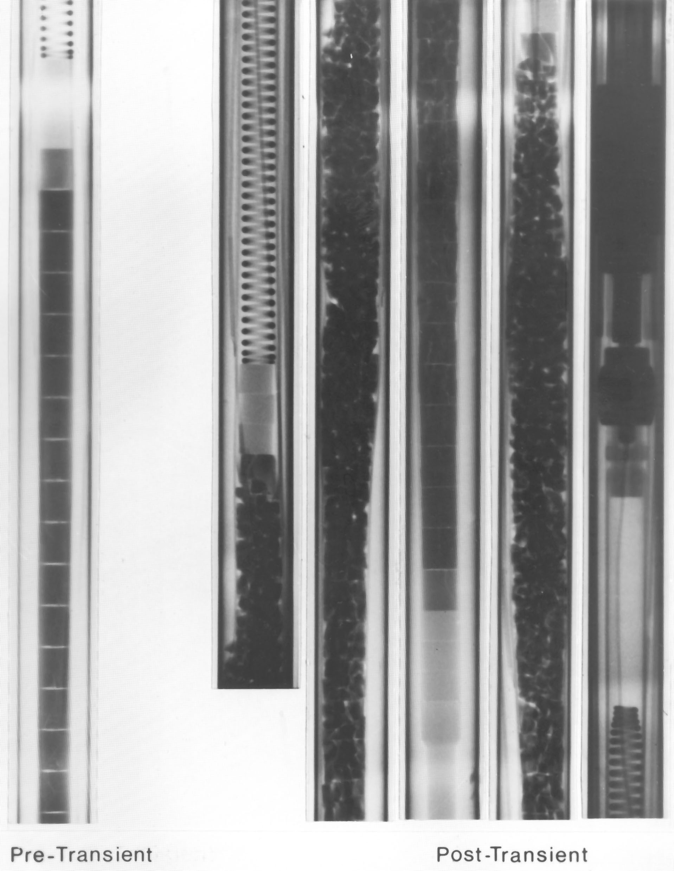
FR2 in-pile single rod tests:
shape of claddings and pellets at ballooning positions
no influence of irradiation on burst shape
neutron radiography: lost of shape of fragmented pellets after ballooning (rod F1, burnup 20 GWd/tU)
Fuel pellet fragmentation did not affect the cladding deformation process
No influence of fission products on cladding burst strain was detected

Slide 15
Single rod tests: change of axial cladding dimensions
and rod bending
Plenum
spring
max 4 mm
Axial cladding contraction and growth depends on temperature:
results of later REBEKA tests with single Zry-4 tubes surrounded with heaters;
rod length 500 mm;
heating rates 1…30 K/s
Results of the FR2 in-pile single rod tests: out-of-pile results [Chung], showing significant bending below 840°C (α-Zr(O)) and negligible values above 840°C, were not confirmed by the in-pile tests. However, the orientation of the rod bend was consistent with out-of-pile results, i.e., the rupture was on the inside of the bend.

Slide 16
Out-of-pile bundle tests FEBA on investigation of coolability
of bundles blocked by ballooning simulators
P. Ihle, K. Rust. KfK 3657, March 1984
Flooding Experiments
with Blocked Arrays:
8 electrical heated bundle simulators, length 3.9 m
Outcome:
Blockage of rod clusters up to 90% don’t affect their coolability for flow rates 2…6 cm/s;
Grid spacers increase the cooling effectiveness.
cross section of FEBA bundle
with 5x5 rods
FEBA rod simulator
FEBA test scenario

Slide 17
FEBA: clad temperature evolution

Slide 18
Out-of-pile bundle tests SEFLEX on influence of clad-fuel gaps and coolability of bundles blocked by pre-ballooned clads
P. Ihle, K. Rust. KfK 4024, March 1986
Fuel Rod Simulator Effects in Flooding Experiments:
4 electrical heated bundle simulators with Zry-4 clads, length 3.9 m.
The required outer shape of the ballooned Zircaloy claddings was produced in a furnace by heating up the pressurized cylindrical tubes placed in correspondingly shaped molds.
Outcome:
Ballooned Zircaloy claddings, forming e.g. a coplanar 90% blockage, are quenched substantially earlier than thickwall FEBA stainless steel blockage sleeves, and even earlier than undeformed rod claddings.
Rods with Zry-4 clads exhibit lower peak cladding temperatures and shorter quench times during reflood than gapless heater rods with FEBA steel claddings.
SEFLEX (REBEKA) rod simulator
SEFLEX bundles
Peak cladding temperatures and quench times
of SEFLEX (Zry) and FEBA (SS) bundles

Slide 19
Out-of-pile REBEKA bundle tests (1978-1987) on Zry-4 clad behaviour under LOCA conditions
K. Wier, KfK 44407, May 1988;
F. J. Erbacher, H. J. Neitzel, K. Wiehr: KfK 4781, August 1990
allocation of thermocouples
radial structure of REBEKA rod
(Reaktor-typisches Bündel-Experiment Karlsruhe)
“cosines” axial power profile
REBEKA-5 post-test appearance:
burst positions

Slide 20
REBEKA test matrix
 | REBEKA 1 | REBEKA 2 | REBEKA 3 | REBEKA 4 | REBEKA M | REBEKA 5 | REBEKA 6 | REBEKA 7
pressure, bar | 60 | 55 | 51 | 53 | 70 | 68 | 62 | 57
burst T, °C | 810 | 870 | 830 | 830 | 754 | 800 | 790 | 790
strain, % | 28 | 54 | 44 | 46 | 63 | 49 | 42 | 55
blockage, % | 25 | 60 | 52 | 55 | 84 | 52 | 60 | 66
burst region, mm |  | 95 | 203 | 242 | 28 | 242 | 140 | 200

Slide 21
Outcomes of REBEKA program
The cooling effect of the two-phase flow increases the temperature differences on the cladding tube circumference and limits in this way the mean circumferential burst strains to values of about 50%.
The circumferential burst strains of Zircaloy cladding tubes are kept relatively small due to temperature differences on the cladding circumference and the anisotropic strain behavior of Zircaloy.
comparison of FR2 data with REBEKA burst ctriterium

Slide 22
Summary of single rod and bundle tests (not pre-oxidised claddings)
performed between 1978 and 1987
Isothermal single cladding tests TUBA given conservative values on maximal burst parameters (dependence of stress burst life on temperature and pressure)
Rod bending was observed only at temperatures below phase transition α → α+β in Zircaloy-4 material (810°C)
Single rod tests FABIOLA with temperature transient confirmed observation of isothermal tests: minimum of burst strain lies in α+β-region at 900°C
Single rod FR2 in-pile tests up to burn-up of 35 GWd/tU showed that 1) Fuel pellet fragmentation did not affect the cladding deformation process; 2) No influence of fission products on cladding burst strain was detected
The observed oxidation degree did not influence the circumferential burst strain
Conclusions of out-of-pile tests REBEKA, SEFLEX and FEBA on bundle thermal-hydraulic behaviour: 1) The cooling effect of the two-phase mixture which is intensified during reflooding increases temperature differences on the cladding tube circumference and thus limits the mean circumferential burst strains to values of about 50%; 2) An unidirected flow through the fuel rod bundle during the reflooding phase causes maximum cooling channel blockage of about 70%; 3) The coolability of deformed fuel elements can be maintained up to flow blockages of about 90%.

Slide 23
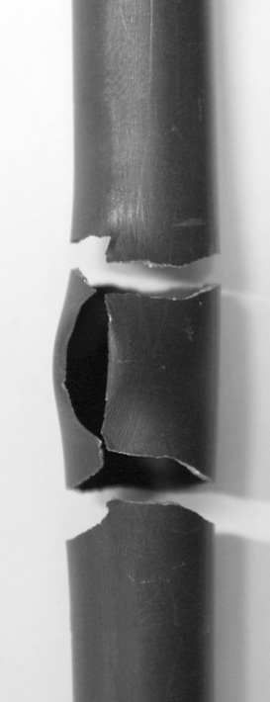
Bundle experiments
of the new QUENCH-LOCA series
Zircaloy-4 rods
Objective and results
Investigation of ballooning, burst and secondary hydrogen uptake of the cladding under representative design basis accident conditions
Detailed post-test investigation of the mechanical properties of the claddings to check the embrittlement criteria and measurement of residual ductility
Two experiments with Zircaloy-4 bundles were performed up to now as commissioning and reference tests
Four bundle tests with non- and pre-hydrogenated M5® and ZIRLO™ claddings will be performed up to 2015
hydrogen bands inside cladding
detected with n⁰-radiography
rupture of cladding during tensile tests
due to stress
concentration
(rods with C_{H}<1000wppm)
double ruptures due to hydrogen embrittlement
(C_{H}<1000wppm)

Slide 24
Acknowledgment
The on-going QUENCH-LOCA experiments are supported and partly sponsored by the association of the German utilities (VGB).
Thank you for your attention
https://www.iam.kit.edu/wpt/loca/
http://www.iam.kit.edu/wpt/471.php
http://quench.forschung.kit.edu/

