Slide 1

The ISTC project #3345 “Ex-vessel source term analysis” (EVAN)”
Analysis of Severe Accident Scenarios.
Analysis of fission product accumulation in fuel and FP release
September 7-10, 2007
St. Petersburg

Slide 2
Analysis of FP accumulation and release
FP behavior consideration and its connection with ISTC tasks

Slide 3
Analysis of FP accumulation and release
FP behavior in normal NPP operation

Slide 4
Analysis of FP accumulation and release
FP behavior in accidents

Slide 5
Analysis of FP accumulation and release
FP release out of fuel in normal NPP operation
  Nuclear recoil mechanism
  Knock-out mechanism
  Diffusion Mechanism
Correlation models of FP release out of solid fuel
CORSOR
CORSOR–М
CORSOR–BOOTH
Mechanistic models of FP release out of solid fuel
  Consideration of xenon and gas bubbles behavior in fuel grains
  Consideration of chemical interactions between FP and dissolved oxigen, formation of solid phases (precipitates) and gaseous matters, released out of fuel
  Fuel oxidation in different gaseous mixtures
FP gap transport and FP leakage out of fuel element
  FP release into gap
  FP release into central hole of fuel tablet
  FP sorbtion & desorbtion on fuel element surfaces
  FP migration from central hole to coolant
  FP release to coolant in case of direct contact of fuel and coolant
FP release description out of fuel element

Slide 6
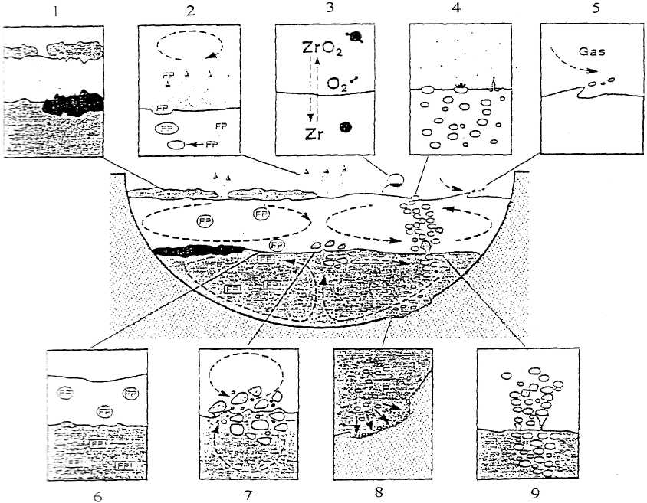
Analysis of FP accumulation and release
1 – crust formation; 2 - evaporation; 3 – chemical reactions; 4 – droplet outcome;
5 – material trapping; 6 – FP layer formation; 7 – convective instability on surface; 8 – interaction with concrete and its ablation; 9 – bubble trapping into flow.
FP release out of melt

Slide 7
Analysis of FP accumulation and release
Calculation:
activity of “light” FP group after t = 1 hour of WWER‑1000 reactor shutdown.

Slide 8
Analysis of FP accumulation and release
Calculation:
activity of “heavy” FP group after t = 1 hour of WWER‑1000 reactor shutdown.

Slide 9
Analysis of FP accumulation and release
Calculation:
comparison of total residual energy release in core

Slide 10
Analysis of FP accumulation and release
Calculation:
iodine accumulation in fuel during normal reactor operation

Slide 11
Analysis of FP accumulation and release
 | Isotope | Т_{1/2} | Class | NC: CORSOR-M | NC: CORSOR-BOOTH | NC: WWER-1000 | Accident: RELEASE | Accident: CORREL
 | - | Y | - | % | % | % | % | %
 | 2 | 3 | 4 | 5 | 6 | 7 | 8 | 9
1 | Kr-85 | 10,7 | Xe | 1,3e-5 18 | 1.0e-5 0,24 | 0,86 | 92 | ~100
2 | Sr-90 | 28,7 | Sr | 0 2,2E-6 | 1,6e-8 3,7е-4 | 0,83 | 1.3е-3 | ~52
3 | Cs-134 | 2,1 | Cs | 1,3e-5 18 | 1.0e-5 0,24 | 1,0 | 89 | ~100
4 | Cs-137 | 30 | Cs | 1,3e-5 18 | 1.0e-5 0,24 | 0,83 | 89 | ~100
5 | Ce-144 | 0,8 | Ce | 0 | 1,7e-10 4,0e-6 | 0,79 | 7е-7 | 0.04
6 | Pm-147 | 2,6 | La | 0 | 1,0e-10 2,5e-6 | 0,89 | 1е-6 | 0.3
Calculation:
long-lived radioactive FP inside gap (WWER-1000)

Slide 12
Analysis of FP accumulation and release
Boundary conditions for aerosol nucleation

Slide 13
Analysis of FP accumulation and release
Summary
Calculation schemes of FP fuel accumulation and FP release out of fuel in normal operation and in accidents have been analyzed.
Results of FP accumulation and release calculation have been analyzed.
Boundary conditions for aerosol nucleation have been formulated.

