Slide 1

Conditions of radioactive aerosol release whithin primary circuit of
NPP with WWER during LOCA severe accidents
Valery Sidorov (SPAEP)
Sergey Tsaun (IBRAE)
ISTC meeting, September 7-10, 2007
St-Petersburg

Slide 2
Conditions of radioactive aerosol release whithin primary circuit of
NPP wiht WWER during LOCA severe accidents
The analysis of thermal/hydraulic parameters in the reactor unit typical for aerosols release condition in primary circuit during a severe accidents
Calculation of fission products behavior during LOCA by means of code SOKRAT
Numerical modeling of convective flow above a surface of melt corium in reactor vessel by means of 3-D CFD code

Slide 3
The analysis of aerosols release condition
The following scenarios of heavy accidents have been reviewed:
Large (Dnom346 - in case of rupture of PRZR surge line ) and small (Dnom25 - from PCP) LOCA’s which is accompanied by a blackout
Large (Dnom300, (Dnom179) and small (Dnom80) LOCA’s from PCP cold leg accompanied by a failure of ECCS active part
accident with steam generator tubes rupture (3 tubes) which is accompanied by a blackout
Severe accident have been studied by means of Russian code SOKRAT

Slide 4
Severe Accident code SOKRAT
(reactor plant analysis)
RATEG — best-estimate code , which can be used for calculate of thermal and hydraulic processes in primary and secondary circuit
  Two-fluid 1D thermal-hydraulic flow
  1D and 2D heat conductivity
SVECHA — realistic simulation of core degradation phenomena
  hydrogen generation
  flowing materials models
GEFEST— realistic simulation of core debris behavior in the reactor bottom chamber
  Vessel-corium interaction
  Vessel deformations and failure
BONUS— fission product accumulation
RELIZ— fission product release in a gap from fuel road
GAPREL— fission product release in coolant
PROFIT— fission product relocation in the primary circuit, release in a break

Slide 5
Stages of core damage
(modeled in SVECHA unit)
2830 ºC |  | Melting of UO2
2710 ºC |  | Melting of ZrO2
2450 ºC |  | Melting of B₄C
1975 - 2830 ºC |  | Formation of corium (U-Zr-O) with ceramic inclusions
1975 ºC |  | Melting of oxide-stabilized α-ZR(O), beginning of UO2 dissolution in melted zirconium
1730 ºC |  | Melting of Zr-1%Nb
1550 ºC |  | Intensification of zirconium oxidation by steam associated with formation of ZrO2 cubic
1230 ºC |  | Eutectic interaction between zirconium alloys and stainless steel, losing of pile capacity by steel constructions
1000 ºC |  | Beginning of zirconium intensive oxidation, formation of liquid U as a result of Zry/UO2 interaction
600 - 2710 ºC |  | Possible ballooning, damage of fuel element cladding as a result of embitterment
380 ºC |  | Beginning of steel constructions oxidation

Slide 6
The design diagram of NPP with VVER-1000
Steam
generator
Steam
generator
Pressurizer
Gas removal system
Reactor
Hot leg
Cold leg
Core

Slide 7
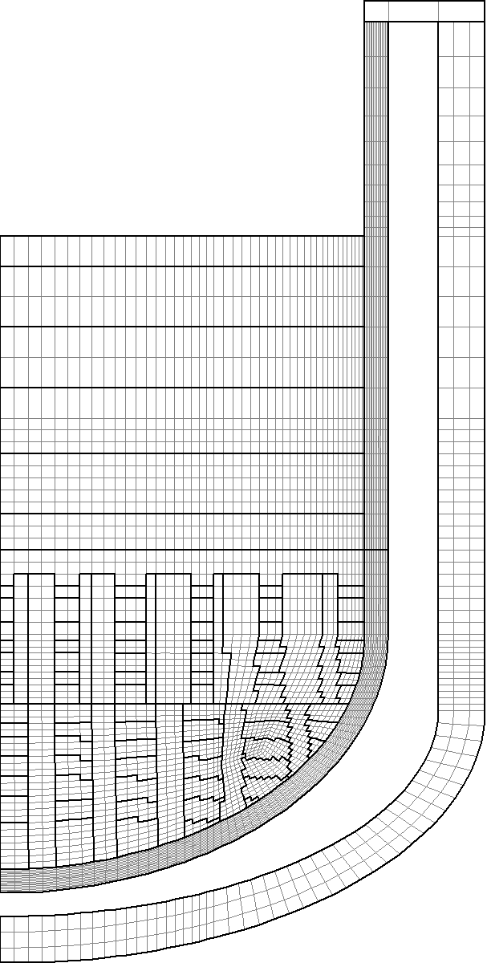
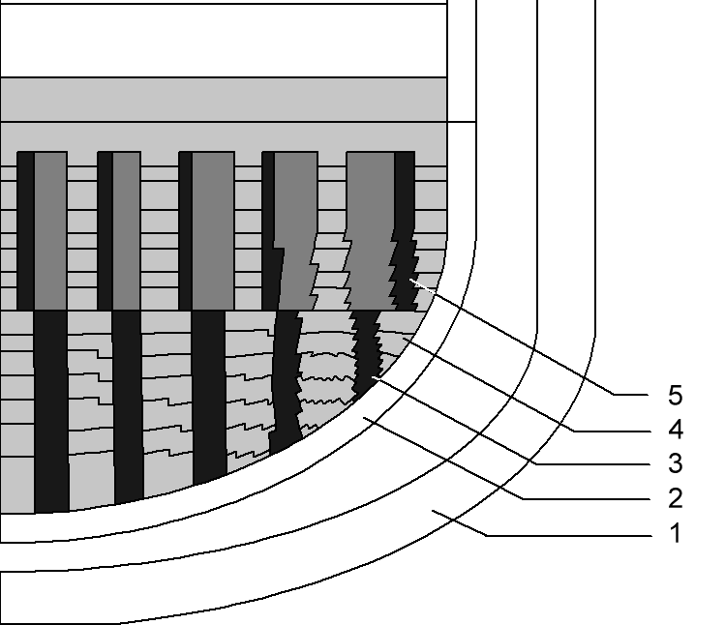
Finite-element partition of a reactor bottom chamber
Partition of internal space filled with relocating
core materials:
1 – reactor pressure vessel, 2 – core barrel wall,
3 – steel supports, 4 – modeled melt layers,
5 – fuel assemblies' support tubes filled in the first place.
Finite element-based division of the lower plenum chamber

Slide 8
Calculation results for in-vessel stage
of severe accidents

Slide 9
The analysis of aerosols release condition
large LOCA Dnom 346
hot leg of break loop, time history of several parametres
Reynolds number
Gas temperature
Gas velocity

Slide 10
The analysis of aerosols release condition
The following maximal value of
parameters have
been obtained:
Large and middle LOCA’s:
gas temperature: 3000 К
Velocity: 97 m/s
Reynolds number: 2,2·10⁶
Small LOCA’s:
gas temperature: 3000 К
Velocity: 38 m/s
Reynolds number: 1·10⁶
Steam generator tubes rupture (SGTR):
Max. Velocity: 324 m/s
Max. Reynolds number: 2.3·10⁷

Slide 11
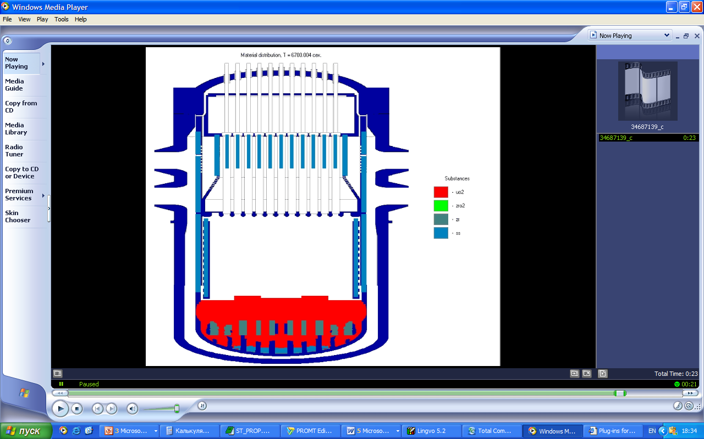
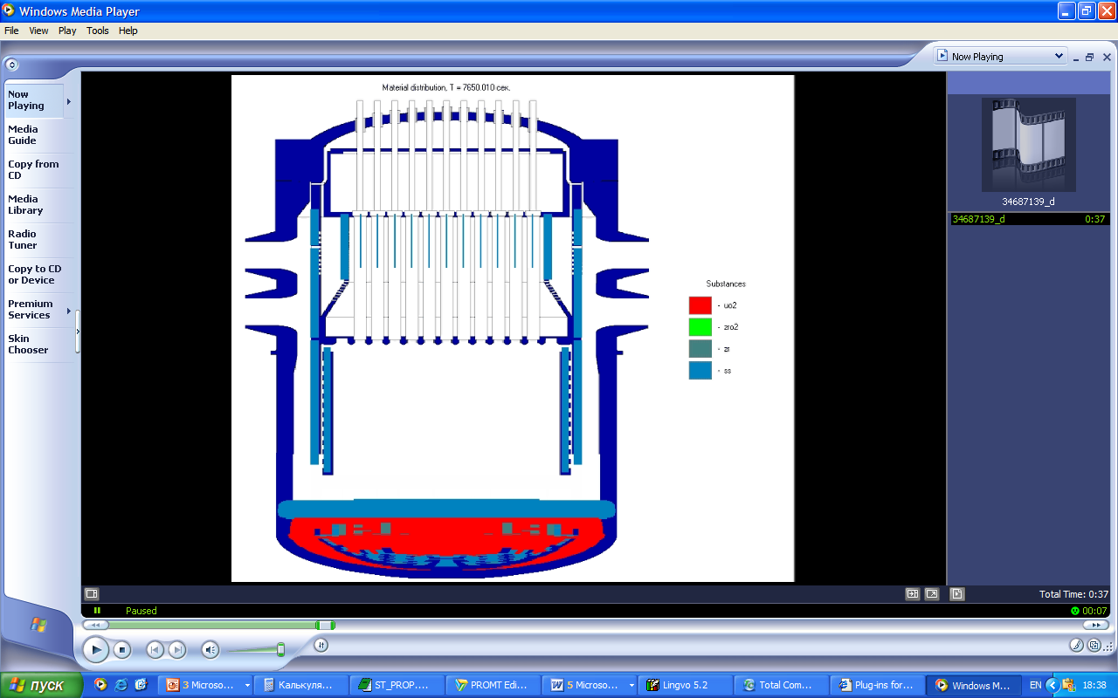
The analysis of aerosols release condition.
Relocation of core materials
Stratification of melt:
  Metallic layer
  Oxidic layer
Focusing effect
Formation of blockages near supporting grid
Formation of molten pool in the core region

Slide 12
The analysis of aerosols release condition.
Parameters of corium bath
parameters | accident
 | Dnom 346 | Dnom 300 | Dnom 179 | Dnom 80 | Dnom 25
Time available before the reactor barrel is melt through, s | 6 150 | 5 920 | 8 540 | 14 900 | 27 700
Time available before the reactor vessel is melt through, s | 8 340 | 7 930 | 10 330 | 16 500 | 29 820
Time available before the corium relocation to the corium catcher stops, s | 11 800 | 10 940 | 13 840 | 22 200 | 36 930
Parameters characterizing corium melt before core barrel melting
Upper layer: temperature, К Mass share of UO2 Mass share of ZrO2 Mass share of Zr Mass share of steel | 2790-2980 0,664-0,554 0,081-0,089 0,048-0,0105 0,207-0,252 | 2840-3000 0,674-0,621 0,086-0,076 0,045-0,093 0,195-0,21 | 2800-3170 0,659-0,566 0,073-0,066 0,048-0,101 0,22-0,267 | 2800-3300 0,756-0,614 0,105-0,102 0,029-0,024 0,109-0,259 | 2690-2890 0,541-0,484 0,159-0,097 0,009-0,008 0,291-0,411
Parameters of melt at the moment of the beginning vessel destruction
metallic layer: temperature, К Mass share of Zr Mass share of steel | 3070 0,053 0,947 | 3080 0,053 0,947 | 3000 0,058 0,942 | 3000 0,016 0,984 | 2650 0,06 0,994
Corium: temperature, К Mass share of UO2 Mass share of ZrO2 Mass share of Zr | 3210 0,786 0,118 0,096 | 3200 0,808 0,102 0,098 | 3160 0,804 0,094 0,103 | 3100 0,779 0,19 0,03 | 2970 0,75 0,233 0,017

Slide 13
The analysis of aerosols release condition.
Parameters of corium bath
large LOCA Dnom 346
the corium relocation to the corium catcher,
temperature of melt
the corium relocation to the corium catcher,
mass share of melt

Slide 14
Calculation of fission products behavior
by means of code SOKRAT.
LOCA Dnom346
Fission product behavior of class CI
during severe accident
Time dependences of release I, Mo and Te
from fuel

Slide 15
Calculation of fission products behavior by means of code SOKRAT.
LOCA Dnom346
Weights of the aerosols which have left
the primary circuit for aerosols of the various sizes
Weights of all aerosols
which have left from the primary circuit

Slide 16
Numerical modeling of convective flow above a surface of melt corium in reactor vessel by means of 3-D code
Fields of temperature and velocity in a longitudinal section for (z=0) at t=600 s

Slide 17
Numerical modeling of convective flow above a surface of melt corium in reactor vessel by means of 3-D code
Fields of velocities and temperatures at a surface of melt (y=0.1м) at t=600 s

Slide 18
Conclusions:
  The analysis of severe accidents (LOCA, SGTR) for an estimation conditions of aerosols release and aerosols relocation have been made using the SOKRAT computer code. The behavior of fission products in primary circuit for large LOCA have been estimated
  The velocities and temperatures fields over a surface of melt by means of 3-D CFD-code have been estimated
  Range of velocities, partial pressures, temperatures and Reynolds numbers, characteristics of upper layer corium melt have been evaluated. Values of this parameters is planned to use for an estimation of boundary conditions in experimental research

Slide 19
Further Research
  The analyses of aerosol behavior during severe accidents (steam generator tubes rupture (SGTR) and small LOCA’s) will be continued at the next stage of project
  Computational analysis of natural convection over melt surface by means of 3-D CFD code taking into account of corium oxidizing reactions will be executed

Slide 20
Thank you !
Acknowledgments
The authors are deeply indebted to
V.Astafjeva, A.Fokin, A.Fillipov, V.Ozrin, V.Tarasov,
G. Kobelev,A.Tkachenko, D.Tomachik, and V. Stepnov
for substantial aid in the carrying-out of this paper

