Slide 1
Analysis of aerosol behavior inside containment during severe accidents
M. Zatevakhin, I. Ivkov
Saint Petersburg Research and Design Institute ATOMENERGOPROEKT
Aerosol code consist of
Multicomponent aerosols condensation block
Multicomponent aerosols coagulation block
Aerosol deposition block
Particles deposition model include
following mechanisms
Gravitational settling (sedimentation)
Brownian diffusion
Diffusiophoresis
Thermophoresis

Slide 2
Coagulation processes: numerical method
Semi-implicit version of Modified Kovetz-Olund method (Stankova E.N., Zatevakhin M.A. The modified Kovetz and Olund method for the numerical solution of stochastic coalescence equation. Proceedings 12th International Conference on Clouds and Precipitation, Zurich, 19-23 August 1996, P. 921-923) .
⇒ Solution is positive at any Δt

Slide 3
Coagulation processes: validation tests
Species mass distributions functions. M_{i}⁰ are initial distributions, M_{i} are final distributions, M_{total} is the total mass, Analitical is analytical solution (Golovin, A.M. The solution of the coagulation equation for cloud droplets in a rising air current. Bull. Acad. Sci. USSR, Geophys. Ser. 1963. No 5. P. 482-487 ).

Slide 4
Coagulation processes: validation tests
Comparison with results of (Yang Zhang, C. Seigneur, J. H. Seinfeld, J. H. Jacobson and F. S. Binkowski. Simulation of aerosol dynamics: a comparative review of algorithms used in air quality models. Aerosol Science and Technology. 1999. Vol. 31. P. 487-514).

Slide 5
Coagulation: influence of dilution: coagulation “freezing”
Monodisperse distribution,
D₀ = 1 μm, T_{coagul}= 6 sec

Slide 6
Coagulation: fluctuation of concentration: the process is practically linear!
Polluted urban conditions:
sum of three log-normal
distributions, T_{coagul}= 350 sec
Parameter
Median diameter (μm )
D_{n} | 0.038
D_{a} | 0.32
D_{c} | 5.7
Standard derivation
σ_{n} | 1.8
σ_{a} | 2.16
σ_{c} | 2.21
Total volume (μm3 cm-3)
V_{n} | 0.63
V_{a} | 38.4
V_{c} | 30.8

Slide 7
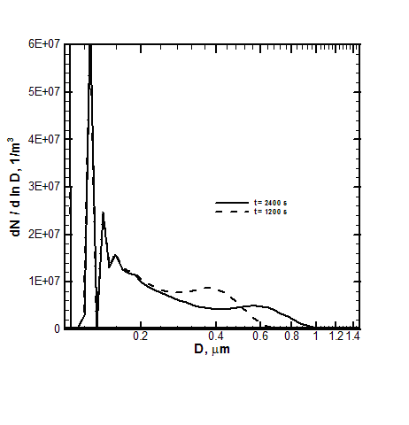
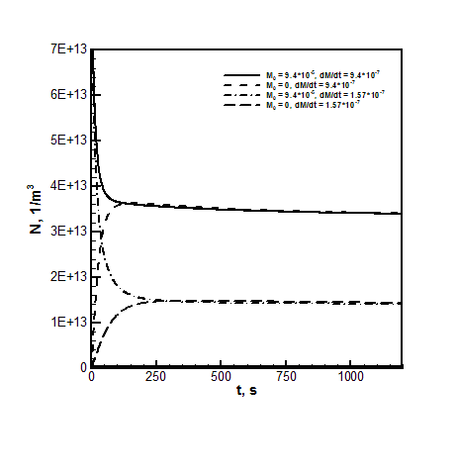
Coagulation in the presence of external sources

Slide 8
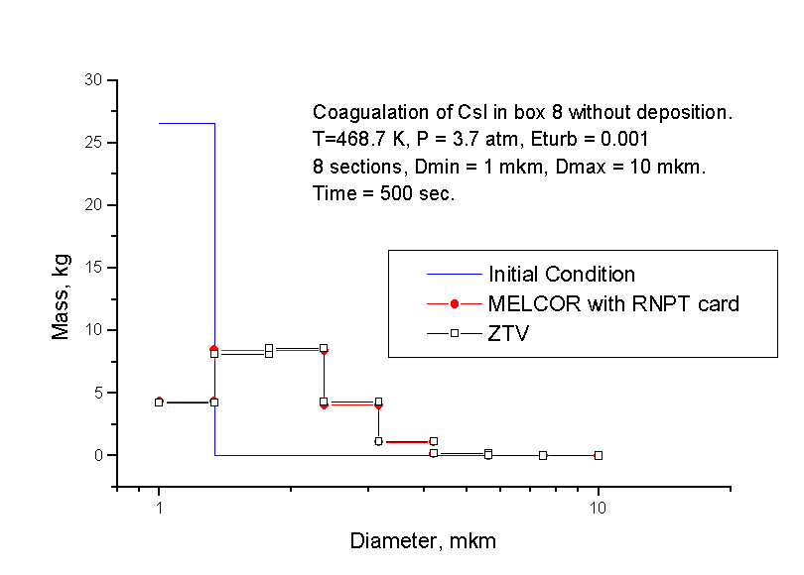
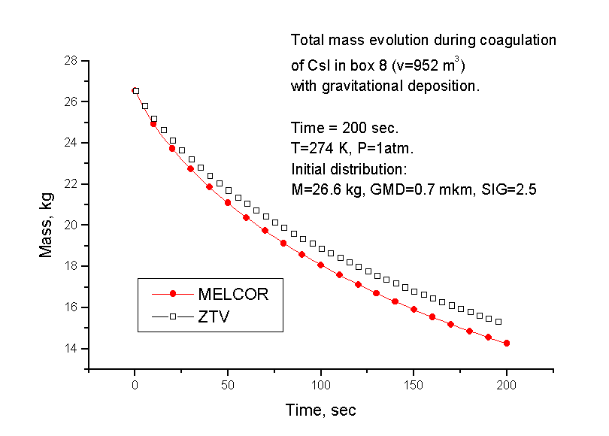
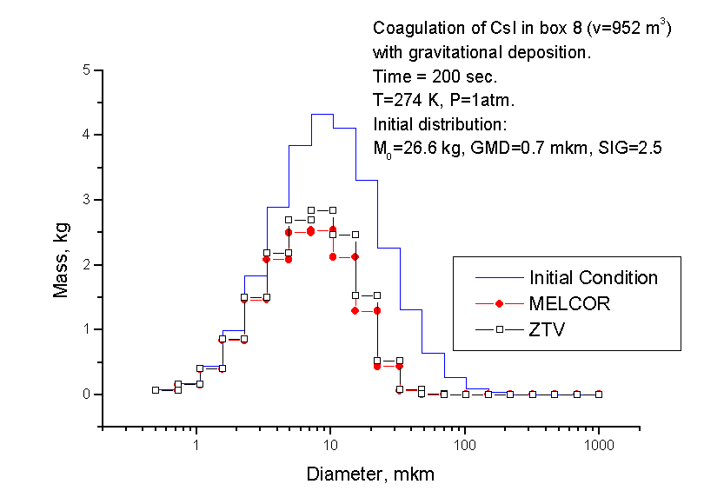
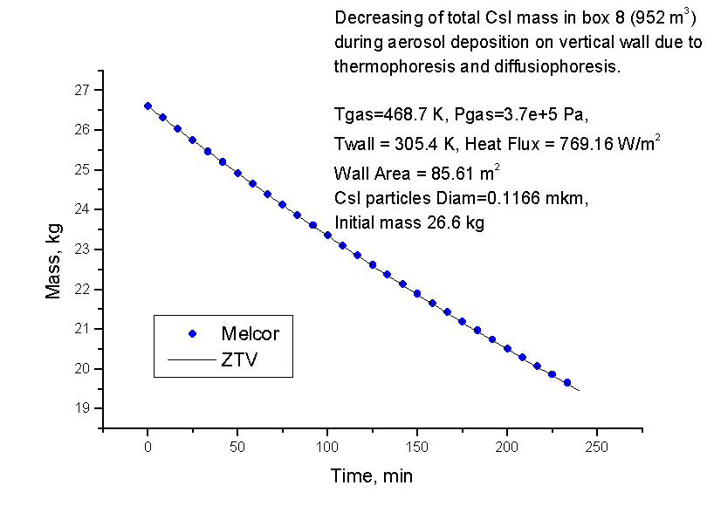
Comparison with MELCOR simulations

Slide 9
Condensation processes: numerical method
Jacobson, M.Z. (1997). Numerical Techniques to Solve Condensational and Dissolutional Growth Equations When Growth is Coupled to Reversible Reactions, Aerosol Sci. Technol. 27: 91-498.
; i=1,…,N_{p}-1
; i=1,…,N_{p}-1, j=1,…,N_{c}

Slide 10
Condensation processes: validation tests
Comparison with results of (Yang Zhang, C. Seigneur, J. H. Seinfeld, J. H. Jacobson and F. S. Binkowski. Simulation of aerosol dynamics: a comparative review of algorithms used in air quality models. Aerosol Science and Technology. 1999. Vol. 31. P. 487-514).

Slide 11
Condensation processes: multi-component particles

Slide 12
Results of calculations aerosol parameters using of aerosol code integrated with KUPOL-M thermohydraulic code
Comparison between calculated aerosol output (1) and data obtained according to project recommendations (2).
Aerosol distribution within control volume at D_{nom}346-break + SBO

Slide 13
Simulation of coagulation process in convective boundary layerатмосферы.
(comparison of 3D LES и 1D diffusion models)
3D LES problem formulation
Computational domain: X=4000 m, Y=4000 m, Z=2400 m.
Grid: N_{x}×N_{y}×N_{z} = 74×74×45 cells.
Periodic conditions is used on vertical boundaries.
At the lower surface universal functions are applied with a roughness z0 = 0.16 m and kinematic heat flux Qs=0.06 K m/s. A stress-free upper boundary was used.
The initial mean temperature profile represents a constant-temperature mixed layer topped by a layer of uniform stability: θ = 26.6 °C for z = 0…1350.4 m and then θ constantly increases with gradient 0.003 K/m.
Fixed flux of 3.5e-4 kg/(m²s) of 0.05 μm monodiperse particles with density of 2160 kg/m³ was applied after 2500 sec convection development
Mass grid consists of 20 bins range from 0.05 to 2.5 μm.

Slide 14
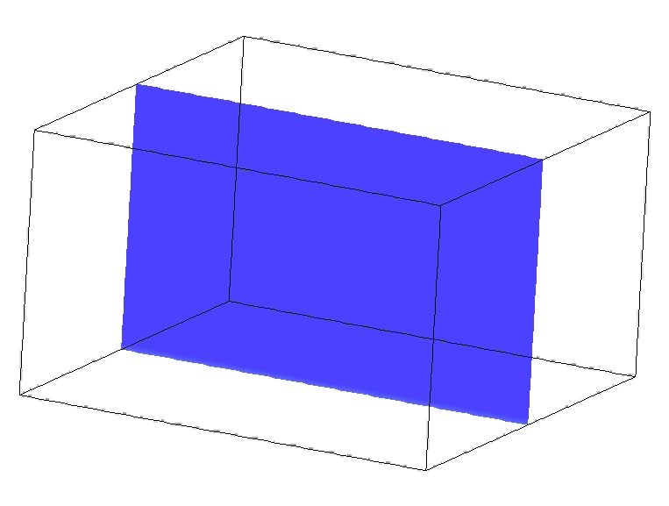
Simulation of coagulation process in convective boundary layerа.
3D LES total mass concentration evolution (animation)

Slide 15
Simulation of coagulation process in convective boundary layer.
(comparison of 3D LES и 1D diffusion models)
1D diffusion model
where:
Z – vertical coordinate,
M_{j} – j-th bin particles density,
Q_{j} –source term describing coagulation process,
K_{D}(Z) – turbulent diffusion coefficient, defined by
LES results as follows:
<…> - horizontal averaging operator at level Z,
K_{DSGS} - subgrid diffusion coefficient.

Slide 16
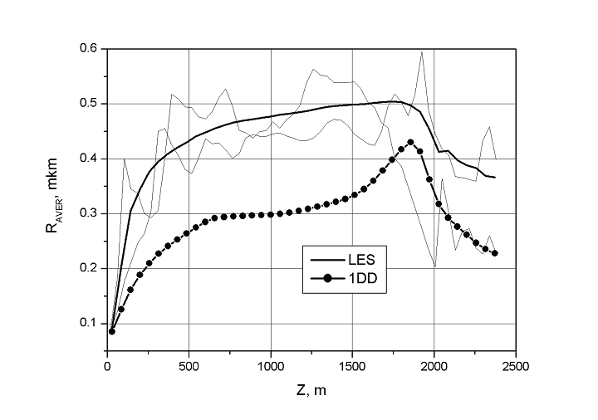
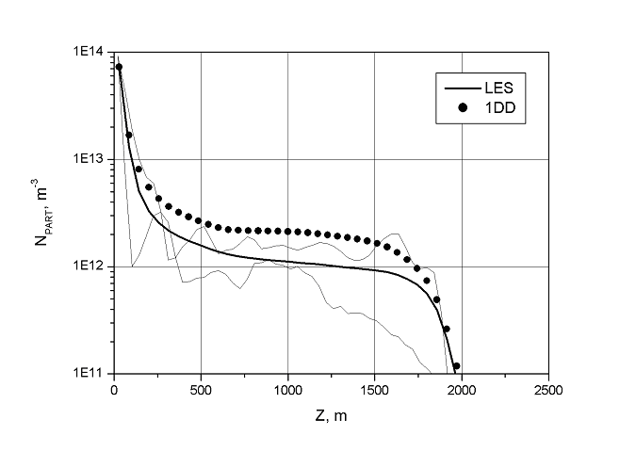
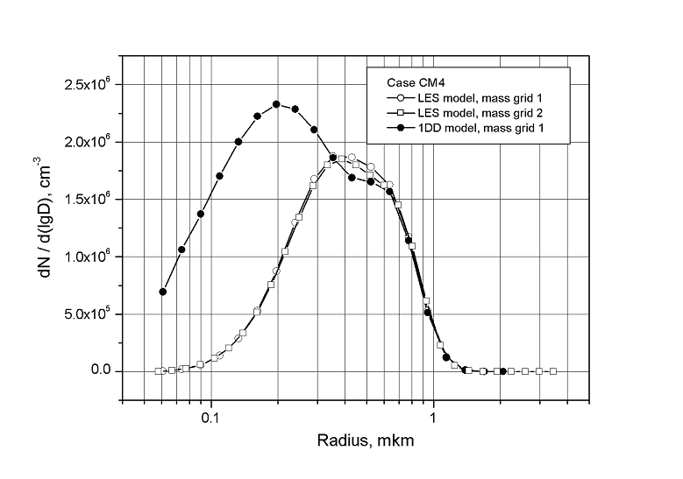
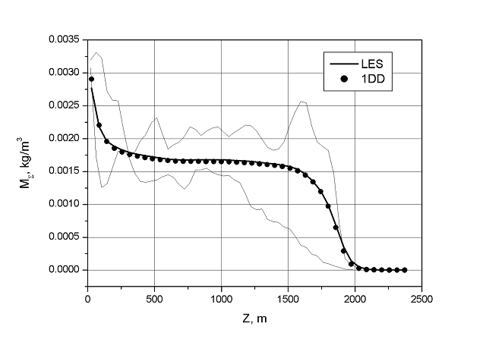
Simulation of coagulation process in convective boundary layerа.
(comparison of 3D LES и 1D diffusion models)
Fig. 1. Total mass concentration
Fig. 2. Total number concentration
Fig. 3. Mean particle radius
Fig. 4. Particles distribution function

Slide 17
Simulation of coagulation process in convective boundary layerа.
Instantaneous distribution of particles mean radius

Slide 18
Possible farther development
  Take into account aerosol hygroscopicity
  Integrate aerosol code with 3D hydrodynamic code
  Use new experimental data for code validation

