Slide 1
A.P. Alexandrov Research Institute of Technology
ISTC EVAN Project
# 3345
Pre-EV1 experiment
Presented by S. Bechta
1st EVAN meeting

Slide 2
Contents
Test objectives
Basic test conditions
Induction furnace schematics
Optimization of the gas flow in the furnace
Gas-aerosol system schematics
Test procedure
Experimental results
Posttest analysis
Conclusions

Slide 3
Test objectives
Test operation of the gas-aerosol system and the furnace
Determine optimal content of the oxidant in the gas mixture
Evaluate melt oxidation kinetics
Determine melt evaporation rate at different melt oxidation indexes

Slide 4
Basic test conditions
Pretest conditions correspond to the main experiment:
Melt
Melt mass: 1600 g
Initial melt composition, mass.%:UO₂-74.1; ZrO₂-19.7; Zr-6.2
Initial corium oxidation index: С-70
U/Zr = 1.2
No fission product simulants
Above-melt atmosphere
High-purity Ar during the molten pool formation and at
stationary regimes
Ar flow-rate 10 l/min
The same flow rate of Ar/O₂ mixture with a volume fraction up
to 20 vol.% in oxidation transients

Slide 5
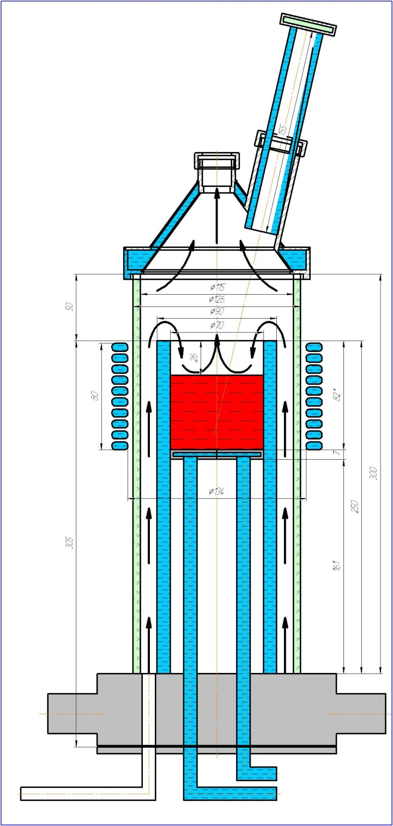
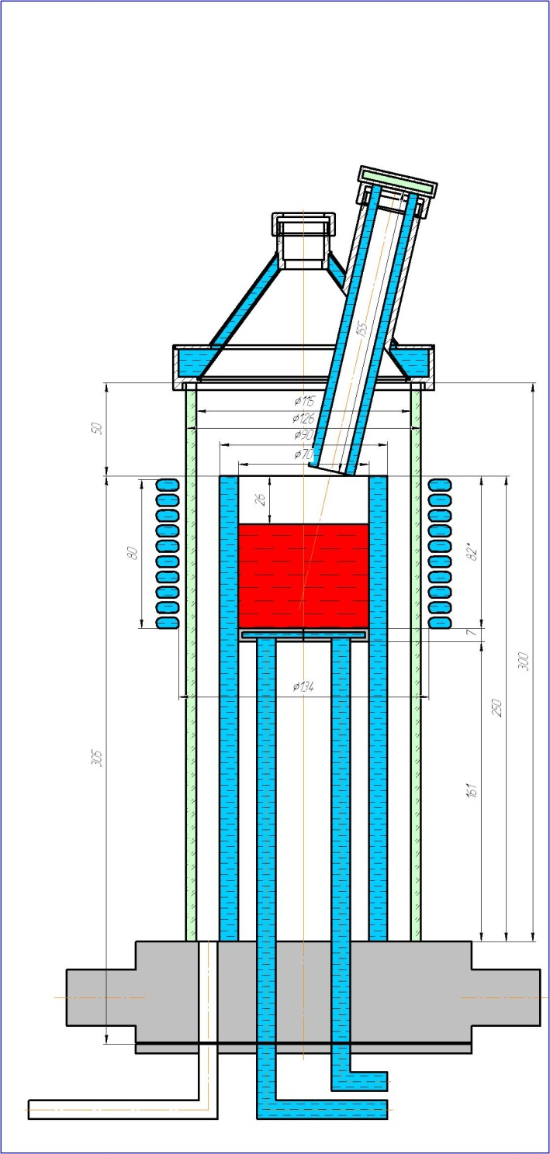
Induction furnace schematics
1
9
1 – Main aerosol line
2 – Furnace lid
3 – Quartz tube
4 – Inductor
5 – Melt
6 – Cold crucible
7 – Bottom calorimeter
8 – Cold crucible manifold
9 – Pyrometer shaft
2
3
4
5
6
7
8
To reduce transport losses the molten pool was
raised to the crucible top (minimal distance from the
molten pool to the crucible edge is 25 mm)
Pyrometer shaft was temporally lowered for precise
temperature measurements
Gas was supplied via the crucible manifold

Slide 6
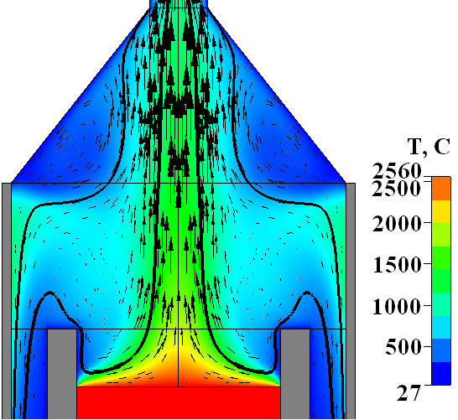
Optimization of the gas flow in the furnace
Final geometry: Temperature and velocity vectors
Q = 10 l/min, Ar/O₂=80:20;
Minimal aerosol deposition on the furnace lid
Maximal aerosol holdup by the carrier gas

Slide 7
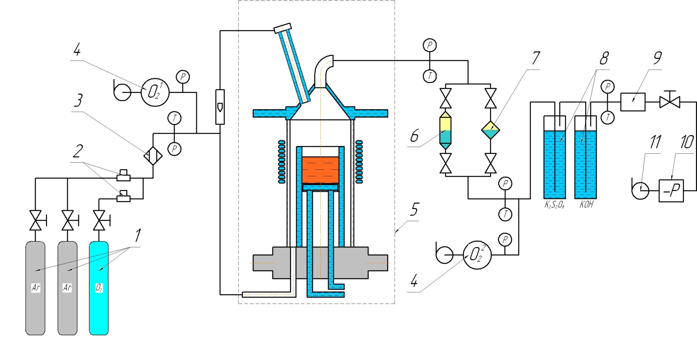
Gas-aerosol system schematics
1 – Argon and oxygen tanks; 2 –Bronkhorst flow rate regulators; 3 – Gas mixing chamber; 4 – Oxygen sensor; 5 – IMCC furnace; 6 – Medium area filter (MAF); 7 – Analytical filter (AAF); 8 – Bubblers; 9- Flowmeter; 10 - Pressure meter, 11 – Vacuum pump.
Ar and O₂ mixing unit was used for the oxidant supply to the furnace
Electrochemical sensors were used for online control of oxygen balance
The bubblers contained potassium hydroxide and persulphate solutions for Ru absorption

Slide 8
Test procedure
Regimes 1, 2, 4, 5, 7- stationary
Regimes 3, 6 – transition (oxidation in progress)

Slide 9
Experimental results (1)
Anode current and voltage dynamics. Pyrometer indications
Tm- pyrometer indications; Ia – anode current; Ua- plate voltage;
1-7 Time intervals of aerosol sampling to the AAF and MAF filters

Slide 10
Experimental results (2)
Melt surface temperatures at different stationary regimes
2700
2630
2655
2565
2545

Slide 11
Experimental results (3)
Regime parameters
Regimes 1, 2, 4, 5, 7- stationary
Regimes 3, 6 – transition (oxidation in progress).

Slide 12
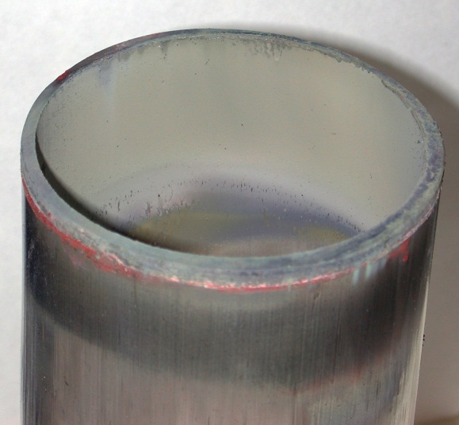
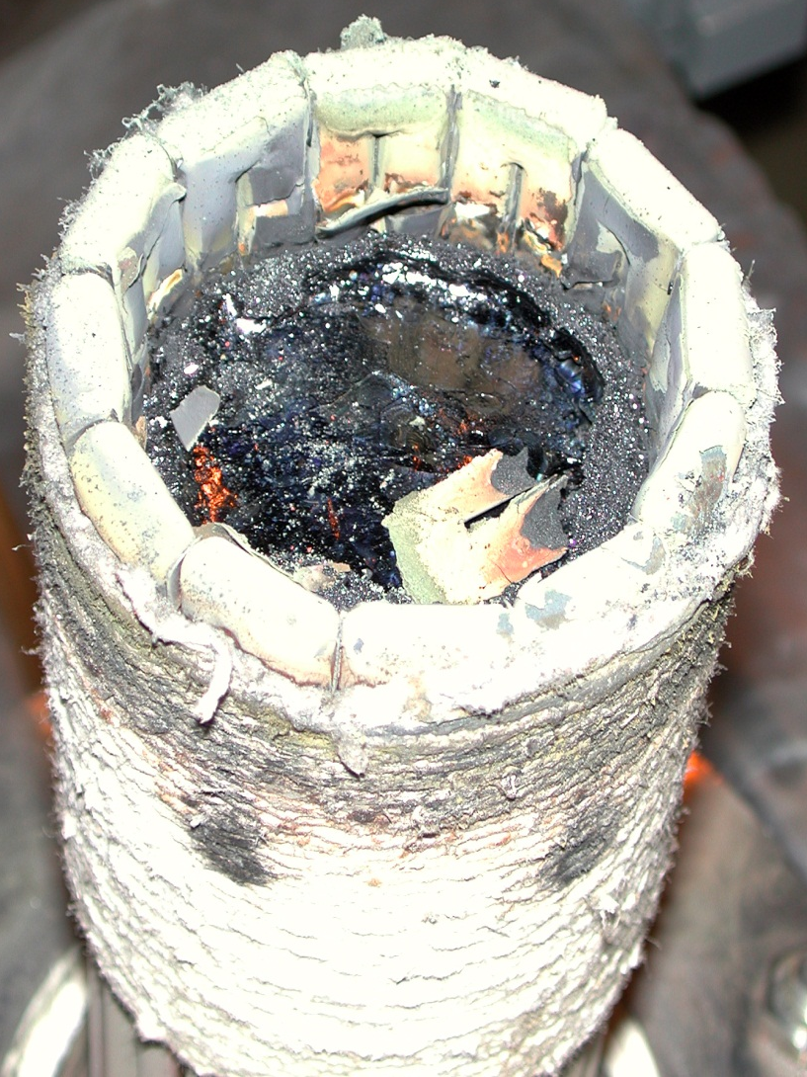
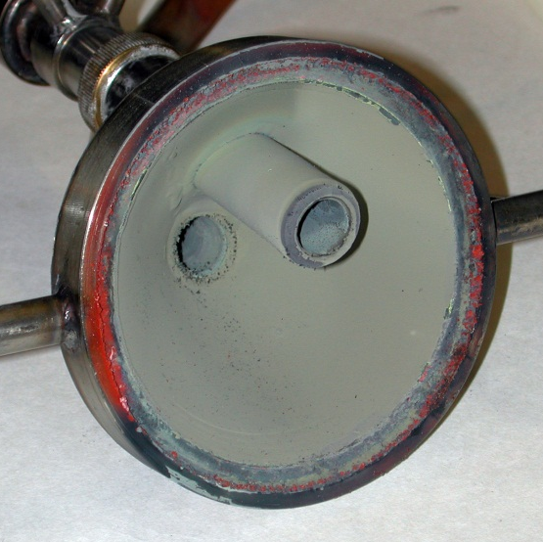
Experimental results (4)
Aerosols from the crucible quartz tube
Aerosol deposition on furnace components
Aerosols from sections
Aerosols from the lid

Slide 13
  Posttest analysis (1)
Material balance
Imbalance +50.4 g indicates that during the experiment not only metallic zirconium got oxidized; also a
part of U⁺⁴ was oxidized to U⁺⁶
Aerosol mass on the filters is much smaller than the mass of aerosol transport loss. The transport
losses are taken into account in calculations of mass release rate

Slide 14
  Posttest analysis (2)
XRF and chemical analysis
Admixtures and О from the residue
Average sample of aerosols collected from crucible sections, lid and quartz tube
Uranium content in the melt decreased due to the evaporation
Aerosol mass composition – uranium oxides (IV, VI) with zirconium oxide admixtures
Stoichiometry of uranium oxides in corium is calculated – UO_{2.08} while in aerosols - UO_{2.37}

Slide 15
  Posttest analysis (3)
Aerosol release rates (1)
– mass of total aerosols collected in the furnace, mg;
– mass of aerosol deposits on the MAF, mg;
– mass of aerosol deposits on the AAF, mg;
- melt surface area, 39.6 cm².
– time of sampling to the AAF, h;

Slide 16
  Posttest analysis (4)
Aerosol release rates (2)
Aerosol release rates are very sensitive to the temperature

Slide 17
  Posttest analysis (5)
Evolution of the melt oxidation
Oxygen absorption mass
Oxidation index
Oxygen absorption rate
1st oxidation period:
9.3 (±0.3) mg О₂/с
2nd oxidation period:
7.3 (±0.2) mg О₂/с

Slide 18
Conclusions
20 % vol. oxidant concentration in the gas mixture has been chosen
for the main experiment; it ensures the accident-free experimental
procedure
Reliable performance of the furnace and all system has been
demonstrated. However aerosol transport losses are significant
It has been established that the melt oxidation rate is not sensitive to
the oxidation index, i.e. free zirconium concentration
(oxygen starvation regime)
Data on aerosol mass release rate at different temperatures and
oxidation indexes have been measured

