Slide 1
THEORETICAL ANALYSIS AND COMPUTATION OF FISSION PRODUCT RELEASE FROM MOLTEN POOL
O. Tarasov
Nuclear safety institute
St. Petersburg, 10.09.2007
Notes:
The topic of my talk is “theoretical analysis and computation of fission product release from molten pool”.

Slide 2
CONTENTS
FP release mechanisms
  In vessel
  In core catcher
2. Corium in vessel
  Composition and properties
  The model
3. FP release
  Most important factors
  Saturated vapor model by Ozrin
  Some results
4. Conclusion
Notes:
In my talk I am going to describe briefly the mechanisms of FP release from the corium in vessel and in core catcher. Then I will say a few words about the properties of the corium itself and the models of it. And after that I will tell about our model of FP release developed by Vladimir Ozrin.

Slide 3
1. FP release mechanisms
In core catcher
Molten corium-concrete interaction
Gas bubbles nucleation, growth, motion
VANESA
Not considered by us
In vessel
Evaporation from the upper boundary of the corium
Our FP release model (Ozrin)
Notes:
First of all, I must say that there are two different cases: FP release from molten corium in vessel and in core catcher. They must be considered separately because of different mechanisms of FP release. In core catcher corium interacts with concrete, and the main mechanism of FP release is formation of gas bubbles. Their nucleation, growth, motion is calculated by codes like VANESA. In vessel the situation is different. Gas bubbles are not expected, and FPs evaporate from the open surface of molten pool. We consider only this case.

Slide 4
2. Corium in vessel: composition
O-U-Zr-Fe-Ni-Cr-B-C-fission products
MASSES:
Core is assumed to melt completely
UO₂ (~ 80 t)
ZrO₂, Zr (~25 t)
Fe (30-40 t)
Ni, Cr (~10 t)
FP and other components (<0.4 t)
Notes:
In order to calculate FP release it is necessary to have a model of liquid corium. Corium at the reactor bottom consists of core materials and steel. Its main components are U, Zr, Fe and O. Fission products can be considered as admixtures in corium.

Slide 5
2. Corium in vessel: properties
Miscibility gap, 2 liquid phases
FP distribution in corium (MASCA):
Mo, Ru – in metal phase
Sr, Ba, Ce, La – in oxide phase
Heat generation mostly in oxide phase
Gravity stratification of phases
Influence on FP release
Notes:
One of the most important thermodynamic properties of liquid corium is a miscibility gap in its phase diagram. Oxide and metal phase appear. Their compositions, physical and chemical properties are different. Some fission products are mostly located in the metal phase, others prefer the oxide phase. In general, heat generation is concentrated mostly in the oxide phase.
The phases have different densities and this leads to their gravity stratification. FPs evaporate into atmosphere from the upper phase, so it is very important to know their densities.

Slide 6
2. Corium in vessel: the model
Non-ideal molecular solution
Atoms: O, U, Zr, Fe
Molecules: UO₂, ZrO₂, U, Zr, Fe, FeO, O
Equilibrium: minimum of Gibbs energy
, p – phase number (ox, met)
, i = U, UO₂, …
– polynomial (x_{i})
Experiment data:
  IVTAN THERMO database
  MASCA STFM experiments
  (pseudo-)binary systems phase diagrams
The code has not been introduced in FP release model yet
Notes:
Thermodynamic properties of corium can be described by the model of non-ideal molecular solution. At present moment we have described the most important 4-component system of O, U, Zr, Fe. It allows to calculate the compositions, masses, densities and some other properties of oxide and metal phases. However, this code has not been implemented in FP release model yet. The simpler model of ideal molecular mixture is used though it can not predict its splitting into oxide and metal phases.

Slide 7
3. FP release: limiting factors
Finite FP transport rate in corium ( ~ 10 sm/s )
Finite FP diffusion rate through the crust
(in case of inverse layers position)
Finite FP evaporation rate (Langmuir model)
Finite rate of blowing away of evaporated FP
(saturated vapor model, Ozrin)
Corium oxidation (in oxygen atmosphere)
FP distribution between metal and oxide phases
Notes:
Now I am going to describe the model of FP release itself.
FP release rate is limited by several factors.
The rate of FP transport to the upper boundary of melt is finite.
If the oxide phase is lighter than metal phase then an upper boundary crust can appear. It slows down the FP release.
The rate of FP evaporation is also finite and can be described by Langemuir model
Evaporated FPs can return back into corium unless they are blown away by an air flux.
FP release rate is also affected by such processes as corium oxidation in the oxygen-containing atmosphere and non-uniform distribution of FPs between oxide and metal phases.
Our model, developed by Vladimir Ozrin, takes into consideration only the most important factor: finite rate of blowing away of saturated FP vapor over the molten pool. In other words, it is supposed that the rate of pool vaporization is proportional to the strength of the wind over it.

Slide 8
3. FP release: the model (Ozrin)
Assumptions
FP vapor over corium is saturated
FP vapor is blown off at finite rate v (L/s)
Infinite rate of all other kinetic processes
Corium model: ideal molecular mixture
Gas model: ideal molecular gas
in gas phase and x_{i} in melt
ΔG_{i} – molecule formation energy
– FP release rate
Notes:
Here are the assumptions of the model.
Evaporated FPs over the molten pool have concentration of a saturated vapor
It is blown away at finite rate which is supposed to be given by hydrodynamic calculations
The rate of other processes is infinite
Corium is described as an ideal molecular mixture
Vapor is described as an ideal molecular gas
The partial pressures of FPs in saturated vapor are obtained from acting mass law. The rate of FP release is proportional to the partial pressure and to the gas flow rate.

Slide 9
3. FP release: the molecule database
Molten corium:
U, Zr, Cs, Mo, Ru, Ba, Sr, La, Ce, Nd, Nb, Sb, Te, Fe, Cr, Ni
UO₂, ZrO₂, Cs₂O, MoO₂, RuO₂, BaO, SrO, La₂O₃, CeO₂, Ce₂O₃, EuO, Eu₂O₃, Nd₂O₃, NbO, NbO₂, Sb₂O₃, FeO, Cr₂O₃, NiO
Gas phase:
O₂, H₂, N₂, H₂O, Cs, CsO, Cs₂O, Cs₂, CsMoO₄, CsI, Cs₂I₂, Mo, MoO, MoO₂, MoO₃, Mo₂O₆, Mo₃O₉, Ru, RuO, RuO₂, RuO₃, RuO₄, Ba, Ba₂, Ba₂O, BaO, Ba₂O₂, BaMoO₄, Sr, Sr₂, SrO, Zr, ZrO, ZrO₂, La, La₂O, LaO, La₂O₂, Ce, CeO, Eu, Eu₂O, EuO, Eu₂O₂, Nd, NdO, Nb, NbO, Sb, Sb₂, SbO, U, UO, UO₂, UO₃, UH₂O₄, Fe, FeO, FeO₂, Fe₂, FeHO, FeHO₂, FeH₂O₂, Ni, NiO, Ni₂, NiHO, NiH₂O₂, Cr, CrO, CrO₂, CrO₃, Cr₂, Cr₂O, Cr₂O₂, Cr₂O₃
Notes:
As I have already said, in our model the molecular approach is used. It allows to describe chemical effects which are very important for calculation of saturated vapor partial pressures. In order to take them into account, a molecular thermodynamic database was created. It allows to calculate Gibbs energies of the most important molecules in liquid and gas phase at all temperatures. The parameters were taken from IVTANTHERMO database and some other sources.

Slide 10
3. FP release: realization of the model
INPUT DATA:
Initial corium composition
Atmosphere composition
Gas flow rate (L/s)
Volume of the gas phase (L)
Time grid
OUTPUT DATA:
Released FP fraction
Corium oxidation
Notes:
A code realizing this model has been developed. Input data are: corium composition, the atmosphere composition, gas flow rate, volume of the gas phase and the time grid. The model calculates the released part of every FP and oxidation degree of the corium.

Slide 11
3. FP release: comparison with experiment
EXPERIMENT MA-6 (MASCA):
Corium C30
Neutral atmosphere
Element | Model/Experiment
U | 2.1
Zr | 1.5
Fe | 6.9
Ni | 18.0
Cr | 2.8
Notes:
Here is the comparison of the results of our model and MA-6 MASCA experiment. We can see that the model overestimates the release rate of all elements. It gives upper, conservative estimate of FP release rate because we assumed that the rate of some kinetic processes was infinite.

Slide 12
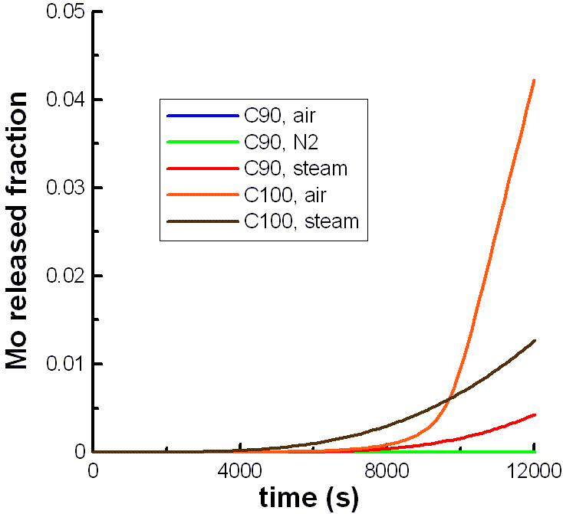
3. FP release: model results
Обозначения:
T = 2500 K
V = 12.5 L
M = 200 kg
v = 0.17 L/s
Notes:
In this picture the time dependence of molybdenum release calculated by our model is shown. Different lines correspond to different atmospheres and degrees of corium oxidation. It can be seen that the release rate depends strongly on these factors. If the atmosphere contains oxygen, molybdenum can oxidize and release at finite rate. If there is no oxygen in the atmosphere, molybdenum has no such possibility and its release rate is expected to be negligible (look at the green line). I’d like to repeat that such effects can be described only if molecular structure of the gas phase is taken into account.

Slide 13
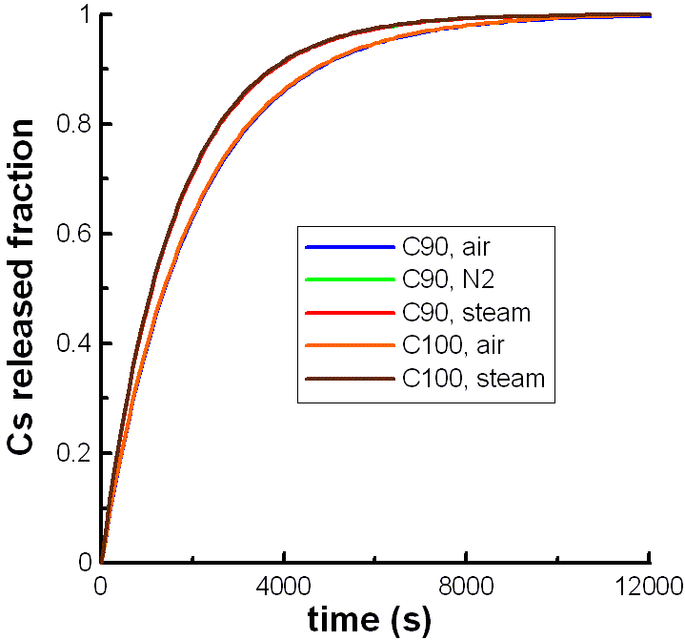
3. FP release: model results
Обозначения:
T = 2500 K
V = 12.5 L
M = 200 kg
v = 0.17 L/s
Notes:
In this picture the release of caesium is shown. It is not oxidized in gas and hence its release rate is expected to be almost independent of the atmosphere composition.

Slide 14
4. Conclusion
RESULTS
FP release from molten corium in vessel is modeled
Upper estimate of FP release in neutral atmosphere
Prediction of FP release in air atmosphere
Can be implemented in SOCRAT
PLANS
Finite rate of corium oxidation in oxygen atmosphere
Non-uniform distribution of FP in gas phase
Non-ideal model of corium, two phases
More realistic estimates of FP release
Notes:
Now I’d like to make a conclusion. We develop a model of fission product release from the molten corium in vessel. It gives an upper estimate of FP release rate into noble gas atmosphere and takes into consideration chemical effects in air atmosphere. A stand-alone code has been developed. It can be implemented into SOCRAT integral code.
We are going to develop this model. The next steps will be:
- Taking into account finite rate of corium oxidation in oxygen-containing atmosphere
Taking into account non-uniform distribution of FP in gas phase
Implantation of non-ideal model of corium, which can split into oxide and metal phases
We expect that it will allow us to obtain more realistic results.

