Slide 1
SPb SPU SPAEP
Model for Particle
Resuspension from
Rough Surfaces
in Turbulent Flow
Yuriy E. Gorbachev, Dmitriy Wiebe
gorbachev@csa.ru wiebe@nio.spbaep.ru
Progress meeting, September, 7 – 10, 2007

Slide 2
Particle Removal Process
Removal process is caused by the lift force F_{L} and aerodynamic drag force F_{D} acting on the particle stuck to the surface
Holding particles to the surface (sticking) is caused by the adhesive forces f_{a} that are of the van der Waals origin
Particles can rock about asperity contact P due to the action of the lift and drag couples counteracted by the adhesive couple at asperity contact Q.

Slide 3
Resuspension Models
Dynamic models assume the energy accumulation and resuspension after overcoming its critical value.
Quasi-static models assume that the resuspension is the result of the breakdown of the equilibrium of forces or moments.
Quasi-static models are the special case of the dynamic ones, when there is no energy accumulation at the natural resonance frequency of the particle-surface vibrations. The resuspension condition in this case is determined by the balance between the instantaneous aerodynamic forces/couples and adhesive forces/couples at each location/deformation in the adhesive surface potential well.
Both types of model are essentially statistical, based on either a Monte-Carlo simulation or on formulae for rate constant for resuspension: such models are referred to as kinetic models because of the analogy with kinetic models for the desorption of molecules a surface and the escape of Brownian particles from a potential wall

Slide 4
Rock ‘n’ roll Resuspension Model
The condition of the particle remove from the surface consists in that the removal force F_{t}(t) exceeds the adhesive one f_{aQ}.
The removal force is determined from the balance of the aerodynamic and adhesive couple F_{t}∙a = F_{L}∙r_{L} + F_{D}∙r_{D}, where r_{L} and r_{D} are corresponding arms of the forces and a is a typical of the distance between asperities, r_{L} ≈ a/2:
F_{t}(t) = F_{L}/2 + F_{D}∙r_{D}/a > f_{aQ}.
For spherical particles r_{D} ≈ r that is the sphere radius.
For non spherical particles the minimal characteristic dimension of the particle can be chosen for r_{D} estimation

Slide 5
Resuspension Rate Constant
, where the integration over the removal force
is done in the range where it force exceeds the adhesive force.
For a Gaussian distribution of the removal force the Resuspension Rate Constant has the form
where
and
are mean and fluctuating
component of a force F_{t}(t), with
being the typical frequency
being the typical frequency of the forcing motion and is given by
where is time derivative of
In practice is taken to be the maximum resuspension rate for a given adhesive force

Slide 6
Mean Lift and Drag Force
Rate Constant parameters can be determined experimentally.
For mean Lift Force the following scaled dependence on the fluid density ρ, kinematic viscosity ν and friction velocity u_{τ}
can be used while for mean Drug Force
Thus the Removal Force
Accounting the experimental result the rms
and neglecting correlations between those forces one obtains
Value for the typical frequency of the forcing motion derived from the experimental data

Slide 7
Resuspension Rate
The log-normal distribution for normalized adhesive forces is
assumed:
where ; is the adhesive force for perfectly smooth contact; is the geometric mean of the normalized adhesive forces and is a measure of the reduction in adhesion due to surface roughness; and is the geometric standard deviation.
Evolution equation for the deposited particles
=> mean particle density
and similarly the Resuspension Rate

Slide 8
Model parameters
To close the model the following parameters should be determined:
a that is typical of the distance between asperities;
r_{D} that is the Drag Force arm (minimal characteristic particle size);
F_{a} that is the Adhesive Force for perfectly smooth contact;
that is the geometric mean of the normalized Adhesive Forces;
that is the geometric standard deviation of the normalized Adhesive Forces.
a and r_{D} are the particle characteristics;
F_{a} is the particle-surface interaction characteristics while
and are universal surface characteristics.
Listed above parameters should be obtained from the experimental data, that set up a claim to the experimental matrix.

Slide 9
Flow in tube simulation
Ammonium chloride is deposited on the inner wall of the vertical tube with the fixed density.
Gas is flowing from the bottom side of the tube with a fixed flux.
Resuspension rates should be calculated at different gas flow velocities.
Additionally it is assumed that:
gas flow is turbulent;
particles are of the spherical form and of the size mach larger than of the gas molecules;
particles form the mono-layer deposit;
collisions of resuspended and deposited particles a negligible and removed particles are carried by the flow.

Slide 10
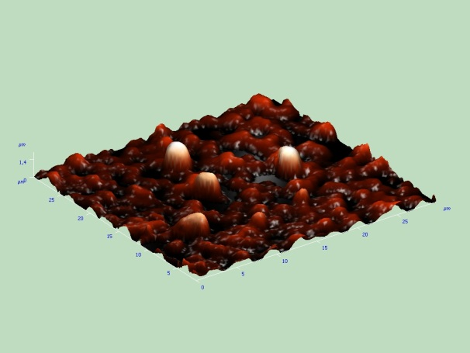
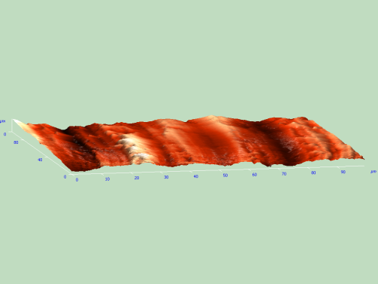
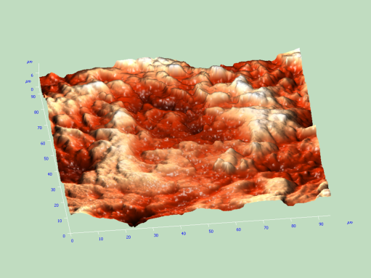
Flow problem parameters
Tube length: L = 5.0 m;
Tube diameter: D = 0.050 m;
Gas density: ρ_{g} = 1.2 kg/m³;
Gas kinematic viscosity: ν = 1.5*10⁻⁵ m²/s;
Adhesive surface energy of the interaction of spherical particles for perfectly smooth contact with the surface: γ = 0.56 J/m²;
Ammonium chloride density: ρ_{NH4Cl} = 1.53*10³ kg/m³.
Deposited particles size distribution function of the ammonium chloride and initial surface density are determined experimentally using the electron microscope technique.
Estimations of the model parameter a that characterize the roughness of the inner tube surface were done on the base of the experimental results obtained by using the electron microscope technique also.

Slide 11
Simulation results
Computations were done for eight values of roughness parameter from 1 to 32 mkm. Figs show the percent mass resuspension rates (that is the percent of the initial deposited mass removed per second) as a function of time for mean flow rates varied from 20 m/s to 80 m/s.

Slide 12
Simulation results
Percent mass resuspension rates
as a function of time for different roughness parameters and for mean flow rate 80 m/s (left fig).
as a function of roughness parameter at the initial time (right fig).

Slide 13
Conclusions
The effectiveness of the resuspension depends essentially on the gas flow velocity. While gas flow changes from 20 to 80 m/s, the percent mass resuspension rate increases by a factor of 10⁸ to 10⁹.
The surface roughness influences essentially on the resuspension rate only if roughness parameter a is lower or of the same order as the mean particle diameter, i.e. when the drag force effect prevails on the lift one. When the roughness parameter is much larger than the mean particle diameter the lift force prevails in the removal and therefore in the resuspension process, that no longer depends on a.

Slide 14
Further Research
Model verification by comparison of the simulation predictions with the experimental data that will be obtained in future experiments;
Analysis of the possible influence of the hydrophilic properties of the particles on the resuspension process.

Slide 15
Questions please
Thank you for your attention
gorbachev@csa.ru

