Slide 1
Joint Institute for High Temperature of Russian Academy of Sciences:
Towards Effective Methods of Energy Production
Mikhail Sheindlin
sheindlin@yandex.ru
http://www.jiht.ru
Institute for High Temperatures, Russian Academy of Sciences
Izhorskaya 13-2, 125412 Moscow, Russia

Slide 2


50 YEARS AT THE FOREFRONT OF POWER GENERATION AND THERMOPHYSICS
Joint Institute for High Temperatures of Russian Academy of Sciences (RAS) is a leading institute of RAS the field of power generation and utilization of various types of energy, thermophysical properties of substances at extremely high temperatures, heat and mass transfer, materials science and extreme states of matter.
Director, member of RAS,
Prof. E.Fortov -
eminent expert in physics of extreme state of matter.
The Institute has 450 researchers, including 12 members of the Russian Academy of Sciences and about 300 researchers with PhD grade.

Slide 3
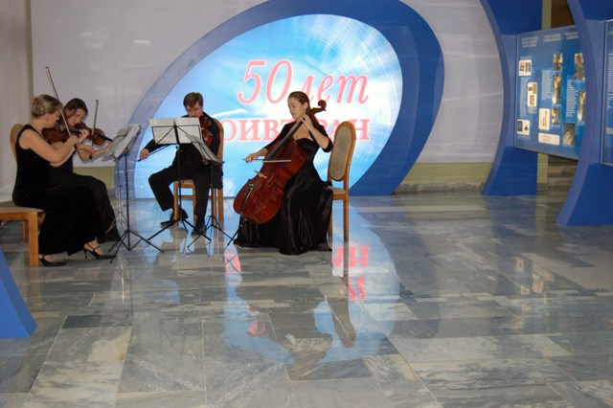
The history of the Joint Institute for High Temperatures of the Russian Academy of Sciences begins in 1960, the year when the High Temperature Laboratory of the USSR Academy of Sciences was set up. During fifty years that passed since that time, the Institute grew up from a small research laboratory at the Moscow Institute of Power Engineering into a major institution of the Division of Energetics, Mechanical Engineering, Mechanics, and Control Systems of the Russian Academy of Sciences – the leading scientific center of the country in the field of power generation and thermophysics (including the region of high energy densities).

Slide 4
Basic activities of the Institute:
Development of effective, safe and reliable energy sources with low impact on environment;
Electrophysical, optical and mechanical properties of substances and low-temperature plasma in a wide range of parameters towards extremely high temperatures and pressures;
Heat and mass transfer, gas- and plasmadynamics;
Thermophysics and high-temperature materials science;
Development of new methods of generation of high energy density;
Energy saving problems, renewable energy, development of electrochemical power generators, increase of efficiency of natural fuel energy sources.

Slide 5
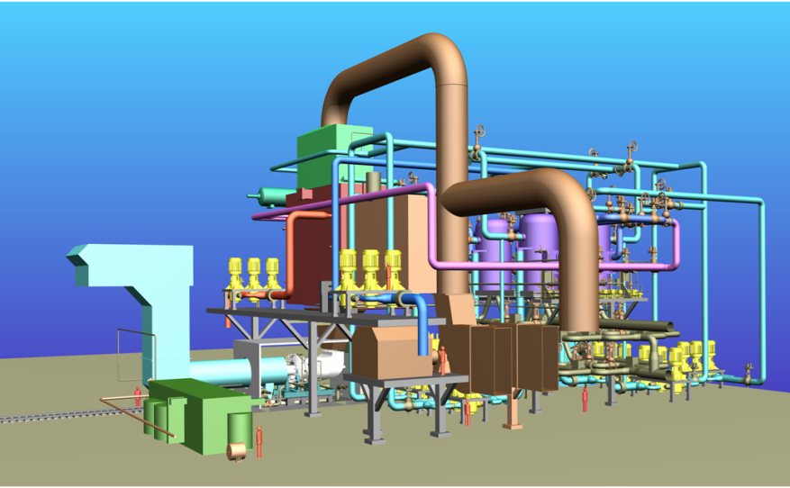
Energy Research
The Concept of Development of Electrical Power Industry in Russia for the Period until 2030
Development of Gas-Turbine Power-Generating Facilities Facilities with Steam Injection
Layout of equipment of a 60-MW gas-turbine unit facility
R&D Activities in the Field of Utilization of Renewable Sources of Energy
Simultaneous Thermal Processing of Wood Waste and Natural Gas
Integrated Processing of Hydrocarbon Gases
New Hydrogen Technologies for Power Generation

Slide 6
AlumoHydrogen Technologies for Power Generation
General Problems of Hydrogen Energy are:
Technical and economy problems of transportation and distribution of hydrogen;
Low energy density of H2 under ambient conditions;
Explosion hazard of hydrogen – air mixture;
High cost and low durability of H2 - air fuel cell stacks.
The new concept: use of Al as energy carrier – directly in Al-Air Fuel Cell, or for hydrogen production during Al oxidation in water.
As well as hydrogen, aluminum is producing from natural raw materials, and the main expenses of its manufacture are caused by the consumption of the electric power. The cost of electric power is of about 70-90 % of total cost of Al manufacture.

Slide 7
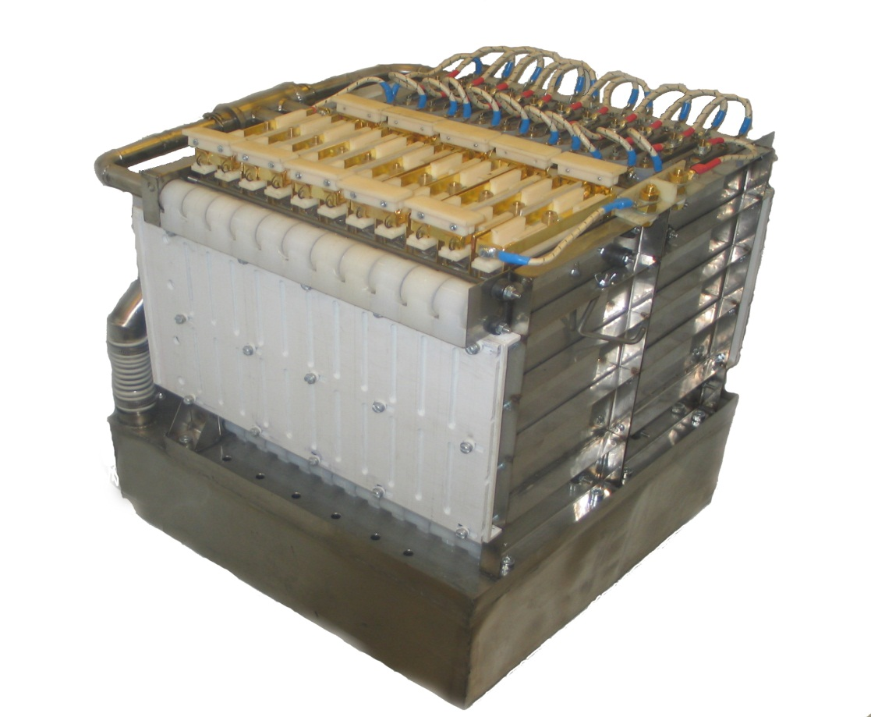
Portable 1.8 kW Al-air generator
Power, kW nominal maximum | 1,3 1.8
Voltage, V open circuit at nominal current | 42,5 27±4
Discharge current, A nominal | 40
Capacity, А.h | 620
Dimensions, L*W*H, cm³ Weight, kg | 46 ^{x}38 ^{x}55 60
Specific Energy, Wh/kg | 270
Al - air fuel cell

Slide 8

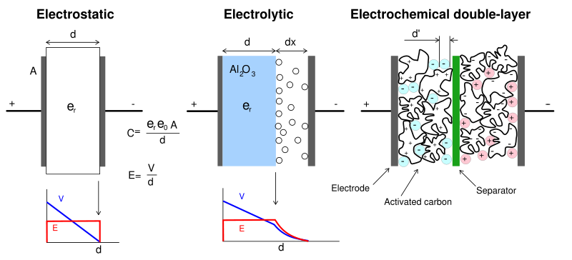
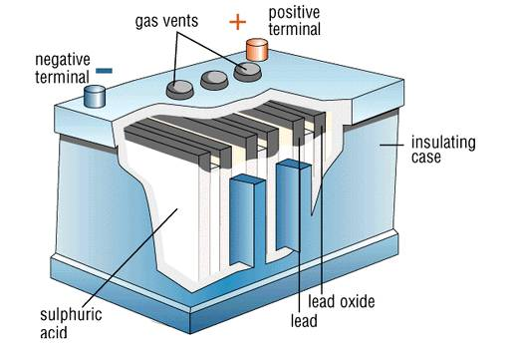
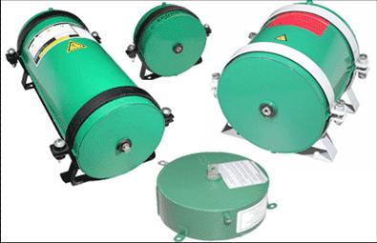
Scheme of the complex power supply system for transport application
Main control module & DC/DC Converter
24 V
48 V
Motor Gen Controller
Al-air Generator
Motor Gen
48 V
lead – acid
batteries
Sup Cap
Various supercapacitors for transport systems

Slide 9
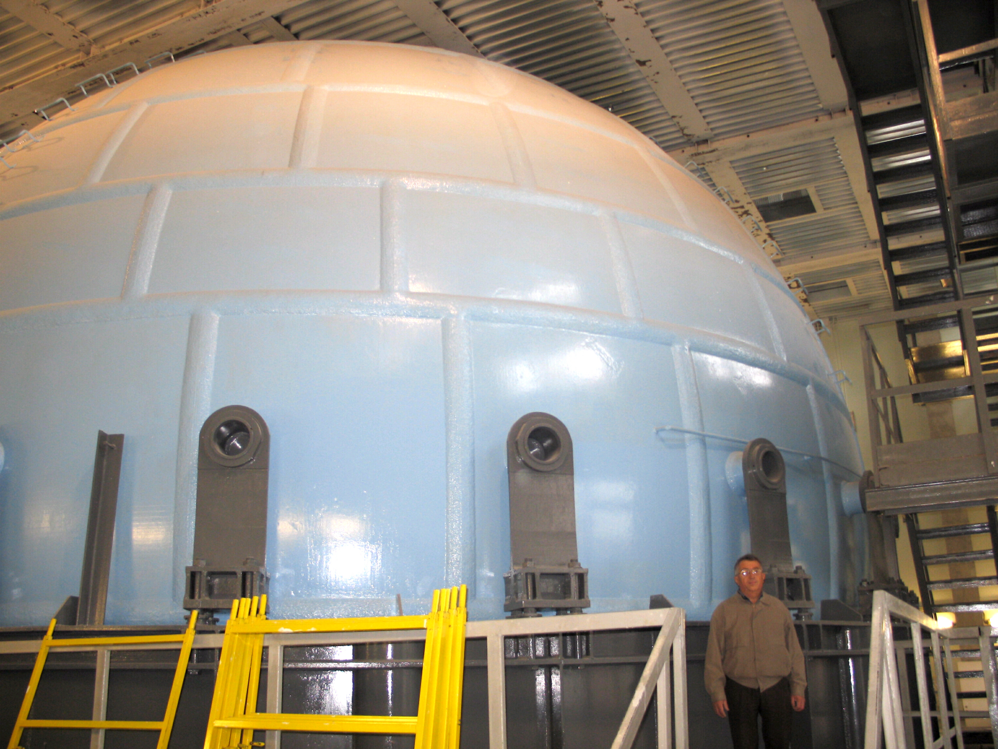
Generation of high energy density: giant blasting camber
Internal diameter 12 m, amount of high explosive up to 1000 kg (trinitrotoluol)
Notes:
9

Slide 10
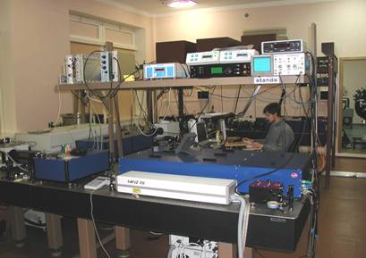
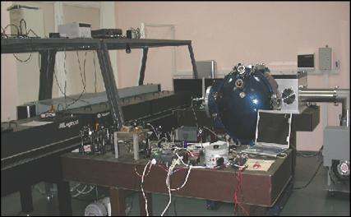
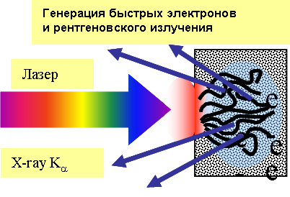
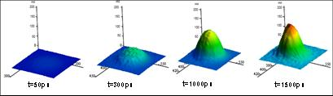
Extreme States of Matter
Use of femptosecond lasers for studies of matter at extremely high energy densities
Generation of fast electrons and
X-rays
Laser
Dynamics of surface ablation

Slide 12
Laser-melting is an alternative approach for studying melting behavior of two-component systems. It was recently demonstrated that it has some advantages in respect to the conventional methods (melting in a crucible):
  No phase segregation due to gravitation forces
  No convection
  No contamination with a crucible material (self-crucible melting)
  Heating with arbitrary power vs time
  Very fast and controllable cooling of melt (quenching) can be performed
  Melting of the surface is local down to about 200-500µm depth. The material’s maximum temperature is seen with depth below the surface
  Large possibilities for various optical measurements (temperature, state of the surface etc.)
  Complex behaviour of material can be easily compared with computer code modelling

Slide 13
Laser vaporisation in vacuum: graphite
Pressure
Solid
Liquid
6 bar
Gas
Temperature
4100 K

Slide 14
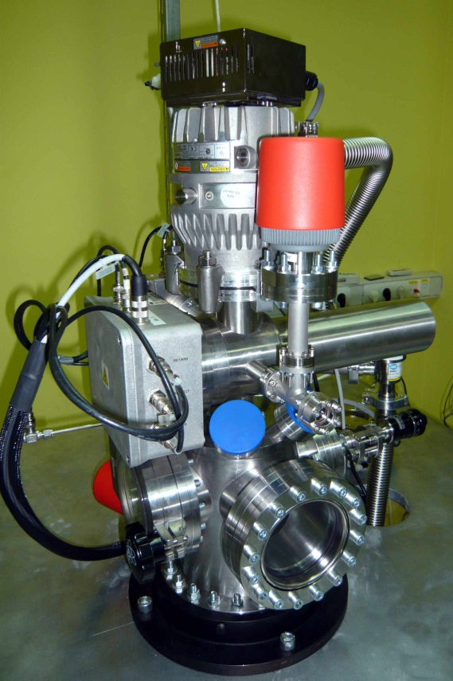
Laser vaporisation in vacuum: TOF measurements, graphite
Time-resolved measurements of mass spectra and of the corresponding temperatures were performed by laser heating coupled to mass spectrometry. It was shown that the vaporisation occurs in a Langmuir-like mode (free surface).
Temperatures of 4100-4150 K were reached, which correspond to a total pressure of approx. 6 bar. The sublimation enthalpies of the main three species were determined up to these temperatures and are in a good agreement with literature values.
The relative partial pressures of C1, C2, C3, C4 and C5 were measured up to 4100 K.

Slide 15
Thanks for your attention

