Slide 1
Progress Report on the ISTC project #3592 “Investigation of Corium Melt Interaction with NPP Reactor Vessel Steel” (METCOR-P)
A.P. Alexandrov Research Institute of Technology
Presented by S. Bechta
12th CEG-SAM meeting

Slide 2
Contents
METCOR-P project general information
Objectives
Experimental matrix
Test results:
Test MCP-1
Test MC12
Test MCP-2
Short-term plans

Slide 3
METCOR-P project general information
Project participants and coordination
Collaborators
FZK, Germany
FORTUM, Finland
JRC ITU,
EK
CEA,
France
AREVA NP, Germany
FZD, Germany
IRSN,
France
KAERI,
Korea
Coordinator
ISTC, Moscow
Steering committee
Operation Agent: A.P. Alexandrov RIT, Russia
ISC RAS,
Russia
SPb Electrotechnical State University, Russia

Slide 4
Objectives of METCOR-P project
Qualification and quantification of physicochemical phenomena of corium melt interaction with reactor vessel steel focused on:
Interaction characteristics at the vertically positioned interface
Peculiarities of interaction with European vessel steel
Corium melt oxidation transients

Slide 5
Experimental matrix for the METCOR-P project
*In accordance with METCOR-P work group decision replaced by MCP2 test with UO_{2+x}– ZrO₂ corium in air and horizontal position of interface

Slide 6
Interaction of molten corium with vertical cylindrical steel specimen: MCP-1 test
Objectives
Study of peculiarities of molten corium interaction with vessel steel at the vertical interface position
Test parameters are similar to MC6 test of METCOR-2:
C-30 corium
15Kh2NMFA vessel steel
Pure argon above the melt
10 h exposition

Slide 7
Furnace design
1 – Water cooled
screen
2 – Cover
3 – Water-in
4 – Quartz tube
5 – Crucible sections
6 – Specimen
7 – Inductor
8 – Bottom calorimeter
9 – Welded crucible
sections
10 – SS support 11 – Water-out
12 –Electromagnetic
screen
13 – Crucible collector

Slide 8
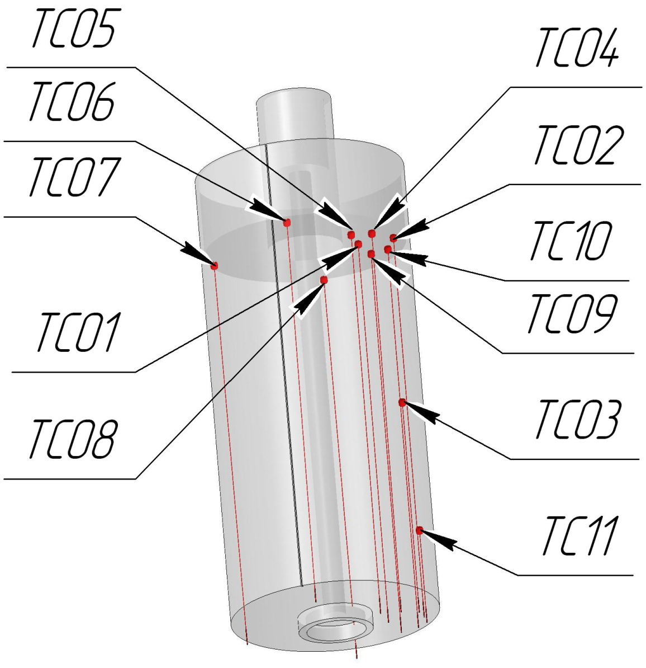
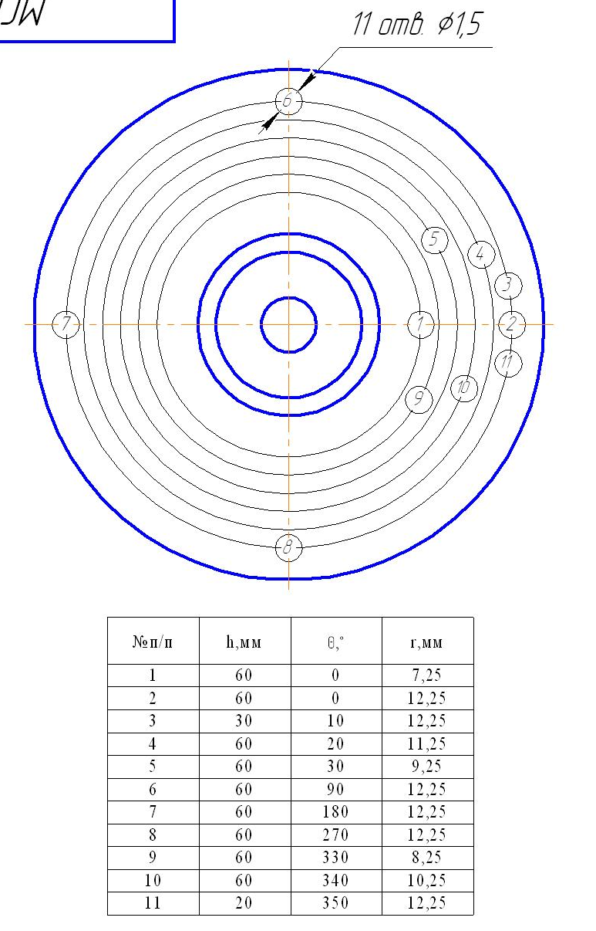
TC locations in the specimen
Coordinates of TC hot junctions

Slide 9
Test procedure
Time, s | Operation mode
0-963 | Furnace deoxygenation by argon flow
963-3550 | Formation and homogenization of the molten pool. Increase of power in the melt to get 1400 ºC on the specimen surface
3550-39874 | Keeping constant surface temperature and power extracted by water from the specimen by inductor voltage control
39875-42000 | Heating disconnection, melt solidification and ingot cooling in argon

Slide 10
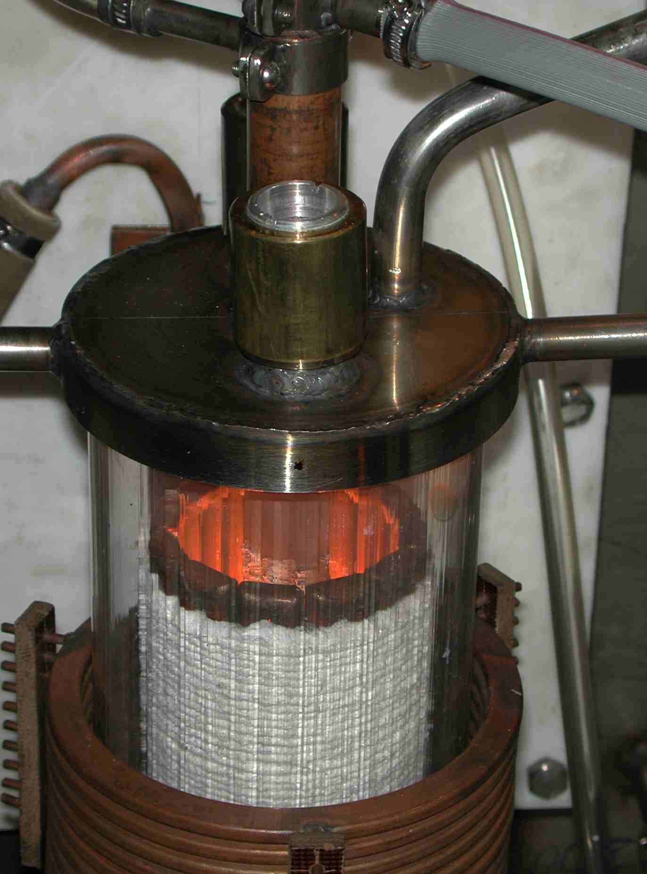
Furnace view in the test

Slide 11
Test results: TC readings
Wrong readings of most thermocouples due to corrosion of wires (not junction!)

Slide 12
Test results: TC readings (2)
Estimation of IZ progression from TC readings
Different lifetime of TCs in the mushy interaction zone
Not possible to estimate interaction kinetics
Short incubation period (or no incubation)

Slide 13
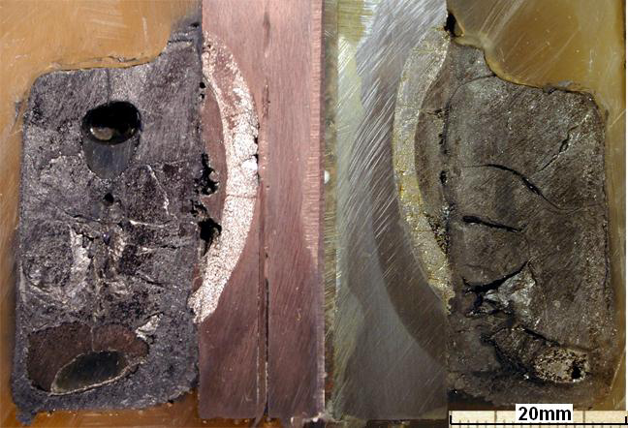
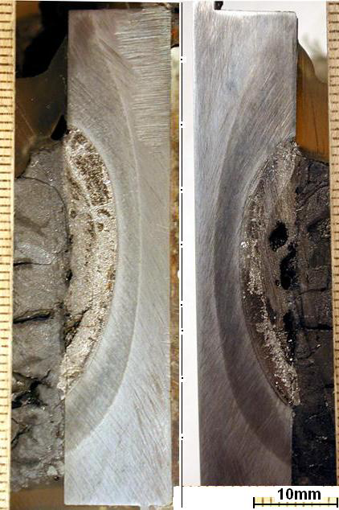
Post test examination
Axial sections of ingot
Corium upper crust is removed
Metal inclusions in corium ingot
Example of TC location

Slide 14
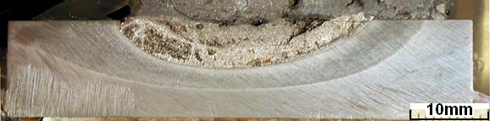
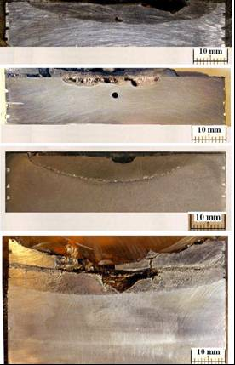
Post test examination (2)
Axial sections of specimen
MCP-1 (90º rotated)
Corium
1st layer
2nd layer
Zone of thermal influence
Steel of initial structure
MC 6
IZ
Steel

Slide 15
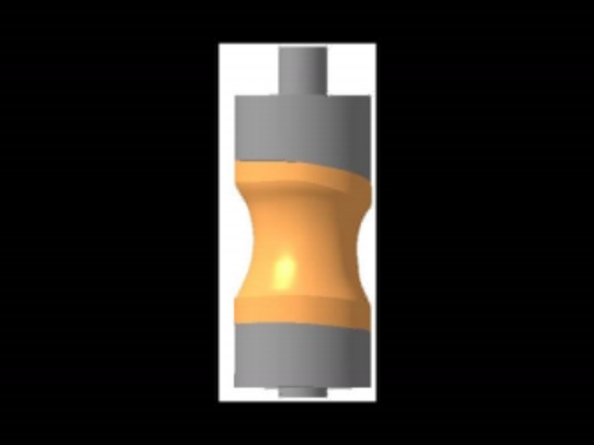
Post test examination (3)
Shape of the boundary between IZ and steel
Initial volume of specimen: 35813 mm³
Volume of uncorroded steel : 25013 mm³
Volume of corroded steel: 10800 mm³

Slide 16
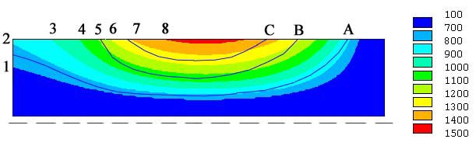
Post test examination (4)
Temperature profile of the specimen (to be specified)
T, ºC
90° rotated
Upper surface
bottom
A – boundary of the thermal influence zone (760 C)
B – 2nd layer boundary (1050-1100 C)
C – 1st layer boundary (~1250 C)
1 – 700 C 5 – 1100 C
2 – 800 C 6 – 1200 C
3 – 900 C 7 – 1300 C
4 – 1000 C 8 – 1400 C

Slide 17
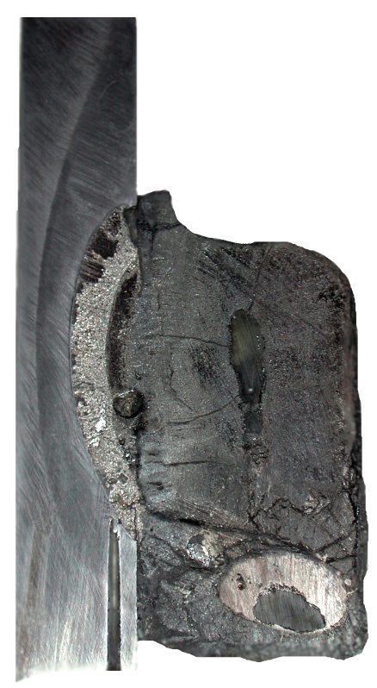
Post test examination (5)
Express XRF and chemical analysis
XRF
ChA
XRF,mass.%
ChA,mass.%
U=66.5
Zr=20.2
Fe=1.7
Cr=0.06
Ni=0.02
U=66.8
Zr=22.3
Fe=2.1
Average
sample of
crust
C_{n}≈48
U=36.5
Zr=22.1
Fe=47.8
Cr=0.8
Ni=0.5
U=54.6
Zr=15.9
Fe=28.5
U=51.7
Zr=13.5
Fe=30.9
Cr=0.6
Ni=0.3
29-31mm
U=66.1
Zr=22.3
Fe=1.0
Cr=0.02
Ni=0.03
U=66.6
Zr=23.2
Fe=1.0
Average
sample of ingot upper part C_{n}≈40
∼25mm
Average
sample of ingot lower part C_{n}≈32
U=57.5
Zr=24.2
Fe=17.8
Cr=0.2
Ni=0.3
U=64.6
Zr=21.7
Fe=3.5
Cr=0.04
Ni=0.08
U=66.7
Zr=22.3
Fe=5.7
∼23mm
Higher content of U and Zr in IZ (40-50 and 13-20 mass %) in comparison with МС6 IZ (24 and 5 mass %)
High content of U and Zr in metal inclusion (∼58 and ∼24 mass %)

Slide 18
Comparison of МС and MASCA tests
Temperature boundary of the IZ final position coincides with its minimum value in MC tests, but it is smaller than in МС6 (at the horizontal interface orientation)
Component concentrations in the IZ are quite different from МС6 and close to MASCA

Slide 19
MCP-1 concluding remarks*
New method and new IMCC furnace have been developed for studying corium melt/vessel steel interaction at the vertically positioned interface
Disadvantages of the experimental setup:
No US online measurements of corrosion kinetics
Limited pool depth (specimen height) and corium mass
Differences from MC6 with horizontal interface
In conditions:
Higher heat fluxes at similar interface temperatures
b) In results:
Shorter or absent incubation period
Metal inclusion in the corium ingot
Different macro and microstructure and composition of interaction zone (higher U and Zr content in IZ)
Lower temperature, which corresponds to the final position of IZ boundary (like in MC7 and MC9)
*) will be specified after the detailed analysis

Slide 20
Interaction of molten corium and vessel steel in the oxidizing atmosphere. Tests MC12,MCP-2

Slide 21
METCOR results for corium UO_{2+X}-ZrO₂-FeO_{Y}
2
W
mm
m
2
W
,
mm
m
q
,
h
МW
q
h
МW
10
10
- air
MC1,2
1
1
- steam
MC11
0.1
0.1
0.01
0.01
0.001
0.001
0.65
0.75
0.85
0.95
1.05
0.65
0.75
0.85
0.95
1.05
1000
1000
1/
К
T
,
К
T
S
S
Insufficient data in the T_{s}>1050°C domain
No validated corrosion model at T_{s}>1050°C, which can explain a bend in the curve “corrosion rate vs. T_{s}“

Slide 22
METCOR results for corium UO_{2+X} - ZrO₂ – FeO_{Y} (2) Test MC12 (not funded by the ISTC)
Number of experimental points substantially increased
Insensitivity of corrosion rate to the composition of oxidizing atmosphere (steam, air) is confirmed for a wide range of temperatures
Absence of sharp bend in the curve “corrosion rate vs. T_{s”}

Slide 23
Interaction zone structure MC12, T_{s}=1125°C, q=1.09 MW/m² (steam)
melt
corium crust
Fe_{1-x}O
steel
Average corrosion layer thickness δ ≈ 0.24 mm

Slide 24
Interaction zone (2) microstructure MC12, T_{s}=1125°C
Zone 1
Zone 3
Grain boundary diffusion of corium components through the corrosion layer Fe_{1-x}O is observed

Slide 25
Interaction zone (3) microstructure MC12, T_{s}=1125°C
Liquid phase exists on the boundary between the corrosion layer and corium

Slide 26
Interaction zone (4)
h, mm
Distribution of components
Temperature
concentrations, mol%
Т°С
Possible formation of liquid phase in the multi-component oxidic system within the corrosion layer

Slide 27
Corrosion model
Corrosion rate depends on the intensity of diffusion processes in the corrosion layer
Two diffusion processes can be assumed to take place during the corium–steel interaction in the oxidizing atmosphere
− Fe²⁺ diffusion through the solid layer
− liquid-phase Fe²⁺ diffusion
The second process prevails at Т_{s}>1050°C

Slide 28
Summary of experimental data
Corium UO_{2+x} – ZrO₂ – FeO_{y}
Proposed semi-empirical correlation gives a good experimental data generalization at 1200 ≥ Т_{s} ≥ 700°C; 1.29 ≥ q ≥ 0.3 MW/m²

Slide 29
Corium UO_{2+x} – ZrO₂ , MC10
Experimental data are insufficient for developing a correlation describing the wide temperature range
Decision on the additional test with corium UO_{2+x} – ZrO₂ taken at the first METCOR-P meeting

Slide 30
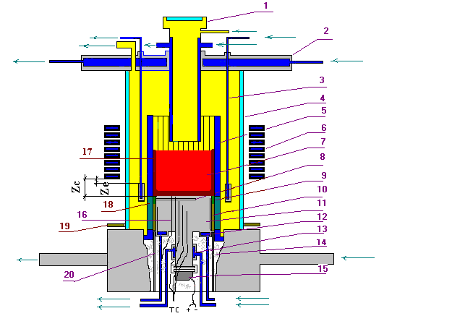
Test MCP-2 Corium UO_{2+x} – ZrO₂
Furnace schematics
1 – Water-cooled pyrometer shaft 2 – Water-cooled lid 3 – Water-cooled electromagnetic screen 4 – Quartz tube 5 – Crucible section 6 – Inductor 7 – Melt 8 – Acoustic defect 9 – Molten ZrO₂ (fianite) 10 – ZrO₂ powder 11 – Vessel steel specimen 12 – Top calorimeter of the specimen 13 – Bottom calorimeter of the specimen 14 – Thermal insulation (mullite cotton) 15 – USS 16 – K-type thermocouples 17 – Crust 18 – Electromagnetic screen (welded crucible sections) 19 – Uncooled electromagnetic screen 20 – Cylindrical support of the specimen
Similar to METCOR tests

Slide 31
TC readings
9
8
7
5
6
3
4
2
1
9 plateaus
Shorter plateaus are explained by a higher corrosion rate caused by T_{s} growth

Slide 32

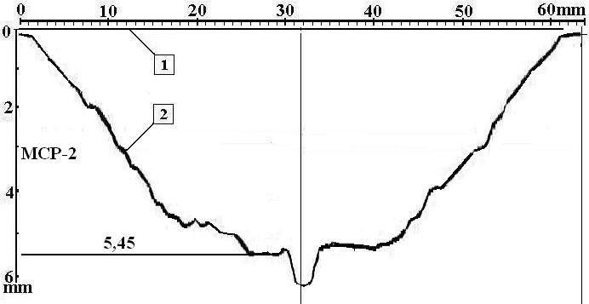
Axial section of the specimen top and profilogram

Slide 33
Steel specimen corrosion kinetics
h, mm
Time, s
posttest measurement
on-line measurement
interpolation of on-line measurements

Slide 34
Preliminary results
Not sensitive to the atmosphere composition (steam, air)
No corrosion intensification up to T_{s} ≈ 1350°C can be explained by the solid crust maintenance due to the high T_{sol} ≈ 2450 °C
Results will be generalized after the posttest analysis

Slide 35
Short-term plans
Conclude posttest analysis of MCP-1, MCP-2 – Sept. 2007
Make a report of the interaction of corium UO_{2+x} – ZrO₂ – FeO_{y} with vessel steel in the oxidizing atmosphere. Test MC12 - Sept. 2007
Make a report of the interaction of corium UO_{2+x} – ZrO₂ with with vessel steel in the oxidizing atmosphere. Test MCP-2 - Oct. 2007
Make a report of the interaction of corium С-30 with vessel steel at the vertical position of interaction interface. Test MCP-1 – Nov. 2007
Test MCP- 3 – Interaction of metallic melt of suboxidized corium with vessel steel at the vertical position of interaction interface - Dec. 2007

