Slide 1
PRECOS ISTC project proposal #3813: Phase relation in corium systems
A.P. Alexandrov Research Institute of Technology
ISTC
Presented by Sevostian V. Bechta
12th CEG-SAM Meeting

Slide 2
Contents
  General information
  Project focus
  Methodology
  Links with CORPHAD project
  PRECOS test matrix
  Conclusions

Slide 3
PRECOS project general information
Project participants and coordination
Collaborators
FZK, Germany
IRSN,
France
ITU,
EK
CEA,
France
Areva NP, Germany
Coordinator
ISTC, Moscow
Steering committee
Operation Agent: A.P. Alexandrov RIT, Russia
ISC RAS,
Russia
IHT RAS,
Russia
SPb Electrotechnical State University, Russia

Slide 4
PRECOS project focus
Project objective:
Experimental study of phase diagrams of corium mixtures
Experimental data
  Liquidus and solidus temperatures versus components concentration
  Temperature-concentration regions of the miscibility gap
  Coordinates of eutectic, dystectic and other characteristic points
  Final solubility in solid solution
Data application
  Thermodynamic database optimisation
  Thermodynamic code validation
  Corium behaviour modelling

Slide 5
Methods of phase diagram experimental study
Visual polythermal analysis in the cold crucible (VPA IMCC)
Differential thermal analysis (DTA) and differential scanning calorimetry (DSC)
Visual polythermal analysis in the Galakhov microfurnace (GM)
High-temperature microscopy (HTM)
Laser pulse heating (LP)
These methods have been applied in the projects: COLOSS, METCOR, CIRMAT, CIT, ENTHALPY, ECOSTAR, OECD/MASCA and CORPHAD

Slide 6
Methods of posttest analysis
Elemental analysis
• X-ray fluorescence analysis (XRF)
• Chemical analysis (СhA)
Phase analysis
• X-ray diffraction analysis (XRD)
• Energy-dispersive X-ray spectrometry (EDX)
Microstructure analysis
• Optical microscopy
• Scanning electron microscopy (SEM)
Oxygen determination
• Carbothermic reduction

Slide 7
CORPHAD.2 project test matrix
Links with CORPHAD projects
Composition | Atmosphere | Experimental data
UO₂ – FeO | Argon/Helium | liquidus, solidus, solubility limits, eutectic points
ZrO₂ – FeO
SiO₂ – Fe₂O₃/Fe₃O₄ | Helium/Air/ Oxygen | liquidus, solidus, miscibility gap, eutectic points
UO₂ – SiO₂ | Argon | miscibility gap
UO₂ – ZrO₂ – FeO/Fe₂O₃ | Argon/Air | ternary eutectic points
U – O | Argon | liquidus, solidus, miscibility gap
U – Zr – O
Zr – Fe – O
U – Fe – O
Complex corium mixture UO₂ – SiO₂ – ZrO₂ – Al₂O₃ – CaO – FeO – Cr₂O₃ | Nitrogen | liquidus, solidus

Slide 8
Scope of experimental work in CORPHAD
3 tests for 1 point on the average
5 tests for 1 point on the average
Additional number of reference specimens: 48

Slide 9
CORPHAD Papers
Bechta S.V., Krushinov E.V., Almjashev V.I., Vitol S.A., Mezentseva L.P., Petrov Yu.B., Lopukh D.B., Khabensky V.B., Barrachin M., Hellmann S., Froment K., Fischer M., Tromm W., Bottomley D., Defoort F., Gusarov V.V. Phase diagram of the ZrO₂–FeO system // J. Nucl. Mater. Vol. 348, pp. 114-121 (2006)
Bechta S.V., Krushinov E.V., Almjashev V.I., Vitol S.A., Mezentseva L.P., Petrov Yu.B., Lopukh D.B., Khabensky V.B., Barrachin M., Hellmann S., Gusarov V.V. Phase relations in the ZrO₂-FeO system // Russian J. Inorg. Chem. 2006. V. 51. N 2. P. 325-331.
Mezentseva L.P., Popova V.F., Almjashev V.I., Lomanova N.A., Ugolkov V.L., Beshta S.V., Khabensky V.B., Gusarov V.V. Phase and chemical transformations in the SiO₂–Fe₂O₃(Fe₃O₄) systems at various oxygen partial pressure // Russian J. Inorg. Chem. 2006. V. 51. N 1. P. 125-133.
Bechta S.V., Krushinov E.V., Almjashev V.I., Vitol S.A., Mezentseva L.P., Petrov Yu.B., Lopukh D.B., Lomanova N.A., Khabensky V.B., Barrachin M., Hellmann S., Froment K., Fischer M., Tromm W., Bottomley D., Gusarov V.V. Phase Transformation in the Binary Section of the UO₂–FeO–Fe System // Russian J. Radiochemistry. 2007. V. 49. N 1. P. 20-24.
Bechta S.V., Krushinov E.V., Almjashev V.I., Vitol S.A., Mezentseva L.P., Petrov Yu.B., Lopukh D.B., Khabensky V.B., Barrachin M., Hellmann S., Froment K., Fischer M., Tromm W., Bottomley D., Gusarov V.V. UO₂–FeO phase diagram // J. Nucl. Mater., 362 (2007) 46-52
Mezentseva L.P., Popova V.F., Almjashev V.I., Lomanova N.A., Ugolkov V.L., Bechta S.V., Khabensky V.B., Barrachin M., Hellmann S., Gusarov V.V. Phase diagrams of the SiO₂–Fe₂O₃(Fe₃O₄) systems in different gas atmosphere // J. Europ. Ceram. Soc., in press

Slide 10
CORPHAD Papers in preparation
Draft titles:
Eutectic compositions in the UO₂–ZrO₂–FeO/Fe₂O₃ systems
(under discussion with collaborators)
Miscibility gap in the UO₂–SiO₂ system
Miscibility gap in the U–O system

Slide 11
Results application: Database optimisation
NUCLEA database (PY. Chevalier et al., 2004)
Version 2004
Version 2005
with CORPHAD points in the optimisation

Slide 12
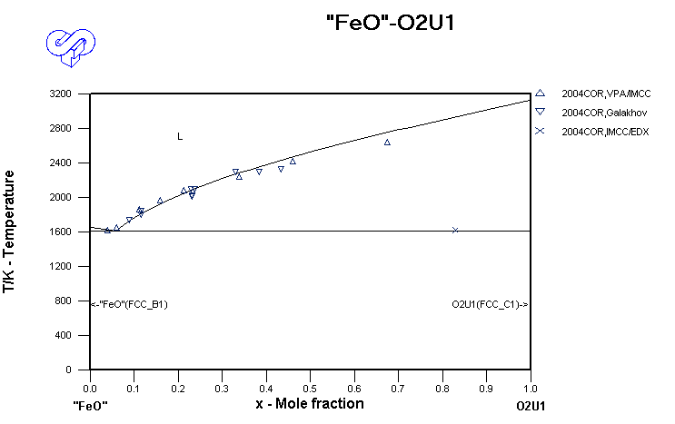

Results application: Database optimisation (2)
NUCLEA database (PY. Chevalier et al., 2004)
Version 2004
Version 2005
with CORPHAD points in the optimisation

Slide 13
PRECOS test matrix
Task | Composition | Atmosphere | Experimental data | Priority level | Pt N
1 | Different compositions in the U-Zr-Fe-O system | Argon | Selected points (liquidus, solidus, tie-lines in the miscibility gap) | 1 | 6
2 | ZrO₂ - FeO_{y} | Air and p_{O2} contol | liquidus, solidus, solubility limits | 2 | 3
 | UO₂ - SiO₂ | Argon | liquidus, solidus, solubility limits, eutectic point | 1 | 7
 | CaO - UO₂ |  |  | 1 | 7
3 | UO₂ – FeO – SiO₂ |  | liquidus, solidus solubility limits, tie-lines in the miscibility gap, ternary eutectic point | 1 | 10
 | UO₂ – FeO – CaO |  | liquidus, solidus solubility limits, ternary eutectic point | 1 | 10
 | ZrO₂ - FeO - SiO₂ |  | ternary eutectic point | 2 | 2
 | ZrO₂ - FeO - CaO |  | ternary eutectic point | 2 | 2
4 | Eutectic composition measurement of a realistic complex corium mixture | Argon or Air | System (atmosphere) proposed by French partners (1 system), System (atmosphere) proposed by German partners (1 system), System (atmosphere) proposed by Russian partners (1 system) | 2 | 3
The matrix has been discussed and updated at the 5th, 6th and 7th CORPHAD Project meetings

Slide 14
Conclusions
Preparation phase of PRECOS project has been
finished
Positive CORPHAD experience instills confidence in
PRECOS feasibility
PRECOS project has high chance for starting in early
2008, if the proposal is supported by CEG-SAM and EU

