Slide 1
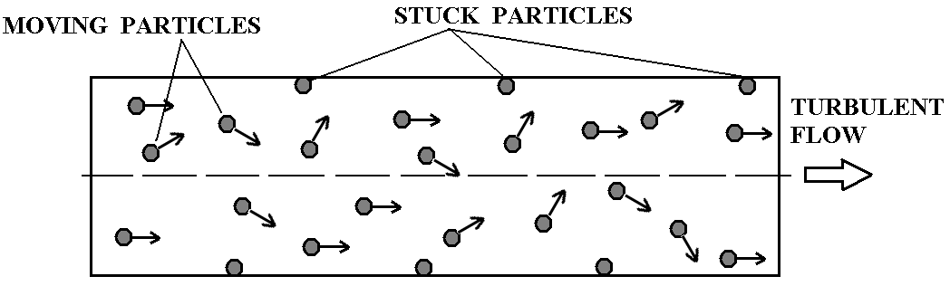
LES simulation of aerosol transport and deposition in turbulent flow in the channel. (Task5)
Objective: numerical simulation of aerosol particles turbo-phoresis in the channel.
Main advantages of LES (Large Eddy Simulation) method: LES is able to resolve realistic turbulent pulsations in contrast of classical RANS (Reynolds Average Navier-Stokes)

Slide 2
LES simulation of aerosol transport and deposition in turbulent flow in the channel. (Task5)
Mathematical model consists of two parts:
1) Hydrodynamic model for incompressible viscous fluid:
For subgrid transport coefficients K_{m} calculation two Smagorinsky type subgrid models are used.
1. Classic Smagorinsy model
2. Shear-improved Smagorinsky model
(Leveque,Toschi,Shao,Bertoglio, 2007)
Where angle brackets < > denote an ensemble average in homogeneous direction.
is the strain tensor.
is the filter width
is the Smagorinsky constant (0.16)

Slide 3
LES simulation of aerosol transport and deposition in turbulent flow in the channel. (Task5)
2) Particle motion model:
where
N_{p} is the number of particles,
x_{k} is the radius-vector of the particle k,
v_{k} is the velocity vector of the particle k,
u_{k} is the fluid velocity at x_{k} .
τ_{p} is the particle relaxation time.
f_{k} is the normal-wall directed lift force
(assumed as f_{k} = 0 ).
Relaxation time depends on particle and fluid densities, Reynolds and Knudcen numbers.
Here and after we will use dimensionless form of relaxation time
where
is the molecular kinematic visosity and,
is the dynamic velocity.

Slide 4
LES simulation of aerosol transport and deposition in turbulent flow in the channel. (Task5)
Numerical methods used for governing equations solving.
Momentum equations are approximated on fully staggered grid.
Advection terms are solved by the second-order Piacsek & Williams approximation.
Viscous terms are second-order central differences.
The forth-order Adams-Bashforth predictor-corrector time stepping is used for time integration.
To solve the system fractional step method is used (Kim, J., Moin, P., Application of Fractional-Step Method to Incompressible Navier-Stokes Equations. //J.Comp.Phys. (59) 1985, pp. 308-323 ).
It leads to Poisson equation for scalar field φ.
Intermediate velocity u* is then projected into divergence free field to get velocity at new time level (n+1):
Poisson equation is solved with iterative conjugate gradient method.
For solving the system of ordinary differential equations describing particle motion second-order Adams-Bashfoth method was used.

Slide 5
LES simulation of aerosol transport and deposition in turbulent flow in the channel. (Task5)
Check up of model accuracy using Taylor Green vortex decay.
The accuracy of the basic dynamic framework of this model was checked by directly simulating the 3D Taylor and Green vortex flow (1937).
Computational domain (in dimensionless form) was a cube
2π × 2π × 2π with periodic boundary conditions applied in all directions
The initial conditions are :
Subgrid parametrization was switched off.
Kinematic viscosity Km was set equal to 1/Re, where
Reynolds number Re = 200
One run was carried out for dimensionless period 10 with a grid number 32 × 32 × 32 cells

Slide 6
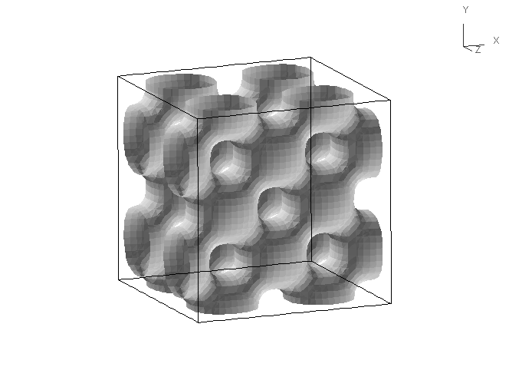
LES simulation of aerosol transport and deposition in turbulent flow in the channel. (Task5)
Check up of model accuracy using Taylor Green vortex decay.
Time evolution of constant velocity iso-surface (|u|=0.5).
The nonlinear advection terms induce vortex stretching and tilting which increase the mean quadratic vorticity and cause the kinetic energy cascade from the larger to smaller scales. The molecular dissipation terms reduce both mean quadratic vorticity and kinetic energy.

Slide 7
LES simulation of aerosol transport and deposition in turbulent flow in the channel. (Task5)
Check up of model accuracy using Taylor Green vortex decay.
The numerical results were compared with two analytical approximations which are rather accurate for short period (t<3…4):
Taylor and Green solution
Goldstein solution:
where
is the mean quadratic vorticity :

Slide 8
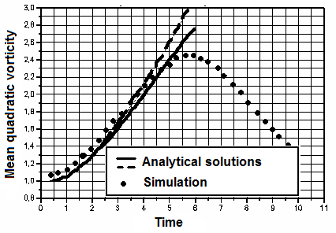
LES simulation of aerosol transport and deposition in turbulent flow in the channel. (Task5)
Check up of model accuracy using Taylor Green vortex decay.
Comparison of numerical solution with analytical one for Taylor-Green vortex problem
Both analytical solutions are rather accurate for short time period t < 3…4.
The figure demonstrates good agreement between analytical and numerical solutions
within this time interval.

Slide 9
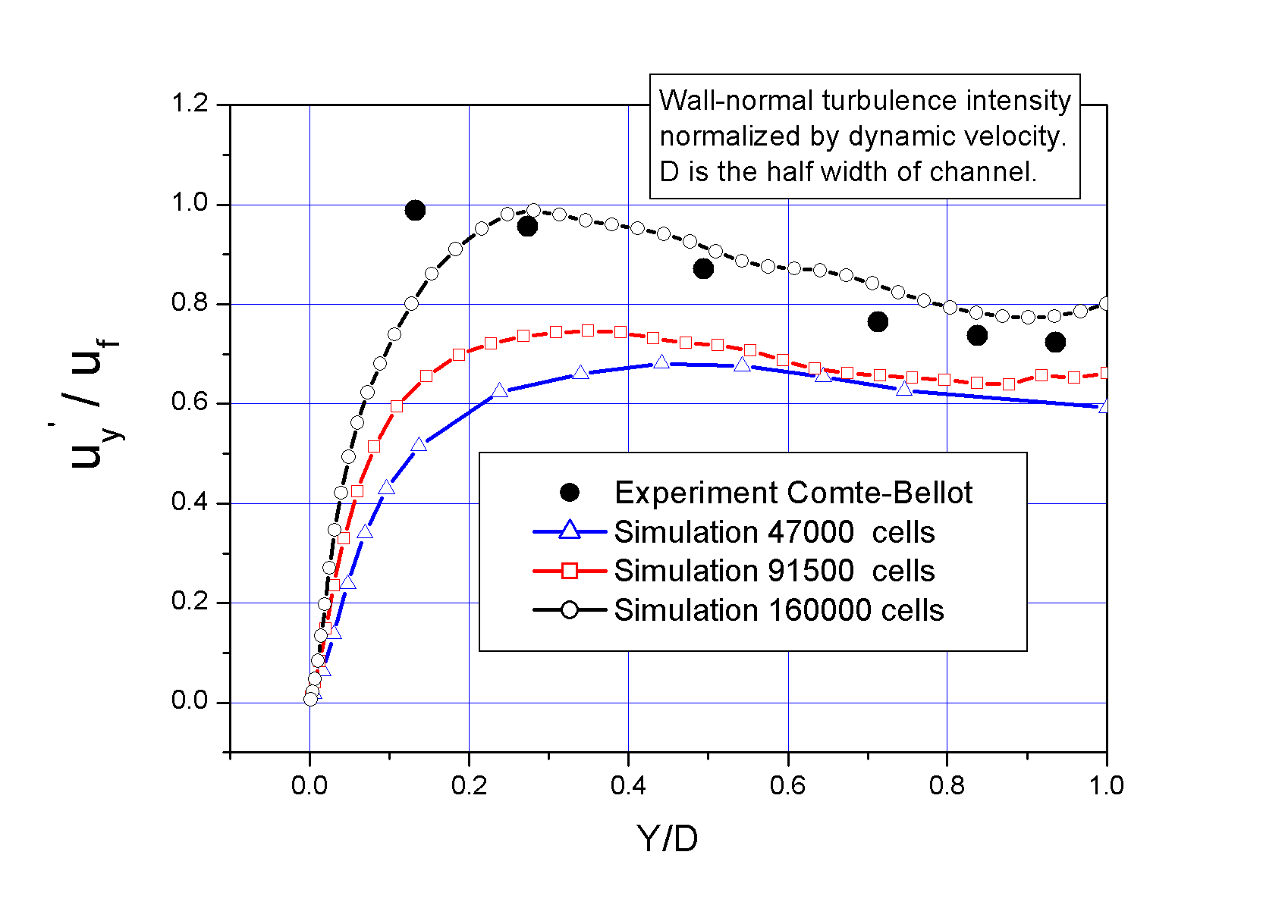
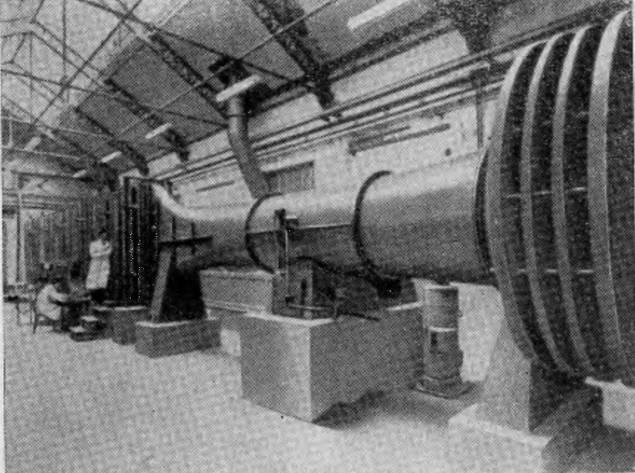
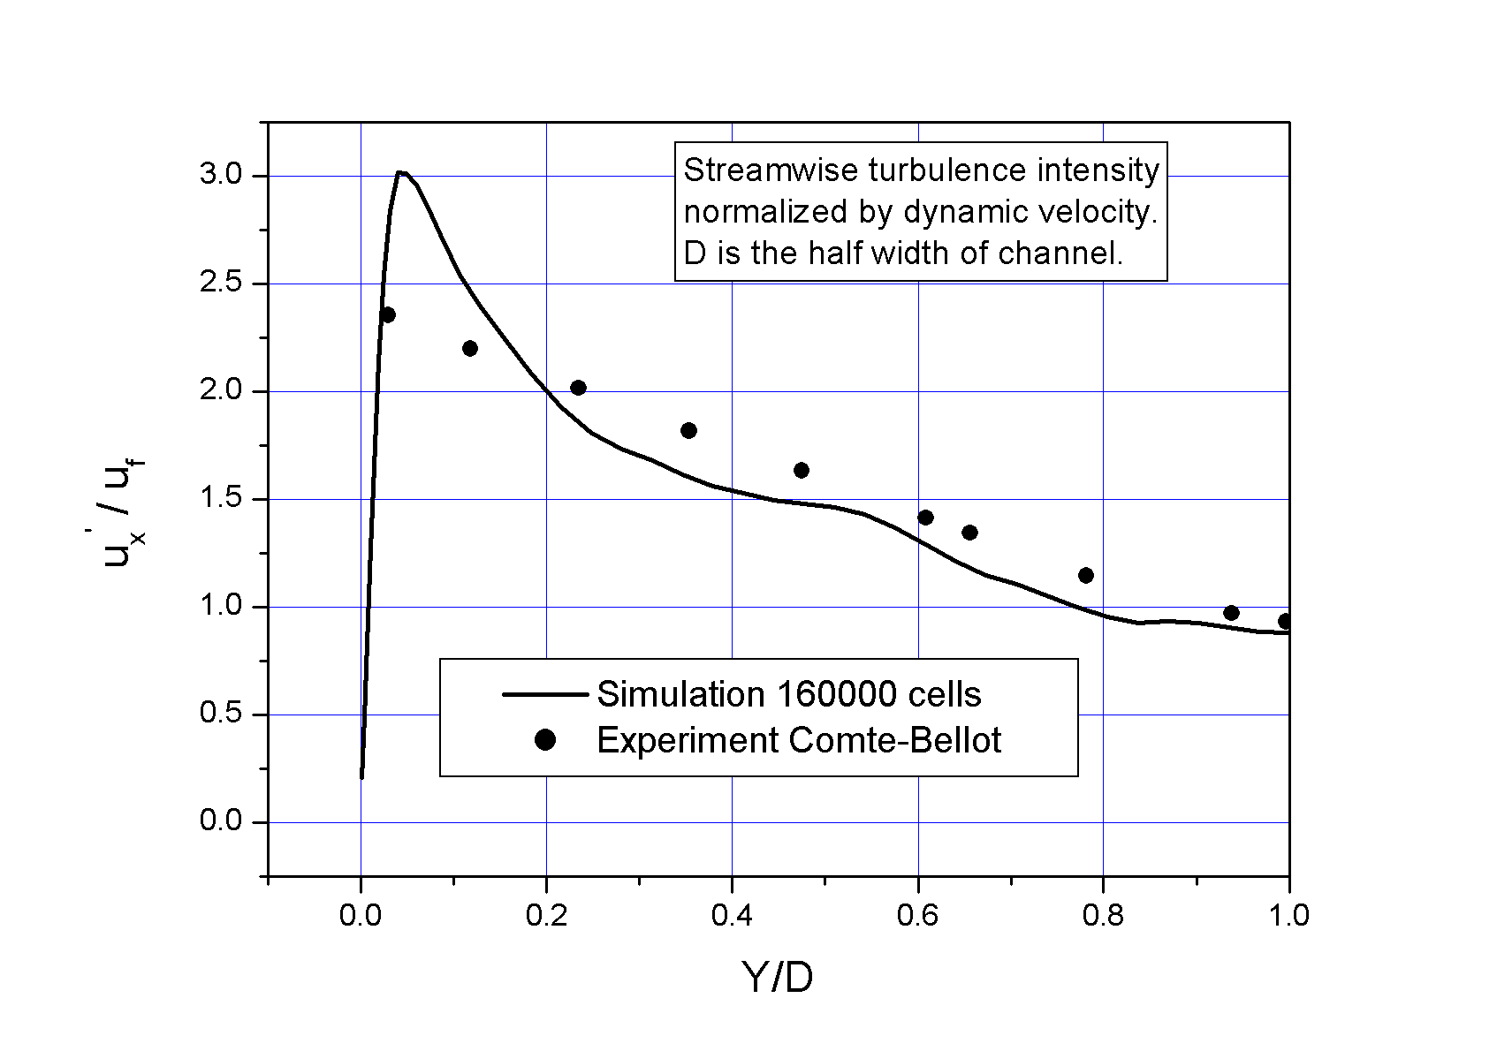
LES simulation of aerosol transport and deposition in turbulent flow in the channel. (Task5)
Validation test without particles
based on experiment of turbulent flow in rectangular duct for Re = 120 000.
(Genevieve Comte-Bellot, Ecoulement turbulent entre deux parois paralleles, Paris, 1965)
Dimensions of the experimental channel were:
length 12 m, height 2,4 m, width 0.18 m.
a)
b)
Experimental setup

Slide 10
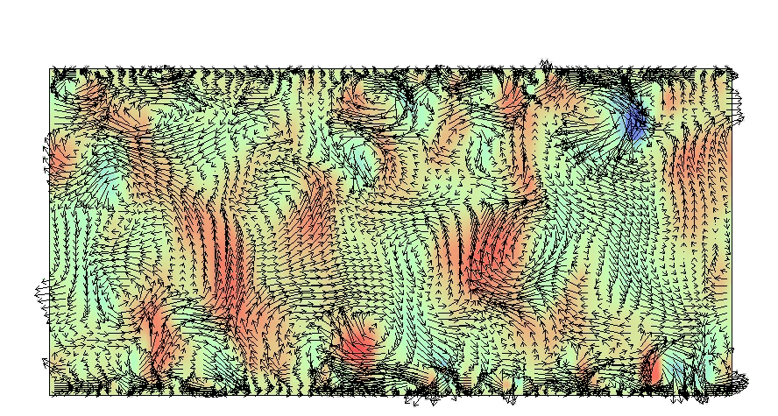
LES simulation of aerosol transport and deposition in turbulent flow in the channel. (Task5)
Simulated vertical component of velocity (color flood)
and vector velocity field in the cross section of the channel (animation).

Slide 11
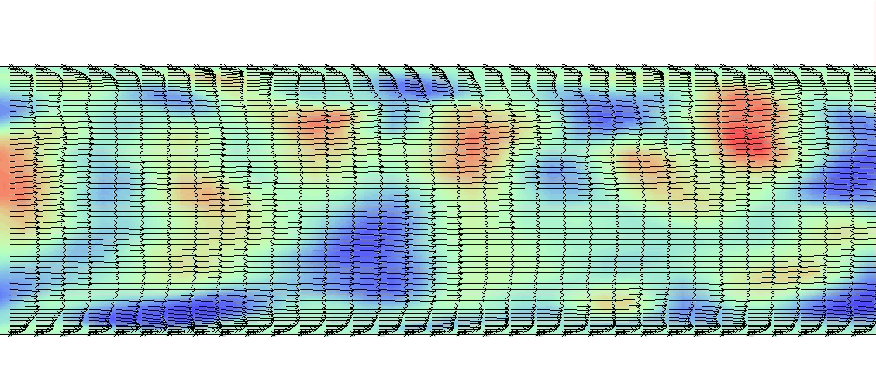
LES simulation of aerosol transport and deposition in turbulent flow in the channel. (Task5)
Simulated vertical component of velocity (color flood)
and vector velocity field in the longitudinal section of the channel (animation).

Slide 12
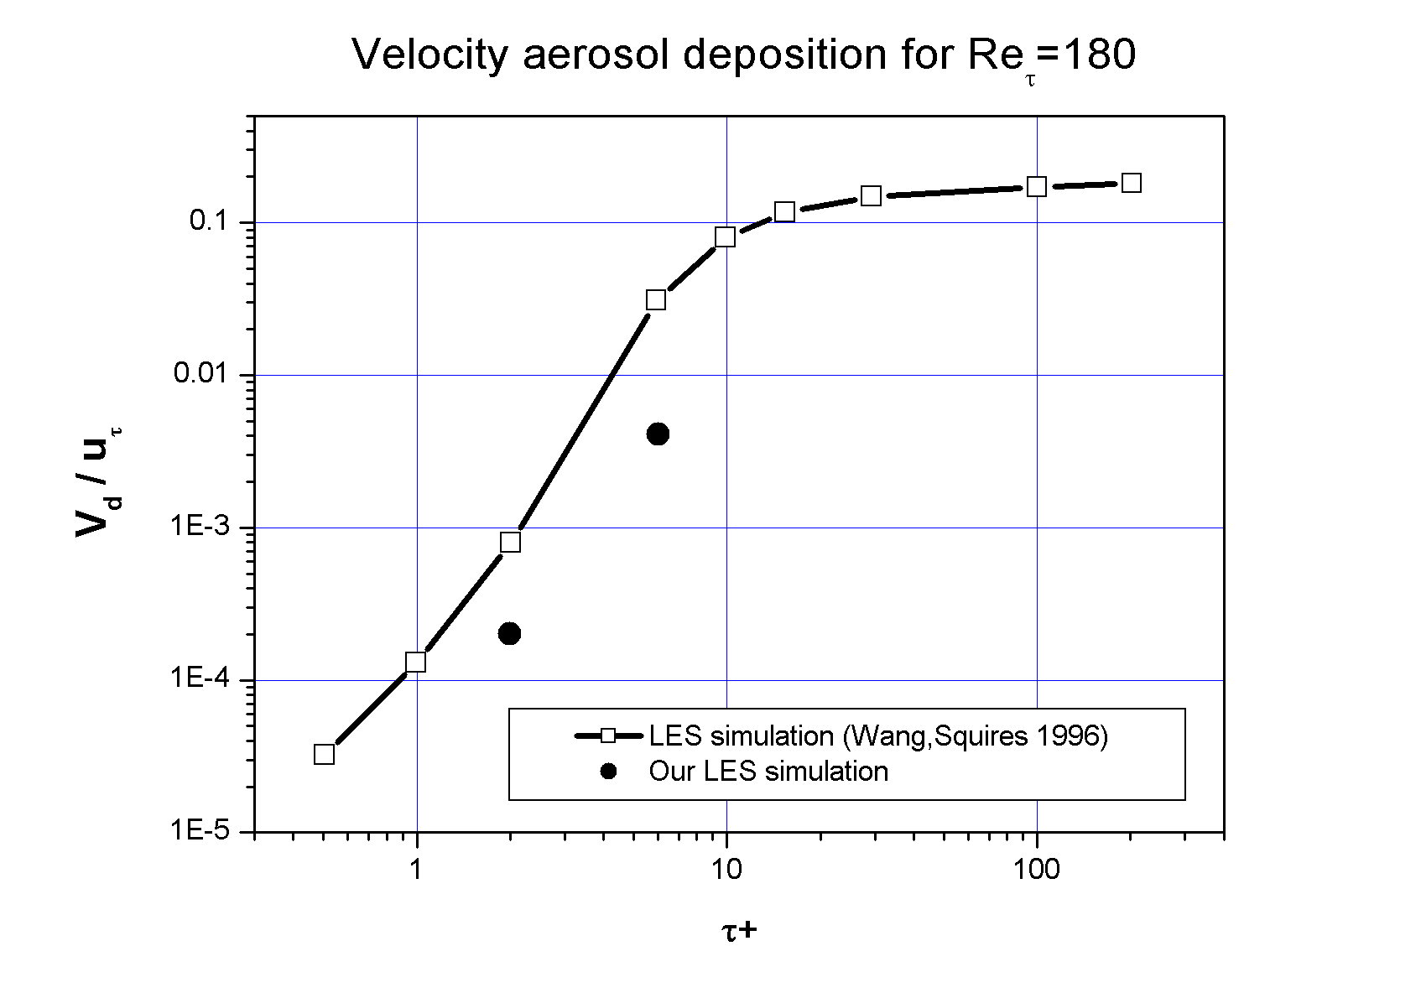
LES simulation of aerosol transport and deposition in turbulent flow in the channel. (Task5)
Validation test with particles.
The following test presents LES simulation of turbulent channel flow with Reynolds number 3200
with particles motion and their deposition.
Number of particles in this calculation was 260 000. We carried out two calculations for particle
relaxation time τ⁺ = 2 and τ⁺ = 6.
Picture below shows comparison of our results for with other LES calculation for velocity deposition
made by Wang & Squires (Wang Q., Squires K.D., Large Eddy Simulation of particle deposition in a
vertical turbulent channel flow, Int. J. Multiphase Flow (1996), v. 22, N 4, pp. 667-683 ).
Some discrepancy may be explained that we did not take into account the lift force of particles.

Slide 13
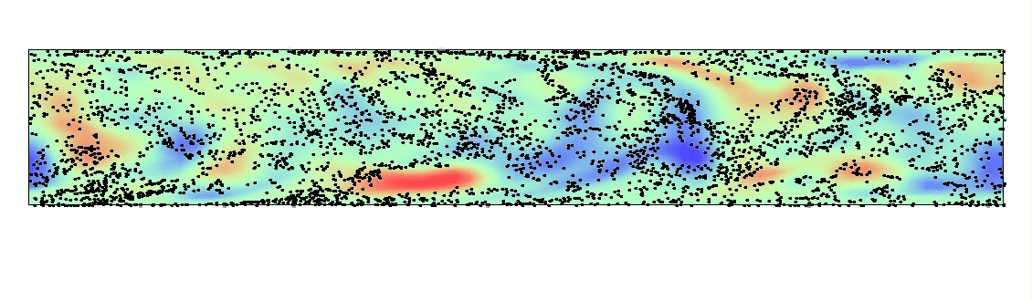
LES simulation of aerosol transport and deposition in turbulent flow in the channel. (Task5)
Particle motion in the longitudinal section (animation)

Slide 14
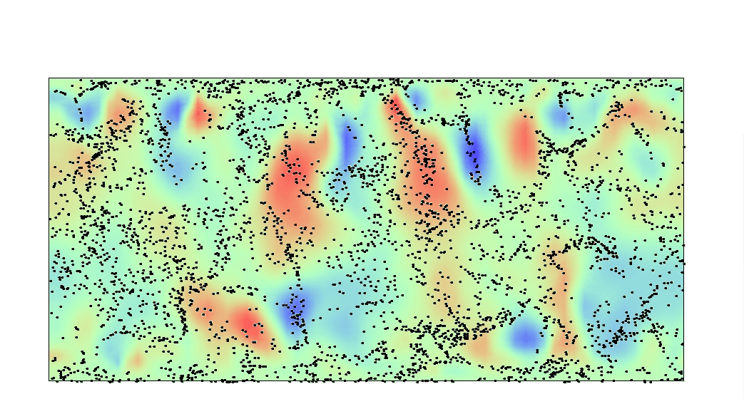
LES simulation of aerosol transport and deposition in turbulent flow in the channel. (Task5)
Particle motion in the cross section (animation)

Slide 15
LES simulation of aerosol transport and deposition in turbulent flow in the channel. (Task5)
Conclusions
Hydrodynamic model and code based on LES model for simulation of turbulent flows in rectangular channels has been developed.
Comparison of experimental and numerical results show satisfactory agreement and confirm code ability to calculate turbulent flows with particles in channels for rather high Reynolds numbers even on relatively coarse grid for LES (160 000 cells).
Due to small time step caused by strong grid stretching near the wall, total number of time iterations required for achievement of stationary level of turbulence may reach one million and such calculation may take time about a month on PC P4 3 GHz, especially for high Reynolds numbers. Therefore more powerful computers for multiple calculations are needed.
In the near future it is planned to modify model of particles and to take into account the lift force directed normally to the wall, and to make a number of calculations for the purpose of comparison with results of the experiments which are carried out within our project.

