Slide 1
Status of PRECOS ISTC project #3813: Phase relation in corium systems
A.P. Alexandrov Research Institute of Technology
ISTC
Presented by S. Bechta
13th CEG-SAM Meeting

Slide 2
Contents
  General information
  Project status
  Project focus
  Methodology
  PRECOS test matrix
  Conclusions

Slide 3
PRECOS project general information
Project participants and coordination
Collaborators
FZK, Germany
IRSN,
France
ITU,
EK
CEA,
France
Areva NP, Germany
Coordinator
ISTC, Moscow
Steering committee
Operation Agent: A.P. Alexandrov RIT, Russia
ISC RAS,
Russia
IHT RAS,
Russia
SPb Electrotechnical State University, Russia

Slide 4
Status of the project
PRECOS test matrix has been finalized with collaborators at the 6th
and 7th CORPHAD project meetings
The project was approved for funding by 44th ISTC MB in December 2007
Work Plan was prepared and sent to ROSATOM Export control in
January 2008
The Work Plan was approved by the Export control in the end of February
2008. Export licensing is not necessary for PRECOS
The Work Plan will be distributed after the 13th CEG-SAM. Collaborators
will be kindly requested to send letters of the Work Plan consent to ISTC
PRECOS has a chance to start in April 2008
Technical preparations for the project are in progress in NITI, IVTRAN
and ISC

Slide 5
PRECOS project focus
Project objective:
Experimental study of phase diagrams of corium mixtures
Experimental data
  Liquidus and solidus temperatures versus component concentrations
  Temperature-concentration regions of the miscibility gap
  Coordinates of eutectic, dystectic and other characteristic points
  Final solubility in solid solution
Data application
  Thermodynamic database optimisation
  Thermodynamic code validation
  Corium behaviour modelling

Slide 6
Experimental methods of phase diagram studies
Visual polythermal analysis in the cold crucible (VPA IMCC)
Differential thermal analysis (DTA) and differential scanning calorimetry (DSC)
Visual polythermal analysis in the Galakhov microfurnace (GM)
High-temperature microscopy (HTM)
Laser pulse heating (LP)
These methods have been used in the projects: COLOSS, METCOR, CIRMAT, CIT, ENTHALPY, ECOSTAR, OECD/MASCA and CORPHAD

Slide 7
Methods of posttest analysis
Elemental analysis
• X-ray fluorescence analysis (XRF)
• Chemical analysis (СhA)
Phase analysis
• X-ray diffraction analysis (XRD)
• Energy-dispersive X-ray spectrometry (EDX)
Microstructure analysis
• Optical microscopy
• Scanning electron microscopy (SEM)
Oxygen determination
• Carbothermic reduction

Slide 8
PRECOS test matrix
Task | Composition | Atmosphere | Experimental data | Priority level | Pt N
1 | Different compositions in the U-Zr-Fe-O system | Argon | Selected points (liquidus, solidus, tie-lines in the miscibility gap) | 1 | 6
2 | ZrO₂ - FeO_{y} | Air and p_{O2} contol | liquidus, solidus, solubility limits | 2 | 3
 | UO₂ - SiO₂ | Argon | liquidus, solidus, solubility limits, eutectic point | 1 | 7
 | CaO - UO₂ |  |  | 1 | 7
3 | UO₂ – FeO – SiO₂ |  | liquidus, solidus solubility limits, tie-lines in the miscibility gap, ternary eutectic point | 1 | 10
 | UO₂ – FeO – CaO |  | liquidus, solidus solubility limits, ternary eutectic point | 1 | 10
 | ZrO₂ - FeO - SiO₂ |  | ternary eutectic point | 2 | 2
 | ZrO₂ - FeO - CaO |  | ternary eutectic point | 2 | 2
4 | Eutectic composition measurement of a realistic complex corium mixture | Argon or Air | System (atmosphere) proposed by French partners (1 system), System (atmosphere) proposed by German partners (1 system), System (atmosphere) proposed by Russian partners (1 system) | 2 | 3
The matrix has been discussed and updated at the 6th and 7th CORPHAD Project meetings

Slide 9
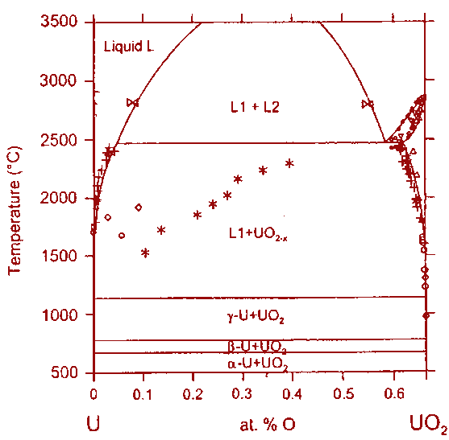
Quaternary system
U-Zr-Fe-O
Fe
20
80
2670°C
CORPHAD DATA
40
2520°C
2515°C
60
60
L1+L2
40
O
80
20
O
20
40
mol %
60
80
Zr
O
?
Fe
20
80
Fe
20
U
80
40
2480°C
40
60
Zr
60
2600°C
60
40
60
40
L1+L2
2370°C
L1+L2
80
20
80
20
U
20
40
mol %
60
80
Zr
O
20
40
mol %
60
80
U

Slide 10
Binary oxidic systems (1)
Petrov Yu.B.
Udalov Yu.P.
Slovak J.
Morozov Yu.G.
(2002)
T, °C
T, °C
2800
ZrO₂-FeO_{y}
ZrO₂
2800
Jones T.S.
Kimura Sh.
Muan A.
(1967)
2400
T, °C
2400
2900
Published
2000
ss
2000
2500
1600
2100
1600
1525
~FeO_{1.3}
1700
1434
1200
CORPHAD
1200
FeO_{x}
20
40
60
80
ZrO₂
(1332±5)°C
Fe₃O₄
20
40
60
80
ZrO₂
mass.%
1300
?
mass.%
ZrO₂
20
40
60
80
FeO
Т, °C
FeO (mol %)
1700
air
10¹
10³
10⁵
1500
10⁻³
10⁻¹
10⁻¹
air
10⁵
1300
10⁻³
10³
1100
10⁻⁵
10¹
10⁻⁷
10⁻¹
900
10⁻³
700
10⁻⁵
Fe₃O₄
10⁻⁷
FeO
Fe₂O₃
500
Fe_{0.938}O
FeO
20
40
60
80
FeO_{1.5}
Darken L.S. Gurry R.W.
(1945,1946)
mol %

Slide 11
Binary oxidic systems (2)
UO₂-SiO₂
?
?
Lungu S. (1962)
CORPHAD DATA

Slide 12
Binary oxidic systems (3)
CaO-UO₂
T, °C
T, K
2800
?
3000
2500
2700
2400
?
2200
2100
1900
1800
?
1500
1600
1200
900
1300
600
1000
300
x (mol)
CaO
20
40
60
80
UO₂
0
0.1
0.2
0.3
0.4
0.5
0.6
0.7
0.8
0.9
1
mol.%
CaO-UO₂
Alberman K.B.
Blakey R.C.
Anderson J.S.
(1951)
Roche M.F.
Leibowitz L.
Fink J.K.
Backer Jr.
(1993)
Voronov N.M.
Sofronova R.M.
Ivanov O.S.
(1972)
Amato I.
(1966)
Holc J.
Kolar D.
(1986)

Slide 13
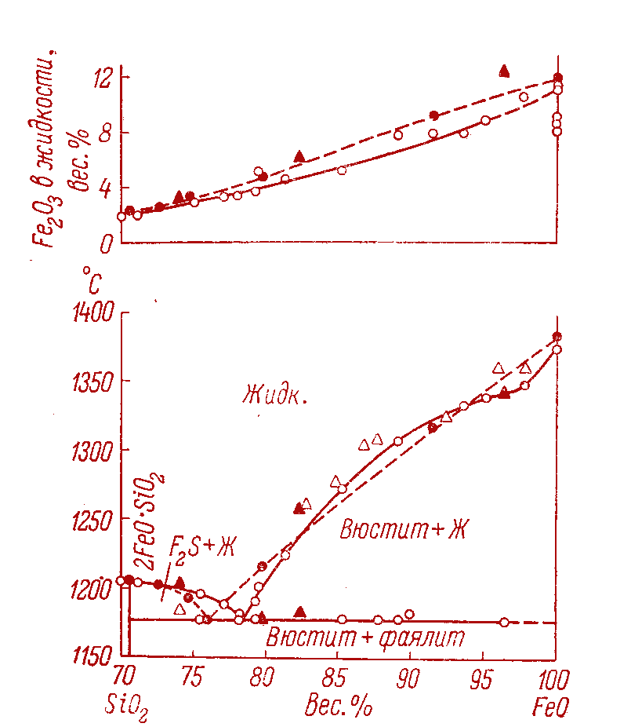
Ternary oxidic systems (1)
UO₂-FeO-SiO₂
UO₂
2900
T, °C
Published
2500
L
2100
1700
L+SS
1300
SS
UO₂
20
40
60
80
FeO
CORPHAD
FeO, mol %
CORPHAD
?
SiO₂
Fe₂SiO₄
FeO
Bowen N.L.
Schairer J. F.
(1932)
Allen W.C.
Snow R. B.
(1955)

Slide 14
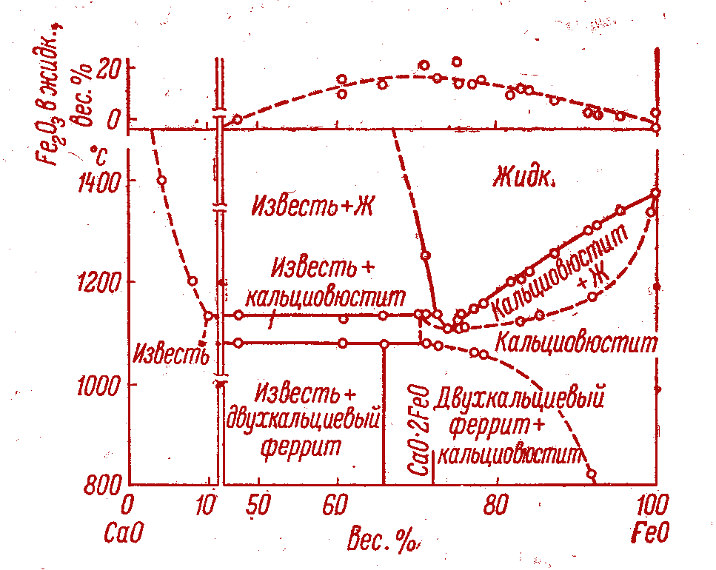
Ternary oxidic systems (2)
UO₂-FeO-CaO
UO₂
2900
T, °C
Published
2500
L
2100
1700
L+SS
1300
SS
CORPHAD
UO₂
20
40
60
80
FeO
T, °C
FeO, mol %
2800
?
?
2500
2200
Allen W.C.
Snow R. B.
(1955)
1900
!
1600
?
?
1300
1000
CaO
20
40
60
80
UO₂
CaO
FeO
mol.%

Slide 15
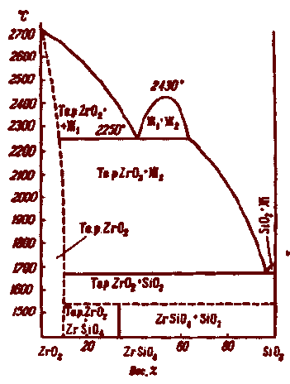
Ternary oxidic systems (3)
ZrO₂-FeO-SiO₂
ZrO₂
2900
T, °C
Published
2500
2100
1700
CORPHAD
(1332±5)°C
1300
ZrO₂
20
40
60
80
FeO
FeO (mol %)
?
Rosen E.
Muan A.
(1965)
Toropov N.A.
Galakhov F.Ya.
(1956)
Bowen N.L.
Schairer J. F.
(1932)
Allen W.C.
Snow R. B.
(1955)
SiO₂
FeO
Fe₂SiO₄

Slide 16
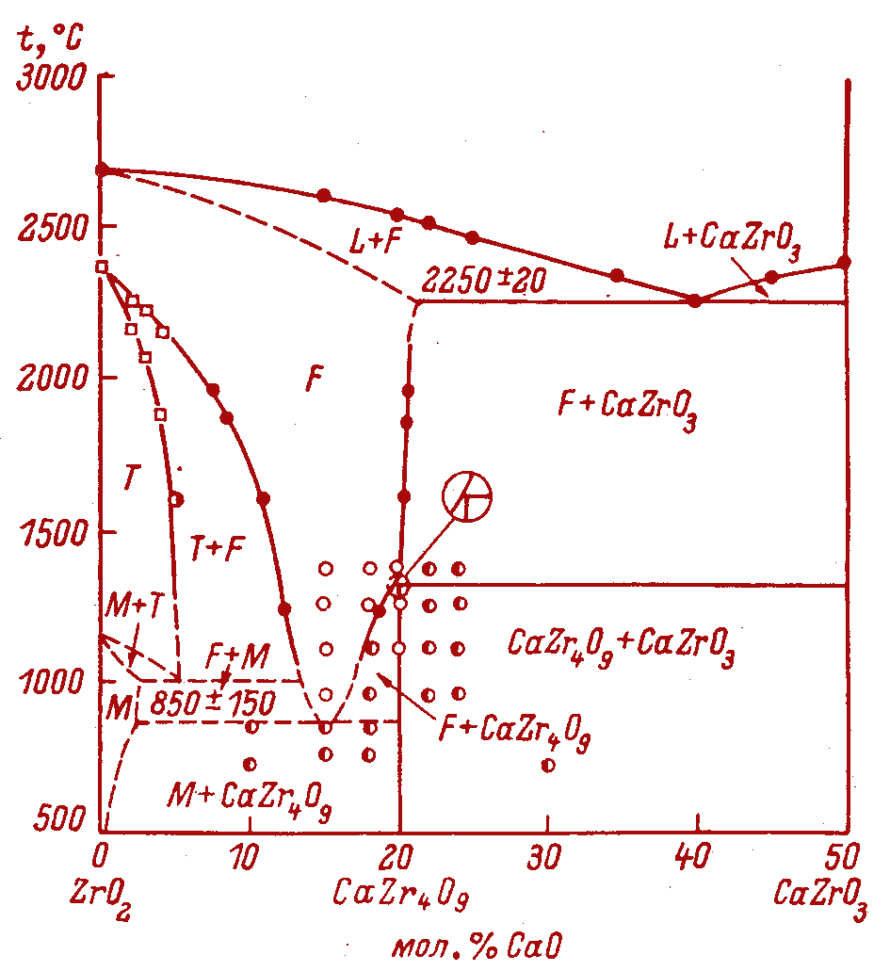
Ternary oxidic systems (4)
ZrO₂-FeO-CaO
ZrO₂
2900
T, °C
Published
2500
2100
1700
CORPHAD
(1332±5)°C
1300
?
ZrO₂
20
40
60
80
FeO
FeO (mol %)
Allen W.C.
Snow R. B.
(1955)
Stubican V.C.
Ray S.P.
(1977)
CaO
FeO

Slide 17
Concluding remarks
PRECOS project is in the initial phase, it can be officially
started in the 2nd quarter 2008
Kick-off project meeting will be held in July 2008 in
St. Petersburg
Compositions to be studied in 2008 will be discussed
at the meeting

