Slide 1
Progress Report on the ISTC project #3592
“Investigation of Corium Melt Interaction with NPP Reactor Vessel Steel”
(METCOR-P)
A.P. Alexandrov Research Institute of Technology (Russia)
Presented by S. Bechta
14th CEG-SAM meeting
September 9-11, 2008, Kiev

Slide 2
Contents
General information
Objectives of METCOR-P project
Experimental matrix for METCOR-P project
Steam oxidation effect on the zone of C-32 corium interaction with vessel steel: MCP-3 test
Thermal and mechanical analyses of the VVER-1000 RPV in an IVR scenario considering corrosion effects
Publications
Organizational problem

Slide 3
General information
Project participants and coordination
Collaborators
FZK, Germany
FORTUM, Finland
JRC ITU,
EK
CEA,
France
AREVA NP,
Germany
FZD, Germany
IRSN,
France
Coordinator
ISTC, Moscow
Steering committee
Operation Agent: A.P. Alexandrov RIT, Russia
ISC RAS,
Russia
SPb Electrotechnical State University, Russia

Slide 4
Objectives of METCOR-P project
Qualification and quantification of physicochemical phenomena of corium melt interaction with reactor vessel steel with particular interest to:
Interaction characteristics at the vertically positioned interface
Peculiarities of interaction with European vessel steel
Corium melt oxidation transients

Slide 5
Experimental matrix for METCOR-P project
*) In accordance with a decision of the 1st project meeting, it is replaced by MCP-2 test with UO_{2+x}– ZrO₂ corium in air and horizontally positioned interface

Slide 6
Steam Oxidation Effect on Zone of Interaction of C-32 Corium with Vessel Steel: MCP-3 Test

Slide 7
Objectives of MCP-3 Test
Qualification and quantification of steam oxidation effect on the interaction zone

Slide 8
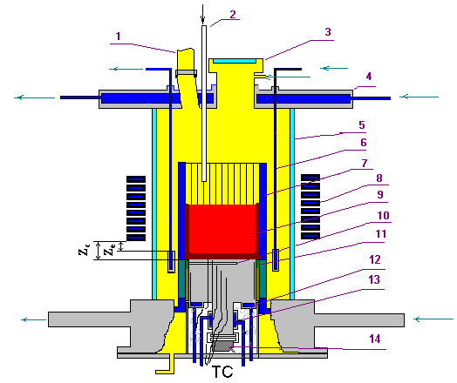
Experimental Setup
RASPLAV-3 Furnace
1 – steam vent from the furnace, 2 – steam supply line, 3 – lid, 4 – water-cooled cover, 5 – quartz tube, 6 – water-cooled electromagnetic screen, 7 – crucible sections, 8 – inductor, 9 – melt, 10 – acoustic defect, 11 – thermal insulation of the specimen, 12 – top specimen calorimeter,
13 – bottom specimen calorimeter, 14 – US sensor
Furnace Charge
Component | Mass, g
UO₂ | 1385.7
ZrO₂ | 164.1
Zr | 272.5
Total | 1822.3
C_{n} = 30.8
U/Zr = 1.188 at.

Slide 9
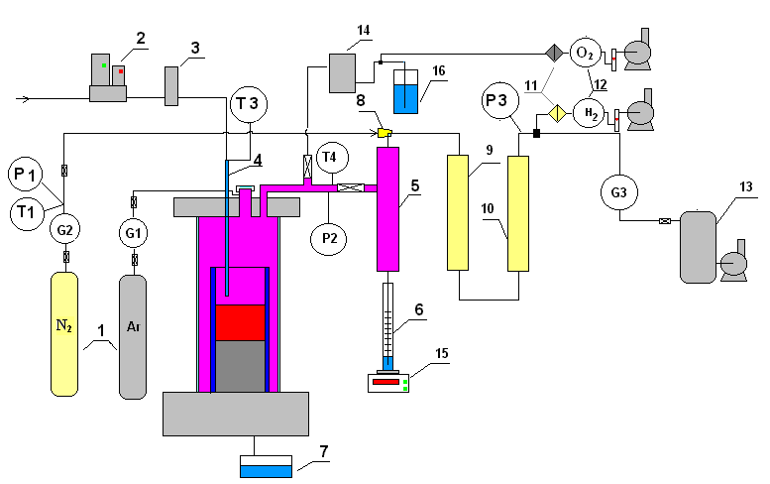
Experimental Setup (2)
Gas-Aerosol Sampling System
1 – tanks with N₂ and Ar
2 – water controller
3 – steam generator
4 – quartz tube for
steam supply into
the furnace
5 – steam condenser
6 – condensate
collector
7 – condensate drop
catcher
8 – ejector
9 – large-area filter
(LAF - steam)
10 – silica gel drier
11 – analytical filter
(AF)
12 – electrochemical
sensors of oxygen
and hydrogen
13 – vacuum receiver
14 – large-area filter
(LAF - Argon)
15 – weight sensor
16 – water lock

Slide 10
Experimental Procedure
Phase | Time interval, s | Description
A | 0…38300 (≈ 11 h) | Molten pool and interaction zone (IZ) formation
B | 38300…42500 | Vessel steel temperature is decreased, crust above the IZ is formed
C | 42500…44300 | Molten pool is oxidized by steam
D | 44300…49200 | Specimen temperature is increased, crust above the IZ dissolves
E | 49200…50490 | Interaction zone and specimen are oxidized

Slide 11
Experimental Results
Thermocouple Readings and Anode Voltage
During all experiment
Fragment: Oxidation period
A B C D E
A B C D E

Slide 12
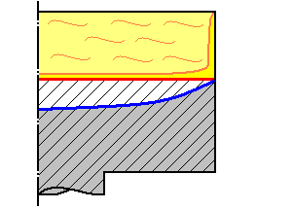
Experimental Results (2)
Corrosion kinetics
A
D
E
Melt
IZ
Specimen
References:
[1] S.V. Bechta, V.B. Khabensky,
V.S. Granovsky etc. EXPERIMENTAL
STUDY OF INTERACTIONS BETWEEN
SUBOXIDIZED CORIUM AND REACTOR VESSEL STEEL. Proc. of ICAPP’06, Reno, NV USA, June 4-8, 2006, Paper 6054

Slide 13
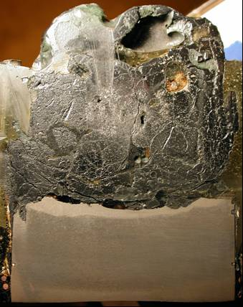
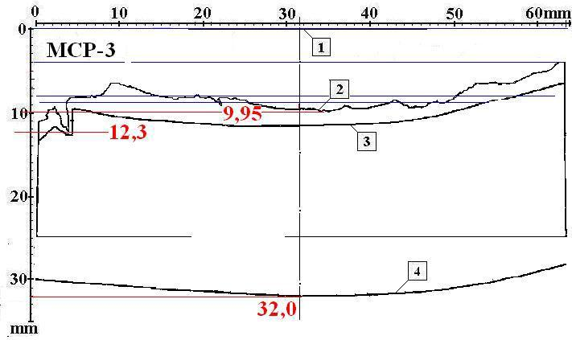
Posttest Analysis
Ingot and Specimen Section
Specimen Section Scheme
1 – undamaged specimen surface
2 – posttest specimen boundary
3 – boundary of the decarbonized steel zone
4 – zone of the melt thermal impact on the
steel macro- and microstructure
(boundary – isotherm 727ºС ?)
Mass of steel that migrated into the melt ≈ 190 g

Slide 14
Posttest Analysis (2)
Chemical Analysis of Samples
Sample | Concentration, mass %
 | Fe⁰ | Fe²⁺ | Fe³⁺ | U⁴⁺ | U⁶⁺ | Zr⁴⁺
Ingot | 1.7 | 4.3 | 1.5 | 54.0 | 3.8 | 21.7
Crust above ingot | – | 3.0 | 1.2 | 59.6 | – | 20.0
Corium splashes | – | 3.5 | 1.7 | 56.6 | – | 23.0
Rod | – | 0.8 | – | 63.7 | – | 24.6
Aerosols on quartz tube | – | 8.4 | 1.3 | 53.0 | 4.8 | 17.3
Aerosols on crucible | – | 3.7 | 2.5 | 34.0 | 28.5 | 2.0
Aerosols on LAF (Ar) | 8.7 | 15.3 | 2.3 | 51.4 | 9.3 | –
Aerosols on LAF (steam) | 19.8 | 28.1 | 2.5 | 29.5 | 6.4 | –
Aerosols in condenser | – | 2.5 | 1.8 | 34.8 | 19.6 | 24.0
Total mass of aerosols – 88.9 g
Mass of evaporated iron – 3.2 g

Slide 15
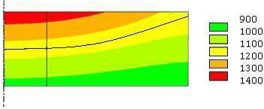
Posttest Analysis (3)
Specimen temperatures during its interaction with suboxidized corium
End of phase A: ~4000 s
1 cm
T, ºC
US sensor
sighting spot
Final position of the interaction
zone (IZ)
Comparison of MC6 and MCP-3 Test Results
Parameter | Test
 | MC6 | MCP-3
Final Corrosion Depth, mm | 6.2 | 7.6
The IZ lower boundary temperature at its final position (T_{B}), ºC | 1180 | 1160

Slide 16
Corium and IZ/specimen oxidation
Hydrogen Generation
Average rates of hydrogen release:
6.9 mg/s – at phase C
3.6 mg/s – at phase E
Hydrogen release rates at the steady states:
9.7 mg/s – at phase C
5.0 mg/s – at phase E

Slide 17
Interaction zone oxidation
Heat Generation during IZ and specimen oxidation (Stage E)
Reactions in the interaction zone:
Zr + O₂ = ZrO₂ + 1090 kJ
U + O₂ = UO₂ + 1060 kJ
2U + O₂ = 2UO₃ + 2360 kJ
Fe + O₂ = FeO + 500 kJ
4Fe + 3O₂ = 2Fe₂O₃ +1440 kJ
The IZ composition was determined using the MC6 test results
Heat of chemical reactions generated at stage E:
≈ 888 kJ
Corresponding average power of chemical reactions :
≈ 0.505 kW
Integral heat power to the specimen surface both from the melt and generated by chemical reactions ≈ 2.5 kW (0.76 MW/m²)
( 2 kW or 0.61 MW/m² – from the melt,
0.5 kW or 0.15 MW/m² – chemical reactions)

Slide 18
Preliminary Conclusions
Posttest analysis is still underway, however the following notes can be made:
Under the conditions similar to those of molten suboxidized С-30
corium interaction with steel in MC6 test, the interaction zone depth in
the USS sighting spot was deeper by approx. 1.4 mm and the incubation
period shorter by approx. 6000 s before oxidation started in MCP-3
The oxidation rate and hydrogen generation rate measured during the
pool oxidation regime were close to MA-9 test (MASCA program). The
oxidation is controlled by steam supply to the molten pool surface
The interaction zone oxidation was realized In the most conservative
regime (after complete oxidation of molten corium),
A partial melting of the steel surface layer in the end of the oxidation
regime was caused by the increase in heat transfer from the melt
(facility-specific factor) and additional heat generated by chemical
reactions. The respective heat fluxes have been evaluated as 0.61 and
0.15 MW/m²

Slide 19
Thermal and mechanical analyses of the VVER-1000 RPV in an IVR scenario considering corrosion effects

Slide 20
Objectives
Evaluation of the influence of corrosion on the vessel integrity under the IVR conditions

Slide 21
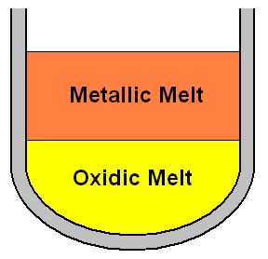
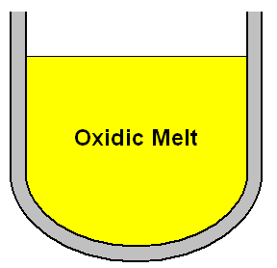
Corium pool configurations
Configuration 1: suboxidized pool
  segregated pool (metal and oxide layer)
  oxide mass: 64 t, metal mass: 116 t
  pool height 2.2 m (1 m + 1.2 m)
Configuration 2: fully oxidized pool
  homogeneous pool
  mass: 210 t
  pool height: 3.1 m

Slide 22
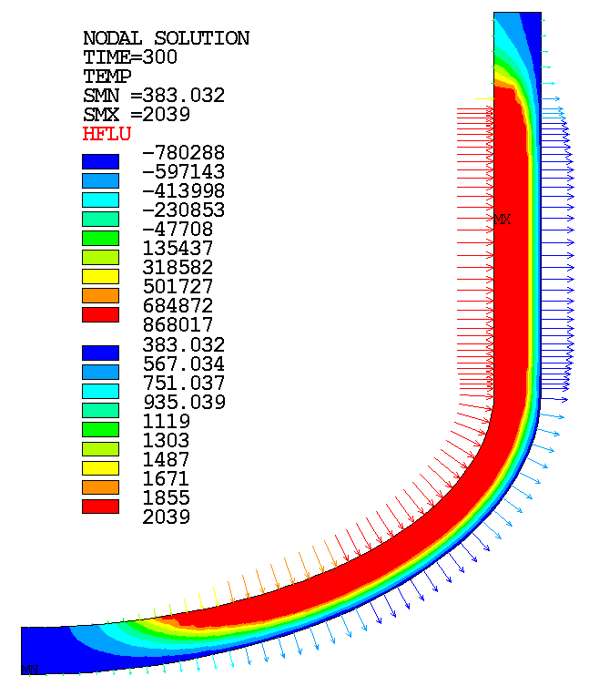
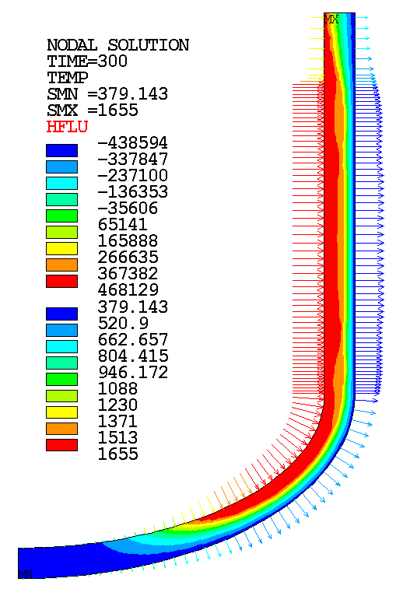
Temperature fields and heat fluxes
segregated pool
homogeneous pool

Slide 23
Analysis of four scenarios
A: segregated pool without corrosion
B: segregated pool with corrosion
C: homogeneous pool without corrosion
D: homogeneous pool with corrosion

Slide 24
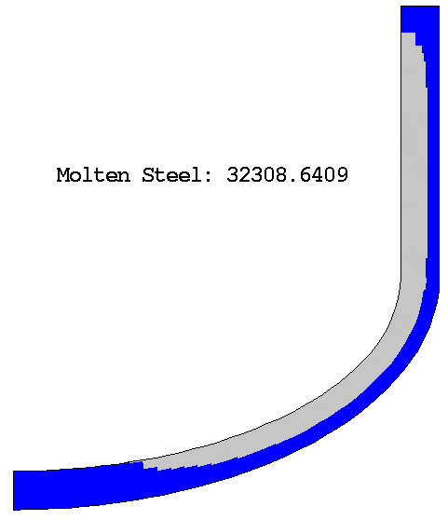
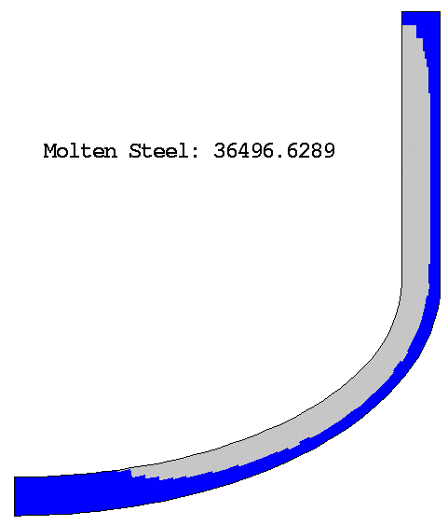
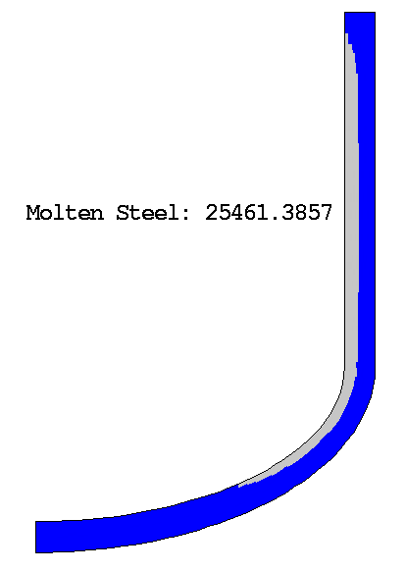
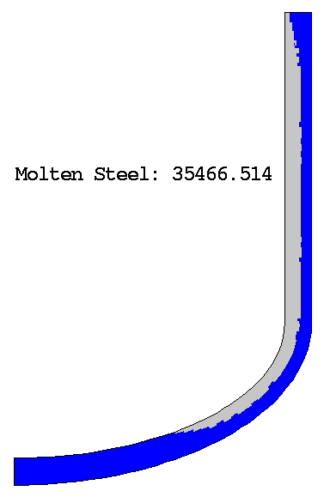
Final ablation
A
B
C
D
The effect of corrosion for the homogeneous pool is higher than for the segregated one

Slide 25
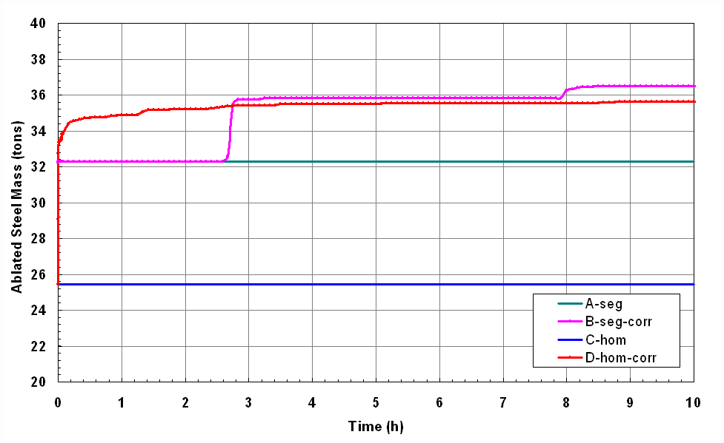
Ablation kinetics
Abrupt changes are due to the computational grid discreteness

Slide 26
Mechanical calculations
Elastic-plastic material behaviour
Material configuration: final ablation state
Temperature field from t = 300 s
Weight of vessel and melt pool
Increasing internal pressure until vessel failure
Failure criterion: allowable stress σ_{max} (T)

Slide 27
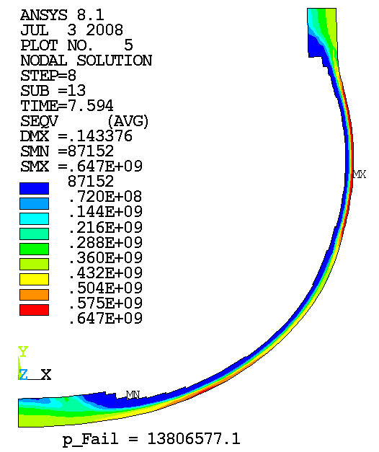
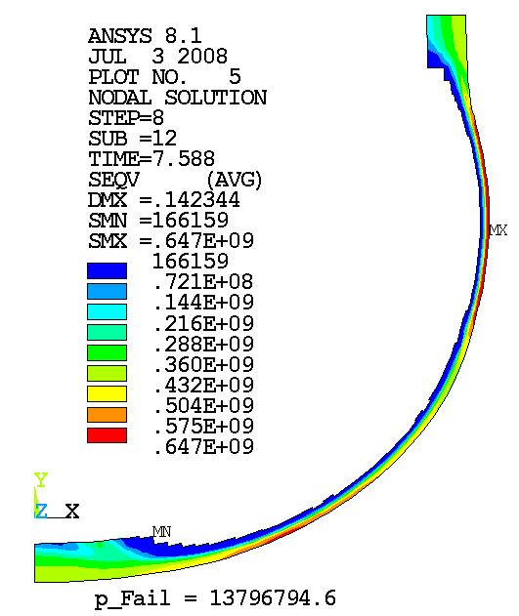
Stress at failure pressure (segregated pool)
A
B
Pa
Pa

Slide 28
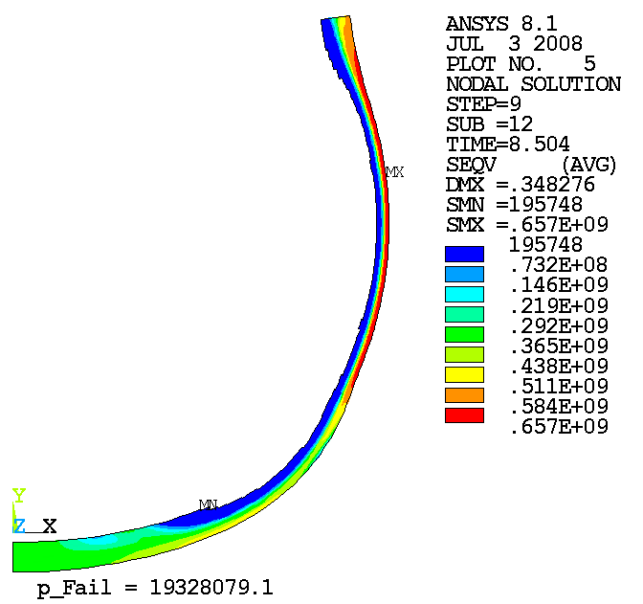
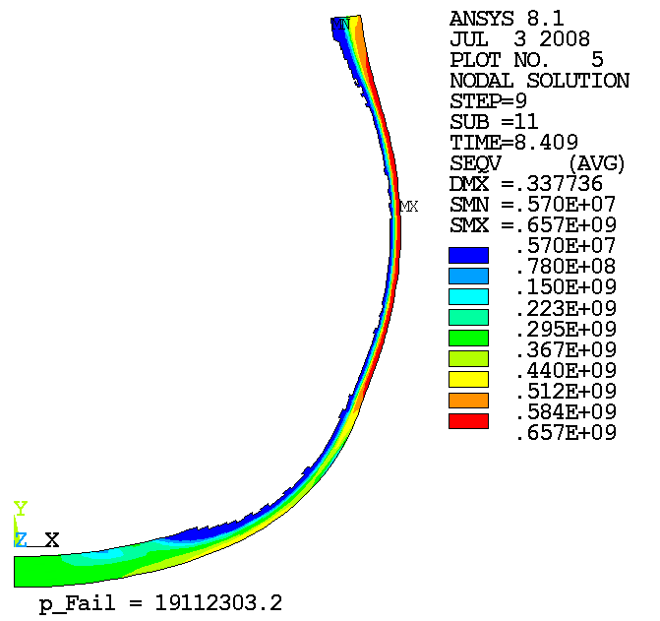
Stress at failure pressure (homogeneous pool)
D
Pa
C
Pa

Slide 29
Main results - overview
Scenario | A | B | C | D
Pool configuration | segregated | segregated | homogeneous | homogeneous
Corrosion | no | yes (suboxidized corium) | no | yes (oxidized corium)
Ablated steel mass, t | 32.3 | 36.5 | 25.5 | 35.5
Min. wall thickness, mm | 60 | 50 | 100 | 70
Failure pressure, MPa | 13.81 | 13.80 | 19.33 | 19.11

Slide 30
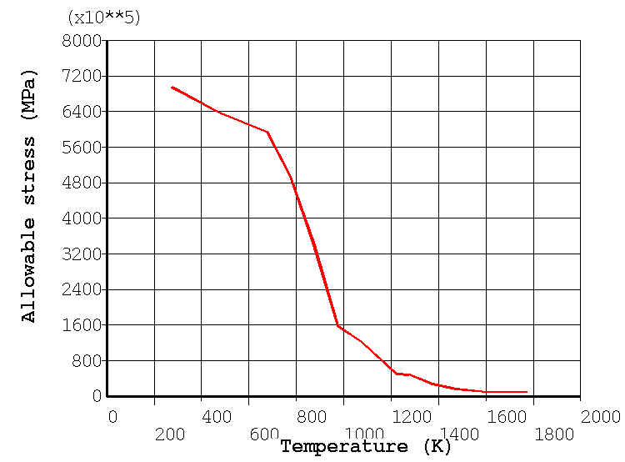
Allowable stress and characteristic temperatures
T_{allow,cr}
T_{B}
T_{liq}

Slide 31
Preliminary conclusions
Corrosion leads to a significantly higher vessel ablation
The effect of corrosion is more pronounced in the homogeneous (oxidized) pool
The segregated pool configuration is more critical due to the higher peak heat flux
The vessel strength is almost not influenced by corrosion
  load is borne by the cold outer region of the vessel wall

Slide 32
Publications
  S.V. Bechta, V.S. Granovsky, V.B. Khabensky, E.V. Krushinov,
  S.A. Vitol, A.A. Sulatsky, V.V. Gusarov, V.I. Almiashev,
  D.B. Lopukh, D. Bottomley, M. Fischer, P. Piluso, A. Miassoedov,
  W. Tromm, E. Altstadt, F. Fichot, O. Kymalainen “Interaction
  between Molten Corium UO_{2+X} - ZrO₂- FeO_{y} and VVER Vessel
  Steel” Proceedings of ICAPP ’08, Anaheim, CA USA, June 8-12,
  2008, Paper 8052
  S.V. Bechta, V.S. Granovsky, V.B. Khabensky, V.V. Gusarov,
  V.I. Almiashev, L.P. Mezentseva, E.V. Krushinov, S.Yu. Kotova,
  R.A. Kosarevsky, M. Barrachin, D. Bottomley, F. Fichot,
  M. Fischer “Corium Phase Equilibria based on MASCA,
  METCOR and CORPHAD Results”, Nuclear Engineering and Design 238 (2008), pp. 2761-2771

Slide 33
Publications (2)
  S.V. Bechta, V.S. Granovsky, V.B. Khabensky, E.V. Krushinov,
  S.A. Vitol, V.F. Strizhov, D. Bottomley, M. Fischer, P. Piluso,
  A. Miassoedov, W. Tromm, E. Altstadt, H. G. Willschutz, F. Fichot,
  O. Kymalainen “VVER Steel Corrosion During In-Vessel
  Retention of Corium Melt” ERMSAR 2008 Conference Paper (In press)
  S.V. Bechta, V.S. Granovsky, V.B. Khabensky, E.V. Krushinov,
  S.A. Vitol, A.A. Sulatsky, V.V. Gusarov, V.I. Almiashev,
  D.B. Lopukh, D. Bottomley, M. Fischer, P. Piluso, A. Miassoedov,
  W. Tromm, E. Altstadt, F. Fichot, O. Kymalainen “VVER Vessel
  Steel Corrosion at Interaction with Molten Corium in Oxidizing
  Atmosphere” (in preparation)

Slide 34
Organizational problem
Restrictions imposed by the Rosatom Export Control:
Export license is necessary
Partner should be found and results confidentiality
should be confirmed
JRS ITU is ready to be the partner
An agreement on the conditions of providing project
deliverables to the ISTC is currently negotiated between
Rosatom and the ISTC

