Slide 1
Progress report on the ISTC project #3813: Phase relation in corium systems
(PRECOS)
A.P. Alexandrov Research Institute of Technology
ISTC
Presented by S. Bechta
14th CEG-SAM meeting
September 9-11, 2008, Kiev

Slide 2
Contents
  General information
  Project status
  Project focus
  Methodology
  PRECOS test matrix
  UO₂-SiO₂ system
  New experimental facilities
  Possible revision of the O-U-Zr phase diagram
  Conclusions

Slide 3
PRECOS project general information
Project participants and coordination
Collaborators
FZK, Germany
IRSN,
France
ITU,
EK
CEA,
France
Areva NP, Germany
Coordinator
ISTC, Moscow
Steering committee
Operation Agent: A.P. Alexandrov RIT, Russia
ISC RAS,
Russia
IHT RAS,
Russia
SPb Electrotechnical State University, Russia

Slide 4
PRECOS project focus
Project objective:
Experimental study of phase diagrams of corium mixtures
Experimental data
  Liquidus and solidus temperatures versus component concentrations
  Temperature-concentration regions of the miscibility gap
  Coordinates of eutectic, dystectic and other characteristic points
  Final solubility in solid solution
Data application
  Thermodynamic database optimisation
  Thermodynamic code validation
  Corium behaviour modelling

Slide 5
Experimental methods of phase diagram studies
Visual polythermal analysis in the cold crucible (VPA IMCC)
Differential thermal analysis (DTA) and differential scanning calorimetry (DSC)
Visual polythermal analysis in the Galakhov microfurnace (GM)
High-temperature microscopy (HTM)
Laser pulse heating (LP)
These methods have been used in the projects: COLOSS, METCOR, CIRMAT, CIT, ENTHALPY, ECOSTAR, OECD/MASCA and CORPHAD

Slide 6
Methods of posttest analysis
Elemental analysis
• X-ray fluorescence analysis (XRF)
• Chemical analysis (СhA)
Phase analysis
• X-ray diffraction analysis (XRD)
• Energy-dispersive X-ray spectrometry (EDX)
Microstructure analysis
• Optical microscopy
• Scanning electron microscopy (SEM)
Oxygen determination
• Carbothermic reduction

Slide 7
PRECOS test matrix
Task | Composition | Atmosphere | Experimental data | Priority level | Pt N
1 | Different compositions in the U-Zr-Fe-O system | Argon | Selected points (liquidus, solidus, tie-lines in the miscibility gap) | 1 | 6
2 | ZrO₂ - FeO_{y} | Air and p_{O2} contol | liquidus, solidus, solubility limits | 2 | 3
 | UO₂ - SiO₂ | Argon | liquidus, solidus, solubility limits, eutectic point | 1 | 7
 | CaO - UO₂ |  |  | 1 | 7
3 | UO₂ – FeO – SiO₂ |  | liquidus, solidus solubility limits, tie-lines in the miscibility gap, ternary eutectic point | 1 | 10
 | UO₂ – FeO – CaO |  | liquidus, solidus solubility limits, ternary eutectic point | 1 | 10
 | ZrO₂ - FeO - SiO₂ |  | ternary eutectic point | 2 | 2
 | ZrO₂ - FeO - CaO |  | ternary eutectic point | 2 | 2
4 | Eutectic composition measurement of a realistic complex corium mixture | Argon or Air | System (atmosphere) proposed by French partners (1 system), System (atmosphere) proposed by German partners (1 system), System (atmosphere) proposed by Russian partners (1 system) | 2 | 3
1st PRECOS meeting decisions: NITI will start with UO₂-SiO₂, ISC - with ZrO₂ - FeO_{y}, IVTRAN with U-Zr-O system

Slide 8
Status of the project
PRECOS test matrix has been finalized with collaborators at the 6th
and 7th CORPHAD project meetings
The project was approved for funding by 44th ISTC MB in December
2007
Work Plan was prepared and sent to ROSATOM Export control in
January 2008
The Work Plan was approved by the Export control in the end of
February 2008. Export licensing is not necessary for PRECOS
Project started from June 1, 2008
Kick-off meeting with the project collaborators took place in
St. Petersburg, July 10, 2008
Test matrix and first tests on UO₂-SiO₂ system has been specified
during the meeting
First results on the UO₂-SiO₂ system were obtained

Slide 9
UO₂-SiO₂ system: GPRS 1-3 tests
Experimental objectives
  To define the monotectic temperature and the boundary curve of the miscibility gap in vicinity of the monotectic temperature
Annealing and quenching in Galakhov microfurnace
UO₂ of >99.0 % purity, SiO₂ of 99.99% purity
Mass of the charge – 150 mg

Slide 10
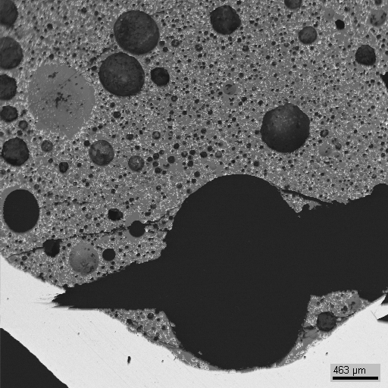
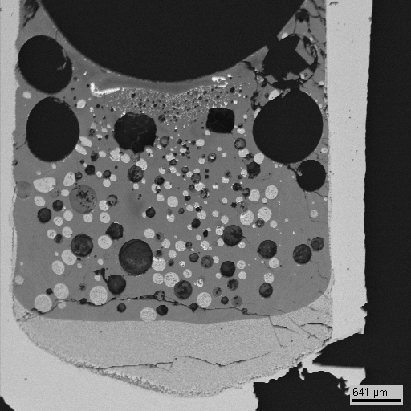
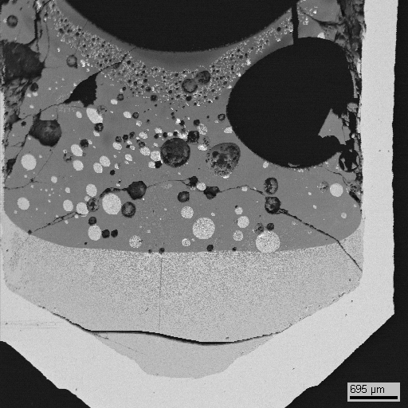
UO₂-SiO₂ system: GPRS 1-3 tests (2)
Sections of the crucibles
Light liquid
Light liquid
Heavy liquid
Heavy liquid
GPRS 1
2050°C 5 min.
below monotectic
GPRS 2
2080°C 5 min.
GPRS 3
2080°C 10 min.
0.5 mm
0.7 mm
0.8 mm
just above monotectic
Mo crucible

Slide 11
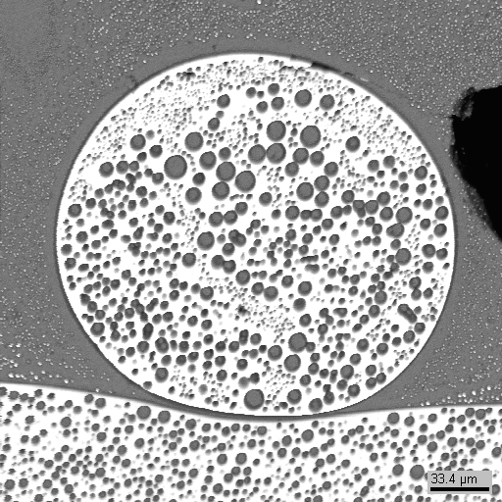
UO₂-SiO₂ system: GPRS 1-3 tests (3)
Inclusion near the phase boundary after quenching
GPRS 2
2080°C 5 min
Secondary separation of lightweight liquid in the dense liquid during melt cooling
30 μm

Slide 12
UO₂-SiO₂ system: GPRS 1-3 tests (4)
EDX analysis different domains in heavy liquid layer
2080°C 5 min
2080°C 10 min
Examined region | Composition, mol %
 | UO₂ | SiO₂
SQ1 | 26.7 | 73.3
SQ2 | 27.3 | 72.7
SQ3 | 28.0 | 72.0
SQ4 | 30.3 | 69.7
Overage value | 28.1±1.6 | 71.9±1.6
Examined region | Composition, mol %
 | UO₂ | SiO₂
SQ1 | 28.1 | 71.9
SQ2 | 31.8 | 68.2
SQ3 | 30.0 | 70.0
SQ4 | 28.3 | 71.7
Overage value | 29.5±1.7 | 70.5±1.7

Slide 13
UO₂-SiO₂ system: GPRS 1-3 tests (5)
EDX analysis of different domains in light liquid layer
2080°C 5 min
2080°C 10 min
Examined region | Composition, mol %
 | UO₂ | SiO₂
SQ1 | 12.6 | 87.4
SQ2 | 11.7 | 88.3
SQ3 | 11.7 | 88.3
Overage value | 12.0±0.6 | 88.0±0.6
Examined region | Composition, mol %
 | UO₂ | SiO₂
SQ1 | 11.5 | 88.5
SQ2 | 11.6 | 88.4
SQ3 | 12.7 | 87.3
Overage value | 12.0±0.7 | 88.0±0.7

Slide 14
UO₂-SiO₂ system: PRS 1 test
Experimental objectives
Determine liquidus temperature at high UO₂ content
VPA IMCC: Fragment of the experiment thermogram showing melt surface
    T_{liq} was measured three times: 2444 ºC, 2404 ºC and 2427 ºC ⇨ T_{liq}=2425 ºC

Slide 15
UO₂-SiO₂ system: results
Red lines – Lungu’ diagram
Blue lines and blue points –
results of our previous work
within the CORPHAD project
Yellow points – results of the
present work

Slide 16
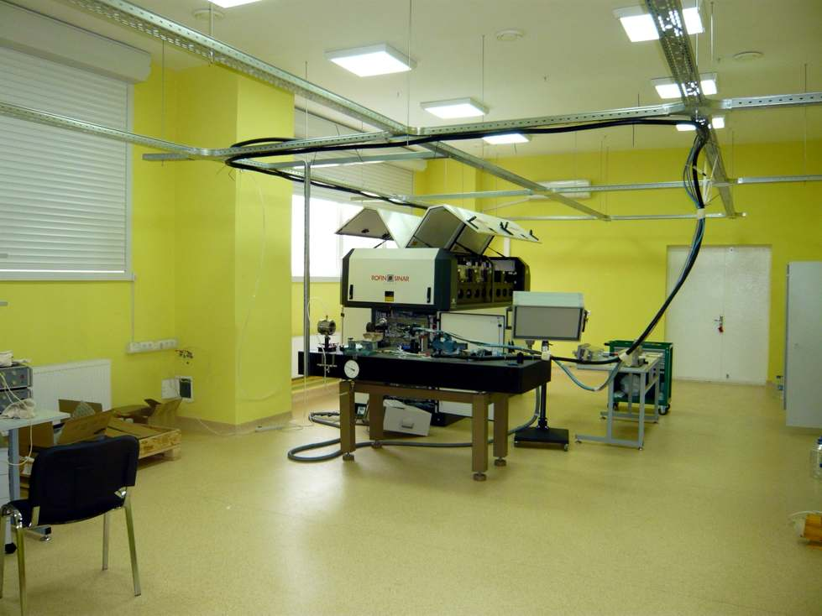
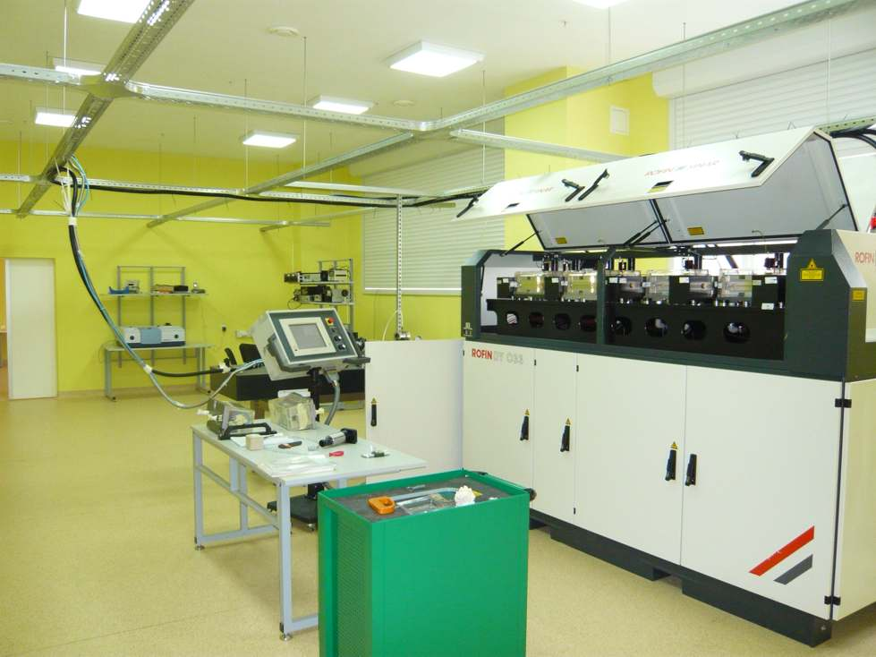
In IVTRAN: Laser pulse heating with 3.3 kW CW-YAG laser
New experimental facilities
- Special ventilation with micro-filtering of the incoming air
- Continuous close cycle dust removal
- Air conditioning
- Thermo stabilized water supply to all experimental set-ups
- Motor-driven jalousie for complete darkening
- Two fibre laser-beam delivery systems
- Laser power regulation according to arbitrary function (time response of ca 1 ms)

Slide 17
Schematic of the laser pulse heating facility
New experimental facilities (2)
Fiber
Fiber
Optic
Optic
Laser
Focusing
Diode Laser
Unit
High Power
Fiber-Laser
Sample
High-Speed
Polychromatic
CCD Camera
Pyrometer
Vacuum/
Pressure
High-Speed
Pyrometer with
extra channel
Transient recorder
Spectra strobe
Laser power

Slide 18
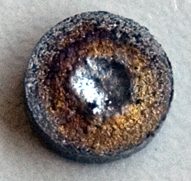
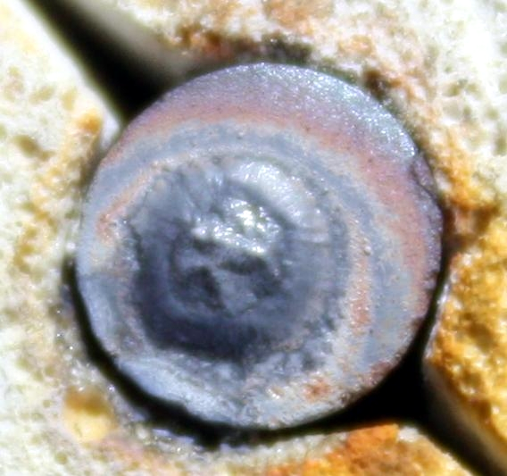
New experimental facilities (3)
Samples after laser pulse heating
Cut out from ingot of CORPHAD test
Pressed (but not sintered) sample
at% :59.9Zr+ 19.9Fe+20.2O
(ZrO_{0.337})_{0.751}Fe_{0.249}
mass%, 28.57 Zr0₂ + 48.26 Zr + 23,17 Fe
Zr_{0.464} Fe_{0.253} O_{0.283}

Slide 19
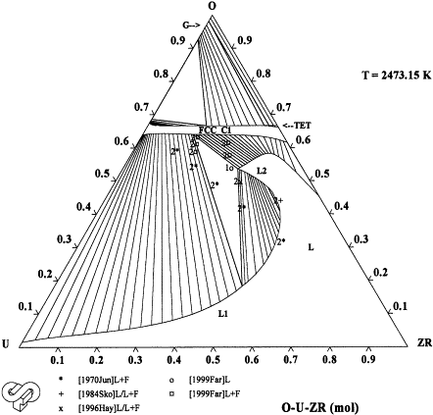
Study of O-U-Zr phase diagram
NUCLEA 07
Optimized with CORPHAD data
2473 K
2473 K
Self-contradiction of experimental data of MG boundary and tie line directions
U-ZrO₂ section study in IVTRAN was proposed

Slide 20
Concluding remarks
Short term planning was discussed during 1st PRECOS meeting as well as the existing problem with U-Zr-O system modeling
Preparation of new installation in IVTRAN is in progress. It will be used for U-Zr-O system study
New results were already obtained for UO₂-SiO₂ system, this work will be continued
Study of ZrO₂ – FeO_{y} system will be carried out in the 2nd quarter

