Slide 1
Progress report on the ISTC project #3813: Phase relation in corium systems
(PRECOS)
A.P. Alexandrov Research Institute of Technology
ISTC
Presented by S. Bechta
15th CEG-SAM meeting
March 10-12, 2009, Villigen

Slide 2
Contents
  General information
  Project objectives
  PRECOS test matrix
  Scope of work in the 2-3 quarters
  Test results:
  - U-Zr-O system
  - UO₂-SiO₂ system
  - UO₂-CaO system
  - ZrO₂ - FeO_{y} system
  Conclusions

Slide 3
PRECOS project general information
Project participants and coordination
Collaborators
FZK, Germany
IRSN,
France
ITU,
EK
CEA,
France
Areva NP, Germany
Coordinator
ISTC, Moscow
Steering committee
Operation Agent: A.P. Alexandrov RIT, Russia
SPb Electrotechnical State University, Russia
IHT RAS,
Russia

Slide 4
Project objectives
Experimental determination of:
liquidus – solidus temperatures
coordinates of reference points (eutectics, etc.)
solubility limits of a solid solutions
compositions of liquids coexisting in the miscibility gap

Slide 5
PRECOS test matrix
Task | Composition | Atmosphere | Experimental data | Priority level | Pt N
1 | Different compositions in the U-Zr-Fe-O system | Argon | Selected points (liquidus, solidus, tie-lines in the miscibility gap) | 1 | 6
2 | ZrO₂ - FeO_{y} | Air and p_{O2} control | liquidus, solidus, solubility limits | 2 | 3
 | UO₂ - SiO₂ | Neutral | liquidus, solidus, solubility limits, eutectic point | 1 | 7
 | CaO - UO₂ |  |  | 1 | 7
3 | UO₂ – FeO – SiO₂ |  | liquidus, solidus solubility limits, tie-lines in the miscibility gap, ternary eutectic point | 1 | 10
 | UO₂ – FeO – CaO |  | liquidus, solidus solubility limits, ternary eutectic point | 1 | 10
 | ZrO₂ - FeO - SiO₂ |  | ternary eutectic point | 2 | 2
 | ZrO₂ - FeO - CaO |  | ternary eutectic point | 2 | 2
4 | Eutectic composition measurement of a realistic complex corium mixture | Argon or Air | System (atmosphere) proposed by: - French partners (1 system) German partners (1 system) - Russian partners (1 system) | 2 | 3
At the first meeting with collaborators it was decided for the 1st Task to carry out several tests in the U-ZrO₂ section in order to determine tie-line directions and compositions of liquids in the miscibility gap

Slide 6
Scope of work in quarters 2-3
For LPH study of the U-Zr-O system (U-ZrO₂ section) NPO LUCH
prepared specimens having the composition specified by
collaborators
For analysis of samples of the UO₂-SiO₂ system the reference
samples in a wide range of composition were synthesized in the
Galakhov microfurnace to be used for the XRF
For study of the ZrO₂-FeO_{y} system specimens were prepared by
mechanical mixing of powders, sol-gel method and hydrothermal
synthesis
Experiments in the following systems have been performed:
  UO₂-SiO₂
  UO₂-CaO
  ZrO₂-FeO_{y}

Slide 7
Scope of work in quarters 2-3 (2)
PRS experiments were performed on the Rasplav-4 setup with 5.28 MHz frequency
GPRS experiments were performed in the Galakhov microfurnace
HPRS experiments were performed using a high-temperature microscope

Slide 8
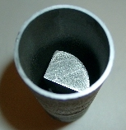
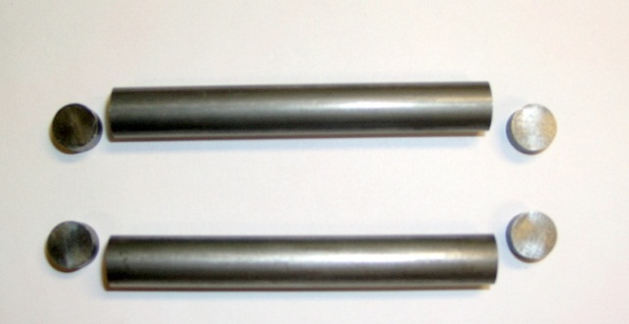
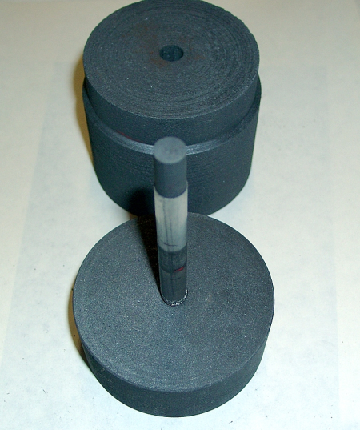
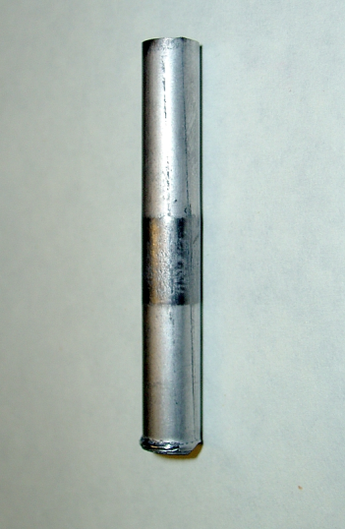
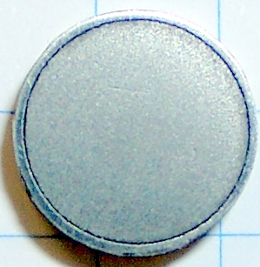
U-Zr-O system (UO₂-Zr section)
Specimen synthesis and control of composition
2
1
Hydride technology of U and Zr preparation
Hydration in a high-purity hydrogen in a tungsten crucible
Charging into a tungsten tube
Sintering in pressurized container
Cutting of tungsten tube with a specimen
Electro-erosion cutting into pellets approx. 3 mm high
Surface polishing and ultrasonic cleaning
X-ray, micro and chemical analysis
3
4
5-6

Slide 9
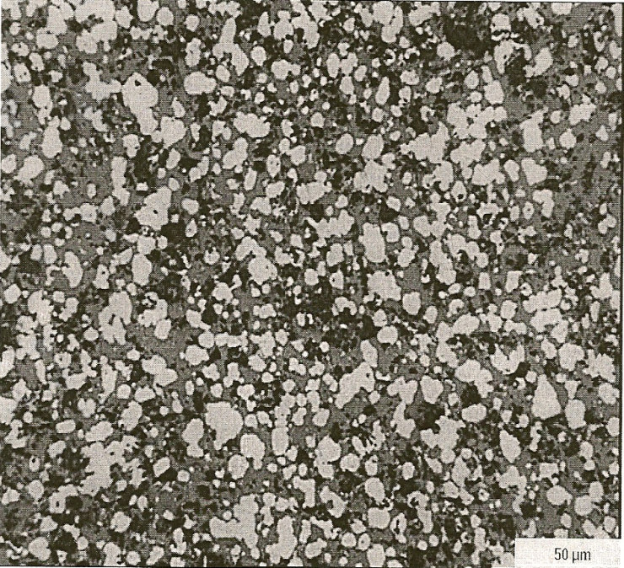
U-Zr-O system: specimen synthesis (2)
Characteristics of synthesized specimens
      Initial materials
      UO₂ and ZrO₂ of >99.85 % purity
50µm

Slide 10
Test results on UO₂-SiO₂ system: GPRS 4-13
Experimental objectives
Determine a critical point
Determination of liquidus temperature at high UO₂ content
Annealing and quenching in Galakhov microfurnace
UO₂ of >99.0 % purity, SiO₂ of 99.99% purity, mass of the charge – 150 mg
SEM/EDX in progress

Slide 11
Test results on UO₂-SiO₂ system: PRS 2
Experimental objectives
Determine liquidus temperature at high UO₂ content
Charge composition
Mol% 40UO₂ + 60SiO₂
VPA IMCC: Fragment of the experiment thermogram showing melt surface
    T_{liq} was measured three times: 2100 ºC, 2085 and 2060ºC ⇨ T_{liq}=2082±30°C

Slide 12

Test results on UO₂-SiO₂ system: PRS 2 (2)
Melt surface cooling during VPA IMCC

Slide 13
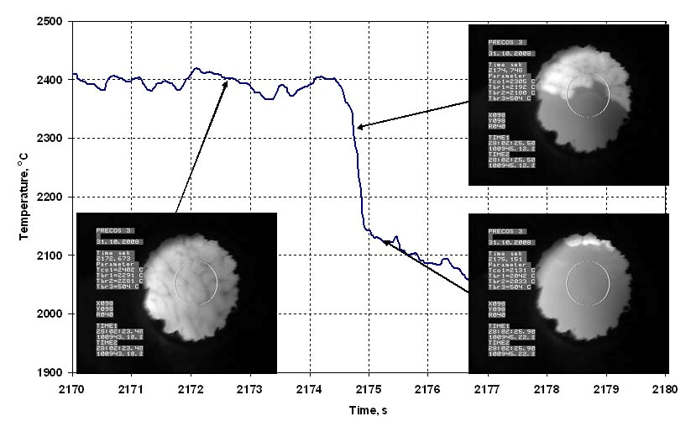
Test results on UO₂-SiO₂ system: PRS 3-1
Experimental objectives
Determine liquidus temperature at high UO₂ content
Charge composition
Mol% 55.8UO₂ + 44.2SiO₂
VPA IMCC: Fragment of the experiment thermogram showing melt surface
    T_{liq} was measured two times: 2400ºC and 2402ºC ⇨ T_{liq}=2401±40ºC

Slide 14
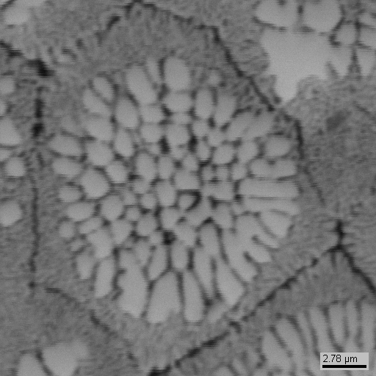
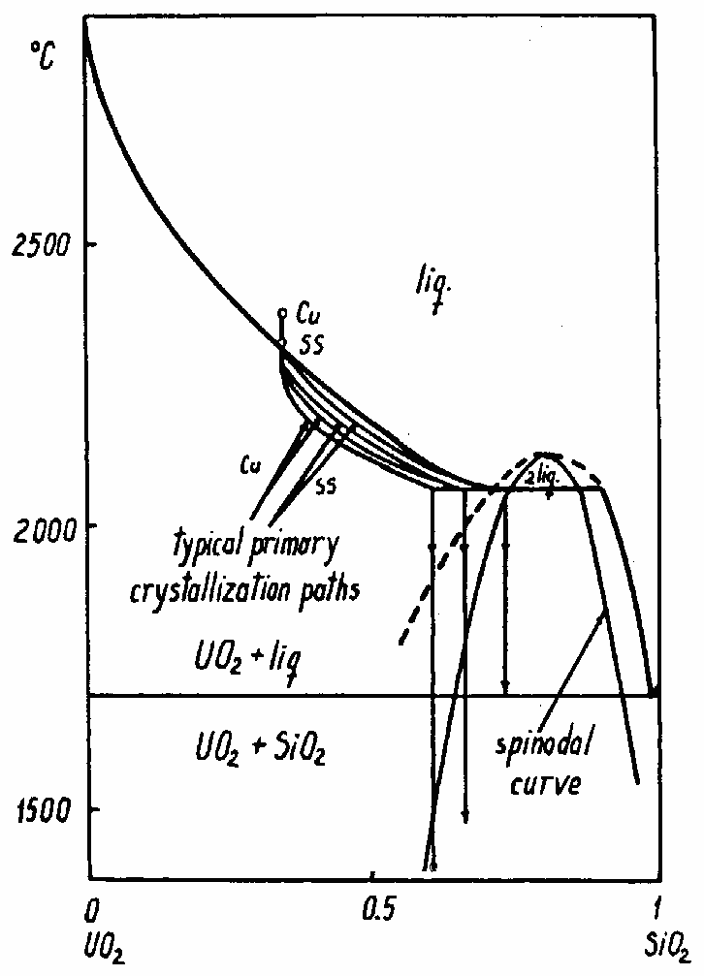
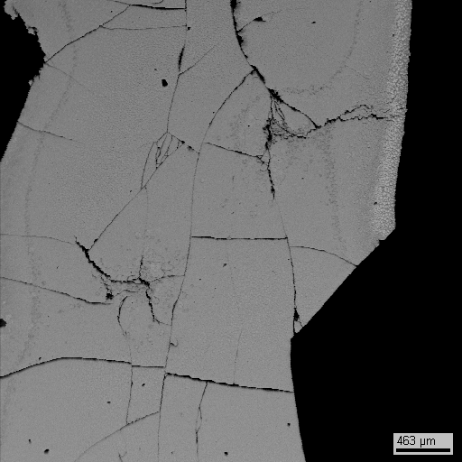
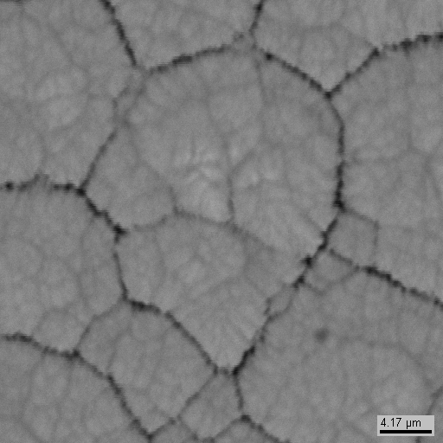
Test results on UO₂-SiO₂ system: PRS 3-1 (2)
Microstructure of quenched sample
2.78µm
UO₂ crystals
463µm
SQ mol%, 62.5UO₂- 37.5SiO₂
S. Lungu et al
Phase spinodal decomposition
Primary crystallization is
suppressed at temperature
below 2070°С
4.17µm

Slide 15
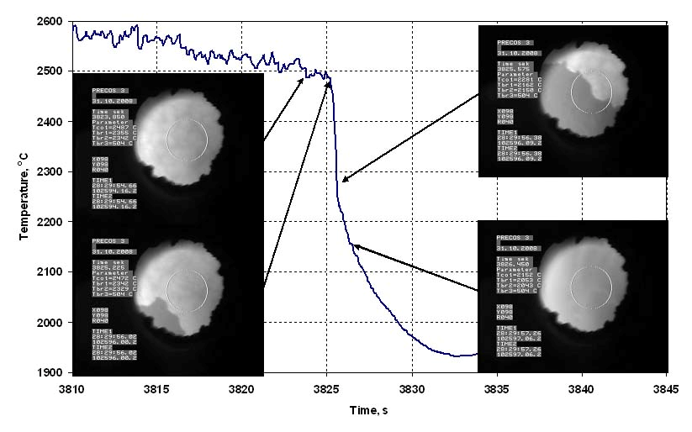
Test results on UO₂-SiO₂ system: PRS 3-2
Charge composition
Mol% 66.7UO₂ + 33.3SiO₂
VPA IMCC: Fragment of the experiment thermogram showing melt surface
    T_{liq} was measured three times: 2487 ºC, 2469 and 2492 ºC ⇨ T_{liq}=2483±40ºC

Slide 16
Test results on UO₂-SiO₂ system
Red lines – Lungu’ diagram
Blue lines and blue points –
results of our previous work
within the CORPHAD project
Green points – results of the
present work (compositions were measured by ChA, XRF in progress)

Slide 17
Test results on UO₂ - CaO system: PRS 4
Experimental objectives
Determine liquidus temperature
Determine final solubility of components in the formed solid solutions
Charge composition
Mol% 50UO₂ + 50CaO
VPA IMCC: Fragment of the experiment thermogram showing melt surface
    T_{liq} was measured three times: 2188ºC, 2195 and 2181ºC ⇨ T_{liq}=2188±40ºC

Slide 18
Test results on UO₂ - CaO system: PRS 5
Experimental objectives
Determine liquidus temperature at very high CaO content (indirect determination of CaO melting point)
Charge composition
Mol% 1UO₂ + 99CaO
Results
Startup heating was successful
Molten pool was not formed and measurements not taken due to low
electric conductivity of the melt
RASPLAV-4 heating current frequency of 5.28MHz is insufficient to
maintain the pool of this composition in a molten state
Decision is taken to increase the concentration of uranium oxide in the
next experiment

Slide 19
Test results on UO₂ - CaO system: PRS 6-1
Experimental objectives
Determine liquidus temperature at high CaO content
Charge composition
Mol% 17.2UO₂ + 82.8CaO
VPA IMCC: Fragment of the experiment thermogram showing melt surface
    T_{liq} was measured two times: 2400ºC and 2378ºC ⇨ T_{liq}=2389±40ºC

Slide 20
Test results on UO₂ - CaO system: PRS 6-2
Charge composition
Mol% 10.2UO₂ + 89.8CaO
VPA IMCC: Fragment of the experiment thermogram showing melt surface
    T_{liq} was measured two times: 2583ºC and 2537ºC ⇨ T_{liq}=2560±50ºC

Slide 21
Test results on UO₂ - CaO system
T, °C
2800
The eutectics composition and solid
solutions were synthesized by
freezing the melt in close-to
equilibrium conditions at slow
(7.5 mm/h) and continuous change
of crucible position versus the
inductor
SEM/EDX in progress
Yellow dots– results of the
present work (Analysis of sample
composition at T_{liq} measurements
are in progress. Plotted dots
represent charge composition)
2500
2200
1900
?
?
1600
1300
1000
CaO
20
40
60
80
UO₂
mol%
Alberman K.B.
Blakey R.C.
Anderson J.S.
(1951)
Holc J.
Kolar D.
(1986)
Amato I.
(1966)

Slide 22
Test results on ZrO₂ - FeO_{y} system: HPRS1-3
Experimental objectives
Determine liquidus and solidus temperature
Methods of charge synthesis
Sol-gel technique
mixing of components at the molecular level => Increase of the processes speed
Hydrothermal synthesis
oxidizing medium => iron state – mainly Fe³⁺solid solution ZrO₂(FeO_{y}) formation

Slide 23
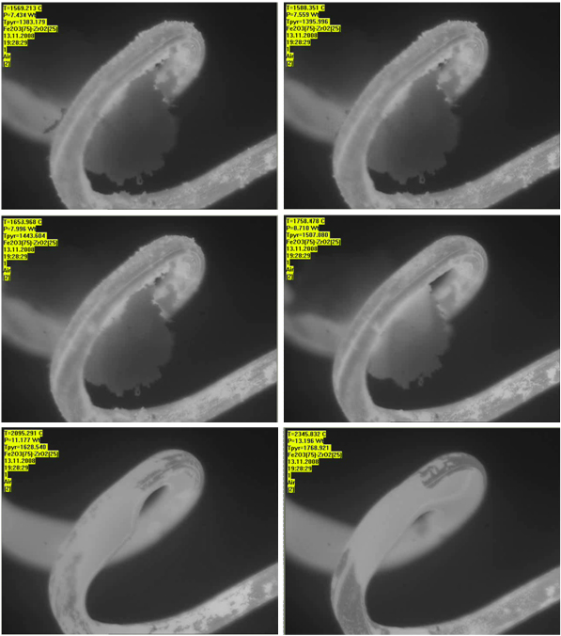
Test results on ZrO₂ - FeO_{y}system: HPRS1-3 (2)
VPA in HTM
Temperature of specimen shape degradation start – 1395°C
Temperature, at which the active specimen spreading on holder starts – 1493°С
Temperature of complete spreading – 1769°С

Slide 24
Test results on ZrO₂ - FeO_{y} system
Blue lines – Jones T.S., Kimura Sh., Muan A. Diagram
Red dots – results of the present work

Slide 25
Conclusions
Experimental facilities have been prepared for PLH measurements. LUCH has prepared specimens. Documentation for radioactive specimen transport to IHT RAS is under preparation
4 points out of 7 have been determined in the UO₂-SiO₂ system. A large amount of new data enables to specify the phase diagram and crystallization peculiarities in the system
First experiments in the UO₂-CaO system have been conducted. Liquidus temperatures have been determined; final solid solutions and eutectic nucleus have been synthesized
Studies in the ZrO₂ – FeO_{y} system have been started. DSC/TG is planned to specify solidus temperature and study thermal effects in detail

