Slide 1
“Examination of VVER
fuel behaviour under
severe accident conditions”
Progress report on the project # 1648.2
Presented by A.Goryachev, RIAR

Slide 2
1648.2 Project ISTC structure
Study of the spent fuel rod segments behavior under reflood conditions.
Integral experiment of QUENCH type using model bundle with 31 VVER fuel rod simulators under QUENCH conditions.
Development of models and codes to describe VVER core behavior under severe accident conditions (“quench” stage).
Involved Institutions: RIAR, IBRAE, JSC MSZ
FZK, IRSN, JRC-ITU, CEA/DEN/DSNI

Slide 3
Technical Schedule for the first year

Slide 5
Single rod tests
During the first year of work it is planned:
Designing and creation of the test rig for the irradiated fuel.
Testing of the rig outside the hot sell.
Realization of experiments with the unirradiated samples
The beginning of experiments with the irradiated fuel.

Slide 6
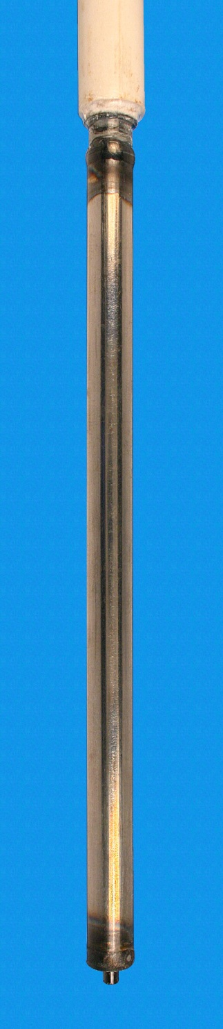
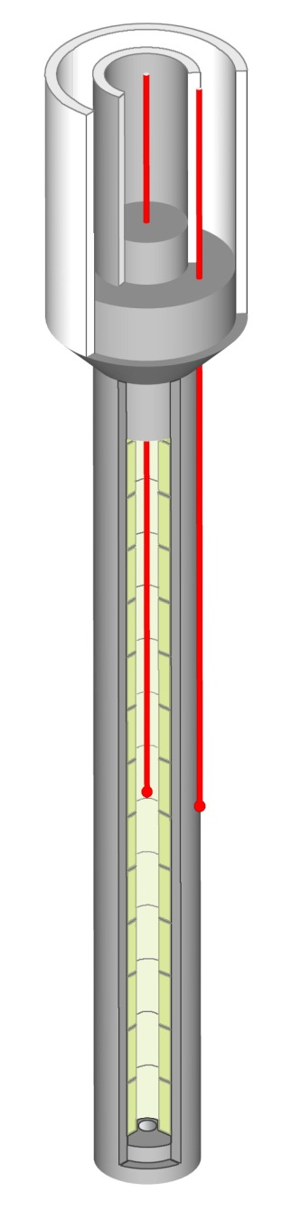
Specimen
suspension bracket
ceramic shield tube
reducing bushing
TC
fuel pellets
cladding
fuel bearing bush

Slide 7
Design test regime

Slide 8
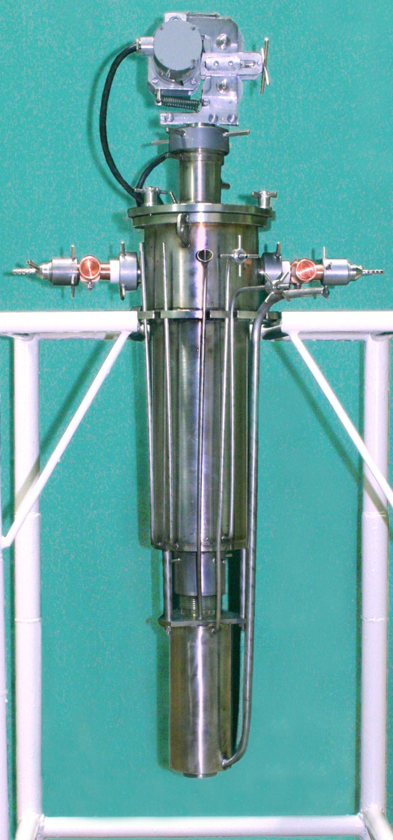
Heating module

Slide 9
Test rig

Slide 10
Preoxidation stage

Slide 11
Quench stage

Slide 12
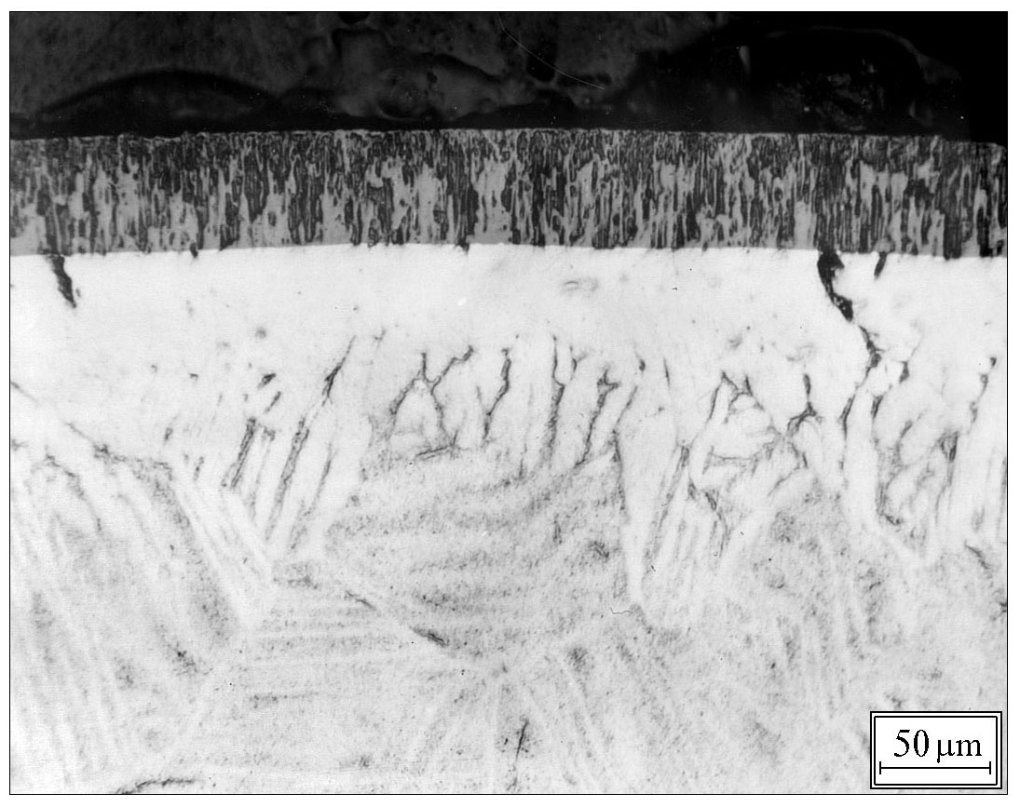
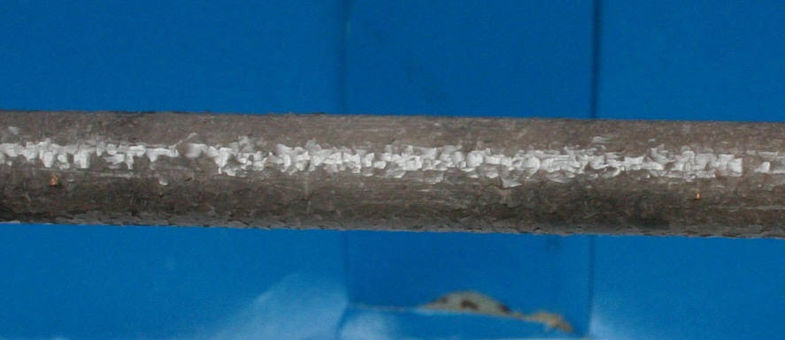
Single rod tests
Temperature uniformity along the specimen need to be improoved

Slide 13
Single rods test shedule
The rig is put in operation at the end 2004.
Trial runs and tests with unirradiated simulators at the first
half of 2005 following by the irradiated samples test.
The irradiated samples test since the August 2005
The finish of the planned test program - at the end 2006.

Slide 14
Bundle quench tests
To the first year of work it was planned:
To organize manufacturing and purchase of details of assembly which should be made in the european firms.
To manufacture the details of assembly from VVER materials
To carry out transportation of the made details to FZK
At present time:
All necessary orders are arranged in firms and the first details have arrived to FZK
Details of assembly of VVER materials are made by JSC "MSZ" and transferred to RIAR for transportation to FZK
The bilateral contract on delivering materials from RIAR to FZK is prepared and delivery of materials is planned during April after the ending of the licensing procedures

Slide 15
FA Quench Model
Development of models and codes to describe VVER core behavior under SA conditions
Task 11
Development of the requirements to models and codes
The requirements to the SVECHA code models (mainly concerning the material properties) were elaborated in order to be able to describe VVER reactor behavior under severe accident conditions.
Task 12
Preparation and adaptation of models and codes
The preliminary stage of the adaptation of the models of high temperature oxidation and mechanical behavior of VVER cladding tubes was performed with respect to:
Comparison of the results obtained during examination of "fresh" and spent claddings;
Development of physical model of time-dependent high temperature cladding oxidation based on the PWR Zry-4 cladding oxidation model developed in IBRAE;
Further development of cladding mechanical behaviour model developed in IBRAE for PWR Zry-4 claddings and application of modified model to describe examined VVER fuel rods.
7th Meeting CEG-SAM GRS Cologne February 28-March 1, 2005

Slide 16
Cladding Oxidation Model
Module PROF
Designed for modelling cladding oxidation and chemical interactions with fuel pellets at Т ≥ 1000 °С
Based on numerical solution of the oxygen diffusion problem in multi-layered UO₂/β-Zr/α-Zr/ZrO₂/steam structure (up to 7 layers)
7th Meeting CEG-SAM GRS Cologne February 28-March 1, 2005

Slide 17
Cladding Oxidation Model
Adaptation to VVER Materials (1)
Simulation of the α-Zr and ZrO₂ layers growth kinetics in the RIAR isothermal tests on Zr-1%Nb cladding oxidation in steam at 1000 and 1100ºC
7th Meeting CEG-SAM GRS Cologne February 28-March 1, 2005

Slide 18
Cladding Oxidation Model
Adaptation to VVER Materials (2)
Simulation of the α-Zr and ZrO₂ layers growth and weight gain kinetics in the RIAR isothermal tests on Zr-1%Nb cladding oxidation in steam at 1200ºC
7th Meeting CEG-SAM GRS Cologne February 28-March 1, 2005

Slide 19
Cladding Oxidation Model
Adaptation to VVER Materials (3)
Calculated oxygen diffusion coefficients in α-Zr and ZrO₂ phases of Zr-1%Nb and Zry cladding materials
7th Meeting CEG-SAM GRS Cologne February 28-March 1, 2005

Slide 20
Cladding Deformation Model
Module CROX
  multi-layered cylindrical rod structure (pellet, gap, Zr+ZrO₂ cladding)
  different physico-mechanical properties of layers
    β-Zr and α-Zr(O) : visco-elastic (various) properties
    ZrO₂: elastic properties up to melting
tight coupling with oxidation model
7th Meeting CEG-SAM GRS Cologne February 28-March 1, 2005

Slide 21
Cladding Deformation Model
Validation
Tests on Zry Cladding Ballooning
Эксперименты:
↑ Sagat et al. (AECL, Canada)
← REBEKA
7th Meeting CEG-SAM GRS Cologne February 28-March 1, 2005

Slide 22
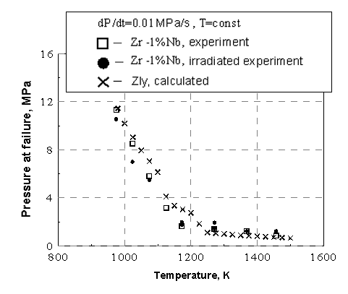
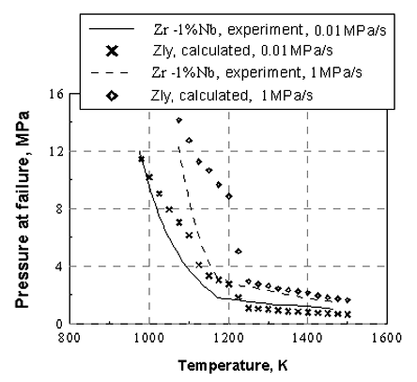
Cladding Deformation Model
Adaptation to VVER Materials
RIAR Tests on Zr-1%Nb Cladding Ballooning
7th Meeting CEG-SAM GRS Cologne February 28-March 1, 2005

Slide 23
Conclusions
During the first three quarters:
Test rig for the single rod quench tests is designed and manufactured and put into operation testing
The preparatory work on the bundle quench test are in progress
First results on adaptation of models of high temperature cladding oxidation and mechanical behavior show the rather good coincidence of calculated and experimental parameters
All works are within the fame of the time schedule of 1648.2 Project Work Plan

