Slide 1

“Examination of VVER fuel behaviour under severe accident conditions, Quench state”
Status report on the ISTC project # 1648.2
Presented by A. Goryachev,
RIAR, Dimitrovgrad, Russia
12 CEG-SAM Meeting September 11-13, 2007 St. Petersburg 1

Slide 2



Determination of FP release
Ar
carrier gas
mass-spectrometer
γ - detector
Ar, ⁸⁵Kr, Xe
MFM
Gas flow rate
Xe concentration
Gamma - spectrum
Quench
tank
Ar
carrier
gas
⁸⁵Kr activity
⁸⁵Kr and Xe release rate
12 CEG-SAM Meeting September 11-13, 2007 St. Petersburg 2

Slide 3
Tests performed in the frame of stage A Spent ROD-QUENCH
Project “Examination of the VVER fuel behavior under the severe accidents. Reflooding stage "
Reflood temperature, °С Oxide film thickness, μm | 1400 | 1600 | 1700
0 | 2 | 2 | 2
100 | 2 | 1
300
1
12 CEG-SAM Meeting September 11-13, 2007 St. Petersburg 3

Slide 4

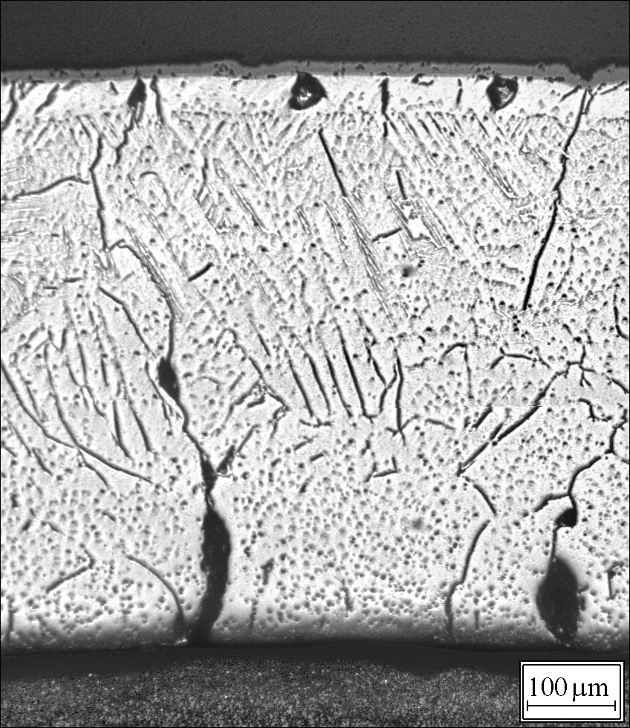
Tests with irradiated simulators quenched without pre-oxidation
Simulator #37
No preliminary oxidation
Annealing within 240 s in argon at 1400 °C to get data for comparative analysis of gaseous fission product release kinetics
Quenching at 1700 °C
Simulator was broken during handling immediately after the test
12 CEG-SAM Meeting September 11-13, 2007 St. Petersburg 4

Slide 5

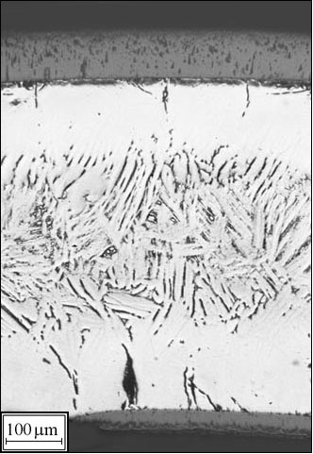
Tests with irradiated simulators quenched with pre-oxidation
Simulator #39
Pre-oxidation time at 1400 °C is 240 s
Quenching at 1400 °C
Simulator was broken during post-test examinations
12 CEG-SAM Meeting September 11-13, 2007 St. Petersburg 5

Slide 6
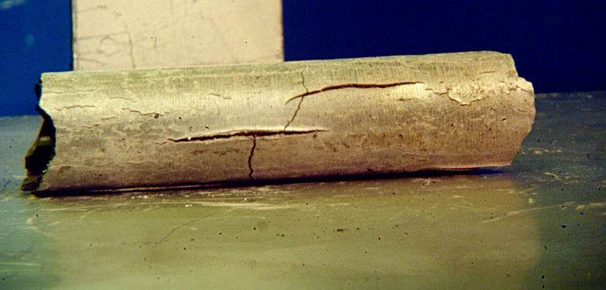
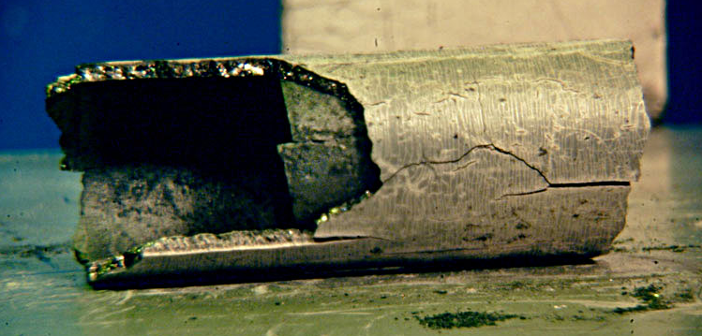
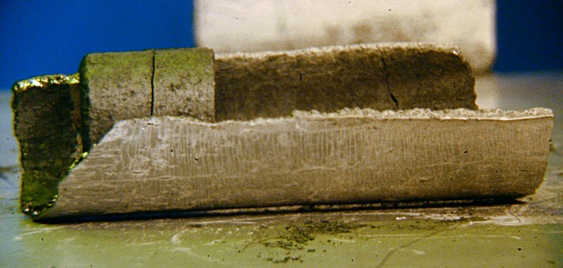
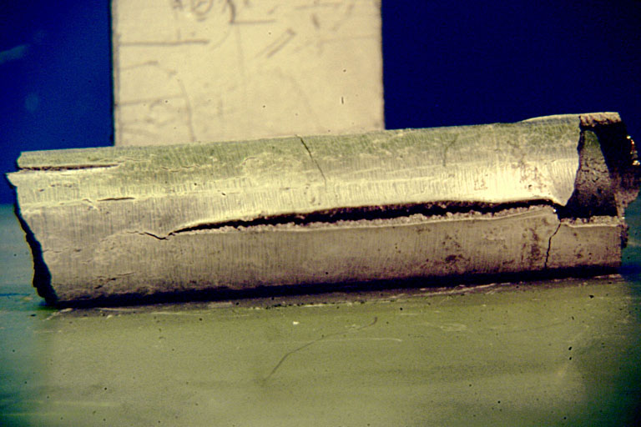
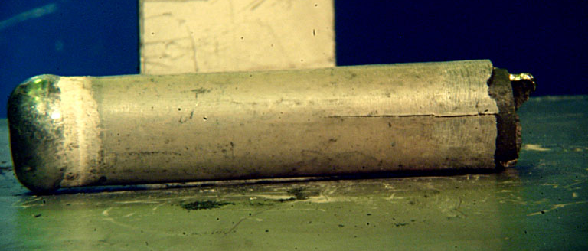
Simulator #51
(1600 ^{о}С, oxidized 100 µm)
12th CEG-SAM Meeting September 11-13, 2007 Saint Petersburg

Slide 7
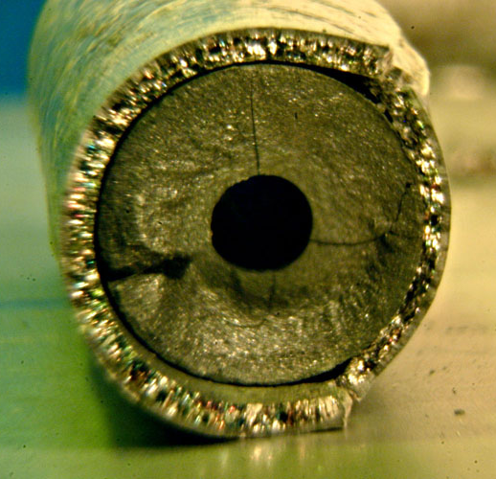
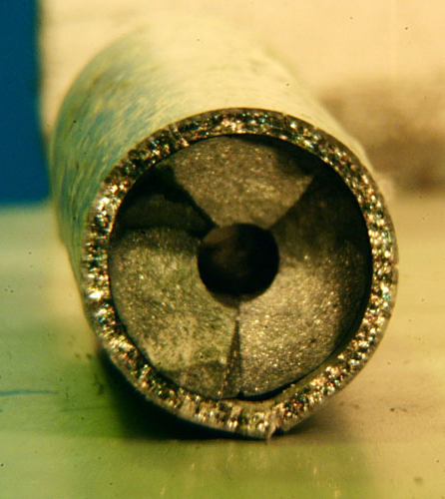
Simulator #51
(1600 ^{о}С, oxidized 100 µm)
12th CEG-SAM Meeting September 11-13, 2007 Saint Petersburg

Slide 8
Results of the irradiated simulator tests
Test # | 36 | 37 | 39 | 40 | 45 | 46 | 47 | 49 | 51
Fuel Burnup, MW·d/kgU | 54 | 54 | 65 | 65 | 65 | 65 | 65 | 65 | 65
Pre-oxidation (annealing) time at 1400 °C, s | 240 | 0 | 240 | 0 | 240 | 240 | 240 | 240 | 240
Simulator environment | steam-Ar | Ar | steam-Ar | Ar | Ar | Ar | Ar | Ar | steam-Ar
Quench temperature, °C | 1400 | 1700 | 1400 | 1400 | 1600 | 1400 | 1600 | 1700 | 1600
Maximum temperature during the quench, °C | 1407 | 1703 | 1428 | 1411 | 1604 | 1422 | 1604 | 1706 | 1658
Total hydrogen production, mg | 164 ± 13 | 16.3 ± 1.3 | 173 ± 14 | 13.6 ± 1.1 | 20.6 ± 1.6 | 9.4 ± 0.6 | 20.4 ± 1.6 | 25.9 ± 2.0 | 208 ± 16
Hydrogen production during the quench, mg | 6.7 ± 0.5 | 14.7 ± 1.2 | 7.0 ± 0.6 | 13.6 ± 1.1 | 20.6 ± 1.6 | 9.4 ± 0.6 | 19.3 ± 1.5 | 23.4 ± 1.9 | 21.1 ± 1.7
12 CEG-SAM Meeting September 11-13, 2007 St. Petersburg 8

Slide 9

Determination of relative release of volatile FP
Relative method.
Test 36 (Burnup 54 MW⋅d/kg U;
isothermal annealing: 1400°C, 240 s; quenching temperature 1400 °C)
12 CEG-SAM Meeting September 11-13, 2007 St. Petersburg 9

Slide 10

Determination of initial content of ⁸⁵Kr and Xe
The content of ⁸⁵Kr and Xe in the reference sample is assumed as the initial ⁸⁵Kr specific activity А_{ref} and initial specific volume of the xenon V_{Xe} _{ref} and calculated on the basis of the results of the experiment on dissolution of the fuel reference sample.
Rig for determination of FP content by fuel dissolution
dissolution device
TC
Hot cell
Ar
heater
filter
bubblers
fuel sample at moving bowl
dump
P 1
filter
MFC
Ge(Li) - detector
γ
mass flow controller
Ar
MS
MS
MFM
mass flow meter
mass spectrometer
12 CEG-SAM Meeting September 11-13, 2007 St. Petersburg 10

Slide 11
Determination of Cs relative release
Volume measurement
Remote probe sampling
Probe
dilution
γ - spectrometry
134Cs, 137Cs activity
Test
solution
γ - detector
The parameters determined :
volumetric activity and radionuclide composition in quench tank water;
- specific activity and radionuclide composition of the acid solution (reference fuel specimen or tested sample);
Relative error of activity determination is 9% (Р=0,95).
12 CEG-SAM Meeting September 11-13, 2007 St. Petersburg 11

Slide 12
FP release calculated using the dissolution results
Test | 36 |  | 37 | 39 |  |  | 40
Burnup, МWd/kg U | 54 |  | 54 | 65 |  |  | 65
Holding time at 1400°С, s | 240 |  | 240 | 240 |  |  | 0
Maximal temperature, °C | 1400 |  | 1700 | 1400 |  |  | 1400
⁸⁵Kr release (on-line measurement), % | 18.1±4.0 |  | 31.8±3.2 | 8.4±4.5 |  |  | 4.1±4.5
¹³⁷Cs release calculated using γ-scanning data, % | 5 |  | - | 9 |  |  | 3
Sample position along the simulator, mm | 90 | 22 | 96 | 131 | 95 | 11 | 136 | 84 | 19
⁸⁵Kr release calculated by dissolution data, % | 18.8 ± 4.0 | 2,0 ± 5.0 | 42,3 ± 2.7 | 16,9 ± 4.1 | 12,7 ± 4.3 | 8,2 ± 4.5 | 9,9 ± 4.5 | 2,2 ± 4.8 | 2,3 ± 4.8
¹³⁷Cs release calculated by dissolution data, % | 8,2 ± 9,2 | <2 | 37,8 ± 6,2 | 6.0 ± 9,4 | 5,4 ± 9,5 | 3,0 ± 9,7 | 7,5 ± 9,3 | <2 | <2
Measured ⁸⁵Kr concentration in the reference samples: 54 МWd/kg U– 3.5 μl/g
65 МWd/kg U– 6.6 μl/g
12 CEG-SAM Meeting September 11-13, 2007 St. Petersburg 12

Slide 13
Simulator test parameters and FP release
Test |  | 36 | 37 | 39 | 40 | 42* | 43** | 45 | 46 | 47 | 49 | 51
Burnup, МWd/kgU |  | 54 | 54 | 65 | 65 | 65 | 65 | 65 | 65 | 65 | 65 | 65
Holding time at 1400°С, s |  | 240 | 240 | 240 | 0 | 0 | 340 | 240 | 240 | 240 | 240 | 240
Quench temperature, °C |  | 1400 | 1700 | 1400 | 1400 | 1600 | 1400 | 1600 | 1400 | 1600 | 1700 | 1600
Total ⁸⁵Kr release, μl STP |  | 37 ± 4 | 65 ± 8 | 33 ± 4 | 16 ± 2 | 29 ± 4 | - | 18 ± 2 | 11 ± 1 | 16 ± 2 | 28 ± 3 | 19 ± 2
Total Xe release, ml STP |  | 12.9 ± 1.3 | 34 ± 3.4 | 9.9 ± 1.0 | 4.9 ± 0.5 | 15.4 ± 1.6 | - | 5.0 ± 0.5 | 3.1 ± 0.3 | 4.9 ± 0.5 | - | -
Relative ⁸⁵Kr release, % |  | 18.1 ± 4.0 | 31.8 ± 3.2 | 8.4 ± 4.5 | 4.1 ± 4.5 | 7.4 ± 4.5 | - | 5.1 ± 4.5 | 3.1 ± 4.6 | 4.2 ± 4.5 | 7.6 ± 4.5 | 5.2 ± 4.5
Relative ⁸⁵Kr release from simulator central part (dissolution data), % |  | 18.8 ±4.0 | 42,3 ±2.7 | 12,7 ±4.3 | 2,2 ±4.8
Cs release in the cooling tank water, % | ¹³⁷Cs | 0.6 ±0.2 | 1.2 ±0.3 | 1.3 ±0.3 | 0.6 ±0.2 | 0.8 ±0.2 | 1.2 ±0.3 | 0.9 ±0.2 | 0.4 ±0.2 | 1.1 ±0.3 | - | 0.8 ±0.2
 | ¹³⁴Cs | 0.5 ±0.2 | 1.0 ±0.2 | 1.2 ±0.3 | 0.6 ±0.2 | 0.9 ±0.2 | 1.2 ±0.3 | 0.9 ±0.2 | 0.4 ±0.2 | 1.1 ±0.3 | - | 0.8 ±0.2
12 CEG-SAM Meeting September 11-13, 2007 St. Petersburg 13

Slide 14
Summary
The progress in tests performance have been achieved after repair of installation.
Data on volatile FP content in samples of initial fuel are obtained
Tests with dissolution of the initial and tested samples have shown that the used method can be applied to the simulators tested at temperatures of
1700 ^{о}С. At lower temperatures (1400 ^{о}С) the error exceeds the result
12 CEG-SAM Meeting September 11-13, 2007 St. Petersburg 14

Slide 15
Part 2. Application of the SVECHA/QUENCH and MFPR codes to simulation of
the RIAR quenching tests
with VVER irradiated fuel rods

Slide 16
Crack formation in RIAR tests with irradiated fuel rod simulators
Group | Test # | Initial temp. | Outer ZrO₂ | Outer Zr(O) | Inner Zr(O) | Inner ZrO₂ | State of the cladding after the test
 |  | °С | μm | μm | μm | μm
I | 36 | 1400 | 111 | 186 | 170 | - | Intact.
 | 39 | 1400 | 92 | 126 | 122 | 27 | Intact. Broken during handling.
 | 43 | 1400 | - | - | - | - | Intact. Broken during handling.
II | 40 | 1400 | 9 | 23 | 90 | 10 | Intact.
 | 46 | 1400 | - | - | - |  | Intact.
 | 42 | 1450* | - | - | - | - | Intact. Broken into 2 parts during handling.
 | 45 | 1600 | - | - | - | - | Intact. Broken into 2 parts during handling.
 | 37 | 1700 | 19 | 31 | 337 | 0 | Intact. Broken into 2 parts during handling.

Slide 17
Simulation of the RIAR quench tests with irradiated fuel rod simulators (1/3)
Test #36
Layers thickness, μm
Elevation, mm | Measurement |  | Simulation
 | Outer Zr(O) | Outer ZrO₂ | Outer Zr(O) | Outer ZrO₂
127 | 162 | 108 | 161 | 111
77 | 186 | 111 | 158 | 113
27 | 47 | 51 | 157 | 112
Hydrogen release, mg
Test ID | Measurement |  | Simulation
 | Total | Quench | Total | Quench
36 | 165.0 | 6.7 | 129.5 | 0.2
39 | 173.2 | 7.1 | 126.9 | 0.2
40 | 13.6 | 13.6 | 12.6 | 12.6

Slide 18
Simulation of the RIAR quench tests with irradiated fuel rod simulators (3/3)
Test #40
Layers thickness, μm
Elevation, mm | Measurement |  | Simulation
 | Outer Zr(O) | Outer ZrO₂ | Outer Zr(O) | Outer ZrO₂
127 | - | - | 18 | 13
77 | 23 | 9 | 19 | 14
27 | 5 | 6 | 11 | 8
Hydrogen release, mg
Measurement |  | Simulation
Total | Quench | Total | Quench
13.6 | 13.6 | 12.6 | 12.6
Comparison of the calculated and measured temperatures in the pellet centre at elevation 77 mm during quenching.

Slide 19
Simulation of the RIAR quench tests with irradiated fuel rod simulators (2/3)
Test #39
Layers thickness, μm
Elevation, mm | Measurement |  | Simulation
 | Outer Zr(O) | Outer ZrO₂ | Outer Zr(O) | Outer ZrO₂
127 | 151 | 101 | 163 | 106
77 | 126 | 92 | 160 | 108
27 | 58 | 39 | 162 | 110
Hydrogen release, mg
Measurement |  | Simulation
Total | Quench | Total | Quench
173.2 | 7.1 | 126.9 | 0.2
Comparison of the calculated and measured temperatures in the pellet centre at elevation 77 mm during quenching.

Slide 20
MFPR code simulation of the RIAR quench tests with irradiated fuel
Test # 36 (53.5 MWd/kgU)
Test # 39 (65 MWd/kgU)
Test # 40 (65 MWd/kgU)
Cs fractional release, %
Test # | Experiment | MFPR calculation
36 | 4.6 | 6.4
39 | 8.8 | 7.1
40 | 2.6 | 4.1

Slide 21
Conclusions
on the modelling of RIAR tests
SVECHA/QUENCH (S/Q) and MFPR codes were adapted to simulate behaviour of the VVER fuel rod simulators in the RIAR quenching tests.
The modified S/Q code well predicts the temperature evolution during quenching, the maximum extent of Zr-1%Nb cladding oxidation and the final mechanical state of the oxidized Zr-1%Nb cladding in the tests with fresh uranium fuel rods.
The S/Q code was extended for simulation of the RIAR quenching tests with irradiated fuel rods. Analysis and simulations of the tests show that the gap collapse and chemical interaction between the burned fuel pellets and the cladding due to swelling leads to additional embrittlement of the cladding.
The MFPR code reasonably predicts Cs release in the RIAR quenching tests with irradiated fuel rods.

