Slide 1
Progress Report on the Project # 1648.2
Examination of the VVER fuel behavior under the severe accidents. Reflooding stage
Presented by
M.S. Veshchunov (IBRAE)
9th Meeting CEG-CM
Paris
March 7-9, 2006
International Science and Technology Center

Slide 2
General Information
Leading Institution: | RIAR, Dimitrovgrad
Supporting Institutions: | IBRAE, Moscow JSC MSZ, Electrostal
Duration: Commencement: | 3 years June 2004
Total cost: | $ 440 200

Slide 3
Non-CIS Collaborators
FZK | Forschungszentrum Karlsruhe GmbH | Germany Karlsruhe
ITU | European Commission Joint Research Centre Institut für Transurane | Germany Karlsruhe
IRSN | Institut de Radioprotection et de Sûreté Nucléaire | France Cadarache
CEA | Commisariat à l’Energie Atomique | France Cadarache

Slide 4
Project Stages
Stage A. Spent ROD-QUENCH: Study of the irradiated fuel rod segments behavior under reflood conditions
STAGE B. Fresh FA-QUENCH: Integral experiment of QUENCH type using model bundle with 31 fuel rod simulators under QUENCH conditions
STAGE C. FA Quench Model: Development of models and codes to describe VVER core behavior under severe accident conditions (“quench” stage)

Slide 5
Stage A
Study of the irradiated fuel rod segments behaviour under reflood conditions
Objective
Extension of the experimental database for the irradiated fuel behaviour during reflooding
Pre-oxidized cladding failure behaviour
Hydrogen generation
Fission products release

Slide 6
Scope of Work
Test rig designing and manufacturing
Tests with unirradiated fuel rod simulators
  Working out the experimental technique
  Experimental database extension
  Comparison with results of the similar tests carried out at FZK
Tests with the irradiated fuel rod simulators.

Slide 7
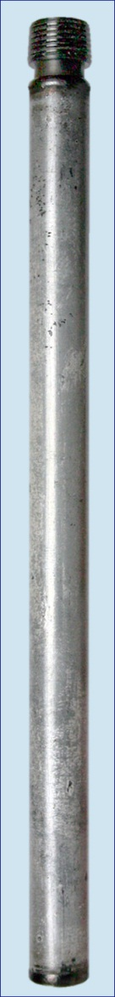
Unirradiated fuel rod simulator
cladding material E110 alloy
cladding length 150 mm
fuel pellets UO₂ VVER-1000 type
Initial pre-oxidation
temperature 1200 °C
environment Ar-O₂ mixture
oxidation time 100 s
oxide thickness 15 - 20 μm
Instrumentation
3 Pt/Rh thermocouples fixed on the cladding outer surface at the elevations of 27, 77 and 127mm
W/Re thermocouple located in the fuel stack central hole at the elevation 75mm

Slide 8
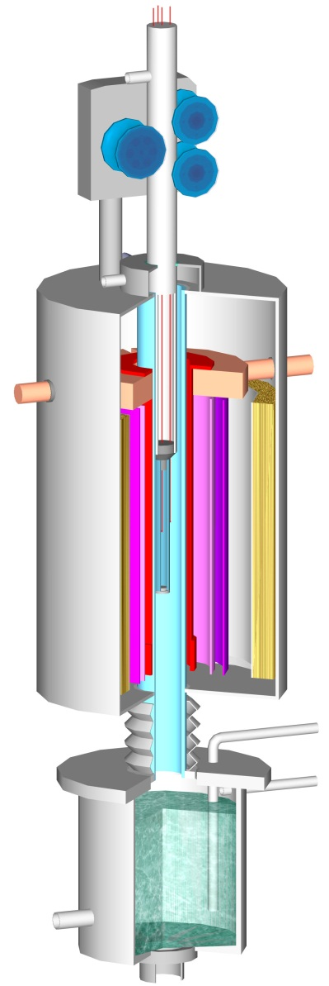
Rig furnace
5
6
Based on the resistive heating
7
4
1 – simulator
2 – operating channel
3 – steam-argon-hydrogen mixture outlet
4 – simulator displacement drive
5 – simulator suspension
6 – thermocouples
7 – argon inlet to the simulator
8 – heater current lead
9 – thermal insulation
10 – molybdenum screens
11 – heater
12 – water sampling pipe
13 – argon (steam-argon mixture) inlet
14 – water inlet
15 – heated quench tank
3
8
2
1
9
10
11
15
12
14
13

Slide 9
Test procedure
steam flow rate 10 mg/(s·sm²)
steam generator is switched off before heating up to quenching
temperature, but some steam is still supplied from the quench tank
simulator is dropped down to quench tank water level at a rate of 245m/s
simulator is immersed into water heated up to 90°C at a rate of 15 mm/s

Slide 10
Test results
Simulator |  | 1 | 2 | 3
Oxidation time at 1400°С, s |  | 800 | 240 | 240
Flooding temperature, °С |  | 1400 | 1600 | 1600
Total hydrogen release, mg |  | 320 | 276 | 270
Hydrogen release at flooding, mg |  | 25 | 35 | 38
ECR, % |  | 32 | 30 | -
Outer ZrO₂ layer thickness, μm | top | 202 | 183 | -
 | center | 201 | 216 | -
 | bottom | 167 | 165 | -
Cladding state |  | Network of non-oxidized through-wall cracks | Single non-oxidized through-wall crack

Slide 11
Temperature and hydrogen concentration at the outlet (Simulator 2)

Slide 12
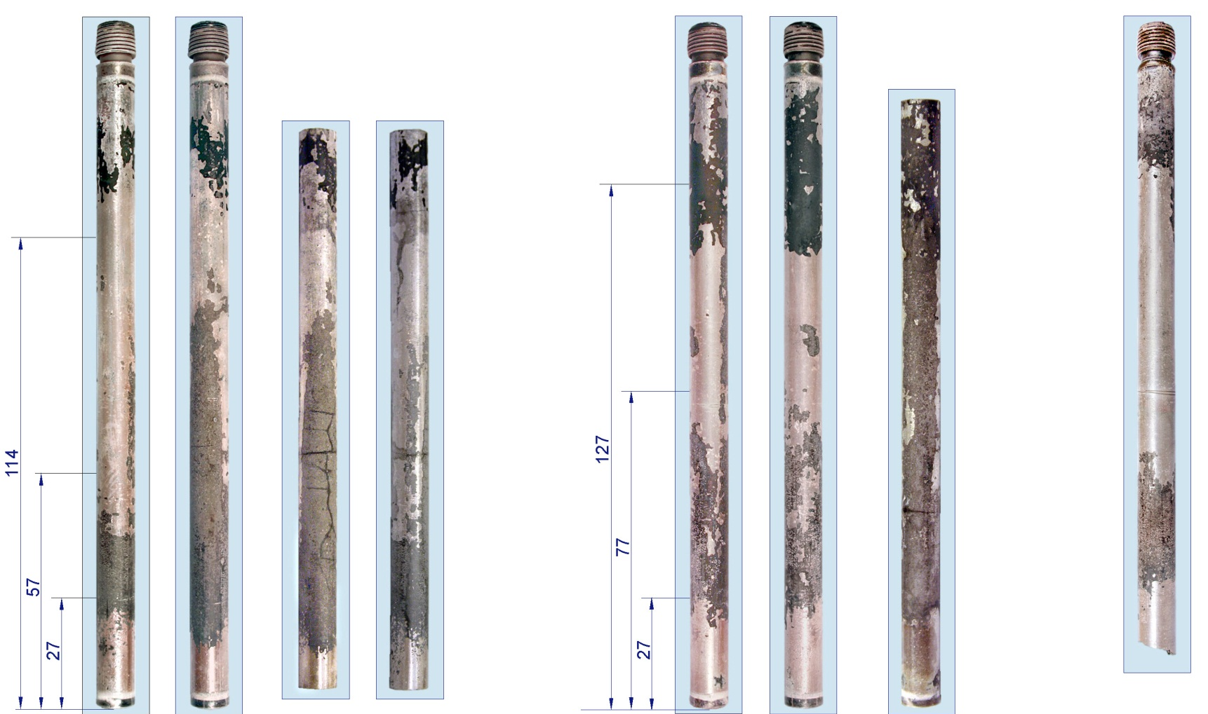
Post-test simulator claddings appearance
crack
visualization
simulator #1
oxidation 800 s, quenching 1400°C
simulator #2 simulator #3
oxidation 240 s, quenching 1600°C

Slide 13
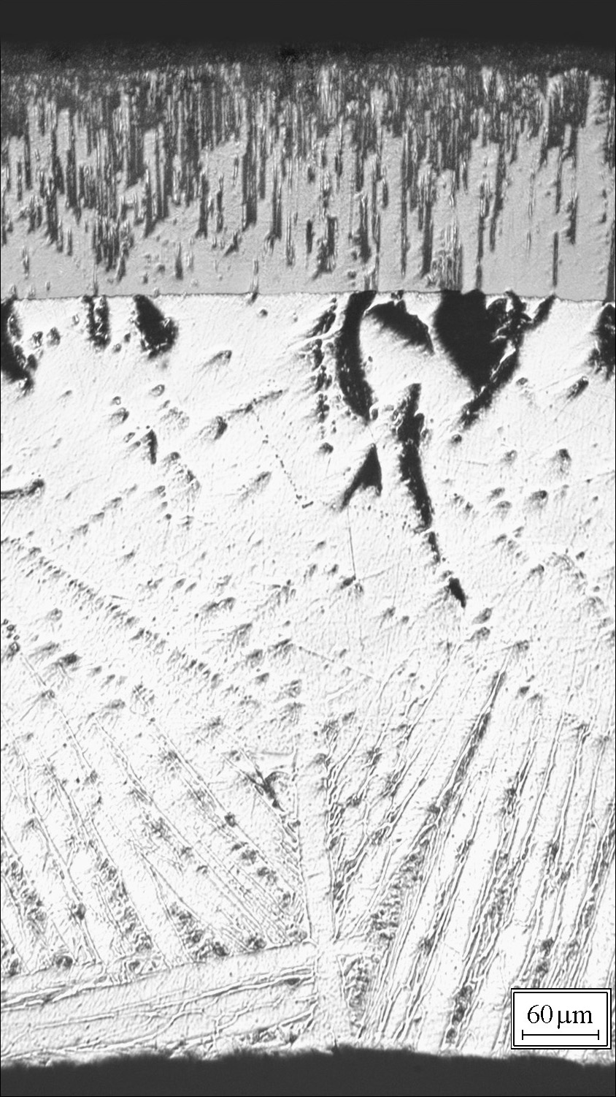
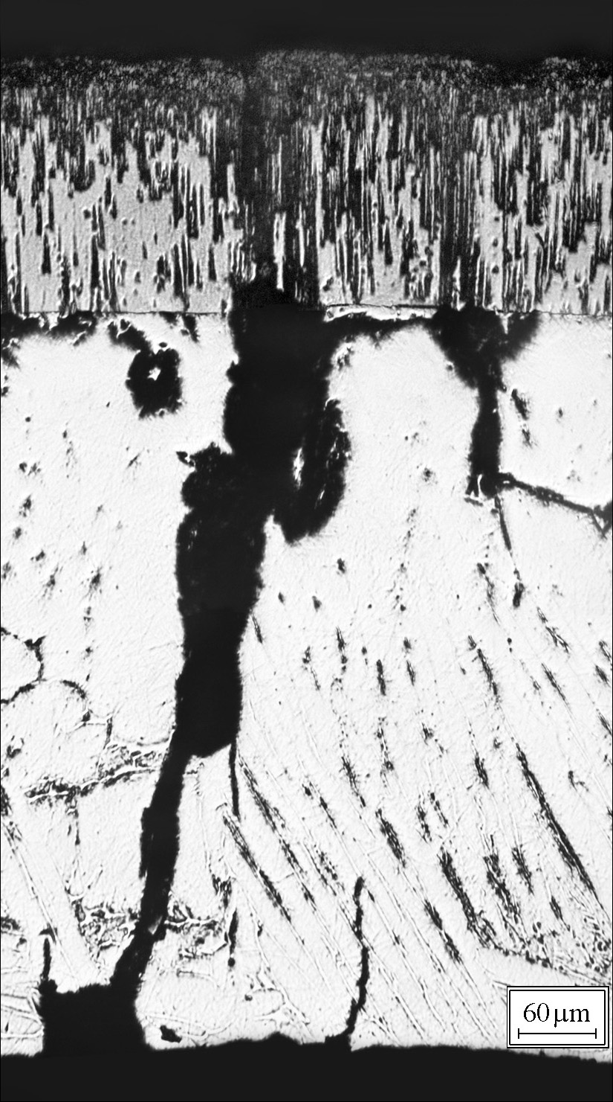
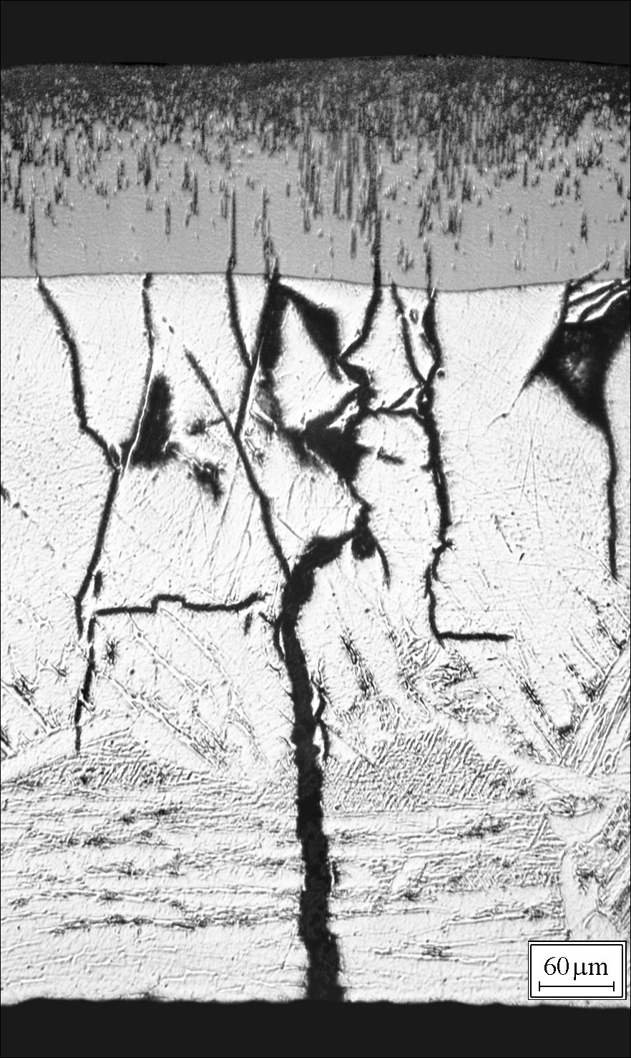
Cladding microstructure Simulator 1
oxidation time 800 s, flooding temperature 1400°С
Elevation 114 mm
Elevation 57 mm
Elevation 27 mm

Slide 14
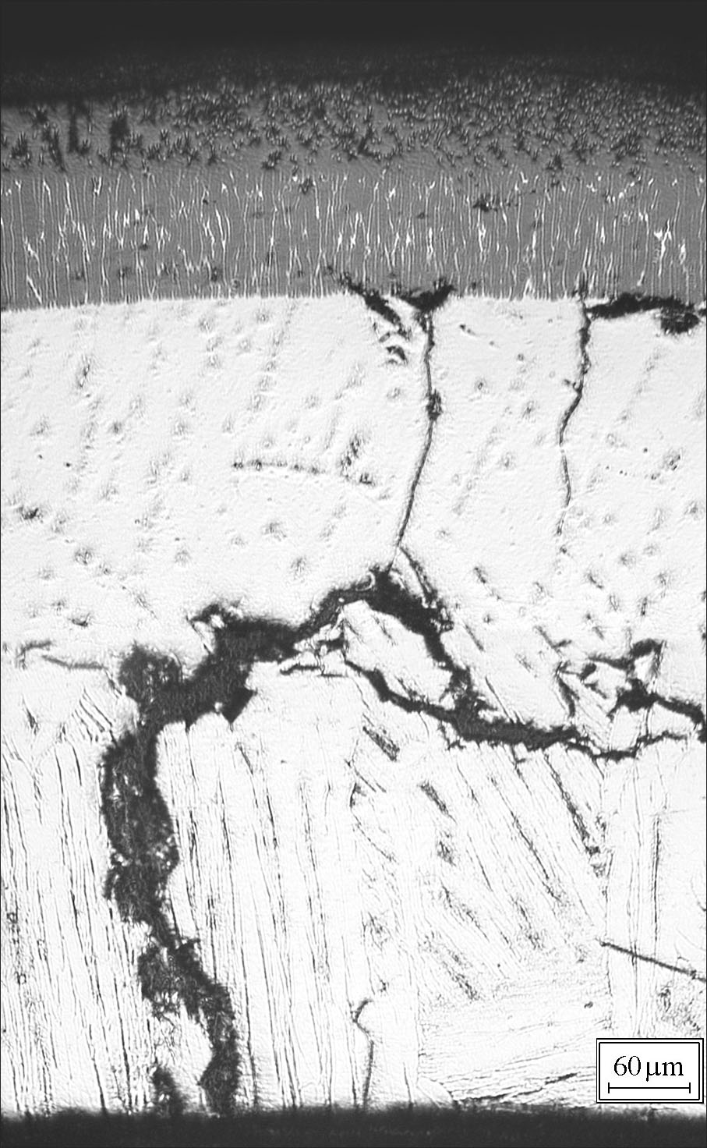
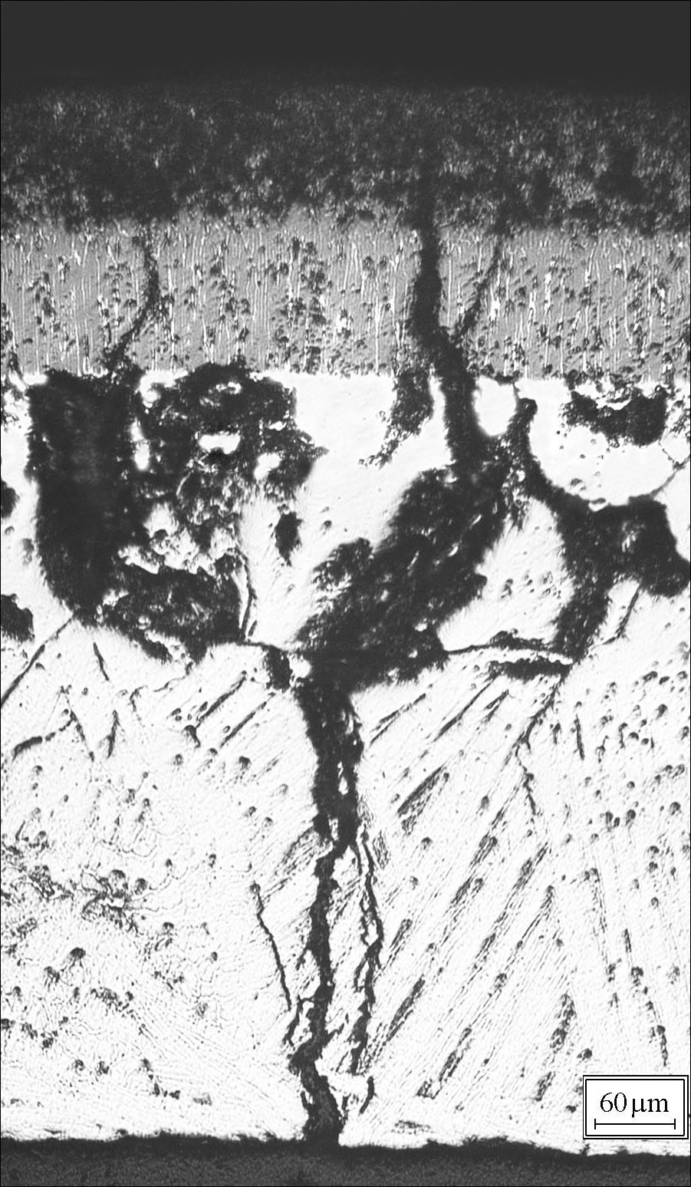
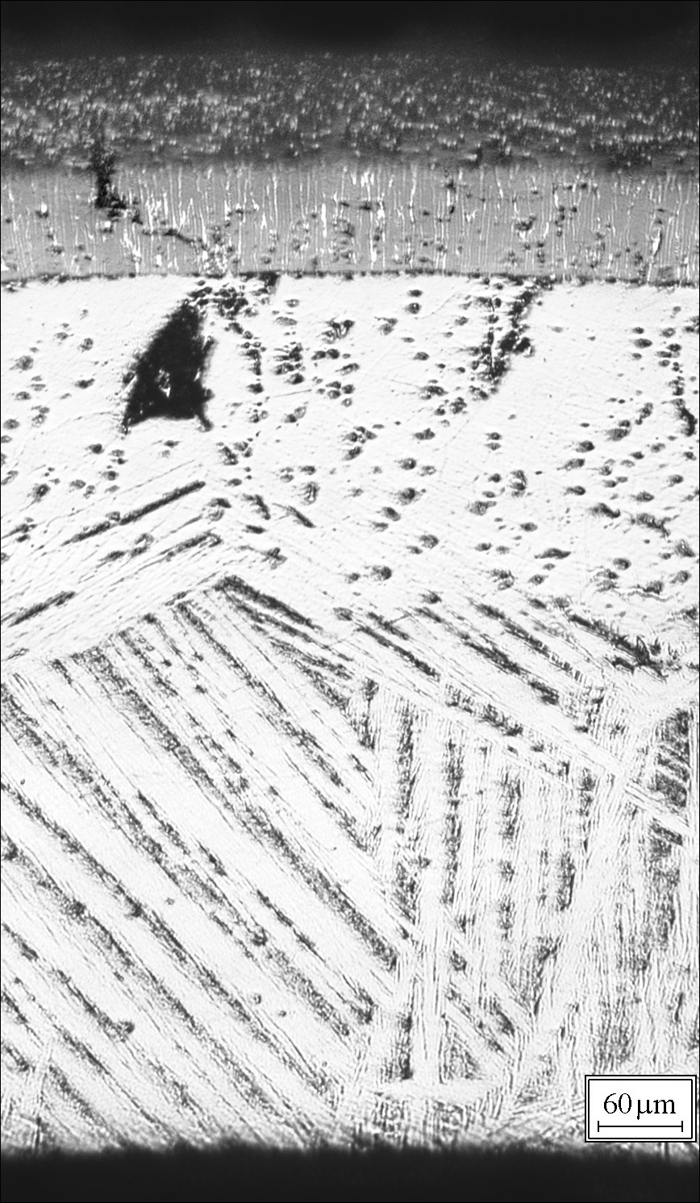
Cladding microstructure Simulator 2
oxidation time 240 s, flooding temperature 1600°С
Elevation 127 mm
Elevation 77 mm
Elevation 27 mm

Slide 15
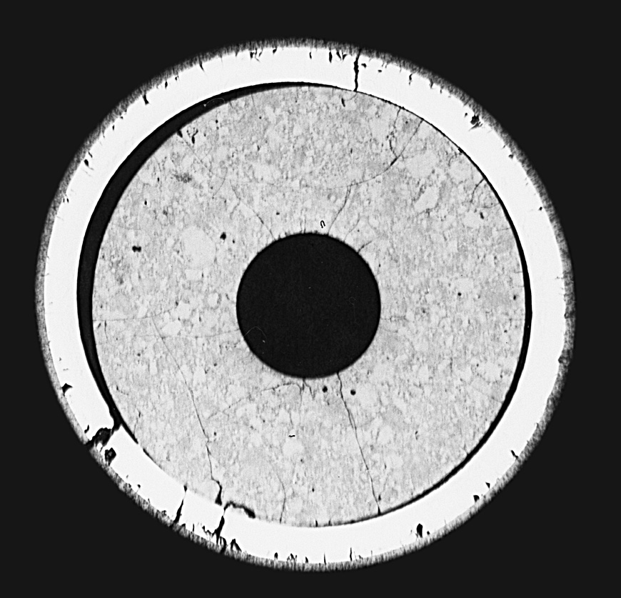
Fuel pellet/cladding interaction
Simulator 1 cross-section (57 mm)
(oxidation 800 s, quenching 1400°C)
Evolution of the fuel rod layers (gap disappearance) during the test calculated by SVECHA/Q code

Slide 16
Single Rod Code
SVECHA/QUENCH
Axial Mesh
Advanced mechanistic SVECHA/QUENCH code was developed by IBRAE in collaboration with FZK for theoretical support and modelling of FZK single rod quench tests
Pellet
Gap
Coolant flow:
H₂O(l), H₂O(g), O₂, Ar, H₂
Cladding

Slide 17
Verification of SVECHA/Q code against RIAR quenching tests
SVECHA mechanistic models for cladding oxidation (PROF) and mechanical deformation (CROX) which describe rapid processes on cool-down of rod in steam/water, by consideration of:
  non-equilibrium oxygen concentrations at inter-layer boundaries
  significant radial temperature gradients in oxide layer
  tetragonal to monoclinic phase transition in oxide layer
  formation and oxidation of through-wall cracks
were modified for simulation of new RIAR tests with segments of VVER fuel rods (UO₂ fuel pellet and Zr-1%Nb cladding), on the base of the RIAR previous separate-effect tests on cladding oxidation and mechanical deformation (presented at 7th and 8th CEG-SAM meetings)
Being applied to description of the new RIAR tests, the S/Q code provides adequate simulation of temperature evolution during quenching, measured at 3 different elevations (currently in 2 tests)

Slide 18
Test #12 (simulator 1)
Time evolution of calculated and measured temperatures at the elevation 127 mm

Slide 19
Test #12 (simulator 1)
Time evolution of calculated and measured temperatures at the elevation 127 mm
Quenching phase

Slide 20
Test #12 (simulator 1)
Time evolution of calculated and measured temperatures at the elevation 77 mm in the centre of the fuel pellet

Slide 21
Test #12 (simulator 1)
Time evolution of calculated and measured temperatures at the elevation 77 mm in the centre of the fuel pellet. Quenching phase

Slide 22
Test #14 (simulator 2)
Time evolution of calculated and measured temperatures at the elevation 127 mm

Slide 23
Test #14 (simulator 2)
Time evolution of calculated and measured temperatures at the elevation 127 mm
Quenching phase

Slide 24
Test #12 (simulator 1)
Comparison of the calculated and measured oxide thickness

Slide 25
Test #14 (simulator 2)
Comparison of the calculated and measured oxide thickness

Slide 26
Hydrogen production
Comparison of the calculated and measured hydrogen amount
Test group | Test, # | Measured, mg | Calculated, mg | Relative error, %
I | 12 | 320 | 256 | 20
 | 14 | 276 | 229 | 17
III | 25 | 216 | 254 | 14,9
 | 26 | 170 | 148 | 14,9
 | 28 | 152 | 159 | 4,4

Slide 27
Conclusions
Test rig is manufactured, installed into the hot cell and prepared for the tests with simulators fabricated from spent VVER fuel rods
Simulator test procedure is worked out
The first experiments with unirradiated VVER fuel rod simulators were performed under the reflooding conditions. Post-test examinations of tested specimens were carried out
The single-rod code SVECHA/QUENCH designed for modelling FZK quenching tests was adapted to simulation of the new RIAR tests
Two RIAR tests #12 and #14 were simulated by SVECHA code
Experimentally measured temperature was reproduced by the code rather accurately
Oxide thickness was somewhat overestimated by the calculations
The amount of produced hydrogen was somewhat underestimated
Further verification work is under way
Preliminary conclusion about similar cladding behaviour in FZK and RIAR quenching tests is supported by S/Q calculations

