Slide 1
Progress Report on the ISTC project #3592
“Investigation of Corium Melt Interaction with NPP Reactor Vessel Steel”
(METCOR-P)
A.P. Alexandrov Research Institute of Technology (Russia)
Presented by S. Bechta
16th CEG-SAM meeting
Moscow, Russia
September 08-09, 2009

Slide 2
Contents
General information
Objectives of METCOR-P project
Experimental matrix for METCOR-P project
Interaction of molten corium with European vessel steel in oxidizing atmosphere – Test MCP- 4
- Objectives
- Installation
- Procedure
- Results
- Concluding remarks
Planning
Publications

Slide 3
METCOR-P project general information
Project participants and coordination
Collaborators
FZK, Germany
FORTUM, Finland
JRC ITU,
EU
CEA,
France
AREVA NP,
Germany
Coordinator
ISTC, Moscow
Steering committee
Operation Agent: A.P. Alexandrov RIT, Russia
SPb Electrotechnical State University, Russia

Slide 4
Objectives of METCOR-P project
Qualification and quantification of physicochemical phenomena of corium melt interaction with reactor vessel steel with particular interest to:
Interaction characteristics at the vertically positioned interface
Peculiarities of interaction with European vessel steel
Corium melt oxidation transients

Slide 5
Experimental matrix for METCOR-P project
*) replaced by MCP-2 test with UO_{2+x}– ZrO₂ corium in air and horizontal position of interface
**) was performed in air (instead of steam) and regimes with UO_{2+x} - ZrO₂ - FeO_{y} corium were added

Slide 6
МСР - 4 Objectives
Comparison of corrosion rates for the European and Russian vessel steels in oxidizing atmosphere

Slide 7
Composition of 15Kh2NMFA and 20MnMoNi5-5 steels

Slide 8
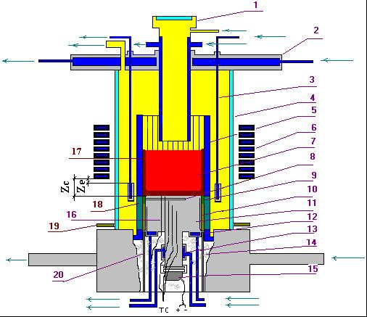
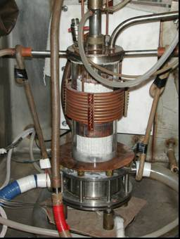
RASPLAV-3 Installation
Furnace schematics
1 –pyrometer shaft; 2 –cover; 3 –electromagnetic screen; 4 – quartz tube; 5 – crucible section; 6 – inductor; 7 –melt; 8 – acoustic defect; 9 – molten ZrO₂; 10 –ZrO₂ powder thermal insulation; 11 – vessel steel specimen; 12 –top calorimeter of the specimen;
13 – bottom calorimeter of the specimen; 14 – kaolin wool insulation; 15 –ultrasonic sensor; 16 –thermocouples; 17 – crust, 18 – electromagnetic screen; 19 – uncooled electromagnetic screen; 20 – cylindrical support of the specimen

Slide 9
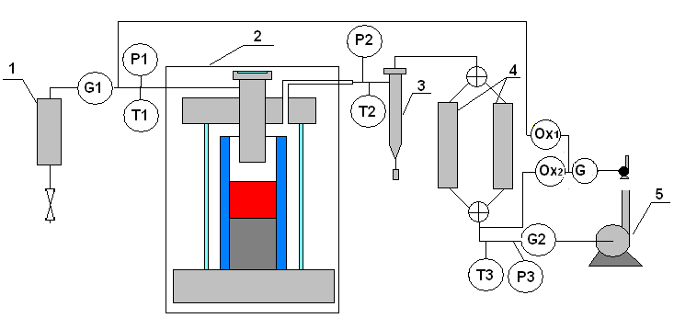
Air supply and evacuation diagram
1 - silica gel air drier; 2 - furnace; 3 – cyclone; 4 – Large Area Filters (LAF); 5 - vacuum pump; P1-P3 – pressure sensors; G1,2 – flow meters ; Т1-Т3 – thermocouples; Ox- electrochemical oxygen sensor

Slide 10
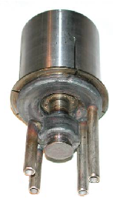
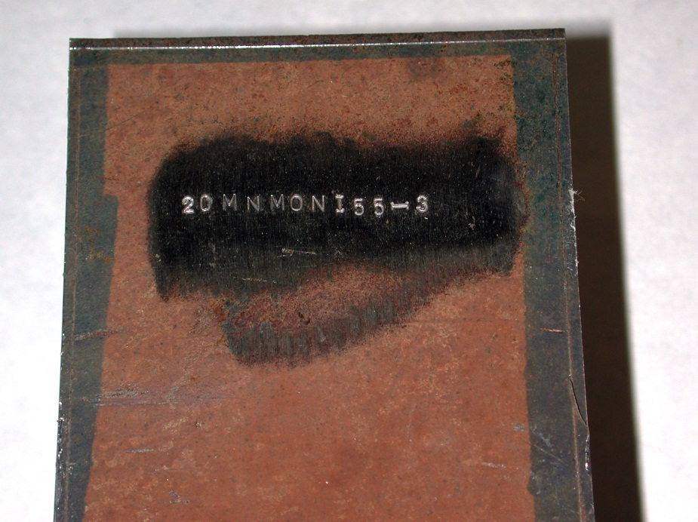
Vessel Steel Specimen
Blank
Upper calorimeter
Lower calorimeter

Slide 11
Location of K-type thermocouples in the specimen

Slide 12
Experimental procedure
UO_{2+x}-ZrO₂ corium
UO_{2+x}-ZrO₂-FeO_{y} corium

Slide 13
Thermocouple readings
1, 2, 3 – UO_{2+x}- ZrO₂ corium
4, 5, 6 – UO_{2+x}- ZrO₂- FeO_{y} corium

Slide 14
Corrosion depth measurements
h, mm
1 2 3 4 5 6
t, s
US measurement data
The maximum corrosion depth was ∼ 6 mm (post test cross section is not ready yet)
1, 2, 3 – UO_{2+x} - ZrO₂
4, 5, 6 – UO_{2+x} - ZrO₂ - FeO_{y}

Slide 15
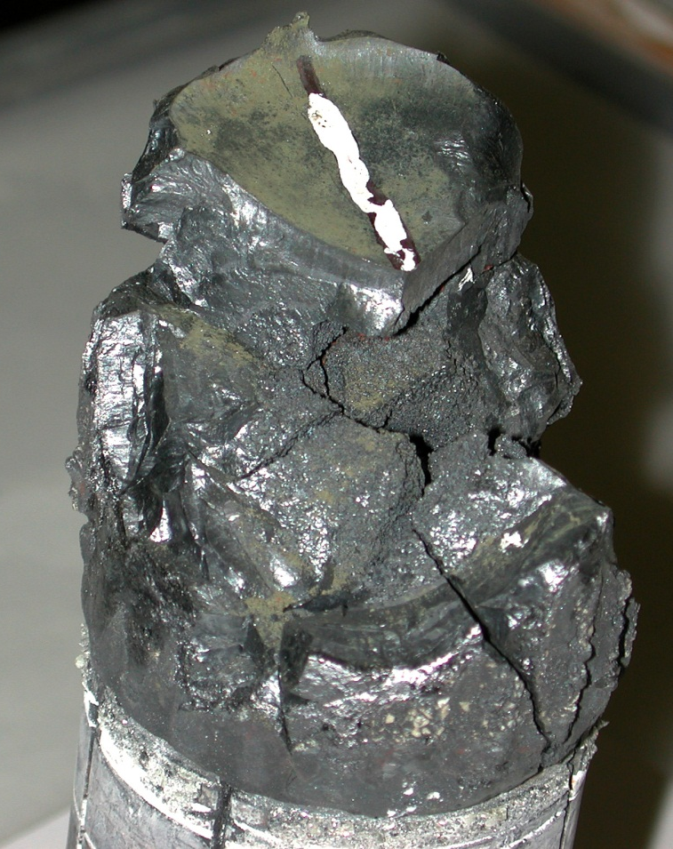
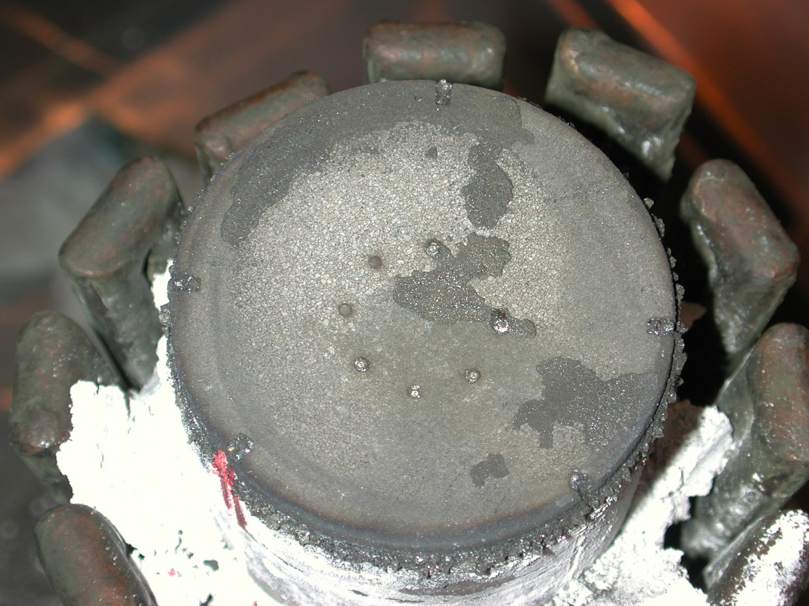
Posttest analysis
Ingot reconstruction
Steel specimen surface after the test

Slide 16
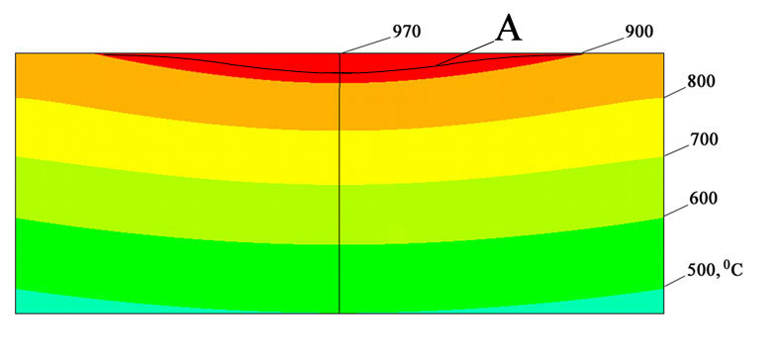
Posttest analysis (2)
Numeric modeling of specimen temperature conditions, regime No.4
Temperature distribution along the specimen height
Temperature field in the specimen upper part
Т, °С
А – corrosion front position
h, mm
ANSYS code was applied

Slide 17
Posttest analysis (3)
Measured corrosion rate (W) versus calculated interface temperature (T_{int})
and corium/steel heat flux (q)
Note: *- Measured and calculated data for these regimes will be specified

Slide 18
Comparison of corrosion rates for the European and Russian vessel steels
 - 20MnMoNi5-5, UO_{2+x} - ZrO₂
O - 20MnMoNi5-5, UO_{2+x} - ZrO₂ - FeO_{y}
Error bars for new data were not calculated yet
Corrosion rates of European and Russian steel agree within experimental error
Insufficient data of European steel corrosion for generalization
VVER steel correlations can be used for estimations
15Kh2NMFA :
O
O
O

Slide 19
Conclusion remarks for MCP- 4 test
Posttest analysis is underway
VVER steel correlations are applicable for Europe steel corrosion estimations
Similarly to the VVER steel, intensification of 20MnMoNi5-5 steel corrosion occurs at the interaction with the fusible UO_{2+x}-ZrO₂-FeO_{y} corium if the interface temperature exceeds some limiting value

Slide 20
Planning
4 more tests are to be performed according to the Experimental Matrix of the Project
Participants’ proposals concerning the remaining tests concretization and possible corrections to the Experimental Matrix were discussed at the last, 3rd Meeting with collaborators
This discussion are continued by correspondence

Slide 21
Reporting
According to Export Control decision, METCOR reports will be sent to JRC ITU only

Slide 22
METCOR-P publications
Bechta S.V., Granovsky V.S., Khabensky V.B., Krushinov E.V., Vitol S.A., Sulatsky A.A., Gusarov V.V., Almjashev V.I., Lopukh D.B., Bottomley D., Fischer M., Piluso P., Miassoedov A., Tromm W., Altstadt E., Fichot F., Kymalainen O. Interaction between Molten Corium UO_{2+x}-ZrO₂-FeO_{y} and VVER Vessel Steel // Proceeding of ICAPP’08, Anaheim, CA USA, June 8-12, 2008, Paper 8052.
Bechta S.V., Granovsky V.S., Khabensky V.B., Krushinov E.V., Vitol S.A., Sulatsky A.A., Gusarov V.V., Almjashev V.I., Mezentseva L.P., Krushinov E.V., Kotova S.Yu., Kosarevsky R.A., Barrachin M., Bottomley D., Fischer M., Fichot F. Corium Phase Equilibria from MASCA, METCOR and CORPHAD Results // Nucl. Eng. and Design, 238, p. 2761-2771 (2008).
Bechta S.V., Granovsky V.S., Khabensky V.B., Krushinov E.V., Vitol S.A., Sulatsky A.A., Gusarov V.V., Almjashev V.I., Lopukh D.B., Bottomley D., Fischer M., Piluso P., Miassoedov A., Tromm W., Altstadt E., Fichot F., Kymalainen O. VVER Vessel Steel Corrosion at Interaction with Molten Corium in Oxidizing Atmosphere // Nucl. Eng. and Design, 239 (2009),
p. 1103-1112.

Slide 23
METCOR-P publications (2)
4. Bechta S.V., Granovsky V.S., Khabensky V.B. et.al. VVER Steel Corrosion during In-Vessel Retention of Corium Melt // Proceeding of the 3rd European Review Meeting on Severe Accident Research (ERMSAR 2008), Paper 2.7, Nesseber, Bulgaria, September 23-25 (2008).
5. Bechta S.V., Granovsky V.S., Khabensky V.B. et.al. Interaction between Molten Corium UO_{2+x}-ZrO₂-FeO_{y} and VVER Vessel Steel // J. Nucl. Technology (in press), Manuscript Number: 08110 (2008).

