Slide 1
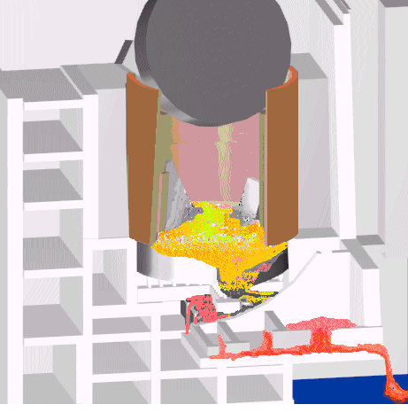
Development of the Models for Nuclear Fuel Behavior during Active Phase of the Chernobyl Accident
(CHESS-1)
FINAL REPORT

Slide 2
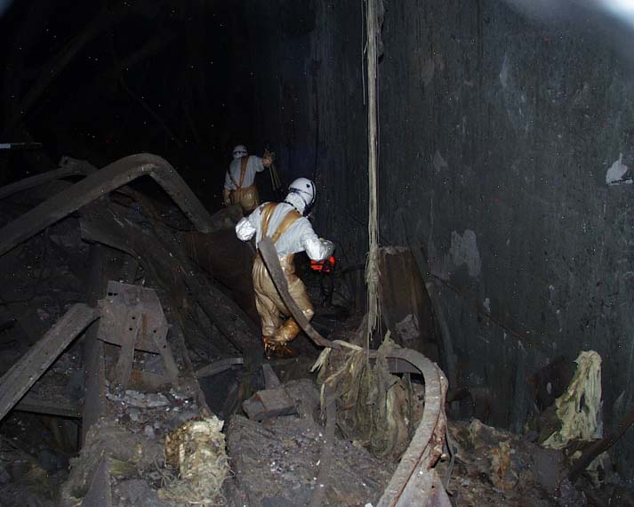
    The project objectives are: -systematization of a huge body of data on lava-like fuel-containing
    materials collected over 20 years of investigations
    at the “Shelter”;
    -generation of a database on their basis;
    and -development of models of the processes
    of lava generation and spreading
    during early post-accident days.

Slide 3
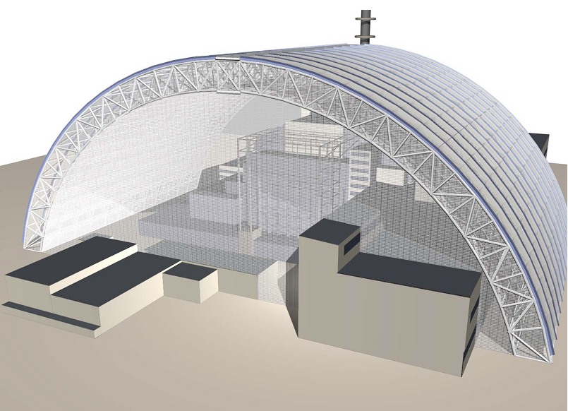
The results of the Project may (and should) be used at subsequent phases of the “Shelter" transformation into an environmentally safe facility

Slide 4
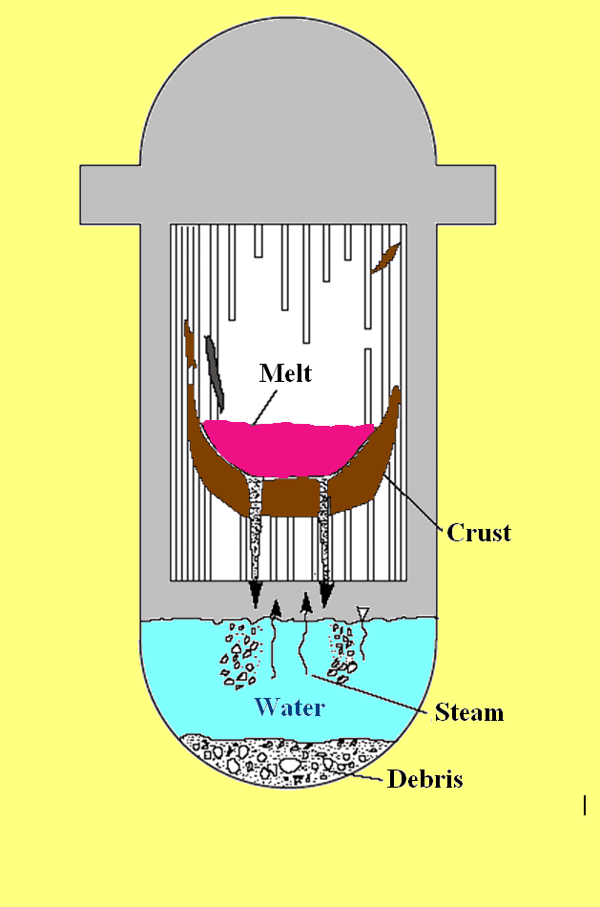
The results of the Project may be of interest while predicting the behavior of corium in localization systems (core-catchers) being developed for some reactors

Slide 5
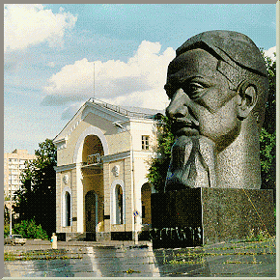
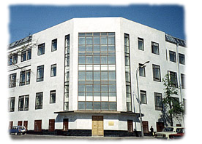
Terms of the Project implementation–
01.02.2005 - 01.08.2007
    Participants of the Project - “Kurchatov Institute” and “Nuclear Safety Institute” of RAS

Slide 6
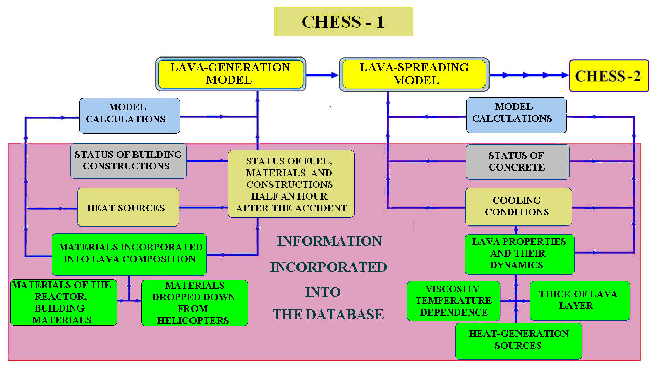
Sequence of the Project Implementation
and Main Results Achieved

Slide 7
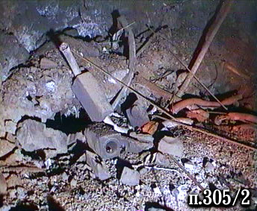
Database Generation
The database generation required verification, analysis and structuring of a huge body of experimental material achieved during investigations at the “Shelter” in 1986 – 2005.
A team of RRC KI’s specialists performed such a work in
2005 – 2006.
During the database development a variety of data taken from publications, presentation, unpublished reports, construction drawings, etc. were verified and analyzed.
Photo- and video-materials were studied as well.
The integral amount of information records used in the database exceeds 6000.

Slide 8
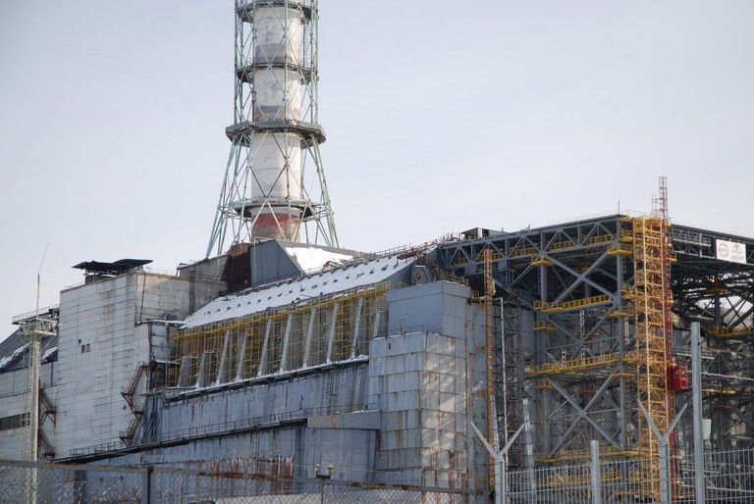
The importance of the database generated goes beyond the scope of the Project.
It may be used at subsequent “Shelter”-transformation stages.

Slide 9
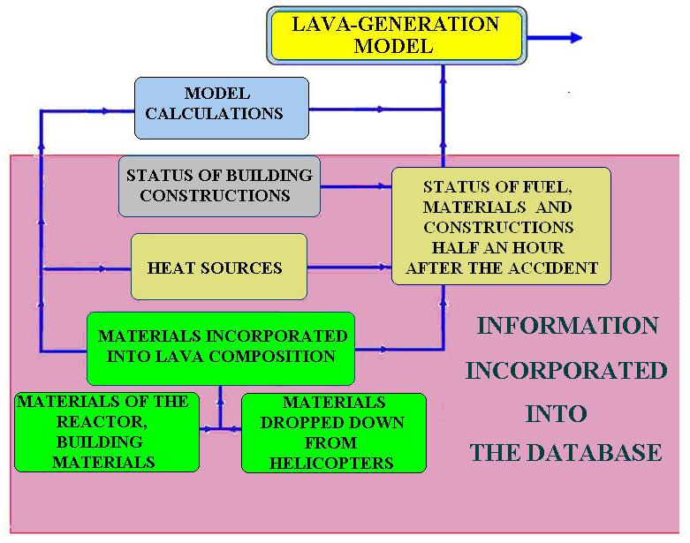
LAVA GENERATION MODEL
Information included into the database
The time 30 minutes after the explosion was taken and the relevant reconstruction of the data was made.
The processes of lava generation were next simulated.

Slide 10
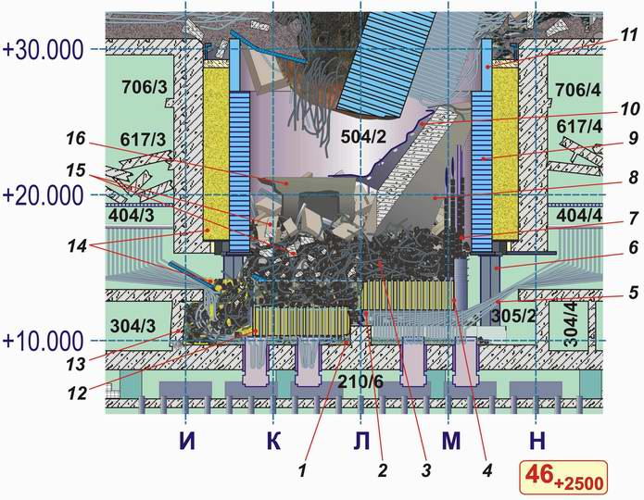
LAVA GENERATION MODEL
LAYOUT OF CONSTRUCTIONS
Time: 30 minutes after the explosion
1 - Serpentinite of the “ОR” component and the inter-compensatory gap
2 - Crushed “С” component (“Cross”)
3 - Fuel, fuel assemblies, fuel elements, process channels, graphite blocks, fragmented concrete
4 - ¾ ОR
5 - BWC tubes
6 - Additional support
7 - Reflector (channels and graphite blocks)
8 - Reinforced-concrete plate (fragments of wall of separator box)
9 - “L” tank
10 - Heat shielding lining of separator box’s wall
11 - “D” tank
12 - ¼ ОR
13 - Damaged wall
14 - Vault’s filling-up-origin sand
15 - Debris of reinforced-concrete constructions
16 - Fragment of reinforced-concrete construction

Slide 11
LAVA GENERATION MODEL
Materials incorporated into the lava
Material | Amount in rooms #504/2* and #305/2, t | Incorporated into lava, t
Fuel (U) | 120 | 90
Steel | 1300** | < 20***
Serpentinite mixture | 580 | 160
Concrete of the under-reactor plate | - | 130
Concrete of building constructions dropped into the vault from upper level marks | 950 | 480
Sand of the vault’s filling material | 300 | 280
Zirconium | ? | 45
Graphite | 750 | ?****
1200 t
* within the reactor space boundaries;
** excepting materials of “С” component and non-melted communications of the reactor bottom;
*** 330 t were melt and spread over the under-reactor rooms;
**** an insignificant admixture was discovered.

Slide 12
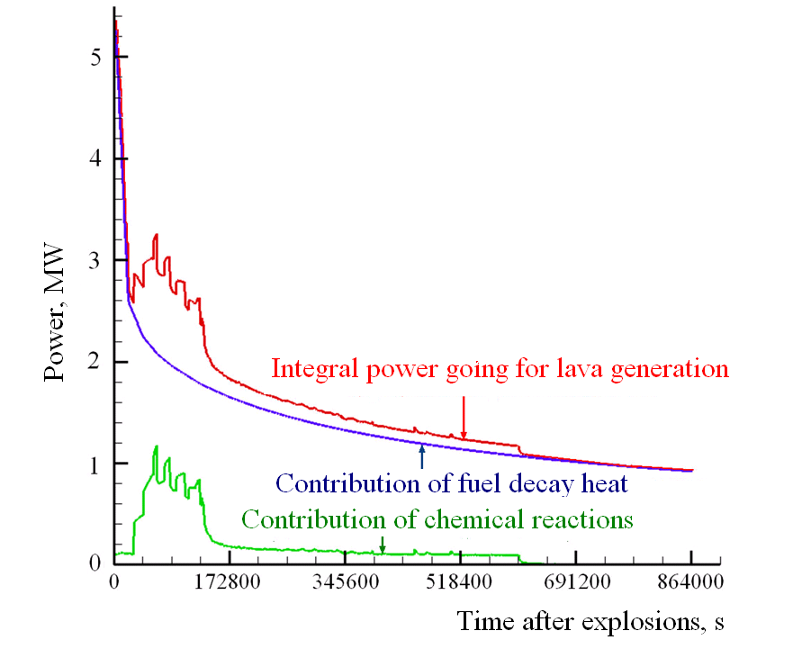
LAVA GENERATION MODEL
HEAT SOURCES

Slide 13
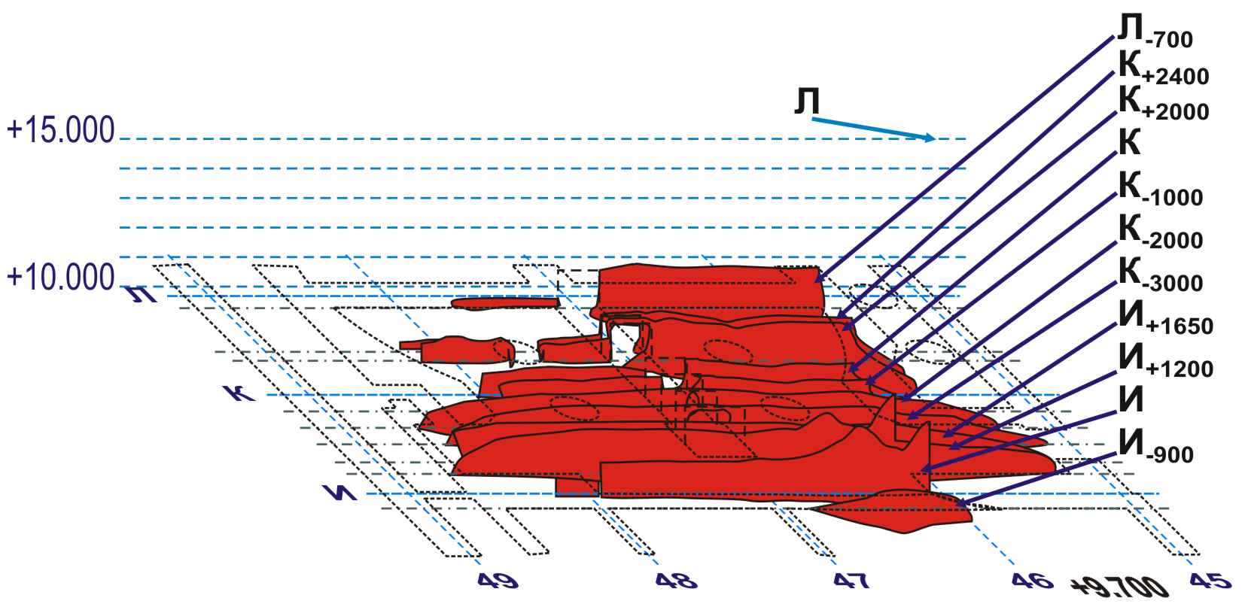
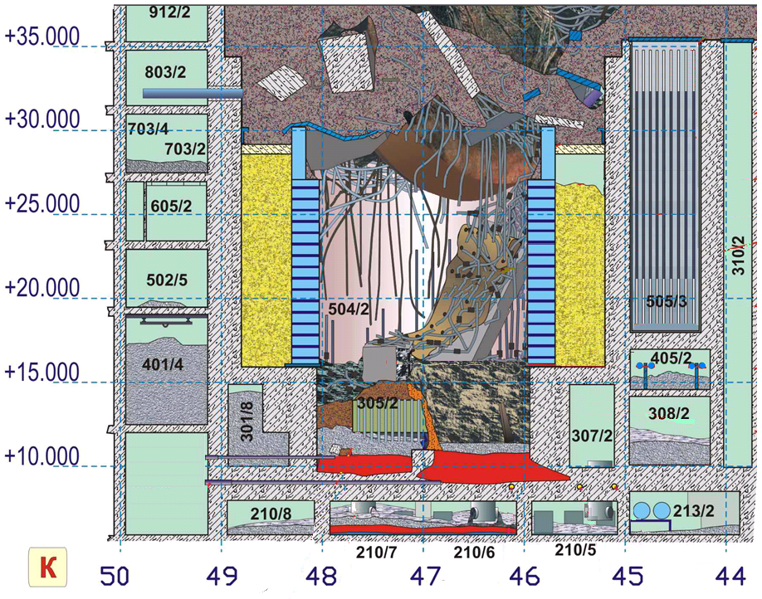
LAVA GENERATION MODEL (RESULTS)
The model has allowed establishing the layout of lava in under-reactor rooms.
Several Unit 4’s sections were used to demonstrate the layout of lava within under-reactor rooms
A fragment of Unit 4. Section through row ‘K’

Slide 14
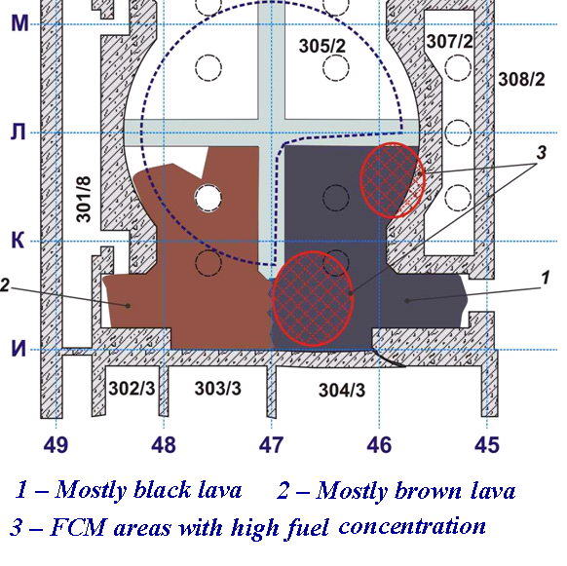
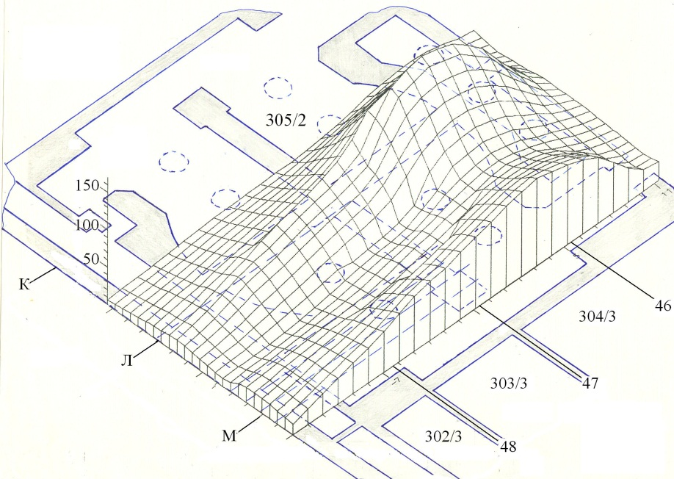
LAVA GENERATION MODEL (RESULTS)
The information collected and analyzed during implementation of the Project indicates possible presence in the under-reactor room of accumulations, the uranium content of which exceeds by far that of “standard” lava.
Temperature field in reactor plate according to the results of investigations (1988‑1989)

Slide 15
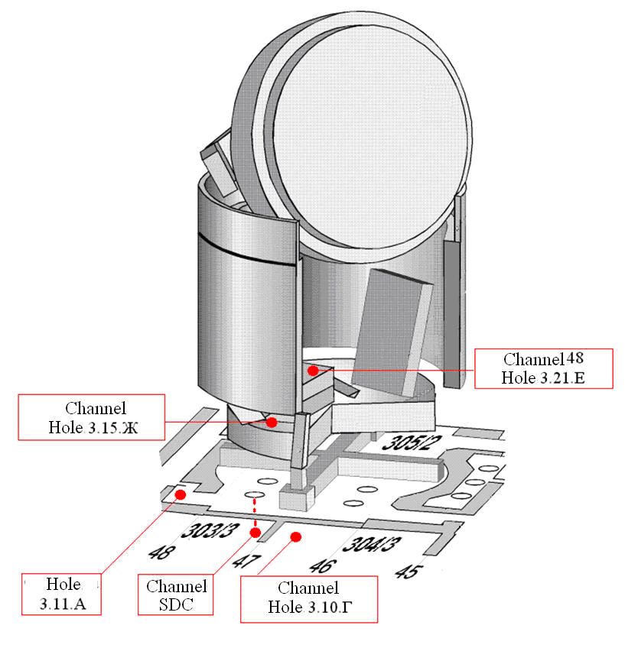
Layout of Neutron Channels of “Finish” System,
Summer 1990
The very first hypothesis of such accumulations was formulated while making an attempt at explaining the so-called “anomalous neutron event” of 1990.
The event consisted in a rather short-run (∼ 1.5 days) but a considerable
(∼ 60 times) increase in the counting rate of neutron sensor of “Finish” system installed in Room #304/3 close to the breach in the wall of Room #305/2
(Channel 50 Hole 3.10.Г).

Slide 16
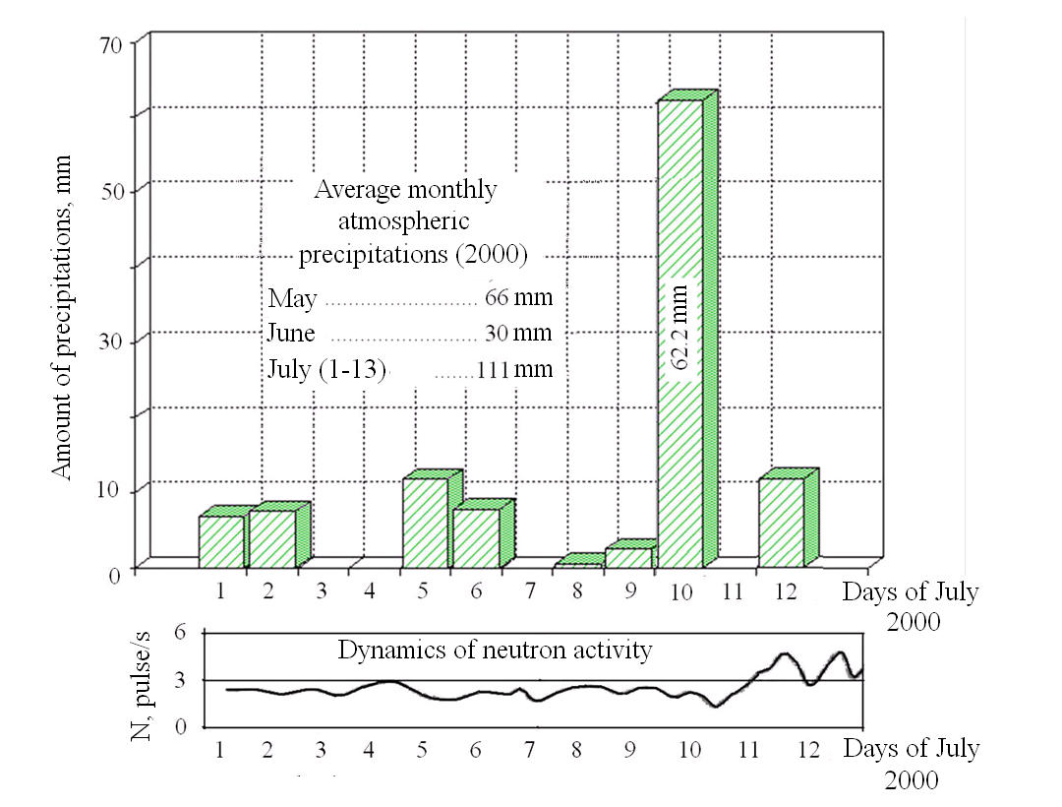
The results of survey of neutron fluxes during periods of abnormally high atmospheric precipitations count in favor of the “hidden-accumulation” hypothesis.
Atmospheric precipitations in July 2000 in the Chernobyl NPP area and the dynamics of neutron activity in Room #305/2 near the breach.
The water level in FCM accumulation near the breach area varies depending on the inflow/outflow rate that determines oscillations in the neutron flux density.
While applying the conservative approach, such oscillations may be attributed to Кeff variations.

Slide 17
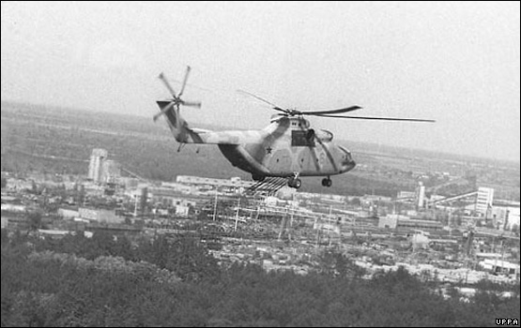
LAVA GENERATION MODEL (RESULTS)
Evaluation of the efficiency of countermeasures undertaken during early post-accident days to localize the Chernobyl NPP accident necessitates understanding of the processes that went on within the damaged power unit at that time.
In our opinion, based on the database developed and the results of simulation one may advance on such a way.

Slide 18
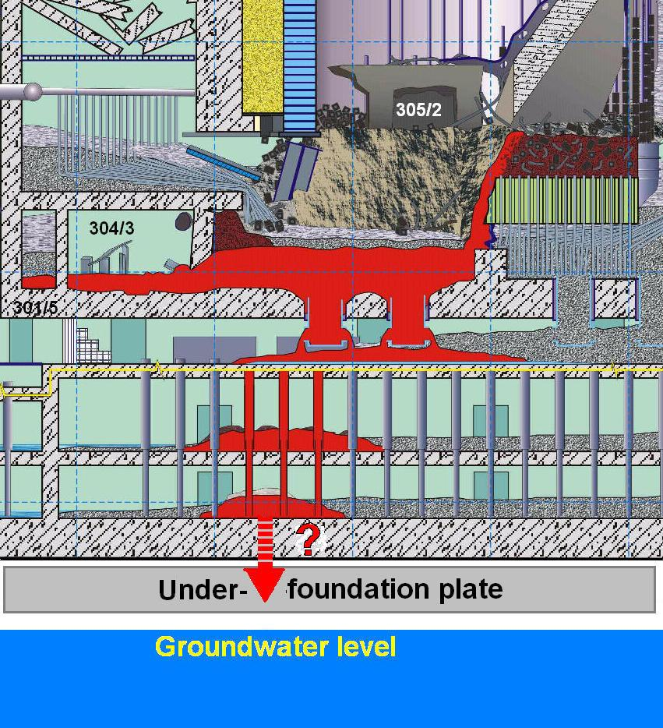
Example of a Countermeasure against the “China Syndrome”
The “China Syndrome” (name of the same-title feature film) implies destruction of concrete slabs by hot fuel and its penetration into groundwater.
After a considerable drop in radioactive release it might have seemed that the main hazard was due to the “China Syndrome”.
A special water-cooled under-foundation plate was built.
It represented a square of ∼ 30×30 m² with a thick of ∼ 2.5 m. In the central part of the plate water-cooling pipes were laid.
The work conditions, including radiation conditions, were extremely hard.

Slide 19
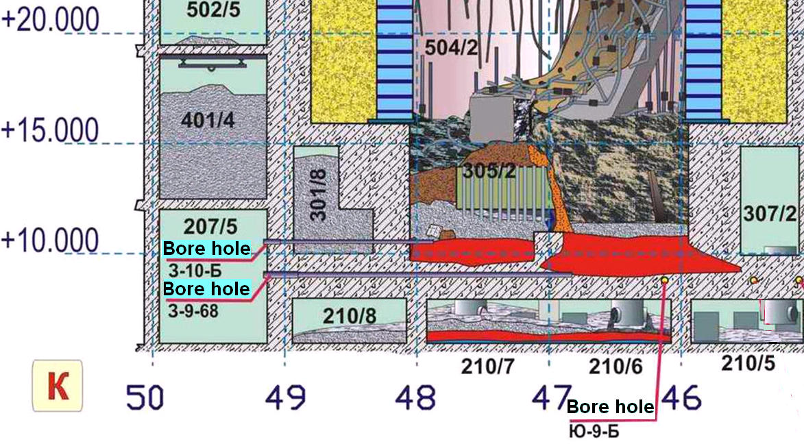
The KI ‑IBRAE model enables a detailed tracing of the processes of melting and gradual descending of materials heated up to a high temperature along with burning by them of concrete floors - i.e. the “China Syndrome” development process.
According to the model, the hazard must have only existed for the concrete floor slab between Room #305/2 and the SDC.
Such a hazard did partly realize indeed.

Slide 20
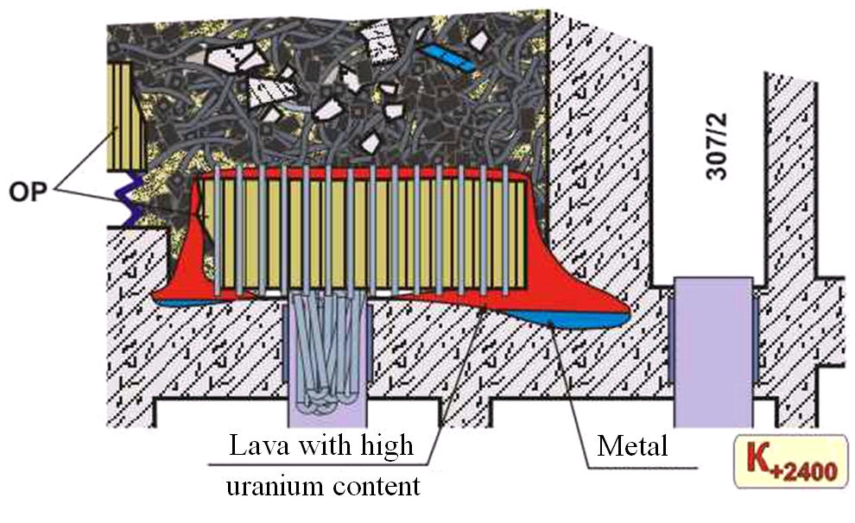
Generation of Horizontal Burnings-through
From the viewpoint of the present-day knowledge and in accordance with the KI‑IBRAE model, complex measures on prevention of Unit 4 slab fusion and penetration of fuel into groundwater were excessive.

Slide 21
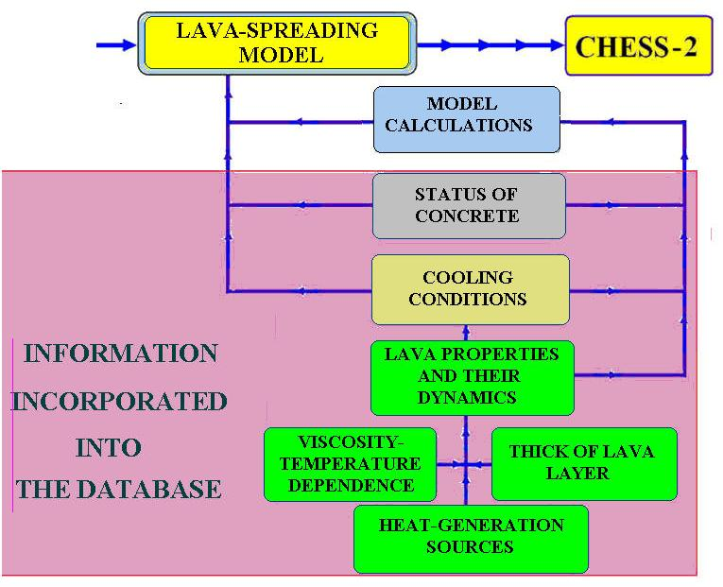
LAVA SPREADING MODEL
Information Included into the Database
CHESS - 1

Slide 22
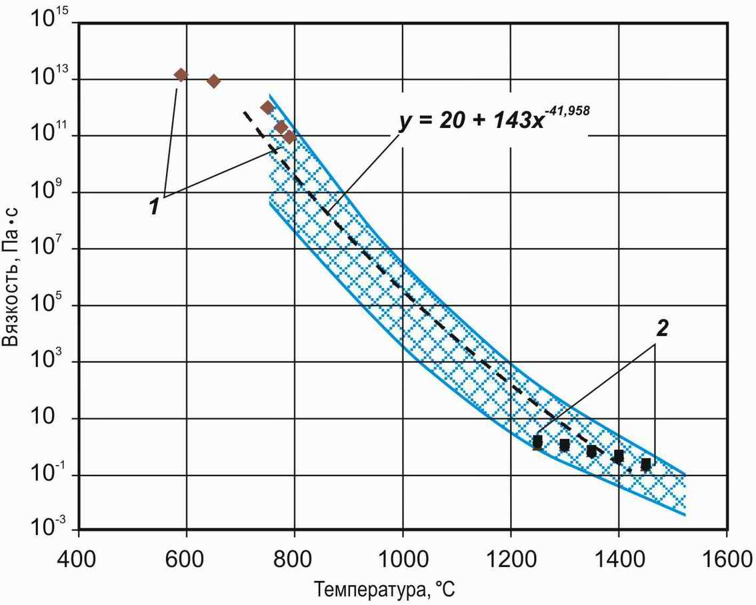
LAVA SPREADING MODEL
VISCOCITY
V, Pa * s
1 – experimental data for brown lavas
2 – results of extrapolation (natural lavas)
T, ⁰C

Slide 23
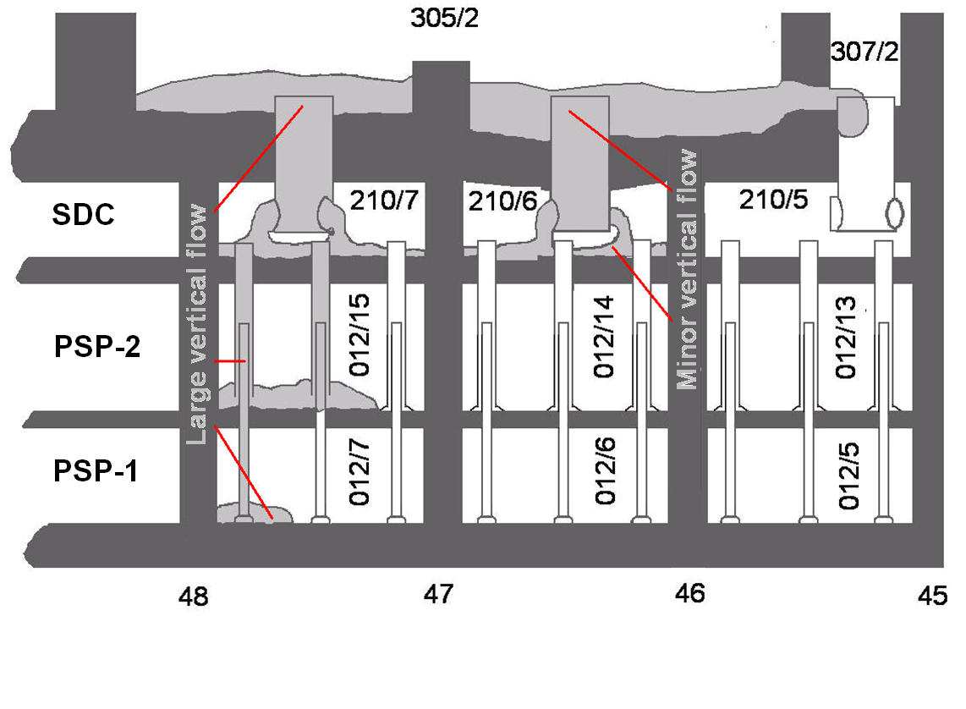
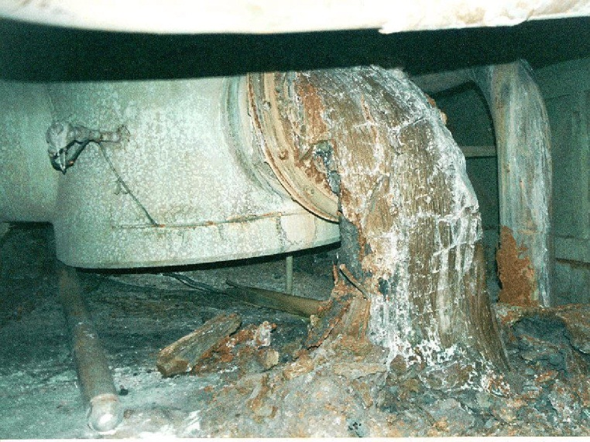
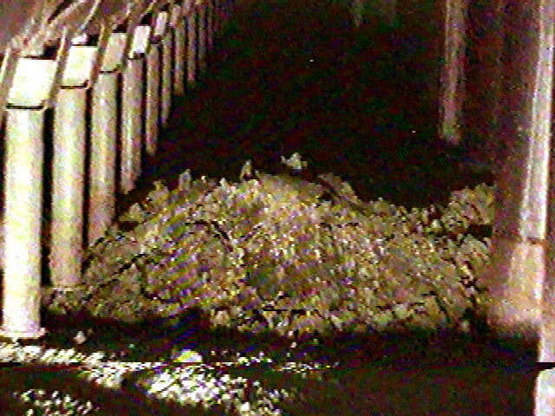
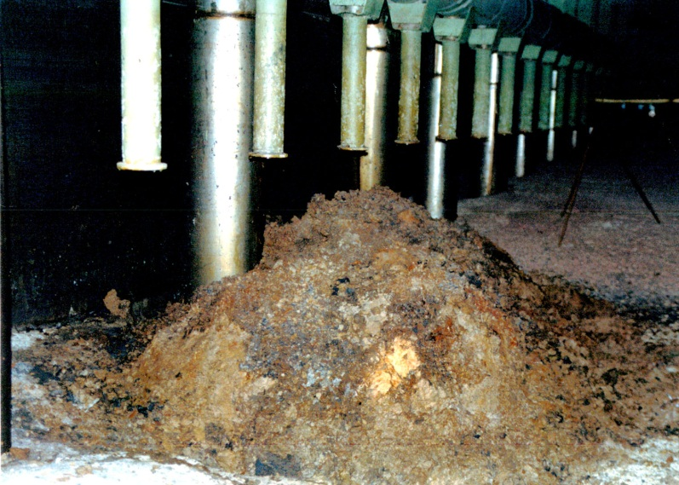
LAVA SPREADING MODEL
VERTICAL FLOWS

Slide 24
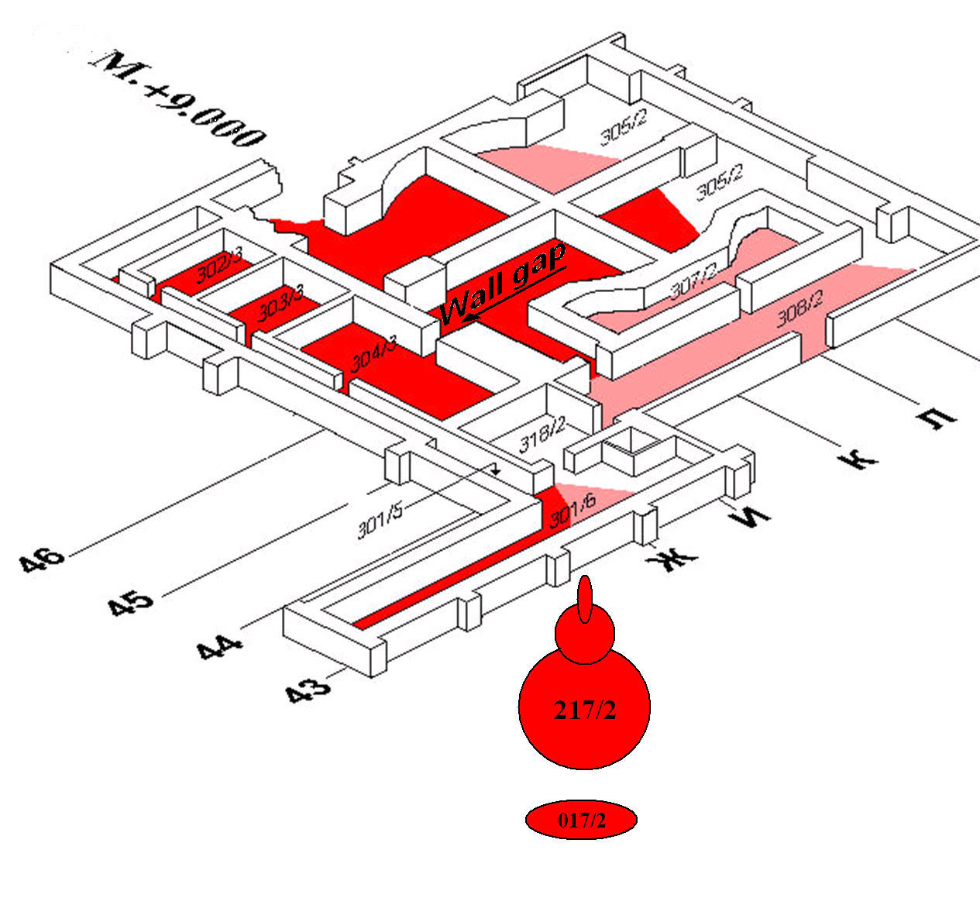
LAVA SPREADING MODEL
HORIZONTAL LAVA FLOW

Slide 25
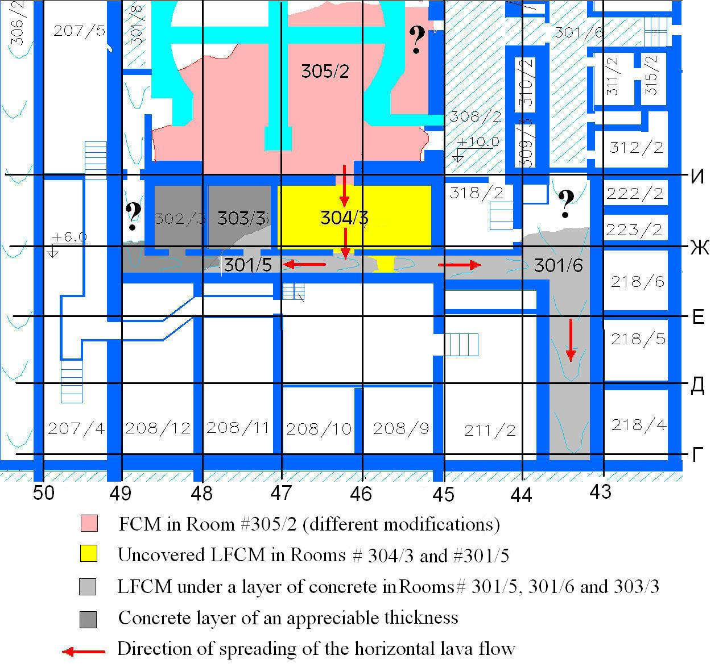
HORIZONTAL LAVA FLOW

Slide 26
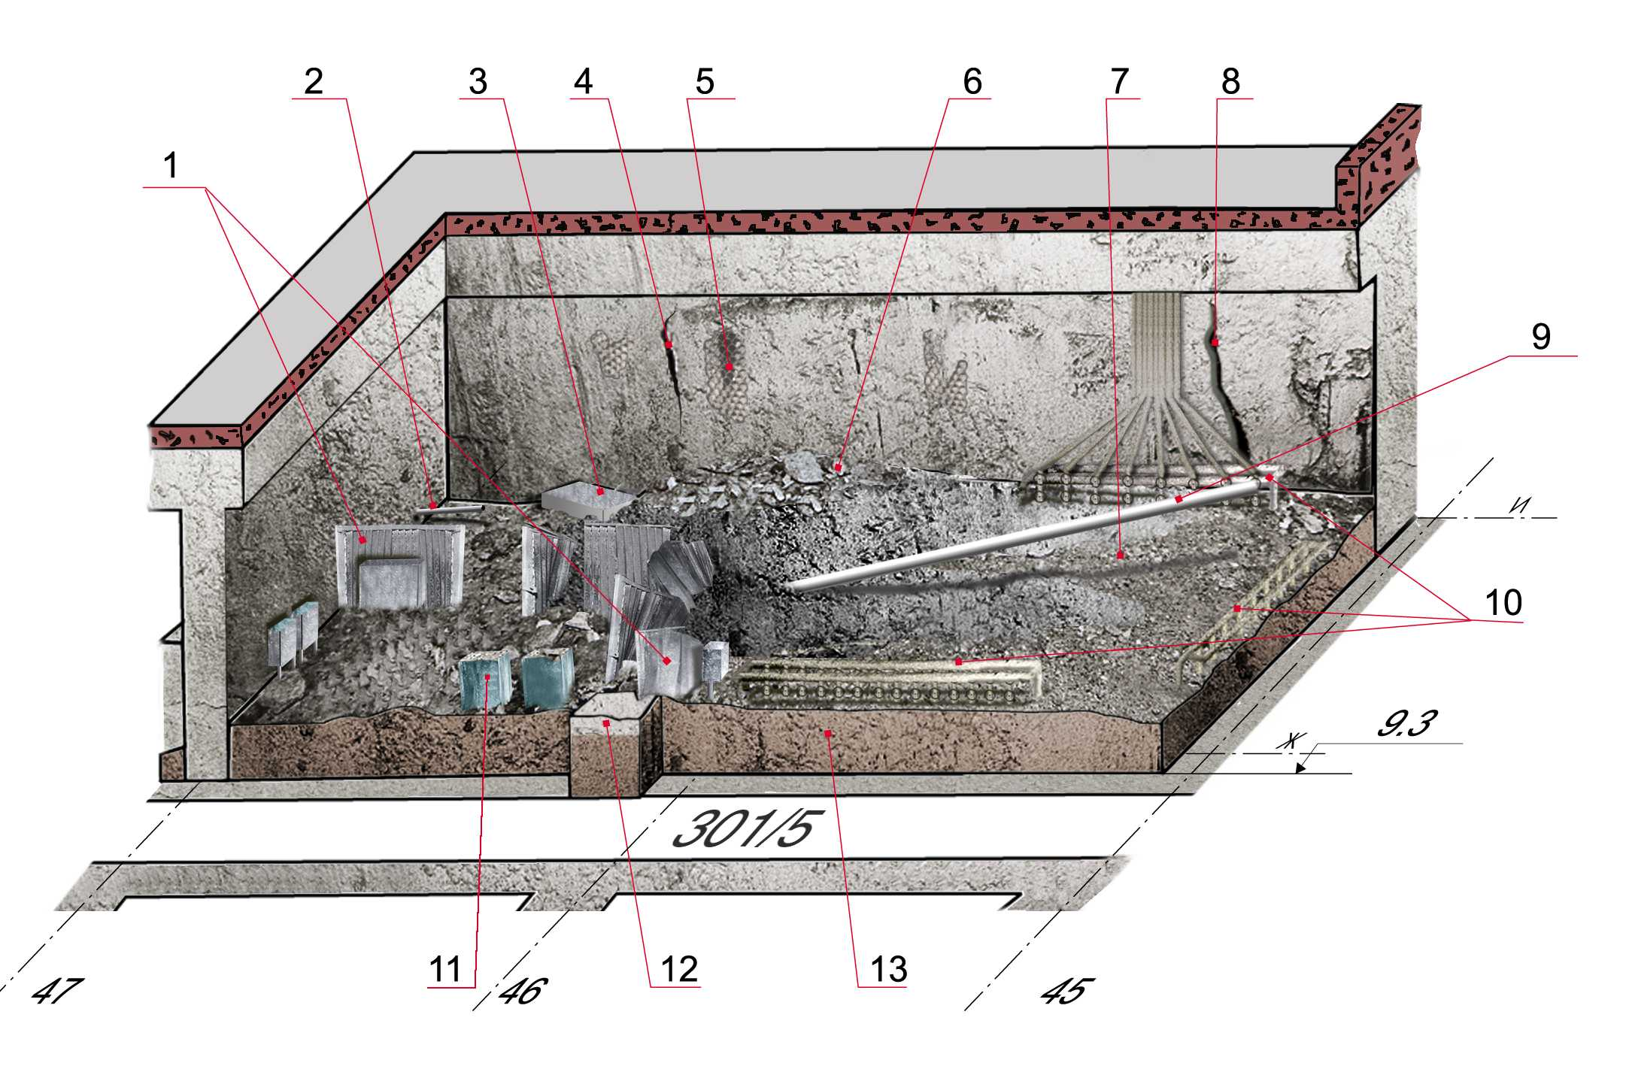
Information on Lava Spreading at +9.000 Level Mark Known from Experimental Investigations
The status of LFCM and concrete in Room No 304/3, wherein lava surface was free from concrete, was studied in detail.
1 – enclosure of electrical cabinets
2 – neutron flux density sensor
3 – a fallen electrical cabinet
4 – cracks in the wall
5 – exposed metal fittings
6 – a rise by the wall separating Rooms #304/3 and #305/2
7 –area with undulating surface
8 – a deep vertical crack
9 – casing of Hole #В-12-79
10 – sampling tubes
11 – containers with refuse and FCM
12 – concrete in the door aperture of Room #304/3
13 – lava layer on the room floor

Slide 27
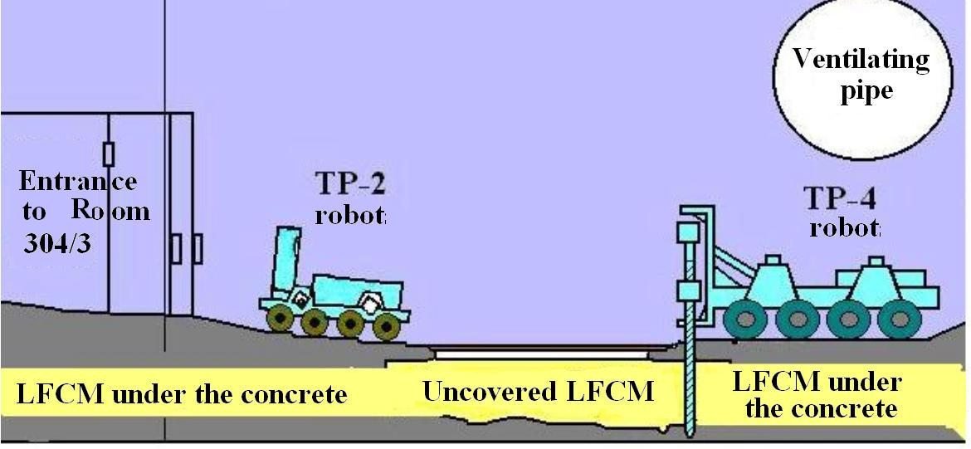
In the corridor No 301/5 the lava layer parameters and the depth of concrete de-structuring were determined at a number of points by means of bore holes and robots, most of the lava surface being covered with a layer of “fresh concrete”.

Slide 28
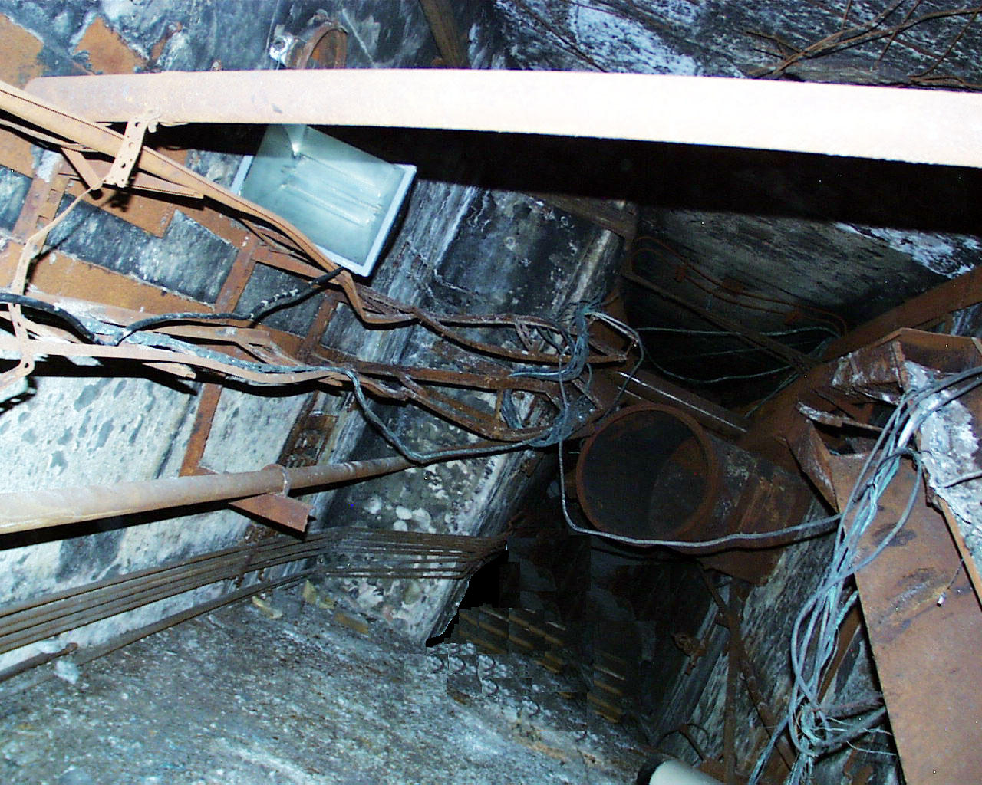
There is virtually no precise information on the lava being under a layer of concrete in Rooms NoNo 301/6, 303/3, 302/3.
?

Slide 29
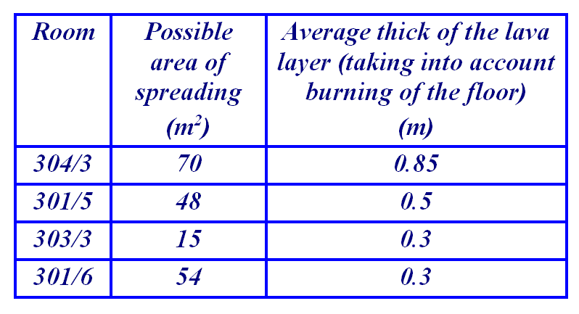
FINDINGS OF THE LAVA-SPREADING MODEL
There are no direct data on lava-spreading boundaries for some ‘concreted’ rooms.
In such a case computer simulation may be helpful. A good agreement of the results of performed calculations with all available experimental data allows drawing several conclusions – to a considerable degree of trustworthiness – on the character of lava-flow spreading over rooms at 9.000-m level mark.

Slide 30
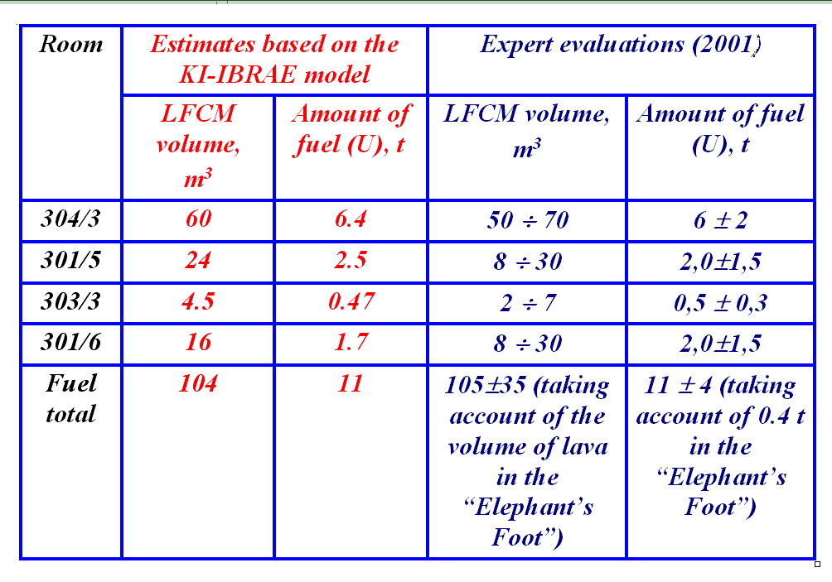
FINDINGS OF THE LAVA-SPREADING MODEL
Estimates of the amount of fuel in the large horizontal flow (according to the KI‑IBRAE model and expert evaluations (2001)

Slide 31
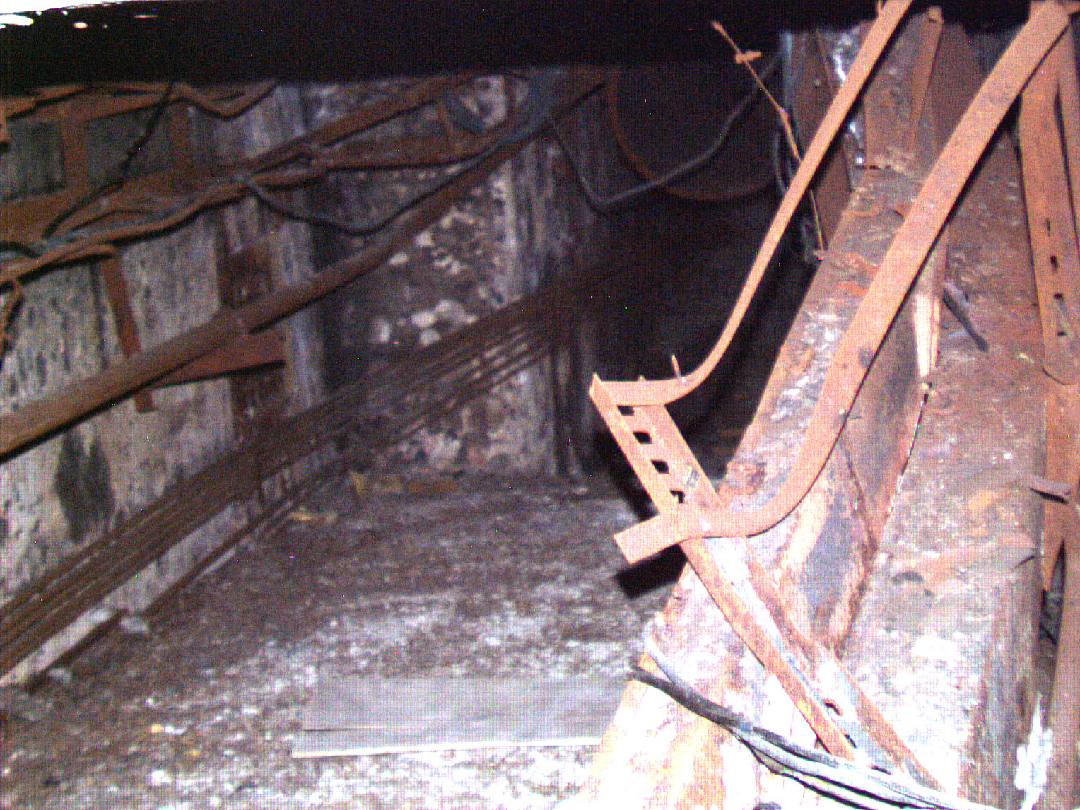
The preceding slide demonstrates a good correlation between model calculations and earlier estimates.
The model also allows fully excluding from consideration the options suggesting a considerably smaller volume of lava in the horizontal flow and an appreciably lesser amount of fuel contained therein as compared to the above data.
In such a hypothetical case spreading of the lava over rooms at +9.000m level mark and at a distance up to ∼ 25 m must have been impossible due to lava cooling.

Slide 32


RRC “KI”
PROJECT #2916

