Slide 1


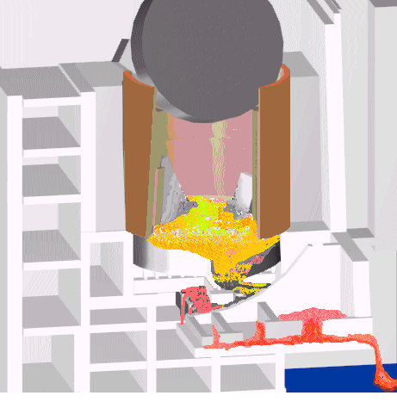
RRC “KI”
Development of the Model for Nuclear Fuel Behavior during Active Phase of the Chernobyl Accident
(№2916, CHESS-1)
Final Report

Slide 2
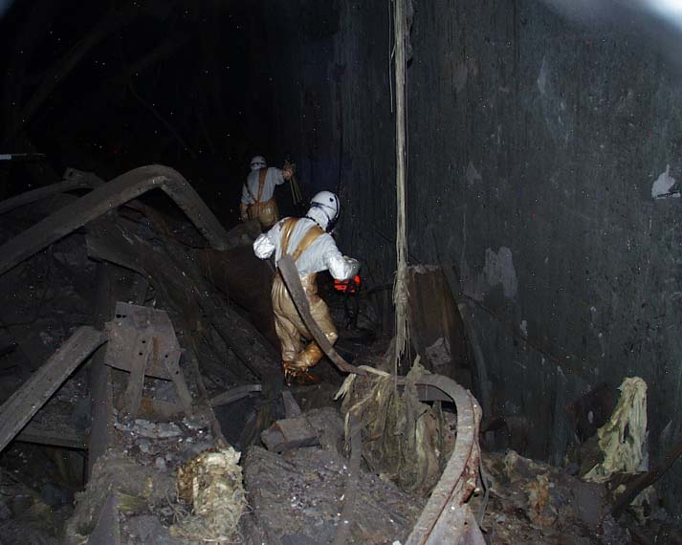
    The project objectives were:
    - systematization of a huge body of data on lava-like fuel-containing materials collected over 20 years of investigations at the “Shelter”;
    - creation of a database on their basis, and -development of models of the processes of lava generation and spreading during early post-accident days.

Slide 3
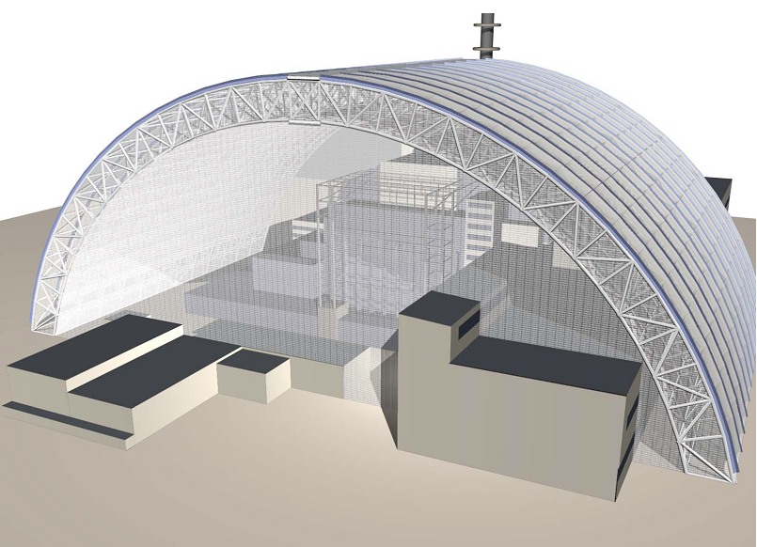
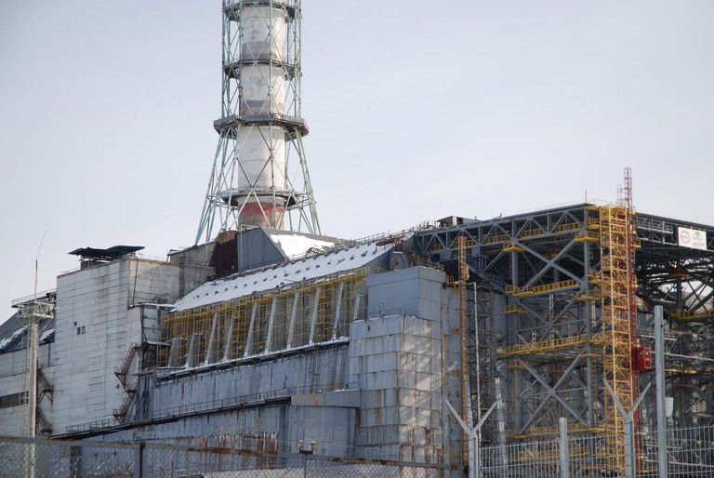
The results of the Project may (and should) be used at subsequent phases of the “Shelter" transformation into an environmentally safe facility

Slide 4
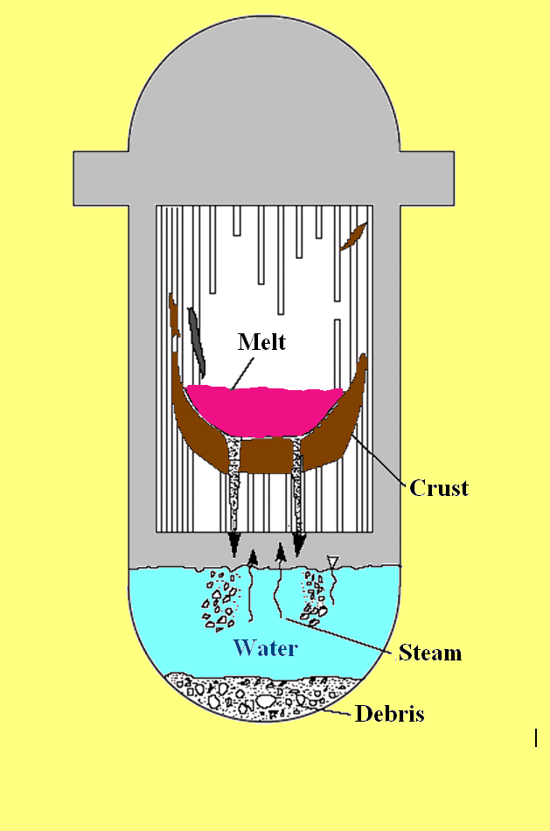
The results of the Project may be of interest while predicting the behavior of corium in localization systems (core-catchers) being developed for some reactors

Slide 5
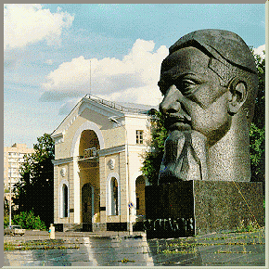
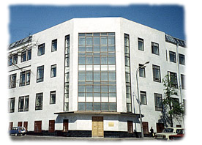
Terms of the Project implementation–
01.02.2005 - 01.08.2007
    Participants of the Project - “Kurchatov Institute” and “Nuclear Safety Institute” of RAS

Slide 6
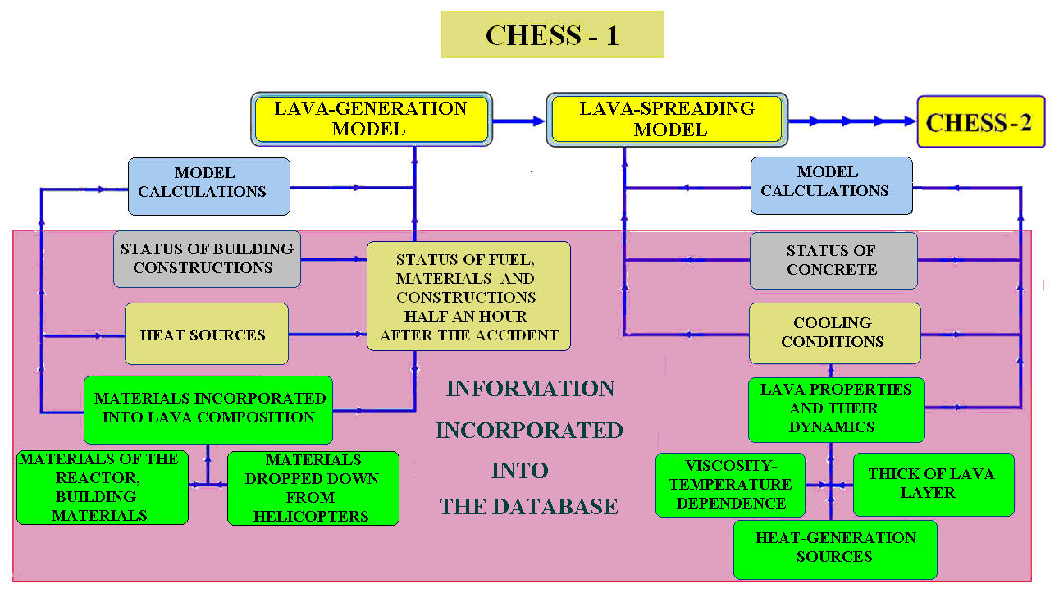
Sequence of the Project Implementation
and Main Results Achieved

Slide 7
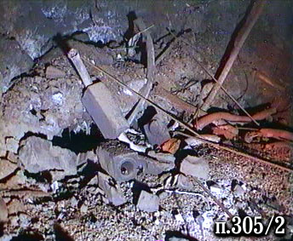
Database Generation
The database generation required verification, analysis and structuring of a huge body of experimental material obtained during investigations at the “Shelter” in 1986 – 2005.
A team of RRC KI’s specialists performed such a work in
2005 – 2006.
During the database development a variety of data taken from publications, presentation, unpublished reports, construction drawings, etc. were verified and analyzed.
Photo- and video-materials were studied as well.
The integral amount of information records used in the database exceeds 6000.

Slide 8
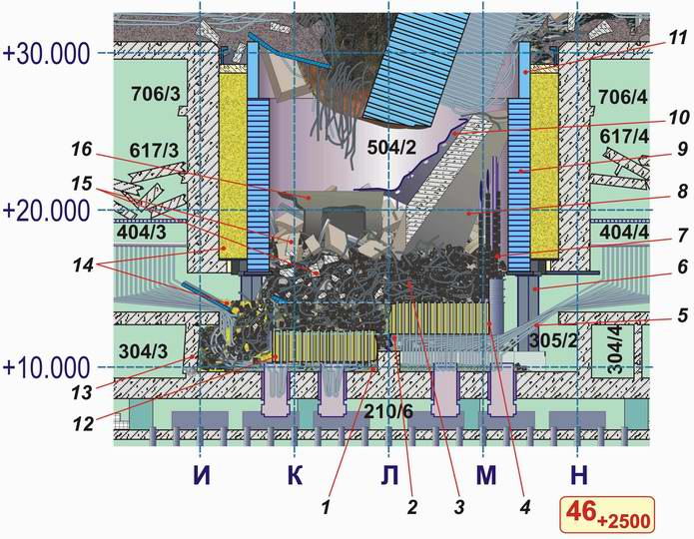
LAVA GENERATION MODEL
LAYOUT OF CONSTRUCTIONS
Time: 30 minutes after the explosion
1 - Serpentine of the “ОR” component and the inter-compensatory gap
2 - Crushed “С” component (“Cross”)
3 - Fuel, fuel assemblies, fuel elements, process channels, graphite blocks, fragmented concrete
4 - ¾ ОR
5 - BWC tubes
6 - Additional support
7 - Reflector (channels and graphite blocks)
8 - Reinforced-concrete plate (fragments of wall of separator box)
9 - “L” tank
10 - Heat shielding lining of separator box’s wall
11 - “D” tank
12 - ¼ ОR
13 - Damaged wall
14 - Vault’s filling-up-origin sand
15 - Debris of reinforced-concrete constructions
16 - Fragment of reinforced-concrete construction

Slide 9
LAVA GENERATION MODEL
Materials incorporated into the lava
Material | Amount in rooms #504/2* and #305/2, t | Incorporated into lava, t
Fuel (U) | 120 | 90
Steel | 1300** | < 20***
Serpentine mixture | 580 | 160
Concrete of the under-reactor plate | - | 130
Concrete of building constructions dropped into the vault from upper level marks | 950 | 480
Sand of the vault’s shield | 300 | 280
Zirconium | ? | 45
Graphite | 750 | ?****
1200 t
?
* within the reactor space boundaries; ** excepting materials of “С” component and non-melted communications of the reactor bottom; *** 330 t were melt and spread over the under-reactor rooms; **** an insignificant admixture was discovered.

Slide 10
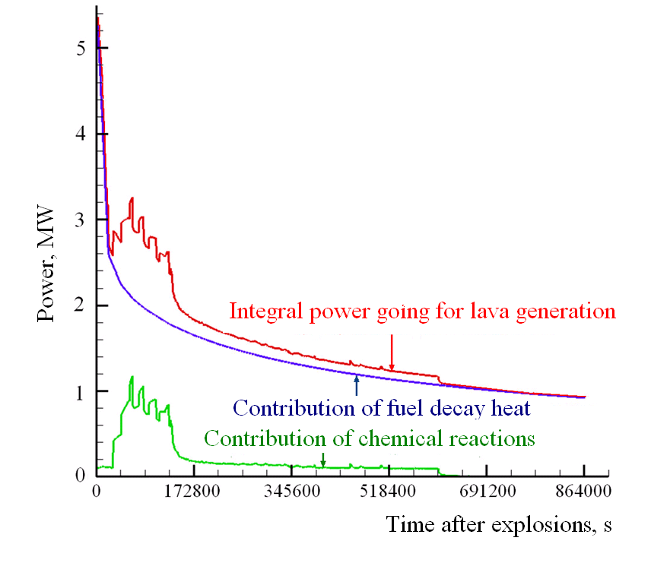
LAVA GENERATION MODEL
HEAT SOURCES

Slide 11
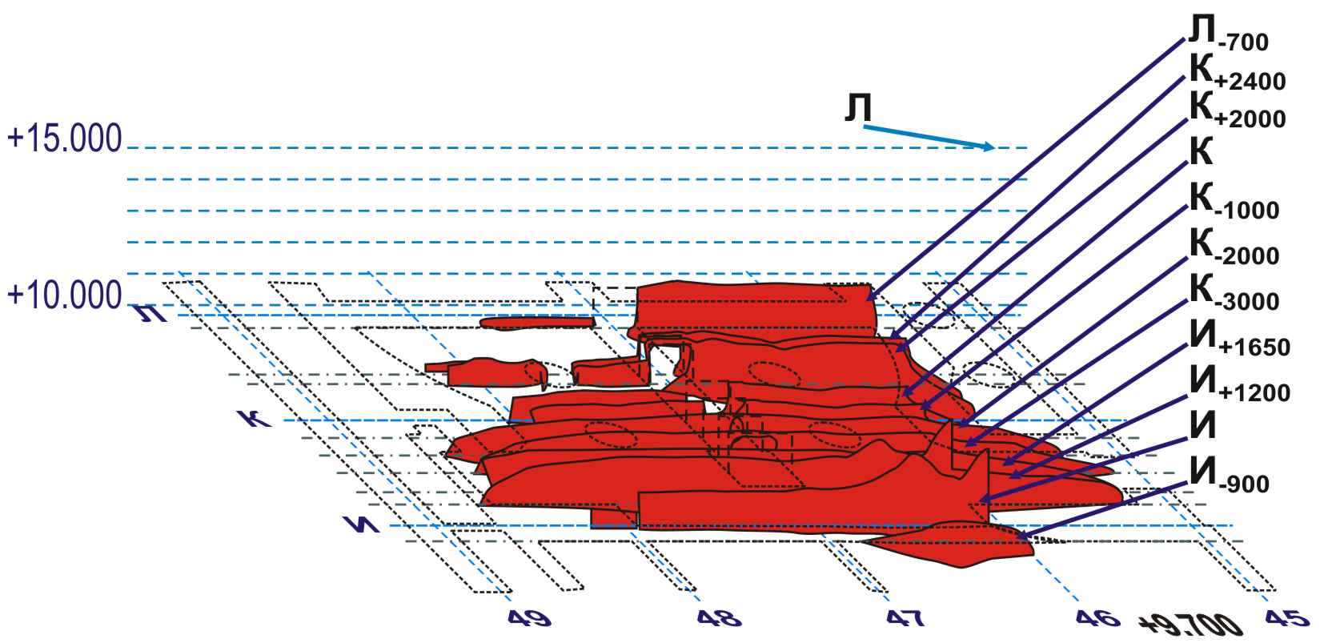
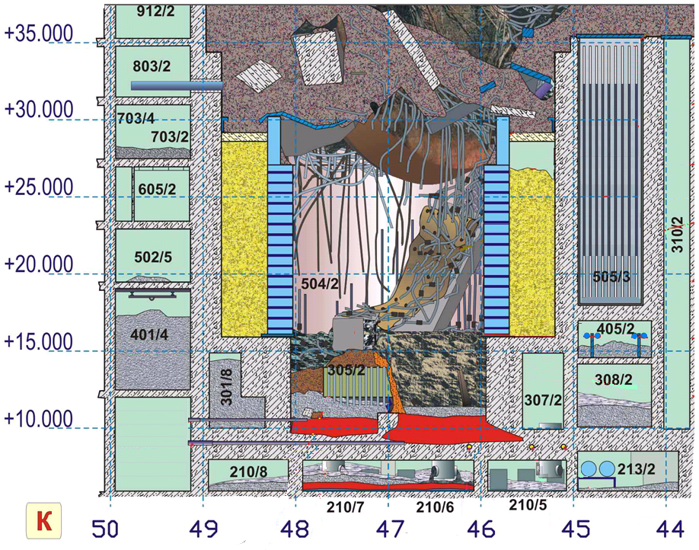
LAVA GENERATION MODEL (RESULTS)
The model has allowed to define the layout of lava location in under-reactor rooms.
Several Unit 4’s sections were used to demonstrate the layout of lava within under-reactor rooms
A fragment of Unit 4. Section through row ‘K’

Slide 12
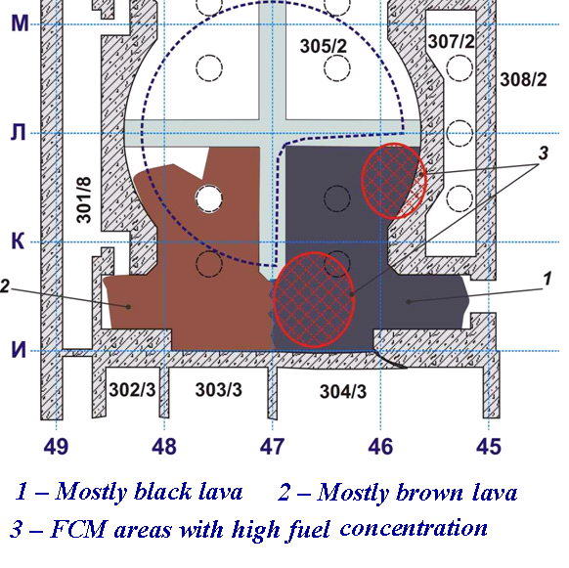
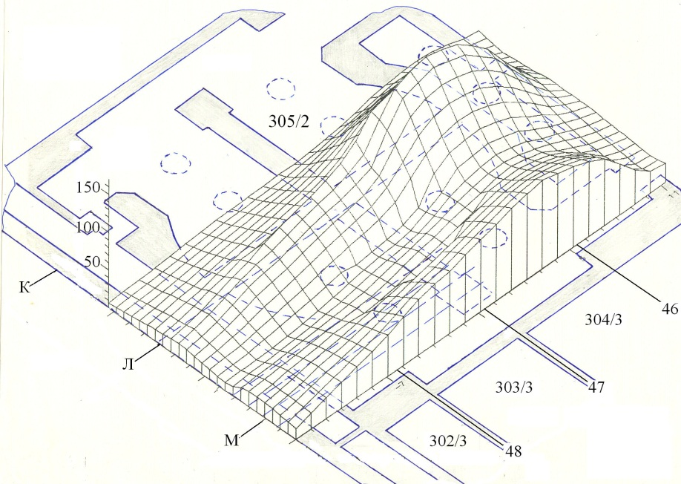
LAVA GENERATION MODEL (RESULTS)
The information collected and analyzed during implementation of the Project indicates presence in the under-reactor room of accumulations, which uranium content exceeds by far that of “standard” lava.
Temperature field in reactor plate according to the results of investigations (1988‑1989)

Slide 13
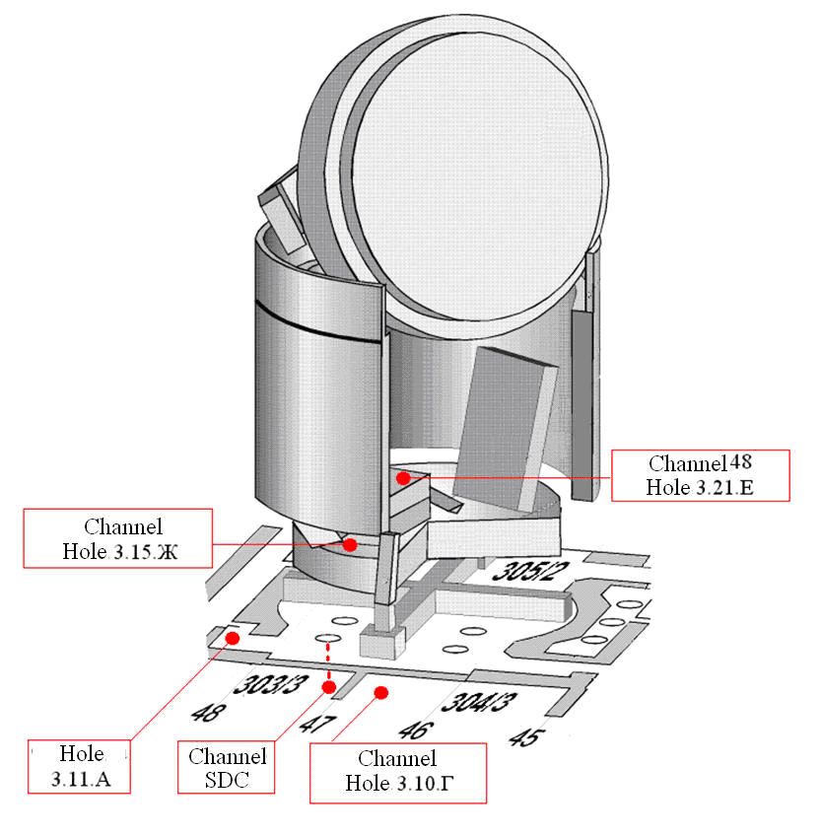
Layout of Neutron Channels of “Finish” System,
Summer 1990
The very first hypothesis of such accumulations was formulated while making an attempt of explaining the so-called “anomalous neutron event” in 1990.
The event consisted in a rather short-run (∼ 1.5 days) but a considerable
(∼ 60 times) increase in the counting rate of neutron sensor of “Finish” system installed in Room #304/3 close to the breach in wall of Room #305/2
(Channel 50 Hole 3.10.Г).

Slide 14
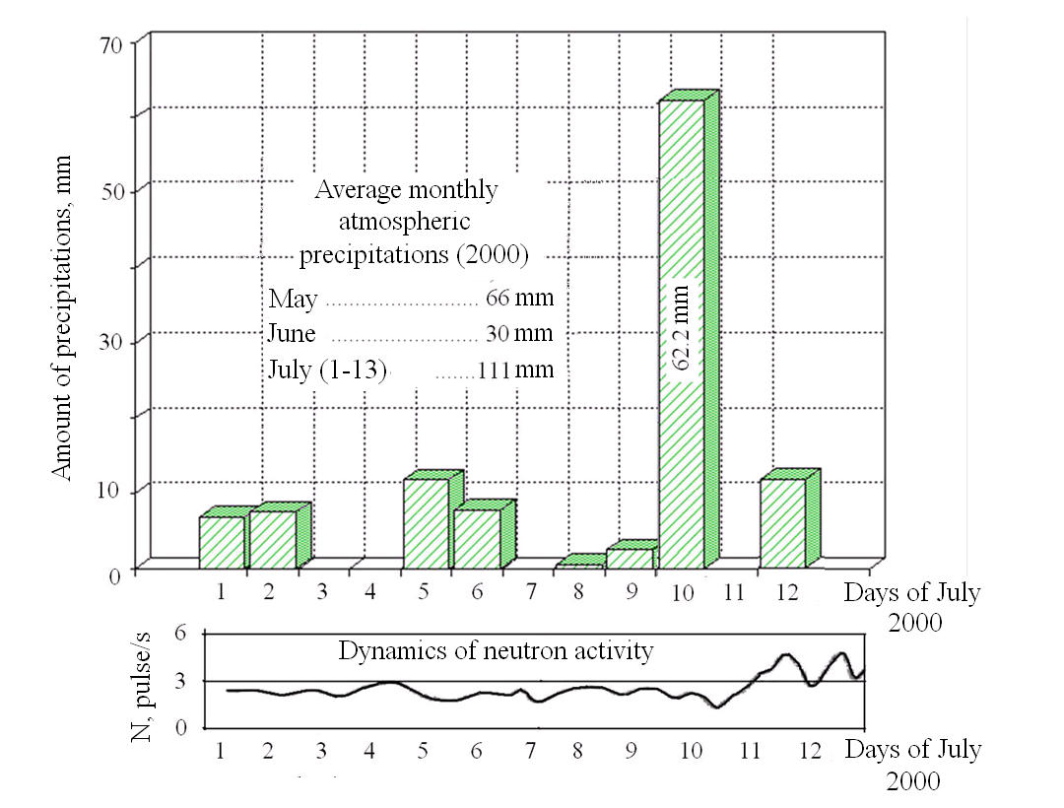
The results of survey of neutron fluxes during periods of abnormally high atmospheric precipitations are indicative of the “hidden-accumulation” hypothesis.
Atmospheric precipitations in July 2000 in the Chernobyl NPP area and the dynamics of neutron activity in Room #305/2 near the breach.
The water level in FCM accumulation near the breach area varies depending on the inflow/outflow rate that determines oscillations in the neutron flux density.
While applying the conservative approach, such oscillations may be attributed to Кeff variations.

Slide 15
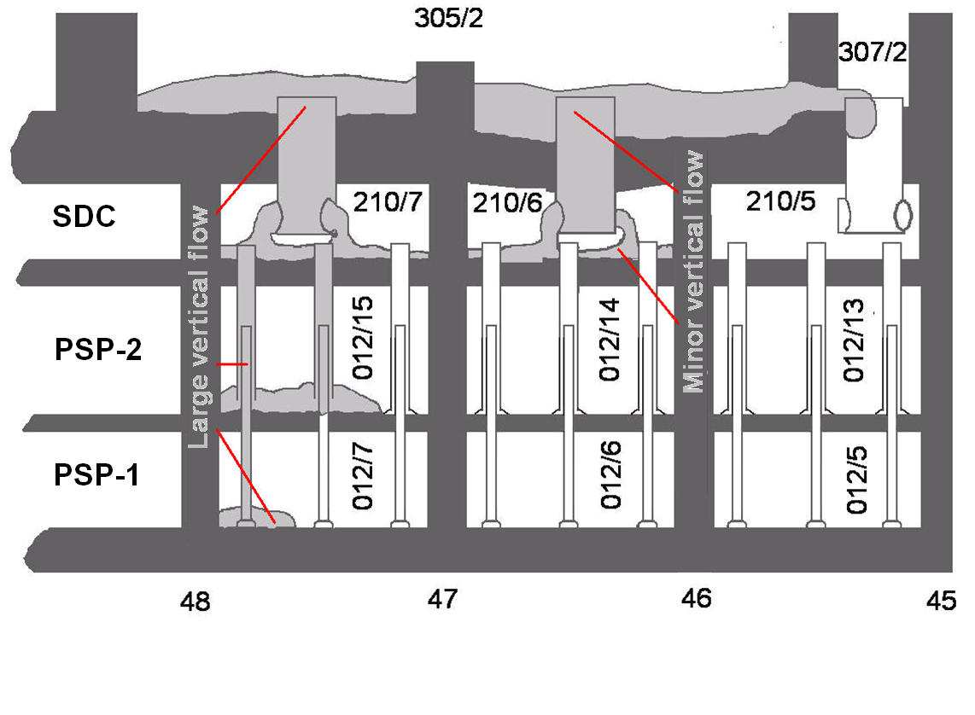
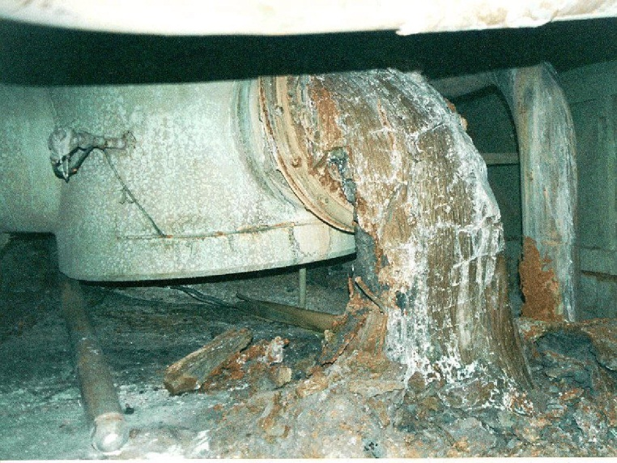
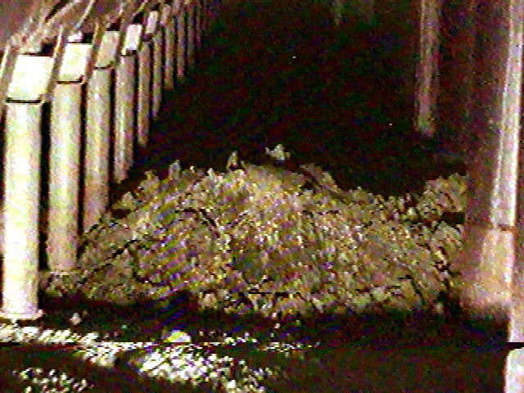
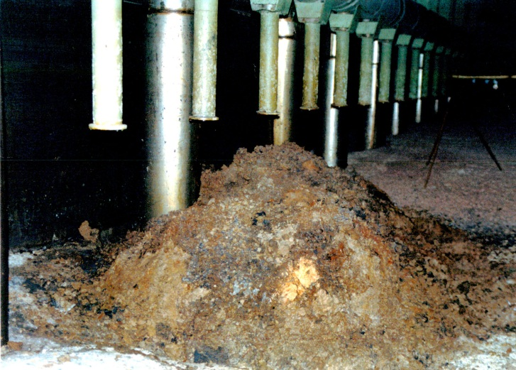
LAVA SPREADING MODEL - VERTICAL FLOWS

Slide 16
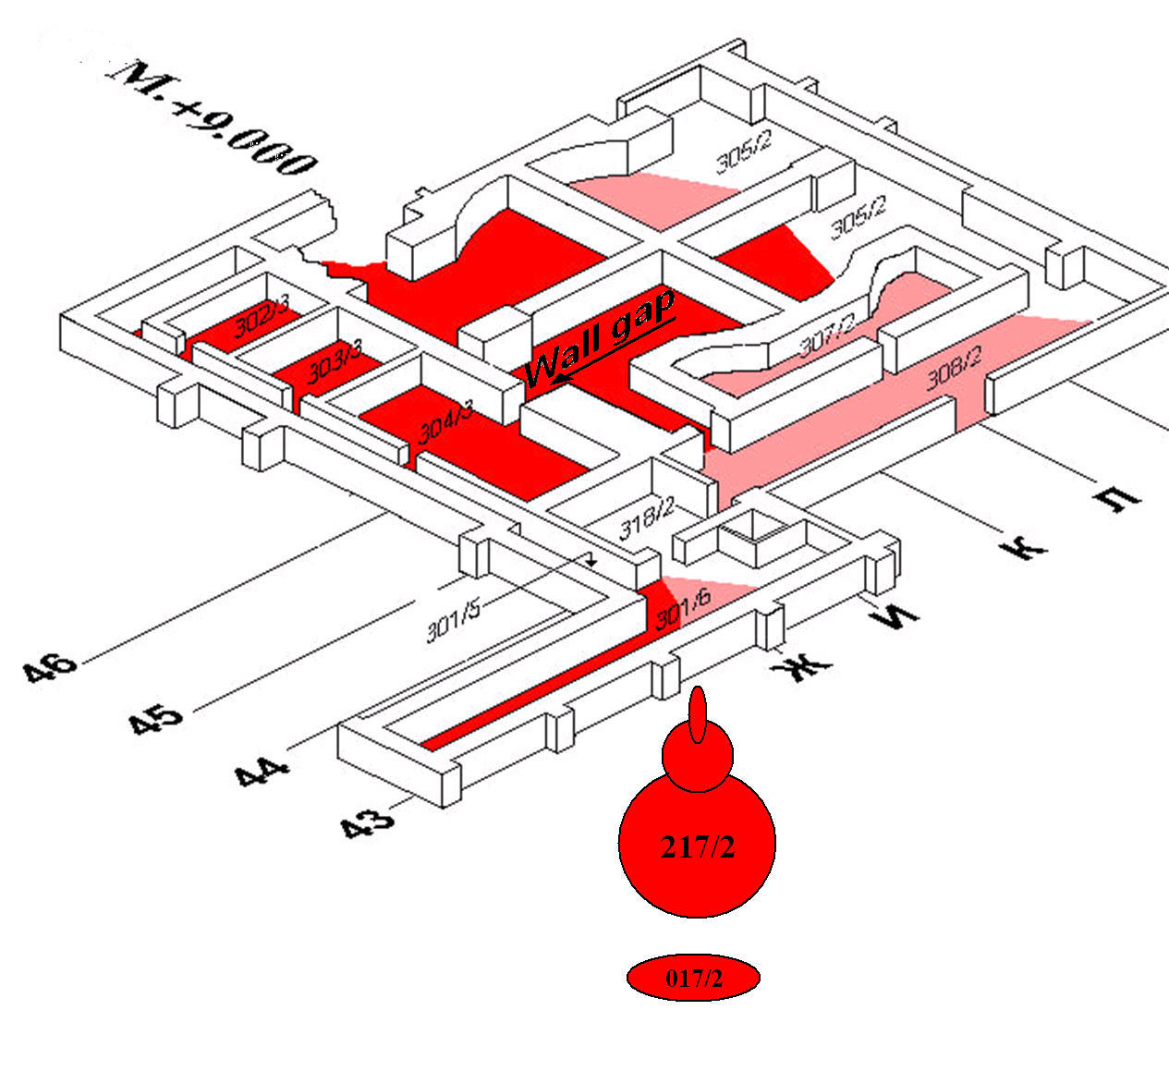
LAVA SPREADING MODEL - HORIZONTAL LAVA FLOW

Slide 17
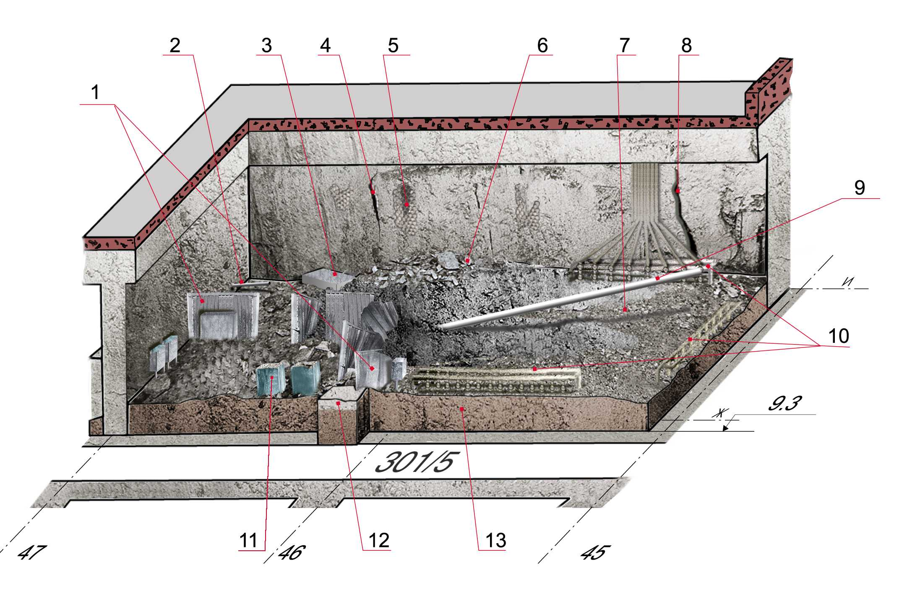
Information on Lava Spreading at +9.000 Level Mark Known from Experimental Investigations
The status of LFCM and concrete in Room No 304/3, wherein lava surface was free from concrete, was studied in detail.
1 – enclosure of electrical cabinets
2 – neutron flux density sensor
3 – a fallen electrical cabinet
4 – cracks in the wall
5 – exposed metal fittings
6 – a rise by the wall separating Rooms #304/3 and #305/2
7 –area with undulating surface
8 – a deep vertical crack
9 – casing of Hole #В-12-79
10 – sampling tubes
11 – containers with refuse and FCM
12 – concrete in the door aperture of Room #304/3
13 – lava layer on the room floor

Slide 18
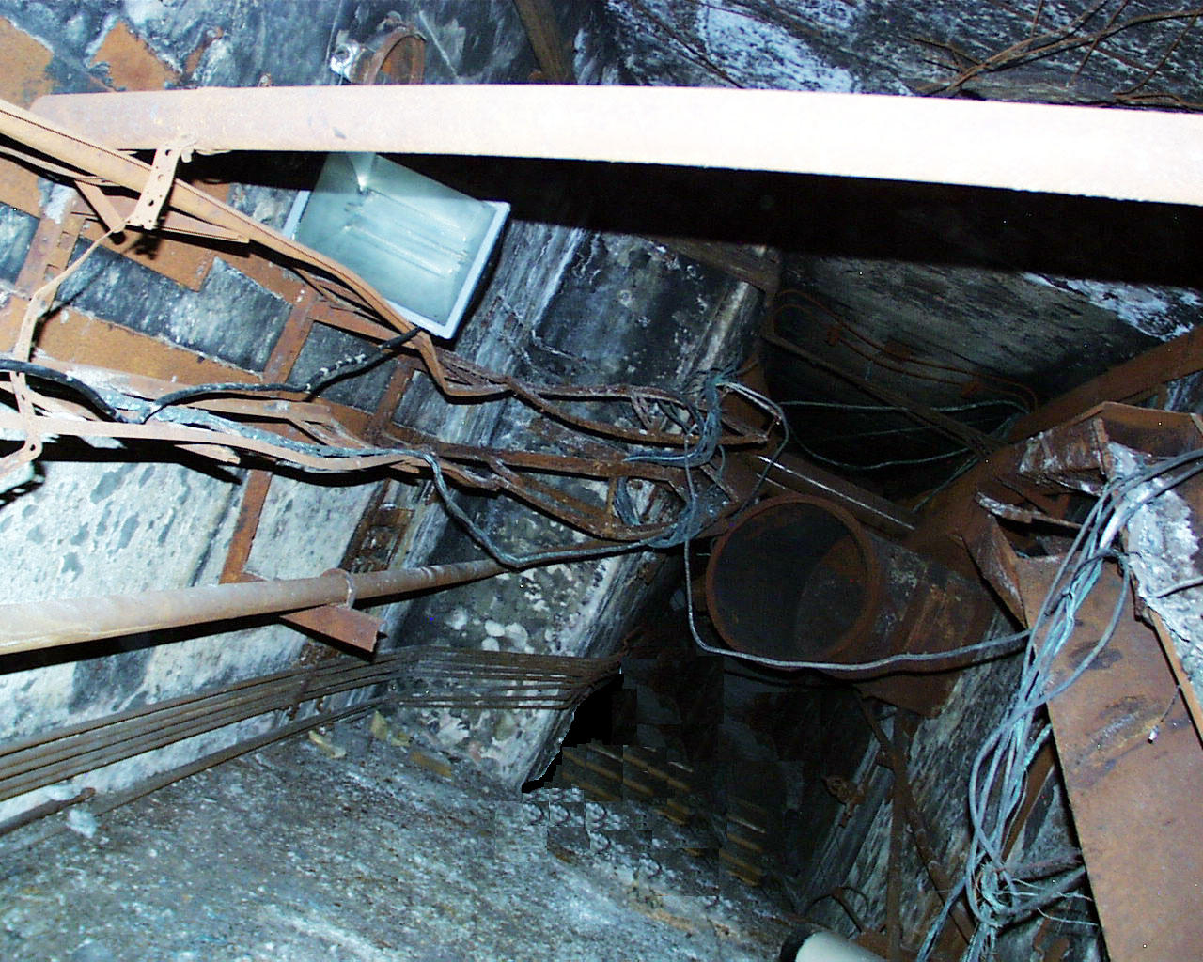
There is virtually no precise information on the lava being under a layer of concrete in Rooms NoNo 301/6, 303/3, 302/3.
?

Slide 19
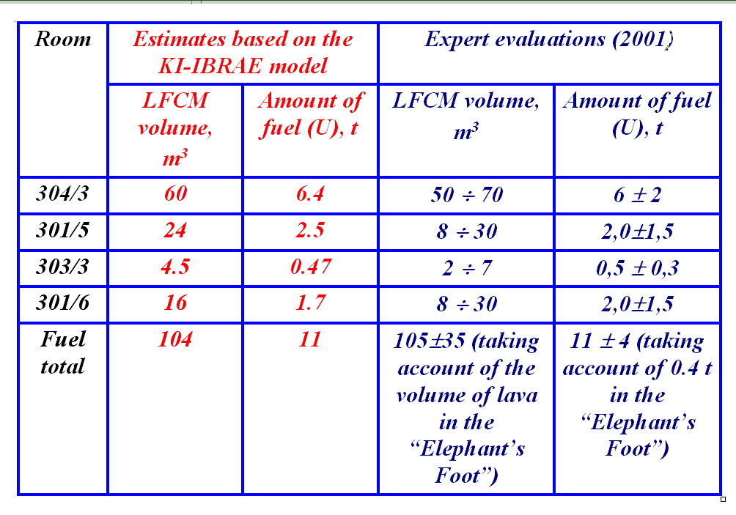
FINDINGS OF THE LAVA-SPREADING MODEL
Estimates of the amount of fuel in the large horizontal flow (according to the KI‑IBRAE model and expert evaluations (2001)

Slide 20
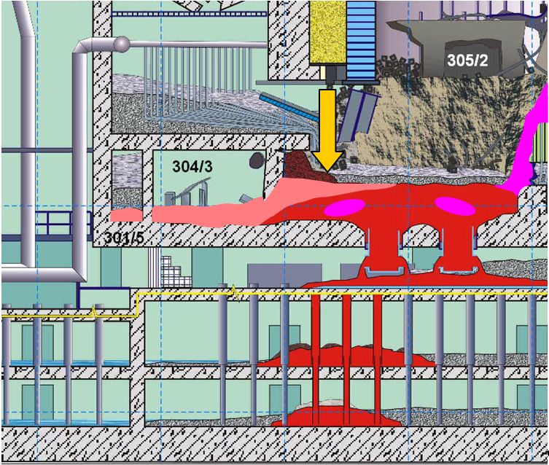
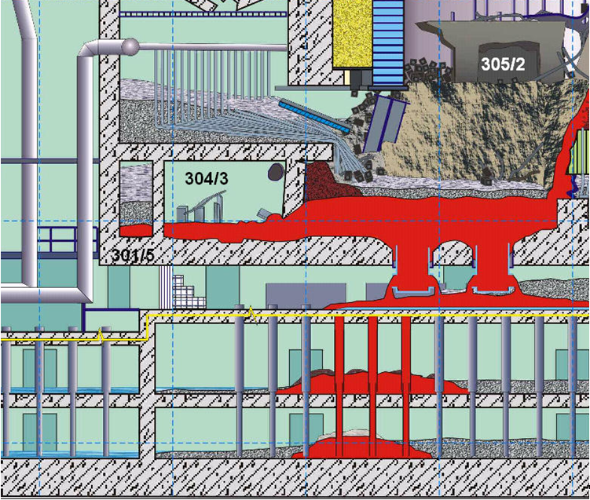
Evolution of vision of internal LFCM structure
Descending sand of lateral shield (concrete structures?)
LFCM – 4 wt.% of U content
LFCM – 16…50 wt.% of U content
LFCM – 8 wt.% of U content

Slide 21
CONCLUSION
Comprehensive bank of initial data has been created
Self-consistent and not contradictory model of LFCM generation has been developed
Results obtained make it possible to predict LFCM location and structure in places where no direct observation or measurements are still possible
Proposals for future studies – long term LFCM behaviour (“CHESS-2”) - would be logical continuation of data acquisition on real reactor accident

