Slide 1

RRC “KI”
Simulation of LAVA behavior
(#2916 CHESS)

Slide 2
Simulation approach
Data on the geometry of compartments
Results of visual observations
Results of LFCM samples examinations
  Content of different species
  Properties measurements (density, viscosity)
Results of LFCM location (bore holes)

Slide 3
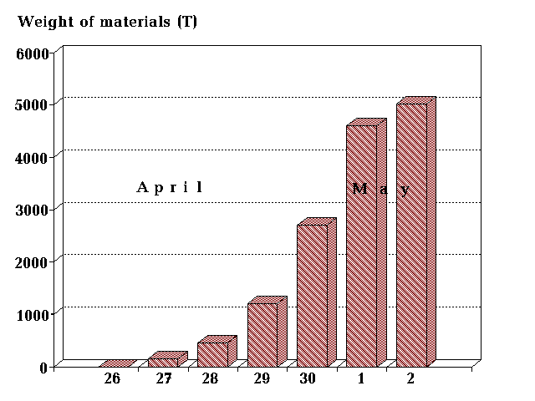
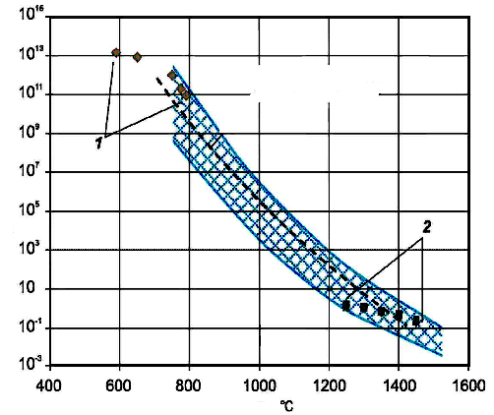
Data uncertainties
Materials remained in the reactor and dropped into the reactor wreck (total of 16600 tons)
Start of melting and interactions with structural materials
Amount of materials incorporated into LFCM
Temperatures and properties

Slide 4
Reactor materials

Slide 5
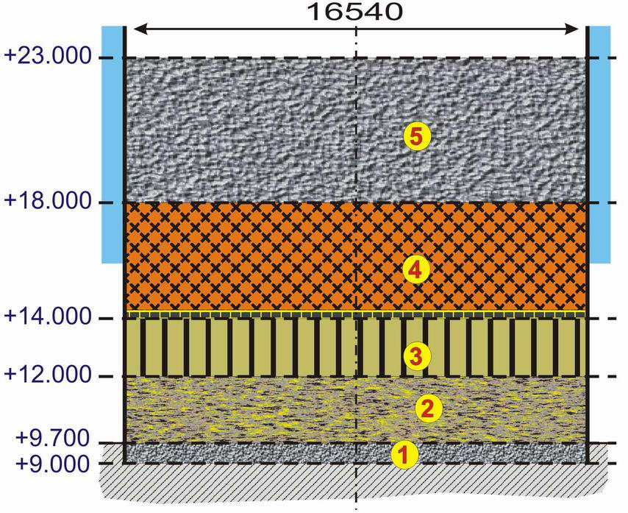
Models used for analysis:
Pancake model
Basemate concrete
Under reactor structures (Steel, sand)
“OR” Scheme (steel, serpentine)
Fuel containing masses (zirconium, steel, graphite, etc.)
Materials from upper structures (concrete, materials dropped into the reactor wreck)
Goal: Timing of events

Slide 6
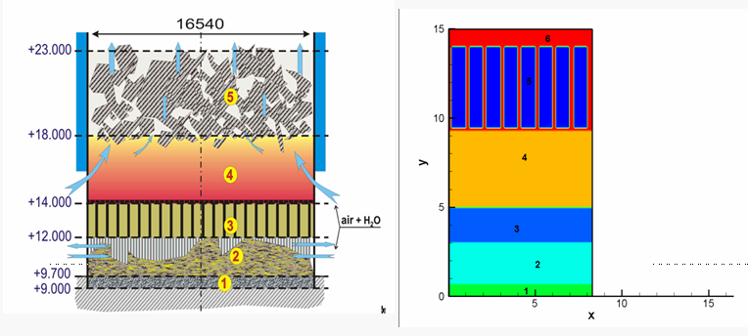
Computational model

Slide 7
Calculated analysis
Main uncertainties:
  Boundary conditions
  Debris cooling by air
  Graphite burning
Calculated scenarios (Time of graphite burning: 4 days, 7 days, 10 days

Slide 8
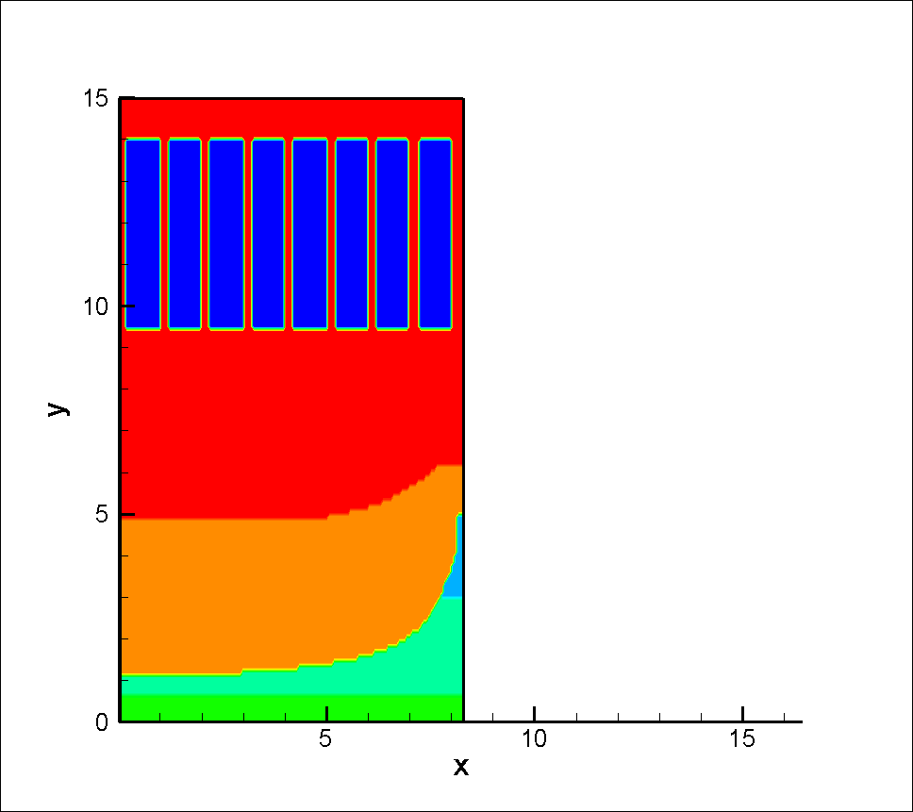
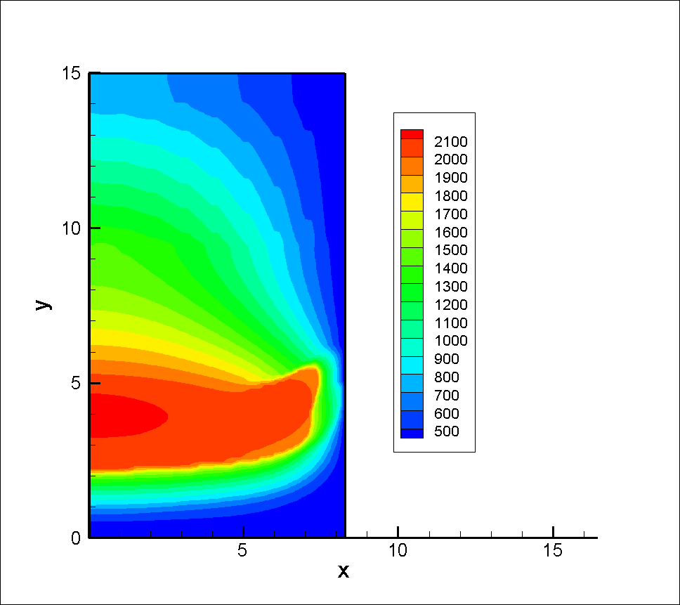
Conditions: 10 days after accident
The conclusion was that final state was reached in 12 – 15
days after accident

Slide 9
Model of MCCI and long term behavior of LFCM
The objective was to analyze the following processes:
  LFCM cooling rates to assess characteristic times
  Concrete erosion depth in different rooms
  Concrete decomposition depth
Criteria of success
  Correspondence to observations
  Assessment of spreading times

Slide 10
Initial data and results
Calculated temperature of the concrete under 305/2 was about 450K

Slide 11
Results of calculations (4%)
Characteristic upper boundary cooling time about 5 hr
Characteristic LFCM cooling time about 20 hr

Slide 12
Spreading model:
Parametric study
Goals of use:
  Numerical predictions of spreading velocity
  Characteristic time of spreading
  Length of spreading
Temperature stopping criteria: cooling below 1100 K (viscosity exceeds 10⁷ Pa⋅s)

Slide 13
Spreading model:
Parametric study

Slide 14
Results of analysis
Spreading time is much shorter then cooling time if temperature exceeds 1100ºC
Most probable temperature at the start of spreading was between 1000 and 1100ºC

Slide 15
Location of LFCM in the room 305/2

Slide 16
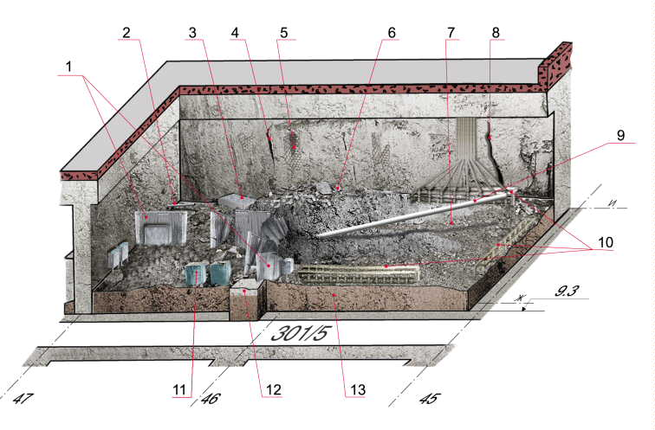
Start of spreading
Intact thickness of wall between 305/2 and 304/3 was 0.93 m
Axial concrete erosion was about 0.7 m
Radial concrete erosion of the same order
Location of areas with high fuel content near the wall between 305/2 and 304/3
Wall crack
Elevations of FCM:
Room 305/2: about 11.0 m
Room 304/3: about 10.3 m

Slide 17
Simulation of LFCM spreading
Initial data:
  3D geometry of rooms
  Varied temperature
  Assume two layers: black ceramics atop
Model includes
  Advection of the melt
  Radiation from melt top surface
  Heat conductivity
  Temperature dependence of viscosity
  Melt source (room 305/2) and melt sinks (room 301/6)

Slide 18
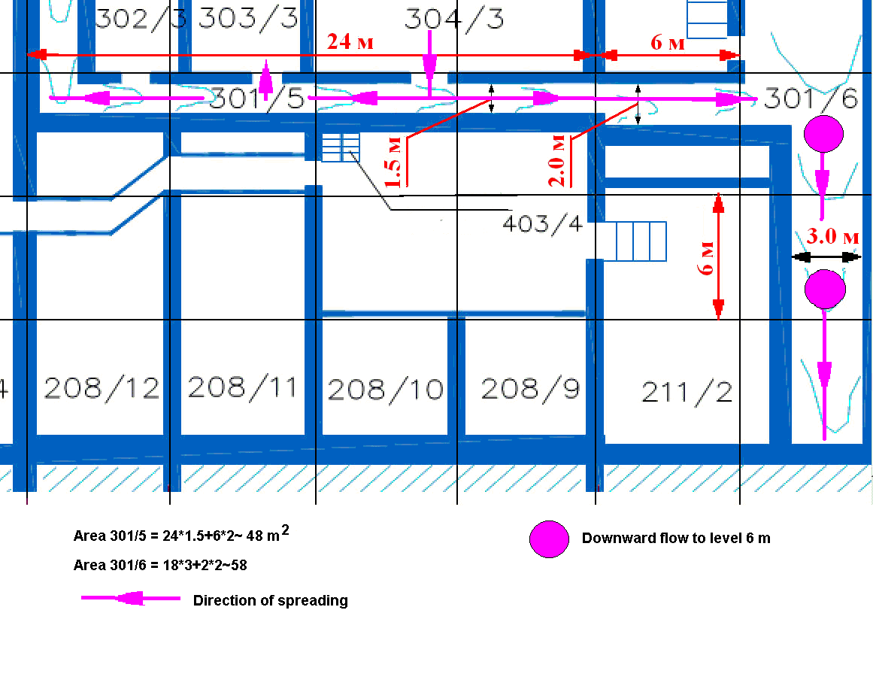
Characteristics of horizontal flow

Slide 19
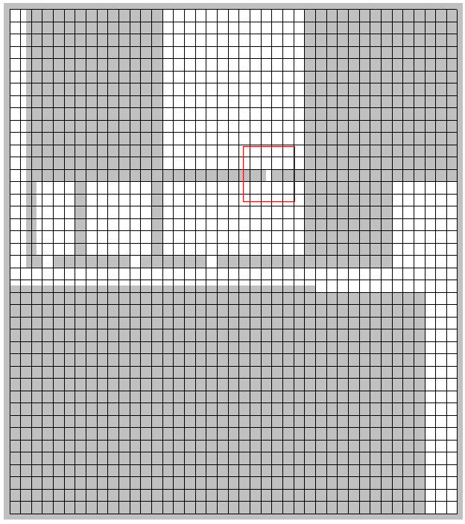
Initial geometry
Room 305: Melt source
Initial height of melt in room 305: 1.7 m
Through wall break between 305 and 304 rooms (0.5 m)
Doors 1 m
305/2
302/3
303/3
304/3
301/5
301/6

Slide 20
Initial data
Mass source: 20 kg/s
Melt temperature:, 1430, 1450 K
  1380 K, spreading length about 18 m
  1430 K, spreading length about 25 m
  1450 K, spreading length about 30 m
Qualitatively spreading length is predicted

Slide 21
Uncertainties
The mass source in the room 305/2
Initial temperature
Dependence of viscosity upon temperature
Mass sinks to lower levels

Slide 22
Summary
Models developed allowed assessments of significant phenomena during late phase of accident and timing of events
No significant interactions with concrete were predicted in the rooms 304/3, 301/5 and 303/3
Qualitative modeling of the spreading if temperature was about 1400 – 1450 K
Temperature dependence of viscosity needs some refinement

Slide 23
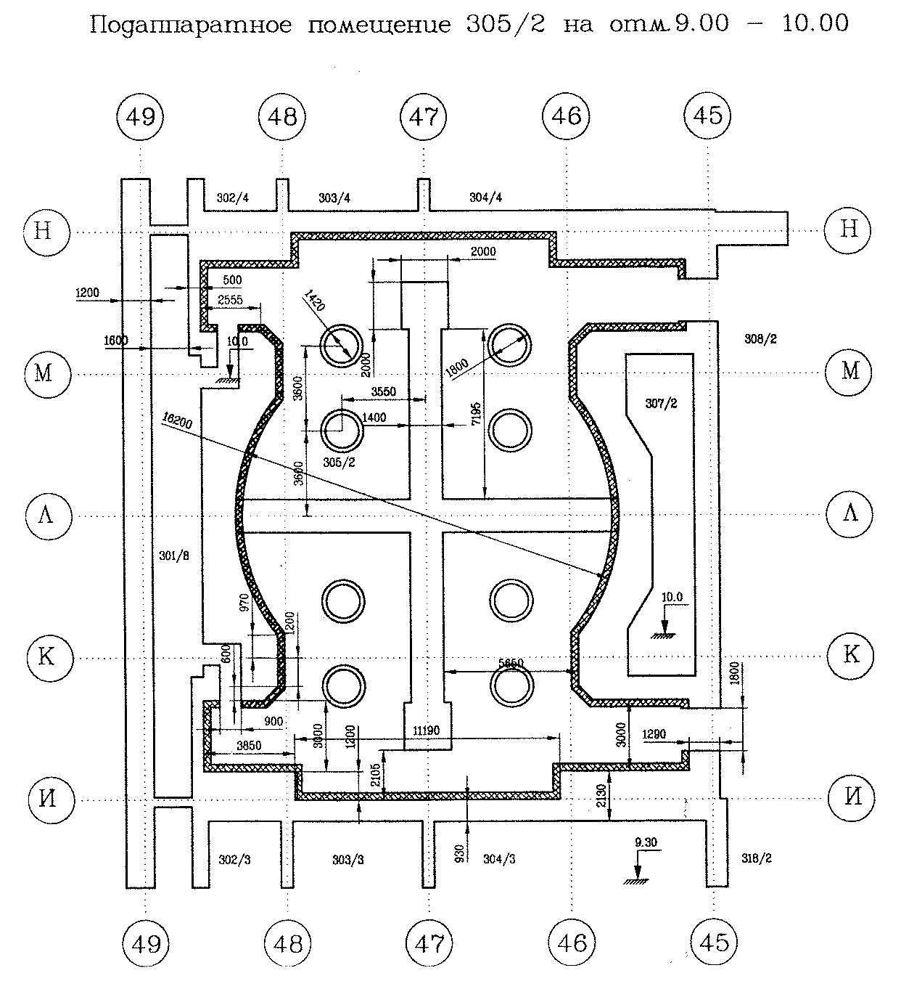
Geometry of 305/2
Floor level 9.7 m
Cross basemate level 11.0 m
Steam valves elevation 0.4 m

Slide 24
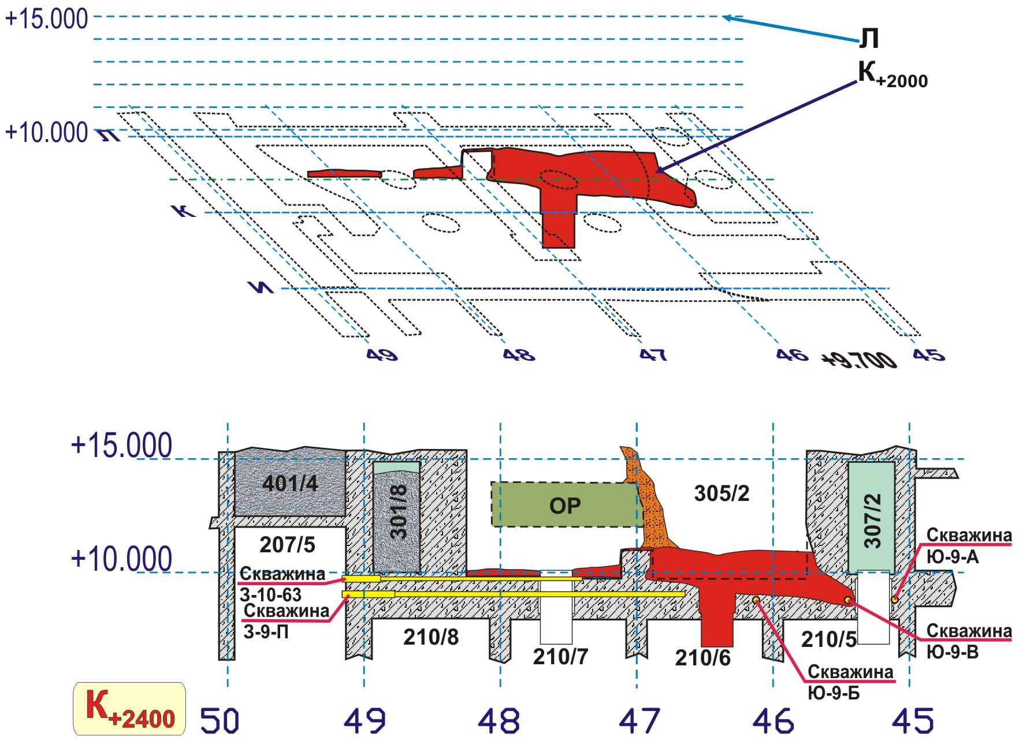
Section K+2400

