Slide 1

RRC “KI”
Current results of the ISTC project #2916 (CHESS)
(Part 2: Modeling and results)

Slide 2
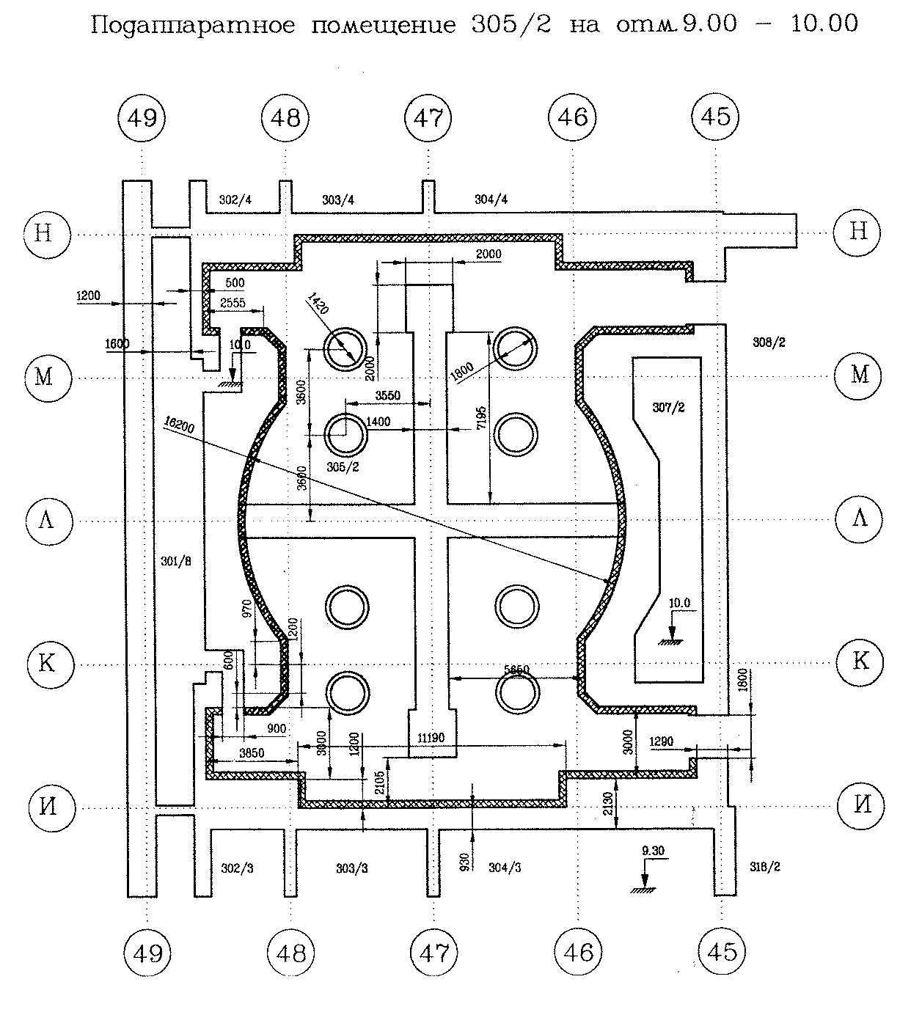
Under reactors rooms 305/2
Level 9.0 – 10.0 m
Floor level 9.7 m
Cross basemate level 11.0 m
Steam valves elevation 0.4 m

Slide 3
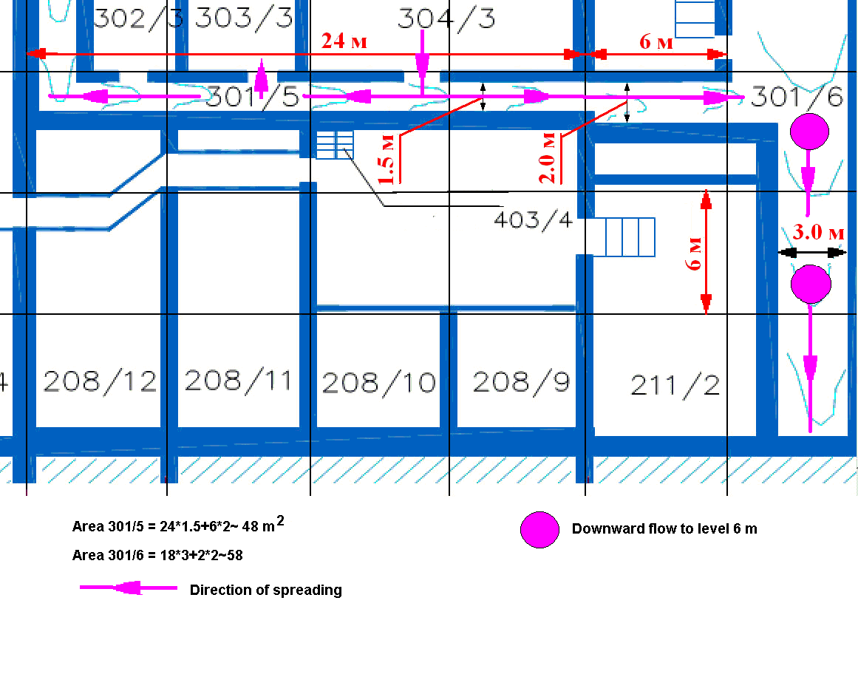
Characteristics of horizontal flow

Slide 4
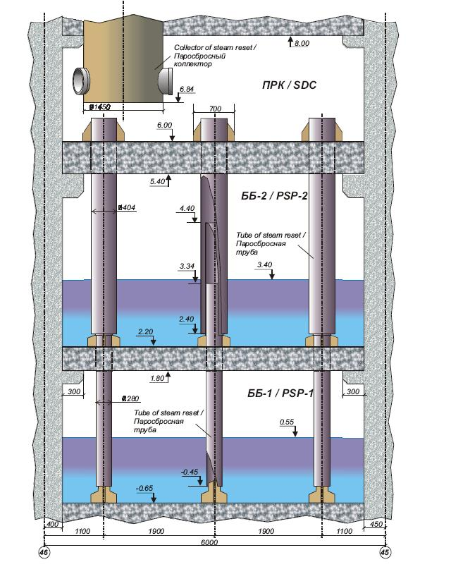
Geometry of SDC/PSP-2/PSP-1
Elevation of steam reset tubes in the SDC 0.35 m above the floor

Slide 5
Model of long term behavior of LFCM
The objective is to analyze the following processes:
  LFCM cooling rates to assess characteristic time
  Concrete erosion depth
  Concrete decomposition depth
Criteria of success
  Correspondence to observations
  Assessment of spreading

Slide 6
Solidus/liquidus temperatures
Mole ratio: UO₂/ZrO₂=1.6
Weight ratio: 0.77:0.23
Two characteristic corium compositions (wt.%):
1) U-8%; Zr-4% (weight ratio UO₂/ZrO₂ 0.65:0.35)
Solidus/liquidus temperatures: 1400/2150K
2) U-4%; Zr-2.5%
(weight ratio UO₂/ZrO₂ 0.60:0.40)
Solidus/liquidus temperatures: 1400/1900K
J.K.Fink, Solidus/Liquidus of UO -ZrO -Concrete Mixtures, www.insc.anl.gov

Slide 7
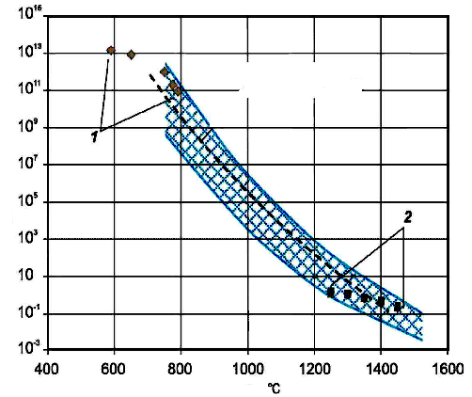
Lava/concrete properties
Concrete solidus/liquidus temperatures were assumed to be 1400/1600K
Viscosity Pa*s
Glass transition temperature range according to Fink 1130 – 1250ºC
Concrete decomposition temperature (Loss of mechanical properties): 1000K

Slide 8
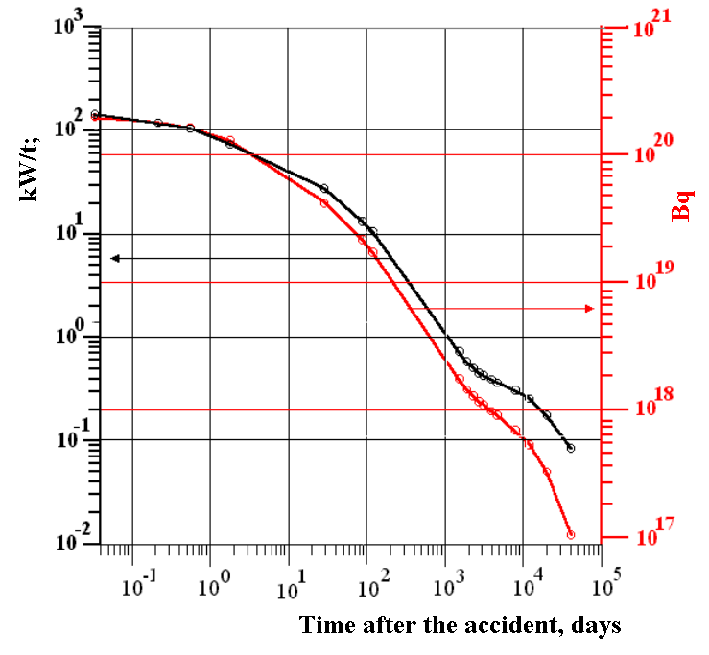
Heat generation (W/kg U)
24 hours: 89 W/kg
72 hours: 68 W/kg
120 hours: 59 W/kg
240 hours:46 W/kg

Slide 9
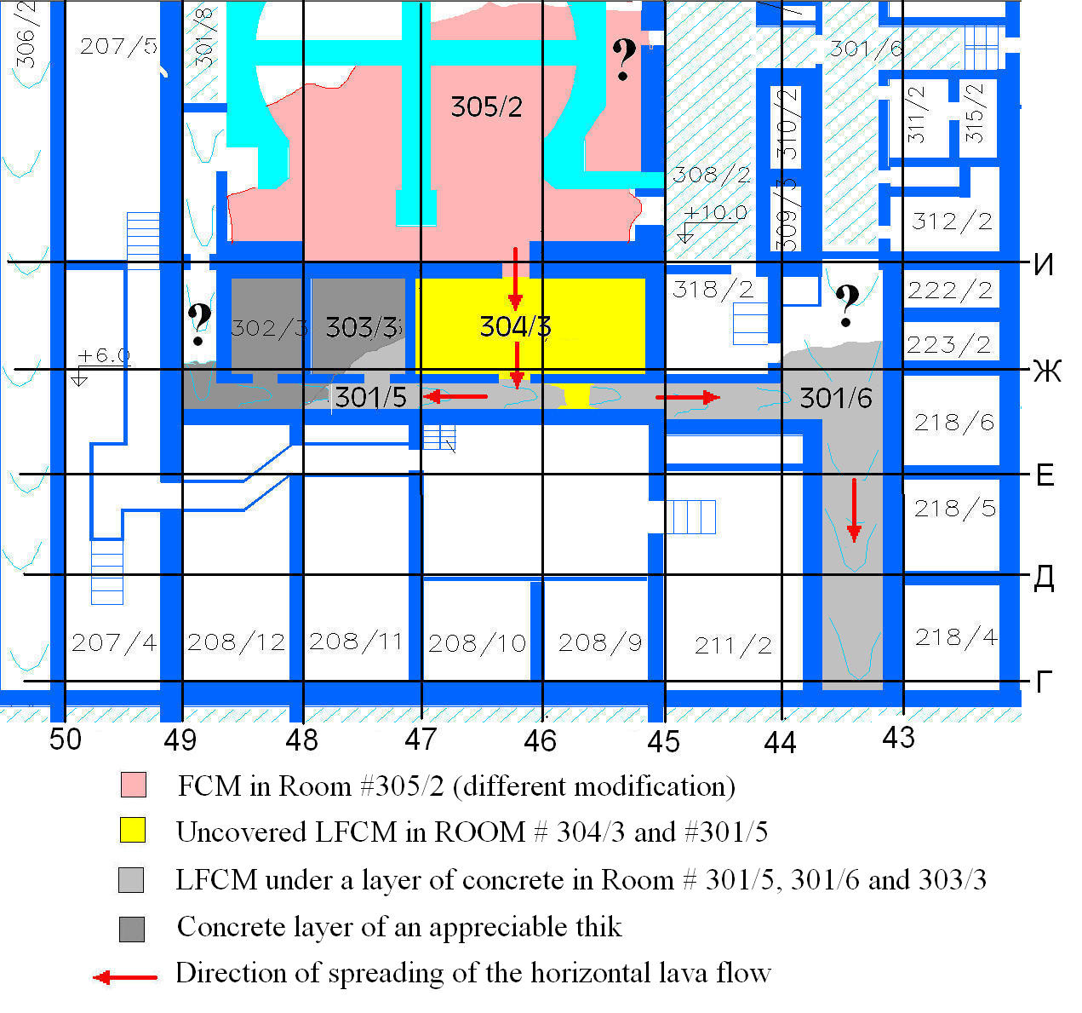
General view of horizontal flow

Slide 10
Initial data (Rooms 301/5, 301/6)
Total spreading area: ~110 m²
Average LCFM thickness:0.4 m
Total LCFM mass: ~100 t.
Average LCFM thickness: 0.4 m
Black ceramics

Slide 11
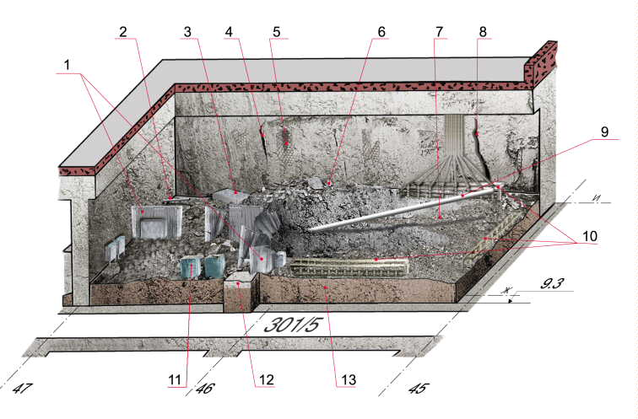
Initial data (Room 304/3)
Total area: ~70 m²
Average LFCM thickness: 0.8 m (varies between 0.6 and 1 m)
Total LCFM mass:
  Above level 9.3 m: ~135 t (50 m³)
  Below level 9.3 m:~27 t (10 m³)
Assumed erosion depth: 0.1 – 0.2 m
Black ceramics
General view

Slide 12
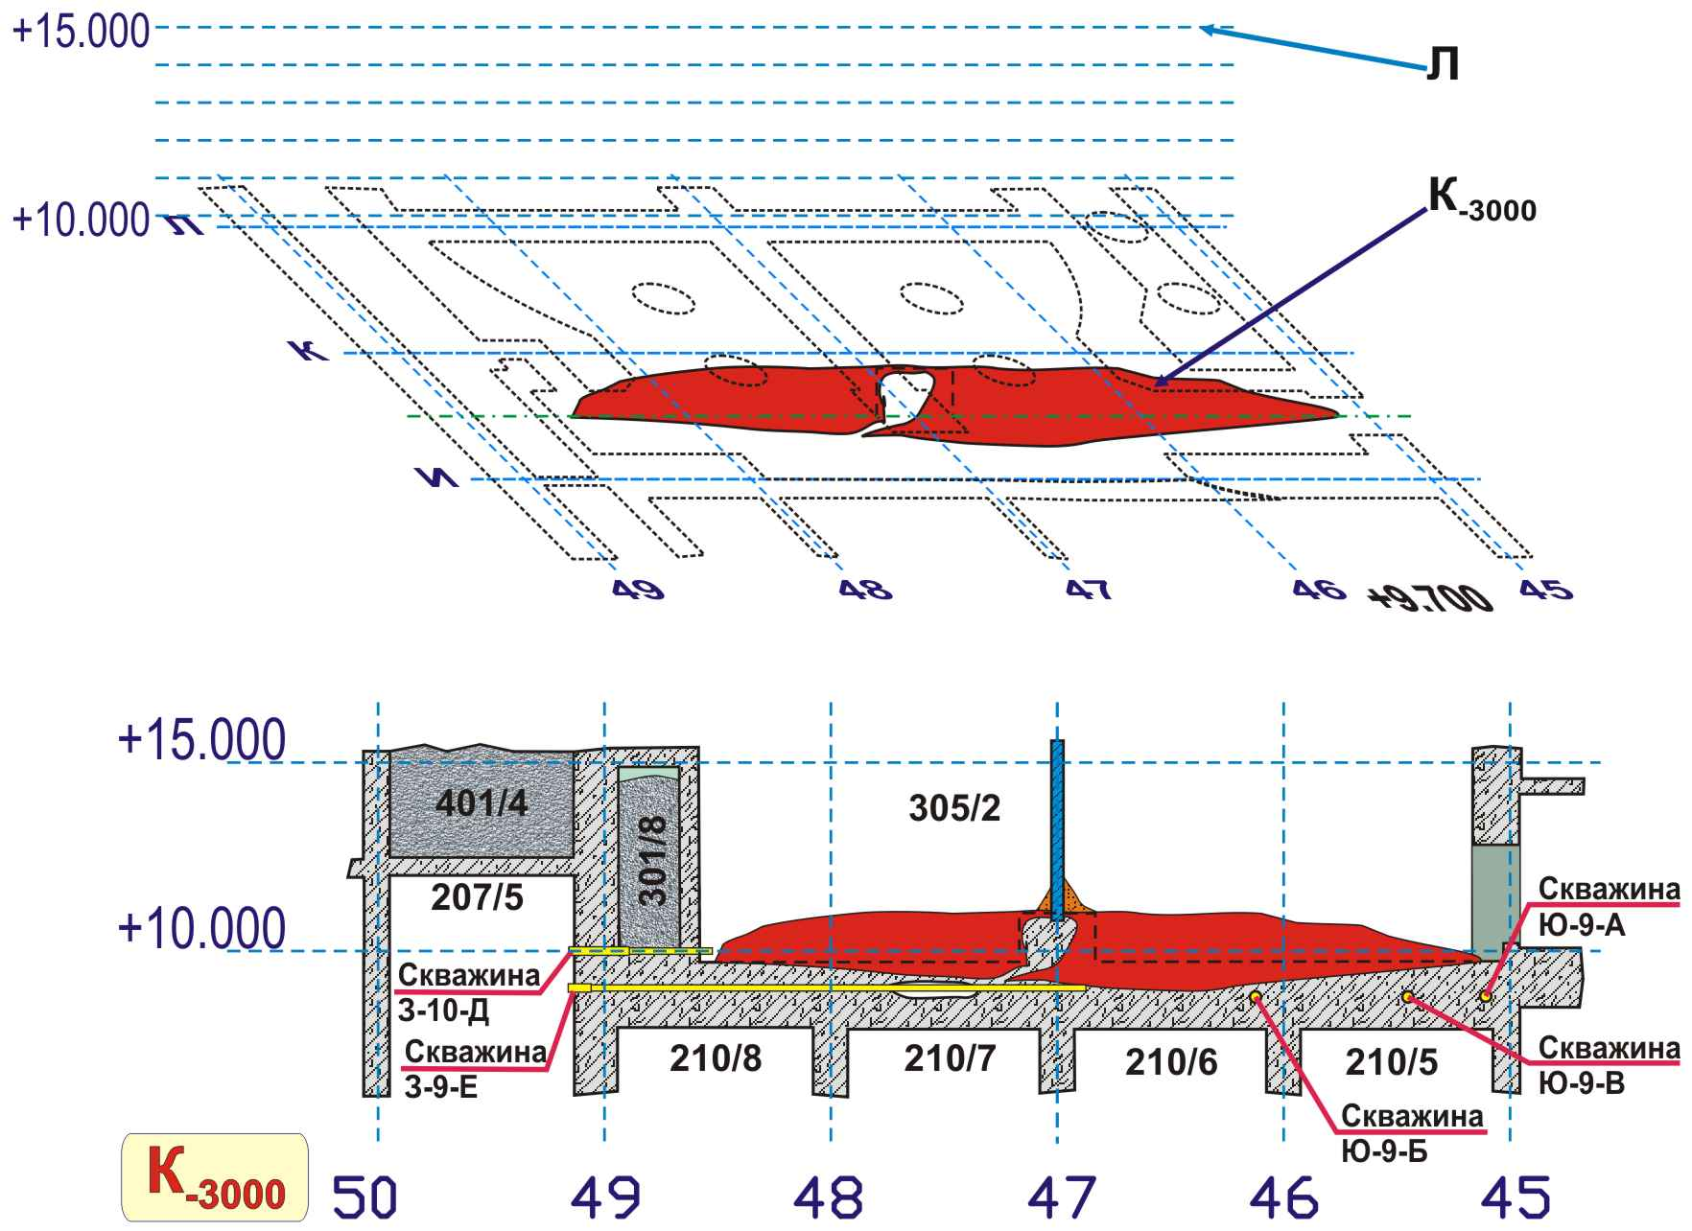
Section K-3000

Slide 13
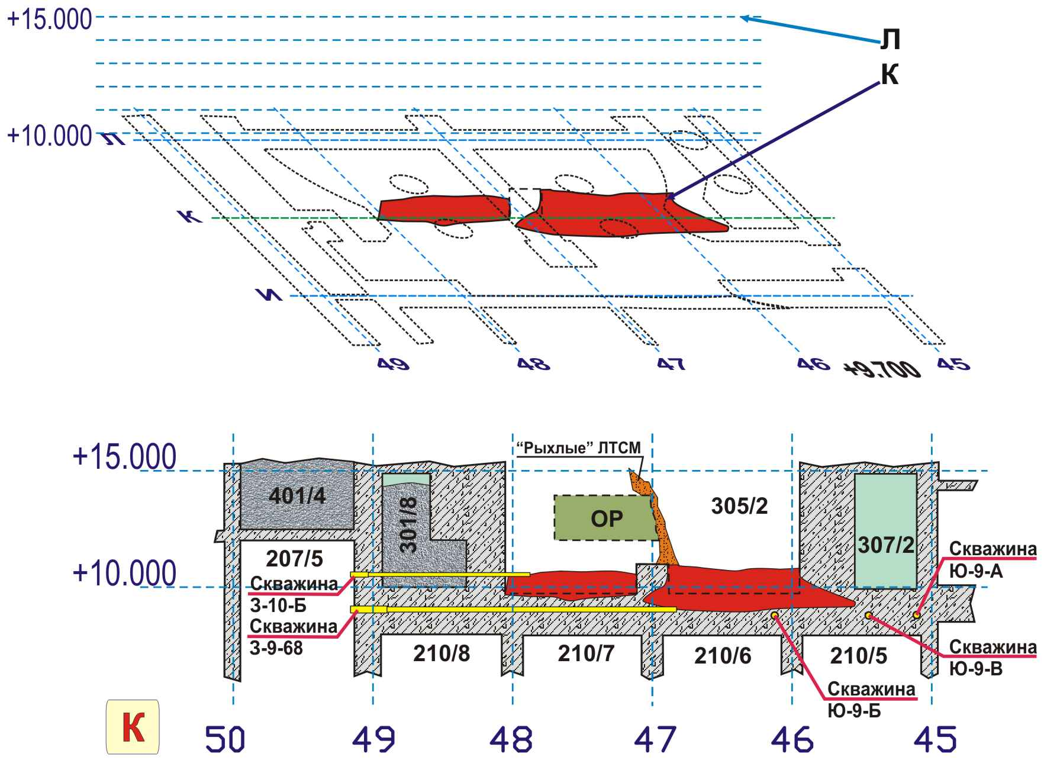
Section K

Slide 14
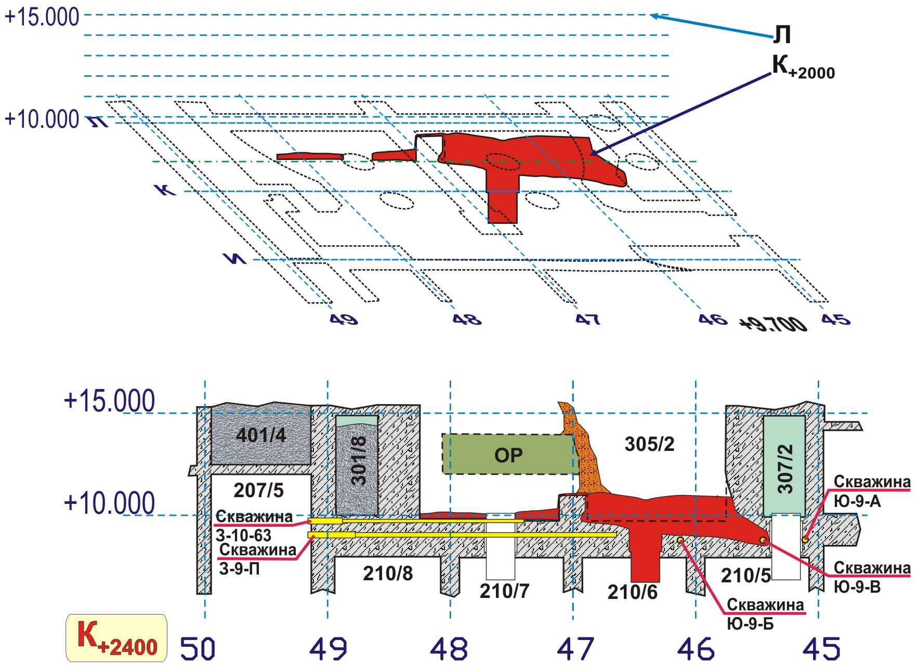
Section K+2400

Slide 15
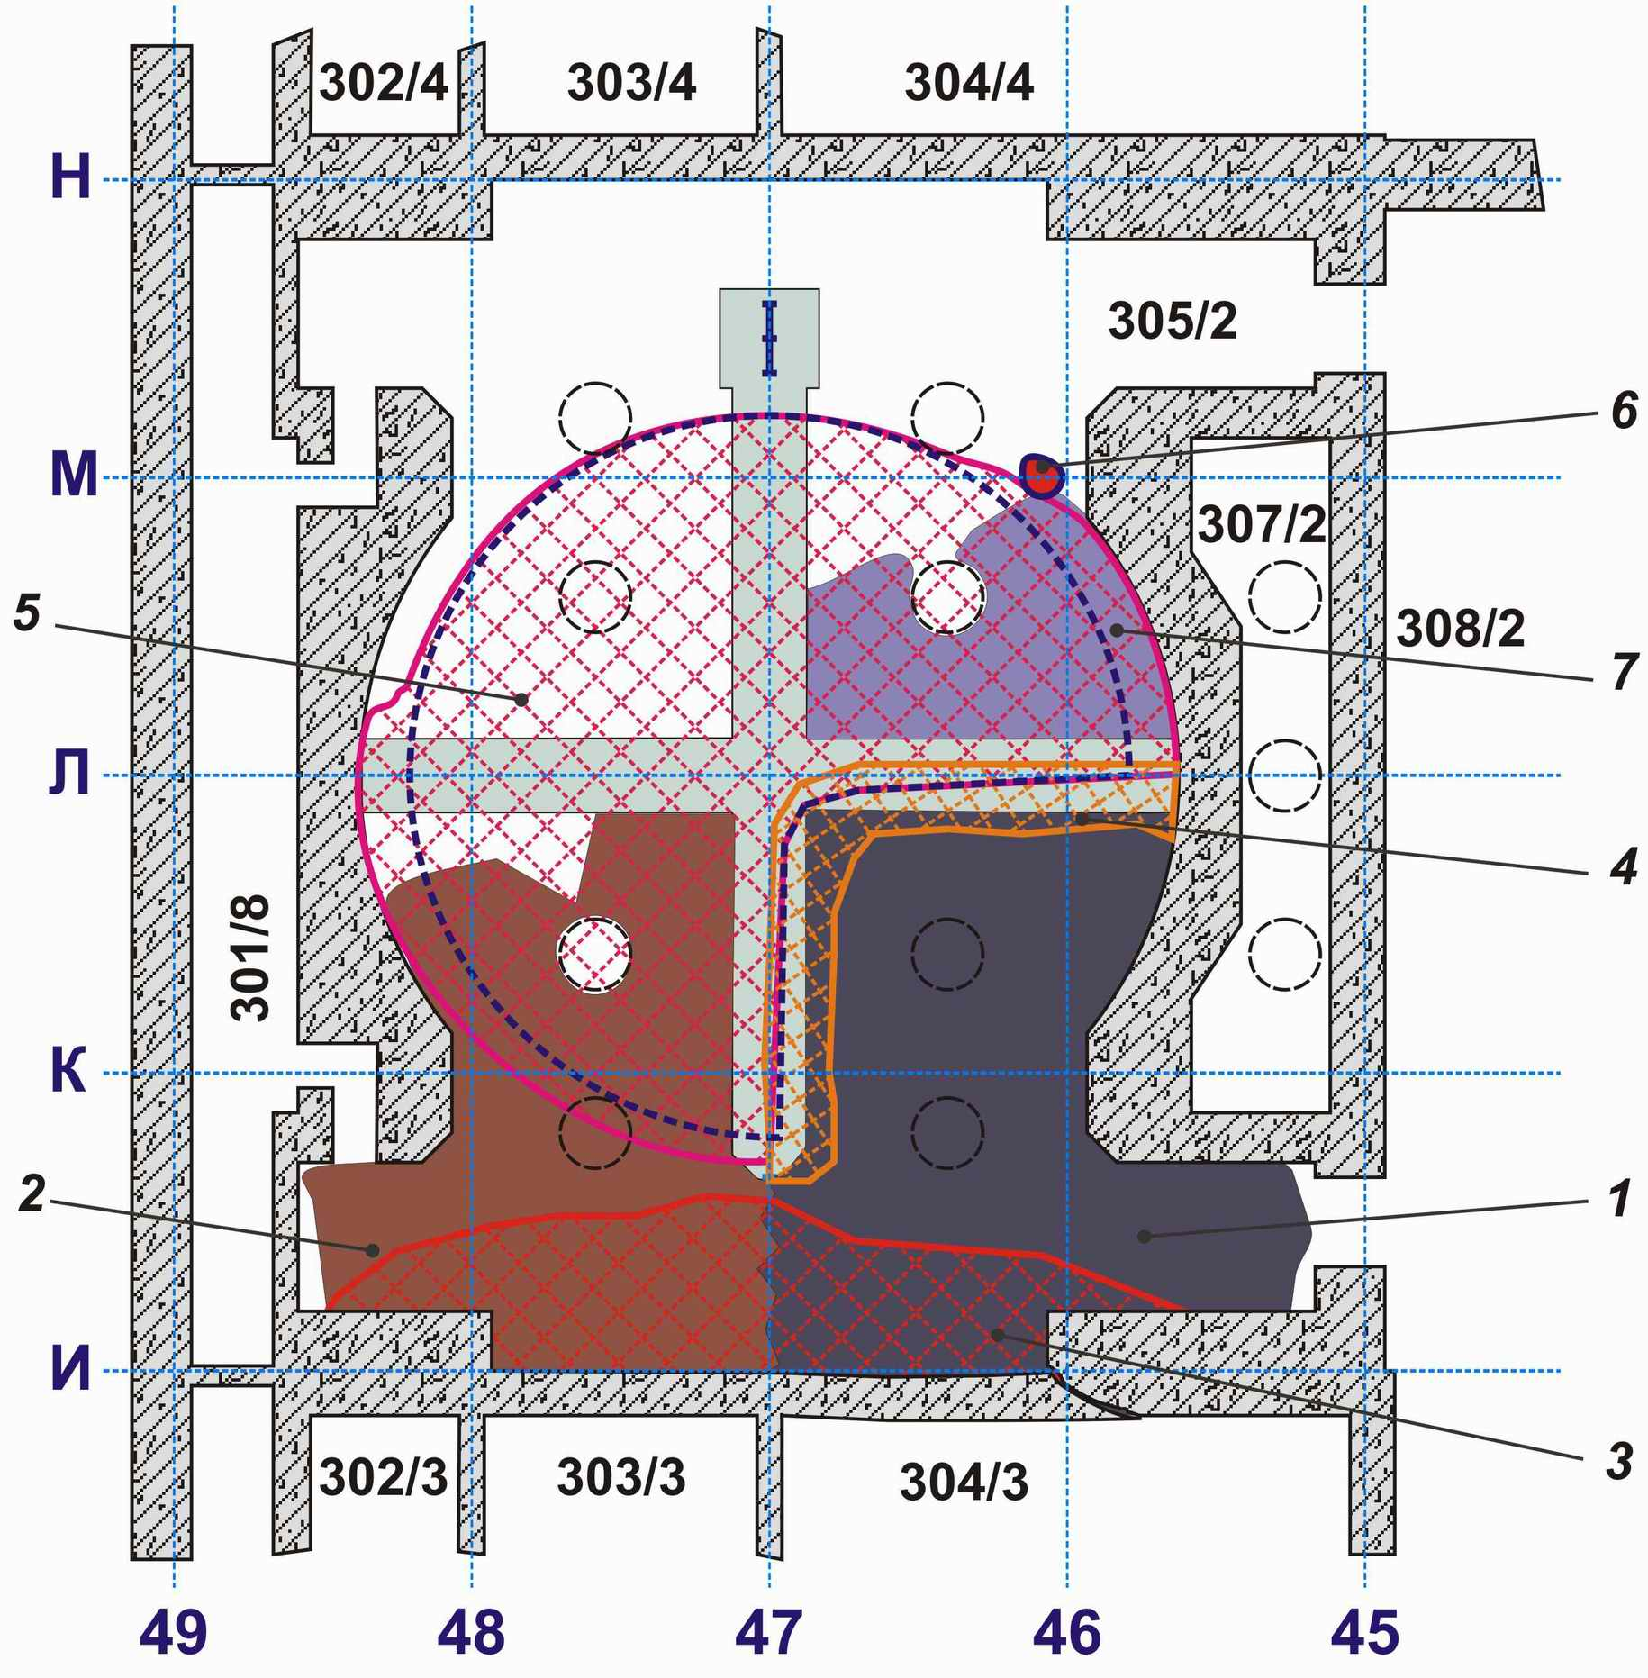
Initial data (Room 305/2)
Total area: ~200 m²
Average LCFM thickness: up to 2.5 m
Total LCFM mass above level 9.7 m: ~270 t (200 m³)
Assumed erosion depth: up to 1.5 m
Black/brown ceramics

Slide 16
LFCM compositions

Slide 17
Analysis of LFCM behavior
Room 301/5
LFCM thickness 0.5 m
Initial U concentration: 4%
Heat generation rate: 1 day (89 W/kg U)
Volumetric heat generation: 9.6 kW/m³
Initial temperature: 2400 K
Concrete thickness: 1.3 m

Slide 18
Results of calculations (4%)
No erosion
Degradation: 0.1 m

Slide 19
Results of calculations (4%)
Characteristic upper boundary cooling time about 5 hr
Characteristic LFCM cooling time about 20 hr

Slide 20
Analysis of LFCM behavior
Room 304/3
LFCM thickness 0.8 - 1 m
Heat generation rate: 1 day (89 W/kg U)
Initial volumetric heat generation: 9.6 kW/m³
Initial temperature: 2400 K
Concrete thickness: 1.3 m
Two hypotheses were considered:
  Initial melt had 4% of U
  Initial melt had 8% of U

Slide 21
Results of calculations (4%)
Erosion: 0.1 m
Degradation: 0.4 m

Slide 22
Results of calculations (8%)
Erosion: 0.33 m
Degradation: 0.73 m

Slide 23
Analysis of LFCM behavior
Room 305/2
Initial LFCM thickness 1.0 m
Initial U concentration: 16%
Heat generation rate: 1 day (89 W/kg U)
Initial volumetric heat generation: 38 kW/m³
Initial temperature: 2400 K
Concrete thickness: 1.7 m

Slide 24
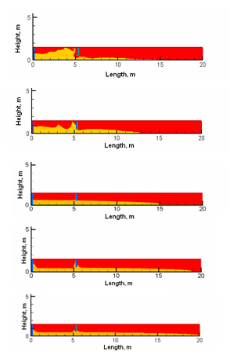
Two-dimensional flows of thin layer for different values of kinematic viscosity
Kinematic viscosity 10⁻⁴ m²/s
Characteristic time 2s
characteristic temperature 1700K
Kinematic viscosity 10⁻² m²/s
Characteristic time 2.7s
characteristic temperature 1500K
Kinematic viscosity 0.1 m2/s
Characteristic time 23 s
Characteristic temperature 1400K
Kinematic viscosity 10 m²/s
Characteristic time 2100 s
Characteristic temperature 1350К
Kinematic viscosity 100 m²/s
Characteristic time 24000 s
Characteristic temperature 1300К

Slide 25
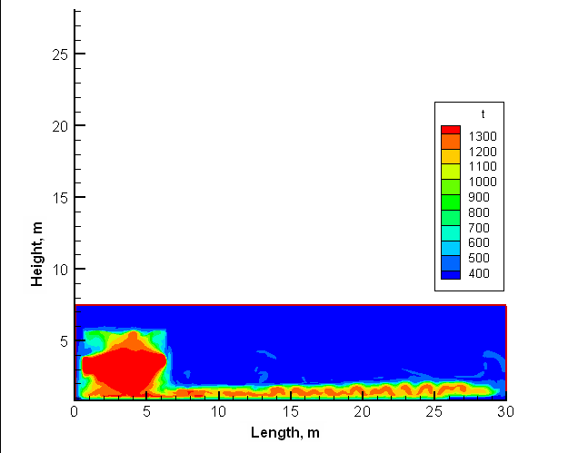
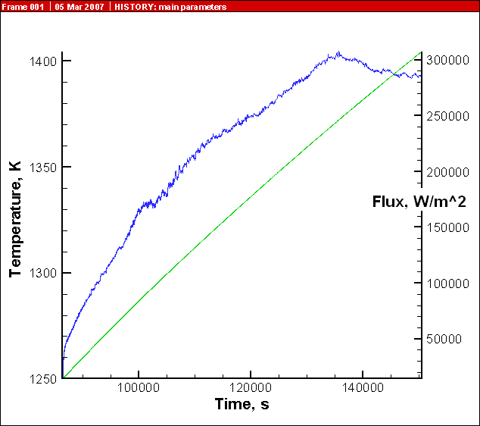
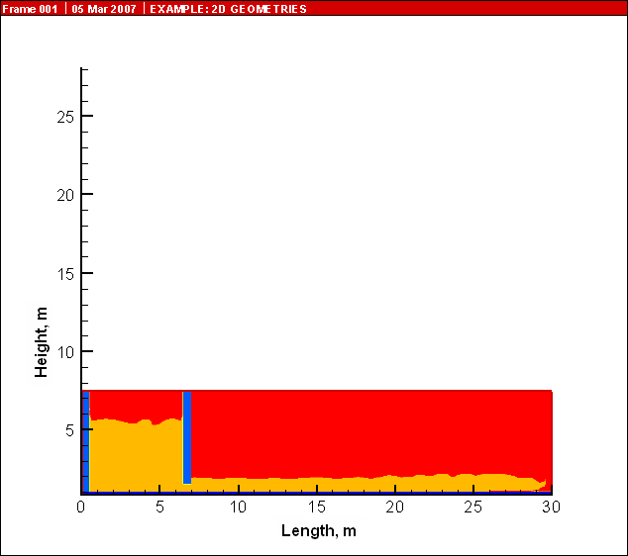
T=1250K, q=3x10⁴ W/m³
Temperature field
Map of materials

Slide 26
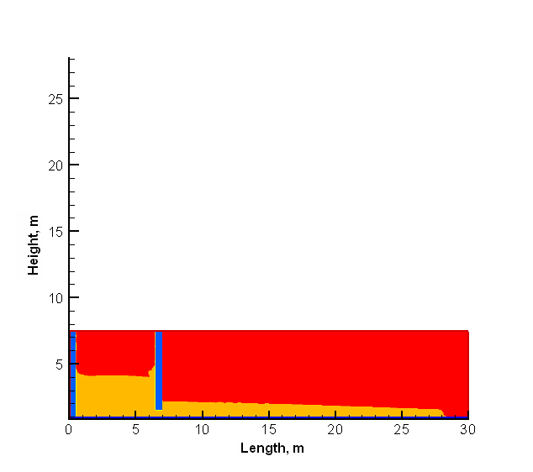
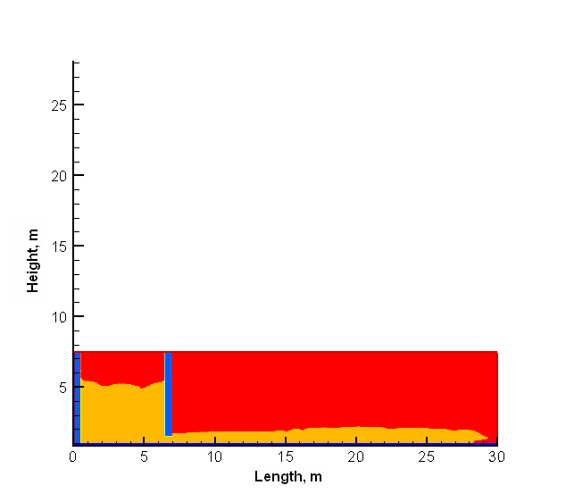
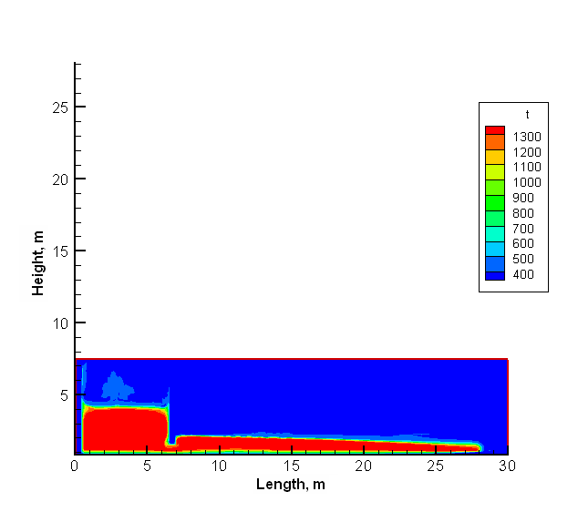
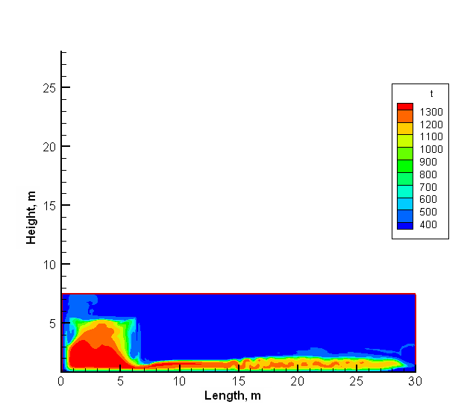
q=3x10³ W/m³
Map of materials
T=1350K
T=1300K
T=1350K
T=1300K
Temperature field

Slide 27
Summary
The computer models for simulation of the LFCM behavior have been developed and validated
Preliminary results of simulation are as follows:
  The time of cooling of 0.5 m thick layer of the melt down to 1300K, at which the process of spreading virtually terminates, makes up about 20 hours. Crust of a rather large thick (0.1 m) is generated during 5 to 6 hours.
  For 0.5 m-thick layer the depth of concrete de-structuring is 10–15 cm. This is in a good qualitative agreement with the observed values.
  For 1 m-thick layer and 4% of U the depth of erosion was about 0.1 m concrete de-structuring is 0.3 – 0.4 m which is in a reasonable quantitative agreement.

