Slide 1
International Science and Technology Center
Progress Report on the Project # 2936
Modelling of Reactor Core Behaviour under Severe Accident Conditions. Melt Formation, Relocation and Evolution of Molten Pool
(Reactor Core Melting)
Presented by
M.S. Veshchunov (IBRAE)
9th Meeting CEG-CM
Paris
March 7-9, 2006

Slide 2
General Information
Leading Institution: | IBRAE, Moscow (Nuclear Safety Institute of Russian Academy of Sciences)
Duration: Commencement: | 3 years August 2004
Total cost: | $ 200 000

Slide 3
Non-CIS Collaborators
FZK | Forschungszentrum Karlsruhe GmbH | Germany Karlsruhe
ITU | European Commission Joint Research Centre Institut für Transurane | Germany Karlsruhe
IRSN | Institut de Radioprotection et de Sûreté Nucléaire | France Cadarache
KAERI | Korea Atomic Energy Research Institute | Korea Taejon
FZR | Forschungszentrum Rossendorf GmbH | Germany Rossendorf
CEA | Commisariat à l’Energie Atomique | France Cadarache

Slide 4
Project Objectives
On the base of detailed analysis of available and new experimental data, to update, improve and verify models on reactor core molten materials behaviour at consecutive stages of a severe accident:
  • from the early stage, when melt formation and progression during core degradation occur (SVECHA/MELT code),
  • to the late stage, when the core is completely degraded and a molten pool is formed in lower head of the PRV (CONV code),
and to prepare them for benchmarking of simplified models and for implementation in the existing SA system codes

Slide 5
Technical Schedule
Task Completion
Quarter | 4 | 7 | 8 | 10 | 12
Task №№ | 1, 6 | 2 | 7 | 3 | 4, 5, 8
Task 1: Modelling of melt formation and onset of melt relocation – completed (reported at the 7-th CEG-SAM Meeting)
Task 2: Modelling of candling process – analytical part completed (reported at the 8-th CEG-SAM Meeting)
Task 3: Modelling of slug relocation – analytical part completed (reported at the 8-th CEG-SAM Meeting)
Task 6: Development of the three-dimensional CFD code and adaptation to the LIVE project - completed (reported at the 7-th and 8-th CEG-SAM Meetings)

Slide 6
Scope of Current Activities
Task 3: Modelling of slug relocation
  Development and implementation in the SVECHA code of the numerical model for the slug relocation*. Performance of verification calculations.
Task 7: Theoretical analysis and the CONV code validation
  The numerical-theoretical analysis of the flows in a boundary layer adjacent to cooled boundaries*. Validation of the developed flow models using experimental data, including experiments with a heat generating fluid such as LIVE, COPO, SIMECO .
  * completed (and presented below)

Slide 7
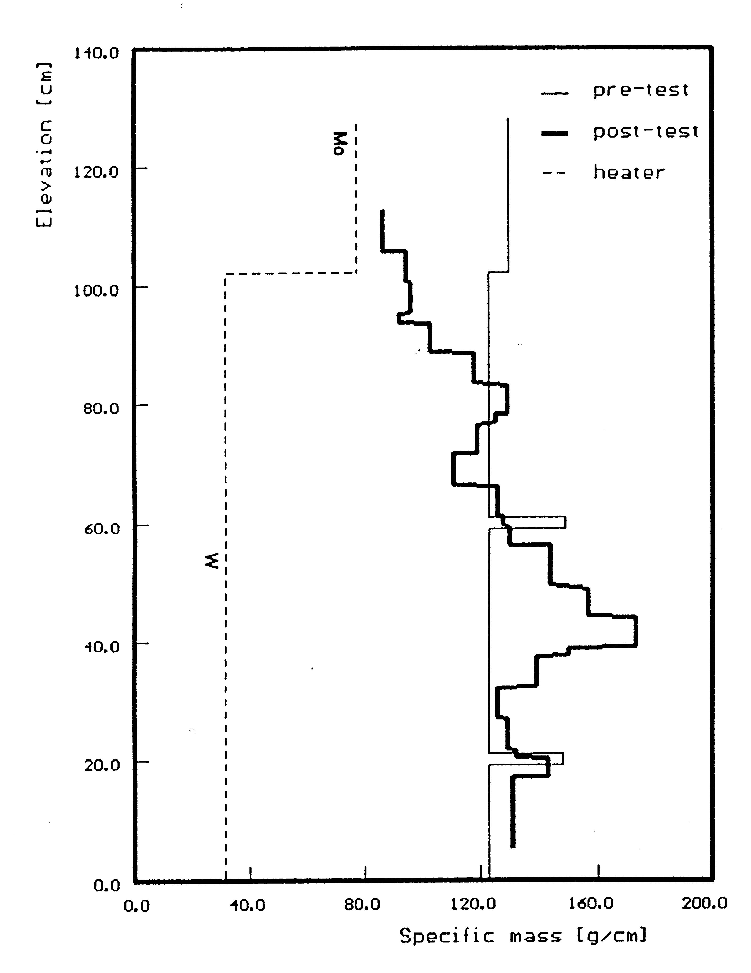
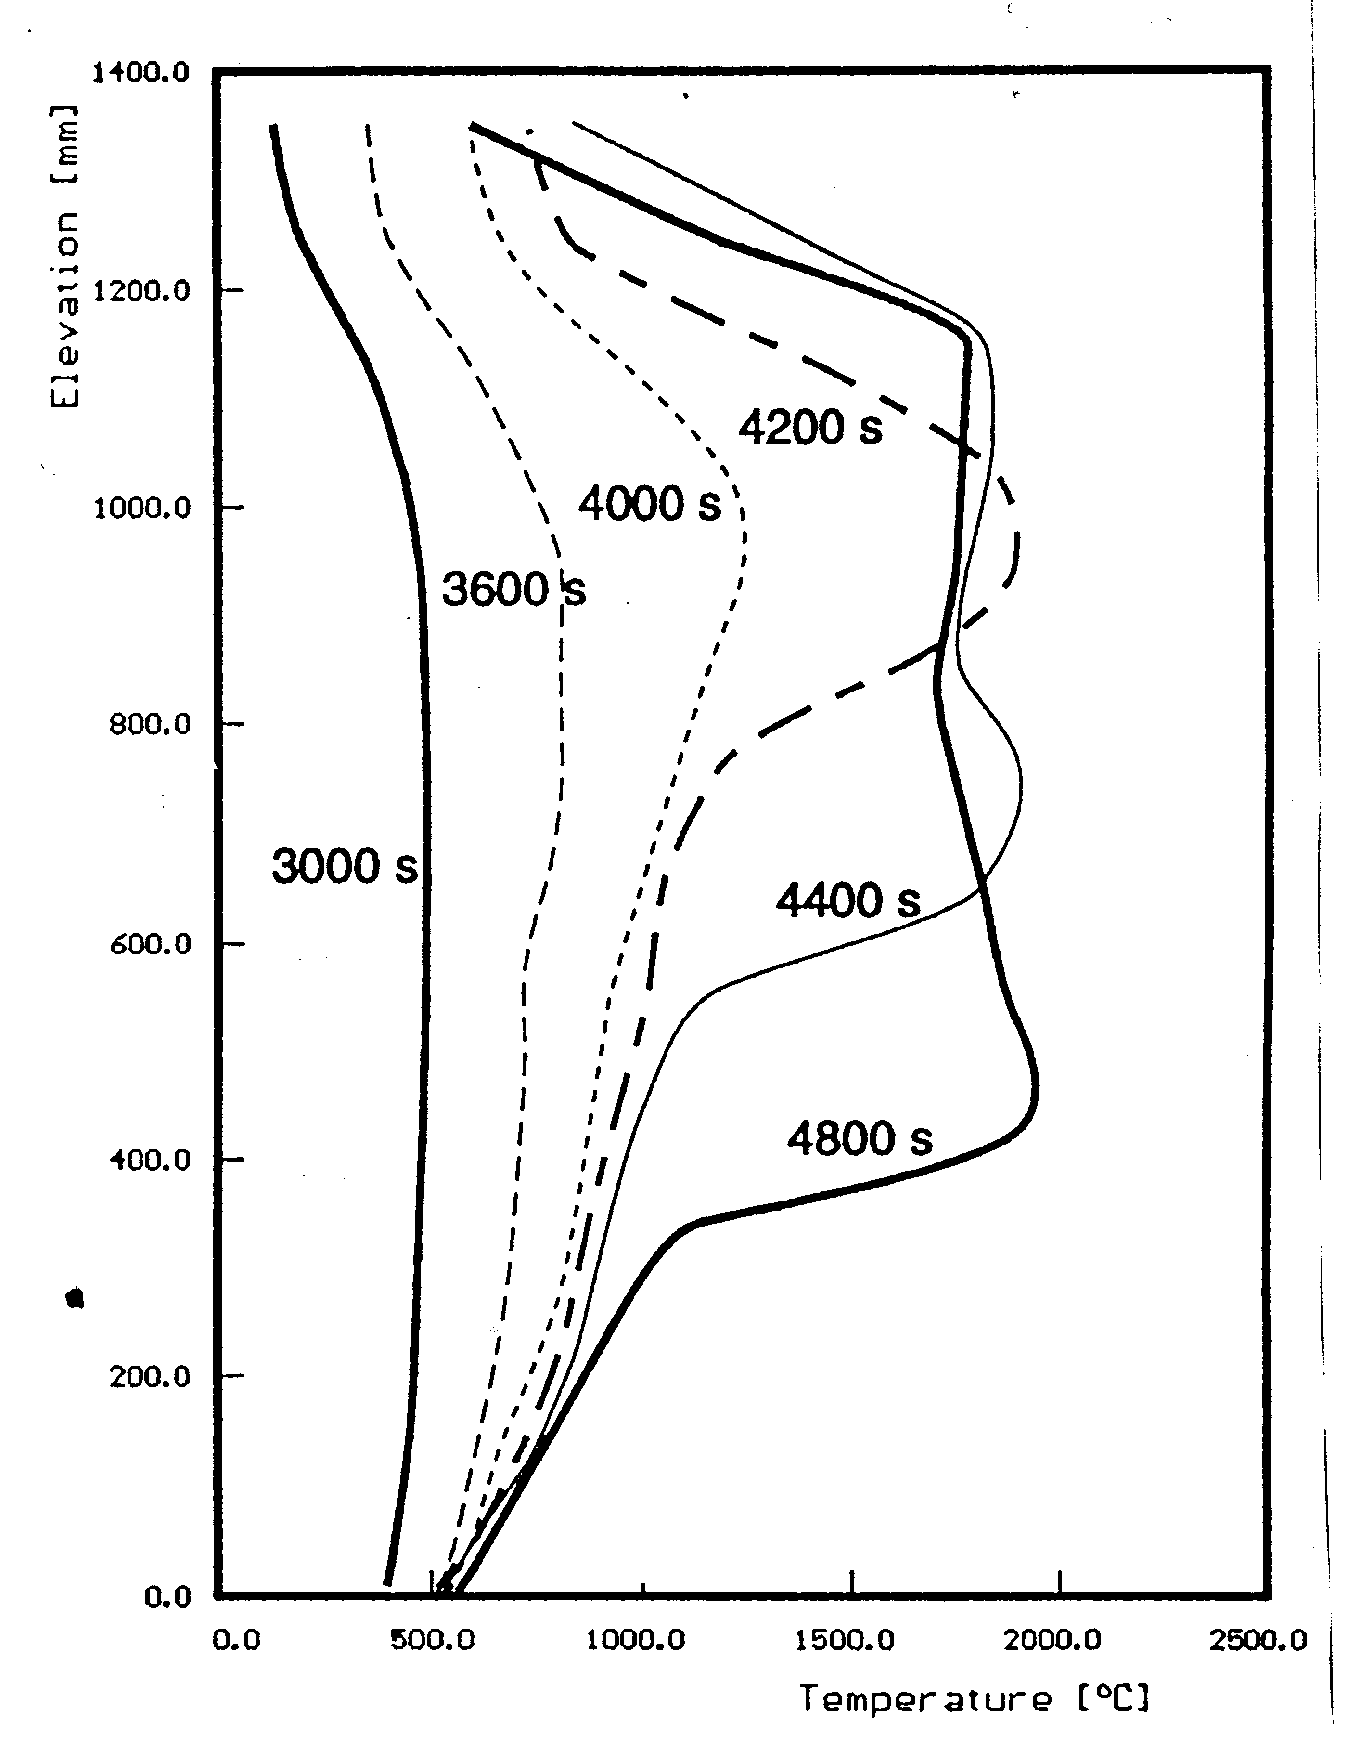
Task 3. Modelling of slug relocation
Axial mass distribution after the test and axial temperature distribution during the transient phase in CORA-W1 test
Estimated velocity of relocation front: ≈ 1mm/s

Slide 8
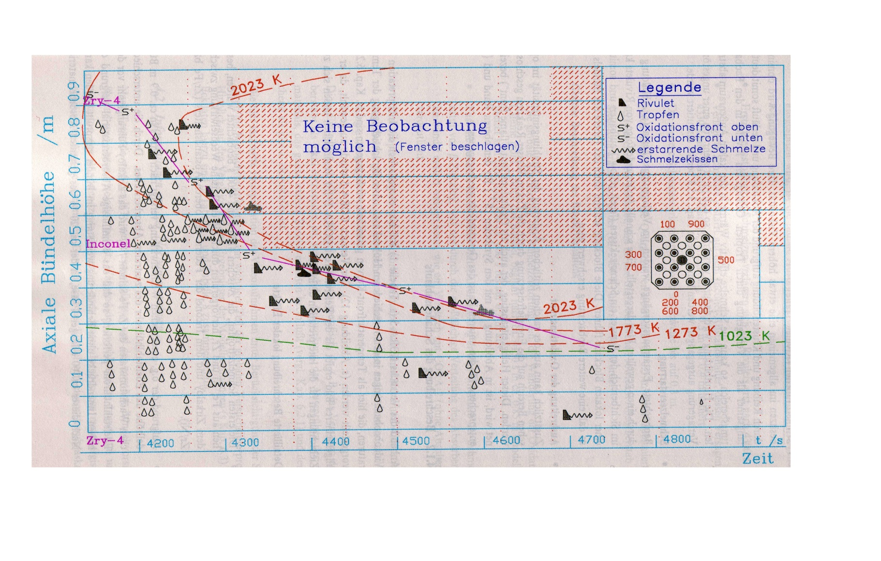
Progression of “flame” and “droplets/rivulets” fronts
.
Analysis of on-line video inspections in CORA-5 test (W. Hering, FZK, thesis)

Slide 9
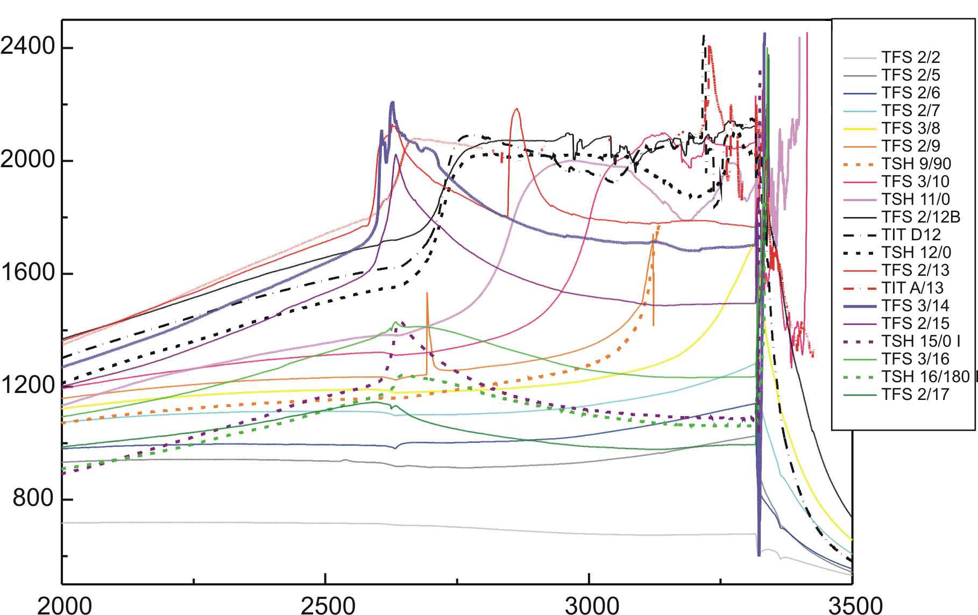
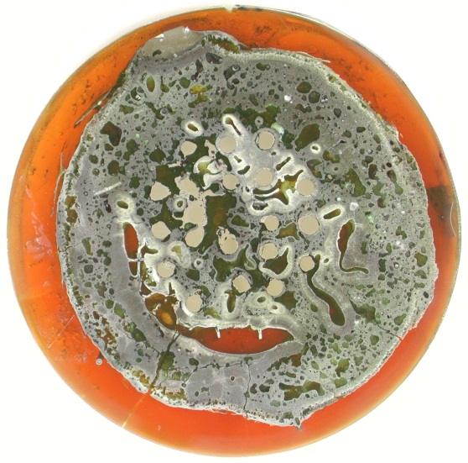
Progression of temperature front during melt relocation in Q-09 test
T, K
.
1050 mm
850 mm
750 mm
650 mm
Final state of slug at elevation 590 mm
Time, s
Temperature evolution at various elevations before quenching.
Estimated velocity of relocation front: ≈ 1mm/s

Slide 10
Main conclusions from tests observations
Temperature front with T≈2000ºC in CORA tests relocated downward with a characteristic velocity v₁ ∼ 1-2 mm/s, which was extremely small in comparison with the characteristic velocities of metal rivulets and droplets (v₂ ∼ 0.5 m/s)
A similar melt progression (v₁∼1mm/s) apparently took place in QUENCH-09 test
Oxidation front (or “flamefront”) in CORA tests relocated coherently either with a “droplet/rivulets front” or with Zr melting isotherm, i.e. fairly associated with the melt progression front

Slide 11
SVECHA code slug relocation model (1)
Mass and heat exchange
The slug relocation model describes slow relocation of a massive melt (“slug”) and its chemical interactions with fuel rods and steam. The model is based on the mass and heat balance relations:
  mass exchange due to slug oxidation and chemical interaction with the neighbouring rods,
  mass exchange due to drops and rivulets joining from the upper elevations,
  heat exchange of the slug with surrounding media.
The model accounts for the heat effects of oxidation and dissolution.
Therefore, the model allows self-consistent calculation of the slug front oxidation and relocation.

Slide 12
SVECHA code slug relocation model (2)
Numerical module
Slug relocation model is realized as the computer module named “QSLG”.
The QSLG module consisted of 18 program units is under implementation in the SVECHA code.
Data on melt oxidation and dissolution are provided by the ‘melt oxidation – fuel dissolution’ module of the SVECHA code coupled with the slug relocation module on a time step.
Data on the slug heat exchange with surroundings (fuel rods temperatures, shroud and gas mixture temperatures, gas mixture thermal conductivity) are provided by the SVECHA heat exchange and gas dynamics modules coupled with the slug relocation module on a time step.
Properties of the U-Zr-O melt (mole mass, enthalpy, density, specific heat capacity and thermal conductivity) are calculated using MATPRO data base.

Slide 13
Task 7: Theoretical analysis and CONV code validation
The numerical simulation of a natural convection and heat flux distribution will be compared with the theoretical analysis of flows in a boundary layer adjacent to cooled boundaries:
  L.A. Bolshov, P.S. Kondratenko, V.F. Strizhov, A semi-quantitative theory of convective heat transfer in a heat generating fluid, Int. J. Heat and Mass Transfer, Vol.41 (1997), № 10, pp.1223-1227.
  L.A. Bolshov, P.S. Kondratenko, Limiting angular characteristics of heat transfer and stratification in a heat-generating fluid, International Journal of Heat and Mass Transfer, Vol.43 (2000), № 20, pp.3897-3905
  L.A. Bolshov, P.S. Kondratenko, V.F. Strizhov. Buoyancy-induced convection of heat generating liquid. Uspehi Fiz. Nauk Vol.171(2001), №10, pp.1051-1070

Slide 14
Free convection in a heat generating fluid
Conservation laws for mass, longitudinal component of impulse and fluid energy in laminar boundary layer (BL):
Solution can be searched in the form of power dependence from polar angle θ and height z:

Slide 15
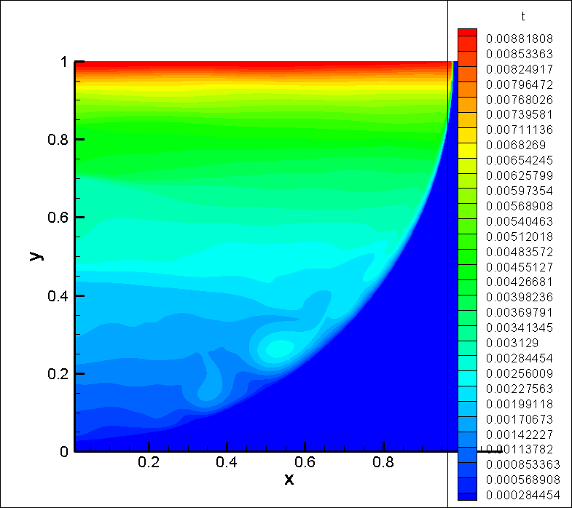
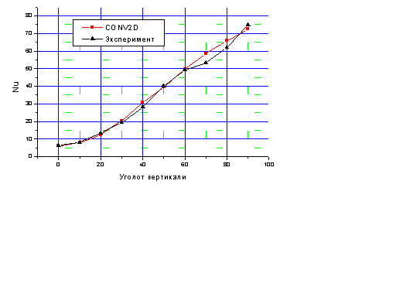
Laminar boundary layer in semicircular geometry
Analytical evaluation:
Direct Numerical Simulation:
(adiabatic upper and isothermal lateral boundaries; Ra=10⁸-10¹²; mesh resolution corresponds to Kolmogorov’s scale)
Nu
θ
Solution:
Solution:
Heat fluxes in BL demonstrate a dependence close to square-law: q ~ a+bθ², in correspondence with theoretical analysis (a = 2).

Slide 16
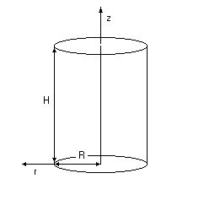
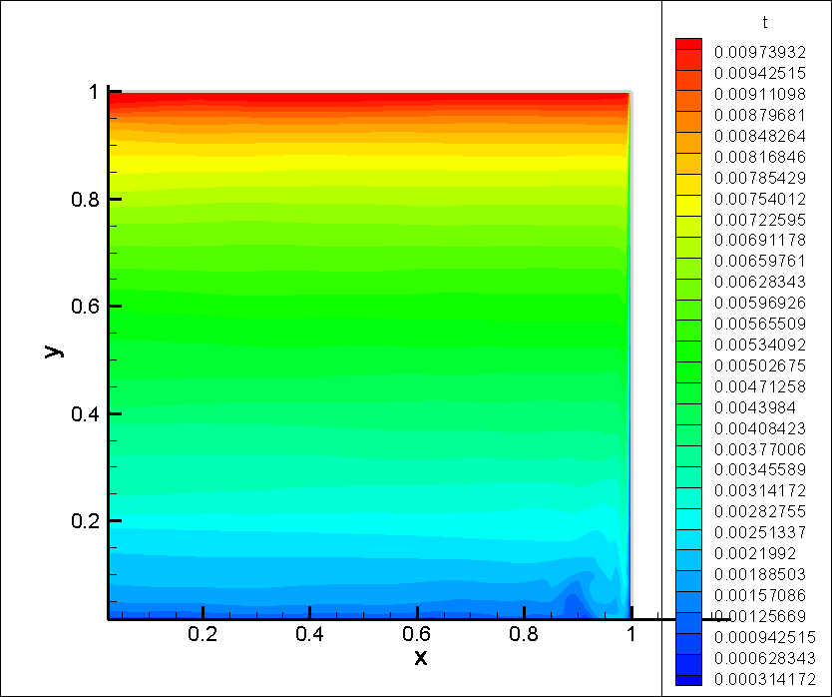
Lateral boundary layer in cylindrical geometry
Analytical evaluation:
Direct Numerical Simulation:
Isotherms.
Ra=10¹²
Solution:
for
for

Slide 17
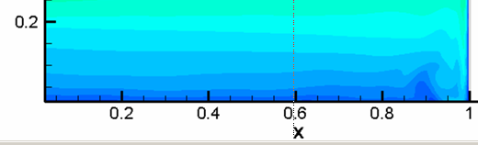
Bottom boundary layer in cylindrical geometry
Analytical evaluation:
Direct Numerical Simulation:
ratio of heat fluxes to the lower and lateral boundaries:
Ra | 10⁸ | 10⁹ | 10¹⁰ | 10¹¹ | 10¹²
r(Ra): analytical | 0.129 | 0.1 | 0.071 | 0.057 | 0.044
r(Ra): numerical | 0.125 | 0.095 | 0.076 | 0.058 | 0.048

Slide 18
Oxidation of confined molten corium (1)
Melt oxidation model, developed within Task 1 of the Project, was applied to designing possible crucible tests in steam
Crucible tests with “cold” ceramic walls and “hot” free oxidizing surface with inductive heating of metallic melt should model molten pool (MP) oxidation in the lower head of the (cooled) reactor vessel
Oxide crust
Steam
Steam
Oxide crust
Zr-O
ZrO₂
Molten corium
Lower head
Schematic representation of crucible tests with “cold” ceramic walls and “hot” free surface, interacting with steam.
Schematic representation of molten pool oxidation in lower head of reactor vessel

Slide 19
Oxidation of confined molten corium (2)
Analysis of heat flux matches at the MP surfaces shows that temperature drop across the boundary layer in the melt is:
  positive on the free upper surface, if heat losses from the surface are less in comparison with oxidation heat generated at this surface
  negative on crucible/melt interfaces owing to high heat losses in the cooled walls
Calculations were performed with the following UO₂ (or ZrO₂) crucible parameters: R = 36.5 mm, h = 10 mm, wall thickness 7 mm. The charge is produced from the mixture of metallic Zr and ceramic ZrO₂ phases with the average atomic composition Zr:O = 2.7:1.
Solution depends on the ratio between positive (over the “hot” surface) and negative (over the “cold” surface) oxygen fluxes

Slide 20
Oxidation of confined molten corium (3)
Predictions for “cold” ceramic walls (ΔT_{w} < 0) and “hot” free surface (ΔT_{up} > 0) at the MP temperature 2540K
ΔT_{w} = -10K; ΔT_{up} = +30K
ΔT_{w} = -30K; ΔT_{up} = +30K
Conclusion: In oxidizing atmosphere cooling of the MP through the walls can be significantly suppressed owing to oxide crust growth on the walls, leading to a hazardous increase of the MP temperature

Slide 21
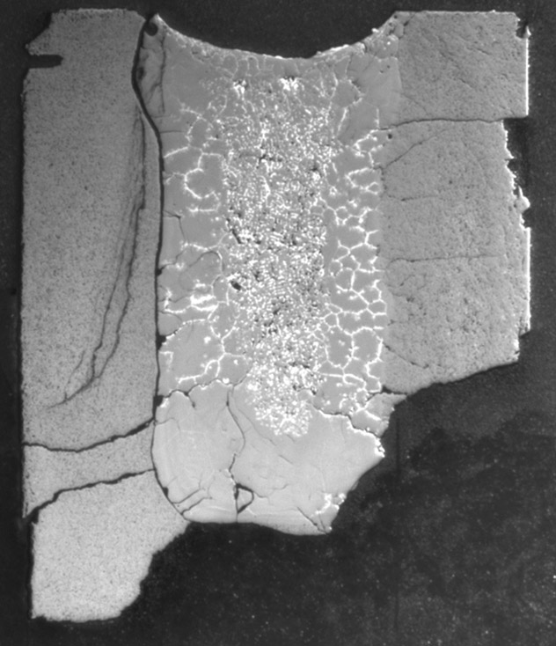
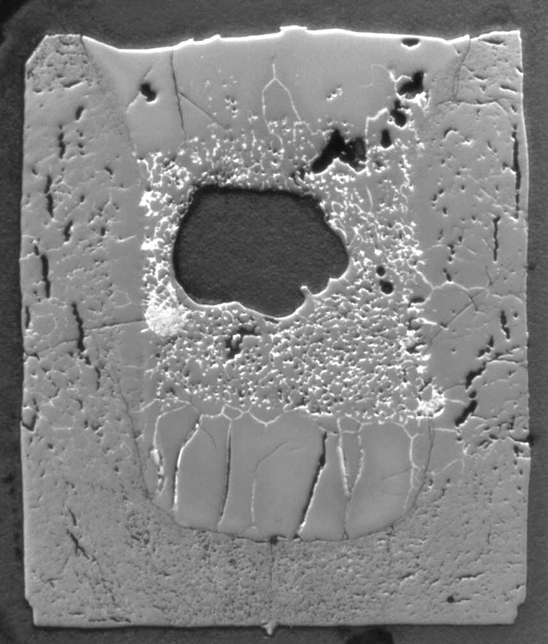
FZK Previous Tests
FA11: 75 min. Corrosion layer 1.69 mm | FA10: 290 min. Corrosion layer 0 mm
Inert atmosphere
“Cold” surface
Tests at 2200 °C

Slide 22
Conclusions
ISTC Project #2936 is under development in accordance with the Project Technical Schedule:
Task 1: The model of corium melt oxidation is further developed and applied to designing possible crucible tests in steam; the model is implemented in the SVECHA code and gives important predictions concerning MP oxidation and cooling
Task 3: Modelling of the slug relocation at the second stage of core degradation: the numerical module is developed on the base of the new physical model and is under implementation in the SVECHA code
Task 7: Theoretical analysis and the CONV code validation:
Results of numerical simulation of a natural convection and heat flux distribution in a heat generating fluid are in good agreement with results of theoretical analysis for distributions of heat fluxes in the boundary layer:
  on the lateral boundary in semicircular geometry
  on the lateral and lower boundaries in cylindrical geometry.

