Slide 1
International Science and Technology Center
Final Report on the Project # 2936
Modelling of Reactor Core Behaviour under Severe Accident Conditions. Melt Formation, Relocation and Evolution of Molten Pool
(Reactor Core Melting)
Presented by
M.S. Veshchunov (IBRAE)
12th Meeting CEG-CM
Saint Petersburg, Russia
SPAEP (Atomenergoproekt)
September 11-13, 2007

Slide 2
General Information
Leading Institution: | IBRAE, Moscow (Nuclear Safety Institute of Russian Academy of Sciences)
Duration: Commencement: | 3 years August 2004
Total cost: | $ 200 000

Slide 3
Non-CIS Collaborators
CEA | Commisariat à l’Energie Atomique | France Cadarache
FZK | Forschungszentrum Karlsruhe GmbH | Germany Karlsruhe
FZR | Forschungszentrum Rossendorf GmbH | Germany Rossendorf
IRSN | Institut de Radioprotection et de Sûreté Nucléaire | France Cadarache
ITU | European Commission Joint Research Centre Institut für Transurane | Germany Karlsruhe
KAERI | Korea Atomic Energy Research Institute | Korea Taejon

Slide 4
Project Objectives
On the base of detailed analysis of available and new experimental data, to update, improve and verify models on reactor core molten materials behaviour at consecutive stages of a severe accident:
  • from the early stage, when melt formation and progression during core degradation occur (SVECHA/MELT code): Tasks 1-5;
  • to the late stage, when the core is completely degraded and a molten pool is formed in lower head of the PRV (CONV code): Tasks 6-8;
and to prepare them for benchmarking of simplified models and for implementation in the existing SA system codes

Slide 5
Task 1: Modelling of melt formation and onset of melt relocation
Improvement and implementation in the SVECHA code of the models for dissolution of ZrO₂ and UO₂ by molten Zircaloy, U-Zr-O melt oxidation and release from the cladding breach. Performance of verification calculations:
The melt dissolution/oxidation model was extended to non-equilibrium conditions of severe accidents, on the base of the new crucible tests data from FZK collaborators. On the base of newly developed models, new numerical modules were developed and implemented in the SVECHA code with tight coupling of these modules with other SVECHA modules describing heat exchange, cladding oxidation and thermo-mechanical deformation.
The model for dissolution of ZrO₂ and UO₂ by molten Zircaloy and U-Zr-O melt oxidation was extended to non-equilibrium conditions and validated against FZK crucible tests data. The modified SVECHA code was applied to interpretation of corium melt behaviour in the in-pile tests Phebus FP, in cooperation with collaborators from JRC, IRSN and CEA.

Slide 6
Single Rod Code
SVECHA/QUENCH
Vertical Mesh
SVECHA/QUENCH code simulates fuel rod behaviour under severe accident conditions.
Fuel rod is divided into a number of meshes along axial and radial directions.
Mesh contains UO₂ fuel pellet and the multilayered oxidized Zr cladding.
α-Zr(O)
Pellet
ZrO₂
Gap
Coolant flow:
H₂O(l), H₂O(g), O₂, Ar, H₂
Zr Cladding

Slide 7
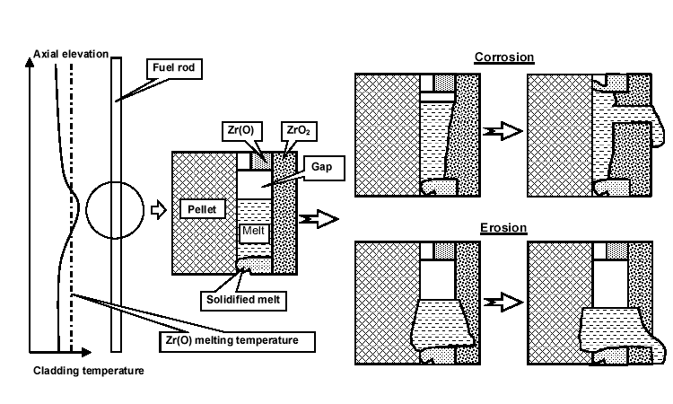
Failure Criteria of SVECHA Code
Gap vanishing owing to volumetric expansion of oxidised cladding
Oxide scale dissolution by metallic melt

Slide 8
Application of Cladding Oxide Shell Failure Criteria (1/2)
Phebus FPT0
PBF SFD 1-4

Slide 9
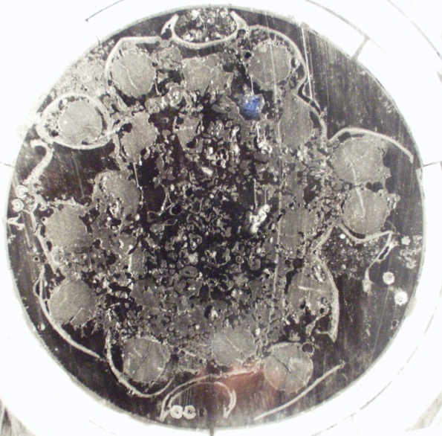
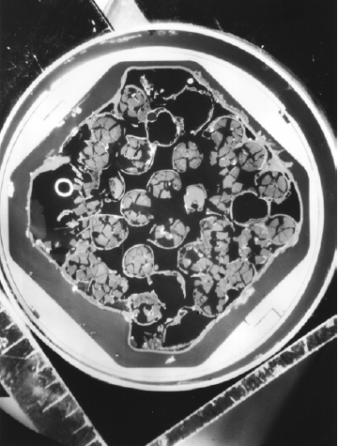
Application of Cladding Oxide Shell Failure criteria (2/2)
Phebus FPT0
PBF SFD 1-4
Upper elevations
Breaching of clad during transient;
Formation of local molten pool(s); Incomplete melt oxidation; Downward melt relocation
Intact geometry of fuel rods;
Complete clad oxidation;
Rupture and slumping of the rods caused by thermal stresses;
Formation of a debris bed in the upper and mid-bundle zone
Conclusion: The core degradation scenario is rather sensitive to the clad failure criteria (paper submitted to NED)

Slide 10
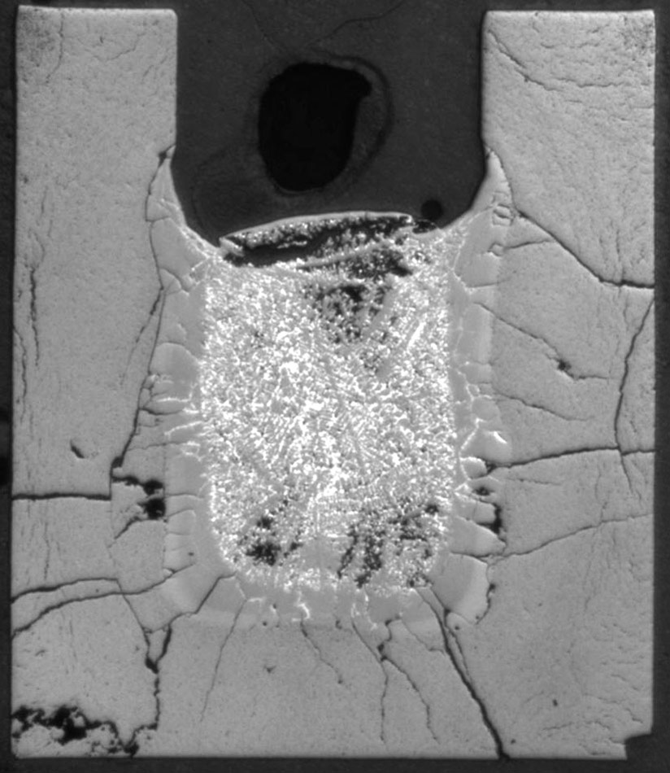
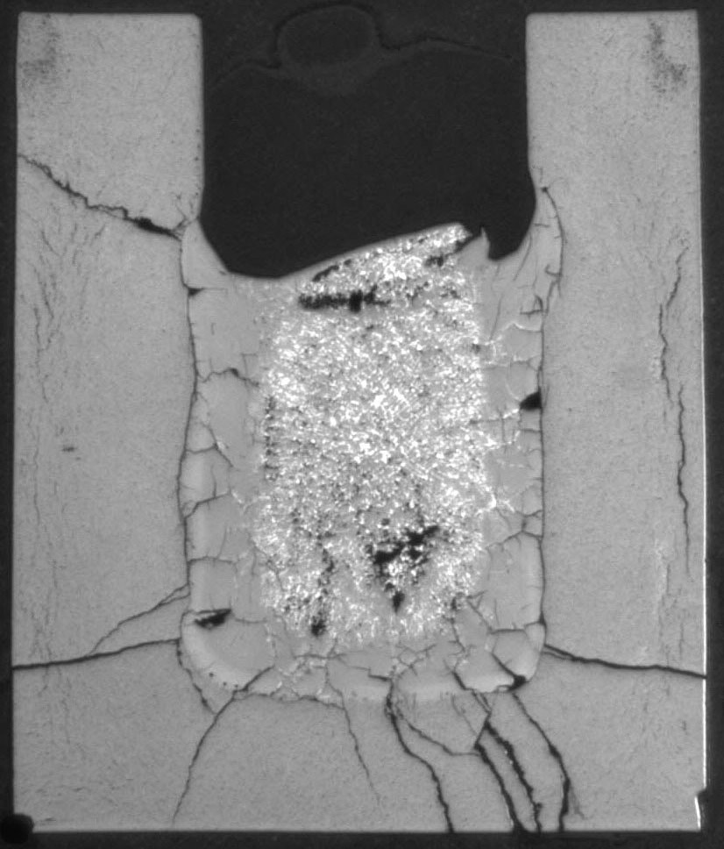
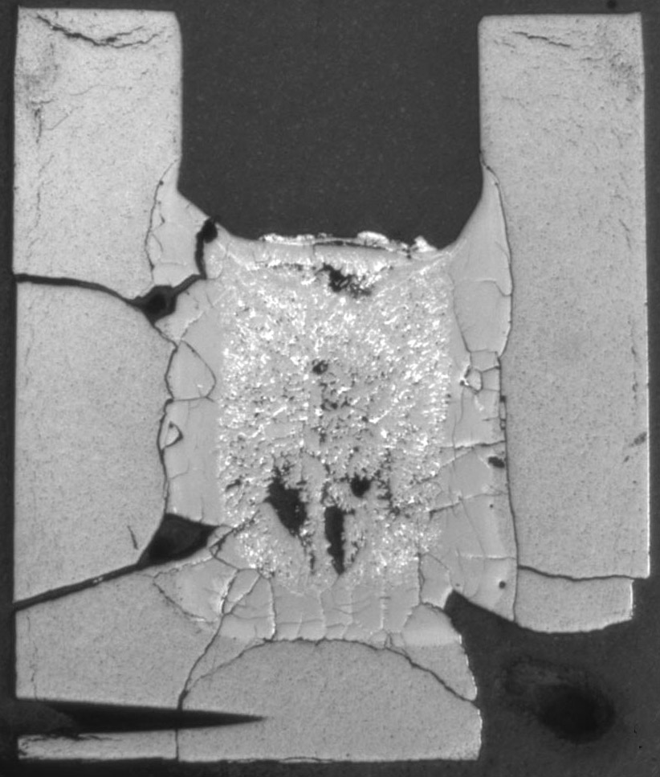
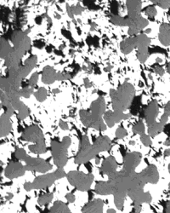
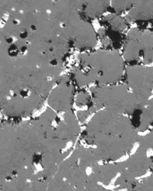
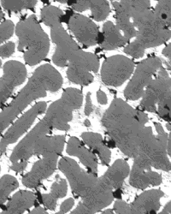
FZK crucible tests
on corium melt oxidation
Zr melt interactions with ZrO₂ crucible walls (J.Stuckert)
T=2200ºC
.
t =10 min.
t =15 min.
t =25 min.
Zr:O= 42:58
Zr:O= 39:61
Zr:O= 37:63

Slide 11
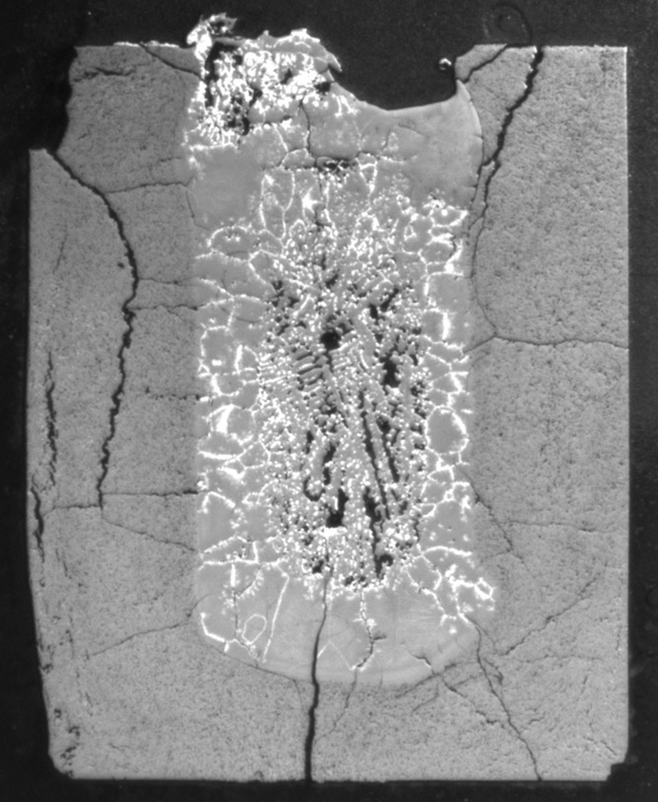
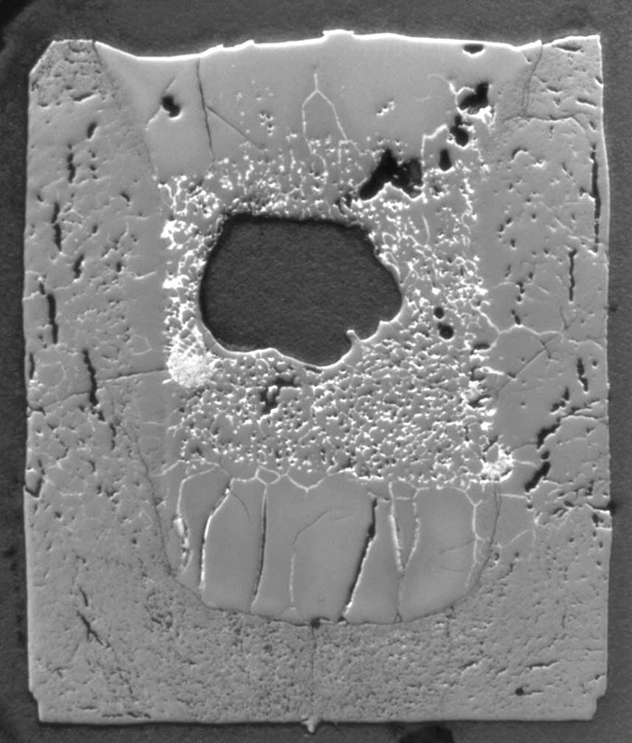
Validation of 2-d MP oxidation model
against FZK crucible tests
200 min.
290 min.
Conclusion: Oxide dissolution on “hot” lateral walls was accompanied with oxide growth on “cold” non-oxidized (!) free surface of melt (+ heavy precipita- tion in the melt) ( paper submitted to NED)

Slide 12
Simulation of molten pool oxidation in new crucible tests (1/2)
Proposed crucible isothermal tests with “cold” ceramic walls and “hot” free oxidizing surface with inductive heating of metallic melt should model molten pool (MP) oxidation in the lower head of the (cooled) reactor vessel
Oxide crust
Steam
Steam
Oxide crust
Zr-O
ZrO₂
Molten corium
Lower head

Slide 13
Simulation of molten pool oxidation in new crucible tests (2/2)
2-d model predictions for “cold” ceramic walls (ΔT_{w} < 0) and “hot” free surface (ΔT_{up} ≥ 0) at the MP temperature 2540K
ZrO₂ crucible parameters: R = 36.5 mm, h = 10 mm, wall thickness 7 mm.
Charge is produced from the mixture of metallic Zr and ceramic ZrO₂ phases with the average atomic composition Zr:O = 2.7:1.

Slide 14
Main results of the 2-d melt oxidation model validation
The model correctly describes the main observations of the FZK crucible tests:
Dissolution of ZrO₂ walls in the initial stage of interactions
Growth of oxide crust at the melt / walls interface
Secondary dissolution of oxide crust in the late stage
Growth of oxide layer on the free (non-oxidised) surface of melt
Heavy precipitation of the ceramic phase in the oxidised melt
The model predicts:
Growth of oxide crust on “cold” non-oxidized free surface of melt in new crucible tests.
The total kinetics of melt oxidation obeys a (close to) linear (rather than parabolic) time law, owing to quick stabilisation of oxide crust thickness at the melt/steam interface.
These predictions can be extended to molten pool oxidation in RPV.

Slide 15
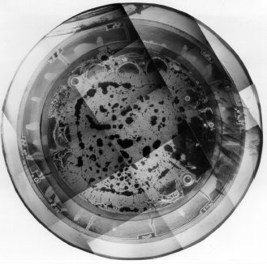
Molten pool behaviour in Phebus FPT tests
Observations:
Atomic composition of corium (at elevations 153/236 mm) was rather homogeneous axially and radially and corresponded to ≈(U_{0.5.}Zr_{0.5})O_{2±x}
At the periphery a crust structure of ≈ 3-4 mm thickness with a similar composition, was formed
Maximum temperature in this bundle zone during heat-up period was below the corium melting point of ≈ 2760 K
During this period a peak in hydrogen generation rate was measured with total mass of ≈ 16 g.
Post-test macrograph at the 228 mm level of FPT1 bundle

Slide 16
Simulation of melt oxidation
in Phebus FPT0 test
6
FPT0
100
FPT0 test: MP with 20 fuel rods and long period of MP oxidation,
5
90
80
4
70
Competitive processes on cool-down:
Growth of ceramic crust on cold surface;
Ceramic phase precipitation
60
Fraction of dissolved pellet, vol.%
Crust thickness, mm
Fraction of precipitates, vol.%
3
50
40
2
30
1
20
10
( paper submitted to NED)
0
500
1000
1500
2000
2500
3000
3500
4000
Time, s

Slide 17
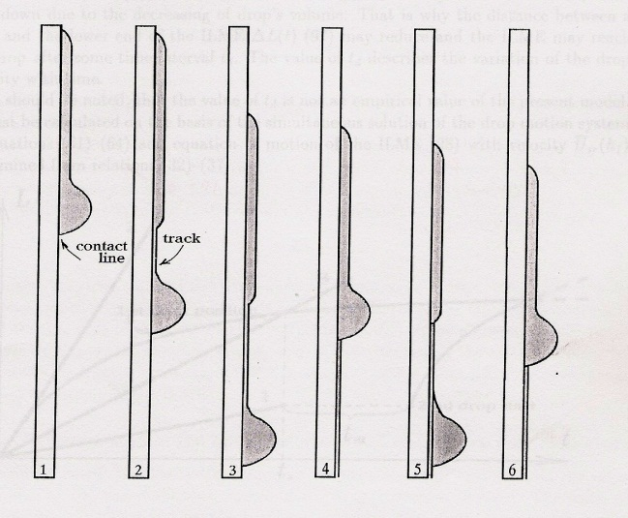
Task 2: Modelling of candling process
Development and implementation in the SVECHA code of the model for the candling process:
The physical model and numerical module on melt relocation in the form of drops and rivulets were developed and implemented in the SVECHA code.
The new numerical module was implemented in the code as a subroutine of the massive blockage (slug) relocation model.
Physical mechanisms:
capillary effects (contact angle hysteresis, contact line resistance to displacement, wetting of the fuel rod surface);
viscous effects (viscous drag force, laminar/turbulent regimes);
heat exchange influence (melting/solidification process, temperature dependence of viscosity, surface tension).

Slide 18
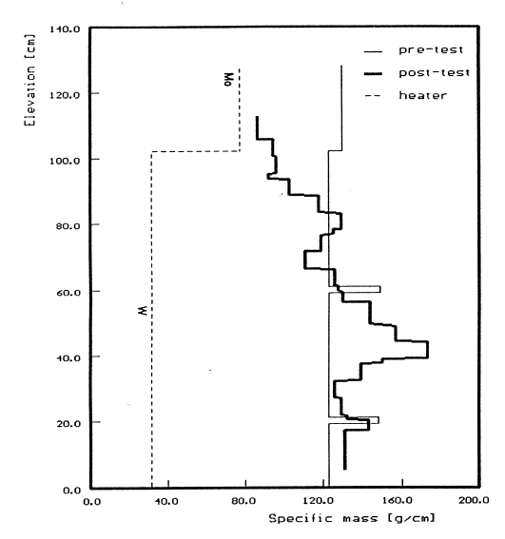
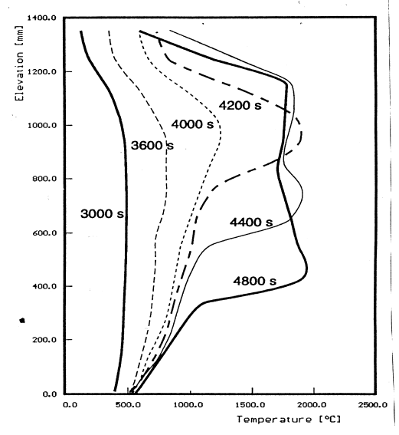
Task 3: Modelling of slug relocation
Development and implementation in the SVECHA code of the model for the slug relocation:
The physical model and numerical module on melt relocation in the form of massive blockage (slug) were developed.
The new numerical module was implemented in the SVECHA code. Tight coupling of this module with other SVECHA modules describing candling, heat exchange, cladding oxidation, thermo-mechanical deformation was organised. The initial and boundary conditions for the model are self-consistently calculated by the SVECHA code.
Temperature front T≈2000ºC in CORA tests relocated downward with a characteristic velocity∼1-2 mm/s, which was extremely small in comparison with the characteristic velocities of metal rivulets and droplets (∼ 0.5 m/s)

Slide 19
Slug model
Melt blockage (pool) is modeled as a cylindrical pool with the vertical length - L_{sl} and radius - R_{sl} .
Molten pool is in contact with N fuel rods.
Slug consists of the main (liquid) part and a crust scale at lower surface
Fuel rod
Shroud
Slug
L_{sl}
2·R_{sl}
Steam flow

Slide 20
Effective fuel rod approach
Effective Rod
Melt
Lateral crust
Arrangement of CORA-W1 test bundle
Horizontal cross section of the melt blockage with the effective fuel rod

Slide 21
Slug relocation velocity
z
UO₂ effective fuel rod
Stefan problem:
Axial heat flux from the melt bulk matching with the sum of heat conduction flux along the claddings and heat losses due to claddings fusion at the melt progression front gives the value of relocation velocity (v_{slug}).
(U-Zr-O) melt
Fusion front
(Zr,U)O₂ oxide
v_{slug}
Zr(O) effective cladding

Slide 22
Task 4: SVECHA/MELT code verification
Verification of the newly developed SVECHA/MELT code against available experimental data. Preparation of the newly developed modules for the implementation in the system codes such as ICARE/CATHARE, MELCOR, or ASTEC:
The developed SVECHA/MELT code includes all the models developed in Tasks 1-3 and describes a complicated process of molten corium relocation under severe accident conditions at NPP.
The code SVECHA/MELT was validated against integral bundle tests CORA-WWER performed by collaborators from FZK.
The new modules for melt relocation and physico-chemical interactions are prepared for implementation in the system codes such as ICARE/CATHARE, ASTEC or MELCOR.

Slide 23
Validation of the slug model against CORA-W1 test (1/2)
Slug temperature
Melt composition

Slide 24
Validation of the slug model against CORA-W1 test (2/2)
Fuel pellet dissolution profile
Slug velocity and volume

Slide 25
Task 5: Modelling of U-Zr-O mixture behaviour
Analytical support for the ITU tests on irradiated and MOX fuel dissolution by molten Zr and U-Zr-O melting points determination:
The previously developed models for fuel dissolution by molten Zr were based on the tests with fresh (unirradiated) UO₂. Furthermore, the ternary U-Zr-O phase diagram is an important issue in modelling dissolution tests.
Analysis of the new ITU tests on irradiated and MOX fuel dissolution by molten Zr and U-Zr-O melting points determination was carried out.
On the base of the tests analysis, correction of the fuel dissolution model for irradiated and MOX fuel was implemented.
The ternary U-Zr-O phase diagram which is a part of the melt physico-chemical interactions model is improved using the new tests data on U-Zr-O melting points determination.

Slide 26
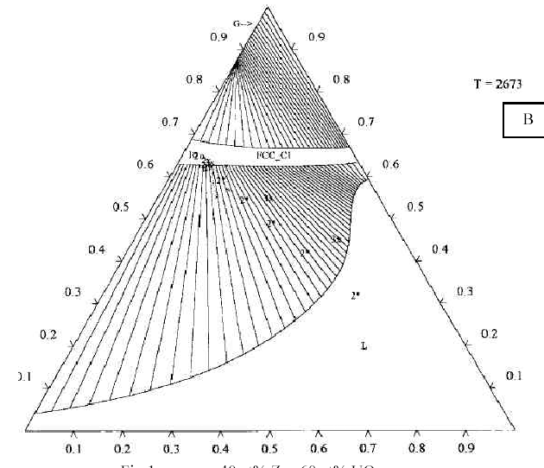
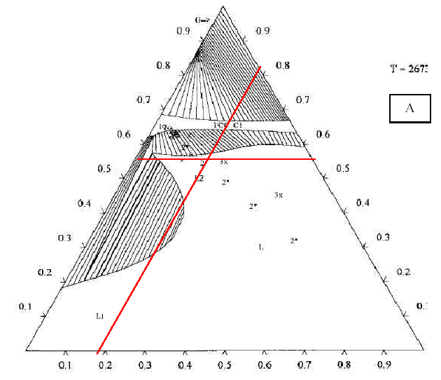
Analysis of ITU measurements (example)
Measured liquidus point:
40 at% Zr : 60 at% UO₂
T_{liq} ≈ 2650 K
Conclusion: diagram A very well fits to the measured liquidus point

Slide 27
Task 6: Development of a three-dimensional code and adaptation to the LIVE project
Adaptation of the three-dimensional CONV code (within Boussinesq approximation) for the LIVE project conditions. Development and implementation in the CONV code of the thermal-hydraulic model with a variable density (without Boussinesq approximation):
The previously developed three-dimensional CONV code was intended for simulation of three-dimensional flows in the Boussinesq approximation on Cartesian grids with a local refinement near domain with singularities of flows.
The model for calculation of flows with a variable density without Boussinesq approximation was developed and implemented in CONV code. The necessary modification of numerical algorithm to fast solving of pressure correction equation with usage of algebraic solver on the basis of Fast Fourier Transformation (with variable properties) was carried out. Comparison with Boussinesq model on such parameters as 3d heat flux distribution on cooled boundary and possible crust formation depending on the power density and the external cooling was conducted.
On the base of the carried out numerical investigations and adaptation of previously developed software, more advanced version of the code permitting calculation of three-dimensional flows with variable properties, appropriate to real corium properties or prototypes was obtained.

Slide 28
Task 7: Theoretical analysis and code validation
Numerical-theoretical analysis of the flows in a boundary layer adjacent to cooled boundaries. Validation of the developed flow models using experimental data, including experiments with a heat generating fluid such as LIVE, COPO, SIMECO:
Numerical simulation of natural convection and heat flux distribution was supplemented by the theoretical analysis of major phenomena such as boundary layers formation, with the analysis of energy balance in heat-generating fluids. Theoretical dependences were compared with the results of calculations, namely for such processes as: free convection in a heat-generating fluid for cylindrical geometry; convective heat exchange for a heat-generating fluid in an upper zone of enclosure. In all cases a good coincidence was obtained between analytical and numerical results.
Heat generating fluids exhibit temperature stratification depending upon boundary conditions at the top (isothermal or adiabatic). Corresponding theoretical assessments for the heat transfer and their dependence upon dimensionless parameters such as Rayleigh number were compared with numerical results and in this case a good coincidence was observed.
Matrix of validation for developed models was elaborated for convection of a heat-generating fluid (BALI, COPO and SIMECO). The preliminary numerical simulation of circular heat used in the experimental facility LIVE was carried out by means of the CONV code which was validated and adapted to conditions of the project.

Slide 29
Task 8: Thermal-hydraulic model with accounting for the crust formation
Development of models and code for numerical simulation of flows at high Rayleigh numbers under conditions of crust formation on a cooled surface. Testing of the developed models and modules on experimental data with crust formation using, for example RASPLAV tests:
Model for numerical simulation of melt flows simultaneously with heat transfer in the reactor case and crust formation at high Rayleigh numbers was developed and implemented in code. For the modeling of turbulence algebraic turbulent models and direct numerical simulation were used. A computing technique for modeling of turbulence was validated on results of problems with lid-driven flows and flow in tube. In all cases the good coincidence of numerical results to the reference data was attained.
On the basis of the modified CONV version the simulation of molten-salt tests obtained in the RASPLAV facility was carried out. The obtained results demonstrate that the developed approach predicts correctly the absolute values of crust thickness.

Slide 30
General Conclusions
The ISTC Project #2936 was successfully completed in accordance with the time schedule of the Project Working Program
The new models developed within the Project allows mechanistic description of the main processes of in-vessel melt behaviour and are thoroughly validated against available experimental data.
The new codes SVECHA/MELT and CONV developed within the Project will be further developed for analysis of new experiments and modelling of accidents with core degradation at NPP.
The developed models will be implemented in the Russian severe accident code SOCRAT and are proposed for implementation in the European system codes such as ICARE/CATHARE, ASTEC or MELCOR.
The work was carried out in tight connection with the SARNET Project and with substantial support of the European collaborators, which are greatly acknowledged.

