Slide 1
Progress report on the
UO₂ – CaO system
A.P. Alexandrov Research Institute of Technology
International Science and Technology Center
Presented by E. Krushinov
2nd PRECOS Project Meeting
May 26, 2009, St. Petersburg

Slide 2
Contents
Available binary diagrams
Test results on UO₂ - CaO system
Plans for further research
Conclusions

Slide 3
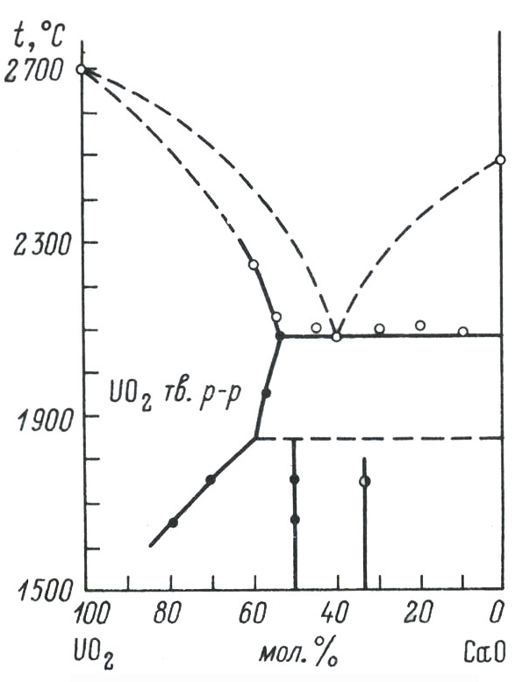
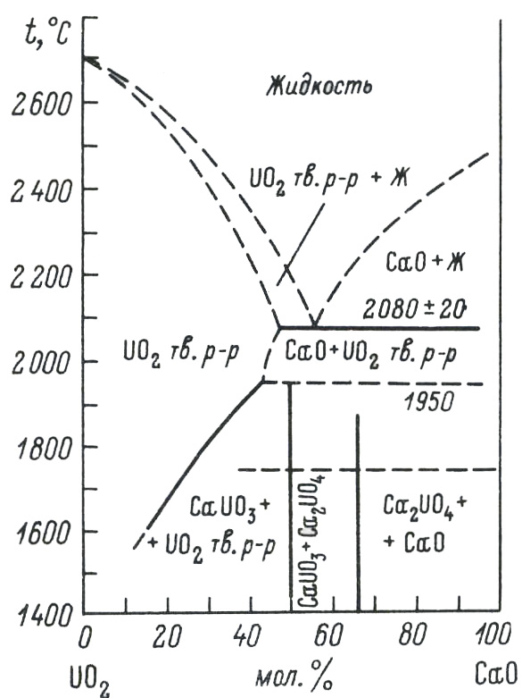
Available binary diagrams (UO₂ – CaO system)
Alberman K.B., Blakey R.C.,
Anderson J.S.
(1951)
Amato I.
(1966)
T_{eut} =2080±20 °C
(eut) – 55%mol.CaO
UO₂(ss) – 47%mol.CaO

Slide 4
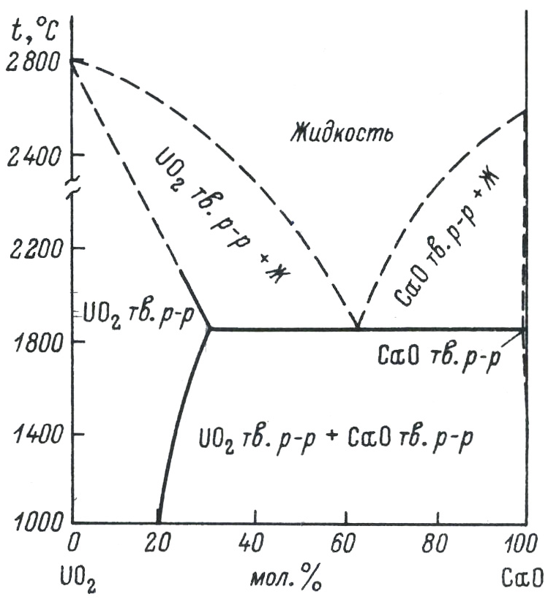
Available binary diagrams (UO₂ – CaO system)
T_{eut} =1850±20 °C
eut – 63%mol.CaO
UO₂(ss) – 30%mol.CaO
CaO (ss) – 0.35%mol.UO₂
Holc J., Kolar D.
(1986)

Slide 5
Test results on UO₂ - CaO system: PRS 4
Experimental objectives
Determine liquidus temperature
Determine final solubility of components in the formed solid solutions
Charge composition
Mol% 50UO₂ + 50CaO
The regime of molten pool formation and T_{liq} measurements
Samples
T_{liq}
Two melt samples were taken and T_{liq} was measured 3 times by VPA IMCC

Slide 6
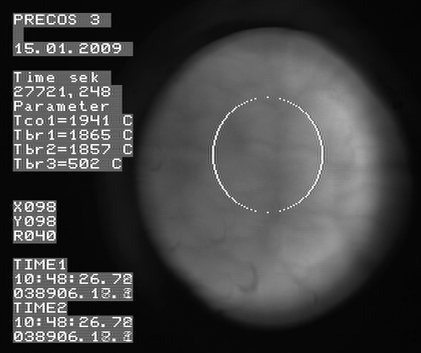

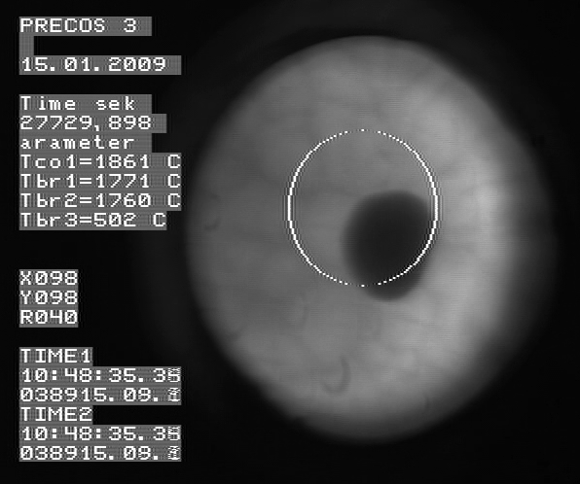
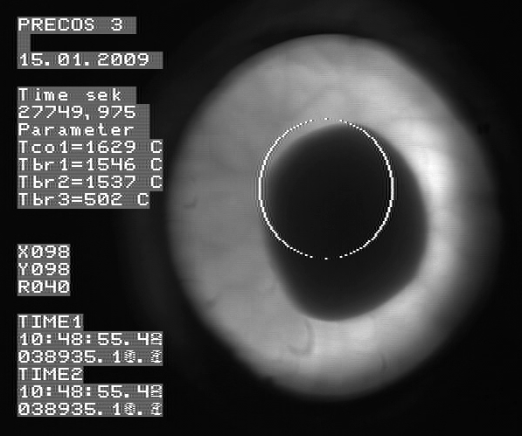
Test results on UO₂ - CaO system: PRS 4
The regime of the eutectic core formation in the ingot
From 6040 s, the pool was pulled out from inductor at 7.5 mm/h for 7 hours. This has ensured close to equilibrium crystallization and the eutectic liquid displacement into the ingot upper part
1941°С
1915°С
1861°С
1629°С
The temperature of the beginning of crystallization at the molten pool surface is below 1920°С

Slide 7
Test results on UO₂ - CaO system: PRS 4
VPA IMCC: Fragment of the experiment thermogram showing
melt surface
Melt samples composition
sample | Cha | XRF | EDX
 | UO₂ mol.%
№1 | 49.8 |  | 38.6
№2 | 48.7 | 51.4 | 38.1
    T_{liq} was measured three times: 2188ºC, 2195 and 2181ºC ⇨ T_{liq}=2188±40ºC

Slide 8
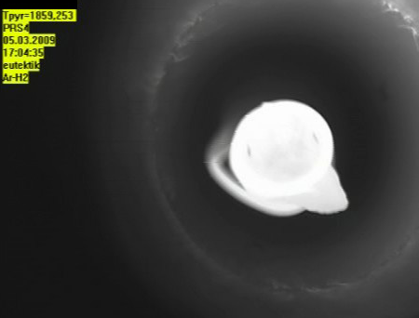

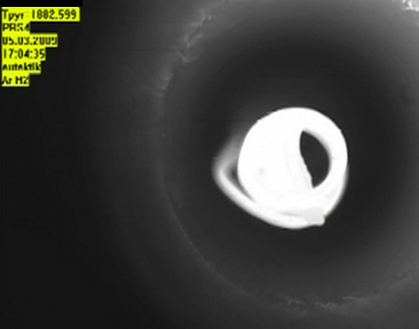
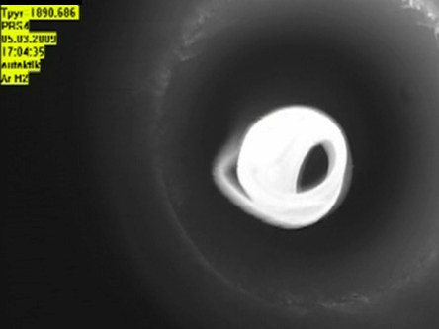

Test results on UO₂ - CaO system: PRS 4
T_{liq} and T_{sol} determination in Galakhov microfurnace
Eutectic nucleus
1859°С
1875°С
1882°С
Differential method results
Tsol
1890°С
1899°С
Visual polythermal analysis in the Galakhov microfurnace T_{sol}=1870°С; T_{liq}=1900°С
An analysis of a sample from the crystallized ingot has shown its composition to be close to eutectic

Slide 9

Test results on UO₂ - CaO system: PRS 4
SEM/EDX analysis
Dendritic microstructure of the melt sample
Quenched
sample
UO₂ ss
 | UO₂ | CaO
 | mol.%
SQ1 | 31.1 | 68.9
SQ2
P1 | 53.1 | 46.9
SQ1,2 – eutectic microstructure in the ingot
P1- the UO₂(CaO) solid solution in the eutectic region of the ingot
1 cm

Slide 10
Test results on UO₂ - CaO system: PRS 5
Experimental objectives
Determine liquidus temperature at very high CaO content (indirect determination of CaO melting point)
Charge composition
Mol% 1UO₂ + 99CaO
Results
Startup heating was successful
Molten pool was not formed and measurements not taken due to low
electric conductivity of the melt
RASPLAV-4 heating current frequency of 5.28MHz is insufficient to
maintain the pool of this composition in a molten state
Decision is taken to increase the concentration of uranium oxide in the
next experiment

Slide 11
Test results on UO₂ - CaO system: PRS 6
Experimental objectives
Determine liquidus temperature at high CaO content
Charge composition
Mol% 17.2UO₂ + 82.8CaO
Samples
Tliq
Sample
Tliq
Two melt compositions have been realized within one melting cycle
3 melt samples were taken and T_{liq} was measured 4 times by VPA IMCC

Slide 12
Test results on UO₂ - CaO system: PRS 6-1
VPA IMCC: Fragment of the experiment thermogram showing melt surface
Melt samples composition
sample | Cha | XRF | EDX
 | UO₂ mol.%
№1 | 26.1 | 26.0 | 17.2
№2 | 26.0 | 26.5 | 18.7
    T_{liq} was measured two times: 2400ºC and 2378ºC ⇨ T_{liq}=2389±40ºC

Slide 13
Test results on UO₂ - CaO system: PRS 6-2
Charge composition (after CaO addition in to the melt)
Mol% 10.2UO₂ + 89.8CaO
VPA IMCC: Fragment of the experiment thermogram showing melt surface
Melt samples composition
Sample | Cha | XRF | EDX
 | UO₂ mol.%
№3 | 17.7 | 17.0 | 12.0
    T_{liq} was measured two times: 2583ºC and 2537ºC ⇨ T_{liq}=2560±50ºC

Slide 14
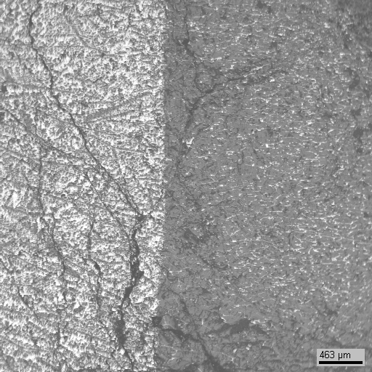
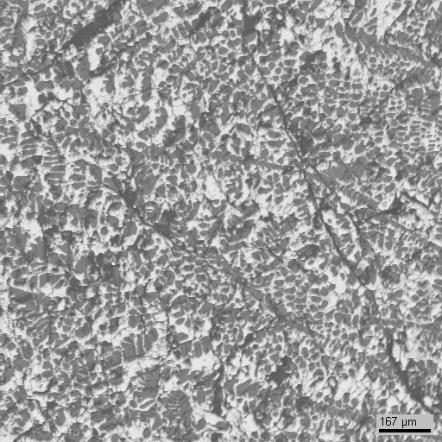
Test results on UO₂ - CaO system: PRS 6
SEM/EDX analysis
Dendritic microstructure
of the melt sample
Quenched
sample
CaO
1 cm
Crust on the ingot
CaO

Slide 15
Test results on UO₂ - CaO system
Possible reasons of discrepancy between the results of Cha, XRF and EDX
Considerable hygroscopic property of samples
Only dry preparation of polished sections for SEM/EDX,
possible CaO crumbling and filling of all possible
depressions in the polished section surface

Slide 16
Test results on UO₂ - CaO system
T, °C
2800
The eutectics composition and solid solutions were synthesized by
slow freezing
SEM/EDX in progress, compositions of the eutectics and solid solutions are not given
Yellow dots – temperatures determined by VPA IMCC, while compositions obtained by chemical analysis and XRF
2500
2200
1900
?
?
1600
1300
1000
CaO
20
40
60
80
UO₂
mol%
Alberman K.B.
Blakey R.C.
Anderson J.S.
(1951)
Holc J.
Kolar D.
(1986)
Amato I.
(1966)

Slide 17
Plans for further research
To specify the eutectic temperature, samples from the eutectic nucleus from PRS4 will be subjected to DTA
CaO-oriented VPA IMCC and equilibrium crystallization of the ingot to form an ultimately solid CaO-based solid solution
UO₂-oriented VPA IMCC for three compositions
Results processing and generalizing
Final report preparation

Slide 18
Conclusions
First experiments in the UO₂-CaO system have been conducted. Liquidus temperatures have been determined; final solid solutions and eutectic nucleus have been synthesized
The eutectic temperature evaluation by VPA in the Galakhov microfurnace has shown it to practically coincide with the data of Holc J.

