Slide 1
FSUE SRI SIA “LUCH”
IBRAE RAS
FSUE EDO “GIDROPRESS”
I S T C
“Fuel Assembly Test under Severe Accident Conditions, PARAMETER facility”
(Status of ISTC project # 3194)
Presented by V. Nalivaev
12th CEG-SAM Meeting
Saint Petersburg, 11 -13 September 2007

Slide 2
The Structure of Project
Financial support – I S T C
The basic participants:
FSUE SRI SIA “LUCH”
IBRAE RAS
FSUE EDO “GIDROPRESS”
3. Another participants:
A.A. Bochvar FSUE VNIINM,
A. I. Leipunsky SSC RF-IPPE,
RSC “Kurchatov Institute”
4. Foreign collaborators: FZK, GRS, EdF, IRSN, CEA

Slide 3
Main Tasks of the Project # 3194
Task 1. Preparation and conduct of the 1-st experiment
at PARAMETER facility under simulated conditions of
a severe accident including low rate flooding of the assembly from the top.
(The PARAMETER SF-1 Experiment).
Task 2. Preparation and conduct of the 2-nd experiment at PARAMETER facility under simulated conditions of
a severe accident including high rate flooding of the assembly from the top and bottom.
(The PARAMETER SF-2 Experiment).

Slide 4
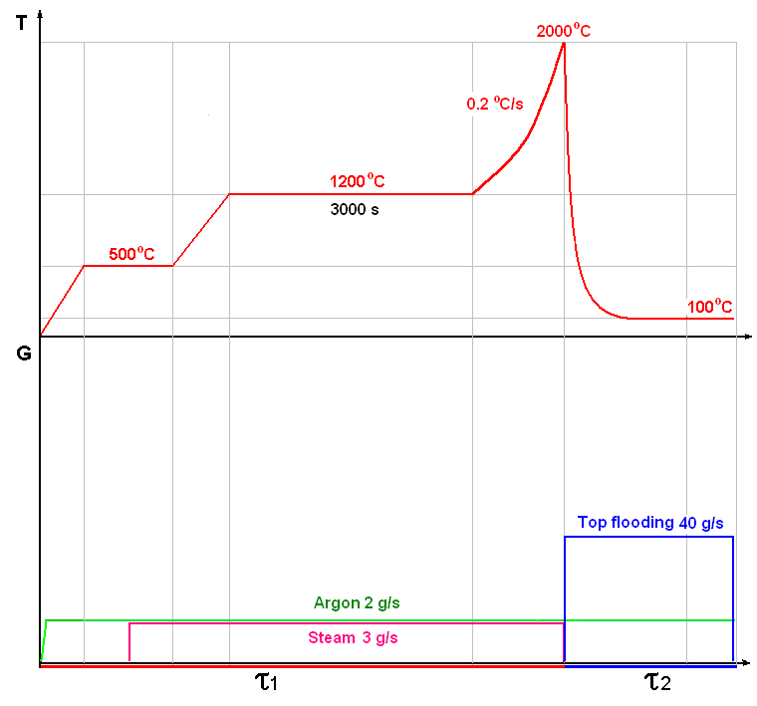
The PARAMETER-SF1 Experiment
Main parameters of the experiment
Sequence diagram of the experiment
Coolant | Steam/ argon
Flow rate of coolant, g/s | 3/2
Temperature of coolant, °C | ∼500
Heating rate of cladding, °C /s | ∼0.2
Temperature of cladding at the pre-oxidation phase, °C | ∼1200
Duration of the pre-oxidation phase, s | ∼ 3000
Maximal temperature of cladding, °C | 2000
Quenching phase | Top flooding
Flow rate of flooding, g/s | ∼ 40

Slide 5
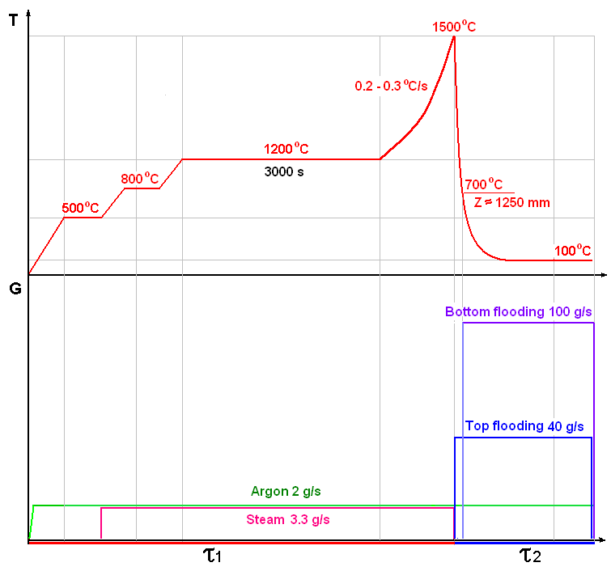
The PARAMETER-SF2 Experiment
Main parameters of the experiment
Sequence diagram of the experiment
Coolant | Steam/ argon
Flow rate of coolant, g/s | 3.3/2
Temperature of coolant, °C | ∼500/400
Heating rate of cladding, °C /s | 0.2- 0.3
Temperature of cladding at the pre-oxidation phase, °C | ∼1200
Duration of the pre-oxidation phase, s | ∼ 3000
Maximal temperature of cladding, °C | 1500
Quenching phase | Top and bottom flooding
Flow rate of flooding, g/s: - top - bottom | ∼ 40 ∼ 100

Slide 6
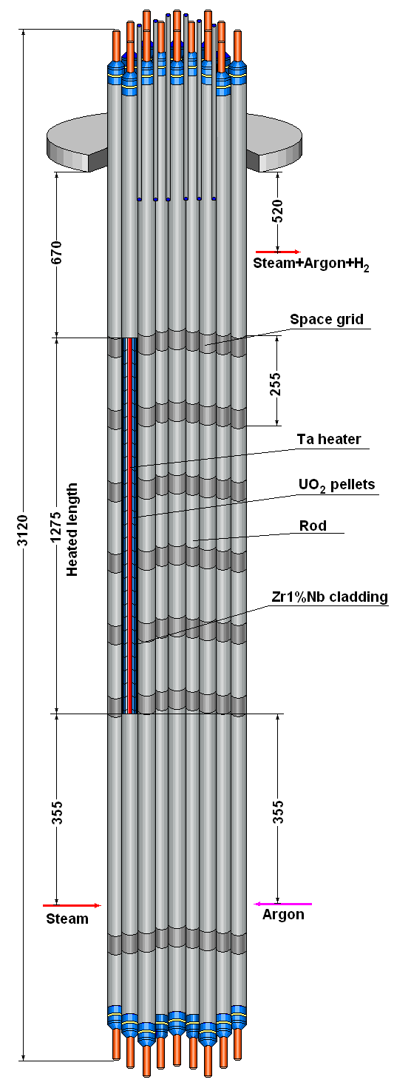
Test Bundle
The main technical characteristics
General view
Type WWER-1000
Number of rods 19
- heated 18
- unheated 1
Rods
- cladding, mm ∅ 9,13/7,73 (Zr1%Nb)
- pellets UO2
- heater ∅ 4/1275 (Ta)
Grid type triangle
- grid pitch, mm 12.75
Spacing grid Zr1%Nb
- height, mm 20
- spacing, mm 255
Shroud Zr1%Nb
- thickness, mm 2
Shape:
- SF-1/SF-2 hexahedron/
cylinder
- height, mm 1650/1490
Thermoinsulation ZrO2 ZYFB-3
- thickness, mm 23
- height, mm 1650/1490

Slide 7
The main results of the PARAMETER-SF Experiments
Test | Test parameters
 | Input parameters | Pre-oxidation phase |  | Transient phase |  | Quench phase |  | Hydro-gen genera-tion
 | Steam/ argon flow rate, g/s | Tcl max, °C | τ, s | δTcl/δτ, °C/s | Tcl max, °C | Top flooding, g/s | Bottom flooding, g/s | M(H2), g
QU-06 | 3/3 | 1200 | 4000 | 0.3 | 1730 | - | 40 | ∼25
SF1 | 3.3/2 | 1200 | 3000 | 0.3-0.5 | ∼2000 | 40 | - | ∼92
SF2 | 3.5/2 | 1200 | 3500 | 0.2-0.3 | ∼1500 | 40 | 130 | ∼28

Slide 8
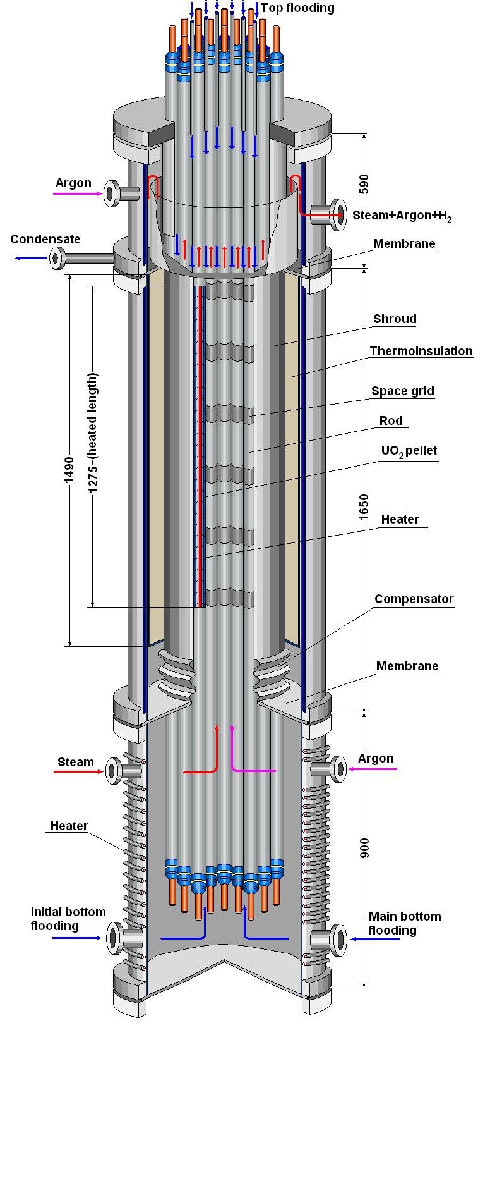
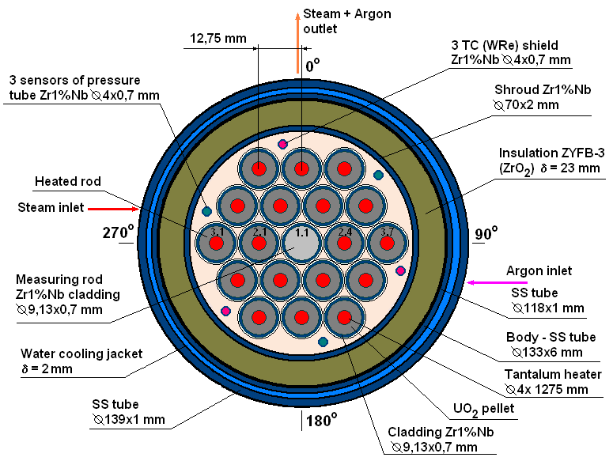
The PARAMETER-SF2 Experiment
1. Test section
Lower part
Middle part
Upper part
The upper water-cooled part provides:
- input rods and TC;
- top flooding;
- input of argon at quenching phase;
- output steam-gas mixture;
- gathering of a condensate and the control of volume of emission of water of the top flooding;
- tight division of the top and middle parts.
The lower heated part
provides:
- separate input steam and argon;
- heating up to temperature
of steam saturation
(Т ∼ 400-410 K at p ∼ 0,30-0,35 МПа);
- bottom flooding.
The middle water-cooled part provides:
- pass steam-gas mixture only through the bundle;
- tightness thermoinsulation and the control of pressure of argon inside of the free space of the thermoinsulation;
- compensation of temperature axial displacements of the shroud .

Slide 9
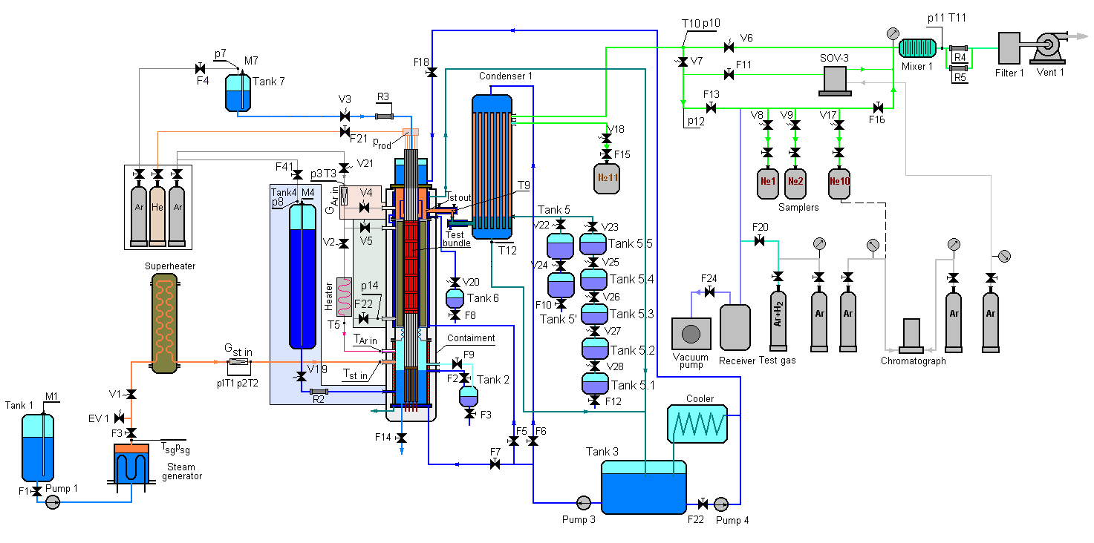
PARAMETER Facility
Main technological systems:
System of filling with argon of a free space of the thermoinsulation
and the control pressure of argon
System of steam– and argon flow input
System of switching of input of argon
System of hydrogen measurement
System of the top and bottom flooding
The monitoring system of balance of steam and water

Slide 10
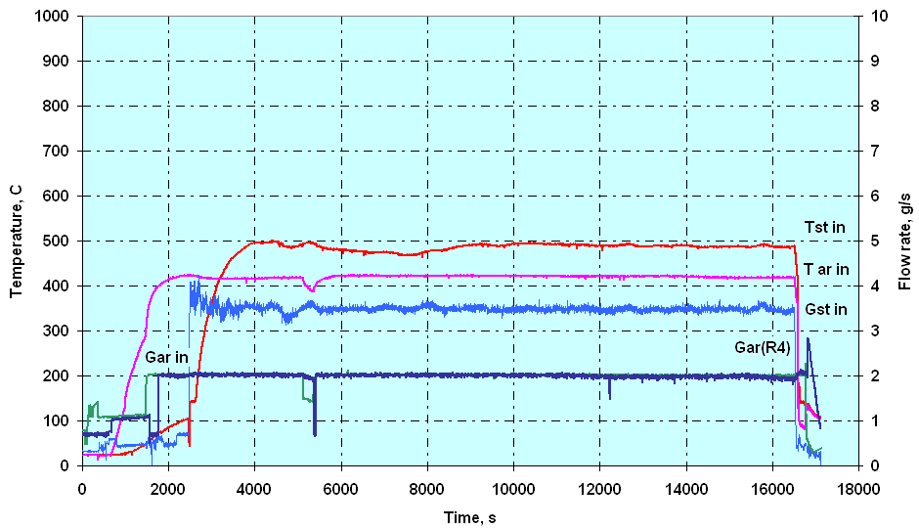
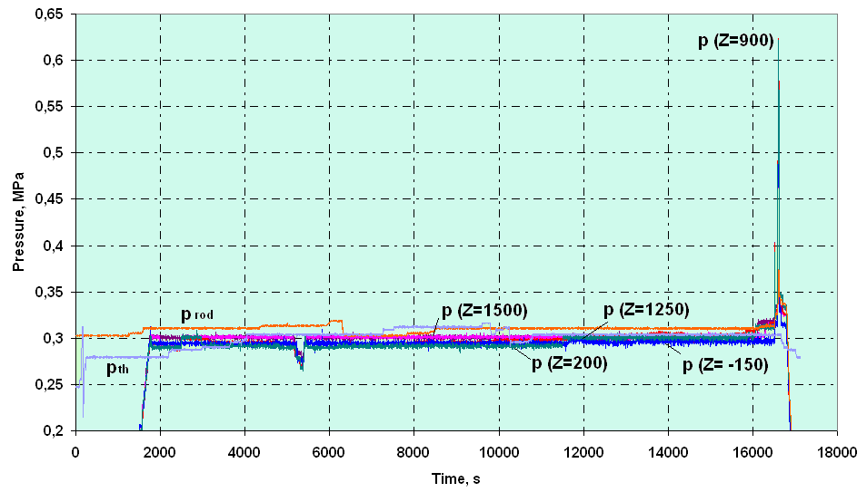
Some results of the PARAMETER-SF2 Experiment
1. Steam and argon parameters
Flow rate and Temperature:
Gst in = 3.5 g/s Tst in = 500 °C
Gar in = 2.0 g/s Tar in = 400 °C
Pressure:
prod = 0.31 MPa
pbnl = 0.3 MPa
pth = 0.3 MPa

Slide 11
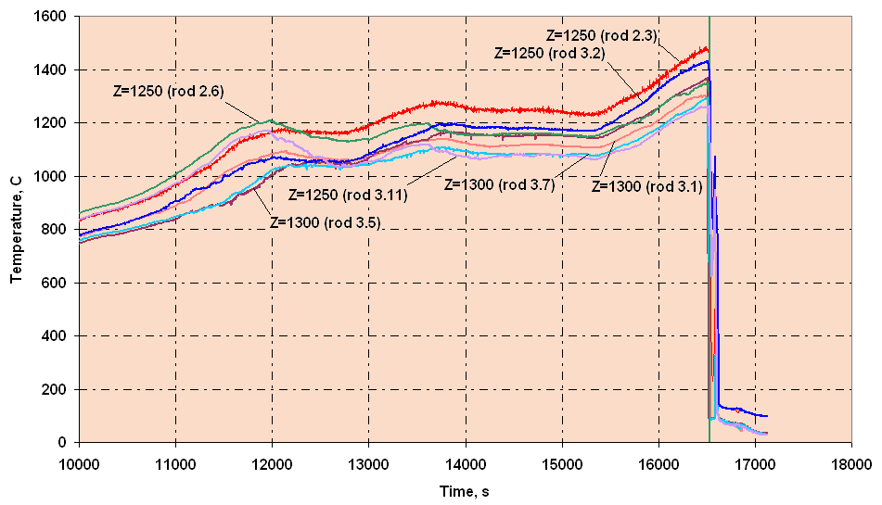
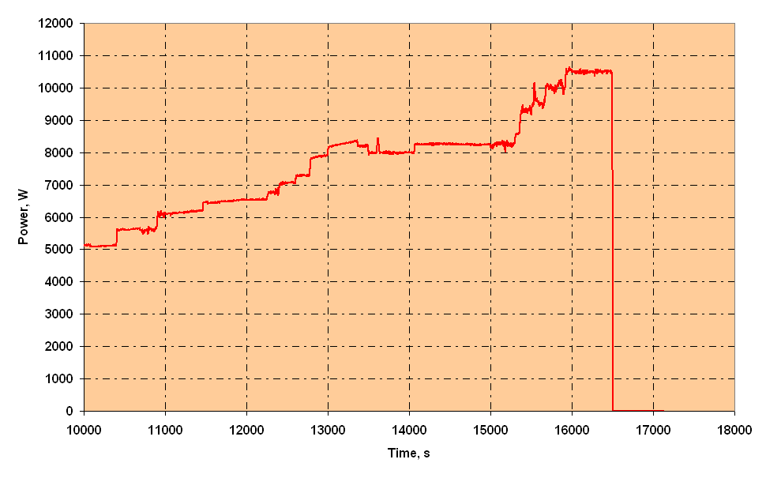
2. Main Test parameters
The temperature of bundle
during a preoxidizing and
transient stages
(elevation 1250 – 1300 mm)
Electrical power

Slide 12
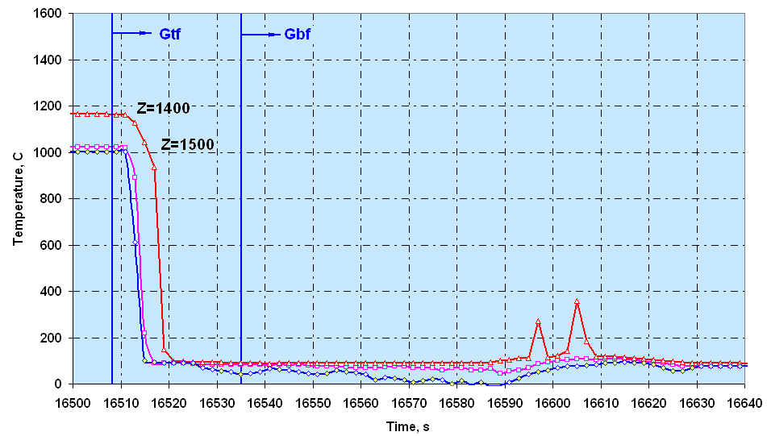
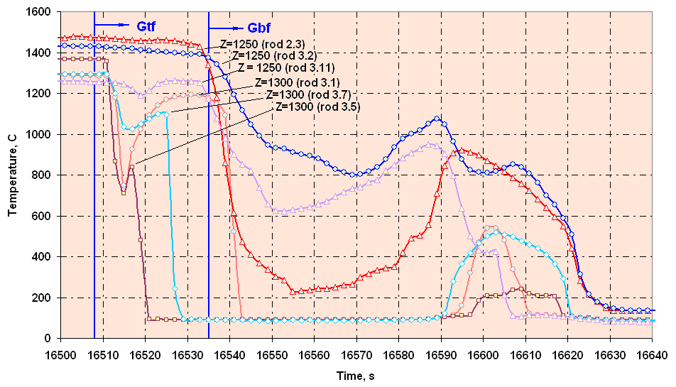
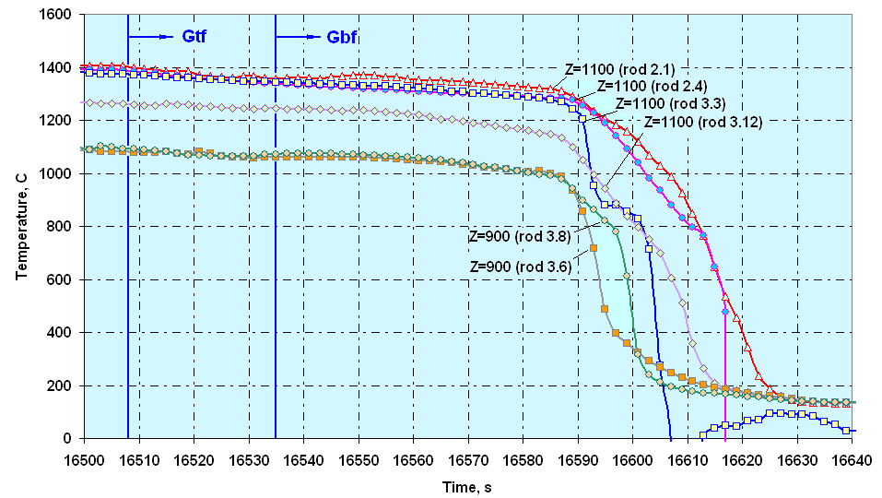
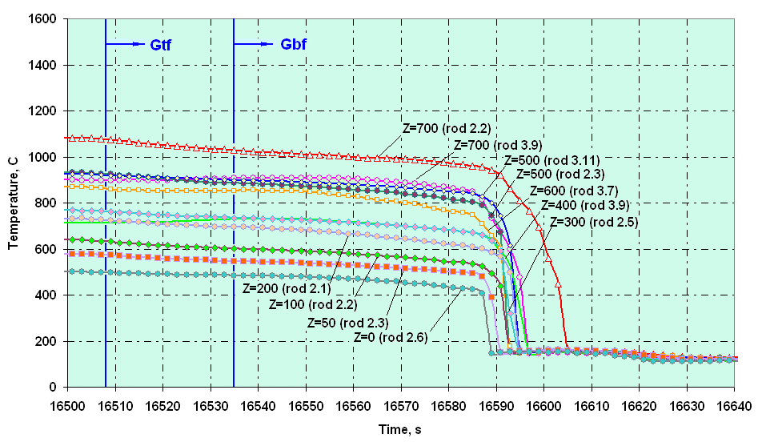
3. The claddings temperature during quench stage
Elevation 1400 – 1500 mm
Elevation 1250 – 1300 mm
Elevation 900 – 1100 mm
Elevation 0 – 700 mm

Slide 13
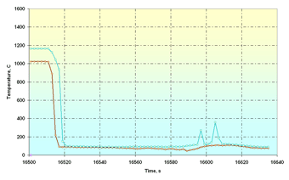
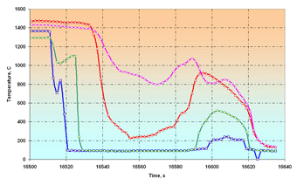
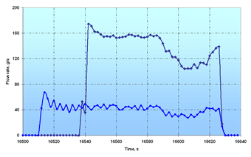
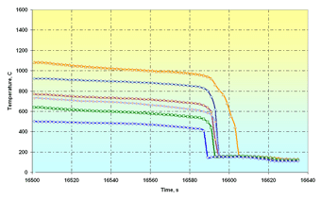
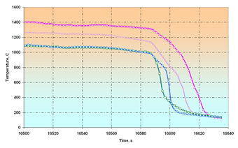
4. The cladding temperature history during quench stage
Elevation 1400 – 1500 mm
Elevation 1300 – 1250 mm
Z = 1250 mm
Z = 1300 mm
Z = 1400 mm
Z = 1500 mm
Top and bottom flooding
Elevation 700 –0 mm
Elevation 1100 – 900 mm
Z = 1100 mm
Z = 900 mm
Z = 700 mm
Z = 0 mm
Z
[

Slide 14
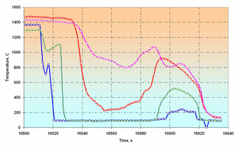
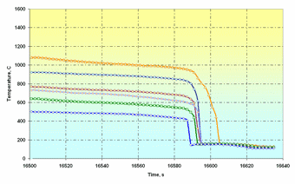
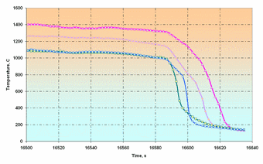
4. The cladding temperature history during quench stage
Elevation 1400 – 1500 mm
Elevation 1300 – 1250 mm
Z = 1250 mm
Z = 1300 mm
Z = 1400 mm
Z = 1500 mm
Top and bottom flooding
Elevation 700 –0 mm
Elevation 1100 – 900 mm
Z = 1100 mm
Z = 900 mm
Z = 700 mm
Z = 0 mm
Z
[

Slide 15
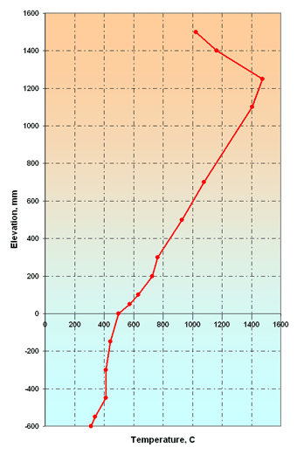
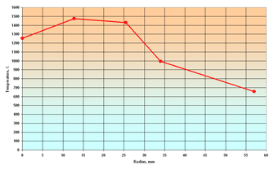
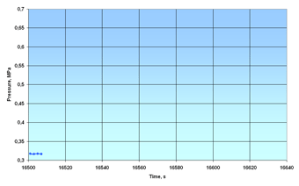
4. The temperature profile of cladding temperature
on height and cross section of bundle during quench stage
The temperature profile of cladding temperature on height of bundle
The temperature profile of cladding
temperature on cross section
(elevation 1300 – 1250 mm)
Central
rod
2nd
row
3rd
row
Shroud
Insulation
The steam-gas mixture pressure
into the bundle
Z
[

Slide 16
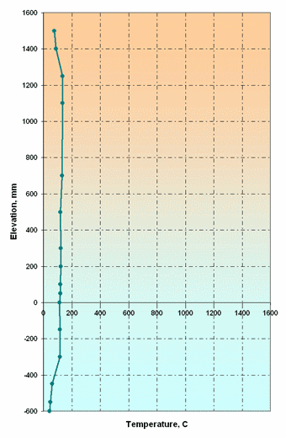
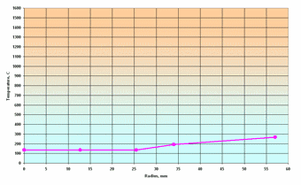
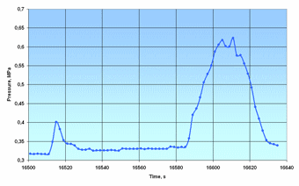
4. The temperature profile of cladding temperature
on height and cross section of bundle during quench stage
The temperature profile of cladding temperature on height of bundle
The temperature profile of cladding
temperature on cross section
(elevation 1300 – 1250 mm)
Central
rod
2nd
row
3rd
row
Shroud
Insulation
The steam-gas mixture pressure
into the bundle
Z
[

Slide 17
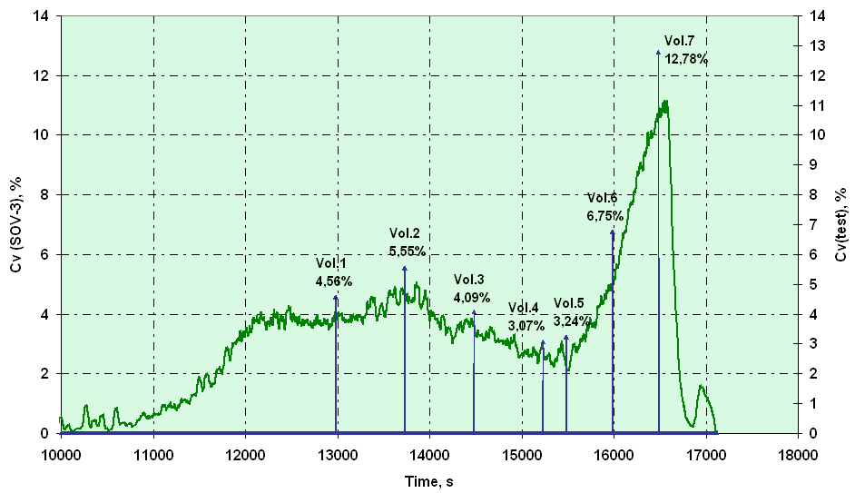
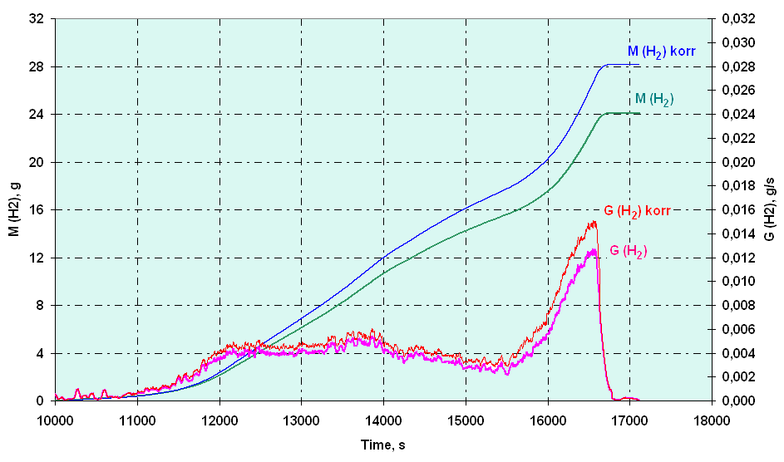
5. The results of measuring of the hydrogen generation
Variation of volumetric hydrogen
concentration versus time
(Cv(SOV-3) and Cv(Vol.))
Regeneration rate and
mass of evolved hydrogen
Z
Integral
∼ 28 g

Slide 18
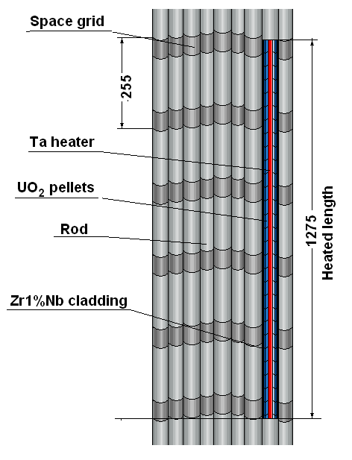
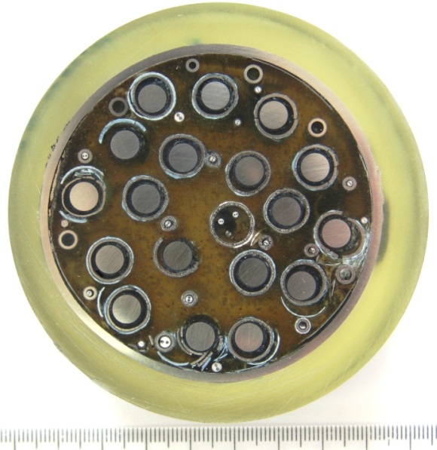
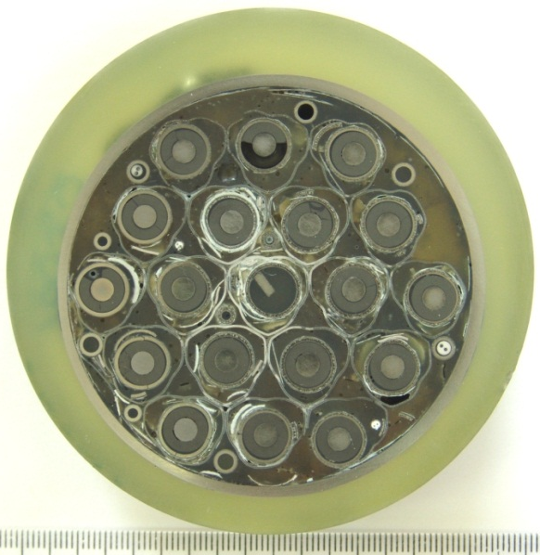
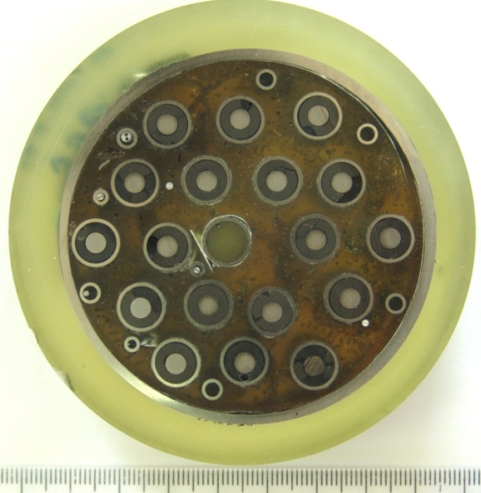
6. Posttest appearance of the SF2 fuel assembly
Z = 1296 mm
Z = 1033 mm
Z = 901 mm

Slide 19
The main results of the Project # 3194
1. Experiments PARAMETER-SF1, 2 on simulating the Severe Accident , including the stage of the top and top/bottom flooding, have been carried out.
2. By results of works documents are released:
- Protocol of PARAMETER-SF1 experiment results.
- Protocol of PARAMETER-SF2 experiment results.
- Protocol on the results of the model FA material studies after the PARAMETER-SF1 experiment.
- Results of calculated studies of experiments of PARAMETER-SF series.
- Scientific and Research Final Report “FUEL ASSEMBLY TESTS
UNDER SEVERE ACCIDENT CONDITIONS (PARAMETER-SF test series)”

