Slide 1
FSUE SRI SIA “LUCH”
IBRAE RAS
FSUE EDO “GIDROPRESS”
Pre-test calculations of PARAMETER-SF2 experiment
(ISTC Project # 3194)
Presented by T.Yudina
Podolsk, 2-6 July 2007

Slide 2
Scope of the PARAMETER-SF tests
The main goal of flooding experiments is to investigate bundle behavior and the hydrogen source term resulting from water injection into an uncovered core
PARAMETER-SF1 is the first experiment modeling behaviour of overheated VVER bundle under top flooding conditions
PARAMETER-SF2 is the first experiment modeling behaviour of overheated VVER bundle under combined (top and bottom) flooding conditions
General answer from planned set of PARAMETER tests is experimental data for severe accident management guide development
These data include:
  bundle cooling possibility
  structural elements status
  Hydrogen release

Slide 3
Analytical support
Numerical analysis is needed to asses a contribution of the available physicochemical processes
Goal – scenario justification and development of requires for measuring and control systems and recommendations.
Used codes - SOCRAT, ICARE/CATHARE, PARAM TG
Participants IBRAE, ККС KI, NPO LUCH .

Slide 4
Objectives and Tasks for codes verification and models development
To check an adequacy of processes modeling during flooding
To assess the oxidation models
To collect data for thermohydraulic models development
  Determination of the heat transfer coefficients in POST-CHF mode using the data on temperature evolution during the quench phase.
  Evaluation of the components deformation after test and possible limitation of surface wetting due to decrease of flow area.
  Specification of parameters in models available in computer codes for POST-CHF heat transfer and flooding treatment. Justification of the applicability of these parameters for simulation of the processes occurring under the conditions similar to the experiment SF2 ones.

Slide 5
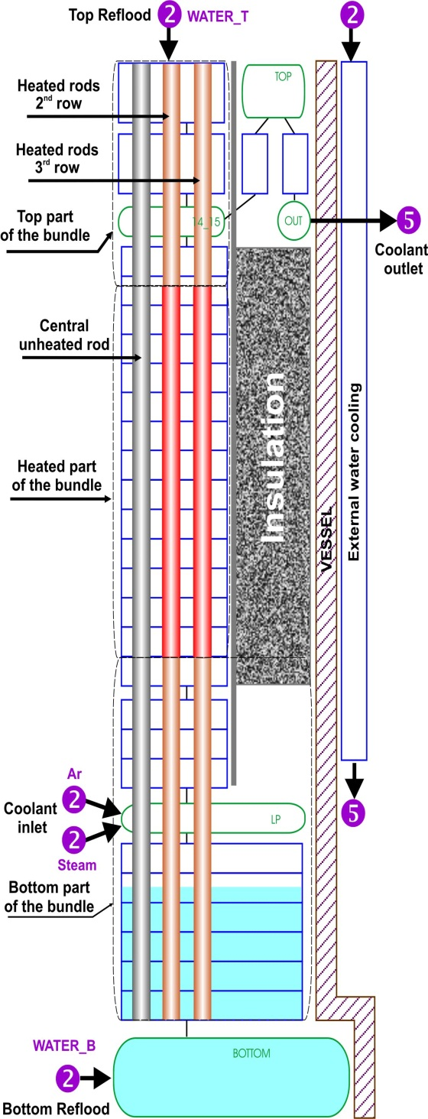
SOCRAT ICARE

Slide 6
Modeling features
Base wall heat transfer and interface friction models were used
Equilibrium thermohydraulic model is available in ICARE/CATHARE V1

Slide 7
Proposed PARAMETER-SF2 test scenario
Stage | Stage substance | Main parameters
 |  | FA temperature, K | Medium | Heating / cooling rate | Time, s
1 | Heating of the fuel bundle with argon | ~300 – 350 | Argon with flow rate of 2 g/s and temperature 670K | - | 0-1000
2 | Heating of the fuel bundle by the electric power, steam and argon flow | ~770 | Steam/Argon with flow rates of 3.3/2 g/s and temperature 770/670K | - | 1000-4000
3 | Heating of the fuel bundle (transient phase I) | 770 → 1470 | -”-”- | ~0.3 К/s | 4000-6000
4 | Pre-oxidation of the bundle | ~ 1473 | -”-”- | - | 6000-10000
5 | Heating of the fuel bundle (transient phase II) | 1470 → 1870 | -”-”- | ~0.3 К/s | 10000- ~11000
6 | Flooding of the fuel bundle from the top after Tmax = 1870 K reached | Up to saturation | Water with flow rate of 40 g/s and temperature 330 K (top reflood) | - | ~150 (duration)
7 | Flooding of the fuel bundle from the bottom 50s after top flooding starting or when T<900K at 1250 mm | Up to saturation | Water with flow rate of 100g/s and temperature 330 K (bottom reflood) | - | ~100 (duration)

Slide 8
Proposed PARAMETER-SF2 test conditions

Slide 9
Sensitivities
Assessment of required power level for the pre-oxidation phase (~1470K)
Assessment of acceptable temperatures deviation and delay of water injection beginning
Pre-injected water level assessment – to avoid unexpected early flooding from bottom by steam or flashing

Slide 10
Power balance
Pre-oxidation stage
Total power ~6÷7 kW
Joule heating power
~5.5÷6.5 kW
Transient phase
Total power ~8-9 kW
Heat losses to shroud
~up to 50% of total power
No significant temperature dependence on steam flow rate

Slide 11
Bundle hottest zone
Maximum cladding
temperature at 1250 mm
(6 thermocouples)
1200 mm
1250 mm
1250 mm
1300 mm
1300 mm
Calculated Max Temperatures
SOCRAT 1200 ÷1250mm
ICARE 1250 ÷1300mm

Slide 12
Temperature & flooding time variation
ICARE
Overheated bundle ~1800K peak temperature
Power & steam off, no flooding in-time
No problem with bundle cooling, temperature not exceed 2100K

Slide 13
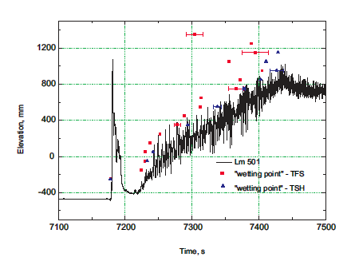
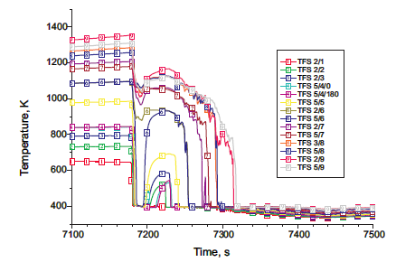
Some results of QUENCH-06*
Water pre-injection in dry hot lower plenum leads to flushing and rapid cooling down of the bundle for short period.
* L.Sepold, W.Hering, C.Homann, A.Miassoedov, G.Schanz, U.Stegmaier ,M.Steinbruck, H.Steiner, J.Stuckert. “Experimental and Computational Results of the QUENCH-06 Test (OECD ISP-45)”, Forschungszentrum Karlsruhe GmbH, Karlsruhe, 2004.

Slide 14
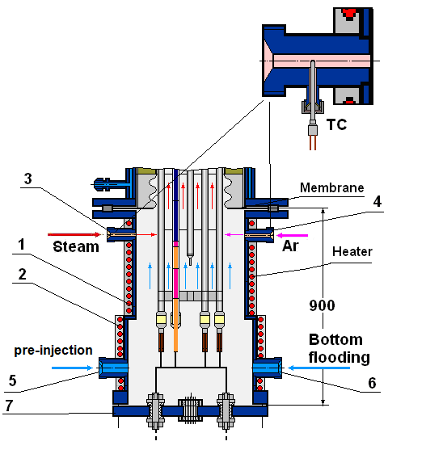
Test section water level
proposed
calculated
Reduction of quench water impact on bottom chamber structures (electrodes degradation, FA cooling down by steam)
Assessment of body temperature and heater power calculated by SOCRAT

Slide 15
Hydrogen generation

Slide 16
Flooding Phase (SOCRAT calculations)
quickly cooling down at 1500-1250 mm due to top flooding.
Reheating up at 1250-1400 mm during simultaneous (top and bottom) flooding

Slide 17
Flooding Phase (ICARE calculations)
No fast cooling from top flooding
Simultaneous cooling by steam/water mixture from bottom flooding

Slide 18
Conclusions
Pre-test runs have been performed
Set of recommendations for SF2 test performance was provided
New data for SFD code improvements are expected for
  Thermal-hydraulic models
  Fuel rod models (oxidation, degradation, heat exchange models)

