Slide 1
FSUE SRI SIA “LUCH”
IBRAE RAS
FSUE EDO “GIDROPRESS”
ISTC
Material investigations of the SF1 fuel assembly.
Posttest appearance of the SF2 fuel assembly.
Presented by D.Ignatyev
Topical meeteng
Podolsk 3-6 July, 2007

Slide 2
Objective
Analysis of model fuel assemblies VVER-1000 appearance after severe accident tests with TOP and TOP&BOTTOM flooding
Main tasks
Analysis of oxidation scale, structure, chemical and phase composition of the bundle elements;
Determination of UO2 pellets dissolution degree and fuel distribution on height of assembly;
Estimation of melt distribution and blockage formation in the bundle.

Slide 3
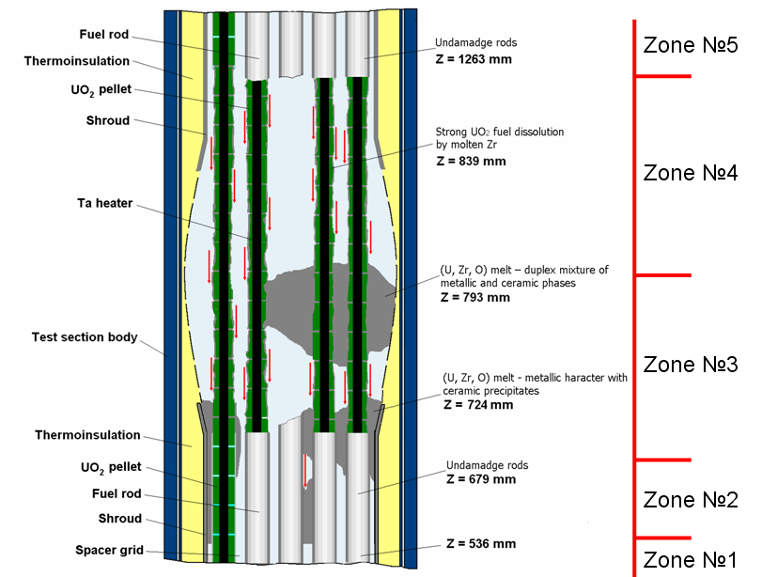
Schematic model of PARAMETER-SF1 assembly
after test
Total amount of cross sections - 18

Slide 4
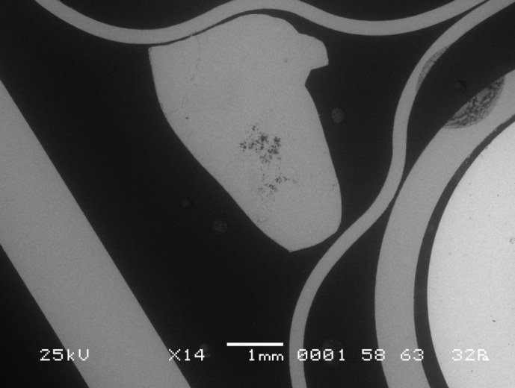
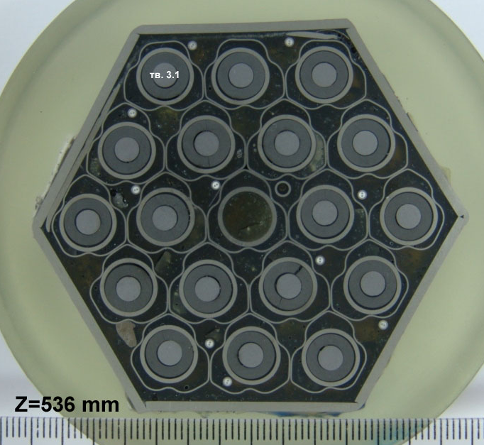
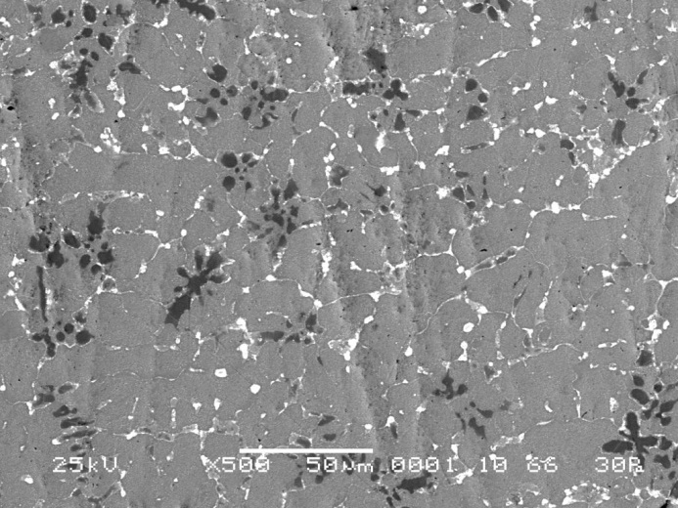
Cross section of the bundle at Z = 536 mm (top)
The assembly has no essential damages, the thickness of oxide scale on the surface of zirconium elements does not exceed 10 microns;
Two drips of a melt are detected between rods;

Slide 5
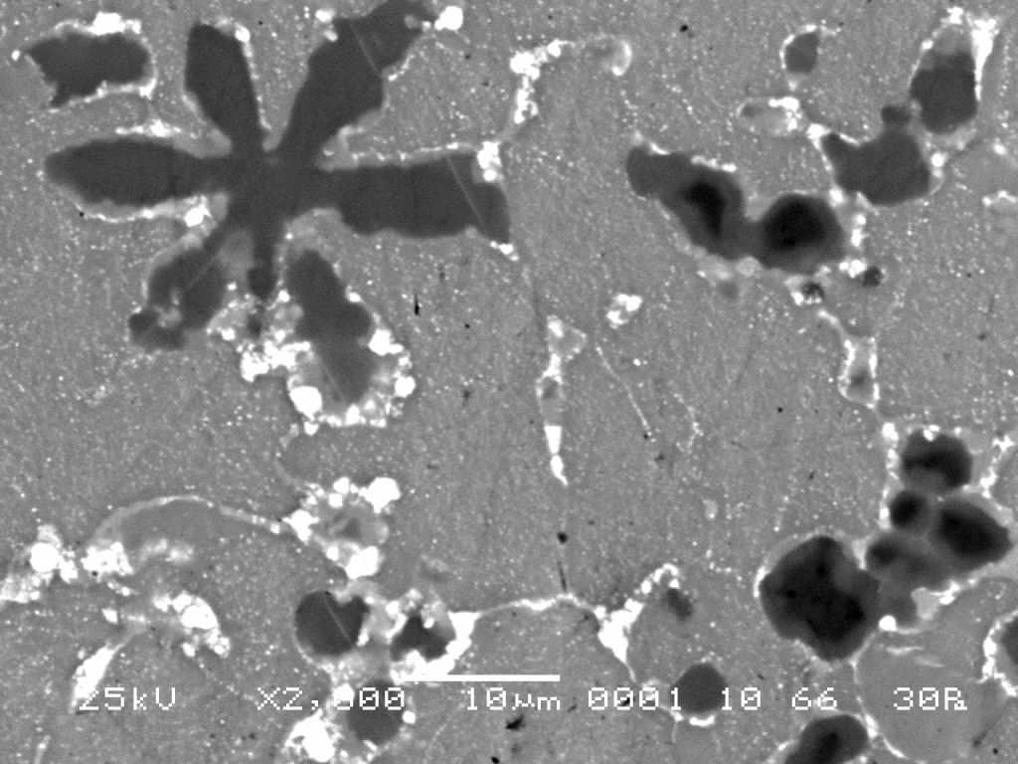
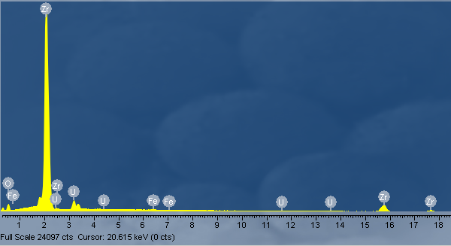
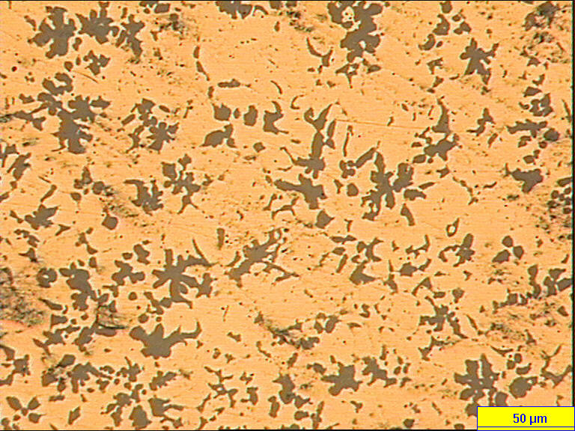
Structure and composition of the melt (Z = 536 mm)
Dark phase
Grey phase
Light phase
Ceramic phase
Metallic phase
Ceramic phase content – 24 %

Slide 6
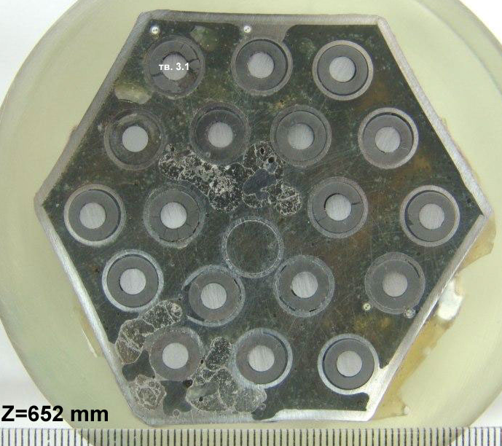
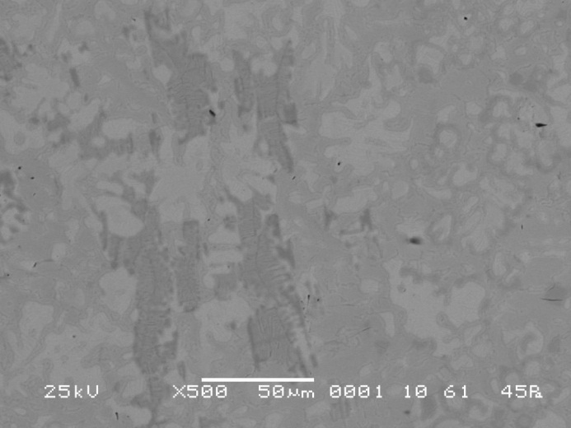
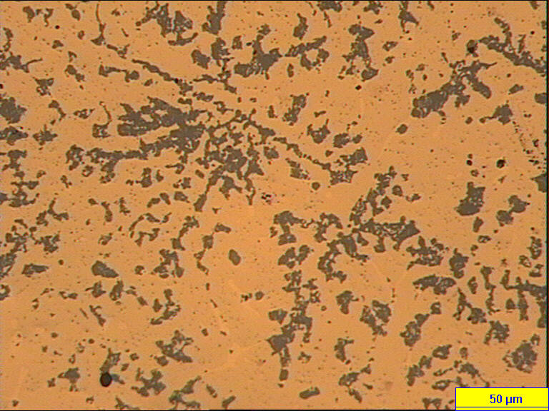
Cross section of the bundle at Z = 652 mm (top)
Eutectic Zr - SS
(U,Zr,O) melt
The melt between rods flew off on rod surface warming up them and diluting claddings;
- Composition of the melt - (U,Zr,O) or eutectic Zr – SS.

Slide 7
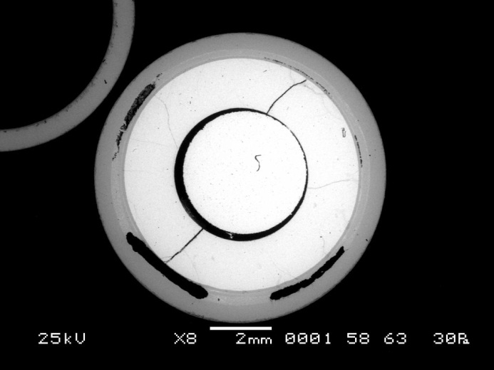
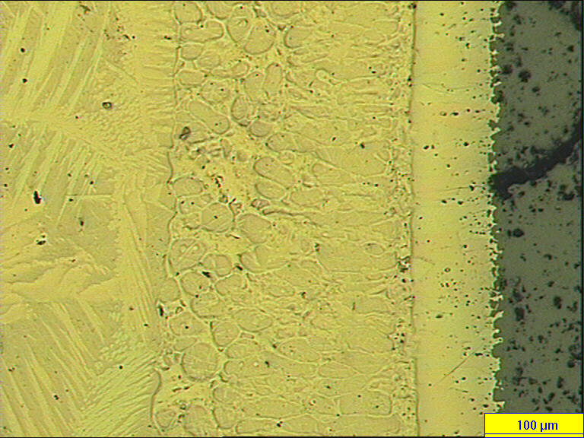
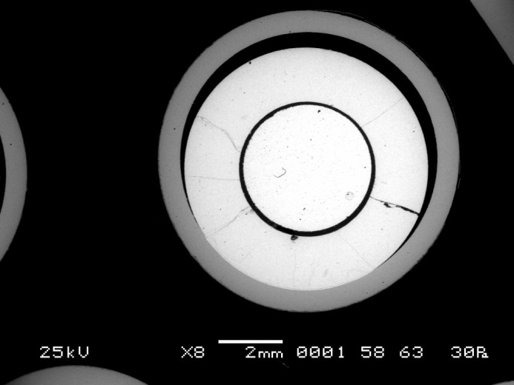
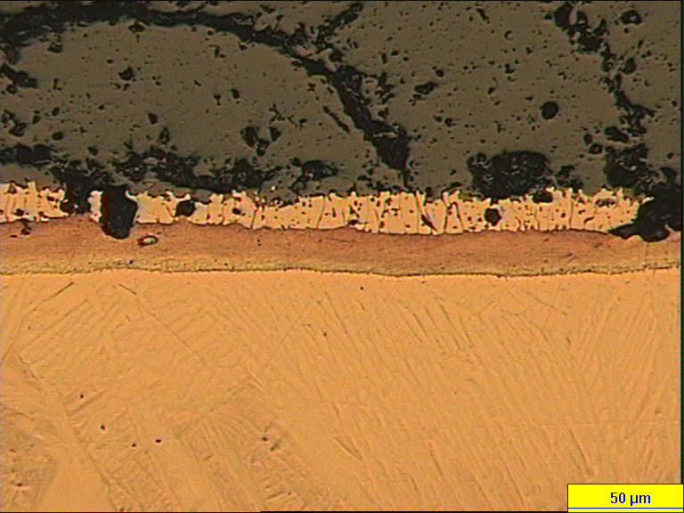
Zr – UO2 interaction (Z =652 mm)
Zr
Melt (Zr, U, O, Fe, Cr, Ni)
UO2
2.4
a – Zr(O) + (U,Zr)
- There was the melt In the cladding-fuel gaps, which was ‘liquefied’ fuel and claddings;
UO2
a – Zr(O)+ (U,Zr)
3.4
(U,Zr)
a – Zr(O)
- In case of cladding-fuel contact the eutectic interaction occured with formation of phases, known to be typical for Zr-UO2 interaction

Slide 8
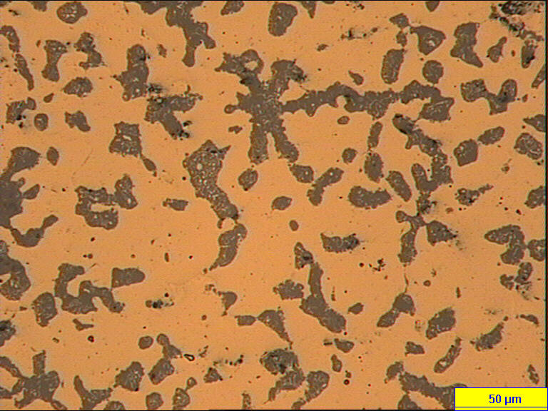
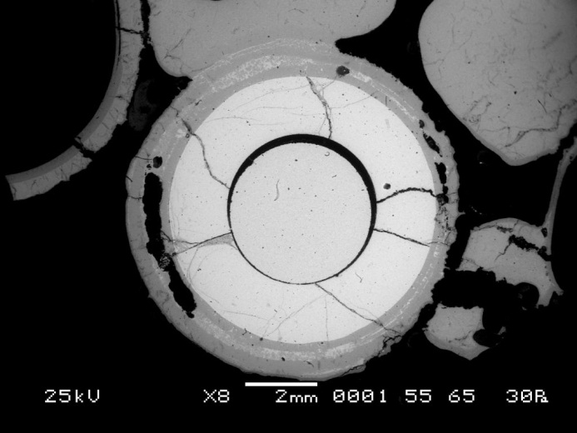
Cross section of the bundle at Z = 699 mm (top)
(U,Zr,O) melt
2.4
- The essential damage of claddings and shroud is noted, that testifies reaching at the given level of melting point of metal Zr-1%Nb (~1870 C).
- The form of claddings was saved by the external oxide layer.

Slide 9
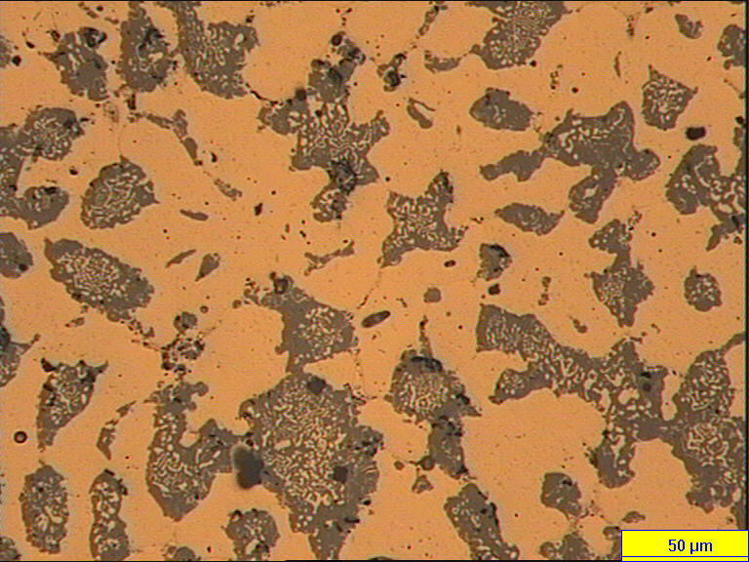
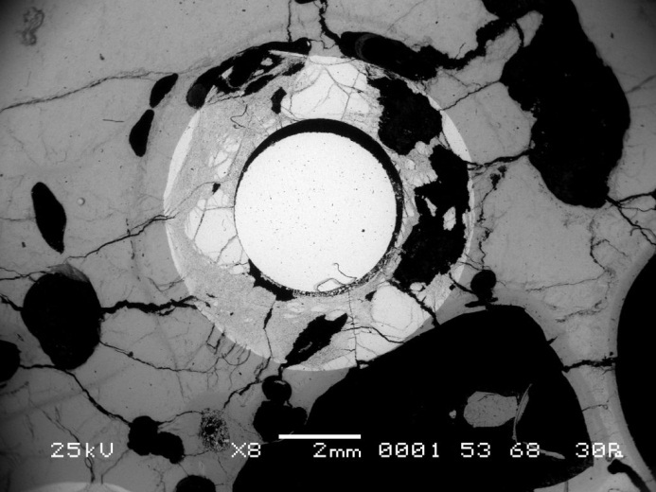
Cross section of the bundle at Z = 723 mm (top)
(U,Zr,O) melt
2.6
Once molten and relocated masses have formed an almost compact blockage (bottom of the blockage); - The structure of melt at this cross section is quite homogeneous; - Claddings and shroud were completely dissolved.

Slide 10
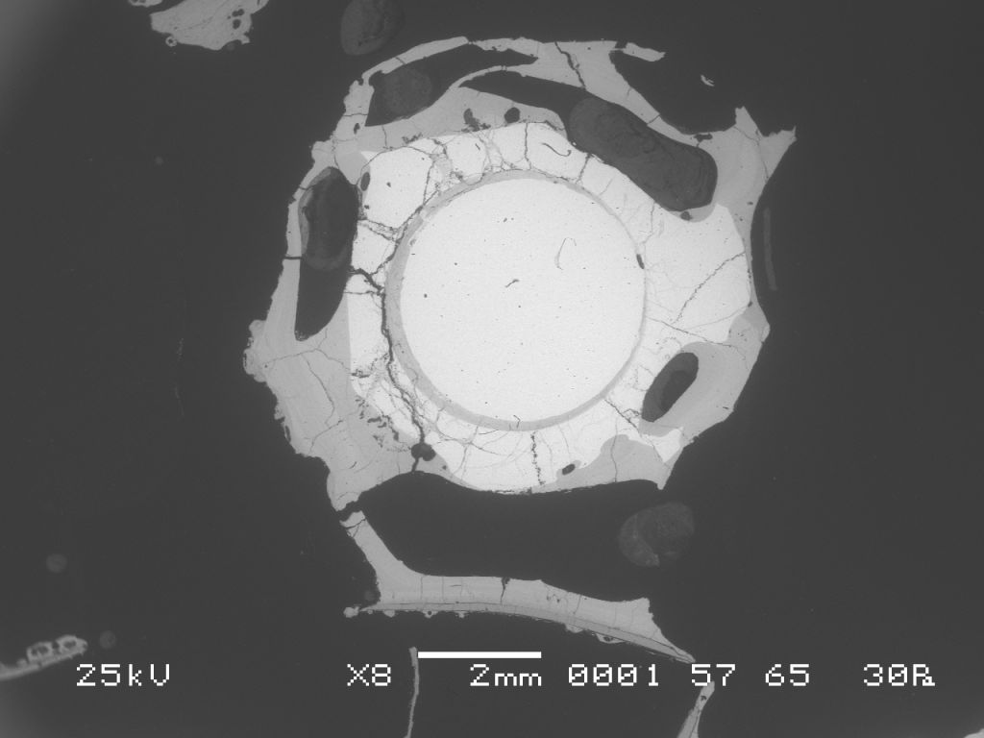
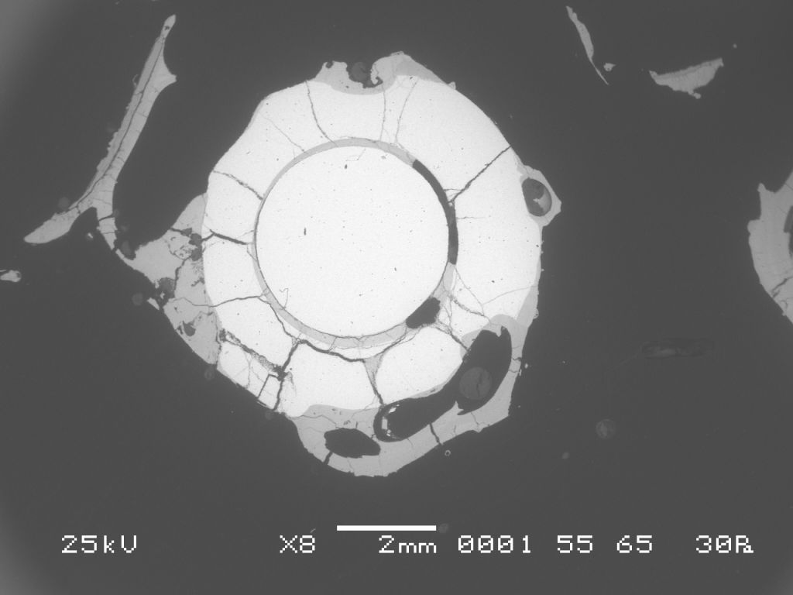
Cross section of the bundle at Z = 745 mm (top)
3.1
2.1
There is no molten material between rods; - Fuel pellets are essentially dissolved; - There is a ceramic (Zr,U)O2 on the surface of the dissolved pellets.

Slide 11
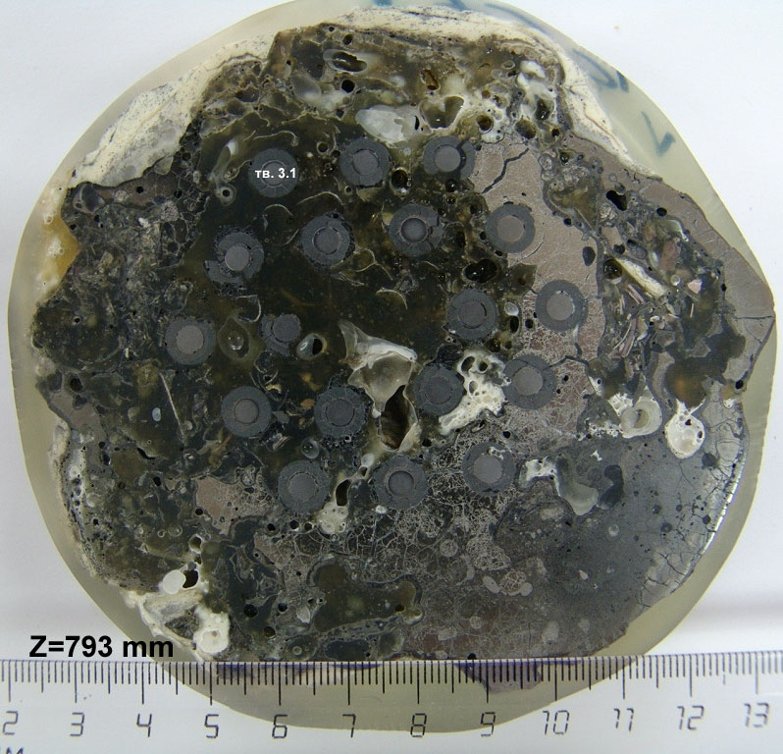
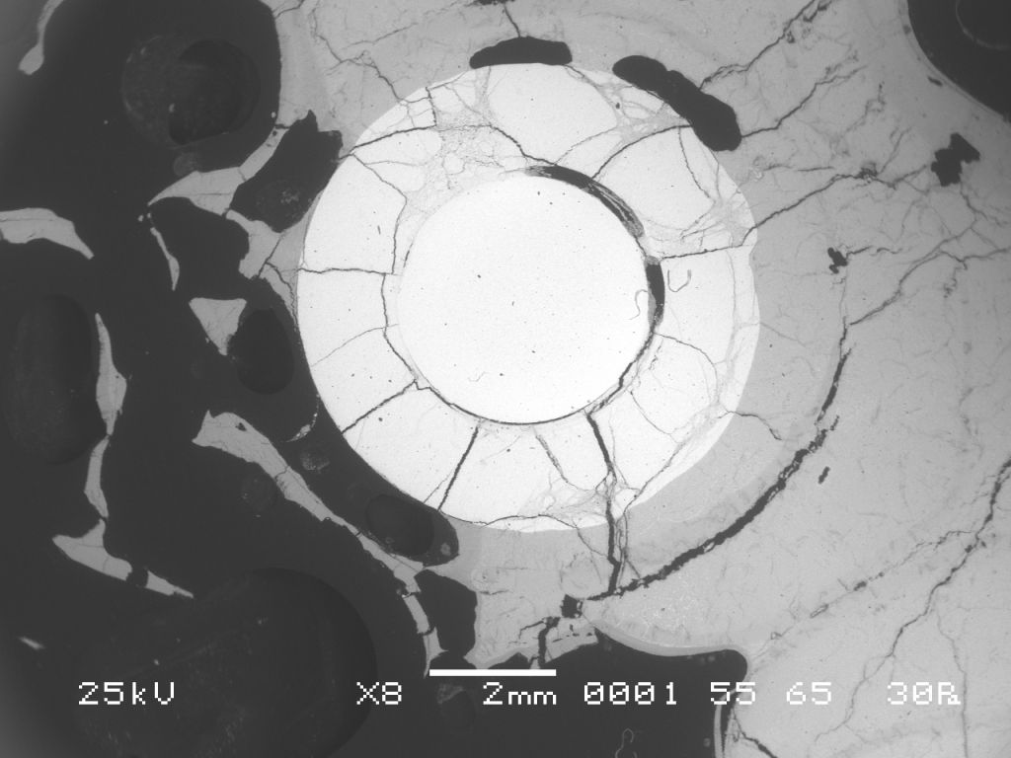
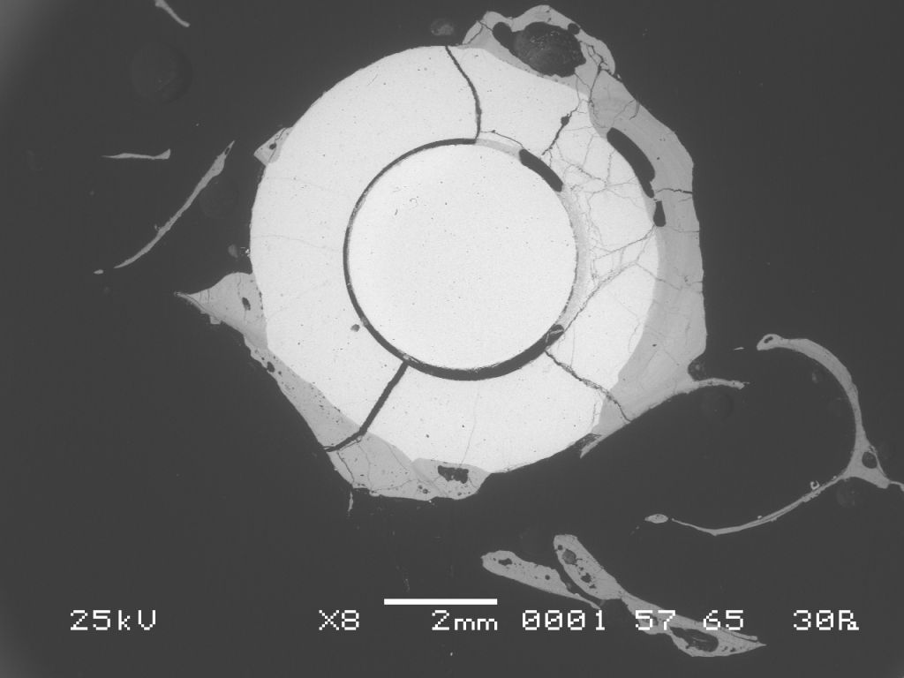
Cross section of the bundle at Z = 793 mm (top)
3.4
2.1
There is a relocated mass of melt at this level (top of the blockage); - This mass of melt is not homogeneous – there are local variations in the brightness of the colour; - Fuel pellets are essentially dissolved.

Slide 12
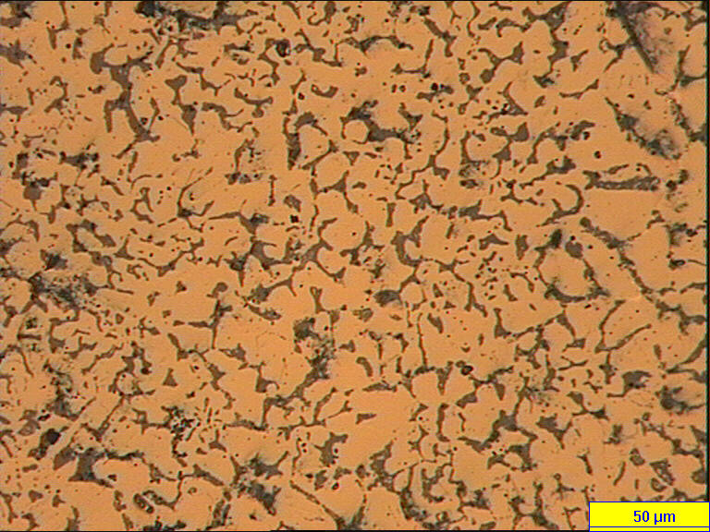
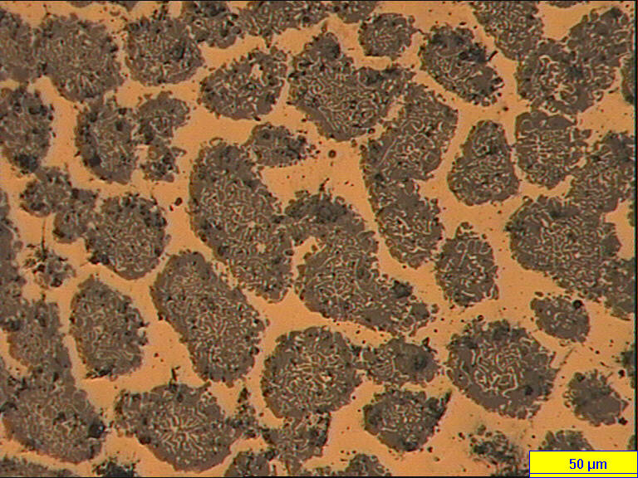
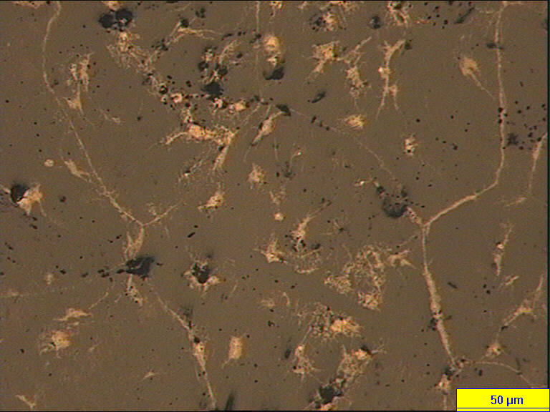
Microstructures of the melt at 793 mm
a – Zr(O) + (Zr,U)O2 + (U,Zr)O2
a – Zr(O) + (Zr,U)O2 + (U,Zr)O2
(Zr,U)O2 + ZrO2

Slide 13
Cross sections of the bundle at 800…1100 mm
Z = 839 mm
Z = 1021 mm
There are no claddings, shroud and molten material at this region; - We can see remains of oxide scale on the rods; - Fuel pellets are essentially dissolved.

Slide 14
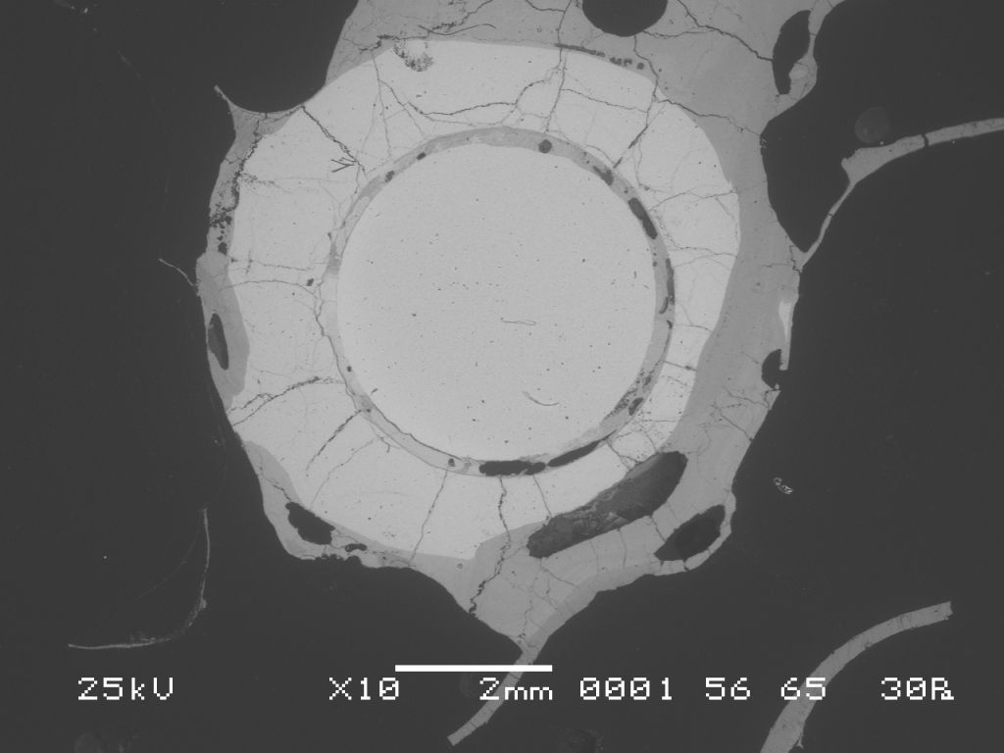
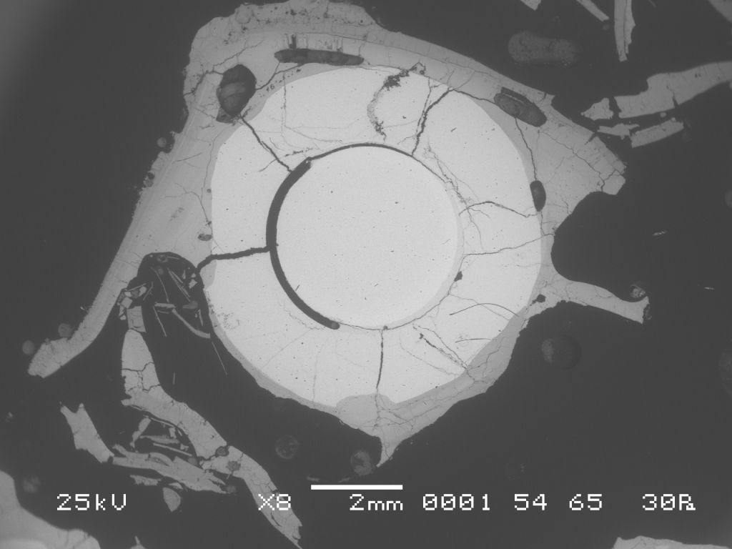
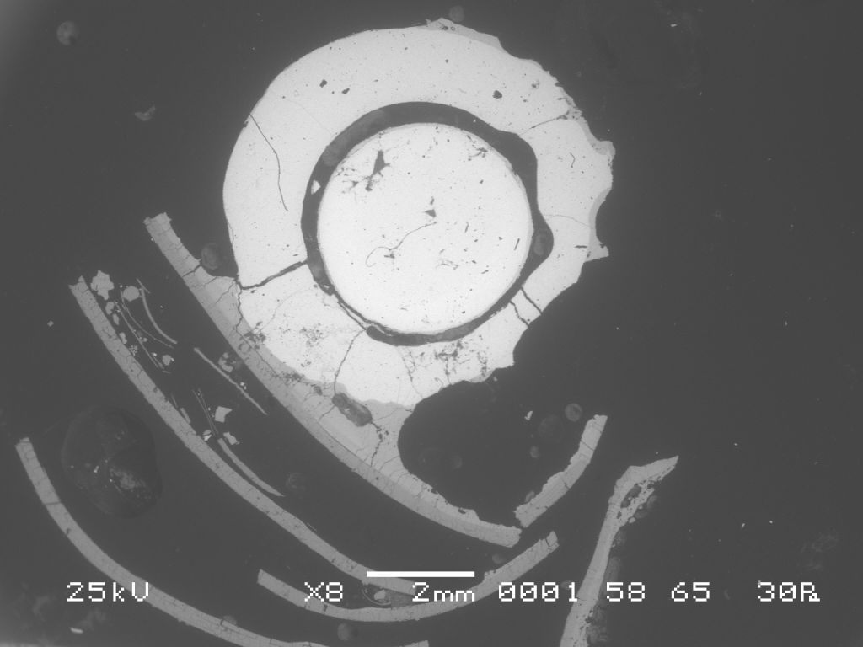
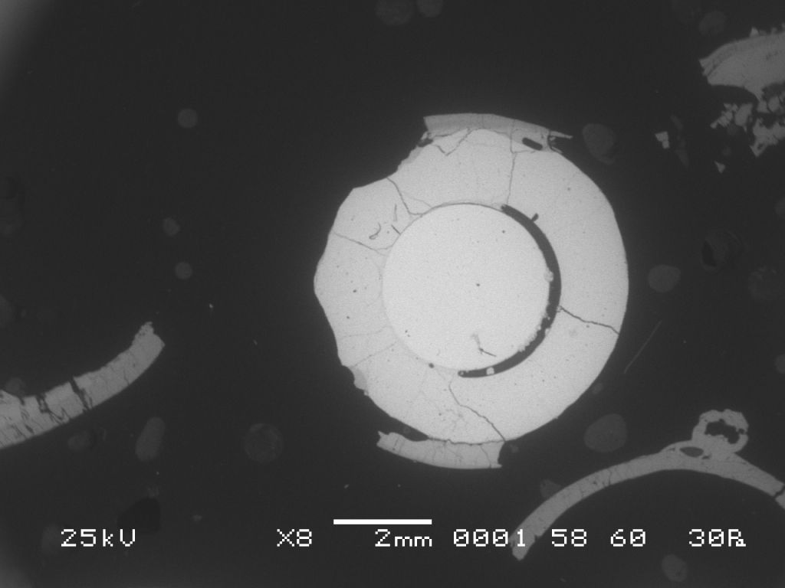
Strong fuel dissolution by relocated melt
3.9
2.3
Z = 839 mm
Z = 886 mm
2.2
2.3
Z = 930 mm
Z = 1021 mm

Slide 15
Fuel fragmentation
Z = 1066 mm
Z = 1091 mm
- Only on these levels fragmentation of fuel was found out, but relocation of fuel does not significant.

Slide 16
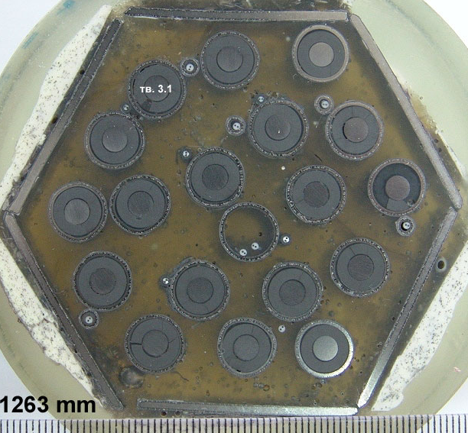
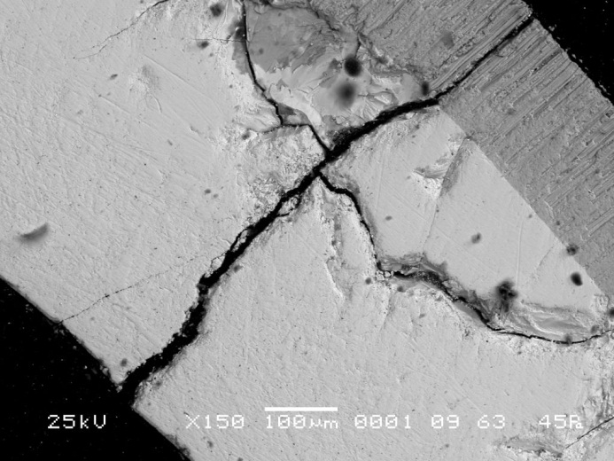
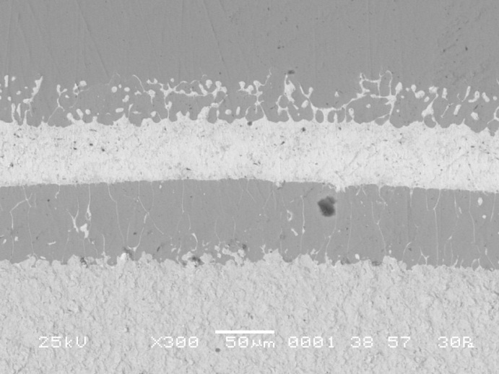
Cross section of the bundle at Z = 1263 mm (top)
ZrO₂
Zr
Zr
(U, Zr)
α - Zr(O) + (U, Zr)
UO₂
Claddings has through-wall cracks, which faces does not oxidized; - In places of cladding-fuel contact were founded the tracers of eutectic interaction.

Slide 17
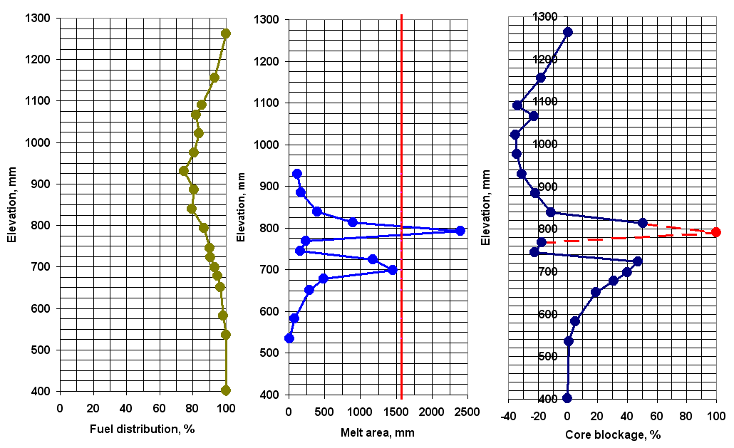
UO2 distribution, melt relocation
and blockage formation in PARAMETER-SF1 bundle

Slide 18
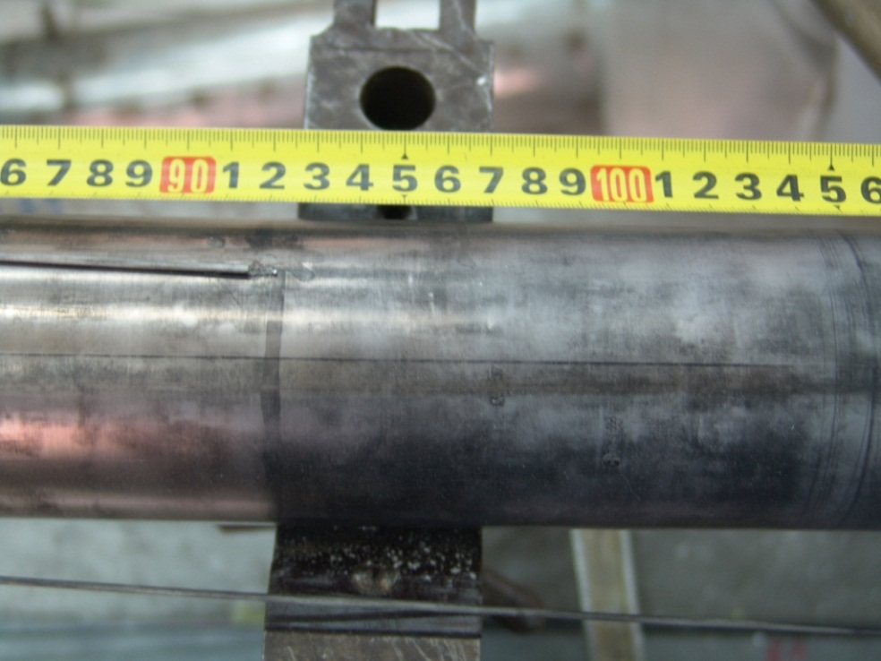
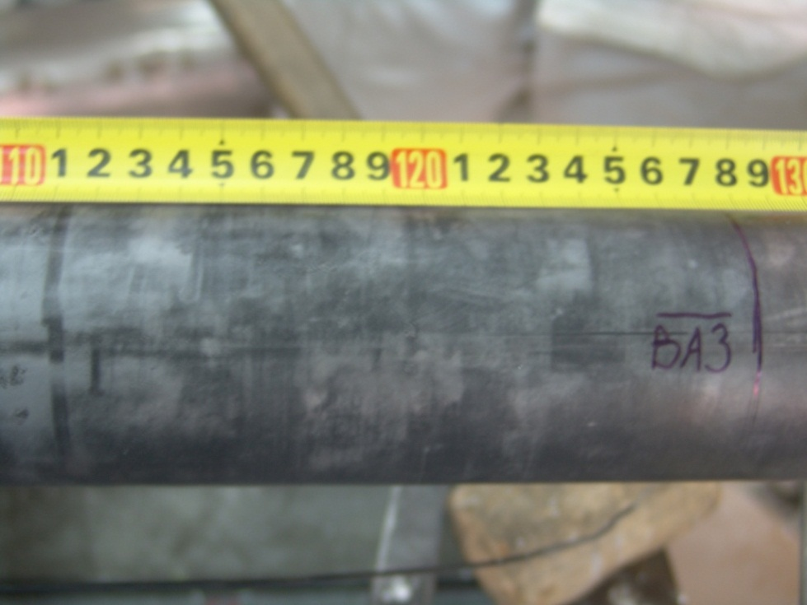
Posttest appearance of SF2 fuel assembly
Shroud kept its integrity and leak tightness;
There is a thin oxide layer on its outer surface;

Slide 19
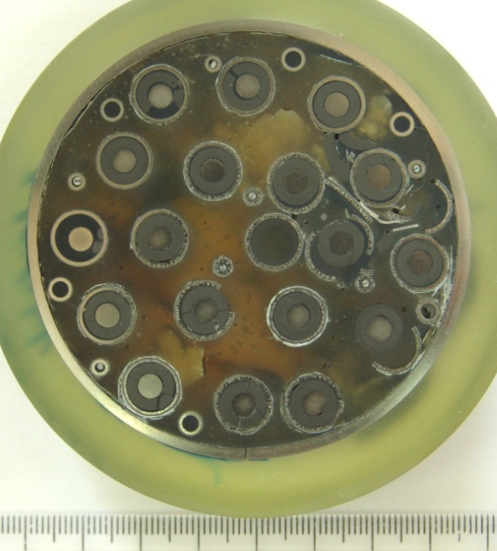
Sampling for material analysis
Z = 1100 mm
Z = 1250 mm
Z = 1300 mm
- Fuel rod claddings were oxidized considerably and partially fragmented;
- There is no melt in the space between fuel rods.

Slide 20
CONCLUSION (1)
The top flooding of overheated up to 2000C bundle resulted in expanded degradation of fuel rods (Z = 700…1100 mm), formation of melt, melt relocation and blockage formation. The integrity of assembly was saved only at the expense of heaters, which one played a role of a hull in the given experiment;
According to the plan of the project ISTC #3194 material investigations of fuel assemly PARAMETER - SF1 were carried out. The obtained date include:
- thicknesses of ZrO2 layers on cladding and shroud;
- thicknesses of oxide phase on melt surface;
- axial UO2 distribution on the bundle hight;
- distribution of relocated masses and blockage in the bundle;
- srtucrure an composition of melt ar different cross sections;
- thicknesses of the layers, formed in consequence of eutectic interaction Zr – UO2;

Slide 21
CONCLUSION (2)
The top&bottom flooding of overheated up to 1500 C bundle resulted in fragmentation of fuel rods without melt relocation and blockage formation;
According to the plan of the project ISTC #3194 fuel assembly PARAMETER – SF2 was filled by epoxy and cut on cross sections.

