Slide 1
FSUE SRI SIA “LUCH”
IBRAE RAS
FSUE EDO “GIDROPRESS”
I S T C
The results of the PARAMETER-SF2 experiment
(flooding from the top and bottom of the overheated
model fuel assembly of VVER-1000)
(Status of ISTC Project # 3194)
Presented by W. Konstantinov
Topical Meeting
Podolsk, 3 -6 July 2007

Slide 2
The Structure of Project
Financial support – I S T C
The basic participants:
FSUE SRI SIA “LUCH”
IBRAE RAS
FSUE EDO “GIDROPRESS”
3. Another participants:
A.A. Bochvar FSUE VNIINM,
A. I. Leipunsky SSC RF-IPPE,
RSC “Kurchatov Institute”
4. Foreign collaborators: FZK, GRS, EdF, IRSN

Slide 3
Main Tasks of the PARAMETER-SF2 Experiment
Study of the behaviour of structural components of 19-rod model FA of VVER-1000 (fuel pellets and claddings, shroud, spacing grids);
Study of the oxidation degree of the structural components of 19-rod model FA of VVER-1000;
Study of interaction and structural-phase changes in the materials of model FA of VVER-1000 (fuel pellets and claddings);
Study of the hydrogen release dynamics.

Slide 4
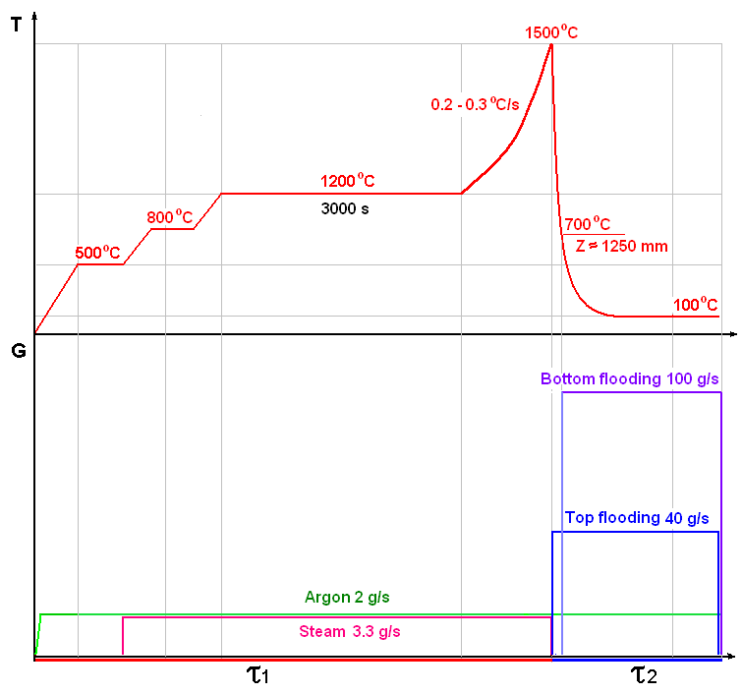
The PARAMETER-SF2 Test
Main parameters of the experiment
Sequence diagram of the experiment
Coolant | Steam/ argon
Flow rate of coolant, g/s | 3.3/2
Temperature of coolant, °C | ∼500/400
Heating rate of cladding, °C /s | 0.2- 0.3
Temperature of cladding at the pre-oxidation phase, °C | ∼1200
Duration of the pre-oxidation phase, s | ∼ 3000
Maximal temperature of cladding, °C | 1500
Quenching phase | Top and bottom flooding
Flow rate of flooding, g/s: - top - bottom | ∼ 40 ∼ 100

Slide 5
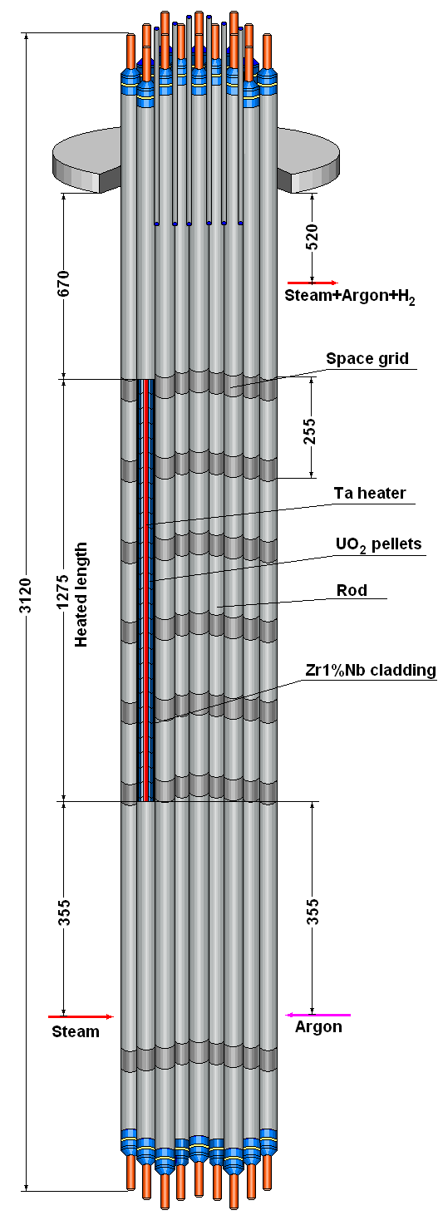
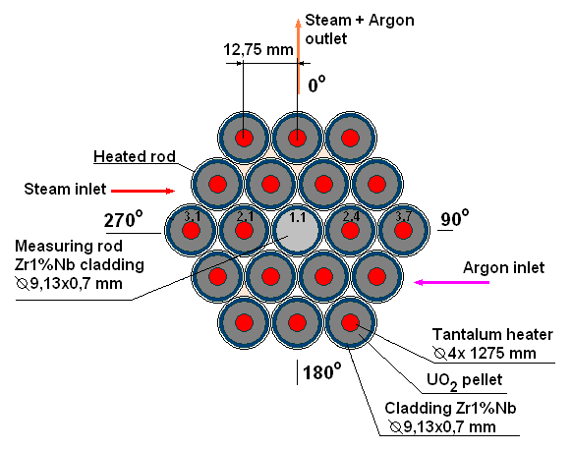
Test Bundle
The main technical characteristics
General view
Type VVER-1000
Number of rods 19
- heated 18
- unheated 1
Rods
- cladding, mm ∅ 9,13/7,73 (Zr1%Nb)
- pellets UO2
- heater ∅ 4/1275 (Ta)
Grid type triangle
- grid pitch, mm 12.75
Spacing grid Zr1%Nb
- height, mm 20
- spacing, mm 255
Shroud Zr1%Nb
- thickness, mm 2
- diameter/height, mm 70/1490
Thermoinsulation ZrO2 ZYFB-3
- thickness, mm 23
- diameter/height, mm 116/1490

Slide 6
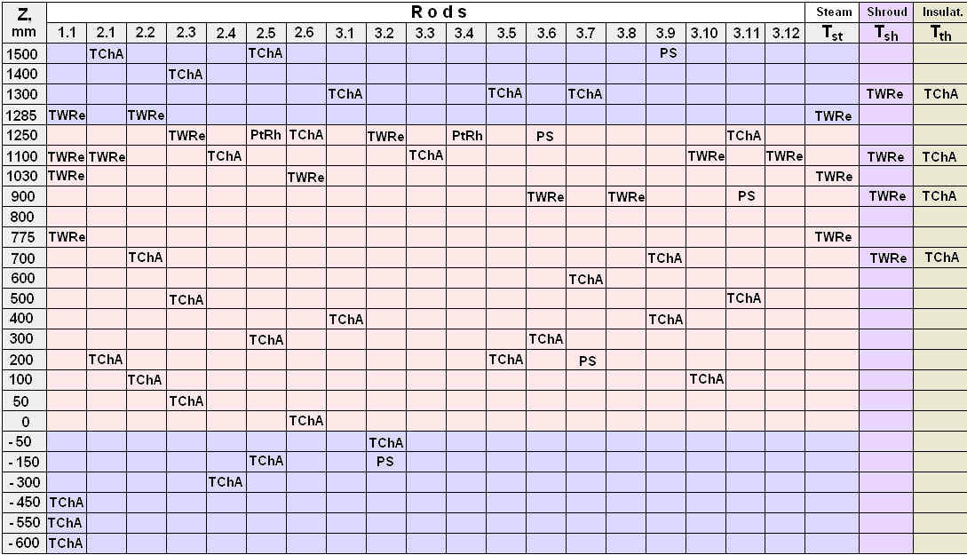
Test instrumentation
TC ChAl - 31, TC WRe – 14, TC PtRh – 2
Tsh – 4, Tth – 4, Tst – 3, PS (pressure sensor) - 5

Slide 7
Comparison of geometrical parameters
of the PARAMETER-SF2 bundle with QUENCH-06 bundle
1) Coolant channel area relationship SF2/Q06 ≈ 0,686
2) Metallic surface relationship SF2/Q06 ≈ 1,03
3) Heated metallic surface relationship SF2/Q06 ≈ 0,95
4) Bundle material mass relationship SF2/Q06 ≈ 0,96

Slide 8
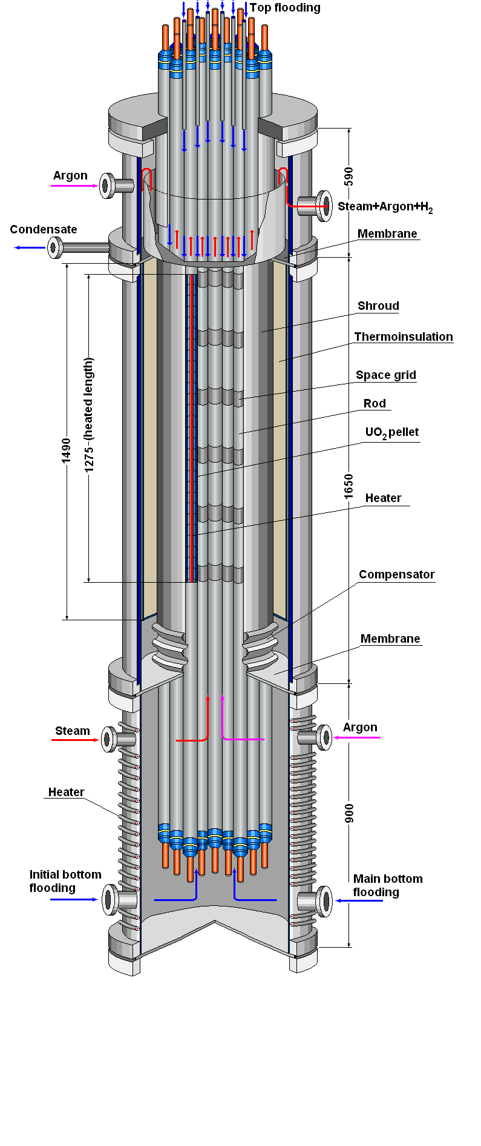
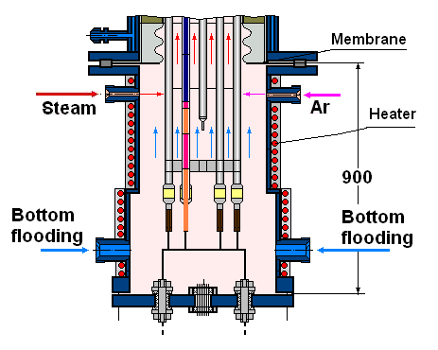
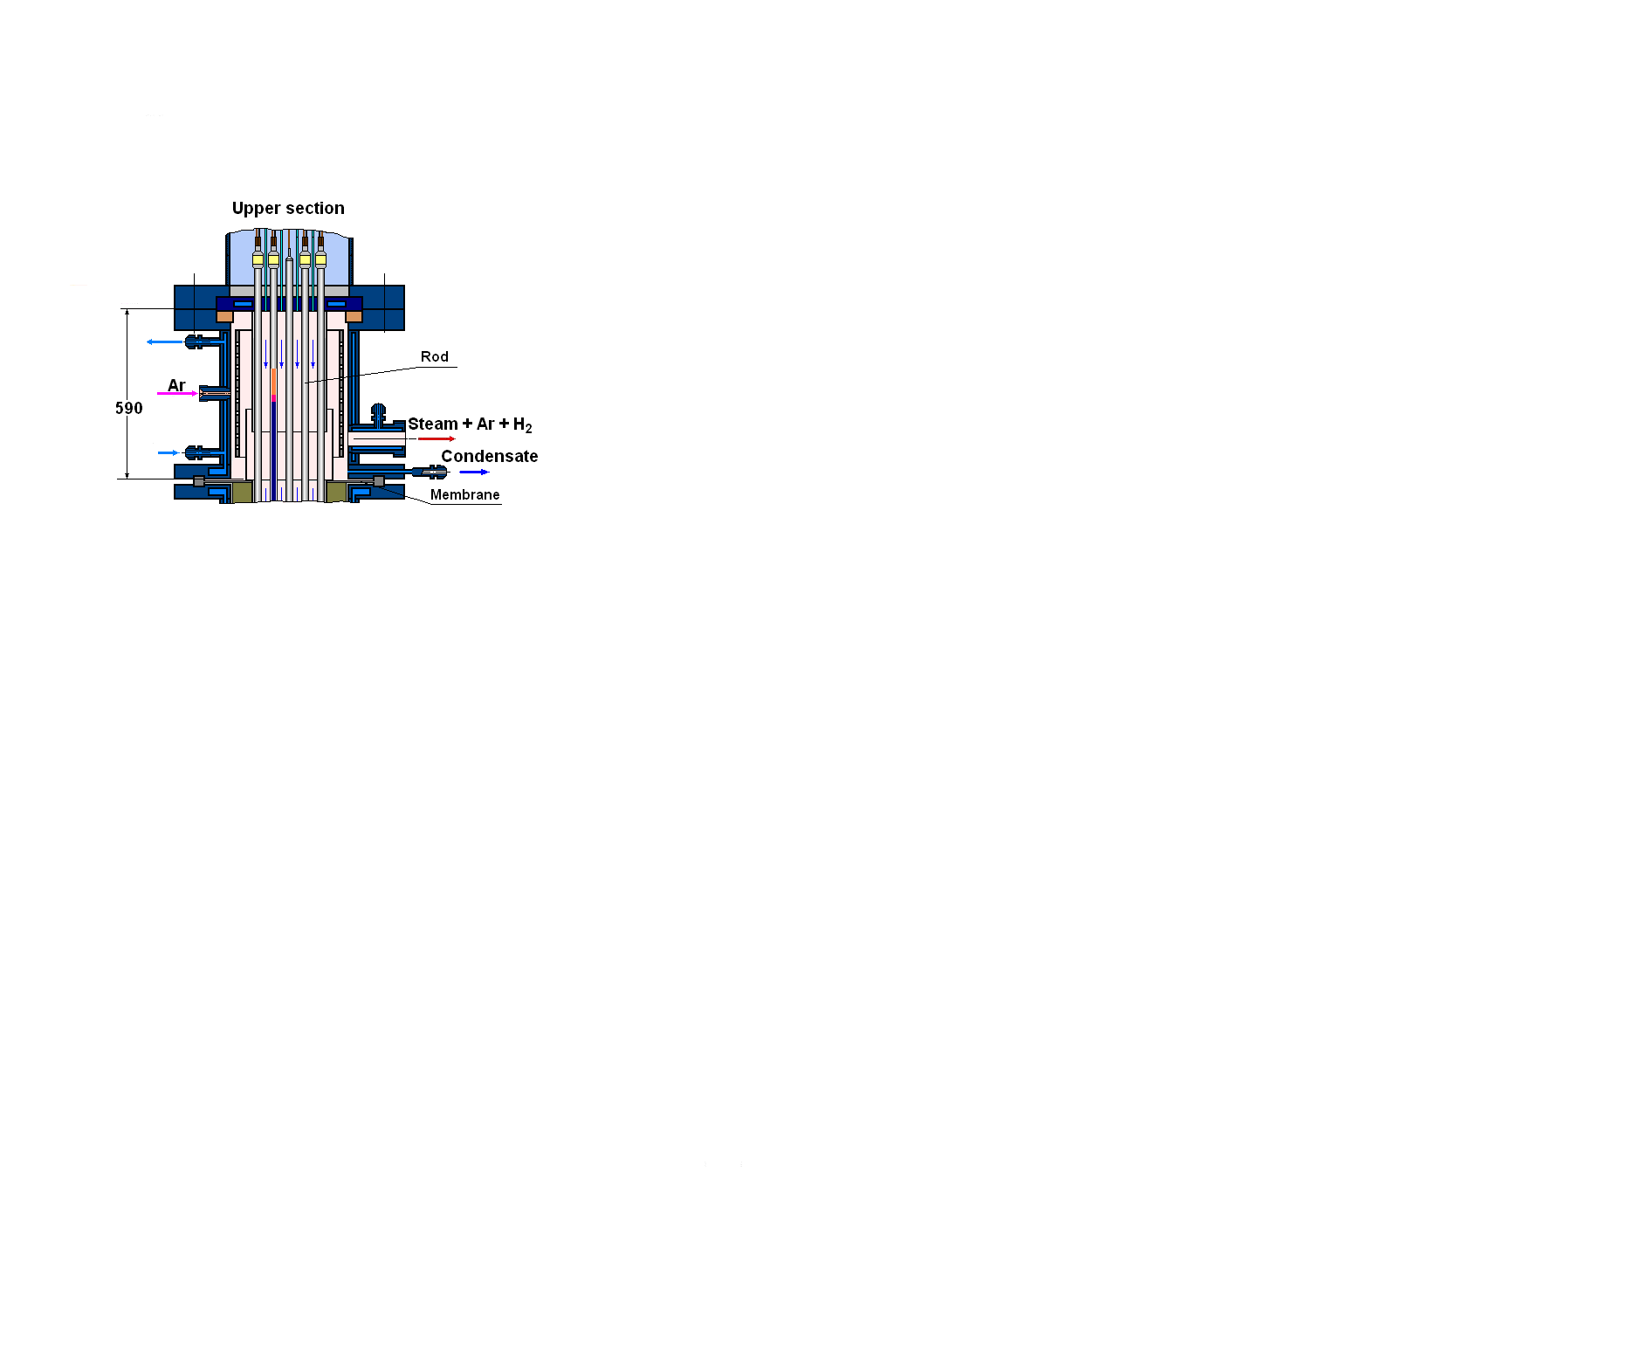
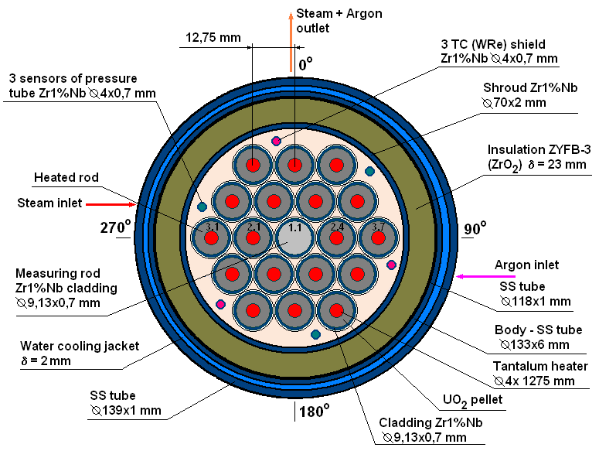
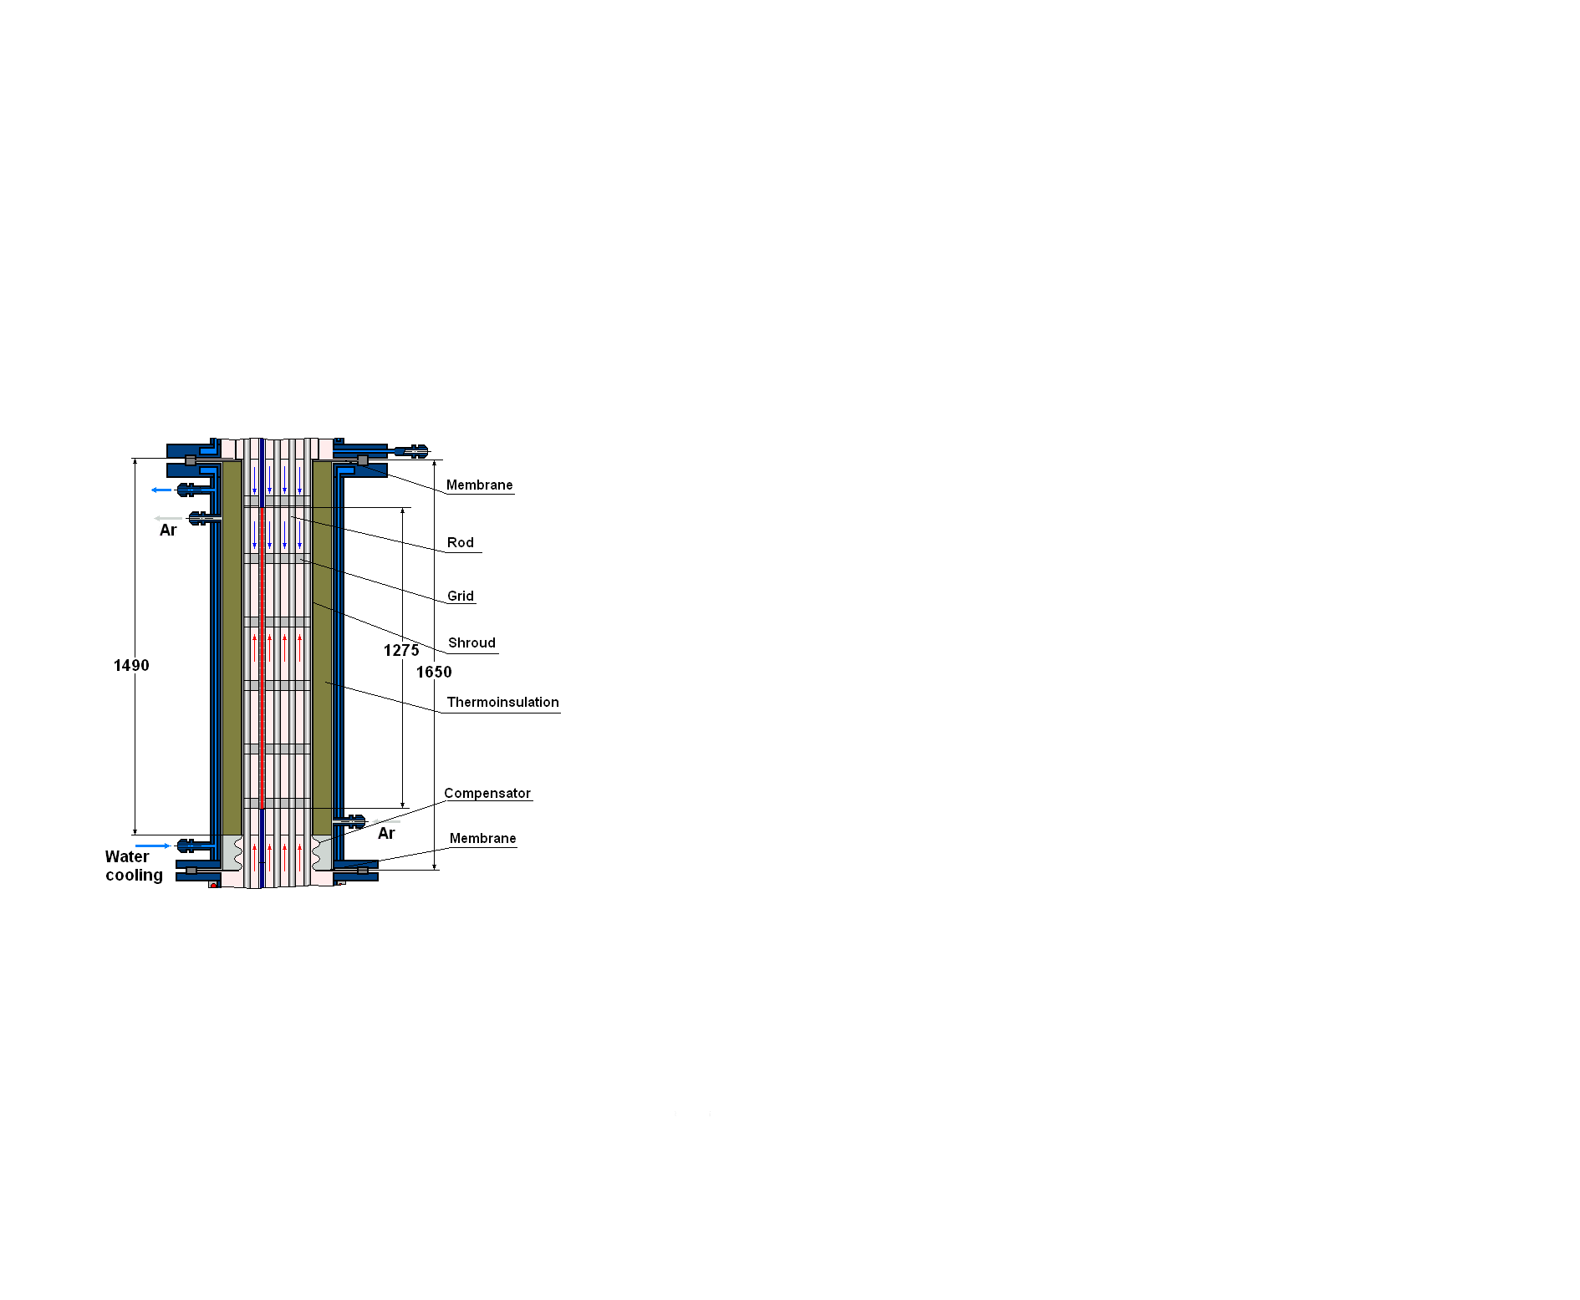
Test facility
1. Test section
Lower part
Middle part
Upper part
The upper water-cooled part provides:
- input rods and TC;
- top flooding;
- input of argon at quenching phase;
- output steam-gas mixture;
- gathering of a condensate and the control of volume of emission of water of the top flooding;
- tight division of the top and middle parts.
The lower heated part
provides:
- separate input steam and argon;
- heating up to temperature
of steam saturation
(Т ∼ 400-410 K at p ∼ 0,30-0,35 МПа);
- bottom flooding.
The middle water-cooled part provides:
- pass steam-gas mixture only through the bundle;
- tightness thermoinsulation and the control of pressure of argon inside of the free space of the thermoinsulation;
- compensation of temperature axial displacements of the shroud .

Slide 9
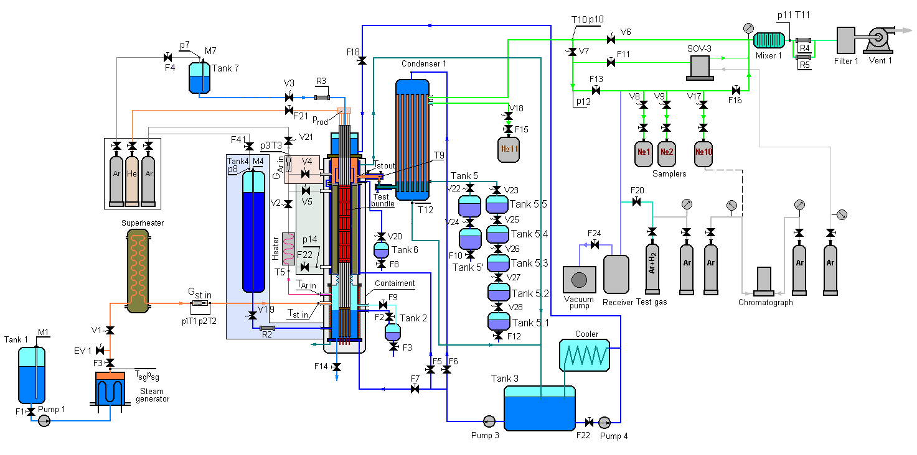
2. PARAMETER Facility
Main technological systems:
System of filling with argon of a free space of the thermoinsulation
and the control pressure of argon
System of steam– and argon flow input
System of switching of input of argon
System of hydrogen measurement
System of the top and bottom flooding
The monitoring system of balance of steam and water

Slide 10
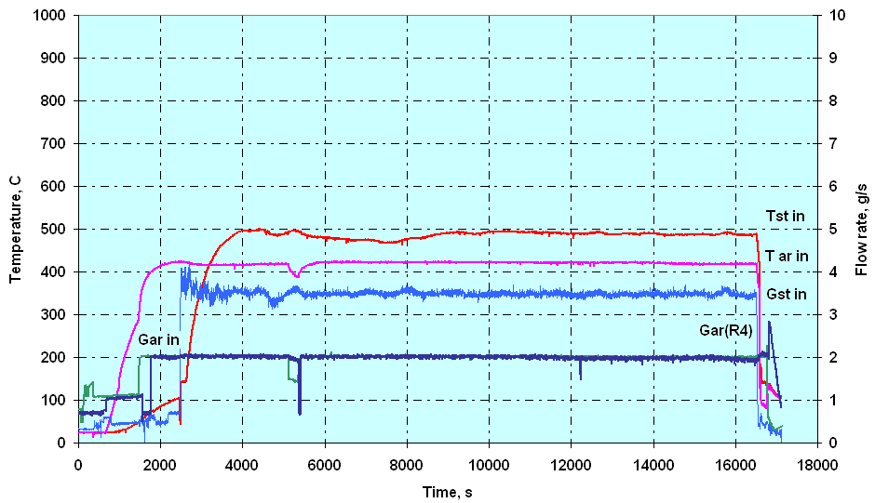
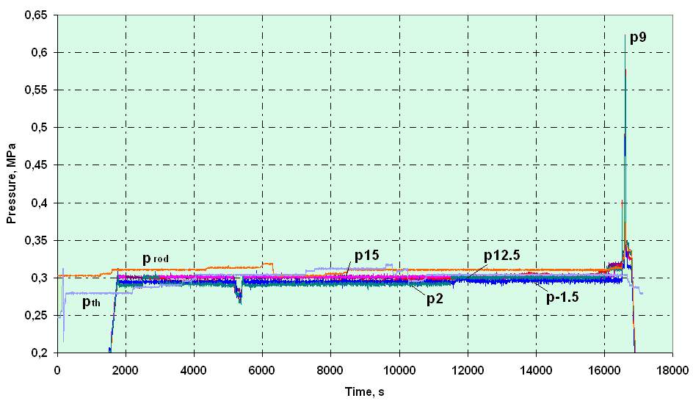
Some results of the PARAMETER-SF2 Test
1. Steam and argon parameters
Gst in = 3.5 g/s Tst in = 500 °C
Gar in = 2.0 g/s Tar in = 400 °C
prod = 0.31 MPa
pbnl = 0.3 MPa
pth = 0.3 MPa

Slide 11
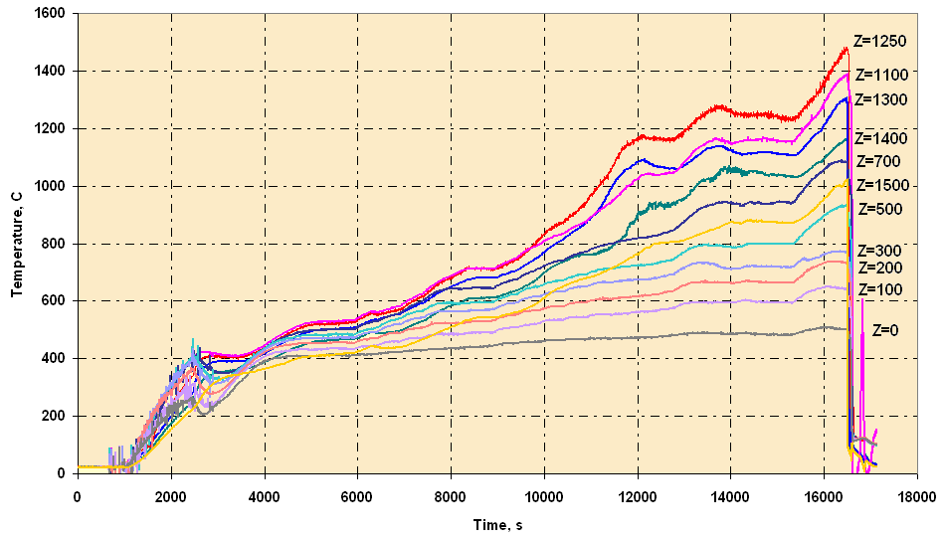
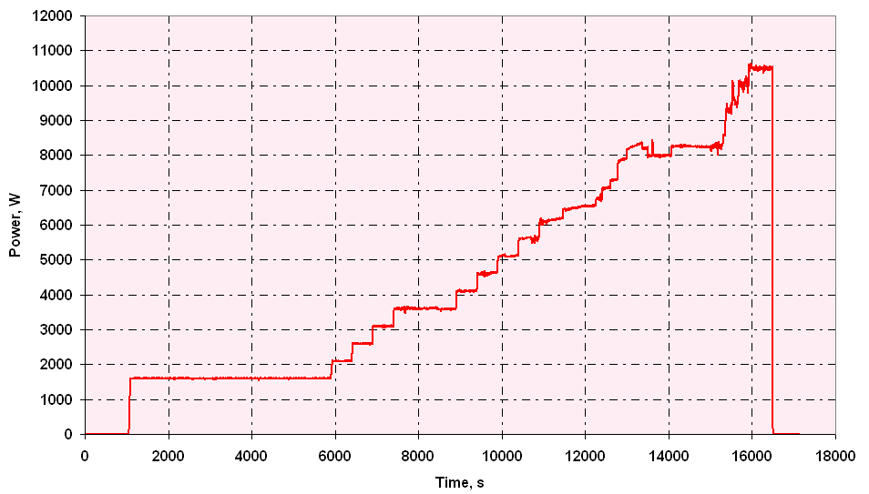
2. Main Test parameters
Bundles temperature
Electrical power

Slide 12
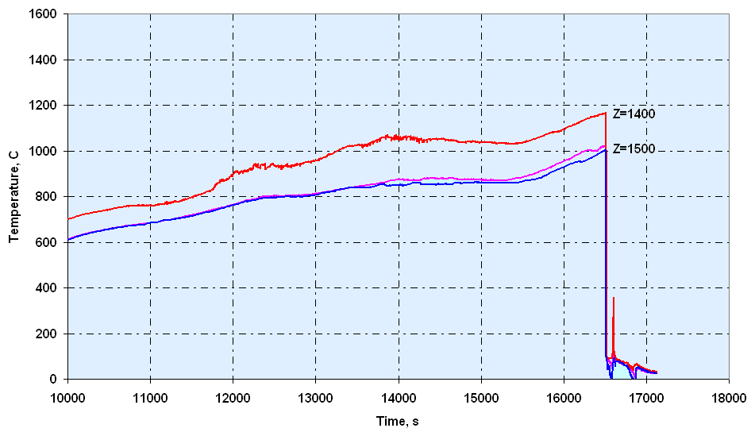
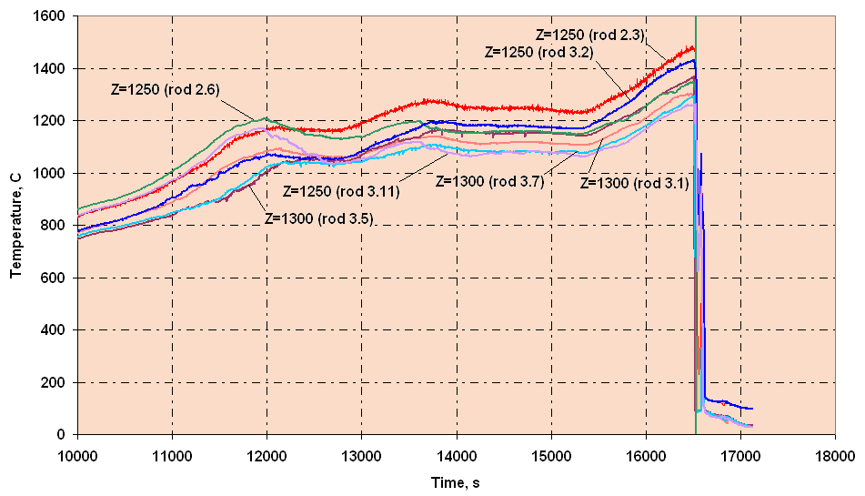
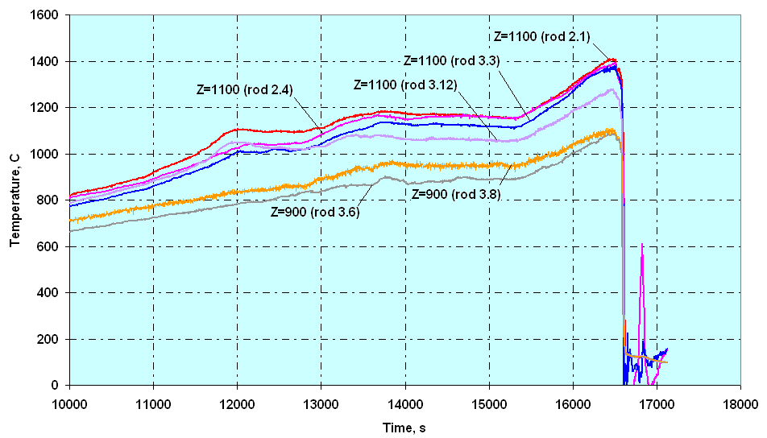
3.1. The claddings temperature during a preoxidizing and transient stages
Elevation 1400 – 1500 mm
Elevation 1250 – 1300 mm
Elevation 900 – 1100 mm

Slide 13
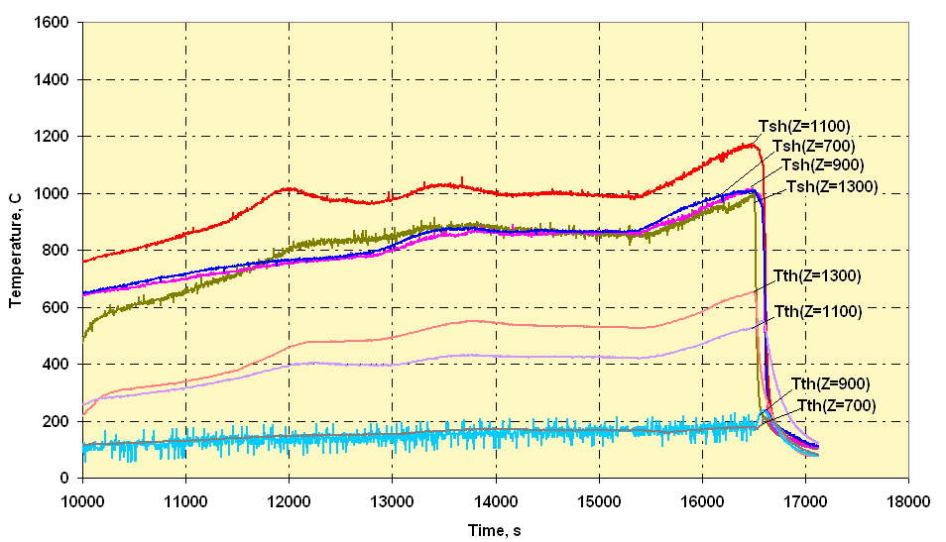
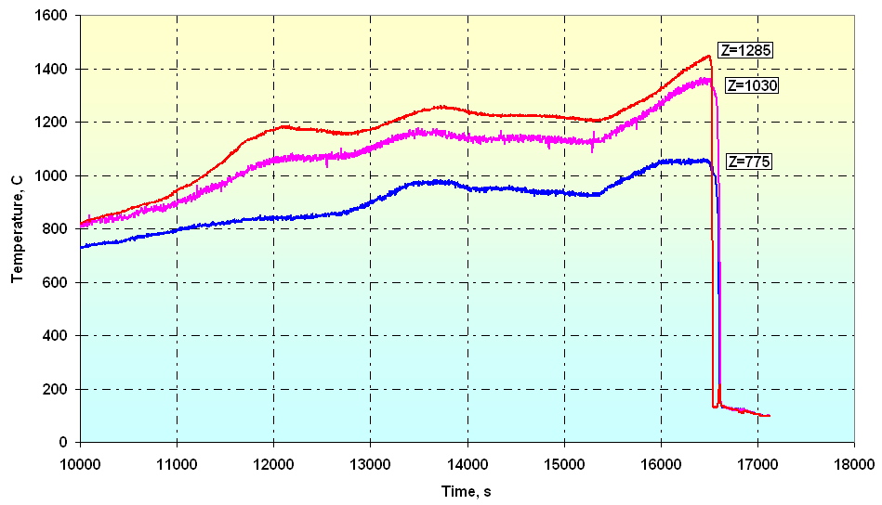
3.2. The bundle component temperature during
a preoxidizing and transient stages
Shroud (Tsh) and thermoinsulation
(Tth) temperature
Space grid temperature

Slide 14
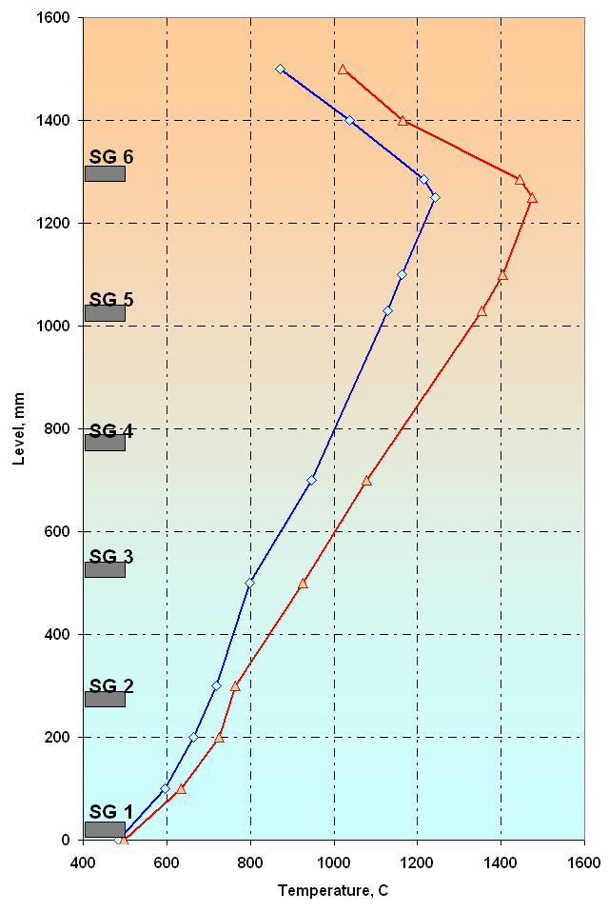
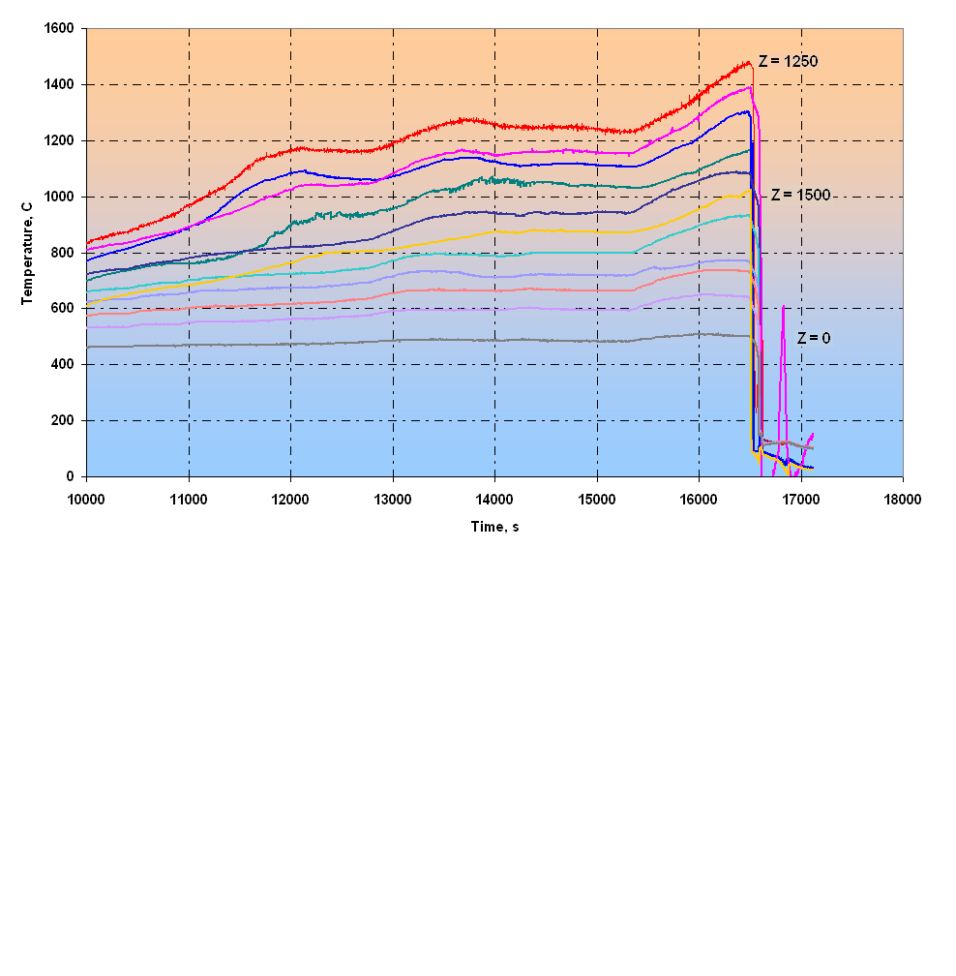
4. The temperature profile of bundle during a preoxidizing
and transient stages
The maximal temperature
during a preoxidizing stage
The maximal temperature

Slide 15
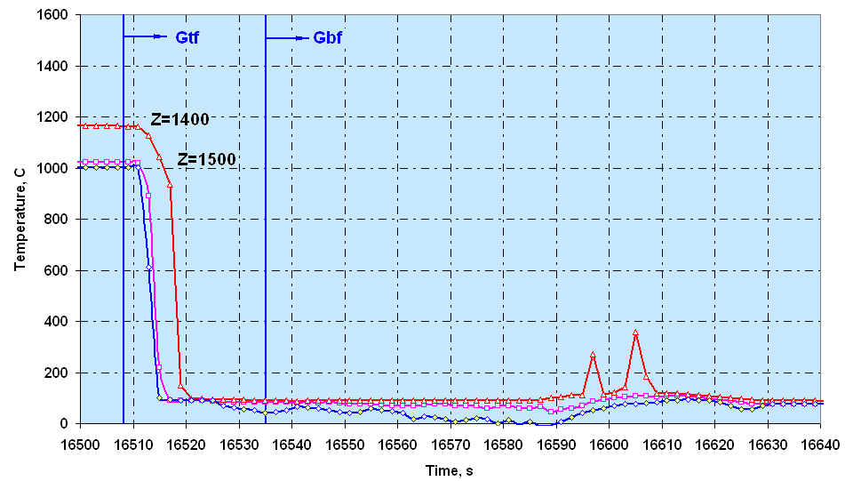
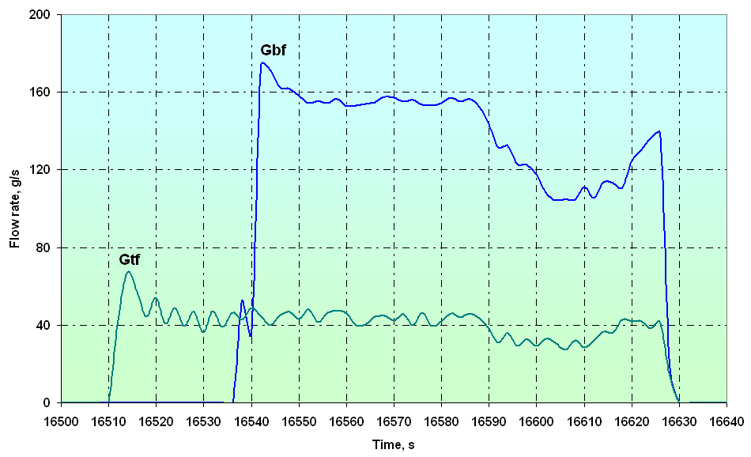
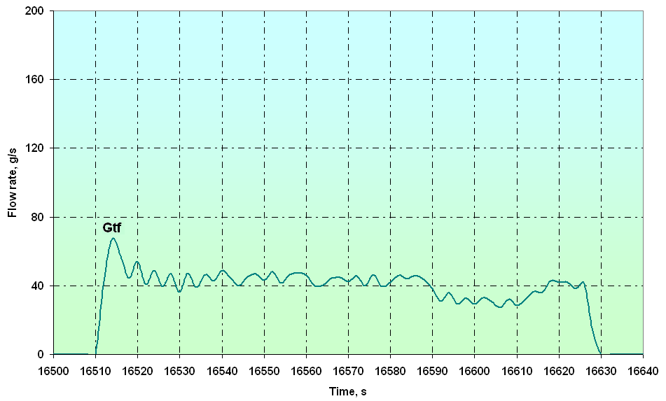
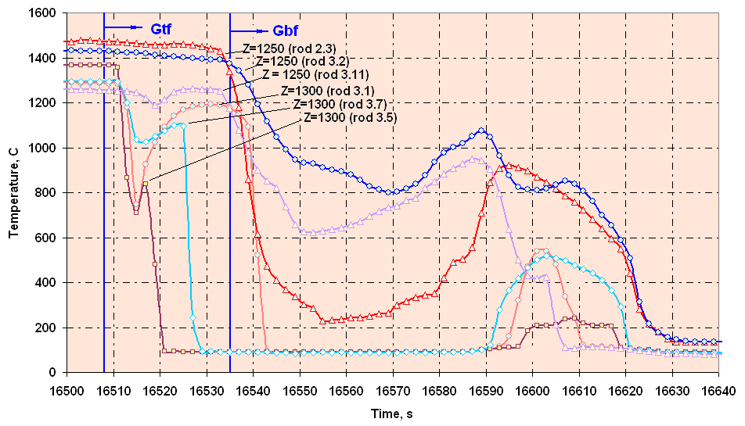
5.1. The claddings temperature during quench stage (elevation 1250 – 1500 mm)
Elevation 1400 – 1500 mm
Top flooding Gtf ≈ 41 g/s
after 27 s – bottom flooding Gbf ≈ 130 g/s
Top flooding Gtf ≈ 41 g/s
Elevation 1250 – 1300 mm

Slide 16
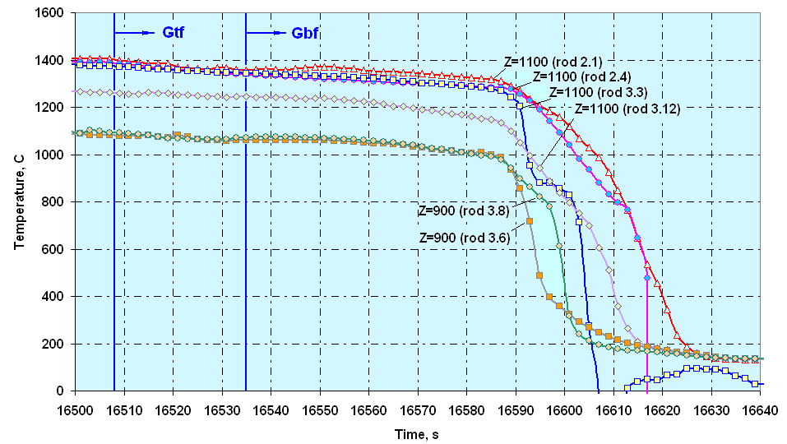
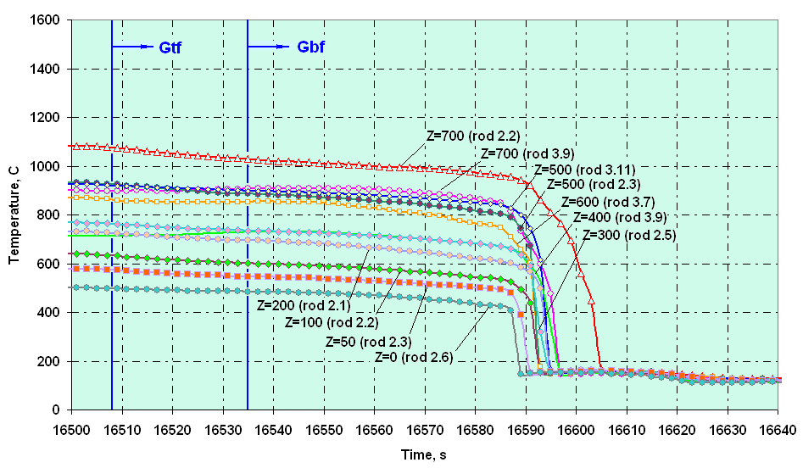
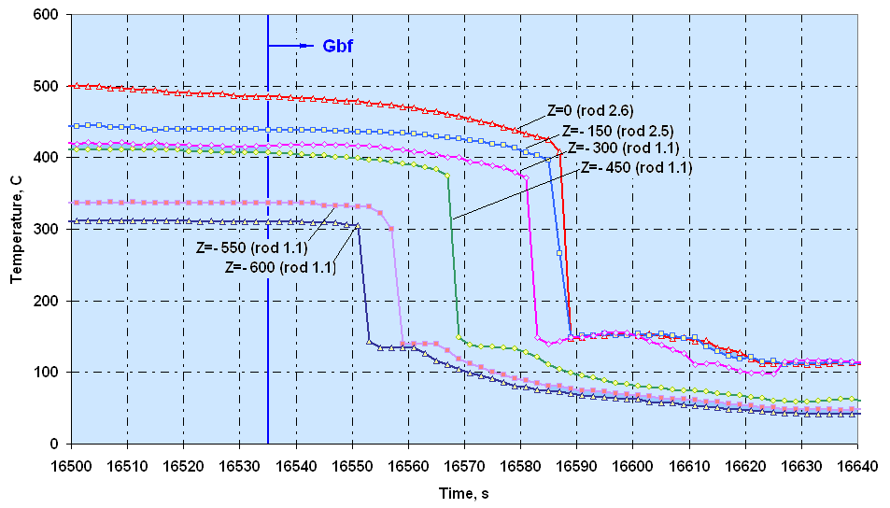
5.2. The claddings temperature during quench stage (elevation -600 – 1100 mm)
Elevation 900 – 1100 mm
Elevation 0 – 700 mm
Elevation - 600 – 0 mm

Slide 17
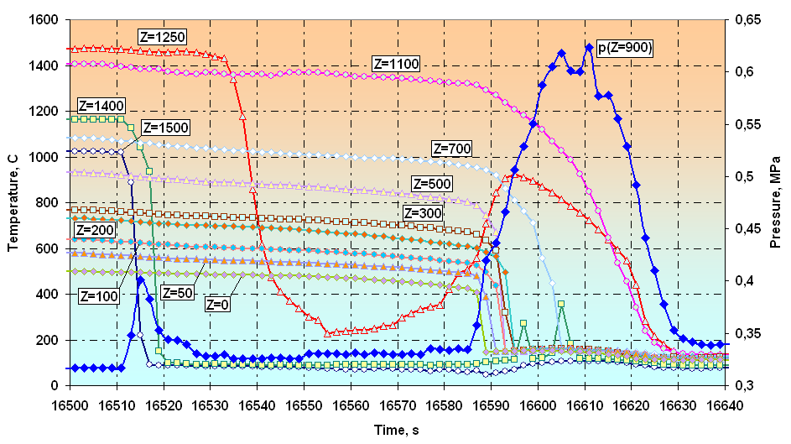
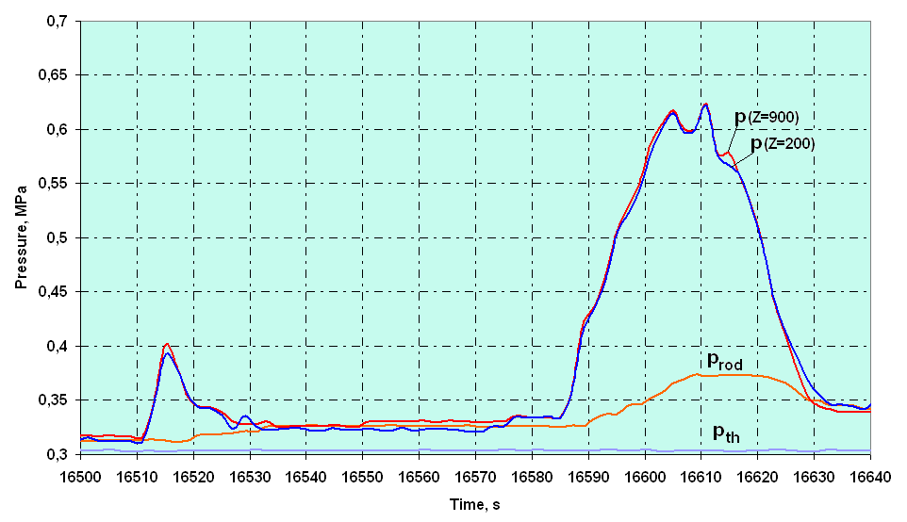
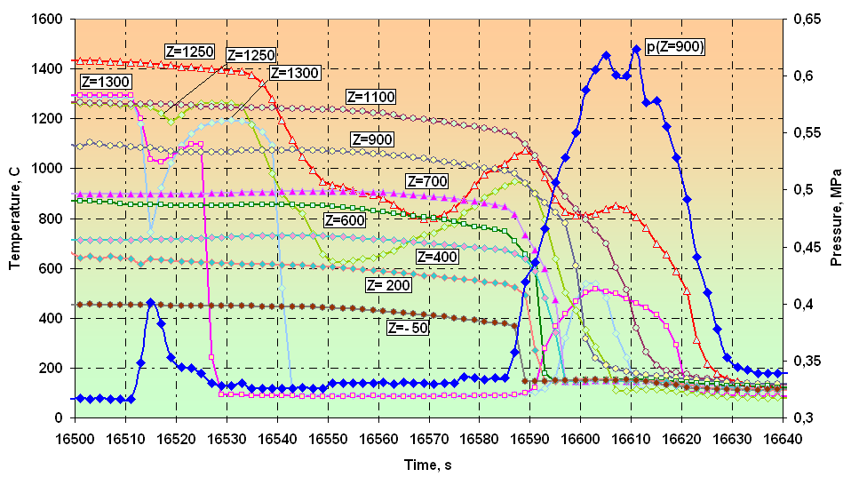
5.3. The steam-gas mixture pressure into the bundle
and cladding temperature of rods of second and third rows
The cladding temperature of rods
of second row (2.1 – 2.6)
Pressure p(Z=900), p(Z=200),
prod, pth
The cladding temperature of rods
of third row (3.1 – 3.12)

Slide 18
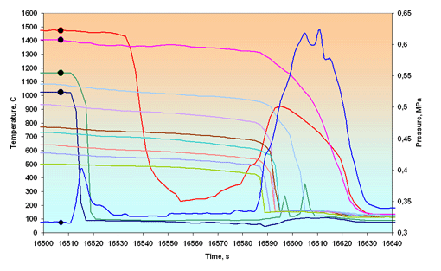
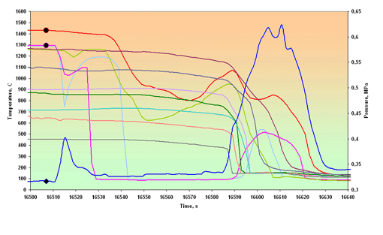
5.4. The cladding temperature history during quench stage
(second and third rows)
The cladding temperature
(rods of second row)
The cladding temperature
(rods of third row)
[

Slide 19
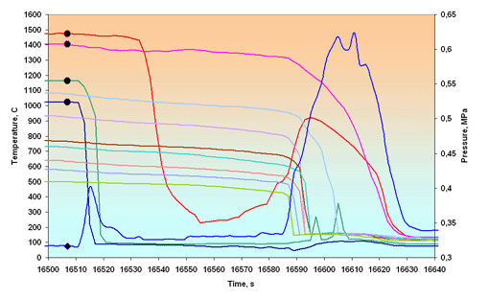
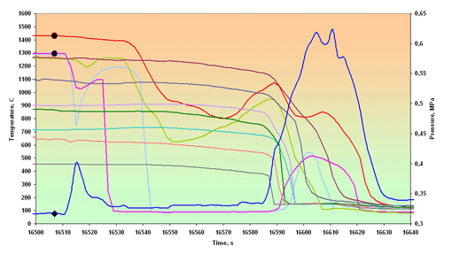
5.4. The cladding temperature history during quench stage
(second and third rows)
The cladding temperature
(rods of second row)
The cladding temperature
(rods of third row)
Z
[

Slide 20
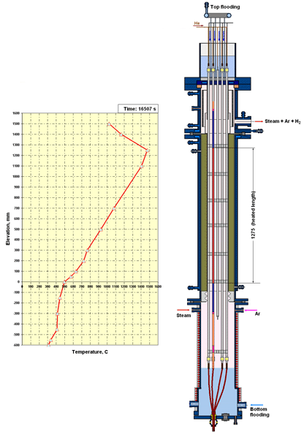
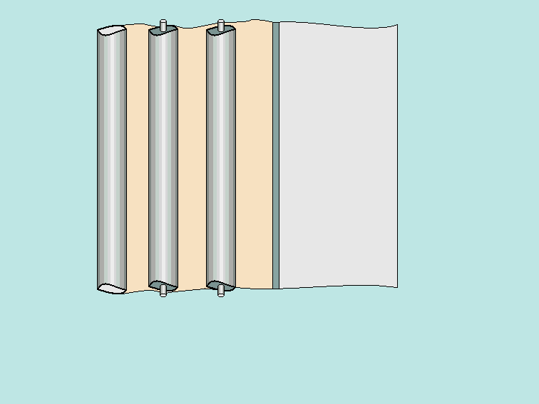
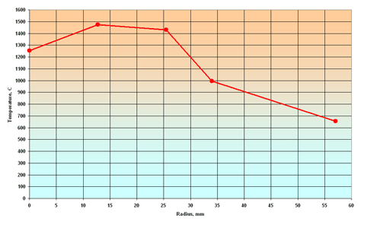
5.5. The temperature profile of cladding temperature
on height and cross section of bundle during quench stage
Elevation: 1250 – 1300 mm
[
Central
rod
2nd
row
3rd
row
Shroud
Insulation

Slide 21
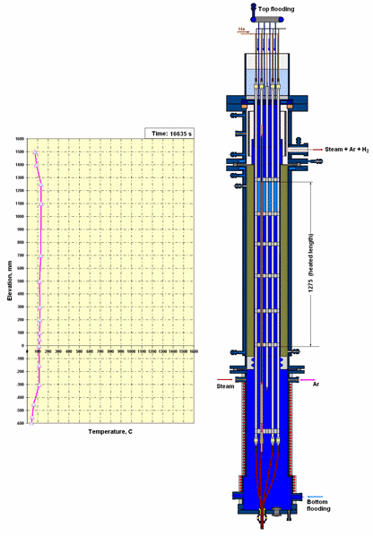
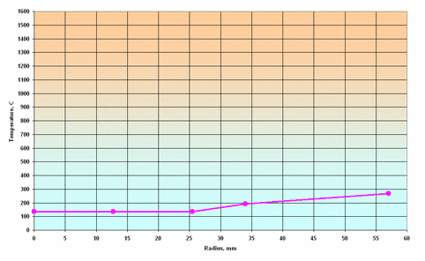
5.5. The temperature profile of cladding temperature
on height and cross section of bundle during quench stage
Elevation: 1250 – 1300 mm
Z
[
Central
rod
2nd
row
3rd
row
Shroud
Insulation

Slide 22
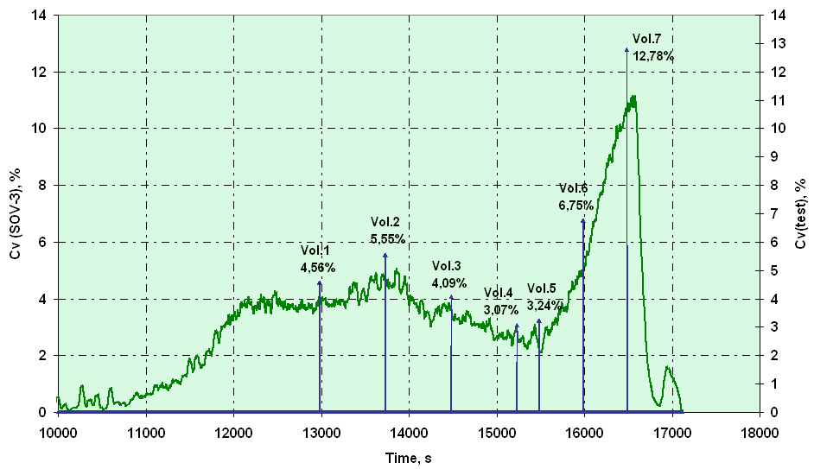
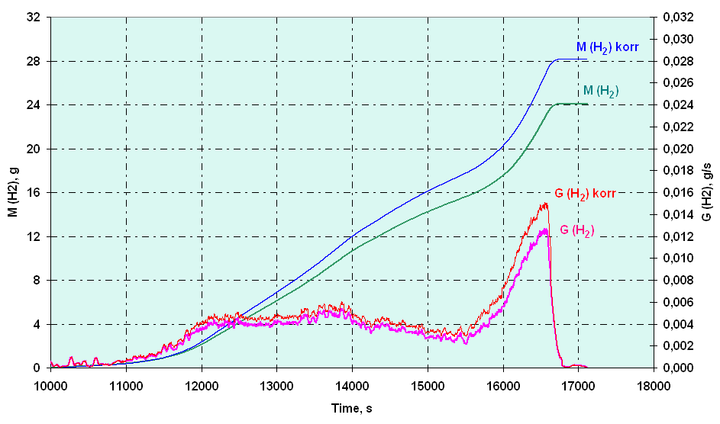
6. The results of measuring of the hydrogen generation
Variation of volumetric hydrogen
concentration versus time
(Cv(SOV-3) and Cv(Vol.))
Regeneration rate and
mass of evolved hydrogen
Z

Slide 23
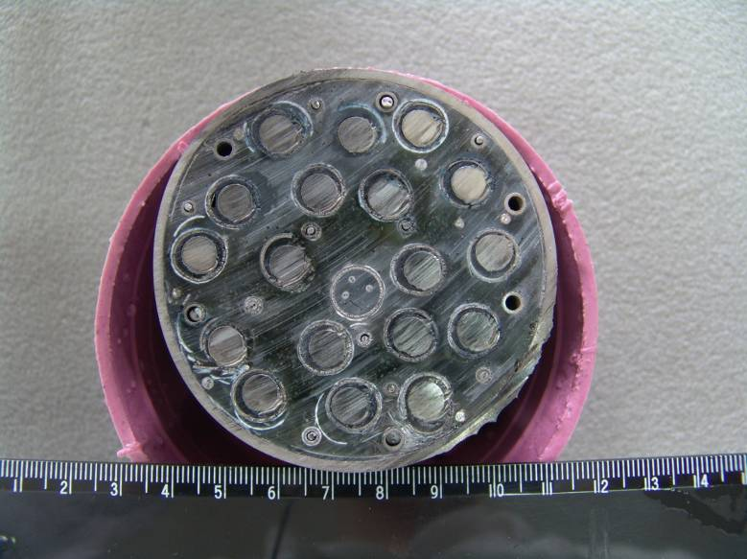
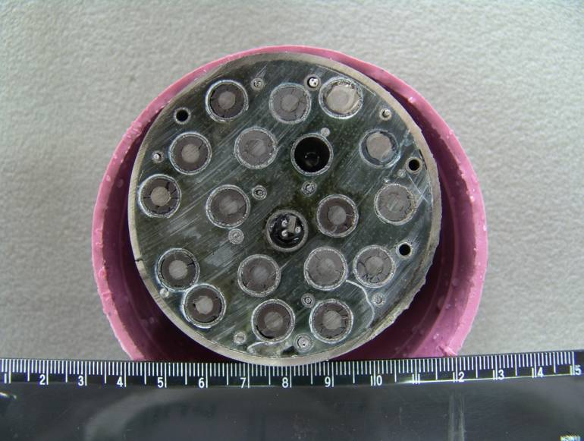
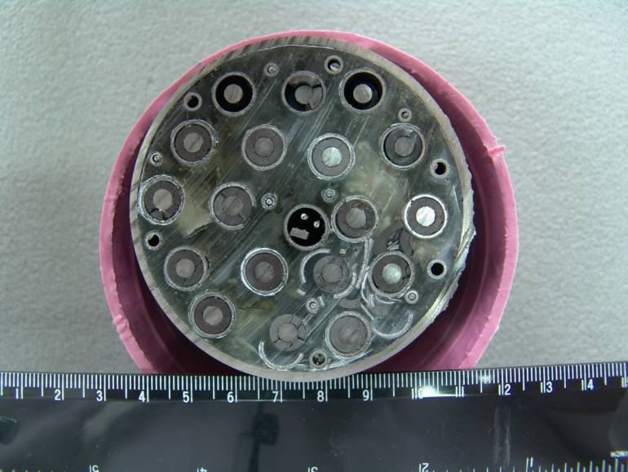
7. Results of the post-test analysis of the bundle
Z = 1300 mm
Z = 1250 mm
Z = 1100 mm
The cross-sections of the bundle
(elevation: 1100 – 1300 mm)

Slide 24
CONCLUSIONS
1. Experiment PARAMETER-SF2 on simulating the initial stage of severe accident , including the stage of the top and bottom flooding, has been carried out.
2. The main parameters of experiment:
- the steam flow rate ~ 3,5 г/с at temperature ~ 500 °С;
- the argon flow rate ~ 2,0 г/с at temperature ~ 400 °С;
- the duration of the preoxidation stage ~ 3500 s at temperature ~ 1200 °С;
- the maximal temperature of the bundle - 1500°С at heating rate ~ 0,25 °С/с.
3. The total of hydrogen measured by continuous and discrete monitoring systems of hydrogen, has not exceeded ~28 g.
4. The cooling overheated up to ~ 1500°C of the bundle has been achieved for
~ 120 s at the combined water flooding from top with flow rate ~ 41 g/s and from bottom with flow rate ~ 130 г/с.
5. Conservation and preliminary cutting of the bundle has been carried out.

