Slide 1
FSUE SRI SIA “LUCH”
IBRAE RAS
FSUE EDO “GIDROPRESS”
Computational assessment (pre- / post-test) of fuel assembly tests in frame of the project # 3194
Presented by A.Kiselev
St Petersburg, 11-13 September 2007

Slide 2
Scope of the PARAMETER-SF tests
The main goal of flooding experiments is to investigate bundle behavior and the hydrogen source term resulting from water injection into an uncovered core
PARAMETER-SF1 is the first experiment modeling behaviour of overheated VVER bundle under top flooding conditions
PARAMETER-SF2 is the first experiment modeling behaviour of overheated VVER bundle under combined (top and bottom) flooding conditions
General answer from planned set of PARAMETER tests is experimental data for severe accident management guide development
These data include:
  bundle cooling possibility
  structural elements status
  Hydrogen release

Slide 3
Pre-test numerical analysis of PARAMETER-SF1 and -SF2 experiments
Goal – scenario justification and development of requires for measuring and control systems and recommendations.
Used codes –
- RATEG/SVECHA (SOCRAT), RELAP, MELCOR 1.8.5, PARAM TG, ICARE/CATHARE, ATHLET, MAAP4 (SF1).
- SOCRAT, ICARE/CATHARE, PARAM TG (SF2)
Blind phase of verification for RATEG/SVECHA, RELAP , MELCOR 1.8.5, ICARE/CATHARE, ATHLET, MAAP4 (SF1).
Participants IBRAE, RRC KI, GIDROPRESS, NPO LUCH, GRS, EdF.

Slide 4
Objectives and Tasks for codes verification and models development
To assess physical-chemical models
To check an adequacy of processes modeling during flooding
To collect data for thermohydraulic models development
  Determination of the heat transfer coefficients in POST-CHF mode using the data on temperature evolution during the quench phase.
  Evaluation of the components deformation after test and possible limitation of surface wetting due to decrease of flow area.
  Specification of parameters in models available in computer codes for POST-CHF heat transfer and flooding treatment. Justification of the applicability of these parameters for simulation of the processes occurring under the conditions similar to the experiment SF2 ones.

Slide 5
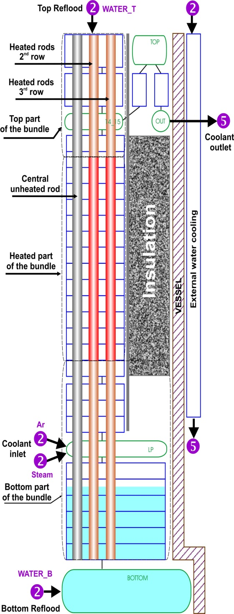
SOCRAT ICARE

Slide 6
Steam flow rate at the assembly inlet
Pre-test calculations, PARAMETER-SF1

Slide 7
Electric power supply
Pre-test calculations, PARAMETER-SF1

Slide 8
Coolant temperature at the elevation of 1250 mm
Pre-test calculations, PARAMETER-SF1

Slide 9
Cladding temperature of fuel rods of the 2nd row at the elevation of 1100 mm
Pre-test calculations, PARAMETER-SF1

Slide 10
Cladding temperature of fuel rods of the 3rd row at the elevation of 1250 mm
Pre-test calculations, PARAMETER-SF1

Slide 11
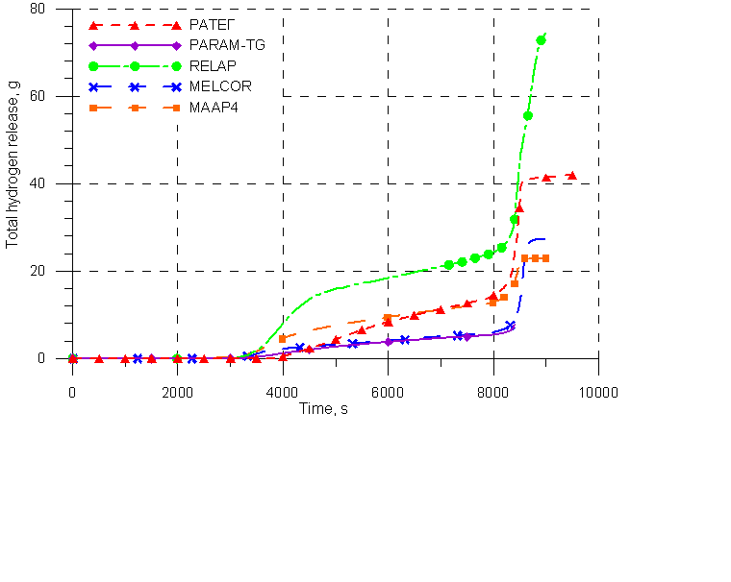
Hydrogen release
Pre-test calculations, PARAMETER-SF1

Slide 12
Pre-test calculations of the PARAMETER-SF1 experiment vs measured data

Slide 13
Post-test calculations of the PARAMETER-SF1 experiment
Main phenomena
Joule heating
Convective and radiative heat transfer
Steam condensation
Steam bypass
Oxidation of claddings, shroud, spacer grids
Zr melting
UO2, ZrO2 dissolution with melt
Water ejection due to CCFL
Thermo insulation wetting
Melt oxidation, relocation
Melt solidification and blockage formation.

Slide 14
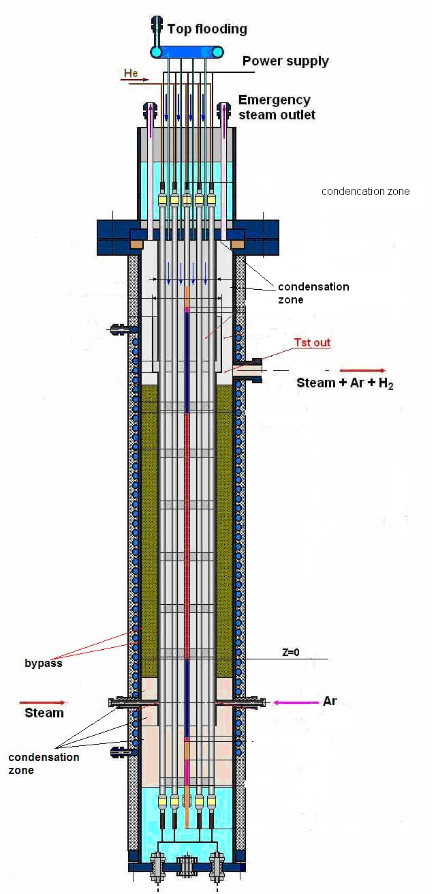
Steam condensation

Slide 15
Electric power supply
Post-test calculations, PARAMETER-SF1

Slide 16
Fuel rods claddings temperature
The 2nd row, elevation of 1100 mm
Post-test calculations, PARAMETER-SF1

Slide 17
Fuel rods claddings temperature
The 2nd row, elevation of 1250 mm
Post-test calculations, PARAMETER-SF1

Slide 18
Hydrogen production
Post-test calculations, PARAMETER-SF1

Slide 19
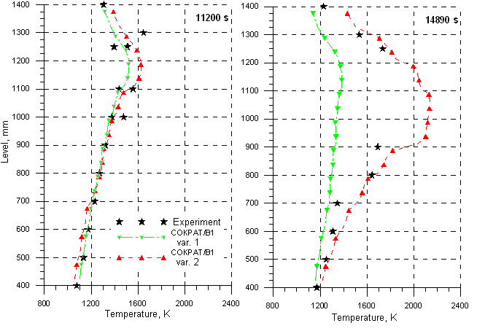
Numerical analysis by SOCRAT
Post-test calculations, PARAMETER-SF1
Temperature front propagation, 2nd row rods claddings

Slide 20
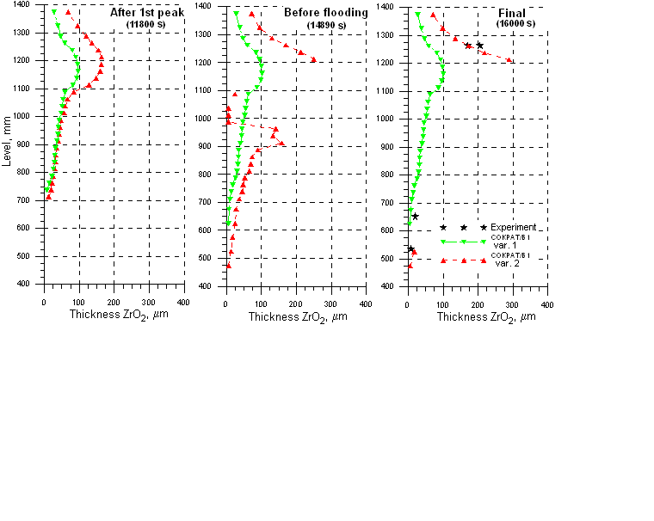
Cladding oxide scale distribution

Slide 21
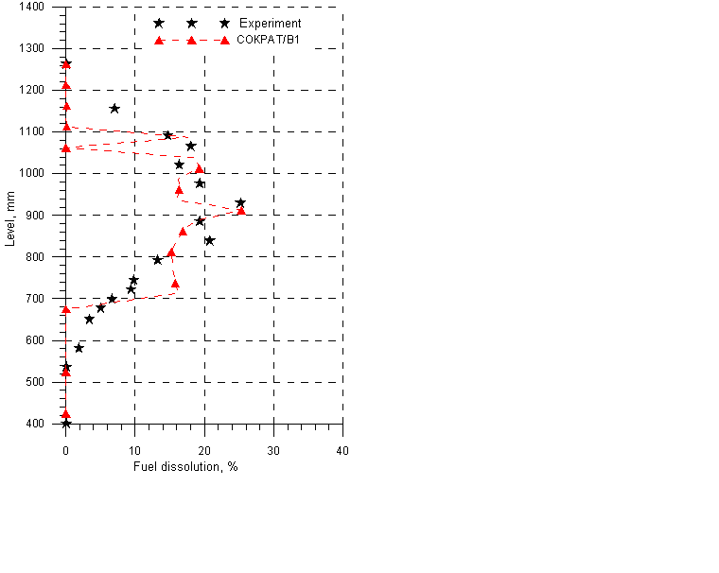
UO2 dissolution

Slide 22
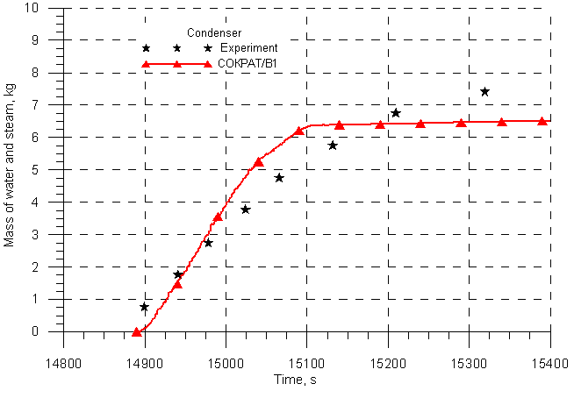
Water mass balance during flooding (account for CCF)

Slide 23
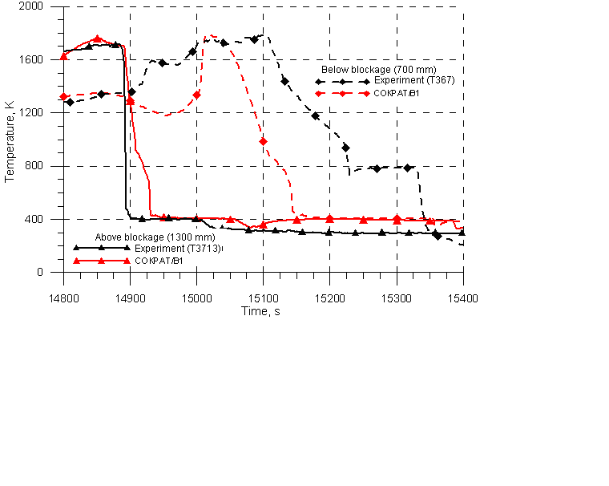
Rod claddings temperature history during flooding stage

Slide 24
Main conclusions derived from numerical analysis of the PARAMETER-SF1 experiment
SF1 Experimental data are well consisted (temperature, oxide scale thickness, UO2 dissolution, hydrogen release) and is generally well predicted by codes.
SF1 test justified that the top flooding of overheated >2000C leads to:
  Significant rod cladding degradation (to 40%)
  Increase of produced hydrogen total mass by factor of 3 (30 g before quenching staring and 91 g is total mass)
SF1 test provided valuable outcomes to be used for in VVERS SAM procedures development and verification

Slide 25
Pre-test calculations of the PARAMETER-SF2 Proposed test scenario
Stage | Stage substance | Main parameters
 |  | FA temperature, K | Medium | Heating / cooling rate | Time, s
1 | Heating of the fuel bundle with argon | ~300 – 350 | Argon with flow rate of 2 g/s and temperature 670K | - | 0-1000
2 | Heating of the fuel bundle by the electric power, steam and argon flow | ~770 | Steam/Argon with flow rates of 3.3/2 g/s and temperature 770/670K | - | 1000-4000
3 | Heating of the fuel bundle (transient phase I) | 770 → 1470 | -”-”- | ~0.3 К/s | 4000-6000
4 | Pre-oxidation of the bundle | ~ 1473 | -”-”- | - | 6000-10000
5 | Heating of the fuel bundle (transient phase II) | 1470 → 1870 | -”-”- | ~0.3 К/s | 10000- ~11000
6 | Flooding of the fuel bundle from the top after Tmax = 1870 K reached | Up to saturation | Water with flow rate of 40 g/s and temperature 330 K (top reflood) | - | ~150 (duration)
7 | Flooding of the fuel bundle from the bottom 50s after top flooding starting or when T<900K at 1250 mm | Up to saturation | Water with flow rate of 100g/s and temperature 330 K (bottom reflood) | - | ~100 (duration)

Slide 26
Proposed PARAMETER-SF2 test conditions

Slide 27
Sensitivities
Assessment of required power level for the pre-oxidation phase (~1470K)
Assessment of acceptable temperatures deviation and delay of water injection beginning
Pre-injected water level assessment – to avoid unexpected early flooding from bottom by steam or flashing

Slide 28
Power balance
Pre-oxidation stage
Total power ~6÷7 kW
Joule heating power
~5.5÷6.5 kW
Transient phase
Total power ~8-9 kW
Heat losses to shroud
~up to 50% of total power
No significant temperature dependence on steam flow rate

Slide 29
Bundle hottest zone
Maximum cladding
temperature at 1250 mm
(6 thermocouples)
1200 mm
1250 mm
1250 mm
1300 mm
1300 mm
Calculated Max Temperatures
SOCRAT 1200 ÷1250mm
ICARE 1250 ÷1300mm

Slide 30
Temperature & flooding time variation
ICARE
Overheated bundle ~1800K peak temperature
Power & steam off, no flooding in-time
No problem with bundle cooling, temperature does not exceed 2100K

Slide 31
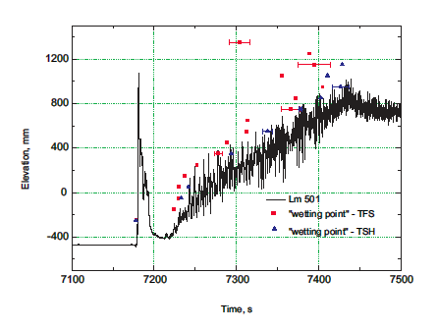
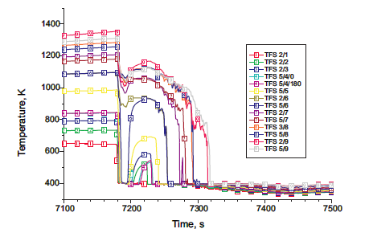
Some results of QUENCH-06*
Water pre-injection in dry hot lower plenum leads to flushing and rapid cooling down of the bundle for short period.
* L.Sepold, W.Hering, C.Homann, A.Miassoedov, G.Schanz, U.Stegmaier ,M.Steinbruck, H.Steiner, J.Stuckert. “Experimental and Computational Results of the QUENCH-06 Test (OECD ISP-45)”, Forschungszentrum Karlsruhe GmbH, Karlsruhe, 2004.

Slide 32
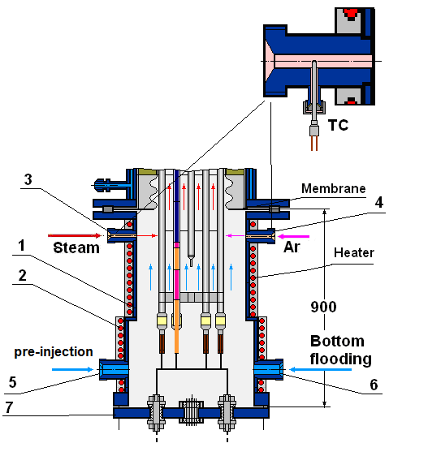
Test section water level
proposed
calculated
Reduction of quench water impact on bottom chamber structures (electrodes degradation, FA cooling down by steam)
Assessment of body temperature and heater power calculated by SOCRAT

Slide 33
Hydrogen generation

Slide 34
Flooding Phase (SOCRAT calculations)
quickly cooling down at 1500-1250 mm due to top flooding.
Reheating up at 1250-1400 mm during simultaneous (top and bottom) flooding

Slide 35
Flooding Phase (ICARE calculations)
No fast cooling from top flooding
Simultaneous cooling by steam/water mixture from bottom flooding

Slide 36
Conclusions
Pre-test and post-test assessment of SF1 and SF2 have been performed:
  Used codes – RATEG/SVECHA (SOCRAT), RELAP, MELCOR 1.8.5, PARAM TG, ICARE/CATHARE, ATHLET, MAAP4 (SF1).
  Participants - IBRAE, RRC KI, GIDROPRESS, NPO LUCH, GRS, EdF.
New data for SFD code assessment and improvements were obtained
  Thermal-hydraulic models
  Fuel rod models (oxidation, degradation, heat exchange models)

