Slide 1
FSUE SRI SIA “LUCH”
IBRAE RAS
FSUE EDO “GIDROPRESS”
Post-test assessment of the top-flooding test PARAMETER-SF1
(ISTC Project # 3194)
Presented by A.Kiselev
September 5-8, 2006, Kurchatov, Kazakhstan

Slide 2
Codes verification against SF1 test
Pre-test runs
Assessment of SF1 test Peculiarities - heat balances
Post-test modeling

Slide 3
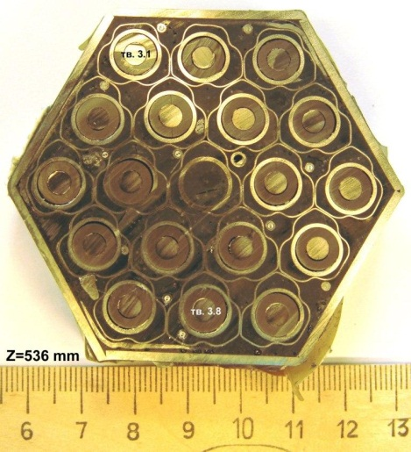
SF1 assessment – participants
Germany:
GRS
FzK
PARAMETER-SF1
Russia:
NPO LUCH
GIDROPRESS
IBRAE RAS
RRC KI
France:
EdF
IRSN

Slide 4
Pre-test runs
RATEG/SVECHA - IBRAE RAS, RRC KI
ICARE/CATHARE – RRC KI
MAAP4 – EdF
ATHLET - GRS
RELAP - OKB “Gidropress”, RRC KI
MELCOR 1.8.5 - OKB “Gidropress”, IBRAE
PARAM TG + RAPTA-5 – NPO “LUCH”

Slide 5
Temperatures: level 1250 mm (second ring of bundle)

Slide 6
Temperatures: level 1100 mm

Slide 7
Temperatures: level 900 mm

Slide 8
Temperatures: level 700 mm

Slide 9
Power vs time

Slide 10
Released Energy - averaged

Slide 11
Results of estimations
Pre-test el. power: 6 kWt or 20 MJ
Averaged experimental el. power: 3.83 kWt or 13.4 МJ
Overheat of steam (450-1200 K): 3.2кWt or 11.2 МJ
Heat loses: 9 MJ
(20-9)/(13.4-9)=2.5 (1.74)
Steam flux: 1.3-2 g/s

Slide 12
Possible reasons
Steam condensation after switching on water cooled jacket
Steam-argon bypasses in technological slots:
  Test section body – SS insulation shroud
  SS insulation shroud-fiber ZrO2 insulation (breakaway of thermal insulation bottom cover plate )

Slide 13
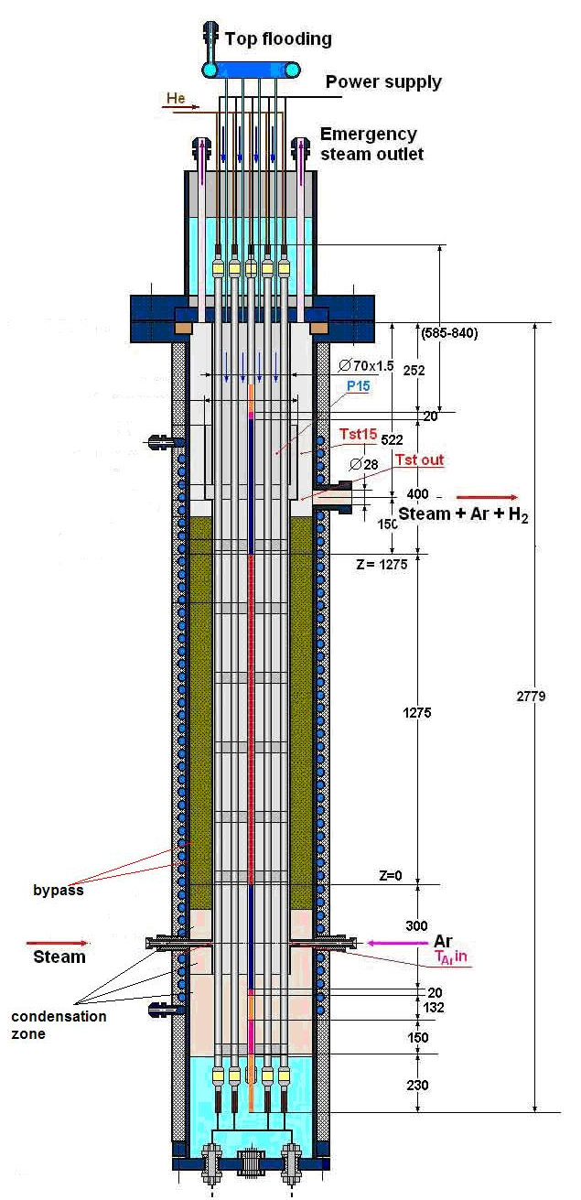
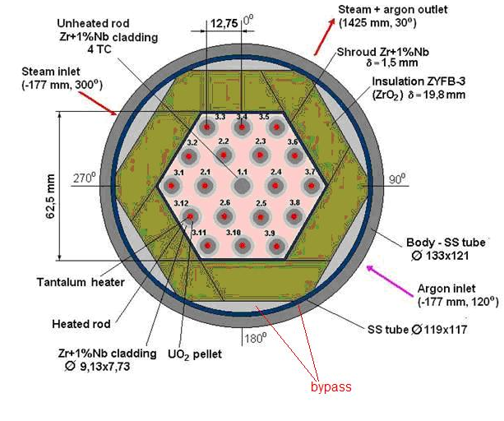
Volume of condensed water in lower plenum, l, versus time (RATEG-SVECHA)

Slide 14
Modeling assumptions
Self consistent modeling of condensation
Bypass for steam-argon mixture:
  Initially: 200 mm2 - technological
  After 11500 s – 1000 mm2 - breakaway

Slide 15
Volume of condensed water in lower plenum, l, versus time (RATEG-SVECHA)
Rate: 1.5 - 2 g/s

Slide 16
Post-test runs
(presented to 1.09.2006)
IBRAE RAS – RATEG/SVECHA
OKB “Gidropress” – RELAP
RNC KI – ICARE/CATHARE
EDF – MAAP4

Slide 17
Electrical power

Slide 18
Volume of condensed water in lower plenum, l, versus time (RATEG-SVECHA)
Rate: 1.5 - 2 g/s

Slide 19
Consistent modeling of steam flow rate through the bundle

Slide 20
Cladding temperature for second radial group at elevation 600mm versus time

Slide 21
Cladding temperature for second radial group at elevation 1250mm versus time

Slide 22
Shroud temperature at elevation 900mm versus time

Slide 23
Hydrogen Production

Slide 24
Phenomena for verification
Condensation in presence of noncondensable
Heat loses through shroud
Escalation
Quench front propagation
UO2 dissolution
Metallic and oxide melt relocation
Oxidation of melt in course of relocation
Melt solidification

Slide 25
Conclusions
Results of post-test runs:
    Acceptable simulation of thermal and hydraulical bundle behavior
Future steps:
    Improvements of oxidation modeling in the course of top flooding
    Improvements of melt relocation modeling under quench conditions
Looking for:
    SF1 Post test material investigations;
    Additional data from SF2 and future (?) tests;
    Account for results of ISTC projects 1648.2 (VVER-QUENCH), 2936 (Melt relocation).

