Slide 1
FSUE SRI SIA “LUCH”
IBRAE RAS
FSUE EDO “GIDROPRESS”
Fuel assembly tests
under severe accident conditions
(PARAMETER Facility)
Proposal # 3194 (earlier #1134)
Presented by W. Nalivaev
Cologne, Germany, February 28- March 1, 2005

Slide 2
Content
  Introduction
  Justification of experimental scenario
  Tests instrumentation
  Analytical Pre-test assessments
  Project Proposal Information

Slide 3
Introduction
Objective:
Investigation of 19-s rods WWER-1000 type bundle behavior under the Conditions of SA, including quenching Phase:
1-st test: Top flooding ;
2-nd test: Simultaneous Top and bottom flooding
Implementation:
FSUE SRI SIA “LUCH”– rig experiments and post test analysis with involvement of experts from FSUE VNIINM named after A.A.Bochvar, SSC RF-IPPE named after A. I. Leipunsky, ESC of MAE
IBRAE RAS – pre and post test analyses
FSUE EDO “GIDROPRESS” – justification of an experimental scenario (WWER-1000 reactor)

Slide 4
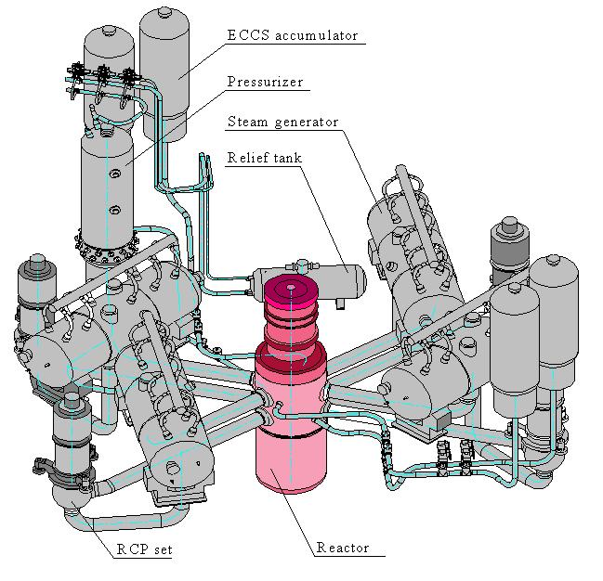
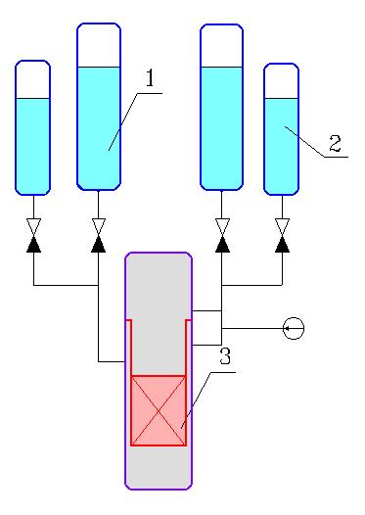
Justification of test scenario: specific features of WWER-1000
1 – ECCS tank (4 items)
2 – ASCPF tank (8 items)
3 – reactor
Top and bottom simultaneous core flooding is inherent design feature of WWER
ED 200
WWER-1000 3D view WWER ECCS outline

Slide 5
Simulated SA scenario
Large break of cold leg of Main Circulation Loop with fault of ECCS (ED 200)
Recovery of 1 channel of ECCS at late accident stage (Tclad>2250 K)
Water injection from top and bottom of core with total rate 200 Kg/s

Slide 6
LB ED200 – results of assessment
1 – at the inlet; 2 – in the middle;
3 – at the outlet
Clad temperature
Du200 cold leg break
1 – LP; 2 - UP; 3 – total
ECCS mass flow rate
Du200 cold leg break

Slide 7
Main outcomes of LBLOCA (ED 200) analysis
Design of WWER-1000 ECCS allows to provide simultaneous top/bottom flooding of overheated core
  Pre flooding stage:
    Clad heat up rate – 1…2 K/s
    Steam flow rate – 0.2 g/s per rod (4 g for 19 rods test bundle)
  Flooding stage:
    Water injection – 2 g/s per rod from top (40 g from top for 19 rods test bundle)

Slide 8
Proposed experimental scenario
Test bundle of WWER-1000 type rods
(18 heated rods, 1 unheated rod)
Steam flow rate - 4 g/s
Temperature of the bundle on pre-oxidation stage - 1500 K
Maximum of total electrical power - 13 KW
Cladding heat up rate - 0.5 ÷ 1.0 K/s
Maximum cladding temperature - 2250 K
Water flow rate on quench stage (from top) - 40 g/s

Slide 9
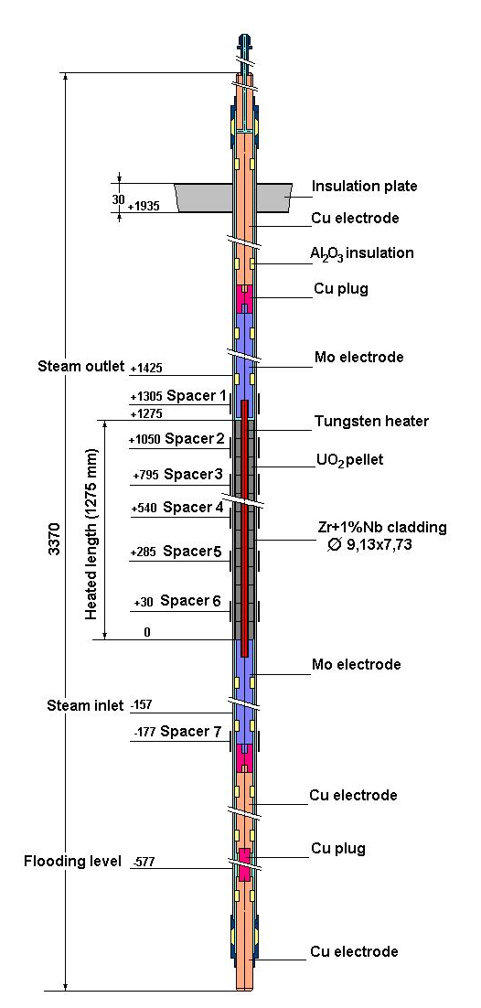
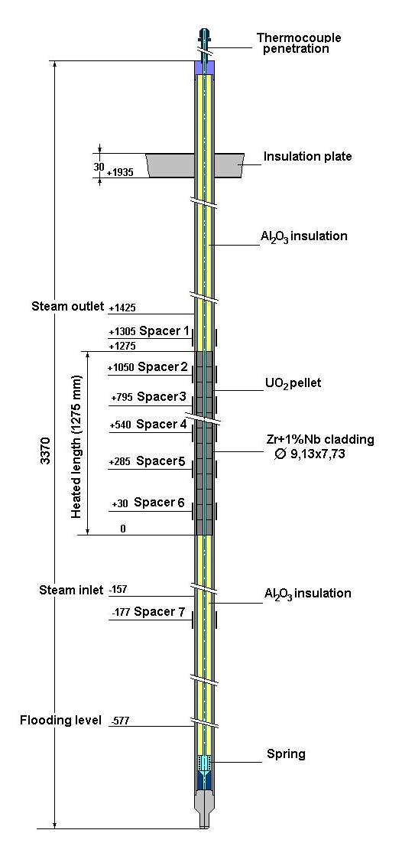
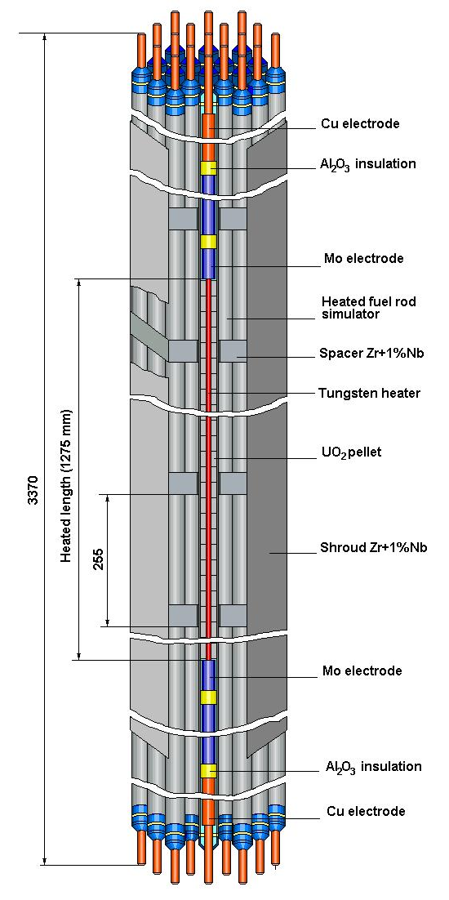
Test Instrumentation
Test Bundle Specification
Heated rod
Unheated rod
Test Bundle

Slide 10
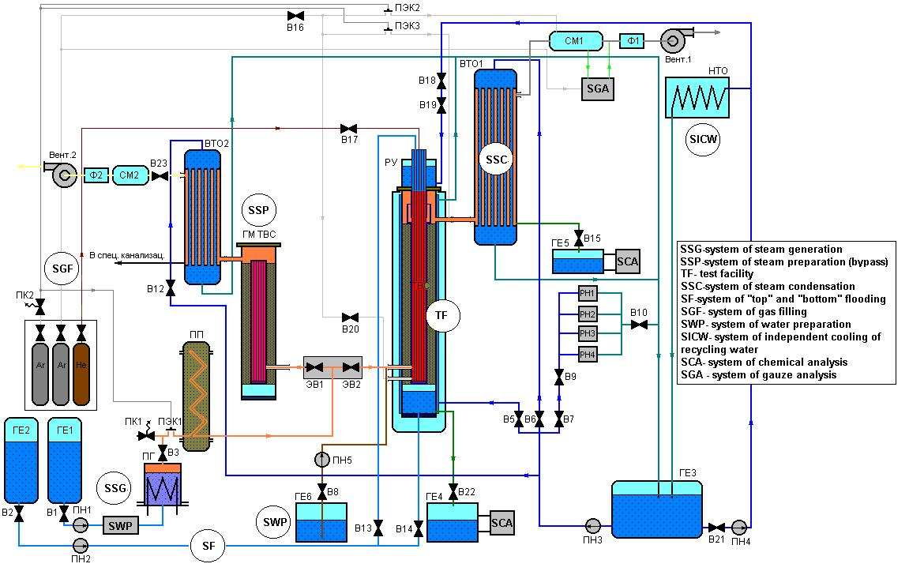
Experimental Facility
Functional Diagram
Technical Parameters
Model test bundle type WWER
Number of rods up to 37
Fuel type UO2 pellets
Coolant flow rate, g/s per rod up to 0.2
Bundle test temperature, K up to 2250
Integral electrical power, kW up to 200
Water flow rate in the system of «top» and «bottom» flooding, g/s up to 200
Cooling water temperature, K up to 330

Slide 11
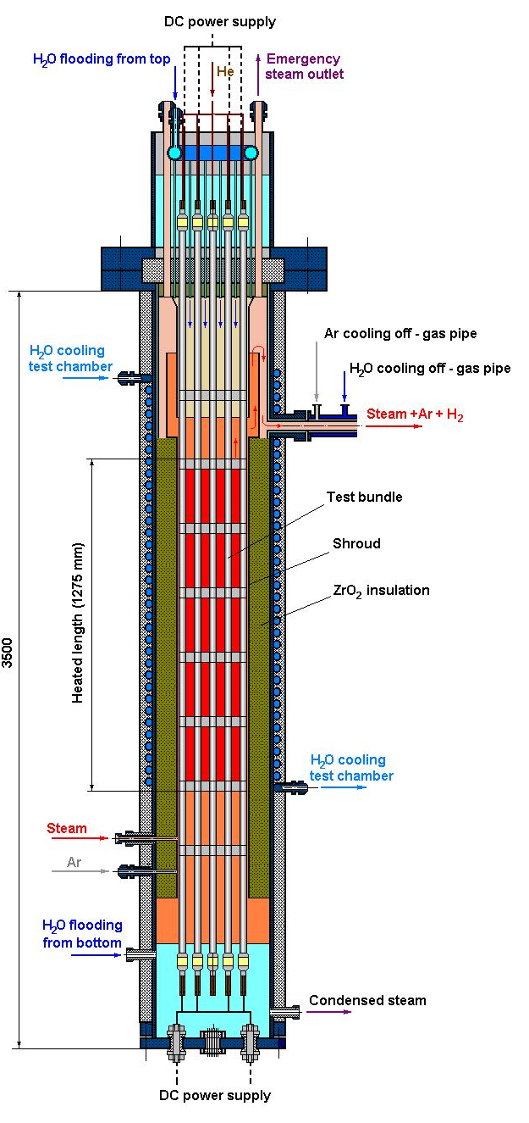
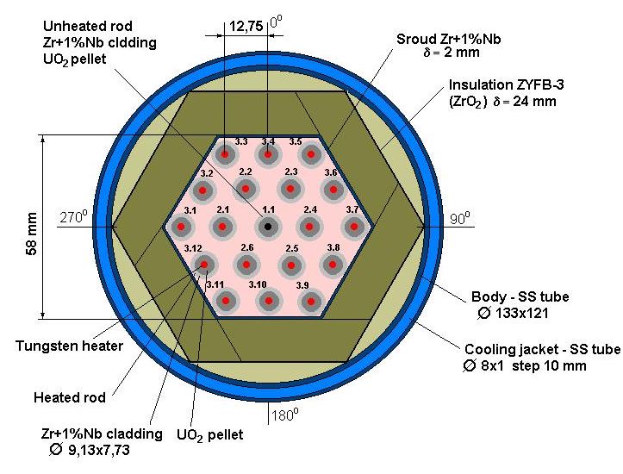
General view of central part of PARAMETER facility
General view
Cross section

Slide 12
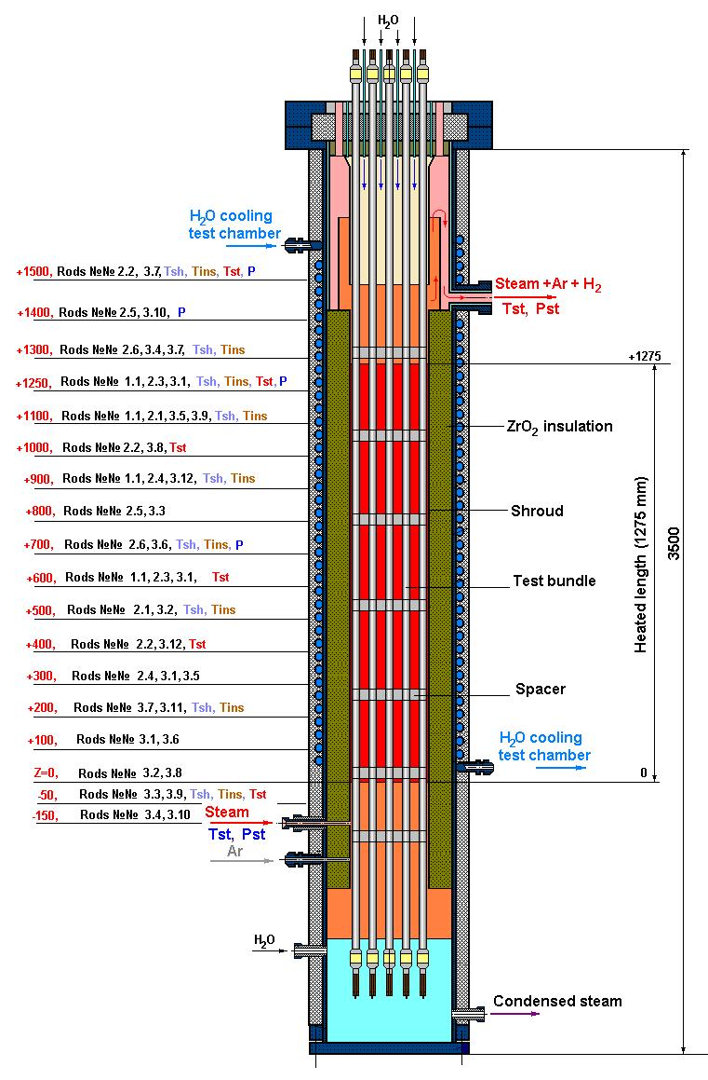
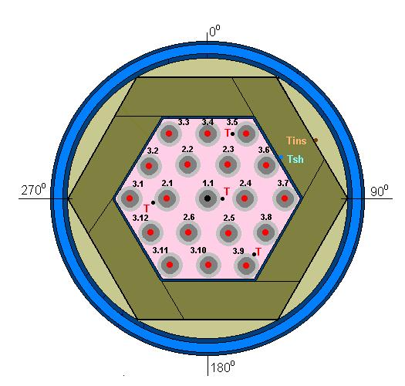

Temperature and pressure measurement
Test section instrumentation
Cross section
Z=1100 mm
Cross section
Z=1200 mm
Temperature and pressure measurement elevations

Slide 13
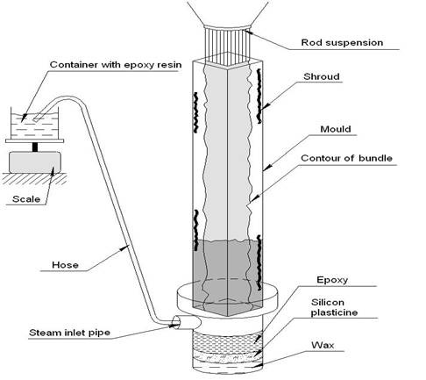
Post-test analysis
Filling by epoxy compound
Preparation of samples
Metallographic investigations
Electron microscopy

Slide 14
Analytical pre-test analysis
Code system:
  RATEG/SVECHA/HEFEST
  MELCOR 1.8.5
  SCDAP/RELAP
  PARAM-TG

Slide 15
Main stages
Development of nodal schemes
Assessment runs
Comparative analysis, recommendation for test performance

Slide 16
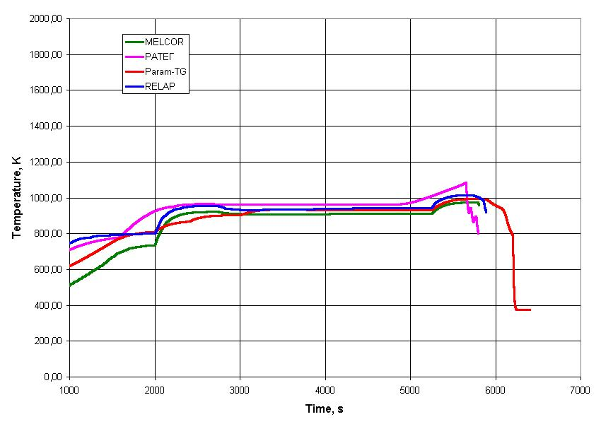
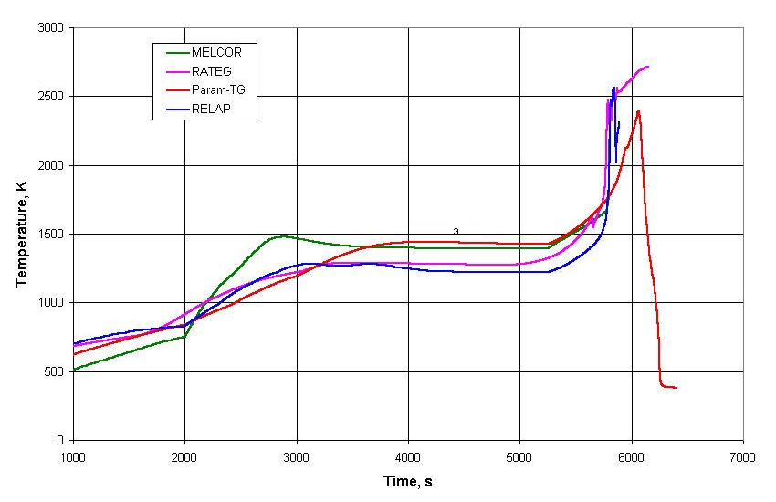
Bundle temperature behavior
Elevation 100 mm
Elevation 1200 mm

Slide 17
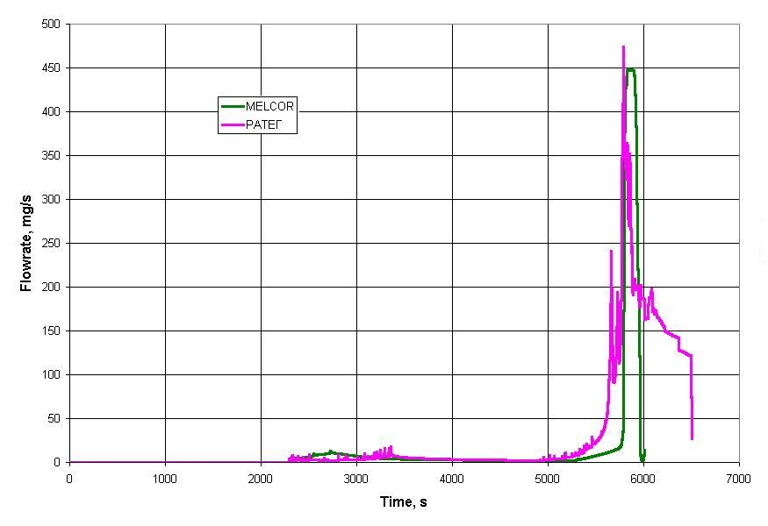
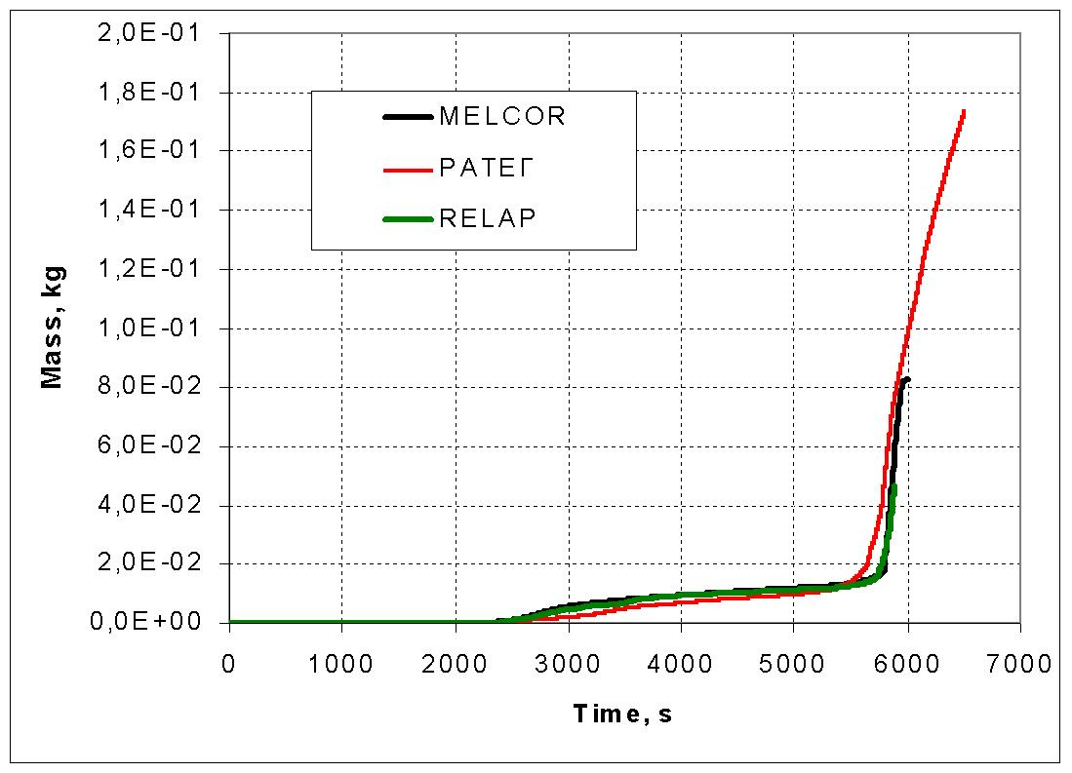
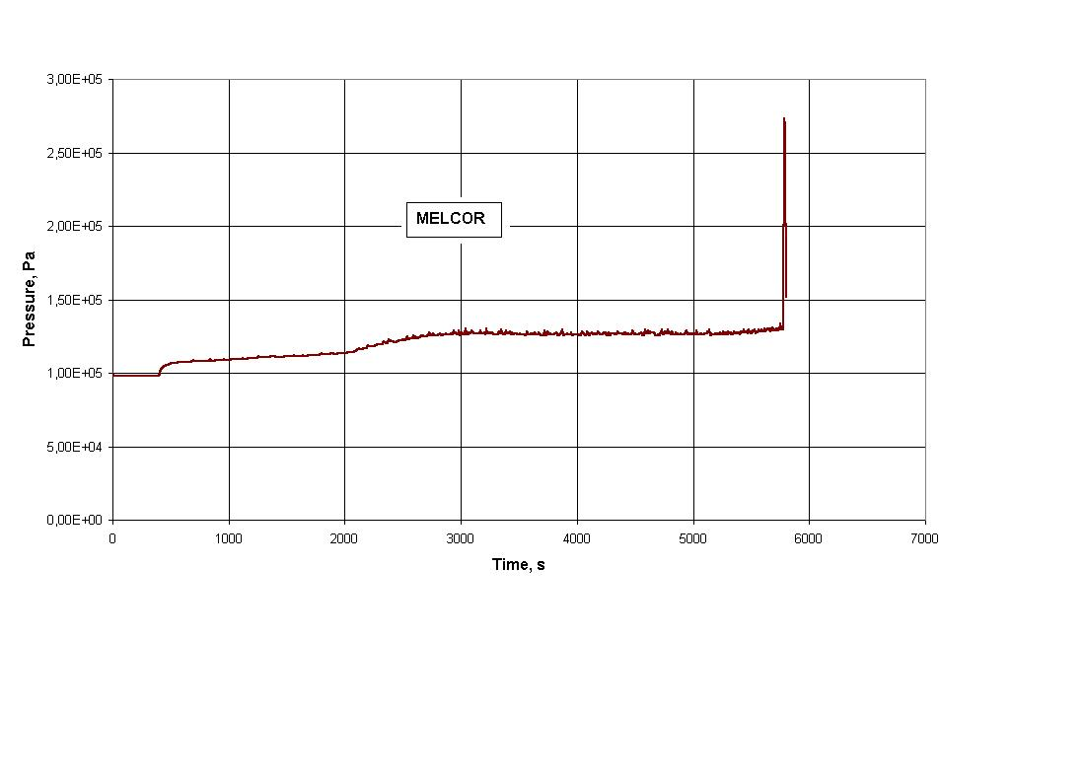
Hydrogen generation and internal pressure
Rate
Total production
Internal pressure

Slide 18
Project Proposal Information
Goal: Two test of overheated up to 2250 K bundle:
  1-st test: top flooding
  2-nd test: simultaneous top and bottom flooding
Project Manager: V. Nalivaev
Participating organization
  SRI SIA “Luch”
  IBRAE
  EDO “GIDROPRESS”
  Other organizations: IPPE, VNIINM, ESC of MAE
Cost estimate: $600000
  Equipment:$73755
  Materials:$85695
  Overhead: $43560
  Personal grants: $329890
  Travel: $41600
  Other direct cost: $25500
Project duration: 24 months

Slide 19
Project proposal: Tasks
Task 1: Study of the top flooding of 19 rods bundle under severe accident conditions
Task 2: Study of the simultaneous top and bottom flooding of 19 rods bundle under severe accident conditions
Each task consists of the following subtasks:
  Subtask 1 Preparatory work
  Subtask 2 Pretest analysis, choice of the test scenario and parameters
  Subtask 3 Test conduction
  Subtask 4 Post test examination and analysis
    Material study
    Post test analysis

Slide 20
Power and steam history
Power history

Slide 21
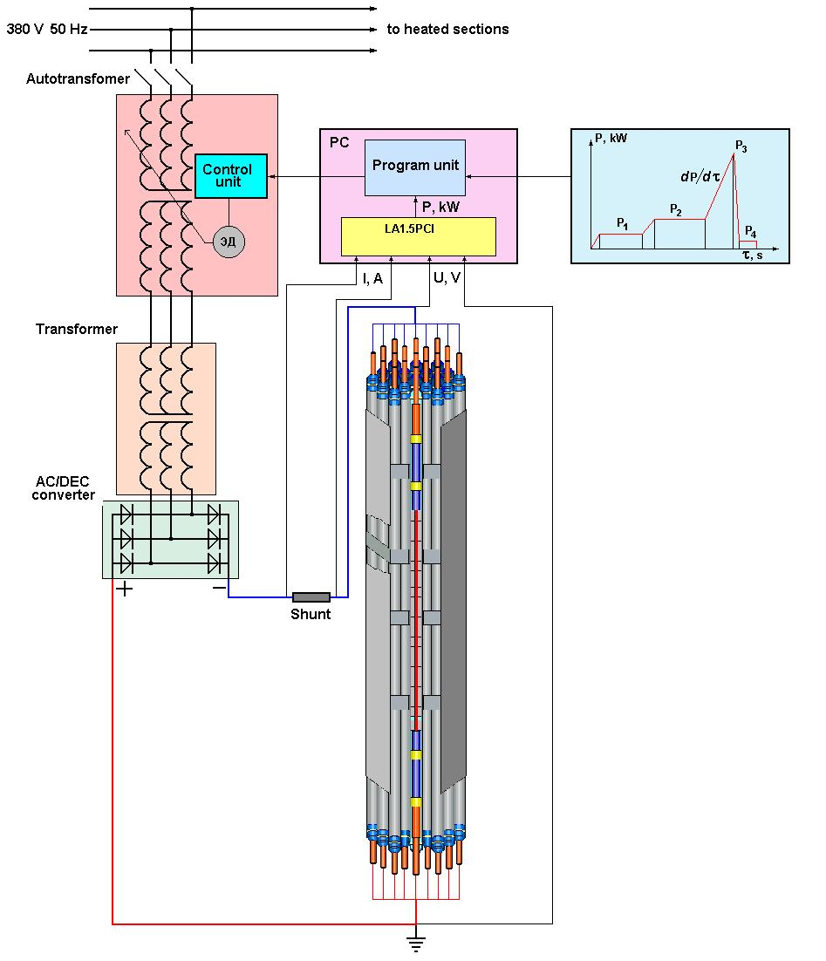
Power supply system
Type – Direct Current
Total DC power per section – up 10 KW
Power increase rate - up to 1 KW/s
Accuracy - 2.5%
Voltage per section – up to 36 V
Current through section - up to 300 А
Power management – programmed per each section

Slide 22
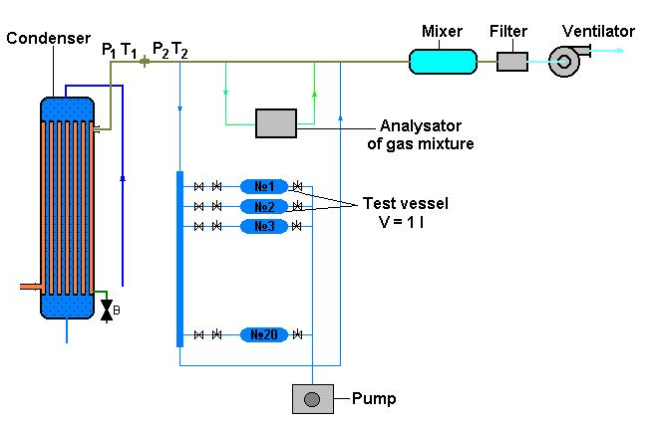
Hydrogen measurement
General view of Gas analyzer
Main technical parameters of analysator:
Range of hydrogen concentrations - 0.002÷100 % vol.
Accuracy:
for concentrations 0.002÷0.2 % vol. - ± 10 %;
for concentrations 0.2÷10% vol. - ± 5 %.
Time per one measurement – 15 sec
Gas overpressure - not less 0.03 MPa

Slide 23
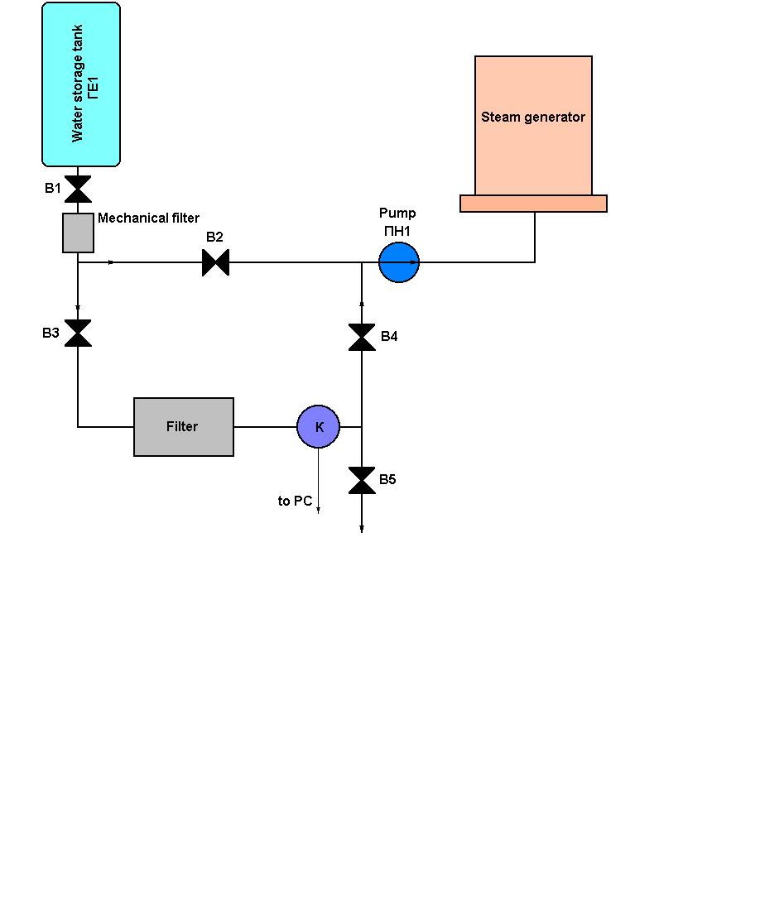
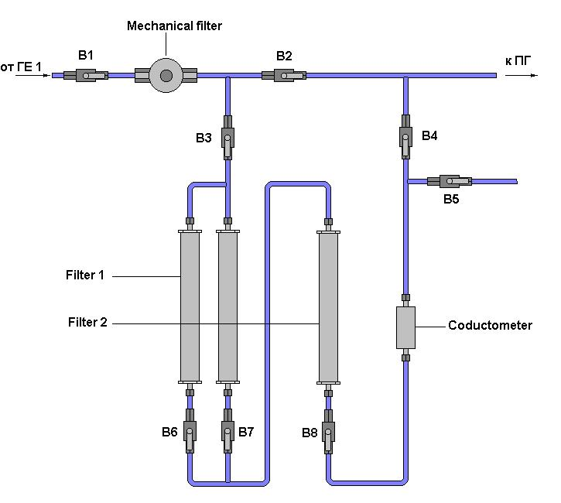
Water preparation system
General view of water preperation system
Scheme of Filter
  Contents of admixture in to water :
-O2, mkg/l, < 5;
-N2 (300 K), mg/l, ~12;
-conductivity, mkSm/sm, ≤ 0,1;
-Cl-ions, mkg/l, < 5;
-Fe corrosion products, mkg/l, < 5;
-рН 7.0±0.5;

Slide 24
Post-test analysis
Posttest appearense of the bundle
Overview of test bundle appearance, visual inspection and photographic documentation
Encapsulating of bundle in epoxy
Cutting of the slabs from epoxied bundle, grinding and polishing of the samples
Macrophotographs of cross sections, ZrO2 scale thickness measurements
SEM/EDX examination

Slide 25
Safety and uncertainties
Pressure not high as 1 MPa
Temperatures in out pipes not exceed 1300 K
There is possibility to achieve overheating of bundle on quench stage (increase oxidation – early flooding)

