Slide 1
FSUE SRI SIA “LUCH”
IBRAE RAS
FSUE EDO “GIDROPRESS”
I S T C
The PARAMETER-SF1 Experiment
(Project # 3194)
(CEG-SAM – 10)
Presented by W. Nalivaev
Kurchatov-City, Republic of Kazakhstan, September 5-8, 2006

Slide 2
The Structure of Project
Financial support – I S T C
The basic participants:
FSUE SRI SIA “LUCH”
IBRAE RAS
FSUE EDO “GIDROPRESS”
3. Another participants:
A.A. Bochvar FSUE VNIINM,
A. I. Leipunsky SSC RF-IPPE,
RSC “Kurchatov Institute”
4. Foreign collaborators: FZK, GRS, EdF, IRSN

Slide 3
Studies of thermal-mechanical and corrosion behavior of structural components of VVER fuel rod assemblies (fuel rod cladding, fuel pellets, guiding tube, spacing grids) in conditions of low rate cooling with inflow from top of the lead assembly superheated up to 2000 C.

Slide 4
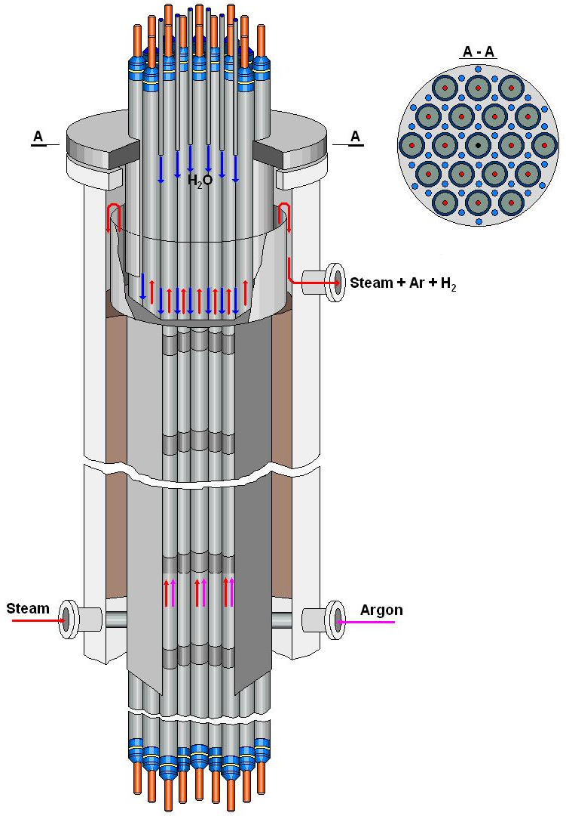
Test bundle
Main technical characteristics
General View
Bundle type VVER-1000
number of fuel rods 19
- heated 18
- unheated 1
Fuel rod VVER-1000
- cladding, mm ∅ 9,13/7,73
(Zr1%Nb)
- pellets UO2
- heater, mm ∅ 4/1275 (Ta)
Grid type triangle
Grid pitch, mm 12.75
Spacing grid Zr1%Nb
- height, mm 20
- spacing, mm 255
Shroud Zr1%Nb
- shape hexahedron
- height, mm 1650
Thermal insulation ZrO2 ZYFB-3
- thickness, mm 19,8
- height, mm 1500

Slide 5
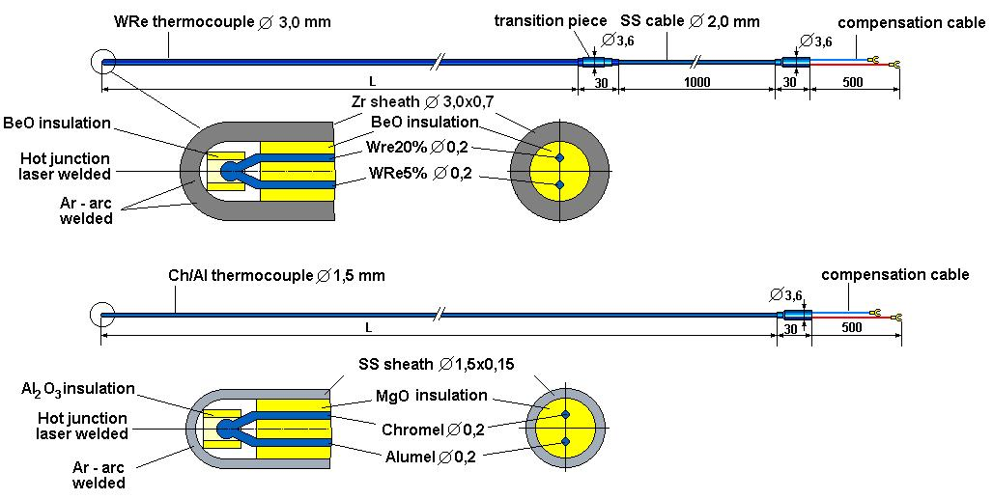
Test instrumentation
Tcl – 46 TC: 12 – WRe, 34 – ChAl;
Tst – 4 TC;
Tsh – 7 TC;
Tins – 7 TC;
Tabc, Tsh c, Tth c
(a – rod, b – row, c – level)

Slide 6
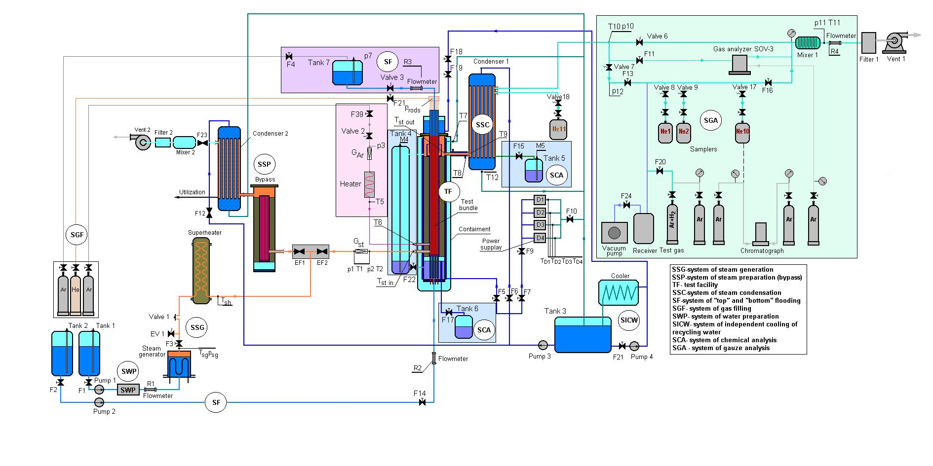
Test facility
Functional scheme
Main technological systems for carrying out of Experiment:
System of separate input of argon;
The monitoring system of balance of steam and water;
System of top flooding;
The monitoring system of hydrogen

Slide 7
The PARAMETER-SF1 Experiment; Sequence of events
Time, s | Events
0 | Start of data recording
∼8200 | Start of heat up to 500 С at the 1100 mm level
∼8800 | Heating up to 500 С of bundle at the 300-1300 mm levels
∼9300 | Start of slow heat up of the bundle
10250 | Cooling jacket was switched on (cooling of the test section body)
∼11000 | Start of pre-oxidation phase
14450 | Start of transient phase
∼14700 | Begin of significant of hydrogen production based on SOV-3 system data
14850 | Electric power shutoff
14858 | Steam flow at zero
14892 | Start of top flooding
15408 | Quench water shutoff
16490 | End of data recording

Slide 8
Flow rates: argon, steam
Steam flow rate Gst, argon
flow rate G(Ar)
Steam: balance
Gst ⋅ τ ≈ M4 + M5
Gst ⋅ τ = 3,3 g/s ⋅ 9410 s = 31620 g
M4 + M5 = 11530 g + 20300 g = 31830 g

Slide 9
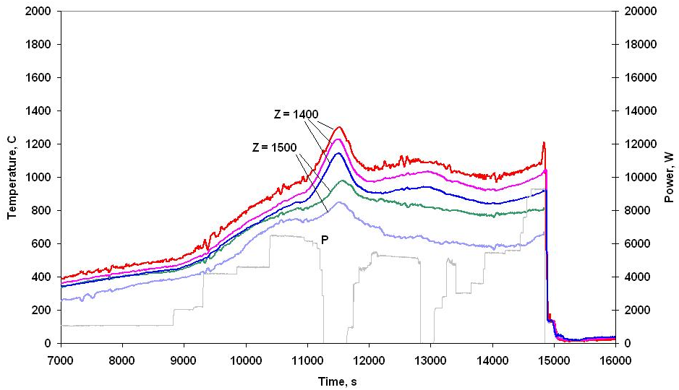
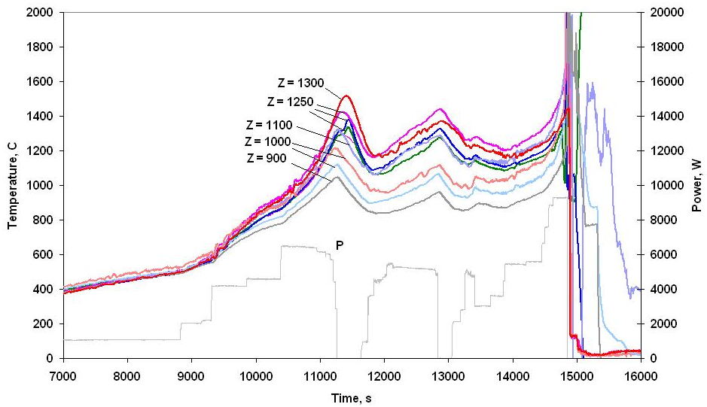
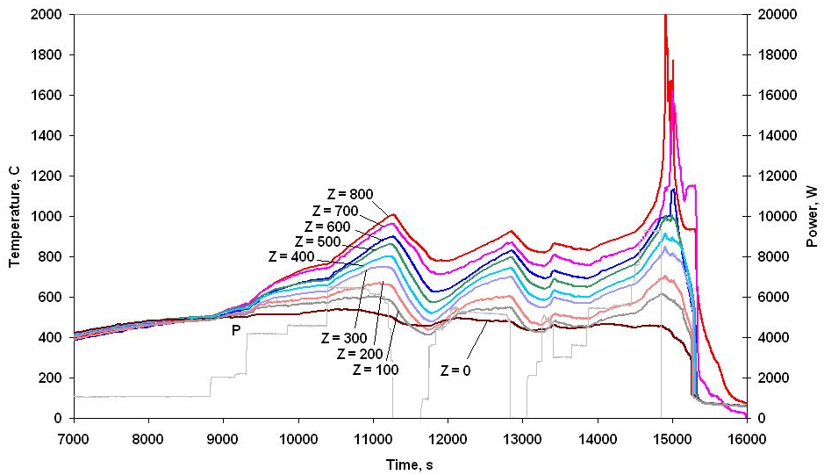
Temperatures: cladding
Level: 1400 – 1500 mm
Level: 900 – 1300 mm
Level: 0 – 800 mm

Slide 10
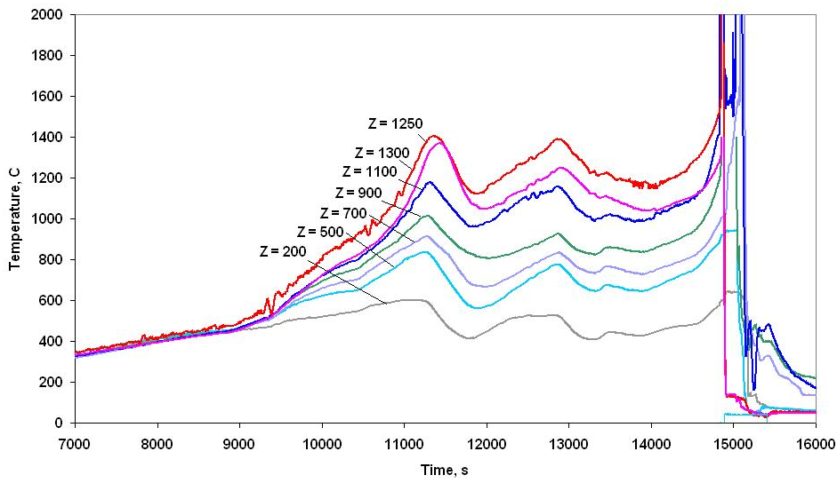
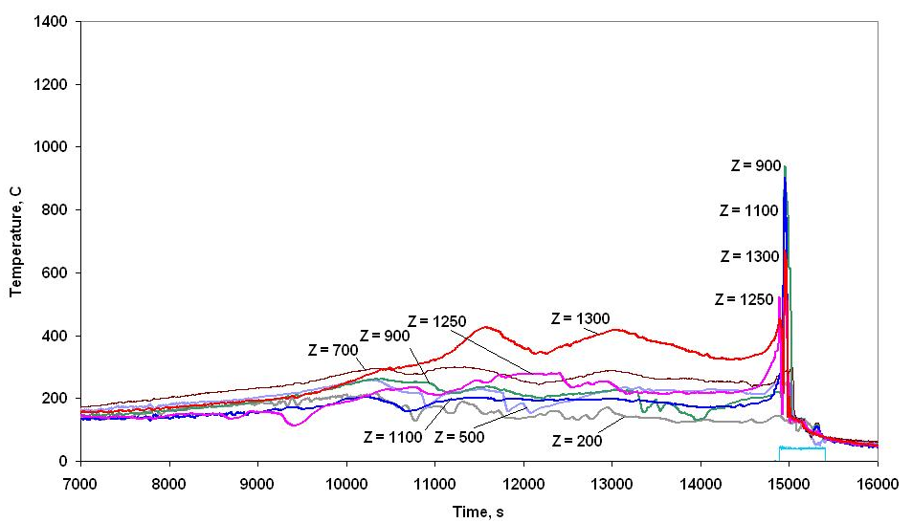
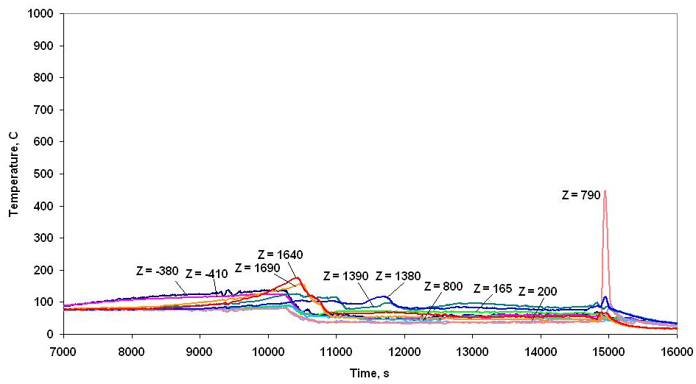
Temperatures: surrounding structures
Shroud temperatures
Thermoinsulation temperatures
Test section body temperatures

Slide 11
Flow rates: quenching
Top flooding water rate Gtf
Water balance
Gtf ⋅ τ = 40 g/s ⋅ 518 s = 20720 g
M4 + M5 = 12700 g + 1400 g = 14100 g
Mth ≈ 5600 g
M4 + M5 + Mth = 19700 g
Gtf ⋅ τ - M4 + M5 + Mth ≈ 1020 g

Slide 12
Temperatures: cladding during top flooding
Level: 1300 – 1500 mm
Динамика охлаждения сборки
Level: 0 – 800 mm

Slide 13
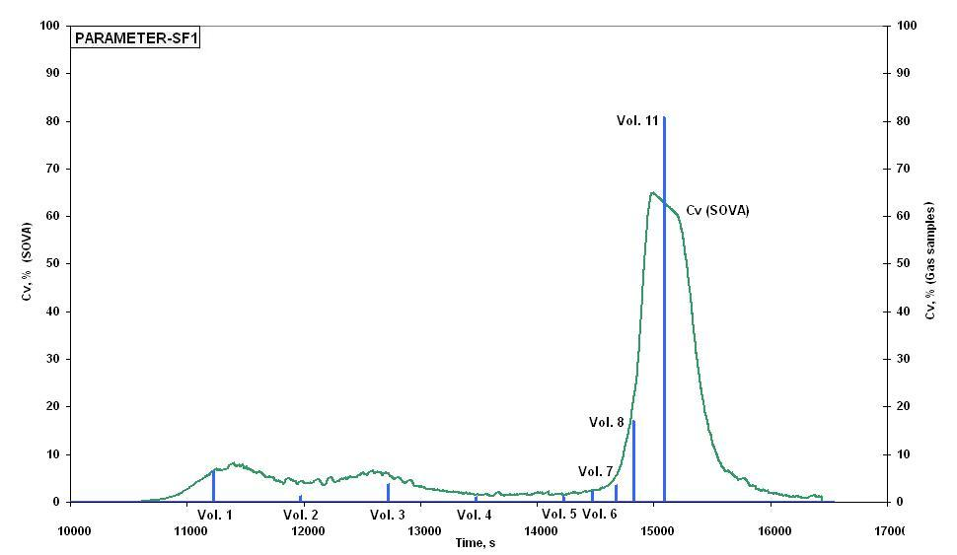
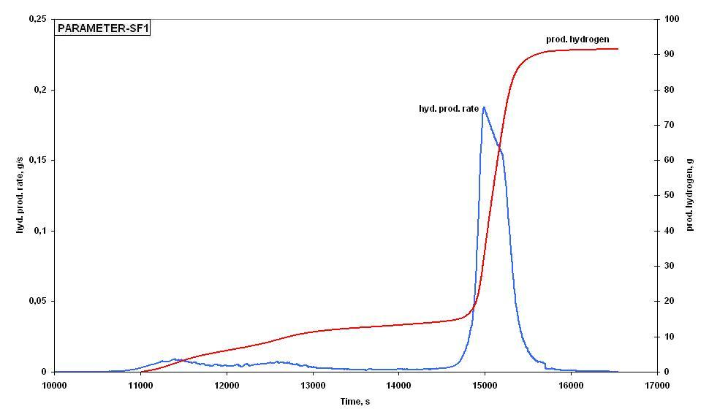
Hydrogen generation
Hydrogen volume
concentration vs. time
Integral hydrogen
release and hydrogen release rate
Results of gas sampling
Vol. | 1 | 2 | 3 | 4 | 5 | 6 | 7 | 8 | 11
C, % v. | ∼6,5 | ∼ 1,1 | ∼ 3,7 | ∼ 1,1 | ∼ 1,3 | ∼ 2,2 | ∼ 3,6 | ∼ 17,2 | ∼ 81
Hydrogen release:
Integral
before quenching
during quenching
∼ 91 g
∼ 36 g
∼ 55 g

Slide 14
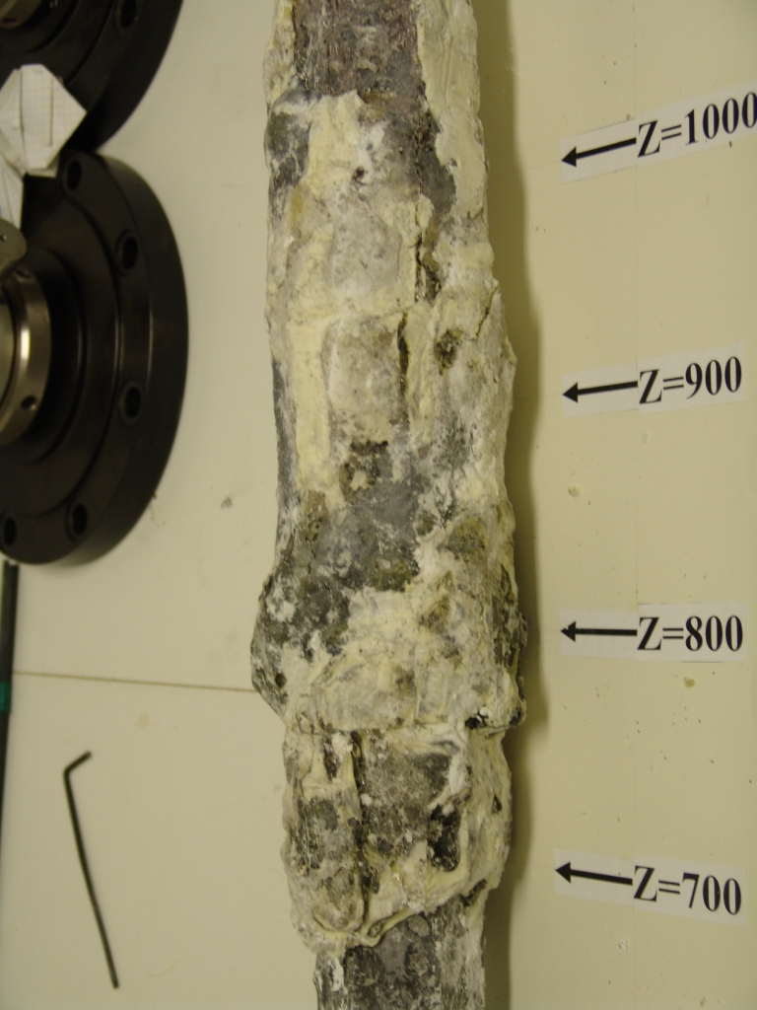
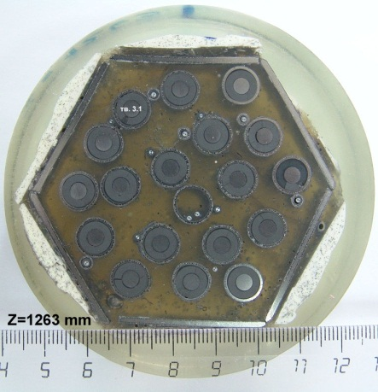
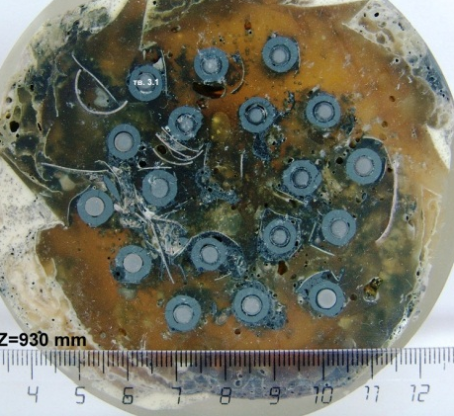
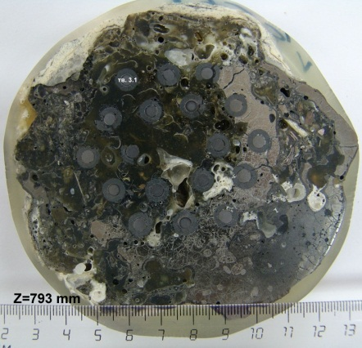
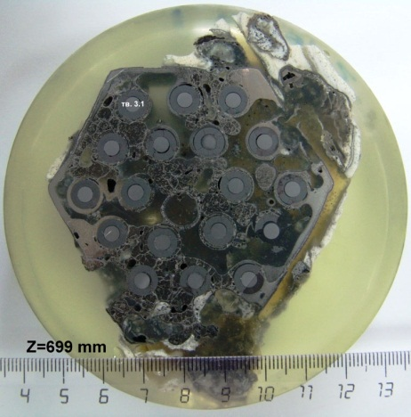
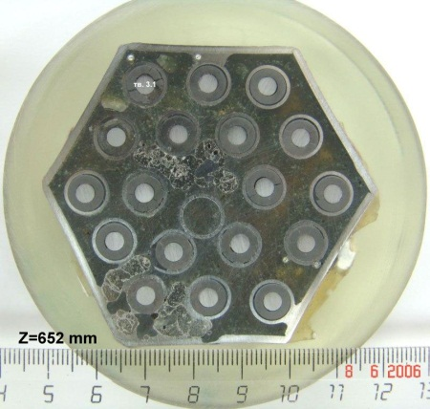
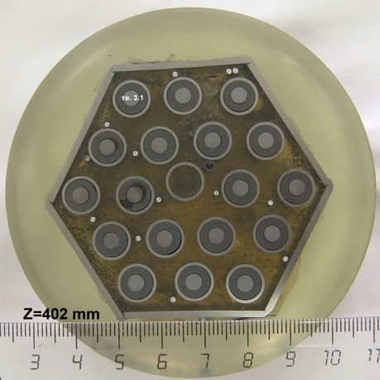
Posttest investigation
Cross sections of the test bundle at elevations (20 cross sections)
Posttest appearance of test bundle

Slide 15
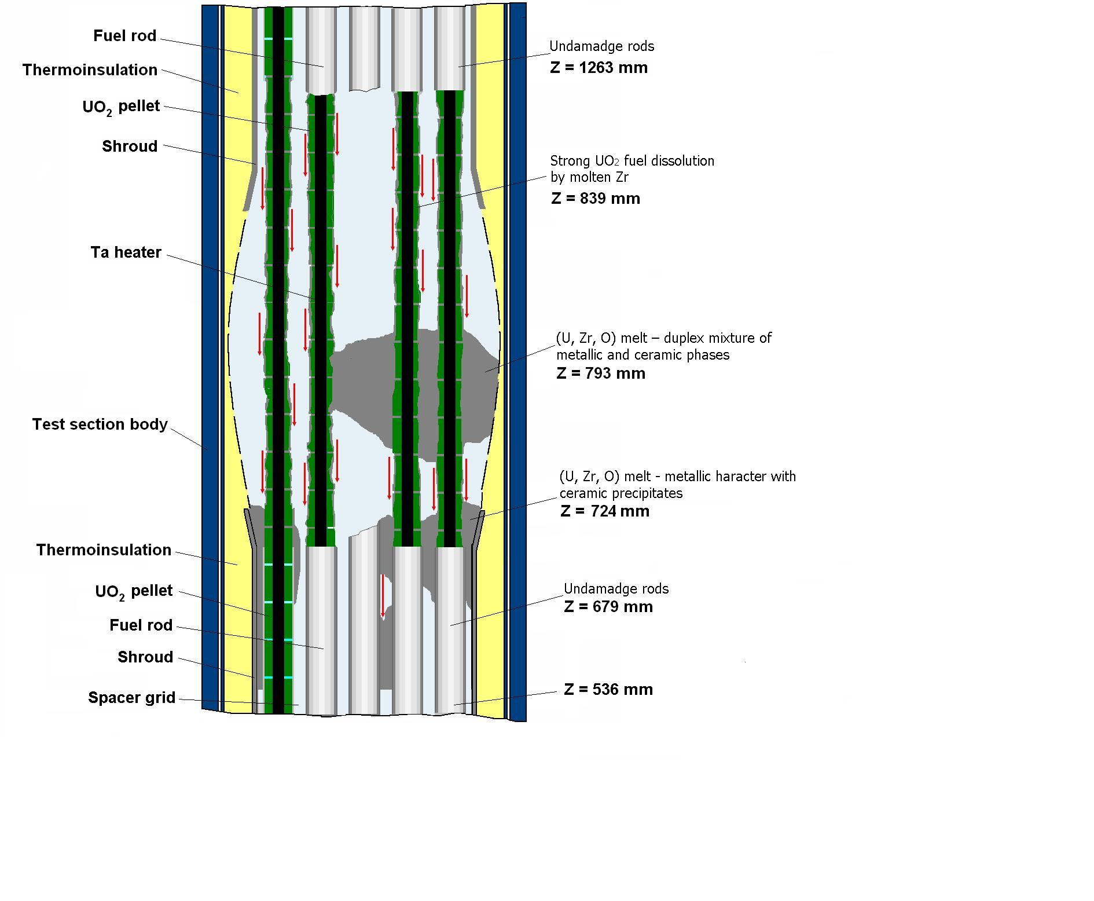
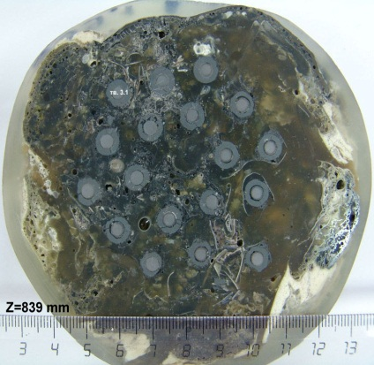
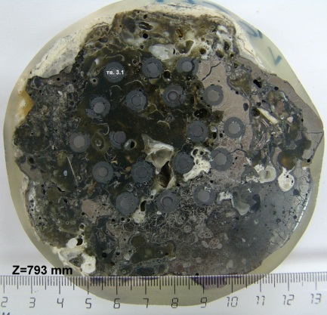
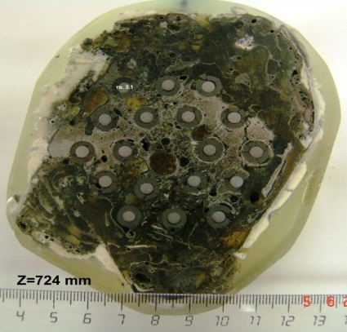
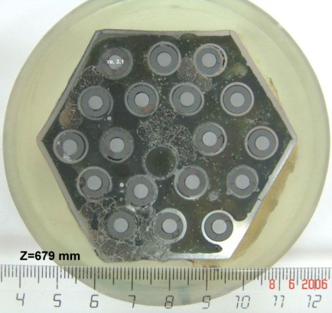
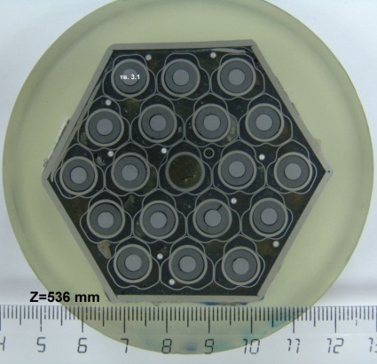
Физическая модель сборки после испытаний

Slide 16
Conclusions
1. SF-1 experiment - successfully completed.
2. Main parameters of test:
- steam flowrate 3.3 g/s at temperature 500 °С;
- argon flowrate - 2 g/s at temperature 480°С;
- stabilization within 3450 s ≈1200°С (dev. 330 °С);
- temperature prior quenching - 2000°C.
3. Hydrogen generation was recorded using two methods – continuous and discrete, that agreed well. The total hydrogen generation within the entire experiment was ≈91 g
4. Successful top flooding was performed: flowrate ≈ 40 g/s for 516 s:
- Confirmed of applicability of top flooding;
- Comprehensive studies should be done – plan further tests.

Slide 19
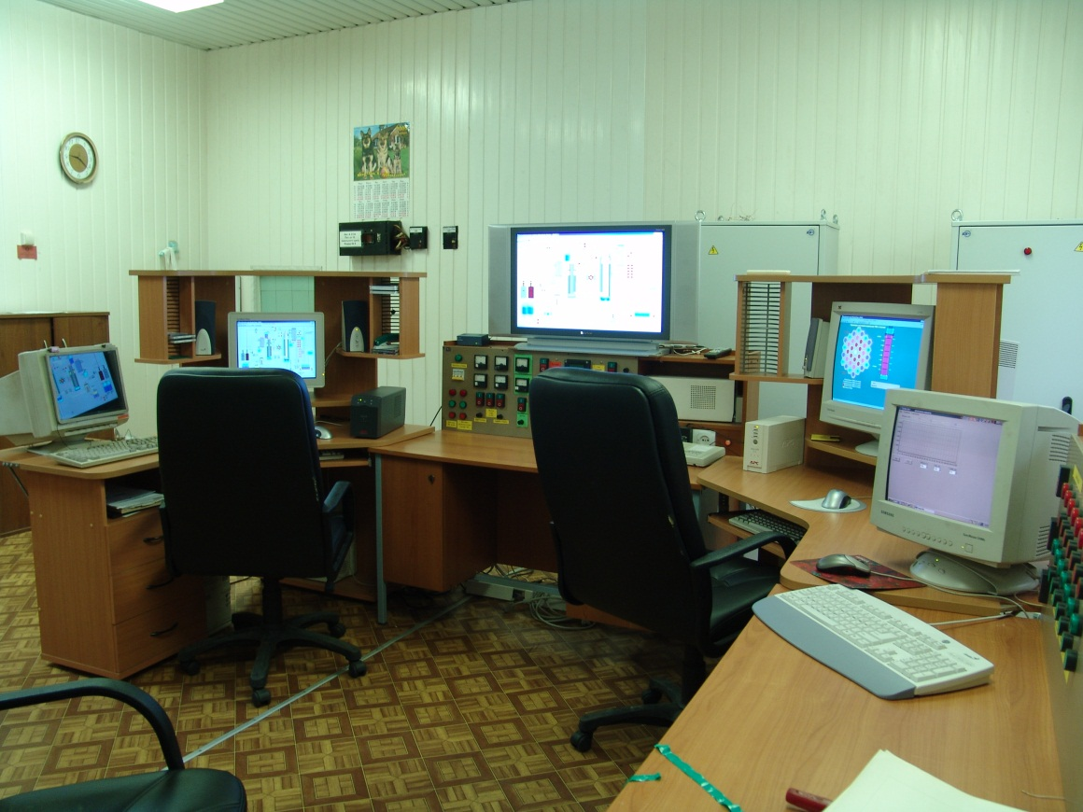
The PARAMETER-SF1 Experiment; PREPARATION
14.04.06 - The report on readiness
15.04.06, 8.20 – all systems are checked and ready
15.04.2006, 8.25 - Test has been performed

Slide 20
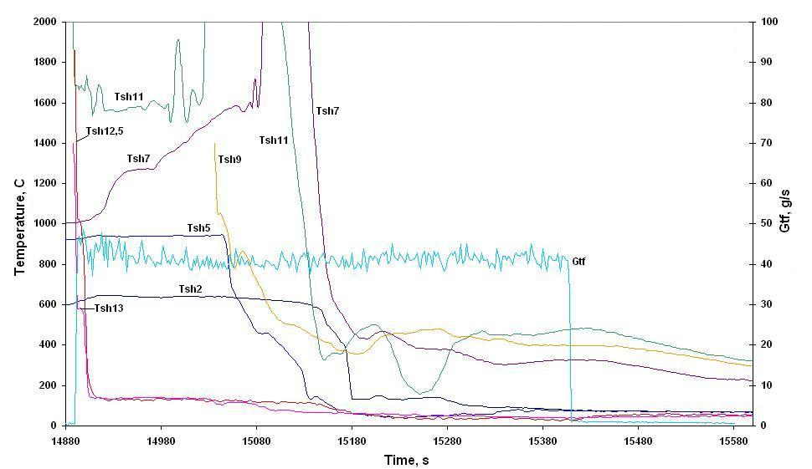
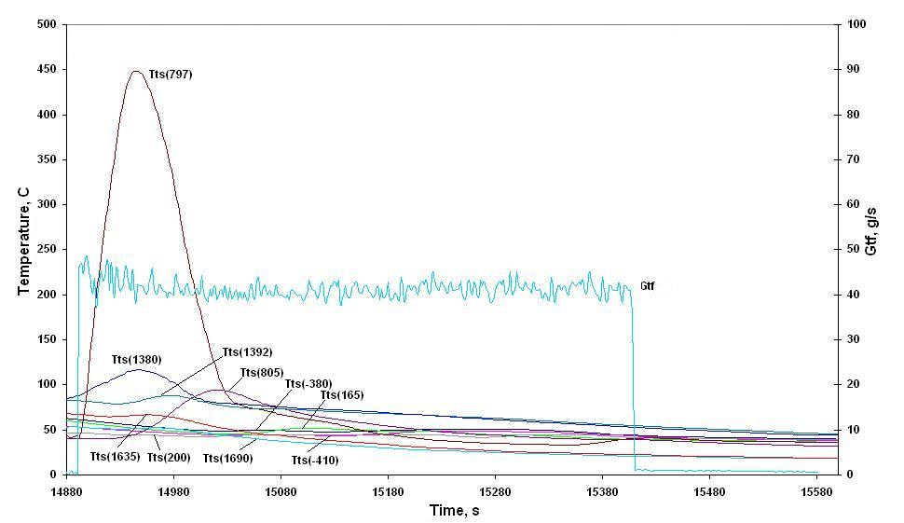
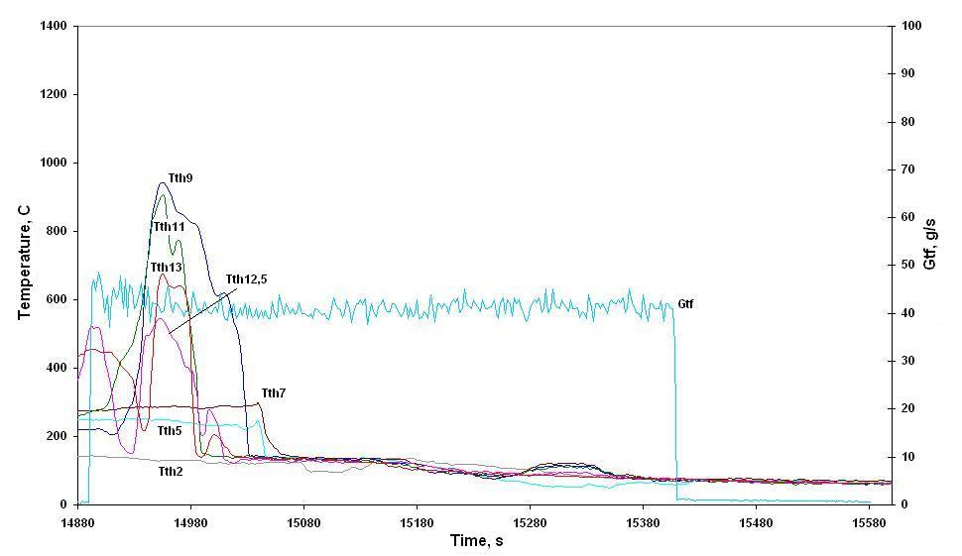
Temperatures: shroud, thermoinsulation and test section during top flooding
Shroud temperature
Test section body temperature
Thermoinsulation temperature

Slide 21
Pressure measurements (quenching)
Pressure measurements in the rods and the bundle test section
Pressure measurements in the off-gas pipe tubes

