Slide 1

Status of the ISTC project #3345 “Ex-vessel source term analysis” (EVAN)”, phase 1
Vladimir Bezlepkin (SPAEP)
12th Meeting of Contact Expert Group on Severe Accident Management (CEG-SAM)
September 11-13, 2007
St. Petersburg

Slide 2
Foreign Collaborators/Partners
Dr. Ari Auvinen VTT Finland
Dr. Hans-Josef Allelein GRS Germany
Dr. Paul David Bottomley JRC-ITU Germany
Dr. Salih Guenty PSI Switzerland
Dr. Bernard Clement IRSN France
Dr. Herve Chalaye CEA-DEN France
2

Slide 3
Project work packages
WP1: Analysis of Severe Accident Scenarios (SPAEP, IBRAE)
WP2: FP release from molten corium pool
  Task 2: Experimental investigations (NITI)
  Task 3: Theoretical and numerical modeling (IBRAE)
WP 3: Primary aerosol transport/deposition
  Task 4: Experimental investigations (NPO CKTI)
  Task 5: Theoretical and numerical modeling (SPAEP, IBRAE)
WP 4: Containment parameters impact on iodine species behaviour
  Task 6: Experimental investigations (VNIPIET)
  Task 7: Theoretical and numerical modeling (VNIPIET, SPAEP)
3

Slide 4
WP1: FP release from molten corium pool (Task1)
Main objectives of EVAN FP release analysis within the frames of Task1 :
- Analysis of calculation results for radioactive releases caused by various classes of severe accidents
- Analysis of FP buildup in fuel and FP release from fuel and molten pools
- Analysis of conditions of radioactive release from reactor plant during severe accidents (LOCA and primary-to-secondary circuit leak).
- Analysis of radioactive source behavior in containment during severe accidents
- Analysis of boundary conditions for the planned experiments
4

Slide 5
WP1: Analysis of Severe Accident Scenarios (Task1)
Part 1: Radioactive releases at severe accidents
Aim of EVAN FP release analysis:
Identification of the main factors affects the accidental releases magnitude
Estimate of conservatism rate for project calculations
Foundation of experimental parameters for Task 2, 4, 6
5

Slide 6
WP1: Analysis of Severe Accident Scenarios (Task1)
Part 1: Radioactive releases at severe accidents
Review of the project approaches and models was executed for:
“NPP-91” project with VVER-1000
EUR, NRC and IAEA recommendations for LWR NPP
6

Slide 7
WP1: Analysis of Severe Accident Scenarios (Task1)
Part 1: Radioactive releases at severe accidents
Main sources of uncertainties of accidental release estimates
L – low, M – medium, H- high level
Group of phenomena | Uncertainty | Sensitivity | Note
Accumulation of FP in fuel | L | M | Calculation of fission products accumulation is performed according to the well verified methodic
Release of FP from fuel under heating and melting | L-M | M-H | Uncertainty for fuel model of VVER is related with evaluation of release of Ru forms and effects of fuel oxidation on fission products release.
Aerosol transport and retention in the primary circuit | M-H | M-H | For analysis of severe accident consequences with containment bypass related with significant releases.
Release of low volatile FP from molten pools (in-vessel) | H | M | Uncertainty for fuel model of VVER is related with evaluation of release of Ru forms and effects of fuel oxidation on fission products release. Conservative assumptions were used in the design calculations.
Release of low volatile FP from molten pools at the ex-vessel stage | M | L | A core catcher preventing core-concrete interaction and decreasing aerosol release at ex-vessel stage.
Aerosol behaviour in the containment | L-M | M-H | Design calculations are taking account only Brownian and gravity coagulation and gravitation sedimentation.
Iodine chemistry | L-H | M-H | level of uncertainty is connected with pH maintaining in containment. High sensitivity of results to parameters determining release of organic iodine forms. Conservative assumptions were used in the design calculations.
Release routs and failure mode effects | M | H | Sensitivity level is related to parameters determining leak rate and mode of containment leakage
7

Slide 8
WP1: Analysis of Severe Accident Scenarios (Task1)
Part 1: Radioactive releases at severe accidents
The analysis was shown the following main factors affects the calculation accidental releases magnitude :
appreciably uncertainties at assessment of FP release from fuel for the elements referred to Ru group (Ru, Mo, Tc)
aerosol deposition and resuspension in reactor equipments at primary-to-secondary leaks accidents (deposition rate up to 0,7)
iodine sorption at polymer facing, steel corrosion products and the core catcher materials (sorption rate up to 0,9)
correct calculating simulation of aerosol transport at containment and inter-containment space
8

Slide 9
WP1: Analysis of Severe Accident Scenarios (Task1)
Part 2: Analysis of FP accumulation in fuel and of FP release
Objective of FP accumulation and release analysis:
- prepare the initial data for FP aerosol formation on the intra-vessel stage of accident in case of fuel destruction
- prepare the initial data for FP aerosol formation on the extra-vessel stage of accident in case of melt formation
- prepare the initial data for consideration of iodine behavior
9
Notes:
Читать слайд

Slide 10
WP1: Analysis of Severe Accident Scenarios (Task1)
Part 2: Analysis of FP accumulation in fuel and of FP release
Status of FP accumulation and release pre-analysis :
- characteristics of the fuel campany of the WWER-1000 (NPP-91 project) have been analyzed (Cycle:3*1years,P=3000MW, Bu=43MW*days/kgU)
- scenarios of accidents have been analyzed
- models of FP release (recoil, knock-out and diffusion) and codes for FP accumulation and release (BONUS, RELEASE, CORREL) have been analyzed
10
Notes:
Читать слайд

Slide 11
WP1: Analysis of Severe Accident Scenarios (Task1)
Part 2: Analysis of FP accumulation in fuel and of FP release
FP accumulation and release analysis main results:
FP composition inside fuel for normal NPP operation at nominal power has been calculated
FP release into gap for normal operation and in accident has been estimated
Accumulation and release of gaseous, volatile and nonvolatile fission products have been analyzed
11
Notes:
Читать слайд

Slide 12
WP1: Analysis of Severe Accident Scenarios (Task1)
Part 2: Analysis of FP accumulation in fuel and of FP release
Long-lived radioactive FP (VVER-1000) in gap
 | Isotope | Т_{1/2} | Class | NC: CORSOR-M | NC: CORSOR-BOOTH | NC: WWER-1000 | Accident: RELEASE | Accident: CORREL
 | - | Y | - | % | % | % | % | %
 | 2 | 3 | 4 | 5 | 6 | 7 | 8 | 9
1 | Kr-85 | 10,7 | Xe | 1,3e-5 18 | 1.0e-5 0,24 | 0,86 | 92 | ~100
2 | Sr-90 | 28,7 | Sr | 0 2,2E-6 | 1,6e-8 3,7е-4 | 0,83 | 1.3е-3 | ~52
3 | Cs-134 | 2,1 | Cs | 1,3e-5 18 | 1.0e-5 0,24 | 1,0 | 89 | ~100
4 | Cs-137 | 30 | Cs | 1,3e-5 18 | 1.0e-5 0,24 | 0,83 | 89 | ~100
5 | Ce-144 | 0,8 | Ce | 0 | 1,7e-10 4,0e-6 | 0,79 | 7е-7 | 0.04
6 | Pm-147 | 2,6 | La | 0 | 1,0e-10 2,5e-6 | 0,89 | 1е-6 | 0.3
12
Notes:
В таблице приведен выход долгоживущих радиоактивных продуктов деления под оболочку твэла реактора ВВЭР-1000 (проект АС-91).
Представлены данные для данные для
газообразных РПД (Kr-95),
летучих РПД (Cs-137, Cs-134) и
нелетучих РПД (Sr-90,Ce-144, Pm-147).
Результаты сравниваются для условий нормальной эксплуатации (колонки 5-7) и аварий (колонки 8-9).
В колонке 7 даны принятые в проекте величины выходов РПД под оболочку твэла. В колонках 5 и 6 представлены результаты расчета выхода РПД с использованием моделей CORSOR-M и CORSOR-BOOTH для условий нормальной эксплуатации. Как видно из сравнения, данные модели не дают адекватного описания накопления РПД на момент начала аварии (видимо, модели должны использоваться только для аварийных условий).
В колонке 8 даны расчеты выхода РПД из топлива с использованием механистических моделей диффузии для аварии ДУ-346. В колонке 9 даны результаты расчета выхода по модели CORSOR для той же аварии.
Видно следующее. Выход летучих и газообразных РПД примерно одинаков. Выход нелетучих РПД существенно различен. Для определения выхода нелетучих РПД требуется наличие достоверной экспериментальной информации.
Видно также, что для нелетучих РПД (Ce-144, Pm-147) выход из топлива при аварии существенно ниже накопленного под оболочкой при нормальной эксплуатации. Корректный учет накопленных под оболочкой нелетучих ПРД при НЭ может определять выход РПД при аварии.

Slide 13
WP1: Analysis of Severe Accident Scenarios (Task1)
Part 3: Conditions of radioactive release from primary circuit
The analysis of aerosols release condition typical to in-vessel and ex-vessel phases of a severe accident
Calculation of fission products behavior by means of code SOKRAT
Numerical modeling of convective flow above a surface of melt corium in reactor vessel by means of 3-D code
The following scenarios of heavy accidents have been reviewed:
Large (Dnom346 - in case of rupture of PRZR surge line ) and small (Dnom25 - from PCP) LOCA’s which is accompanied by a blackout
Large (Dnom300, (Dnom179) and small (Dnom80) LOCA’s from PCP cold leg accompanied by a failure of ECCS active part
13

Slide 14
WP1: Analysis of Severe Accident Scenarios (Task1)
Part 3: Conditions of radioactive release from primary circuit
large LOCA Dnom 346
Break loop, hot leg
The maximal value of
parameters :
Large and middle LOCA’s:
gas temperature: 3000 К
Velocity: 97 m/s
Reynolds number: 2,2·10⁶
Small LOCA’s:
gas temperature: 3000 К
Velocity: 38 m/s
Reynolds number: 1·10⁶
Steam generator tubes rupture (SGTR):
Max. Velocity: 324 m/s
Max. Reynolds
number: 2.3·10⁷
14

Slide 15
WP1: Analysis of Severe Accident Scenarios (Task1)
Part 3: Conditions of radioactive release from primary circuit
parameters | accident
 | Dnom 346 | Dnom 300 | Dnom 179 | Dnom 80 | Dnom 25
Time available before the reactor barrel is melt through, s | 6 150 | 5 920 | 8 540 | 14 900 | 27 700
Time available before the reactor vessel is melt through, s | 8 340 | 7 930 | 10 330 | 16 500 | 29 820
Time available before the oxidic corium relocation to the corium catcher stops, s | 11 800 | 10 940 | 13 840 | 22 200 | 36 930
Parameters characterizing corium melt before core barrel melting
Upper layer: temperature, К Mass share of UO2 Mass share of ZrO2 Mass share of Zr Mass share of steel | 2790-2980 0,664-0,554 0,081-0,089 0,048-0,0105 0,207-0,252 | 2840-3000 0,674-0,621 0,086-0,076 0,045-0,093 0,195-0,21 | 2800-3170 0,659-0,566 0,073-0,066 0,048-0,101 0,22-0,267 | 2800-3300 0,756-0,614 0,105-0,102 0,029-0,024 0,109-0,259 | 2690-2890 0,541-0,484 0,159-0,097 0,009-0,008 0,291-0,411
Parameters of melt at the moment of the beginning vessel destruction
metallic layer: temperature, К Mass share of Zr Mass share of steel | 3070 0,053 0,947 | 3080 0,053 0,947 | 3000 0,058 0,942 | 3000 0,016 0,984 | 2650 0,06 0,994
Corum: temperature, К Mass share of UO2 Mass share of ZrO2 Mass share of Zr | 3210 0,786 0,118 0,096 | 3200 0,808 0,102 0,098 | 3160 0,804 0,094 0,103 | 3100 0,779 0,19 0,03 | 2970 0,75 0,233 0,017
Small LOCA Dnom 25
the corium relocation to the corium catcher,
mass share of melt
the corium relocation to the corium catcher,
temperature of melt
15

Slide 16
WP1: Analysis of Severe Accident Scenarios (Task1)
Part 3: Conditions of radioactive release from primary circuit
Fission product behavior of class CI
during severe accident
Weights of all aerosols
which have left from the primary circuit
Time dependences of release I, Mo and Te
from fuel
Weights of the aerosols which have left
the primary circuit for aerosols of the various sizes
16

Slide 17
WP1: Analysis of Severe Accident Scenarios (Task1)
Part 3: Conditions of radioactive release from primary circuit
Fields of temperature and velocity in a longitudinal section for (z=0) at t=600с
Fields of velocities and temperatures at a surface of melt (y=0.1м) at t=600с
17

Slide 18
WP1: Analysis of Severe Accident Scenarios (Task1)
Part 3: Conditions of radioactive release from primary circuit
Further Research
  The analysis of aerosol behavior in the time of steam generator tubes rupture (SGTR) and small LOCA’s will be continued at the next stage of project
  Computational analysis of natural convection over melt surface by means of 3-D CFD code taking into account corium oxidizing reactions will be executed
18

Slide 19
WP1: Analysis of Severe Accident Scenarios (Task1)
Part 4: Numerical simulation of aerosol particle behaviour in the containment
Multicomponent aerosols condensation block: Jacobson, M.Z. (1997). Numerical Techniques to Solve Condensational and Dissolutional Growth Equations When Growth is Coupled to Reversible Reactions, Aerosol Sci. Technol. 27: 91-498.
Multicomponent aerosols coagulation block: Semi-implicit version of (Stankova E.N., Zatevakhin M.A. The modified Kovetz and Olund method for the numerical solution of stochastic coalescence equation. Proceedings 12th International Conference on Clouds and Precipitation, Zurich, 19-23 August 1996, P. 921-923)
Particles deposition model includes gravitational settling (sedimentation), Brownian diffusion, diffusiophoresis, thermophoresis
Verification test results
19

Slide 20
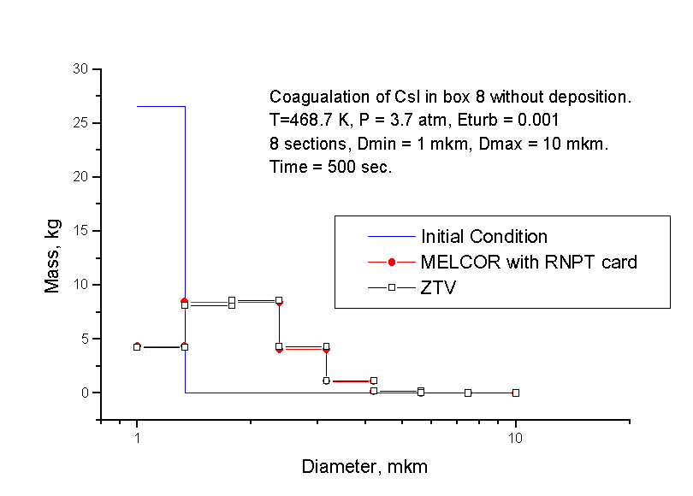
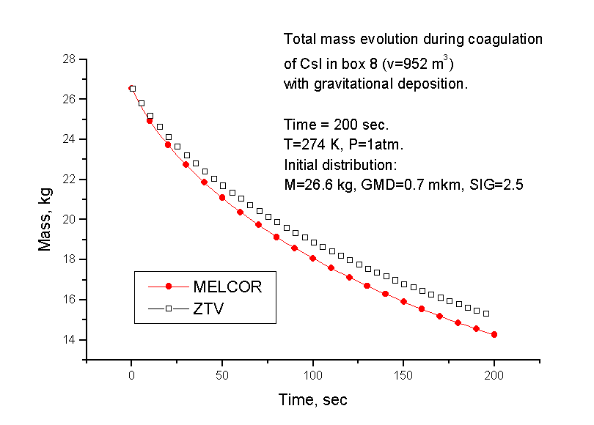
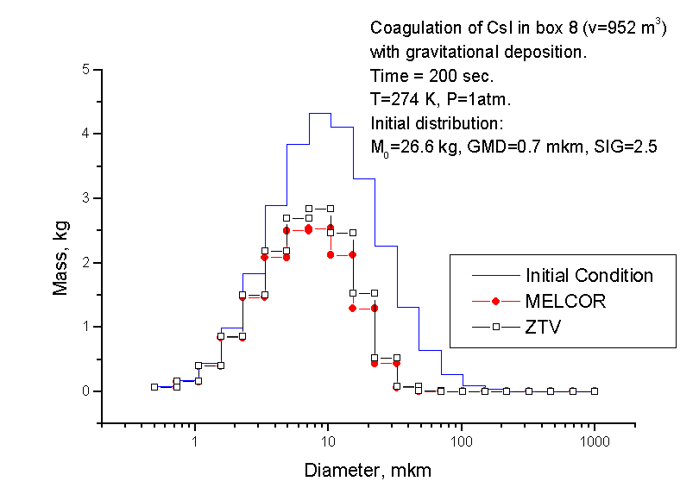
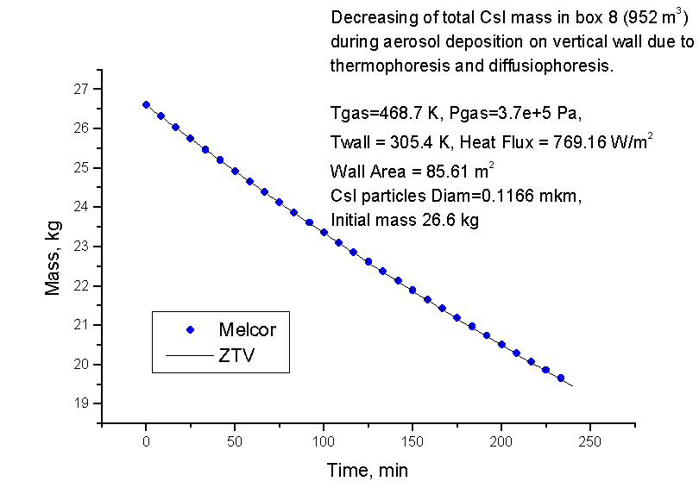
WP1: Analysis of Severe Accident Scenarios (Task1)
Part 4: Numerical simulation of aerosol particle behaviour in the containment
Aerosol code verification: comparison with MELCOR simulations
20

Slide 21
WP1: Analysis of Severe Accident Scenarios (Task1)
Part 4: Numerical simulation of aerosol particle behaviour in the containment
Results of aerosol code
Conclusion
Aerosol code was developed and verified
Farther development:
Take into account aerosol hygroscopicity
Use new experimental data for code validation
Integrate aerosol code with 3D hydrodynamic code
Comparison between calculated aerosol output (1) and data obtained according to project recommendations (2). Slow aerosol output at the beginning stage is caused by relatively small size of aerosol particles and absence of water vapor condensation due to superheated media.
21

Slide 22
WP2: FP release from molten corium pool (Task2)
Objective of EVAN-FP1 experiment:
- Determination of release rates of fission product simulants and melt components at corium oxidation transient from Сn=70 to Сn=100
- Simulants: Sr, Ba, Ce, La, Ru, Mo
- Oxidation index:
M_{Zr,Σ}, - mass of Zr and ZrO₂ M_{Zr, met} - mass of Zr
22

Slide 23
WP2: FP release from molten corium pool (Task2)
Status of EVAN-FP1 experiment:
- Test parameters and procedure have been coordinated
- Installation has been prepared
- Pretest has been carried out
23

Slide 24
WP2: FP release from molten corium pool (Task2)
Objectives of Pre-EVAN FP1 experiment:
- Functional check of the furnace and gas-aerosol system
- Choice of oxygen content in Ar/O₂ mixture
- Determination of melt oxidation rate during transient from C 70 to C 100
24

Slide 25
WP2: FP release from molten corium pool (Task2)
Pre-EVAN FP1 conditions:
Main parameters of melt
Melt mass: 1600 g
Initial index of corium oxidation: С-70
U/Zr = 1.2
No FPS in the melt
Above-melt atmosphere
Dry, high-purity Ar (At steady state)
Argon/oxygen mixtures with O₂ volume fraction 5…20 vol. % (During transients)
Flow rate 10 l/min (like in FPRMP and LPP tests)
25

Slide 26
WP2: FP release from molten corium pool (Task2)
Pre-EVAN FP1 main results:
Efficiency of installation has been demonstrated
Minor factors: high aerosol transport losses and unknown efficiency of the bubblers for entrapping gaseous Ru
20 vol % of O₂ content in Ar have been selected for EVAN FP1 test
Melt oxidation rate is not sensitive to metallic Zr content in the melt
Aerosol mass releases have been determined without FPS
26

Slide 27
WP2: FP release from molten corium pool (Task2)
Planning for the next quarter:
EVAN FP1 test: October 2007
Posttest analysis: November 2007
Report: December 2007
27

Slide 28
WP2: FP release from molten pool modeling (Task 3)
Objective of work:
- Modeling of fission product release from the molten corium at the reactor vessel bottom
Status of the work
- A model of fission product release from molten corium pool is being developed
- A beta-version of code has been developed
28
Notes:
The objective of this work is theoretical analysis of fission product release from molten corium pool at the reactor vessel bottom and code developing. At present moment a beta-version of code has been created. It allows to calculate the rate of release of all fission products.
Цель работы – теоретический анализ выхода продуктов деления из расплавленного кориума на днище реактора и разработка соответствующего программного кода. На данный момент создана бета-версия кода, позволяющего вычислять выход из расплава всех возможных продуктов деления.

Slide 29
WP2: FP release from molten pool modeling (Task 3)
Model assumptions
- No gas bubbles in molten corium
- Saturated FP vapor over molten pool blown off at finite rate
- Not considering other kinetic effects (convection, evaporation)
- Molten corium and gas phase is ideal molecular mixture
Experimental data used
- IVTANTHERMO database
- MASCA experiments (release of U, Zr, Fe, Ni, Cr)
29
Notes:
The main assumptions of the model are as follows.
There is no gas bubbles in molten corium. They are created in core trap because of corium-concrete interaction. This case must be considered separately.
Fission product vapor over molten corium is saturated. It is blown away at finite rate and this determines the rate of fission product release.
Finite rate of other kinetic effects like fission products evaporation is not taken into consideration. Such an approach gives the upper estimate of FP release rate
The molten corium and the gas phase over it is considered as molecular ideal mixture. It allows to take into consideration chemistry effects which are of great importance for calculating FP release rate.
Experimental data used in the model were taken from IVTANTHERMO database and some other bases. Release rate of U, Zr, Fe, Ni, Cr predicted by model was compared with results of MASCA experiments.
Главные предположения модели следующие.
В кориуме на днище реактора нет газовых пузырей. Они могут возникать лишь в ловушке в результате взаимодействия кориума с бетоном. Выход ПД из ловушки нужно рассматривать отдельно.
Пар ПД над кориумом насыщенный, равновесный. Он сдувается с заданной скоростью, что и определяет скорость выхода ПД.
Конечная скорость других кинетических эффектов, таких как конвекция ПД в кориуме или испарение их с поверхности, не учитывается. В результате получается верхняя, консервативная оценка скорости выхода ПД.
Жидкий кориум и газовая фаза рассматриваются как идеальные смеси молекул. Молекулярная структура позволяет описать химические эффекты, которые очень важны для описания выхода ПД из расплава.
Экспериментальные данные, на основании которых строилась модель, брались из термодинамической базы IVTANTHERMO и некоторых других баз. Предсказания модели сравнивались с результатами экспериментов MASCA.

Slide 30
WP2: FP release from molten pool modeling (Task 3)
Results:
- Upper estimate of FP release rate in neutral atmosphere
- Description of FP release in oxygen-containing atmospheres
Planning for the next quarter:
- Finite rate of corium oxidation in oxygen-containing atmosphere
- Non-uniform distribution of FP in gas phase
- More realistic estimates of FP release rate
30
Notes:
The model gives an upper estimate of FP release in neutral atmosphere because finite rate of some kinetic processes is neglected. Molecular approach allows to describe also FP release into oxygen-containing atmospheres.
In the next quarter we planning to take into consideration finite rate of corium oxidation in oxygen-containing atmosphere and non-uniform FP distribution in gas phase. More realistic estimates of FP release is expected.
Модель даёт верхнюю оценку выхода ПД в нейтральной атмосфере, поскольку конечная скорость некоторых процессов не учитывается. Молекулярные представления позволяют в едином ключе описывать также выход ПД и в кислородсодержащие атмосферы.
В следующем квартале планируется учесть конечную скорость окисления кориума в кислородсодержащей атмосфере и неоднородное распределение ПД в газовой фазе. Ожидается, что это приведёт к более реалистичной оценке выхода ПД из расплава.

Slide 31
WP3: EXPERIMENTAL STUDY OF AEROSOLS TRANSPORT PROCESS IN THE PRIMARY CIRCUIT EQUIPMENT (Task4)
Matrix of experiments of phase 1
31

Slide 32
Aerosol test facility ATF3
32

Slide 33
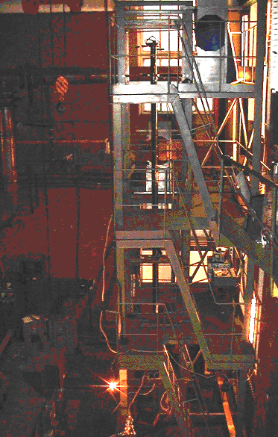
General view of the test structure
33

Slide 34
Measurement techniques
Velocity related parameters of the carrying media and disperse phase of the flow
Size and concentration of the disperse phase
Thermoanemometer
Laser Doppler anemometer
Spectral transparency (extinction) method
Forward scattering (Fraunhofer diffraction) method
Particle counter
34

Slide 35
Aerosol transport process: measurement results
Regime | Air velocity [meter/s] | Measured parameters
 |  | Mean drop diameter [μm] | Mass concentration of the disperse phase (g/m³) | Relative drop enlargement [%] (level to level) | Relative decrease of mass concentration (%) (level to level)
R1 | 6.5 | 0.55 | 6.5 | 5 | 14±2
R2 | 6.5 | 0.53 | 9.5 | 6 | 14±2
R3 | 34.0 | 0.48 | 1.5 | 6 | 4±2
R4 | 42.0 | 0.48 | 1.5 | 6 | 4±2
35

Slide 36
LDA measurements: seeding particles comparison
Axial flow velocity ≈ 3 m/s, level 2
Mean axial velocity profile | Turbulence intensity profile
Smoke
Fog
Smoke
Fog
36

Slide 37
Measurement of aerosol mass concentration (R1)
Air velocity [meter/s] | Mass concentration of liquid [g/m³]
6,5 | 6,5
37

Slide 38
WP3 Summary TASK 4
Developed and constructed test facility can be successfully used for the investigation of the aerosol transport processes in the primary circuit equipment
Constructed test-rig is equipped with measurement tools, which allows to measure the cinematics of the carrying and disperse phases of the up-flow in the vertical channel, including mean and pulsating components of the axial and tangential flow velocities
The measurement technique for the estimation of size and concentration of liquid particles makes it feasible to measure the parameters along the air up-flow in the vertical duct
First experimental results obtained with the developed measurement instruments attested the efficiency of the developed techniques
Preparation are made to learn in details the transport of liquid particles and to start the solid particles study
38

Slide 39
WP3 Perspectives for stage 2 TASK 4
September 2007
October 2007
November 2007
December 2007
Mounting of the new channel and the measurement equipment
Experiments
Data processing and analyses
Final report
39

Slide 40
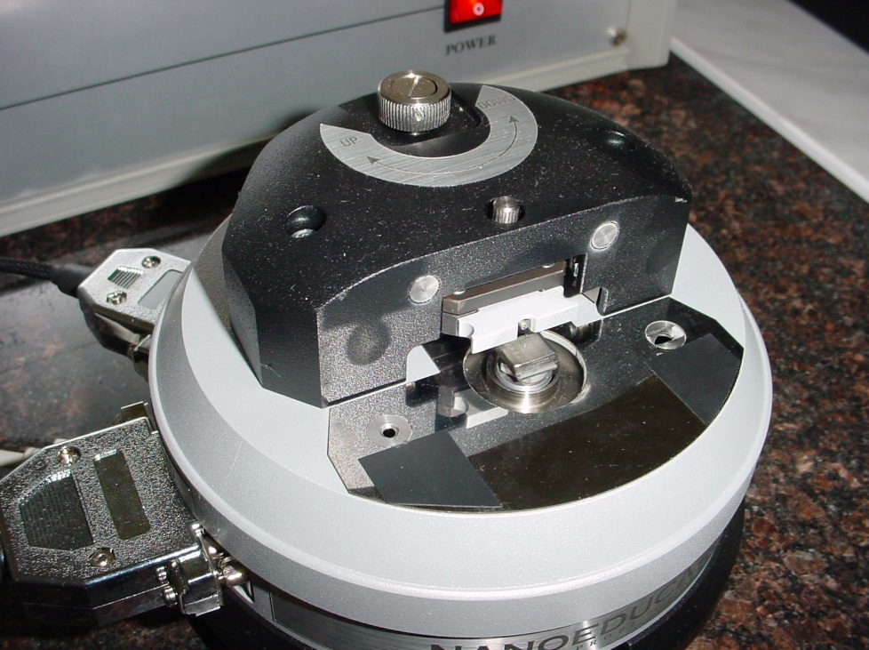
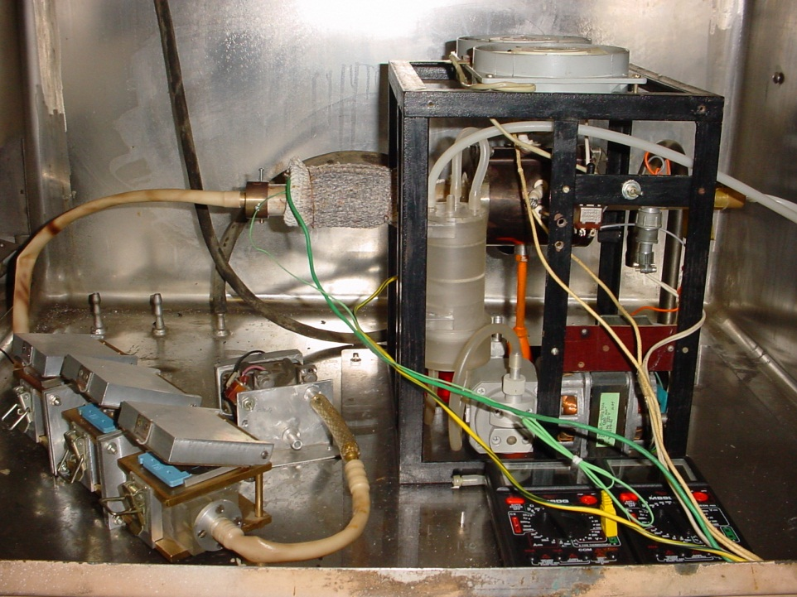
Experimental determination of aerodynamic diameter and mass of ammonium chloride aerosol particles
Aim of the work:
Generation of the ammonium chloride particles within a definite range of sizes;
Determination of their aerodynamic parameters (aerodynamic diameter, mass and density of substance, geometrical shape, size distribution);
Surface morphology determination.
Main facilities:
atomic-force probe microscope Nanoeducator (RF Co NT-MDT)
condensation aerosol generation plant (self designed and built)
41

Slide 41
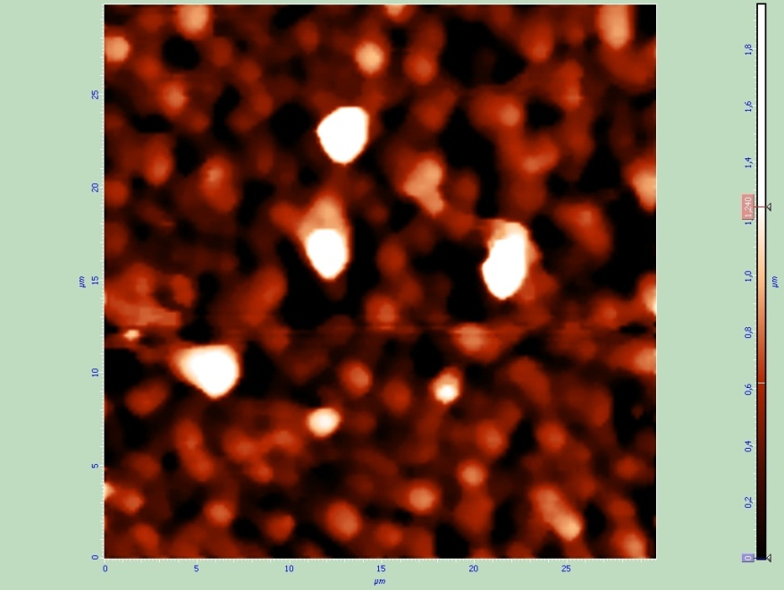
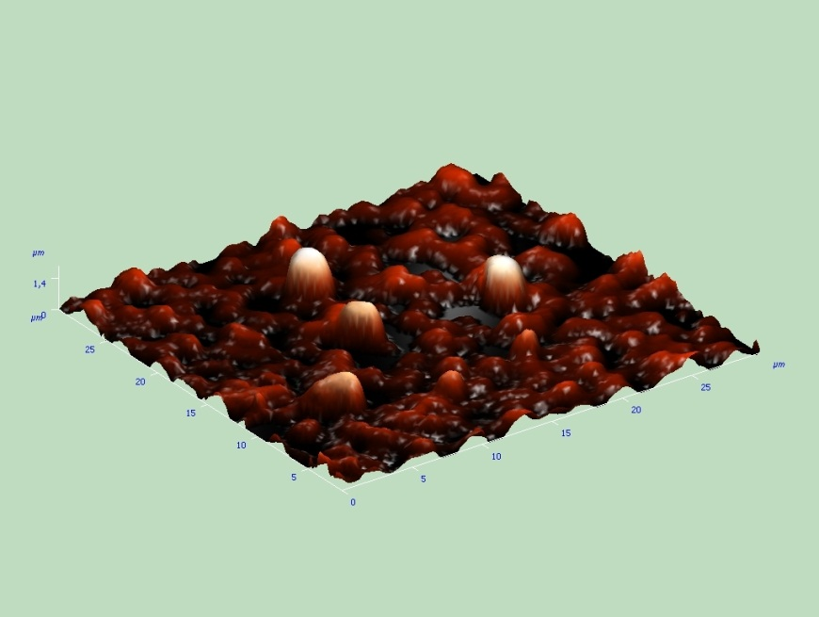
Experimental determination of aerodynamic diameter and mass of ammonium chloride aerosol particles
Preliminary Results:
condensation aerosol generation plant allows to generate the ammonium chloride particles with mean radii of about 1.5 µm;
procedure based on re-condensation of the ammonium chloride vapor on the generated particles allows to enlarge generated particles up to 3-4 µm in radius;
no particles with complicated microstructure are produced by the condensation aerosol generation plant.
Two-dimensional image of on-carrier settled particles under primary condensation conditions
Three-dimensional image of on-carrier settled particles under primary condensation conditions
41

Slide 42
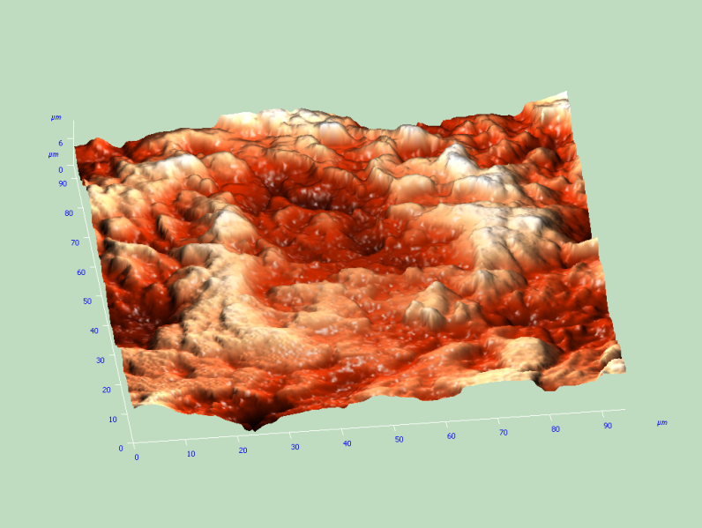
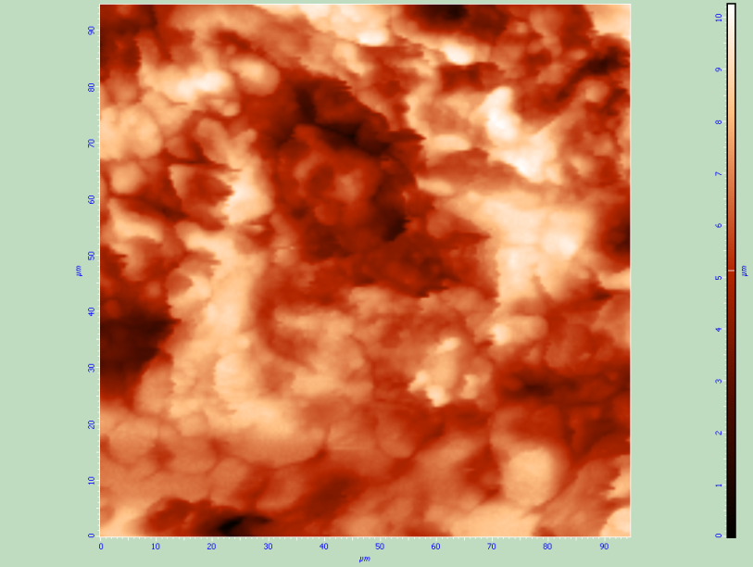
Experimental determination of aerodynamic diameter and mass of ammonium chloride aerosol particles
Preliminary Results:
Surface thin structure images for roughness characteristic determination were obtained.
Images of the inner tube surface obtained by electron microscope technique
Those images allow to estimate the surface roughness parameters that are necessary for simulation of resuspension process.
42

Slide 43
Experimental determination of aerodynamic diameter and mass of ammonium chloride aerosol particles
Further Research:
Providing one more point of substance evaporation in the system to provide repeated influence for the purpose of achieving the particle size within the range required;
Providing the mechanical separating devices for particle cutoff;
Making the calibration measurements of aerodynamic parameters by direct sedimentation method;
Calculating the particles distribution in terms of their sizes and aerodynamic characteristics;
Investigating the evolution of particle adhesion properties;
Calculating the optical characteristics (damping coefficients and scattering indicatrices) for the different-size particles within a range from 0.5 µm to 10 µm as well as for the ensembles of particles.
43

Slide 44
WP3: Theoretical and numerical modeling(Task5)
Objective of this work:
- State-of-art review of modeling capabilities of the processes in question by modern computer codes, justification of applicability of the expected experimental results for models validation
- Pretest/posttest calculations
44

Slide 45
WP3: Theoretical and numerical modeling(Task5)
Status of work:
- The analysis of various mechanisms of aerosol particles coagulation and sedimentation was done.
- New dependence of speed of sedimentation has been constructed
- The model of resuspension of aerosol particles has been developed.
- Pretest calculation has been carried out
45

Slide 46
WP3: Theoretical and numerical modeling(Task5)
Pretest analysis. Deposition rate
Basic deposition mechanisms
Turbulent diffusion
Turbulent migration (turbophoresis)
Deposition rate (m/s) versus their size.
Densities: I - ρp=1000kg/m3; II - ρp=4000kg/m3
Flow rates:1 - Um=0.5m/s; 2 - Um=1m/s; 3 - Um=2m/s;
4 - Um=5m/s; 5 - Um=10m/s;
6 - Um=20m/s; 7 Um=50m/s; 8 Um=100m/s
46

Slide 47
WP3: Theoretical and numerical modeling(Task5)
Pretest analysis. Effect of dispersion of aerosol size distribution on the deposition efficiency
- deposition efficiency
σ- dispersion
U- flow rate
ds- mean diameter
47

Slide 48
WP3: Theoretical and numerical modeling(Task5)
Main results:
Calculations of deposition rate of aerosol particles in turbulent channel flow are performed for conditions of experiments at ATF facility.
- The results received allow us to estimated entrance concentration of aerosols which if exceeded, requires taking into account the effect coagulation.
- A strong effect of a dispersion of aerosol size distribution on efficiency of deposition takes place.
48

Slide 49
WP3: Theoretical and numerical modeling(Task5)
Planning for the next quarter:
Posttest calculation: October 2007
Posttest analysis: November 2007
Report: December 2007
49

Slide 50
WP3: Theoretical and numerical modeling (Task 5.2)
The Rock ‘n’ roll Resuspension Model (RRRM)
RRRM is a kinetic quasi-static model;
removal dynamics from the rough surface is determined not by the direct effect of the removal force, but by the couples, that cause rocking of the particle about the contact zone of a single asperity;
previously RRRM was formulated for the spherical particles only, and now it was developed for the particles of arbitrary shape.
Models based on the direct effect of the removal force gives the values of the resuspension rate constant much less than the RRRM one.
The condition of the particle removed from the surface is that the removal force F_{t}(t) at point Q exceeds the adhesive one f_{aQ}.
Fluctuation of the turbulent flow causes the fluctuation of both lift F_{L} and drag F_{D} forces.
50

Slide 51
WP3: Theoretical and numerical modeling (Task 5.2)
The list of RRRM parameters:
a is a typical distance between surface asperities;
r_{D} is a vertical half-size of the deposited particle (for spherical particles it is of the order of its radius);
γ is the adhesive surface energy for spherical particles, or F_{a} that is the adhesive force for perfectly smooth contact;
is the geometric mean of the normalized adhesive force ;
is the geometric standard deviation of the adhesive forces.
a is the surface characteristic,
r_{D} is the particle characteristic,
γ or F_{a} are characteristics of the particle interaction with perfectly smooth surface,
and reflects the roughness effect on particle surface interaction.
All these parameters should be obtained experimentally.
51

Slide 52
WP3: Theoretical and numerical modeling (Task 5.2)
Turbulent flow in the tube was simulated.
Estimations of the surface roughness parameter as well as particle size were done on the base of the experimental results obtained by using the electron microscope technique.
Obtained parameters were used for resuspension rate calculations.
The effectiveness of the resuspension depends essentially on the gas flow velocity. While gas flow changes from 20 to 80 m/s, the percent mass resuspension rate increases by a factor of 10⁸ to 10⁹.
The surface roughness influences essentially on the resuspension rate only if roughness parameter a is lower or of the same order as the mean particle diameter, i.e. when the drag force effect prevails over the lift farce. When the roughness parameter is much larger than the mean particle diameter the lift force prevails in the removal and therefore in the resuspension process, that no longer depends on a.
52

Slide 53
WP3: Theoretical and numerical modeling (Task 5.2)
Further Research:
Model verification by comparison of the simulation predictions with the experimental data that will be obtained in future experiments;
Analysis of the possible influence of the hydrophilic properties of the particles on the resuspension process.
53

Slide 54
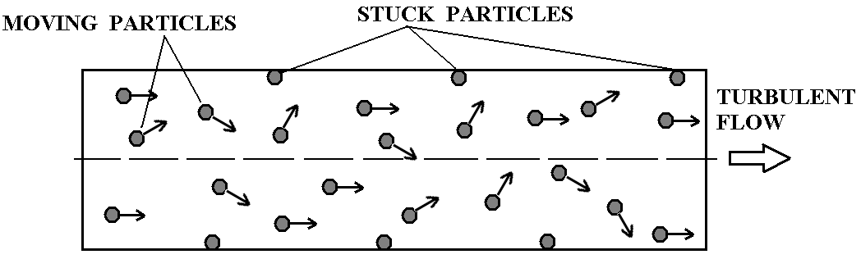
WP3: LES simulation of aerosol transport and deposition in turbulent flow in the channel. (Task5)
Objective: numerical simulation of aerosol particles turbo-phoresis in the channel.
Main advantages of LES (Large Eddy Simulation) method: LES is able to resolve realistic turbulent pulsations in contrast of classical RANS (Reynolds Average Navier-Stokes)
Mathematical model consists of two parts:
1) Hydrodynamic model for incompressible viscous fluid:
where
is the subgrid turbulent viscosity according to modified Smagorinsky model (Leveque at al., 2007).
2) Particle motion model:
where
N_{p} is the number of particles,
x_{k} is the radius-vector of the particle k,
v_{k} is the velocity vector of the particle k,
u_{k} is the fluid velocity at x_{k} .
τ_{p} is the particle relaxation time.
f_{k} is the normal-wall directed lift force
(assumed as f_{k} = 0 ).
54

Slide 55
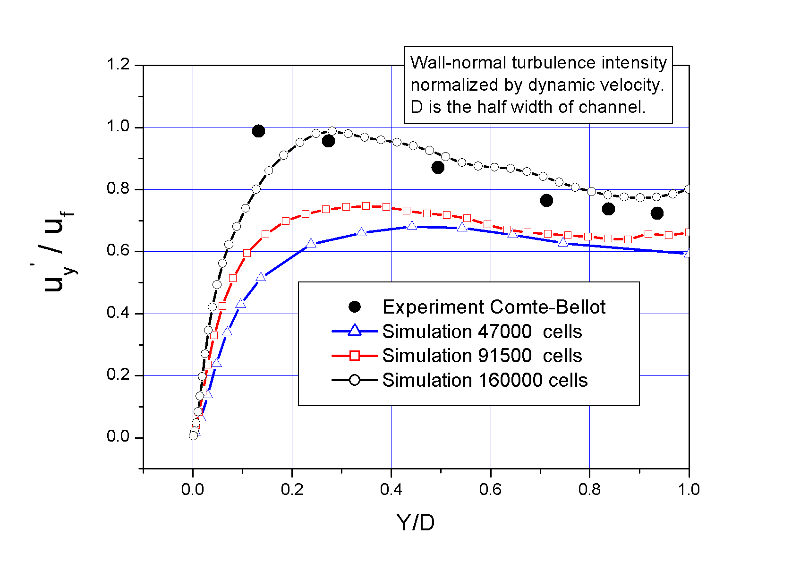
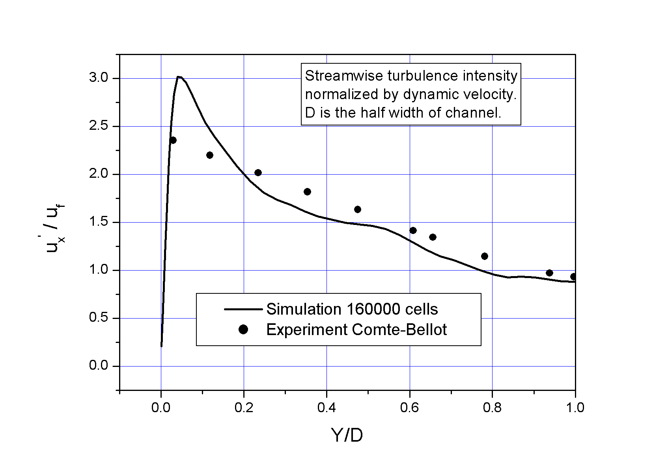
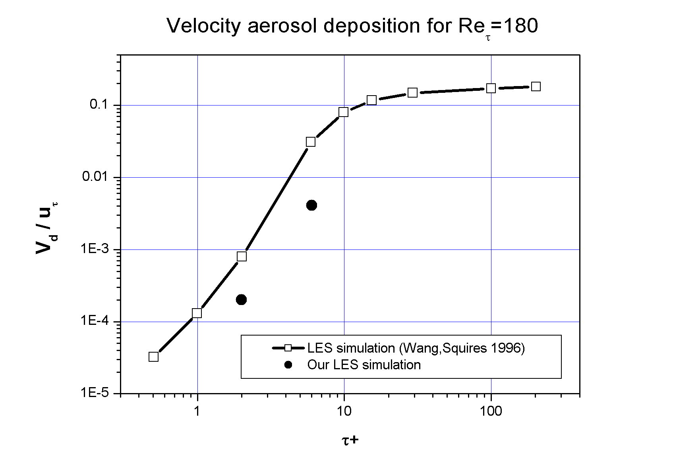
WP3: LES simulation of aerosol transport and deposition in turbulent flow in the channel. (Task5)
Validation tests
Turbulent flow in the channel with Re=120 000 (Re_{τ} =5400)(without particles).
Compare with experiment (Genevieve Comte-Bellot, Ecoulement turbulent entre
deux parois paralleles, Paris, 1965)
a)
b)
2. Turbulent flow in the channel with Re=3200 (Re_{τ}=180). (with particles)
Compare with other LES simulation (Wang,Squires, 1996)
55

Slide 56
WP3: LES simulation of aerosol transport and deposition in turbulent flow in the channel. (Task5)
Conclusions
Hydrodynamic model and code based on LES model for simulation of turbulent flows in rectangular channels has been developed.
Comparison of experimental and numerical results show satisfactory agreement and confirm code ability to calculate turbulent flows with particles in channels for rather high Reynolds numbers even on relatively coarse grid for LES (160 000 cells).
Due to small time step caused by strong grid stretching near the wall, total number of time iterations required for achievement of stationary level of turbulence may reach one million and such calculation may take time about a month on PC P4 3 GHz, especially for high Reynolds numbers. Therefore more powerful computers for multiple calculations are needed.
In the near future it is planned to modify model of particles and to take into account the lift force directed normally to the wall, and to make a number of calculations for the purpose of comparison with results of the experiments which are carried out within our project.
56

Slide 57
WP 4: Containment parameters impact on iodine species behavior
(Task 6: Experimental investigations)
Experimental investigations on Task 6 are aimed at assessing sump sludge content and impact of containment parameters on iodine volatility.
Table 1 - Matrix of tests on project EVAN, Task 6
57

Slide 58
WP 4: Containment parameters impact on iodine species behavior
(Task 6: Experimental investigations)
This slide presents the used analytical methods of iodine determination in water and gas phases.
Iodine Analytical Methods
Aqueous solution
Air atmosphere
Kinetic-photometric
method
(0,2-1 mkg/l)
Spectrometry
of ionic mobility
(≥1 mkg; iodine
forms
identification)
Absorption
and desorption
of volatile
iodine forms
by fibrous
carbon
materials
(≥0,5 mkg)
Ion-chromatography
(25 mkg/l – 5 mg/l)
Iodine-selective
electrode
(10⁻¹ – 10⁻⁷ mol/l)
58

Slide 59
WP 4: Containment parameters impact on iodine species behavior
(Task 6: Experimental investigations)
SCHEMATIC DIAGRAM OF THE APPARATUS FOR THE EXPERIMENTAL INVESTIGATION OF IODINE WATER/GAS PARTITIONING
1 - thermostat (20-150 ºС); 2 – autoclave (Teflon); 3 – gas phase; 4 – aqueous solution (I⁻); 5 – iodine source; 6 – iodine concentration and species analysis in the aqueous phase; 7 – pH, potential and pI measuring instrument; 8 –iodine species separation in gas samples: 8a – adsorbing filters (or sorbents); 8b – barbateur; 9 – water-jet pump; 10 - thermocouple; 11 – platinum electrode; 12 – compared electrode; 13 – glass electrode; 14 – iodide-selective electrode; 15 – iodine sensor; 16 – locked tap; 17 – line of solution sampling or vapour I₂ (gas) supply; 18 – heater; 19 – gas sample volume measuring
59

Slide 60
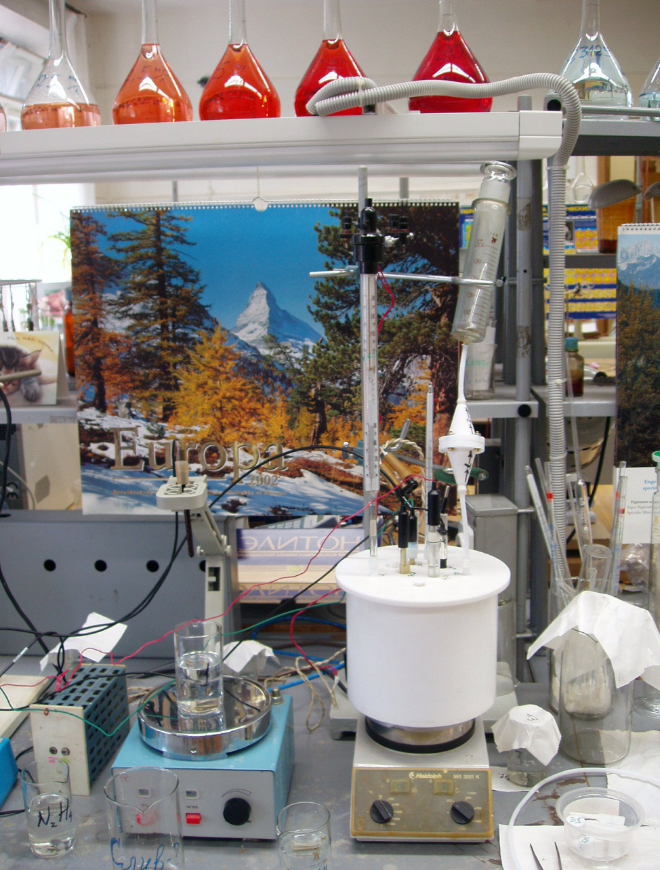
WP 4: Containment parameters impact on iodine species behavior
(Task 6: Experimental investigations)
View of autoclave for experimental investigations of iodine aqueous solution/air partitioning
60

Slide 61
WP 4: Containment parameters impact on iodine species behavior
(Task 6: Experimental investigations)
Table 2 - Aqueous solution parameters and volatile iodine forms content in gas phase
(10 g/l H₃BO₃)
These results were confirmed that the change of pH and temperature has slight influence on iodine volatility in absence of γ-radiation. Formation of iodine volatile compounds with yield up to 90% and high velocity of stainless steel corrosion are revealed at γ-irradiation at 150 ºC solution of CsI and H₃BO₃ (10 g/l). In the presence of FeOOH iodine volatility is reduced.
61

Slide 62
WP 4: Containment parameters impact on iodine species behavior
(Task 6: Experimental investigations)
Planning for the next half-year:
Further realization of experiments
according to matrix of tests: November 2007
Report: December 2007
62

Slide 63
WP 4: Containment parameters impact on iodine species behavior
(Task 7: Theoretical and numerical modeling)
Kinetic model has been developed for calculating the distribution of iodine forms among aqueous and gaseous phases
Model consist of:
Process | Equation toll | Species toll
Water radiolysis | 54 | 9
Iodine hydrolysis & radiolysis | 26 | 12
Radiolysis products and organic impurities | 18 | 8
Interaction of iodine forms on gaseous phase | 15 | 5
Mass exchange between aqueous and gaseous phases | 7 | 7
Sorption/desorption from/to surfaces | 10 | 6
63
Notes:
Fewfrefwsfefwsf

Slide 64
WP 4: Containment parameters impact on iodine species behavior
(Task 7: Theoretical and numerical modeling)
For adapting model to experiment two differential equations have been introduced:
Caq(t) - concentration of aqua's form (Сaq = [I−]aq), mol/dm³
Сsorb(t) - concentration of sorption's forms (Сsorb = [I−]s), mol/dm²
χ and α - constants are chosen from comparison of calculated and experimental
dependences.
64

Slide 65
WP 4: Containment parameters impact on iodine species behavior
(Task 7: Theoretical and numerical modeling)
Results of Calculated on Model
Test № | Total iodine concentrations at test ending ( 2 hour )
 | water phase, mg/l |  | gas phase, mkg
 | calculated | experiment | calculated | experiment
I 6-2-1 | 1,016 | 1,016 | 0,003 | 7,0
I 6-2-2* | 11,43 | 2,67 | 0,83 | 1200
I 6-2-3 | 7,40 | 7,60 | 1,16 | 21
* at carrying out of this experiment an outflow of vapor and condensate from an autoclave was occurred, therefore values reported, obviously, undere-stimate of iodine concentration in a water phase and overestimate it in a gas phase where iodine has arrived not owing to volatility, but has been released by the vapor and a condensate.
65

Slide 66
WP 4: Containment parameters impact on iodine species behavior
(Task 7: Theoretical and numerical modeling)
Conclusion
Iodine model has been adapted to experiment
Pre-test calculation and a part of post-test calculation have been performed
Created and adapted model is being improved for best agreement between calculation and experimental data
Planning for the next half-year:
Post-test calculation: November 2007
Report: December 2007
66

