Slide 1

ISTC project #3345:
Ex-Vessel Source Term ANalysis (EVAN)
Status and Workplan
Vladimir Bezlepkin (SPAEP)
10th Meeting of EU-ISTC Contact Expert Group on Severe Accident Management (CEG-SAM)
5-8 September 2006
Kurchatov, Kazakhstan
Notes:
Good morning/afternoon, ladies and gentelmen!
I will briefly present the current information on our EVAN project. The Project Agreement is signed now, and we expect to start experiments during this autumn

Slide 2
Project tasks
WP1/Task 1: Analysis of Severe Accident Scenarios (SPAEP, IBRAE)
WP2: Molten pool/core catcher FP release
  Task 2: Experimental investigations (NITI)
  Task 3: Theoretical and numerical modeling (IBRAE)
WP 3: Primary aerosol transport/deposition
  Task 4: Experimental investigations (NPO CKTI)
  Task 5: Theoretical and numerical modeling (SPAEP, IBRAE)
WP 4: Containment parameters impact on iodine species behaviour
  Task 6: Experimental investigations (VNIPIET)
  Task 7: Theoretical and numerical modeling (VNIPIET, SPAEP)
Notes:
Here are the work packages for the project and the tasks for the project. I will shortly describe each task, showing the present situation.

Slide 3
Task 1: Analysis of severe accident sequences modeling
Participants: SPAEP, IBRAE
Information for analysis:
  Data provided by foreign collaborators (Western LWRs, VVER-1000, Phebus (ISP-46), SARNET (PSA-2 and OPTSAM data)
  Data already available for Russian participants (VVER-640, VVER-1000)
Results:
  Justification of bounding parameter ranges for experiments (Tasks 2, 4, 6)
  Justification of applicability of experimental data for validation of models
Notes:
For this task we will make analysis of calculations of severe accident scenarios. These calculations were made for NPP designs with Russian and Western reactors.
Different computer codes were used for the calculations. The Russian codes were RATEG/SVECHA/HEFEST, CORCAT, DINCOR, KUPOL-M. The Western codes were SCDAP/RELAP, MELCOR and others.
For this Task 1 we will prepare a report with some more analysis and justification of initial data end boundary conditions for experiments. This report also will contain some justification of experimental data applicability to the codes validation.
It is important to notice that the test matrices for the other tasks were developed following the requests of our collaborators.

Slide 4
Task 2: Experiments on Fission Product Release from Molten Pool
Research team: NITI
Corium composition: UO₂–ZrO₂-Zr, U/Zr(at)=1.2 ( from C-32 to C-100)
Corium mass: 1-2 kg
Melt temperature: T_{liq}+(50-100)C
FP: Ru, Mo, Ce, La, Sr, Ba
Results: Data on low-volatile FP release from molten pool
Notes:
For this task the experiments are performed in NITI, by research team of Prof. Khabensky, Dr. Bechta, Prof. Gusarov, and others. The tests are performed at the set of “Rasplav” experimental installations, equipped with aerosol sampling system, for studying high-temperature phenomena in molten corium.
Also there is a complex of instruments and equipment for tests preparation, for conducting posttest analyses.
During the first year of the project it is planned to determine FP release during melt transition from sub-oxidized (C-30) to fully-oxidized (C-100) state. The low-volatile fission product release still is the source of high uncertainty in determining the source term.
The fission products to be studied are also shown at the slide.
Experimental investigations of low-volatile fission products release during water supply onto the melt surface are planned for the second stage of the project.

Slide 5
Task 3: Analytical support of FP release experiments
Participants: IBRAE (Dr.A.Kiselev’s team)
Pre-test calcs for experiments and follow-up analysis
Justification of the results for validation of models
Notes:
For this task, to do the calculations, we suppose to use codes RATEG/SVECHA and code RELOS, Germany, if it will be provided by collaborators. For additional analysis IBRAE experts can use the experimental data from LPP project from European Union Framework Programme.

Slide 6
Task 4: Experimental study of aerosols transport processes in the primary circuit equipment
Participants: NPO CKTI
1 tests series: Transport and deposition
  Re number from 10000 to 260000
  Vertical pipe with 98 mm diameter, height ~6 m (upwards flow), steel 10ХСНД
  Liquid aerosol up to 10 μm
2 tests series: Deposition and resuspension
  Re number from 50000 to 240000
  Vetrtical pipe from stainless steel having diameter ~36 mm, height ~6 m,
  Solid aerosol particles of NH₄Cl up to 10 μm
Notes:
Now about the next task.
The next task is devoted to experimental study of aerosols transport processes in the primary circuit. Main tests will be performed by NPO CKTI in St.Petersburg ( the team of Dr.Krektunov).
Support analytical tests on properties of generated aerosol particles will be at Polytechnical University in St.Petersburg.
Compared to the previous version of workplan, we introduced several changes:
- The Raynolds numbers were increased which will allow more reliably study the effect of turbulence on the deposition and resuspension of aerosols;
- In the second test series new tube diameter is used and another setup is used. We will use a single-pass system instead of closed-loop circuit. Also we added a device for preparation of the aerosol particles of the specified size;
Also we increased the maximal diameter of the aerosol in the first test series and improve the parameters and measurement techniques.

Slide 7
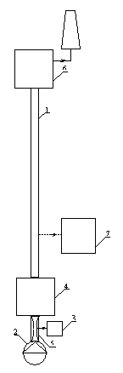
Scheme of experimental unit - Task 4
1 – Working section;
2 – Ventilator;
3 – Aerosol generator;
4 – Aerosol sizer;
5 – Mixing chamber;
6 – Aerosol neutralization system;
7 – Automated data gathering and processing system.
Notes:
This slide show the principal diagram of the experimental setup.

Slide 8
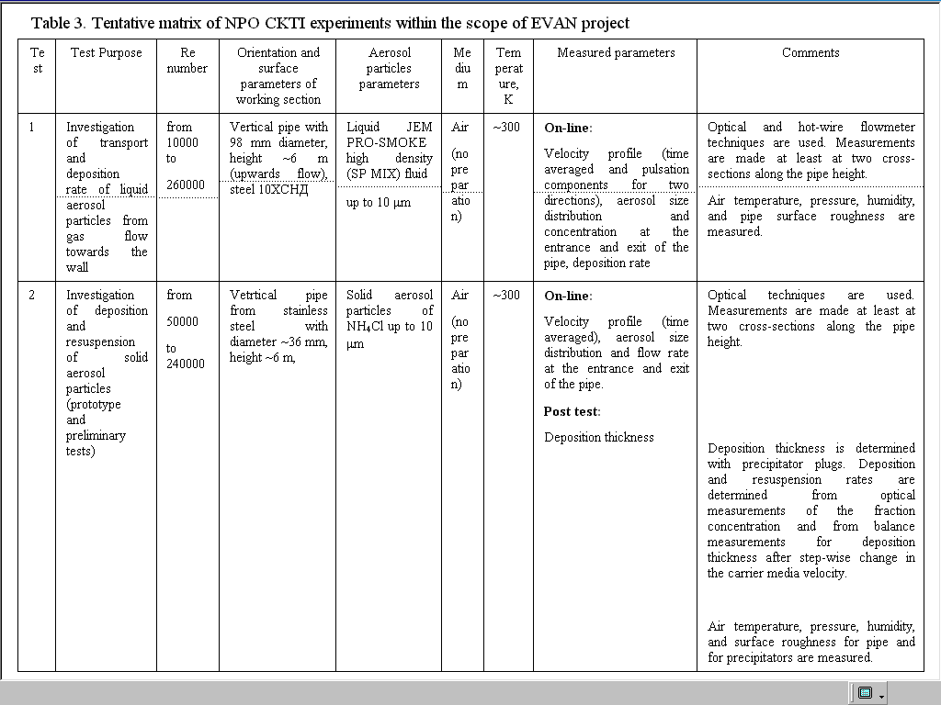
Notes:
The test matrix is given here.
For the first series of tests with liquid aerosol we will measure on-line:
- the velocity profile -- time averaged and pulsation components for two directions
- the aerosol size distribution
- the aerosol concentration at the entrance and at the exit of the pipe.
- the deposition rate
For the second series of the tests with solid aerosol we will measure on-line:
- the velocity profile (time averaged)
- the aerosol size distribution
- the aerosol flow rate at the entrance and exit of the pipe
Post test:
- the deposition thickness

Slide 9
Task 5: Modeling of aerosol transport in the reactor plant
SPAEP team
  Mechanistic aerosol kinetics models coupled to 2D and 3D CFD models (LES-based)
IBRAE severe accident research lab
  integral aerosol model PROFIT coupled to RATEG/SVECHA/GEFEST code
Deliverables: Report on modeling results for aerosol particles transport in the primary curcuit
Notes:
For this task the theoretical modeling will be performed in SPAEP and IBRAE.

Slide 10
Task 6: Experiments on Iodine Species Behaviour
Participants: VNIPIET
Experiments on containment sump solution with sludge presence
- Changing pH, T, irradiation, iodine concentration
- Sludge content was agreed with collaborators
- Well-controlled conditions, blank tests and single effect tests for direct comparison
- Two basic experimental techniques (single-autoclave and multi-ampoule) to be worked out
Notes:
For this task there were many discussions about the test matrix, and finally it was approved by all collaborators.
We dispose of two basic experimental techniques – single-autoclave end multi-ampoule.
The modelling is performed by VNIPIET and by SPAEP

Slide 11
Autoclave setup for experimental investigation of iodine partitioning between the water and gas phases
1 - thermostat; 2 – autoclave (PTFE); 3 – gas phase; 4 – water solution (I−); 5 – iodine source ; 6 – water-phase iodine concentration and species analyzer; 7 – meter for рН, pI and potential; 8 – iodine species separation in gas samples; 8а – sorbent filters; 8b – bubble condenser with solution; 9 – water jet pump; 10 - thermocouple; 11 – Pt electrode; 12 – comparison electrode; 13 – glass electrode; 14-iodine-selective electrode; 15 – iodine sensor; 16 – shut-off valve; 17 – solutions sampling line or I2 vapor supply line; 18 – heaters; 19 – measuring gas vessel
Notes:
Here is the diagram of the autoclave setup for experimental investigation of iodine partitioning between the water and gas phases

Slide 12
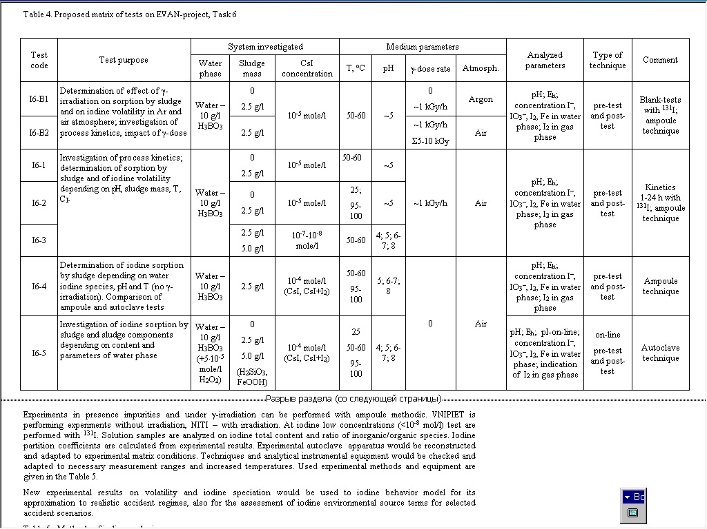
Notes:
The objective of the experiments is investigation of effect of the ferro-silicate sludge on the iodine volatility depending on different parameters and composition of the containment sump.
During the experiments we will determine:
- The effect of gamma-irradiation on the iodine sorption by the ferro-silicate sludge and on the iodine volatility
- Effect of other parameters ( рН, sorbent mass, temperature and concentration composition of sumpwater)

Slide 13
Task 7: Analytical Support of Experiments
Participants: VNIPIET, SPAEP
  Containment iodine behaviour model developed by VNIPIET/SPAEP
  Applicable calculation techniques, published data, iodine databases.
Pre-test calcs for experiments and follow-up analysis
Justification of applicability of the obtained results for validation of models
Notes:
The modelling is performed by VNIPIET and by SPAEP

Slide 14
EVAN Project Status & Schedule
Phase 1 (1 year) Mounting/installation, pilot expertiments and analysis
  Now the Project Agreement is being signed by ISTC and SPAEP.
  The date for the 1 st year progress meeting will be defined later.
Phase 2 (2 years) More detailed testing & analysis selected on the evaluation of Phase 1 results
  Proposal preparation will start on 4th quarter of Phase 1
Notes:
The Project Agreement has been prepared ISTC and expected to start with experiments We hope that our project will be successful. We would like to thank all our collaborators, all our Western partners, and of course, our hosts from Kazakhstan, thank you very much.

Slide 15
Thanks
To CEG-SAM members and chairs
To collaborators
To Russian colleagues
To NNC host

