Slide 1

Status of the ISTC project #3345 “Ex-vessel source term analysis” (EVAN)”
Vladimir Bezlepkin (SPAEP)
13th Meeting of Contact Expert Group on Severe Accident Management (CEG-SAM)
March 5-7, 2008
Budapest

Slide 2
Foreign Collaborators/Partners
Dr. Ari Auvinen VTT Finland
Dr. Hans-Josef Allelein GRS Germany
Dr. Paul David Bottomley JRC-ITU Germany
Dr. Salih Guenty PSI Switzerland
Dr. Bernard Clement IRSN France
Dr. Herve Chalaye CEA-DEN France
Dr. Luis Herranz CIEMAT Spain
2

Slide 3
Project work packages
WP1: Analysis of Severe Accident Scenarios (SPAEP, IBRAE)
WP2: FP release from molten corium pool
  Task 2: Experimental investigations (NITI)
  Task 3: Theoretical and numerical modeling (IBRAE)
WP 3: Primary aerosol transport/deposition
  Task 4: Experimental investigations (NPO CKTI)
  Task 5: Theoretical and numerical modeling (SPAEP, IBRAE)
WP 4: Containment parameters impact on iodine species behaviour
  Task 6: Experimental investigations (VNIPIET)
  Task 7: Theoretical and numerical modeling (VNIPIET, SPAEP)
3

Slide 4
Aims:
- identification of the main factors affecting the accidental releases
- estimate of uncertainties for project calculations
- definition of experimental parameters for Task 2, 4, 6
WP1: Analysis of Severe Accident Scenarios (Task1)
The approaches for calculatios of radiological consequence of severe accidents for NPP with LWR were analyzed
The following objectives were considered:
the fission product (FP) build up in the fuel, FP release from the fuel and from the molten pool
conditions of radioactive release and aerosol transport from reactor unit during severe accident in the primary circuit
Iodine behavior in the containment
aerosol particles kinetics and its behavior during severe accidents in the containment
4

Slide 5
Main uncertainties affecting the calculation magnitude of accidental releases:
WP1: Analysis of Severe Accident Scenarios (Task1)
FP release from molten poll for the elements referred to Ru group (Ru, Mo, Tc) both in-vessel and ex-vessel stages
aerosol deposition and resuspension in reactor equipments at primary-to-secondary leaks accidents
iodine sorption at polymer facing, steel corrosion products and the core catcher materials
correct calculating simulation of aerosol transport at containment and inter-containment space
5

Slide 6
WP1: Analysis of Severe Accident Scenarios (Task1)
The analysis of severe accidents for an definition conditions of aerosols release in the primary circuit
For the purpose of definition of aerosols release conditions an analysis of severe LOCA accident and SGTR with by-pass of containment has been made using code SOCRAT
Estimations of temperature and velocity fields over melt surface in the reactor have been made with 3D codes
Quantities of termo-hydraulic parameters (velocity, partial pressure, temperatures, Reynolds's numbers and characteristics of the melt top layer) in the reactor are defined
The results of aerosols behavior in broken SG tubes during SGTR
(SOKRAT calculations)
 | Unit | Value
Input dates
length of tube | m | 11,07
Diameter | m | 0,013
Time interval | s | 3300
Density of FP | kg/m³ | 4000
Results of calculations
Mass of FP (sedimentation in 1 tube) | kg | ~ 1,96
Time before tubes blockade | s | 1300
Results of the analysis have been used results were used for experimental setup intended for investigation of aerosol deposition.
6

Slide 7
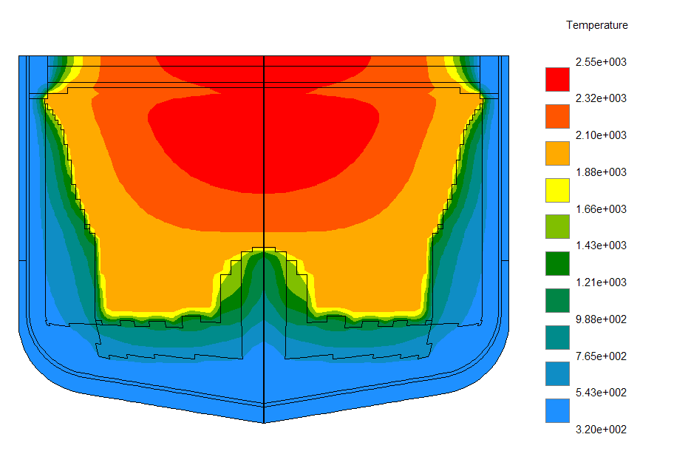
The analysis of aerosols release condition in the bath of melting corium
WP1: Analysis of Severe Accident Scenarios (Task1)
Accident – large break (Dnom 346) in case of
rupture of PRZR surge line accompanied by a complete blackout
Temperature and mass share of molten-pool materials in the core catcher.
Temperature and mass share of molten-pool materials in reactor vessel
Time, s | Temperature of corium, К | UO₂, Mass share % | ZrO₂ Mass share % | Zr Mass share % | Steel Mass share %
9 000 | 3 005 | 71,1 | 10,7 | 5,1 | 13,0
10 000 | 2920 | 56,1 | 8,4 | 40 | 31,5
11 000 | 2620 | 48,6 | 7,3 | 3,5 | 40,0
Temperature distribution in a core catcher (calculations by means of code HEFEST-CATCHER)
For experimental investigation of fission products release the parameters relevant for molten pool in the reactor vessel are chosen.
7

Slide 8
The boundary conditions for “Iodine” experiments research
WP1: Analysis of Severe Accident Scenarios (Task1)
NPP-91 project: “Iodine” problem solved by controlling pH level in the containment at all stage of accident (by discharging KOH/NaOH solution) -- рН > 7
Design assumption for iodine release inside containment under conditions of pH control in the containment above the value
(EUR recommendation):
CsI (aerosol form) – 95%
I2 (molecular form) – 4,85%
IR (organic form) – 0,15%
Conditions in the containment after accident with aerosol release
(CUPOL calculations and design assumptions)
Parameter | Value
Temperature of medium | Up to 120-160 degr. С
Gamma-radiation dose rate during 24 hours after beginning accident (integral dose) in air in water | 1-70 кGr/h (360 кGr/day) 2-25 кGr/h (170 кGr/day, up to 500 кGr/30 days)
Н₃ВО₃ concentration in water | 15-16 g/l
рН in water | 4-8
8

Slide 9
WP2: FP release from molten corium pool (Task2)
Determination of release rates of FP and corium components at different melt surface temperatures and corium oxidation indexes C_{n}
FP simulants: Ba, Sr, Ce, La, Mo, Ru
Corium components: U, Zr
С_{n}=100(M_{Zr,Σ}-M_{Zr,met})/ M_{Zr,Σ}, %
M_{Zr,Σ} – integral mass of Zr in oxidized and free form;
M_{Zr,met} – mass of Zr-free
9

Slide 10
Test matrix of Task 2
WP2: FP release from molten corium pool (Task2)
Pr1-EV1: pretest carried out for facility functional check and determination of melt
oxidation rate
Pr2-EV1: pretest carried out for preparation of the crucible charge of high density
(m=1390 g, grading 200-300 µm)
EVAN-1FP: main test
BaO and SrO were added in the form of their zirconates
10

Slide 11
Conclusion remarks for the Task 2 (1)
WP2: FP release from molten corium pool (Task2)
The following qualitative effects have been detected:
Decrease of the evaporation rate of melt components and fission
products, excluding molybdenum, after the increase of the corium
oxidation index. Therefore, melt oxidation in the catcher has in general
a positive influence on the radiation situation in the containment
Strong adhesion of the chemically prototypic corium aerosols, especially
to cold metallic surfaces. This also reduces the release of aerosols into
atmosphere of the containment.
Kinetics of melt oxidation is controlled by the supply of oxidizer to the pool
surface, i.e., depends on characteristics of the steam-gas mixture natural
convection in the reactor at the in-vessel stage of a severe accident, or in
the reactor shaft at the ex-vessel stage
11

Slide 12
Conclusion remarks for the Task 2 (2)
WP2: FP release from molten corium pool (Task2)
Qualitative effects (2):
The submicron particles fraction in the release is noticeable. Their inertia
and gravitational deposition are weak. This fraction keeps increasing
during the melt surface oxidation. Characteristics of the aerosol release
during melt oxidation at its interaction with sacrificial material have not
been determined yet
There exists evidence that ruthenium and a part of molybdenum, which
concentrate in the metallic melt, stratify in molten corium C 100. Under
conditions of the test, no release of gaseous RuO₄ was recorded after
free zirconium in the melt has oxidized completely
12

Slide 13
Conclusion remarks for the Task 2 (3)
WP2: FP release from molten corium pool (Task2)
The obtained quantitative results can be used for the development and verification of models and codes which describe the release of FP during a severe accident.
These results include:
Correlations of the element release rates with the melt temperature and
oxidation index
Aerosols chemical and phase composition
Dispersion and masses of aerosols collected along the facility duct at
different distances from the release source
For verification use of the data, the report offers the facility’s design and geometry, in particular, of its gas-aerosol duct, as well as characteristics of the gas-aerosol mixture flow
13

Slide 14
WP2: FP release from molten pool modeling (Task 3)
Objective of work
- Modeling of fission product release from the molten corium at the reactor vessel bottom
Status of the work
- Two approaches: molecular and atomic
- Both models predict release rate of FPs: Mo, Ru, Ba, Sr, Ce, La
- Model predictions are compared with EV-1 experimental results
14
Notes:
The objective of this work is theoretical analysis of fission product release from molten corium pool at the reactor vessel bottom. At present moment two models are developed. One of them is based on atomic approach and the other supposes the existence of molecules. Both models can predict the release rate of all FP simulants used in EV-1 experiment. The results of the models are compared with the results of this experiment.

Slide 15
WP2: FP release from molten pool modeling (Task 3)
Model assumptions
- Consider only evaporation in vessel
- No gas bubbles in molten corium
- Evaporation from open surface of melt
Atomic model
- Melt is atomic regular mixture
- Evaporation rate is described by Langmuir model
Molecular model
- Melt is regular molecular mixture
- Atmosphere is ideal molecular gas
- FP vapor over molten pool blown off at finite rate
- FPs in melt: non-ideality of interaction
- FPs in gas: finite rate of diffusion
- Melt under oxygen-containing atmosphere: oxidization
15
Notes:
Both models describe only evaporation from molten corium pool at the bottom of the reactor vessel. In this case FPs are expected to evaporate from an open surface of the melt without creation of any bubbles.
Atomic model supposes that the melt is a regular atomic mixture. Evaporation of FPs is described by Langmuir model.
Molecular model considers the melt as a regular molecular mixture and atmosphere over it as an ideal molecular gas. FP release rate is determined by the composition of the gas over the melt and the rate of its blowing off by an air flux. The model of the melt now contains a simplified description of non-ideal interaction of FPs with the melt and finite rate of their diffusion in the gas phase. There is also a preliminary model which describes oxidization of the melt under oxygen-containing atmosphere. It is of great importance for the solution of the main task.

Slide 16
WP2: FP release from molten pool modeling (Task 3)
Results: Molecular model
Total aerosol release rate: good agreement
16
Notes:
Here are some results of the molecular model. The conditions were chosen as in the EV-1 experiment. The left graph shows time dependence of the release rate of some FPs in the experiment. The right graph shows the same dependence, predicted by the model. The agreement is satisfactory. Total aerosol release is in good agreement with the experiment.

Slide 17
WP2: FP release from molten pool modeling (Task 3)
Conclusion remarks for task 3
The atomic model FPs are developed. Non-ideal parameters for FP-melt interaction are obtained. It can describe the release of FPs.
Molecular model gives a simplified description of the oxidization of the melt under oxygen-containing atmosphere. Consideration of the finite diffusion rate of FPs in the gas makes the model sensible to some geometrical properties of the system. For example, the more the surface of the melt, the higher the rate of FP release.
The total aerosol release predicted by the model is in a good agreement with the results of EV-1 experiment. Introduction of non-ideal interaction of FPs with the melt allows to describe the release rate of each FP in a satisfactory way. The molecular model is realized as a stand-alone code. However, its implementation for the case of real severe accident requires its further development.
17
Notes:
Here are the conclusions. Two models of FP release from the melt are developed.
In the atomic model FPs are introduced. Non-ideal parameters for FP-melt interaction are obtained. Now it can describe the release of FPs and CMs.
Molecular model gives a simplified description of the oxidization of the melt under oxygen-containing atmosphere. Taking into account finite diffusion rate of FPs in the gas makes the model sensible to some geometrical properties of the system. For example, the more the surface of the melt, the higher the rate of FP release.
The total aerosol release predicted by the model is in a good agreement with the results of EV-1 experiment. Introduction of non-ideal interaction of FPs with the melt allows to describe the release rate of each FP in a satisfactory way. Molecular model is realized as a stand-alone code. However, its implementation for the case of real heavy accident requires its further development.

Slide 18
WP3: EXPERIMENTAL STUDY OF AEROSOLS TRANSPORT PROCESS IN THE PRIMARY CIRCUIT EQUIPMENT (Task4)
Matrix of experiments for phase №1 and phase №2
Test | Velocity for deposition phase, m/s | Velocity for resuspension phase, m/s | Particle size d, mkm | Temperature, K | Test Purpose | Aerosol particles parameters | Orientation and surface parameters of working section
EVAN–№3345 AT 1.1 | 33,8 | None | 0.2 – 5 | 300 | Investigation of transport and deposition rate of liquid aerosol particles from gas flow towards the wall | Liquid JEM PRO-SMOKE high density (SP MIX) | Vertical pipe with 98 mm diameter, height ~6 m (upwards flow), steel 10ХСНД
EVAN–№3345 AT 1.2.1 | 39,6 | None | 0.2 – 28 | 300
EVAN–№3345 AT 1.2.2 | 33,8
EVAN–№3345 AT 1.2.3 | 24,8
EVAN–№3345 AT 1.2.4 | 6,5
EVAN–№3345 AT 2.1 | 20 | 65 | 0.3 – 10 | 320 | Investigation of deposition and resuspension of solid aerosol particles (prototype and preliminary tests) | Solid aerosol particles of NH4Cl | Vetrtical pipe from stainless steel with diameter ~50mm, height ~5 m,
 |  | 105
EVAN–№3345 AT 2.2 | 30 | 75
 |  | 105
EVAN–№3345 AT 2.3 | 38 | 75
 |  | 105
18

Slide 19
WP3: EXPERIMENTAL STUDY OF AEROSOLS TRANSPORT PROCESS IN THE PRIMARY CIRCUIT EQUIPMENT (Task4)
The experimental results for phase 1
Test | Um | Particle size | С₁ | С₂ | C₁-C₂ | M | F
 | m/s | mkm | g/m³ | g/m³ | g/m³ | g/s | g/(m²s)
EVAN–№3345 AT 1.1 | 33,8 | 0,52 | 4,80 | 4,10 | 0,700 | 0,185 | 0,182
EVAN–№3345 AT 1.2.2 | 33,8 | 5,5 | 1,50 | 0,750 | 0,750 | 0,198 | 0,195
EVAN–№3345 AT 1.2.1 | 39,6 | 5,5 | 0,730 | 0,250 | 0,480 | 0,143 | 0,141
EVAN–№3345 AT 1.2.3 | 24,8 | 5,5 | 1,10 | 0,500 | 0,600 | 0,112 | 0,110
EVAN–№3345 AT 1.2.4 | 6,5 | 5,5 | 4,50 | 2,40 | 2,10 | 0,103 | 0,101
Particle spectrum for AT 1.2
Particle spectrum for AT 2.1
]
-
1.0
[
эксперимент
experiment
“
“
а
а
”
эксперимент
”
experiment
“
“
б
b
”
0.8
”
аппроксимация.
approximation
0.6
Relative frequency
0.4
0.2
0.0
0.0
0.5
1.0
1.5
2.0
2.5
3.0
3.5
diameter
[
mkm
]
19

Slide 20
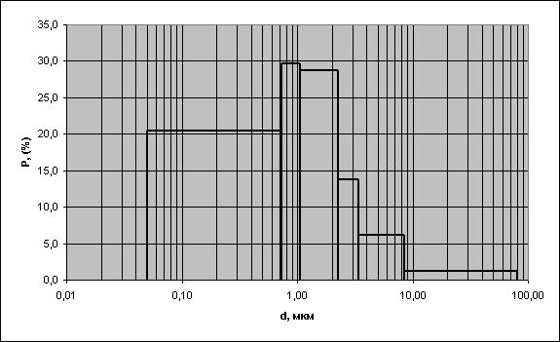
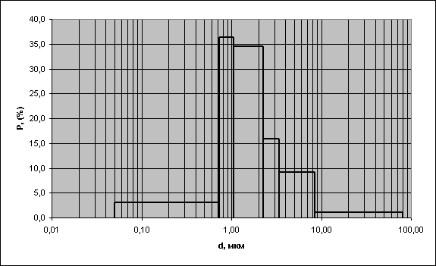
WP3: EXPERIMENTAL STUDY OF AEROSOLS TRANSPORT PROCESS IN THE PRIMARY CIRCUIT EQUIPMENT (Task4)
The experimental results for phase 2
Particle spectrum for AT 2.2.1
Particle spectrum for AT 2.1
20

Slide 21
WP3: EXPERIMENTAL STUDY OF AEROSOLS TRANSPORT PROCESS IN THE PRIMARY CIRCUIT EQUIPMENT (Task4)
Conclusion remarks for task 4
Deposition velocities of liquid aerosol in a range 0,3... 28 microns in the cylindrical vertical channel by Reynolds numbers from 10000 to 240000 have been determined.
Parameters of carrier gas flow (average velocity, velocity fluctuations and fluctuation frequencies) in the cylindrical vertical channel in diameter of 98 mm have been measured.
Particle size spectra and particle concentrations along the channel (В=98 мм) are obtained.
A novel experimental setup for investigation of solid aerosol deposition and resuspension has been constructed.
The design of the ammonium chloride aerosol generator based on use of reversible chemical reaction (dissociation - recombination) has been developed.
Deposition intensities of ammonium chloride aerosol in size of 0,3 to 10 microns in the vertical channel in diameter of 50 mm have been obtained under air velocity from 20 to 38 m/s. It has been found out that deposition intensities depend on two simultaneous processes – deposition and resuspension.
21

Slide 22
Modelling of Aerosol Deposition in a Nuclear Reactor during a Severe Accident (Task5)
Objective
Develop analytical models and approximations for predicting the deposition of aerosol-shaped fission products.
Achievement
On the basis of comparisons with experimental data and
numerical simulations, it can be concluded that the models
presented correctly reproduce the main tendencies of the
effect of diffusion−migration and convection−force
mechanisms on the aerosol deposition rate in channel
turbulent flows.
The models for predicting the deposition rate of aerosol
particles are implemented in the PROFIT code
22

Slide 23
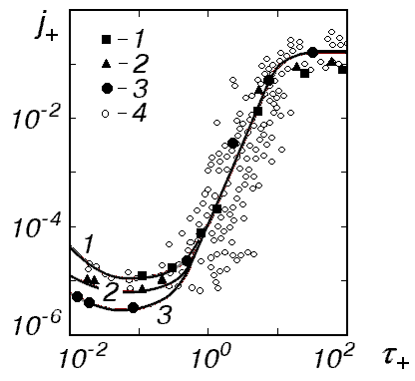
Modelling of Aerosol Deposition in a Nuclear Reactor during a Severe Accident (Task5)
Analytical approximation for the deposition rate due to Diffusion and Turbulent Migration (Turbophoresis)
The deposition coefficient against the dimensionless
particle response time in channel flows
1 − Re=1.5·105, B=5·105; 2 − Re=6·10⁴, B=1.2·10⁶; 3 − Re=1.5·104, B=4.2·106;
4 − experimental data by McCoy & Hanratty (1977)
23

Slide 24
WP3: Theoretical and numerical modeling (Task 5)
The model for particle resuspension process in the turbulent dusty flow was developed;
The model is based on the Rock ‘n’ roll description of the particle removing from the rough surface that assumes not the direct effect of the removal force, but effect of the couples, that course rocking of the particle about the contact zone of a single asperity;
The model allows to describe the evolution of multilayer wall coverage by polydisperse particle mixture for simultaneous deposition/resuspension processes;
The code for deposition/resuspension process simulation was designed;
Simulations for the experimental setup were perfomed.
The condition of the particle remove from the surface consists in that the removal force F_{t}(t) at point Q exceeds the adhesive one f_{aQ}.
Fluctuation of the turbulent flow causes the fluctuation of both lift F_{L} and drag F_{D} forces.
24

Slide 25
WP3: Theoretical and numerical modeling (Task 5)
Experimental Setup Simulation
Comparison of the simulation results and experimental data for the surface mass density of the deposited particles after deposition process
25

Slide 26
WP3: Theoretical and numerical modeling (Task 5)
Conclusion remarks
Comparison of the simulation results for dusty turbulent flow with the obtained experimental data shows that at the whole range of studied flow velocities (20 – 110 m/s) the resuspension and deposition process are of the same value of importance.
Good agreement of the simulation results with experimental data is achieved. This allows to conclude that the model proposed describes adequately the resuspension/deposition processes in the turbulent dusty flows and can be recommended for further investigations.
26

Slide 27
LES simulation of aerosol transport and deposition in turbulent flow in the channel. (Task5)
Objective
Numerical simulation of aerosol particles deposition in the channel based on Large Eddy Simulation
Achievement
Hydrodynamic model and code based on Navier-Stokes and particle equations within LES framework for simulation of turbulent flows in rectangular channels has been developed.
Comparison of experimental and numerical results show satisfactory agreement and confirm code ability to predict particle velocity deposition on the channel walls.
27

Slide 28
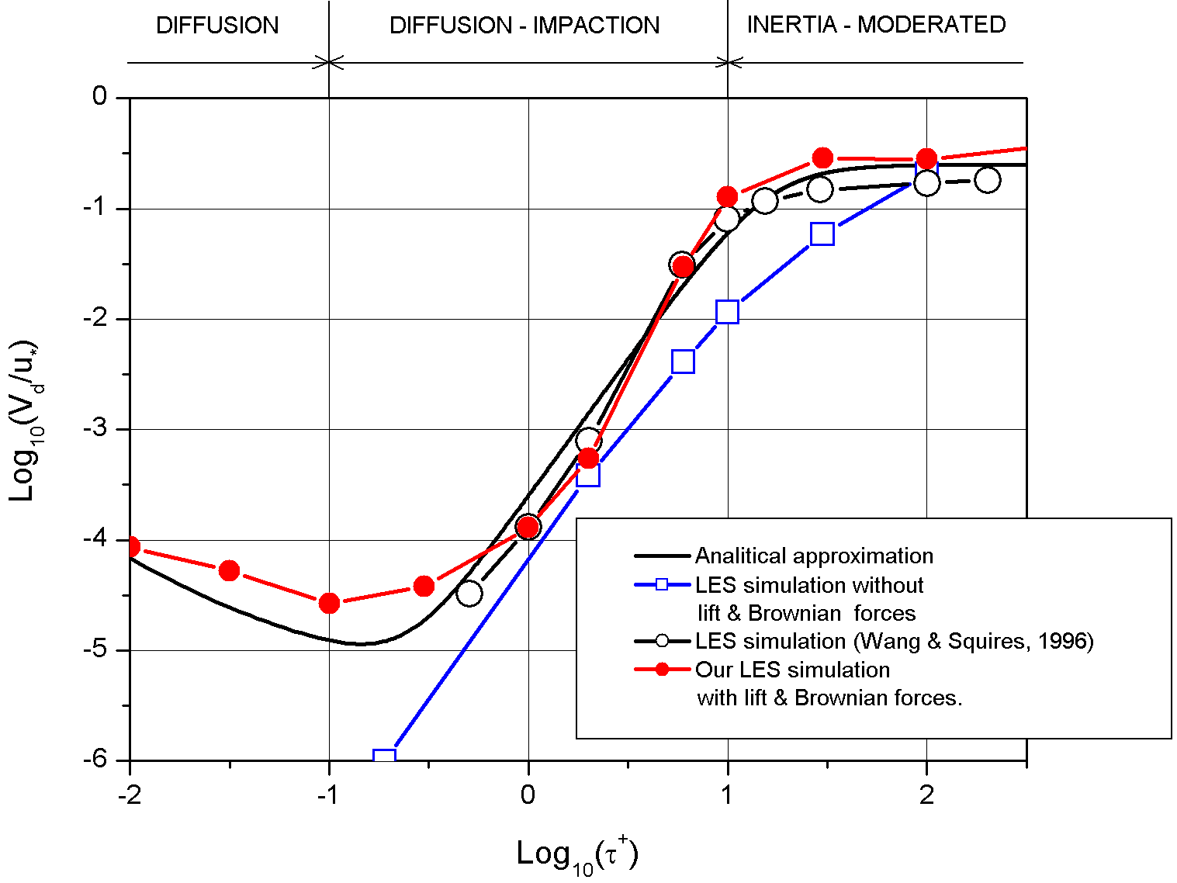
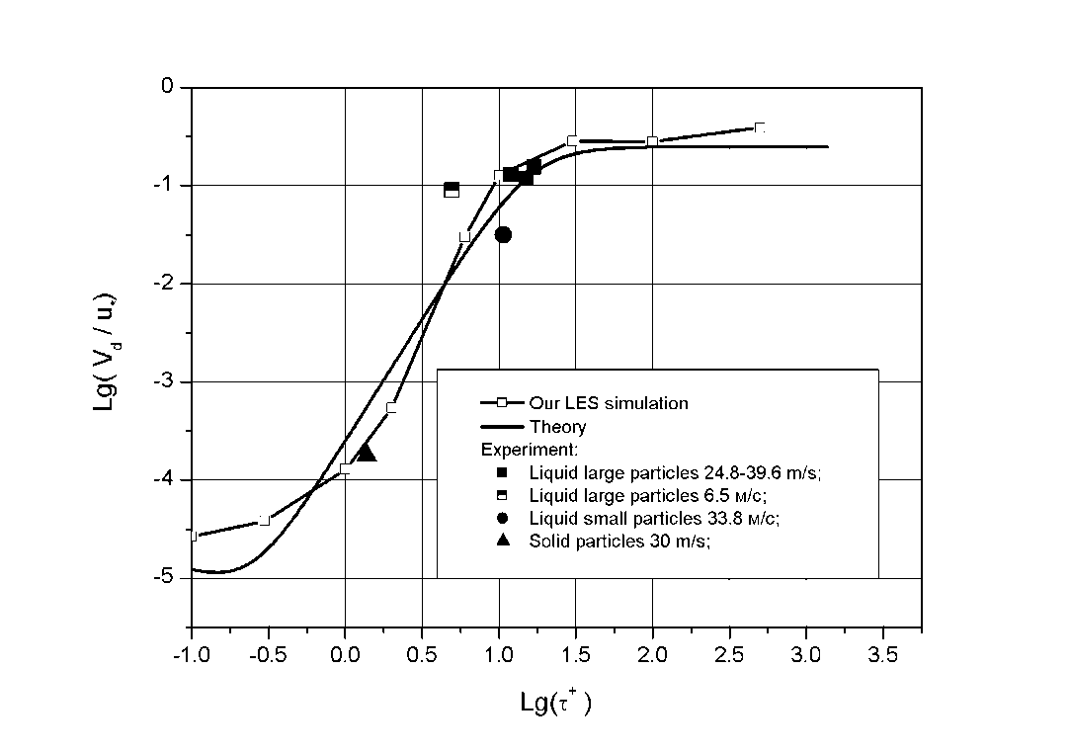
LES simulation of aerosol transport and deposition in turbulent flow in the channel. (Task5)
Velocity deposition versus response time
Comparison with other LES simulation and analytical approximation
Comparison with EVAN
experiments
28

Slide 29
LES simulation of aerosol transport and deposition in turbulent flow in the channel. (Task5)
Conclusions for the LES modelling
Hydrodynamic model and code based on LES model for simulation of turbulent flows in rectangular channels has been developed.
Comparison of experimental and numerical results show satisfactory agreement and confirm code ability to calculate turbulent flows with particles in channels.
16

Slide 30
WP 4: Containment parameters impact on iodine species behavior
(Task 6: Experimental investigations)
Aim
Determination of ferric hydroxides sludge's impact on iodine volatility at containment parameters (T, pH, iodide concentration, integral dose of γ-irradiation).
Conditions of the experiments
Sludge simulant – synthetic FeOOH.
Kinetics of iodine interaction with FeOOH at thermal oxidation (2-24 h).
T = 30, 60, 90-95, 120, 150 ºC
pH = 4, 5, 6-7, 8
[I⁻]_{aq} = 10⁻⁵-10⁻³ mol/dm³
Integral dose rate – 2-14 kGy (D ~ 1 kGy/h).
30

Slide 31
WP 4: Containment parameters impact on iodine species behavior
(Task 6: Experimental investigations)
The following qualitative effects have been estimated:
1. At thermal iodide oxidation in the presence of FeOOH the iodine volatility ([I⁻]_{aq}=10⁻⁴ M; pH 5) dependes on temperature:
At 30 ºC – effect is absent;
at 60 ºC – effect is unstable; it is observed as volatility increasing, so and volatility reducing;
at 90 ºC – iodine volatility increases.
2. It was supposed that at the interaction of iodide with FeOOH two processes proceede:
- iodide reversible adsorption on FeOOH;
- iodide oxidation by FeOOH or Fe³⁺-ions.
31

Slide 32
WP 4: Containment parameters impact on iodine species behavior
(Task 6: Experimental investigations)
3. Under irradiation the adsorption process prevails. In the presence of FeOOH iodine release in gas phase reduces on 10% at 60 ºC and in 2-10 times at 90-120 ºC.
4. It is shown that the noticeable iodide thermal oxidation and increased iodine volatility are stipulated by anionic impurities in water, especially by chlorides.
32

Slide 33
WP 4: Containment parameters impact on iodine species behavior
(Task 6: Experimental investigations)
The obtained quantitative results may be used for the verification and correction of models and codes which describe iodine behavior in containment under severe accident.
These results includes:
Correlation of the iodine release magnitudes in gas phase with temperature, pH and iodide concentration at the thermal iodide oxidation.
Values of stationary iodine concentration in gas phase in hermetic volume as temperature function.
Extent of FeOOH sludge's impact on the iodine volatility at the thermal and radiolytical iodide oxidation as the function from temperature and pH of water phase.
33

Slide 34
WP 4: Containment parameters impact on iodine species behavior
(Task 7: Theoretical and numerical modeling)
For the solve of this task it was used the following data and models:
water radiolysis model
iodine hydrolysis model
model of iodine forms reaction with water radiolysis
products and impurities
model of the additives and the impurities reaction
with water radiolysis products
model of the reaction in gas phase
published data on iodine forms adsorption by iron
hydroxide
new experiments results, obtained at the fulfillment of
Task 6 Project #3345
34

Slide 35
WP 4: Containment parameters impact on iodine species behavior (Task)
Obtained qualitative results are following
Without an irradiation:
at identical initial conditions (temperature, initial concentration of iodide-ion in water) calculation shows iodine PC growth with рН increase. At рН in a range 4-6 this tendency is expressed poorly, but it becomes more obvious at рН>6, in experiments such dependence is traced feebly;
injection in an initial solution of iron-hydroxide sludge (at the identical temperature and pH) can cause both insignificant increase of iodine PC, and its appreciable falling - if to compare data of experiments. Calculation predicts PC falling in both cases. Probably, that at pH=6-7 and temperature 60ºC heterogeneous oxidation of iodide-ion by trivalent iron proceeds.
Under irradiation:
the iodine PC at identical рН, temperature and the moment of sampling falls on the order of value concerning experiments without irradiation;
change of PC with pH is traced weakly;
with injection of iron-hydroxide sludge in an initial solution at identical temperature ≤60 ºC and рН=5 increase of iodine PC is not traced distinctly; apparently, sludge influence at the given conditions (dose rate, duration) is insignificant. At 95 ºC and 120ºC and sludge presence PC grows in 2-10 times.
35

Slide 36
Conclusion remarks for task 7
WP 4: Containment parameters impact on iodine species behavior
(Task 7: Theoretical and numerical modeling)
The module and the calculation program for severe accident code modeling iodine forms behaviour in containment of WWER reactors at a chemical stage of accident with destruction of core are created.
Verification of the created calculation code is carried out with use of autoclave experiments results on influence of temperature, рН and gamma irradiations on formation of volatile iodine forms in a water solution of iodide-ion and on their output to the gas environment, including at presence iron hydroxide sludge in water phase.
Experimental and calculation values of iodine partition coefficient in the investigated pH range, initial iodide-ion concentrations and temperatures in view of the reached accuracy of measurements agree within the limits of the order of value.
36

Slide 37
Final conclusion of the ISTC project #3345 “Ex-vessel source term analysis” (EVAN)”
The program of experimental studies has been completed
Experiments have been analyzed and post test calculations have been performed
Mathematical models have been verified and brought up to date
Part of the uncertainties in the evaluation of containment release and environmental release during a severe accident at NPP have been preliminarily eliminated
37

