Slide 1
Progress Report on the ISTC project #3592
“Investigation of Corium Melt Interaction with NPP Reactor Vessel Steel”
(METCOR-P)
A.P. Alexandrov Research Institute of Technology (Russia)
Presented by S. Bechta
17th CEG-SAM meeting
Madrid, Spain
March 29-31, 2010

Slide 2
Contents
Essential information
Objectives of METCOR-P project
Experimental matrix for METCOR-P project
Interaction of molten corium with European vessel steel in oxidizing atmosphere:
Test MCP- 4
Response to M. Veshchunov comments on the METCOR model of steel corrosion caused by the interaction with oxidized corium
Interaction of suboxidized molten corium with European vessel steel:
Test MCP-5
Comments on the M. Veshchunov model of steel corrosion caused by the interaction with suboxidized corium
Planning
Publications

Slide 3
METCOR-P project general information
Investigation of Corium Melt Interaction with NPP
Reactor Vessel Steel (#3592 METCOR-P)
Project participants and coordination
Collaborators
FZK, Germany
FORTUM, Finland
JRC ITU,
EU
CEA,
France
AREVA NP,
Germany
Coordinator
ISTC, Moscow
Steering committee
Operation Agent: A.P. Alexandrov RIT, Russia
SPb Technological University, Russia
SPb Electrotechnical State University, Russia

Slide 4
Objectives of METCOR-P project
Qualification and quantification of physicochemical phenomena of corium melt interaction with reactor vessel steel with particular interest to:
Interaction characteristics at the vertically positioned interface
Peculiarities of interaction with European vessel steel
Corium melt oxidation transients

Slide 5
Experimental matrix for METCOR-P project
*) In accordance with the 1st project meeting decision it is replaced by MCP-2 test with UO_{2+x}– ZrO₂
corium in air and horizontal position of interface
**) In accordance with a decision taken at the 3rd project meeting, the test was performed in air (instead
of steam) and regimes with UO_{2+x} - ZrO₂ - FeO_{y} melt were added

Slide 6
Interaction of molten corium with
European vessel steel in oxidizing atmosphere (air)
TEST MCP-4
Objectives
Comparison of corrosion rates for the European and Russian vessel steels in the oxidizing atmosphere

Slide 7
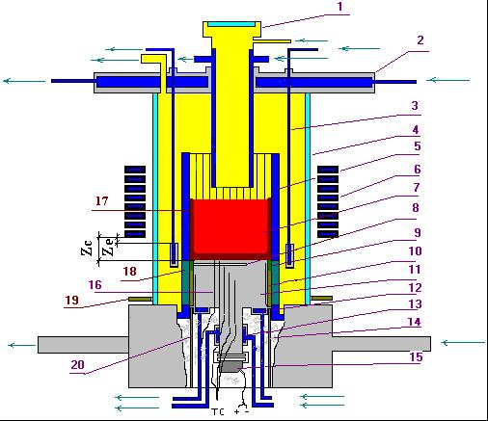
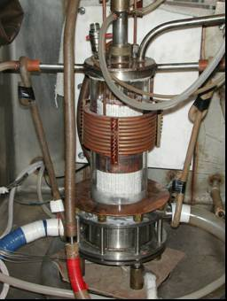
RASPLAV-3 Installation
Furnace schematics
1 –pyrometer shaft; 2 –cover; 3 –electromagnetic screen; 4 – quartz tube; 5 – crucible section;
6 – inductor; 7 –melt; 8 – acoustic defect; 9 – molten ZrO₂; 10 –ZrO₂ powder thermal insulation;
11 – vessel steel specimen; 12 –upper calorimeter of the specimen;
13 – lower calorimeter of the specimen; 14 – kaolin wool insulation; 15 –ultrasonic sensor;
16 –thermocouples; 17 – crust, 18 – electromagnetic screen; 19 – uncooled electromagnetic screen; 20 – cylindrical support of the specimen

Slide 8
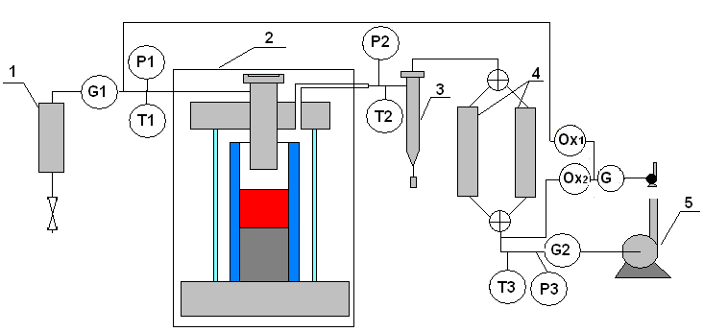
Air supply and evacuation diagram
1 - silica gel dehumidifier; 2 - furnace; 3 – cyclone; 4 – large area filters (LAF);
5 - vacuum pump; P1-P3 – pressure transducers; G1,2 – flow transducers;
Т1-Т3 – thermocouples; Ox- electrochemical oxygen sensor

Slide 9
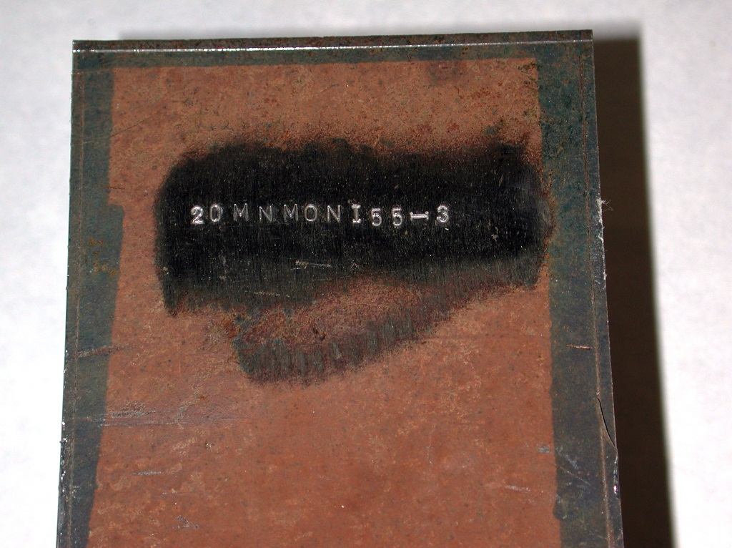
Vessel Steel Specimen
Blank

Slide 10
Location of K-type thermocouples in the specimen

Slide 11
Experimental procedure

Slide 12
Specimen temperature versus time
1, 2, 3 – UO_{2+x}- ZrO₂ 4, 5, 6 - UO_{2+x}- ZrO₂- FeO_{y}

Slide 13
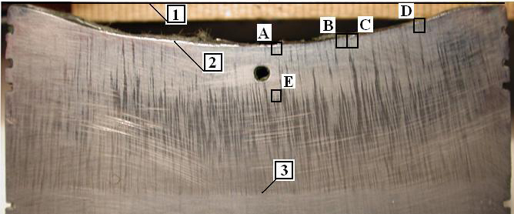
Corrosion depth measurements
⎯ US measurement
• – Post test measurement of specimen section
The maximum corrosion depth was ∼ 6 mm
1, 2, 3 – UO_{2+x} - ZrO₂
4, 5, 6 – UO_{2+x} - ZrO₂ - FeO_{y}

Slide 14
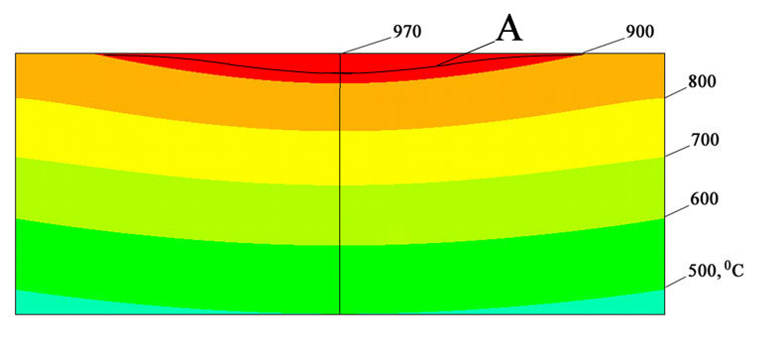
Processed experimental data
Temperature profile and field in the
specimen upper part (Reg. 4)
Resulting data used in comparison

Slide 15
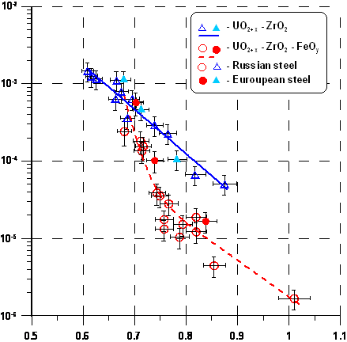
Comparison of corrosion rates for the European and Russian vessel steels
Difference in values for
European and Russian steels
is insignificant (in logarithmic
coordinates)
The data inventory for
European steel is too limited
to construct generalizing
correlations

Slide 16
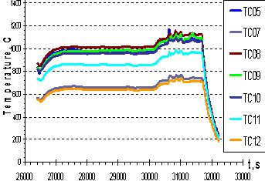
Specific features of corrosion at the final stage of experiment
final stage
5 6
Temperature on the interaction interface is the highest, it is close to the temperature of regime 6
Corrosion rate is much smaller than in regime 6, it is close to regime 5
Why?

Slide 17
Dynamics of oxygen concentration in the gas out and changes of melt oxygen potential versus time
“Gas data” are measured
with a delay due to the gas line
transport and inertia of the gas
bulk in the furnace volume
Drop in the oxygen potential
of the melt when heated steel
has a high oxidation rate
Lower corrosion rate at the
final stage of experiment is
explained by the insufficient
air supply to the melt and by
its decreased oxygen potential
Ox₁ – concentration of oxygen in
Ox₂ – concentration of oxygen out
– Fe³⁺/ (Fe²⁺+Fe³⁺) – U⁶⁺/ (U⁴⁺+U⁶⁺)
– samples – ingot

Slide 18
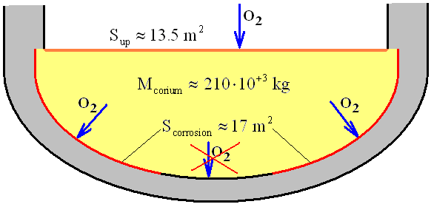
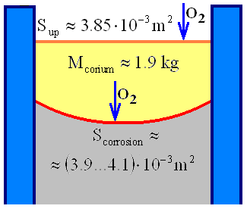
Comparison of parameters influencing the oxygen balance in the VVER molten pool, METCOR tests
VVER-1000
METCOR-P tests
Parameter |  | VVER-1000 | METCOR-P tests
M_{corium}/S_{corrosion} | kg/m² | 12 400 | 460…490
M_{corium}/S_{up} |  | 15 600 | 494
S_{corrosion}/S_{up} | 1 | 1.26 | 1.01…1.06
The melt mass vs. corrosion area and
the area of molten pool surface, through
which the melt is oxidized, do not comply
with the requirements for prototypic
experimental conditions
Oxygen potential of the melt on the
vessel bottom is less sensitive to the
vessel wall corrosion than in the tests

Slide 19
Conclusions
The data on European steel are too limited both for a decision about the applicability of correlations developed for VVER steel for describing EU steel corrosion, and for developing correlations specific for this steel
In the final regime of МСР-3 the vessel steel corrosion rate was so high that the oxygen supply into the pool from air was insufficient for maintaining the steady oxygen potential in the melt. A decrease in the melt oxygen potential caused a slowdown of corrosion rate. It is necessary to check the influence of this effect at other regimes
In order to determine the corrosion rate at a fixed oxygen potential of the melt we can recommend a higher flow rate of oxidant through the furnace, an increase in the melt mass and a smaller diameter of the steel specimen (crucible diameter being the same)

Slide 20
Response to M. Veshchunov comments on the METCOR model of corium melt – steel interaction in the oxidizing atmosphere
(16-th CEG-SAM Meeting)

Slide 21
METCOR Model
Main diffusion resistance for Fe²⁺ ions – corium crust on steel surface
Crust thickness δ_{Σ} is determined by the heat conductivity equation; it does not change in time (at steady temperature on the corrosion front)
Corrosion rate is evaluated by Tamman equation:
δ_{Σ}>>δ

Slide 22
METCOR Results
Diffusion coefficient D at Т=800°С
Depends on FeO_{y} concentration in molten corium
UO_{2+x}-ZrO₂-FeO_{y}: D=(10⁻¹¹…10⁻⁹) m²/s
UO_{2+x}-ZrO₂: D≈10⁻¹⁰ m²/s

Slide 23
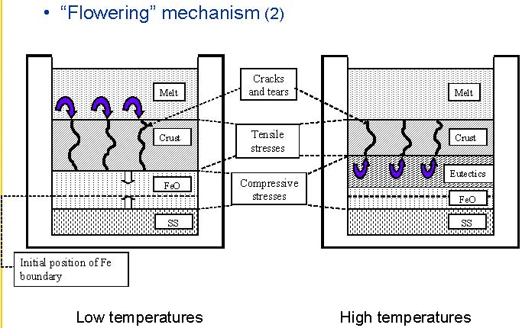
Comments of M. Veshchunov
Coefficient of Fe diffusion in ZrO₂ at Т=800°С
D≈10⁻²³ m²/s << D_{METCOR}
Proposed alternative model

Slide 24
Response
Corium crust composition
For UO_{2+x}-ZrO₂-FeO_{y} melt
UO_{2+x}∼46, ZrO₂∼40, FeO_{y}∼14, mass.%
For UO_{2+x}-ZrO₂ melt
UO_{2+x}∼72, ZrO₂∼ 28, mass.%
ZrO₂ is not the main component in the corium composition. Consequently it does not determine the diffusion coefficient in the METCOR crust

Slide 25
Response (2)
Coefficient of Fe²⁺ diffusion in FeO
Kofstad P., 1972. Nonstoichiometry. In: Diffusion and Electrical Conductivity in Binary Metal Oxides, Wilеy-Interscience, New York.
At Т=800°С D ≈ 10⁻¹² m²/s >>10⁻²³
But no data available on Fe²⁺ diffusion in UO_{2±x}!

Slide 26
Response (3)
The flat steel surface in METCOR does not produce a compressing impact on the FeO layer (differently from a cylindrical fuel rod)
There are no reasons for stochastic (in time and space) generation of cracks in the crust (flowering)
Even if the generation of cracks takes place, they are healed during the corium melt ingress by low local temperatures [see the dissertation of Yu. Petrov]
In accordance with the Veschunov model a transition from “low” to “high” temperatures should always result in the qualitative changes of corrosion process. But this is not observed in case of UO_{2+x}-ZrO₂ corium
Conclusion: No reasons for rejecting the METCOR model

Slide 27
Interaction of suboxidized molten corium with European vessel steel
TEST MCP-5
Objectives
Comparison of the corrosion rate and depth for European and Russian vessel steel at its interaction with suboxidized molten corium

Slide 28
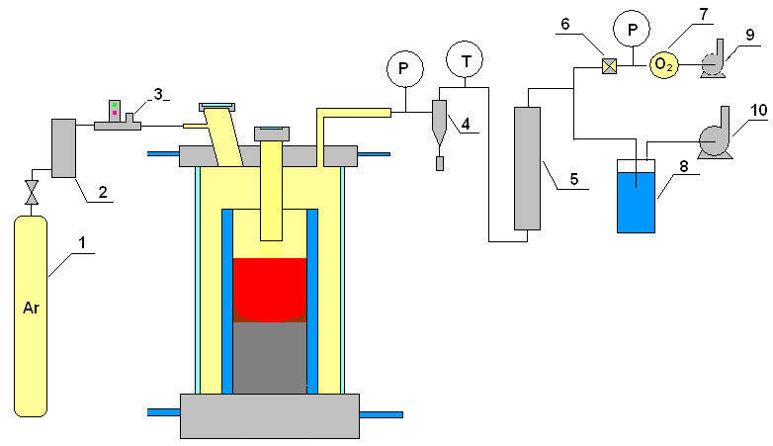
Argon supply and gas-aerosol system
1 – Ar tank; 2 – silica gel dehumidifier; 3 – flow-rate transducer; 4 – cyclone; 5 – LAF filter; 6 – AFA filter;
7 – electrochemical oxygen detector; 8 – hydro lock;
9,10 – vacuum pump

Slide 29
Experimental procedure

Slide 30
Specimen temperature versus time
Thermocouple readings in the plot are cut at times of TC breaks down due its corrosion
caused by the impact of U-Zr-Fe melt
As the heated top-level TCs break down, the stationary regime is controlled using the
indications from of lower and cooler thermocouples

Slide 31
Corrosion depth dynamics
Uncertaint sounding interpretation
Long incubation period - approximately 20 000 s
Corrosion decreases as its front progresses into the specimen bulk –
a lower-temperature region
Difference in final depths determined by the US monitoring and by direct
measurement in the axial section of the specimen

Slide 32
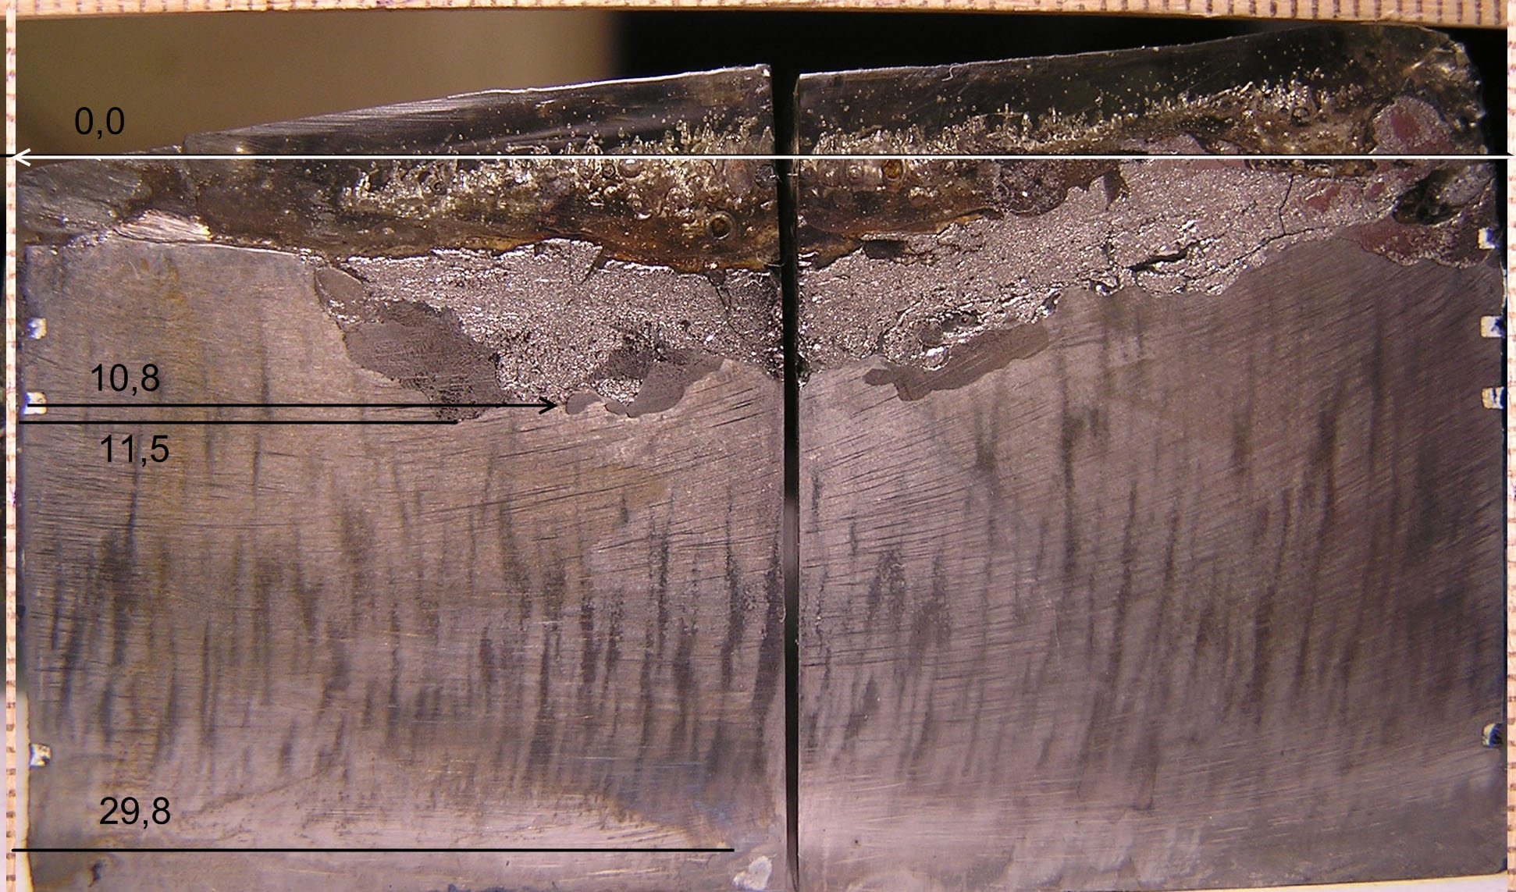
Photograph of the specimen axial section
0.0
A
8.5
10.8
11.5
29.8
The section plane and the ultrasonic defect axis are perpendicular
A – initial position of the specimen surface
Non-even boundary of the interaction zone
2 different structural components of the IZ, distinguished at the macrolevel

Slide 33
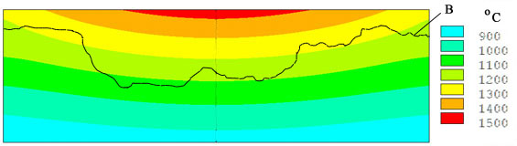
Specimen temperature conditions
Т,ºC
A
h, m
Calculated by the ANSYS code using the measured boundary conditions and temperatures in certain points
A – initial position of the specimen surface, В – final boundary of the interaction zone
It follows from the figure that the final interaction zone boundary is in the 1150- 1250 ºC temperature region

Slide 34
First conclusions
Corrosion kinetics in MCP-5 and МС6 tests are qualitatively similar and have incubation phase, transient to fast corrosion and saturation phase
In comparison with МС6 the MCP-5 incubation period increased from 16000 s to 20000 s
Differently from МС6 the final boundary of interaction zone is irregular (not smooth)
The final position of the interaction zone boundary was found in the temperature range of 1150-1250 °С ( For comparison: МС6 – 1120…1200°С, МСР-5 – 1060…1250 °С)
Posttest analysis is in progress

Slide 35
Comments to M. Veshchunov model of suboxidized corium melt – steel Interaction (16-th CEG-SAM Meeting)

Slide 36
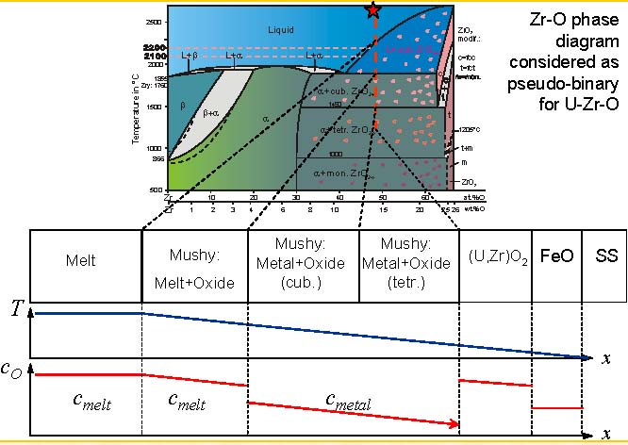
Oxygen diffusion through mushy crust (UO₂+ZrO₂+Zr melt)

Slide 37
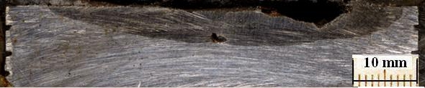
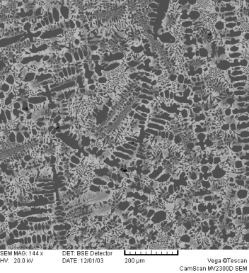
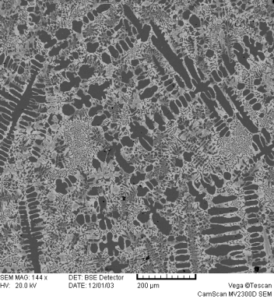
Comments
Test МС6, corium С-30, (U, Zr)ат≈1.2
In the Veschunov model the distribution of components does not reflect the real picture
Corrosion of steel at its interaction with suboxidized corium melt is caused not by its oxidation, but by eutectic melting (dissolution) of steel
Redistribution (repartitioning) of components, including oxygen, between the melt and interaction zone is similar to the components’ repartitioning between oxidic and metallic melts (MASCA) with certain peculiarities explained by thermal gradient conditions
Interaction zone
SEM
● Р1
Eut2
Eut3
● Р3
Eut4
● Р2
SQ3 SQ4
EDX data
Proc. of ICAPP′04, Paper 6054
Proc. of ICAPP′06, Paper 4114

Slide 38
Planning
According to the Experimental Matrix of the Project, 3 more tests are to be performed
Participants’ proposals concerning the remaining tests concretization and possible corrections to the Experimental Matrix have been discussed at the last, 3rd Meeting and by e-mails. Next test procedure will be distributed before the mid of April
Due to a delay in Project implementation a 6-month project time extension without additional funding has been approved by the ISTC

Slide 39
METCOR-P project reporting
First three reports have been sent to ITU under export control conditions

Slide 40
Publications during METCOR-P
Bechta S.V., Granovsky V.S., Khabensky V.B., Krushinov E.V., Vitol S.A., Sulatsky A.A., Gusarov V.V., Almjashev V.I., Lopukh D.B., Bottomley D., Fischer M., Piluso P., Miassoedov A., Tromm W., Altstadt E., Fichot F., Kymalainen O. Interaction between Molten Corium UO_{2+x}-ZrO₂-FeO_{y} and VVER Vessel Steel // Proceeding of ICAPP’08, Anaheim, CA USA, June 8-12, 2008, Paper 8052.
Bechta S.V., Granovsky V.S., Khabensky V.B., Krushinov E.V., Vitol S.A., Sulatsky A.A., Gusarov V.V., Almjashev V.I., Mezentseva L.P., Krushinov E.V., Kotova S.Yu., Kosarevsky R.A., Barrachin M., Bottomley D., Fischer M., Fichot F. Corium Phase Equilibria from MASCA, METCOR and CORPHAD Results // Nucl. Eng. and Design, 238, p. 2761-2771 (2008).
Bechta S.V., Granovsky V.S., Khabensky V.B., Krushinov E.V., Vitol S.A., Sulatsky A.A., Gusarov V.V., Almjashev V.I., Lopukh D.B., Bottomley D., Fischer M., Piluso P., Miassoedov A., Tromm W., Altstadt E., Fichot F., Kymalainen O. VVER Vessel Steel Corrosion at Interaction with Molten Corium in Oxidizing Atmosphere // Nucl. Eng. and Design, 239 (2009),
p. 1103-1112.

Slide 41
Publications during METCOR-P (2)
4. Bechta S.V., Granovsky V.S., Khabensky V.B. et.al. VVER Steel Corrosion during In-Vessel Retention of Corium Melt // Proceeding of the 3rd European Review Meeting on Severe Accident Research (ERMSAR 2008), Paper 2.7, Nesseber, Bulgaria, September 23-25 (2008).
5. Bechta S.V., Granovsky V.S., Khabensky V.B. et.al. Interaction between Molten Corium UO_{2+x}-ZrO₂-FeO_{y} and VVER Vessel Steel // J. Nucl. Technology, Vol. 170, №1 (2010), p. 210-218

