Slide 1
Progress Report on the ISTC project #3592
“Investigation of Corium Melt Interaction with NPP Reactor Vessel Steel”
(METCOR-P)
A.P. Alexandrov Research Institute of Technology
Presented by S. Bechta
13th CEG-SAM meeting

Slide 2
Contents
Essential information
Objectives
Experimental matrix
Test results:
  MCP-1
  MC12, MCP-2
Planning test:
  MCP-3
Organizational problem

Slide 3
Essential information
Project participants and coordination
Collaborators
FZK, Germany
FORTUM, Finland
JRC ITU,
EK
CEA,
France
AREVA NP,
Germany
FZD, Germany
IRSN,
France
Coordinator
ISTC, Moscow
Steering committee
Operation Agent: A.P. Alexandrov RIT, Russia
ISC RAS,
Russia
SPb Electrotechnical State University, Russia

Slide 4
Objectives of METCOR-P project
Qualification and quantification of physicochemical phenomena of corium melt interaction with reactor vessel steel with particular interest to:
Interaction characteristics at the vertically positioned interface
Peculiarities of interaction with European vessel steel
Corium melt oxidation transients

Slide 5
Experimental matrix for the METCOR-P project
*) In accordance with the 1st project meeting decision it is replaced by MCP-2 test with UO_{2+x}– ZrO₂
corium in air and horizontal position of interface

Slide 6
Interaction at vertically positioned interface: MCP-1 test
Objectives of the test
Comparison with results of MC6 test with horizontally
positioned interface
Test parameters are similar to MC6 test of METCOR-2:
C-30 corium charge
15Kh2NMFA vessel steel
Pure argon above the melt
10 h exposition

Slide 7
Furnace design
1 – Water-cooled
screen
2 – Lid
3 – Water in
4 – Quartz tube
5 – Crucible sections
6 – Specimen
7 – Inductor
8 – Bottom calorimeter
9 – Welded crucible
sections
10 – SS support
11 – Water out
12 – Electromagnetic
screen
13 – Crucible collector

Slide 8
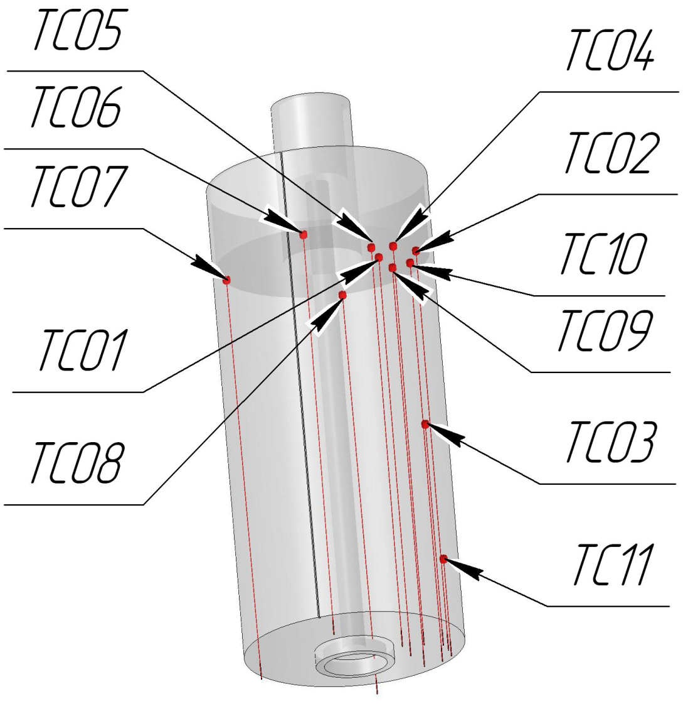
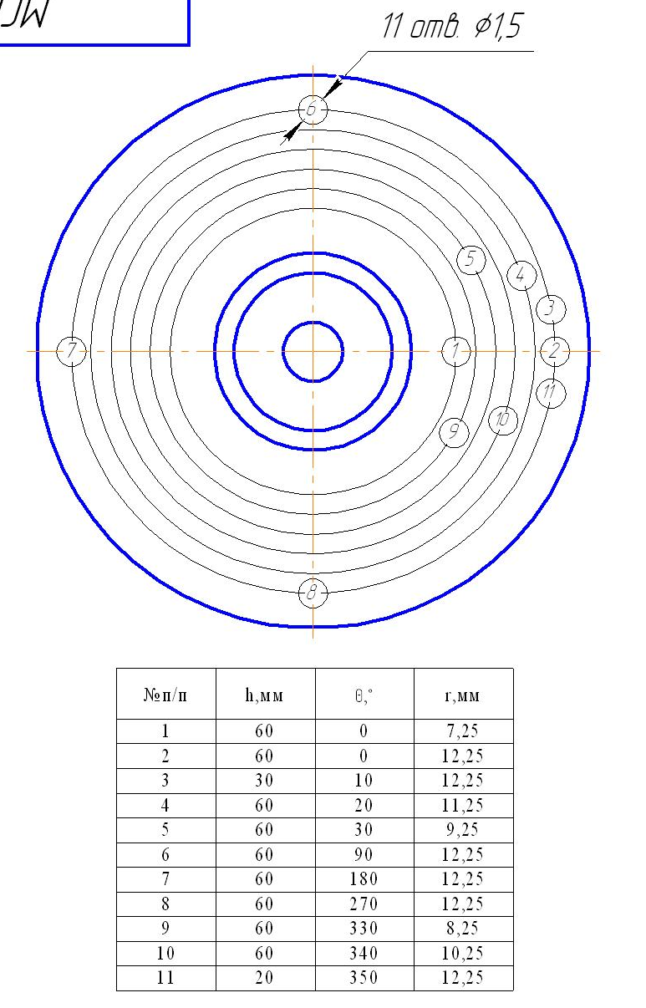
TC locations in the specimen
Coordinates of TC hot junctions
Majority of TC were installed at H=50 mm elevation, where the maximum depth of specimen corrosion was expected according to the pretest calculations

Slide 9
Test procedure
Time, s | Operation mode
0-963 | Furnace deoxygenation by argon flow
963-3550 | Formation and homogenization of the molten pool. Increase of power in the melt to get 1400 ºC on the specimen surface
3550-39874 | Surface temperature and specimen - water power kept constant by inductor voltage control
39875-42000 | Heating disconnection, melt solidification and ingot cooling in argon

Slide 10
Test results: TC readings (1)
Wrong readings of several thermocouples due to corrosion of wires below the hot junctions

Slide 11
Test results: TC readings (2)
Estimation of IZ progression from TC readings
Different lifetime of
TCs in the mushy
interaction zone
Not possible to
estimate interaction
kinetics
Short incubation period
(or no incubation)

Slide 12
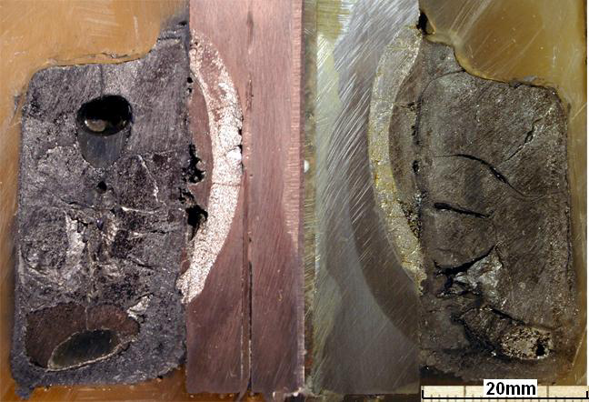
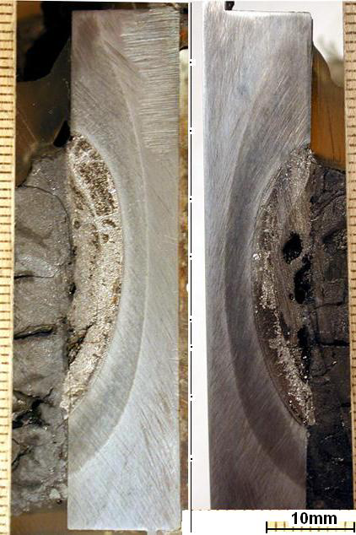
Posttest examination (1)
Axial sections of ingot
Axial sections of ingot
Axial sections of ingot
Corium upper crust is removed
Metal inclusions in corium ingot
Example of TC location
The maximum depth of corrosion is in the middle section of the specimen (Н ≈ 30 mm) due to formation of a thick corium upper crust and decrease in the melt depth

Slide 13
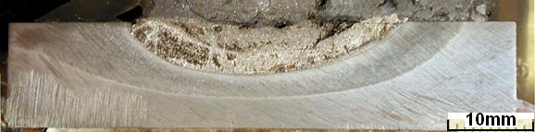
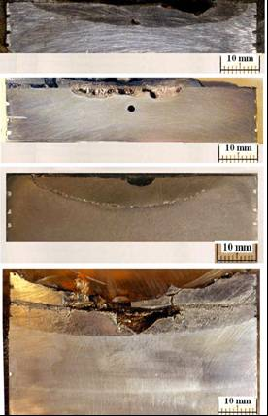
Posttest examination (2)
Axial sections of specimen
MCP-1 (90º rotated)
Corium
1st layer
2nd layer
Zone of thermal influence
Steel of initial structure
MC 6
IZ
Steel

Slide 14
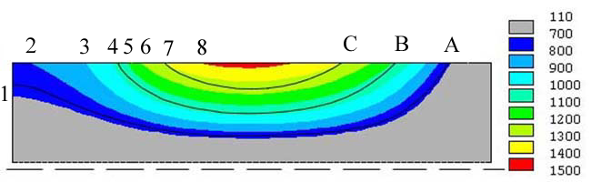
Posttest examination (3)
Temperature profile of the specimen
T, ºC
90° rotated
Upper surface
bottom
A – boundary of the thermal influence zone (lamellar pearlite structure indicating eutectic composition formation at 727 C)
B – boundary of the 2nd layer (1000-1090 C)
C – boundary of the 1st layer (1240-1300 C)
1 – 700 C 5 – 1100 C
2 – 800 C 6 – 1200 C
3 – 900 C 7 – 1300 C
4 – 1000 C 8 – 1400 C

Slide 15
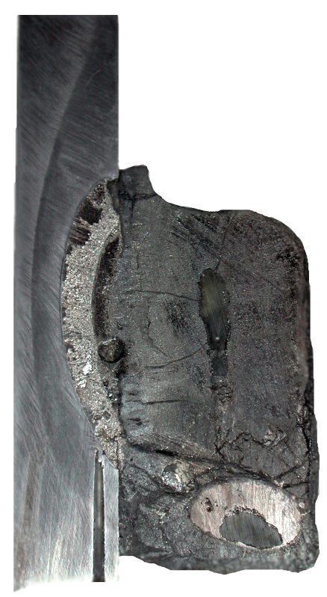
Posttest examination (4)
XRF and chemical analysis
XRF
ChA
XRF,mass.%
ChA,mass.%
U=66.1
Zr=20.1
Fe=1.7
Cr=0.06
Ni=0.02
U=66.8
Zr=22.3
Fe=2.1
Average
sample of
crust
C_{n}≈48
2nd layer:
U=36.4
Zr=14.3
Fe=47.8
Cr=0.8
Ni=0.5
1st layer:
U=52.4
Zr=13.7
Fe=30.9
Cr=0.6
Ni=0.3
29-31mm
U=65.6
Zr=22.1
Fe=1.0
Cr=0.02
Ni=0.03
U=66.6
Zr=23.2
Fe=1.0
Average
sample of ingot upper part C_{n}≈40
∼25mm
Average
sample of ingot lower part C_{n}≈32
U=57.5
Zr=24.2
Fe=17.8
Cr=0.2
Ni=0.3
U=64.4
Zr=21.7
Fe=3.5
Cr=0.04
Ni=0.08
U=66.7
Zr=22.3
Fe=5.7
∼23mm
Reduction of C_{n} up to ≈17% (instead of 30) at the interaction start is explained by
a high oxygen content in the upper crust
Higher content of U and Zr in IZ (40-50 and 13-14 mass %) in comparison with
МС6 IZ (24 and 5 mass %)
High content of U and Zr in metal inclusion (∼58 and ∼24 mass %)

Slide 16
Posttest examination (5)
SEM/EDX analysis
1 mm
Steel
Corium
____________
U(Zr)O₂
α-Zr(O)
Crust
__________
U(Zr)O₂
intermetalics
1st layer
__________
U(Zr)O₂
Zr(U)Fe₂
U₆Fe
U(Zr)- Fe
eutectic
2nd layer
_________
U(Zr)Fe₂
Fe- U(Zr)
eutectic
UFe₃
U(Zr)Fe₃
No liquid in the crust
Small solid fraction in the 1st layer
Small liquid fraction in the 2nd layer (only in a thin layer contacted with steel)

Slide 17
Comparison of MCP-1 and MC6 data
Conditions Results
Different conditions not only in the interface orientation, but also
in corium oxidation index and heat flux
Reason of result differences ?

Slide 18
Discussion of results
Possible reason of sorter incubation period in МСР-1 in comparison with МС6:
- thinning of crust between melt and IZ caused by increased
heat flux and surface temperature
Lower temperature of MCP-1 IZ final boundary in comparison with MC6 is explained by a significantly increased U/Zr concentrations in МСР-1 IZ
The latter concentrations are probably influenced by decreased C_{n}, i.e. increased content of Zr-free
in the melt

Slide 19
Planning for the 1st item of the test matrix
Additional test is recommended with:
С-30 melt composition
On-line measurements of specimen corrosion depth
Thermometry of the zone of maximum heat flux
Technical preparation is in progress (higher furnace power, selection of ultrasonic sensors, …)
Test matrix will be updated at the next project meeting

Slide 20
Interaction of molten corium and vessel steel in the oxidizing atmosphere.
Tests MC12, MCP-2

Slide 21
Test MC12 (1)
(not funded by ISTC)
Corium UO_{2+x}-ZrO₂-FeO_{у}
Atmosphere: air, steam
New data on steel corrosion rate,
which confirms corrosion intensification at
T_{s} > 1050 ⁰C
SEM/EDX data explain the intensification
as a result of liquid-phase diffusion of steel
and corium components

Slide 22
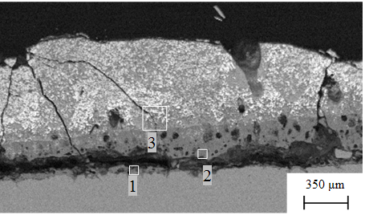
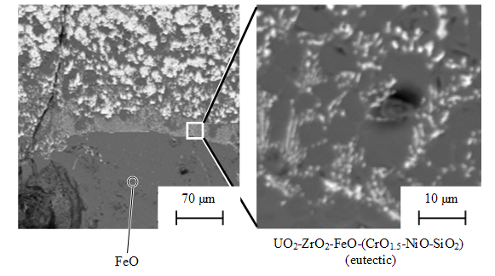
Test MC12 (2)
SEM/EDX analysis
SEM- image IZ corium/steel
SEM- image of corrosion layer and
corium crust interface
On corrosion layer/corium crust interface a liquid eutectic
mixture is formed which is a multi-component system of corium
and steel oxides. It produces channels trough the corium crust

Slide 23
Test MCP-2 (1)
Corium UO_{2+x} – ZrO₂
Atmosphere : Air
New corrosion rate data extend the relevant temperature range. No corrosion intensification is observed until the temperature reaches T_{s} = 1370 ⁰C
SEM/EDX analysis shows liquid phase in corrosion layer and its absence in corium crust during interaction

Slide 24
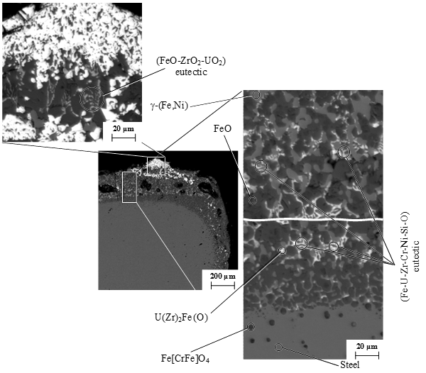
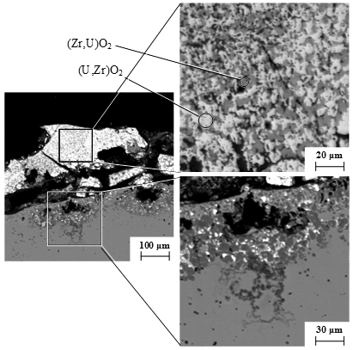
Test MCP-2 (2)
IZ microstructure on the
specimen periphery
IZ microstructure in the
specimen center
Presence of liquid phase in corrosion layer
Absence of liquid phase in corium crust

Slide 25
Corrosion model
- Tamman equation;
W – corrosion rate, m/s
A – pre-exponential factor;
E_{a} – activation energy, J/mol;
R = 8.314 J/(mol⋅К) – universal gas constant;
δ – thickness of corium crust, m;
λ – thermal conductivity, MW/(m К);
T_{sol} , T_{S} – solidus temperature of crust composition and temperature
on the steel surface, К;
q – heat flux, MW/m².
Assumptions:
corrosion layer thickness is neglected;
λ = const;
T = T_{s}

Slide 26
Summary of experiment data
Mean-square deviations:
Corium UO_{2+x}-ZrO₂ – 25 %
Corium UO_{2+x}-ZrO₂-FeO_{у} – 35 %

Slide 27
Correlations for corrosion rate
Corium UO_{2+x}- ZrO₂
(U/Zr)_{at} ≈1.1 ; T_{s} = 870…1370°C; q = 0.74…1.19 MW/m²; C_{FeOy} = 0…5 %mass
Corium UO_{2+x}- ZrO₂- FeO_{y}
.
(U/Zr)_{at} = 0.11... 1.05; T_{s} = 720…1200°C; q = 0.3…1.3 MW/m²; C_{FeOy} = 20…30 %mass
Units: W – m/s; q – MW/m²; T - K

Slide 28
Discussion (1)
Liquid phase diffusion causes corrosion intensification at steel interaction with fusible UO_{2+x} – ZrO₂ – FeO_{y} corium after reaching 1050°C on the steel surface
Corrosion rate depends on corium composition. It is 2…3 times higher for UO_{2+x} – ZrO₂ than for UO_{2+x} – ZrO₂ – FeO_{y} at T_{s}<1050°C, in absence of a liquid phase in the corium crust. The higher is Fe concentration in melt, the faster is diffusion of Fe ions through the corium crust.
Corrosion rate is insensitive the above melt atmosphere (steam, air)

Slide 29
Discussion (2)
Corrosion model and correlations for corrosion rates have been developed for reactor application (e.g. IVR analysis) Further corrosion intensification at Ts→Tsol for fusible corium require to consider heat generated during chemical reaction of RPV steel components oxidation in IVR analysis
Further corrosion intensification at Ts→Tsol for fusible corium require to consider heat generated during chemical reaction of RPV steel components oxidation in IVR analysis
Papers are being prepared for publications (ICAPP’08, NED, …) using the outputs of vessel steel corrosion studies in oxidizing condition

Slide 30
Planning for the 2nd item of the test matrix:
Interactions during corium oxidation
MCP-3 test objectives: Determination of
Thermal response of the specimen caused by IZ oxidation and
chemical heat deposition (will be measured by TC)
Oxidation kinetics (will be derived from in- and off-gas composition
and flow rates)
Structure and composition of IZ after oxidation (will be determined
by the standard set of post test analysis)
The test should be carried out before the next test with vertical interface orientation
Procedure (according to test matrix – item 2, line 4):
- repetition of MC6 test with С-30 corium until corrosion
saturation
- oxidation of corium (and IZ) by atmosphere replacement

Slide 31
Organizational problem
No ROSATOM Export Control approval of the project
Export licensing is required. A partner - recipient of
the project results should be nominated. Information
confidentiality and nonproliferation should be confirmed
Possible solution: The funding party (EC) will authorize e.g. one
of its Joint Research Centers as the Partner
The project is suspended until ROSATOM and ISTC decision

