Slide 1
ISTC Project «Scale experimental investigation of the thermal and structural integrity of the VVER pressure vessel Lower Head in severe accident» (#3635)
Participating Institutions:
- «Moscow Power Engineering Institute» (MPEI): Leading Institution
- Federal State Unitary Enterprise «Experimental and Design Organization “GIDROPRESS” (EDO «GP»)
- Lavrentyev Institute of Hydrodynamics of the Siberian Branch of the Russian Academy of Sciences (IGiL)
Duration: 36 months

Slide 2
Collaborators:
Material and Components Safety Department, Institut fur Sicherheitsforschung, Forschungszentrum Rossendorf (Germany)
Department of Engineering Physics, College of Engineering, University of Wisconsin (USA)
Forschungszentrum Karlsruhe GmbH (Germany)
Institute of Nuclear Technology, Institute of Nuclear Safety System, Incorporated (Japan)
Division of Nuclear Power Safety, Department of Physics, Royal Institute of Technology (Sweden)
EC JRC, Institute for Transuranium Elements (Karlsruhe), Hot Cell Technology (Germany)
CEA Saclay, DEN/DANS/DM2S/SEMT, Laboratoire de Mecanique Systeme et Simulation (France)
Mechanical & Nuclear Engineering, The Pennsylvania State University (USA)

Slide 3
The overall objective of this project:
the experimental and numerical study of the VVER-440 LH reactor vessel scale models within transient thermal and its overpressure loading which correspond to realistic SA scenarios accompanied by the high-temperature heating, creep deformation of the reactor vessel.
The necessity of suggested project is determined by:
  a lack of the experimental data on the VVER-440 vessel deformation and failure because of the high-temperature creep phenomenon of the vessel steel. These experimental data are necessary to straighten out the real behaviour of the VVER vessel during SA, as well as for the verification of the computer SA codes;
  achievement of the project’s tasks will permit to reduce the conservatism of the numerical simulations associated with VVER safety, and also to elaborate and to carry out all necessary actions for SA management strategy;
  the material property creep tests of the 15Kh2NMFA vessel steel samples shall permit to define more precisely and to complete available data on its creep and failure, and to clarify the constitutive creep model and ordinary mechanical characteristics of this steel also.

Slide 4
The project efforts are focused on the following problems:
- the designing and construction of the test facility for test examinations of the VVER-440 vessel scale models on the conditions which correspond to SA in the VVER;
- manufacturing of the VVER-440 reactor vessel scale models (scale 1:5) . Material and technology, as well as thermal treatment have to correspond the same conditions of the regular VVER vessels manufacturing;
- pursuance of the material creep test experiments with samples from the VVER vessel steel on the time range 2-50 h and temperature range 700 - 1200 C to receive the creep data for refinement of the constitutive creep model and ordinary mechanical characteristics of this steel;
- the carrying out the scale experiments with VVER vessel models on the high-temperature heat-up and creep deformation of the vessel;
- the mathematical treatment and analysis of scale experiments, carrying out the numerical pre- and post-test structural analyses of scale experiments with vessel models by means of domestic code ATM-VVR and also by commercial codes MSC.Marc, MELCOR, RELAP/SCDAP for validation of the mathematical models implemented in these codes.

Slide 5
Expected Results.
In the course of fulfillment of the given project it is supposed to receive the following results:
- experimental data on the creep behaviour, heat up and failure of the VVER-440 vessel scale models that will enlarge the current knowledge about the VVER behaviour and the essence of the governing thermal and creep processes during this SA stage;
- experimental data received in the course of the VVER vessel model tests will be used as a basis for verification of the thermo-mechanical numerical codes (native and western commercial), which are used in the safety assessment in SA and SA management strategy for NPPs with vessel type reactors;
- the material property creep test results of the 15Kh2NMFA vessel steel samples will permit to obtain an additional material property of the VVER vessel steel in the range of 700 to 1200 С and failure times from 2 to 50 hours (as a basic to clarify the constitutive creep model of this steel);
- data of the VVER-440 vessel scale model tests will give the possibility to perform preliminary comparison of the computing possibilities of the numerical thermo-mechanical codes.

Slide 6
Main Project Tasks.
The work in the course of this project might be presented in the form of several interrelated tasks:
Task “A”: analytical studies that include:
- the choosing of the accident scenarios and test conditions of the scale experiments;
- carrying out of the pre- and post-tests of the scale experiments
Expected Results:
- SA scenarios and SA conditions will be reproduced during the scale experiments with VVER vessel models;
- Expected thermal and deformation behaviour of the vessel models (as a result of the pre-test calculations) during the scale tests, and the post-test calculation results of the performed experiments on the VVER vessel scale models

Slide 7
Technical Approach and Methodology
Within the framework of the project is planned to consider three SA scenarios in VVER-440, which conditions will be reproduced on the scale experiments with vessel models.
- The numerical simulations associated with choosing the test conditions of the VVER-440 scale vessel models, will be carried out by means of the RELAP/SCDAP and MELCOR codes.
- Pre-test simulations of the vessel models behaviour during scale experiments for the chosen SA scenarios will be carried out by means of the various codes at the project participants disposal.
Both the thermal history of the tested vessel model and the load conditions during scale experiments will be used as the basis for post-test numerical simulations.

Slide 8
Task “B”: development and manufacturing of the experimental test facility and supporting systems for the VVER scale vessel models testing
Expected Results:
- Produced experimental test facility and its components;
- Produced VVER-440 vessel scale models;
- Produced test facility control system and DAS and its assembling on the test installation

Slide 9
Technical Approach and Methodology
Development and manufacturing of the experimental test facility and supporting systems for the VVER scale vessel models testing are associated with decision of a number of the constructional and technological problems:
- The heater is a central component of discussed experimental test facility. The heater construction thus will work on extreme temperature conditions (more than 1500 C) during the course of a few tens hours. Because of this, the serviceability preservation of the heater will be provided by using of the special materials (ceramics etc) and refractory alloys. The heater design and its main parameters will be determined on base of the scale model testing conditions;
- The development and creation of the experimental installation and its auxiliary systems will assume a realization of the appropriate design works, manufacturing of the details and units of the installation, and also their assembling.

Slide 10
Experimental test facility to be built will incorporate:
- the experimental protective box;
- heating system, control and data acquisition system (DAS), ancillary equipment and systems (gas, water, electricity systems etc.).
The working space of the test installation will consist of the scale model (mock up) of the VVER-440 reactor pressure vessel lower head, heater, cooling system, measurement sensors and devices (temperature, displacement, pressure), support systems’ armature (gas, water and electricity etc.).
- Pressure in the scale model: < 3.0 MPa;
- number of measuring channels:
a) for temperature (T): > 40 channels;
b) for vessel displacements : > 40 channels
c) It is planned to use not less
than 4 channels for control by the electrical, gas and water systems;

Slide 11
VVER-440 vessel scale model
The vessel scale models will be made of the original VVER steel. Material and technology, as well as thermal treatment have to correspond the same conditions of the regular VVER vessels manufacturing.
The heater is a central component of the experimental test facility. The heater construction thus will work on extreme temperature conditions (more than 1500 C) during the course of a few tens hours. Because of this, the serviceability preservation of the heater will be provided by using of the special materials (ceramics etc) and refractory alloys.
Geometrical Scale: 1:5
The inner diameter: ~700 mm
Wall thickness: ~30 mm

Slide 12
More than the 30 thermocouples on the outer and more than 6 thermocouples on the inner vessel wall surfaces will be used to measure the wall temperature during testing.
The monitoring of the vessel model deformation in course of the testing will be carried out by linear displacement transducers (at the 10 locations). There are two displacement gauges at each location (one for horizontal displacement and one for vertical displacement).
The arrangement of the thermocouples and displacement transducers will be determined after choosing the SA scenarios and test conditions within the Task “A” framework.

Slide 13
Task “C”: carrying out of scale experiments on the VVER vessel model
Expected Results:
- Data of the scale experiments with VVER vessel models.
Technical Approach and Methodology
It is planned, three scale experiments on the time range from 10 to 30 h will be carried out within this experimental program.
The various heating conditions, structure loading and cooling conditions of the model will be simulated in each of these tests. It is planned, the outer surface of the model will be cooled by air only
The local thickness of the vessel wall will be measured before and after tests at a number of points on the outer vessel surface (at least the 30 locations) that will allow to synthesize a “thickness map” of the vessel wall.

Slide 14
The following cases of the hot focus location on an inner surface of the vessel wall will be investigated:
- the heat flux peak is located on the inner surface of the cylindrical vessel wall and is above (~50 mm) the welded seam (joining the elliptical lower head and a cylindrical part of the vessel model);
- the maximum of the peaked flux is located on the elliptical bottom of the scale model. The polar angle of the heat flux peak lies in the range between 75 and 85⁰. The bottom center of the lower head is 0⁰.
The peaked heat flux distribution on an internal surface of the scale model will be reproduced in each of these tests. Such heat flux profile corresponds to realistic SA scenarios accompanied by the formation of a stratified melt pool in the lower plenum of the VVER-440 reactor pressure vessel.

Slide 15
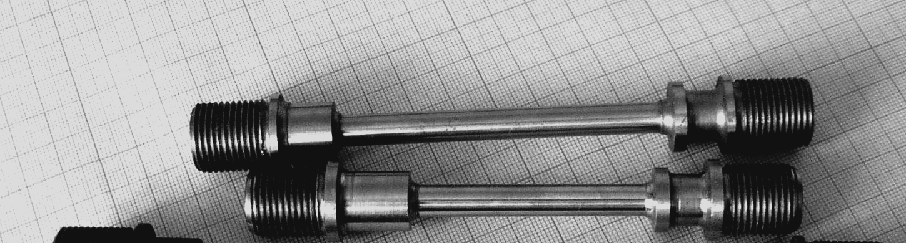
The task “D”: the manufacturing and material creep testing of the samples from VVER vessel steel and material property creep testing of the samples cut from the tested VVER vessel models
Expected Results:
- The test specimens fabricated of the original VVER vessel steel (15Kh2NMFA) and manufactured from the vessel models after experiments
- the material property creep test data of the VVER vessel steel specimens.
The considered project stage is concerned with determination of the creep characteristics and ordinary mechanical properties of the VVER vessel steel (15Kh2NMFA) in temperature range from 700 to 1200 C on the time range from 2 to 50 hours.

Slide 16
Technical Approach and Methodology
During the material property creep experiments there will be two or three tests per temperature and stress level to evaluate the scatter of the mechanical properties. Some of these tests will be carried out at the same conditions (stress and temperature) which correspond to the test conditions of the French vessel 16MND5 steel, to allow a direct comparison of these steels.
The appropriate tests for determination of the ordinary mechanical properties of the VVER vessel steel will be carried out with tensile rate ~20 mm/min to avoid relaxation due to the creep during testing.
Within the framework of present project it is supposed to carry out the material property tests of this steel for two cases of the sample fabrication: the test specimens fabricated of the original VVER vessel steel (case #1) and manufactured of the vessel models after testing (case #2).
The results of the 2-nd case tests will allow to estimate the influence of the prior heating and accumulative damage (as a result of the creep of the vessel model during the test) on the creep strength of the VVER vessel steel.

Slide 17
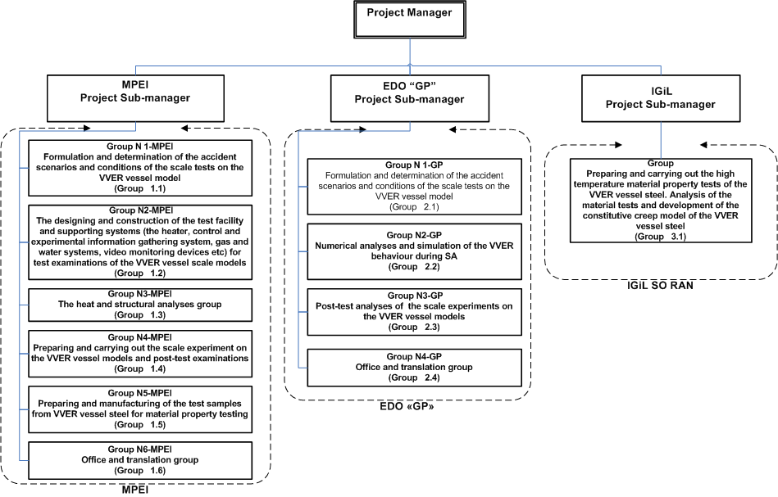
Managerial responsibilities

Slide 18
Thank You!
End

