Slide 1
ISTC Project «Scale experimental investigation of the thermal and structural integrity of the VVER Pressure Vessel Lower Head in severe accident» (#3635)
Participating Institutions:
- «Moscow Power Engineering Institute» (MPEI): Leading Institution
- Federal State Unitary Enterprise «Experimental and Design Organization “GIDROPRESS” (EDO «GP»)
- Lavrentyev Institute of Hydrodynamics of the Siberian Branch of the Russian Academy of Sciences (IGiL)
Start: Sept. 01, 2007
Duration: 36 months
ISTC Project #3635. 17th CEG-SAM meeting, Madrid, CIEMAT, Spain, March 29-31, 2010

Slide 2
Collaborators:
Forschungszentrum Karlsruhe GmbH (Germany)
CEA Saclay, DEN/DANS/DM2S/SEMT, Laboratoire de Mecanique Systeme et Simulation (France)
Material and Components Safety Department, Institut fur Sicherheitsforschung, Forschungszentrum Rossendorf (Germany)
EC JRC, Institute for Transuranium Elements (Karlsruhe), Hot Cell Technology (Germany)
Division of Nuclear Power Safety, Department of Physics, Royal Institute of Technology (Sweden)
Department of Engineering Physics, College of Engineering, University of Wisconsin (USA)
Institute of Nuclear Technology, Institute of Nuclear Safety System, Incorporated (Japan)
Mechanical & Nuclear Engineering, The Pennsylvania State University (USA)
ISTC Project #3635. 17th CEG-SAM meeting, Madrid, CIEMAT, Spain, March 29-31, 2010

Slide 3
The project efforts are focused on the following problems:
- the designing and construction of the test facility for test examinations of the VVER-440 vessel scale models on the conditions which correspond to SA in the VVER;
- manufacturing of the VVER-440 reactor vessel scale models (scale 1:5) . Material and technology, as well as thermal treatment have to correspond the same conditions of the regular VVER vessels manufacturing;
- pursuance of the material creep test experiments with samples from the VVER vessel steel on the time range 2-50 h and temperature range 700 - 1200 C to receive the creep data for refinement of the constitutive creep model and ordinary mechanical characteristics of this steel;
- the carrying out the scale experiments with VVER vessel models on the high-temperature heat-up and creep deformation of the vessel;
- the mathematical treatment and analysis of scale experiments, carrying out the numerical pre- and post-test structural analyses of scale experiments with vessel models
ISTC Project #3635. 17th CEG-SAM meeting, Madrid, CIEMAT, Spain, March 29-31, 2010

Slide 4
1. Task “А”: Development and manufacturing of the experimental test facility and supporting systems for the VVER scale vessel models testing (1)
Experimental test facility IVRSA-VVER (Investigation of the Vessel Rupture during Severe Accident on the VVERs) is intended for thermomechanical tests of scale models of the VVER reactor vessels in the conditions simulating a stage of SA in reactor installations with VVER, when the molten fragments of the core accumulate in the lower head of the reactor vessel.
The test facility consists of a protective casing, an auxiliary premise for placing of auxiliary systems, system of the model heating, water and gas systems, video monitoring system, and also data acquisition system (DAS).
Fig.1.1 – The sketch of the IVRSA experimental test facility
ISTC Project #3635. 17th CEG-SAM meeting, Madrid, CIEMAT, Spain, March 29-31, 2010

Slide 5
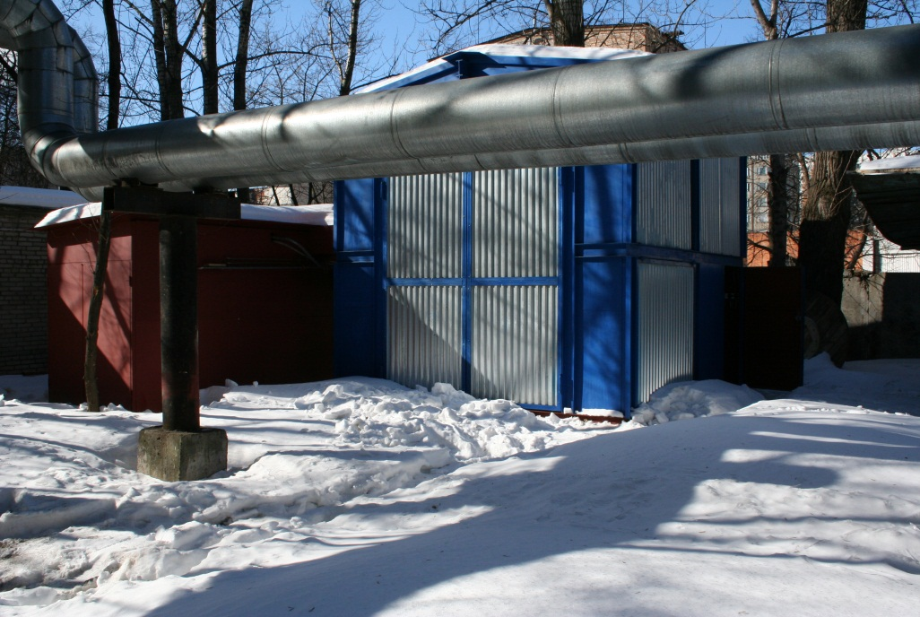
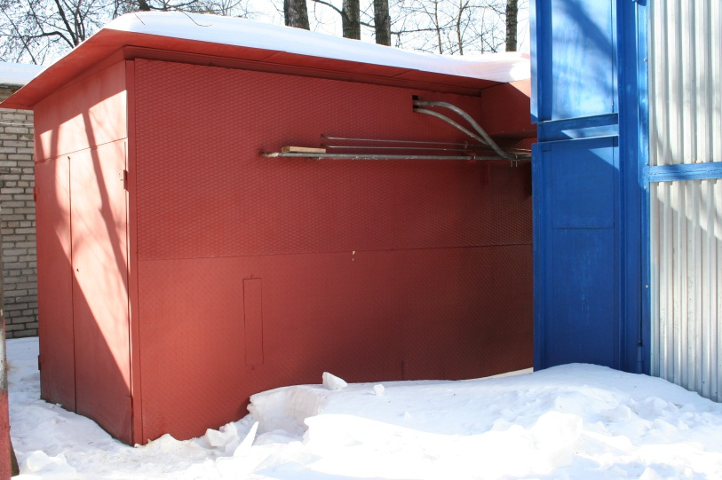
1. Task “А”: Development and manufacturing of the experimental test facility and supporting systems for the VVER scale vessel models testing (2)
Fig.1.2 – IVRSA experimental test facility (March, 2010)
Status: Erection of the IVRSA experimental test facility and auxiliary systems (electric, water, gas, DAS) are completed now
ISTC Project #3635. 17th CEG-SAM meeting, Madrid, CIEMAT, Spain, March 29-31, 2010

Slide 6
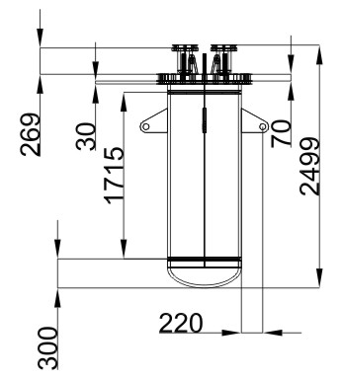
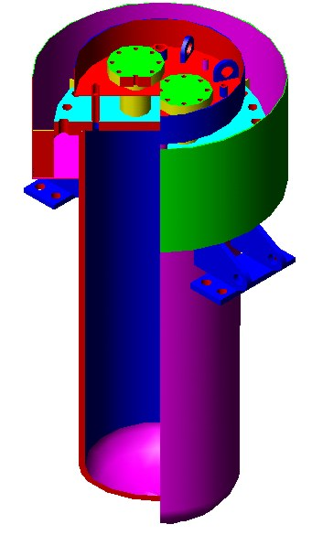
2. Task “B”: Experimental VVER-440 vessel scale model (1)
The object of investigations in the present project is the model of the VVER-440 reactor vessel (lower part) on scale ~1:5.
The material and technological features of scale models manufacturing should correspond as much as possible to the manufacturing technique of original VVER vessels. First of all, the following is meant herein:
- the material of the vessel model is the original VVER vessel steel (15Kh2NMFA);
- the technique of manufacturing of the vessel model components (manufacturing of forgings for steel bars of cylindrical course) and heat treatment should correspond to standard technique of the VVER vessels manufacturing.
Fig.2.1 – design of the vessel scale model. Var. #1 (“Base variant”)
During the project implementation some designs of the vessel model have been developed.
A design of the vessel model, presented in fig. 2.1, was developed as a base variant. In this construction the cylindrical course, the bottom and the flange of the vessel model have been made of the VVER vessel steel 15Kh2NMFA.
In connection with economic conditions which have developed in Russia in 2008-2009, manufacturing of the given model construction has been suspended.
ISTC Project #3635. 17th CEG-SAM meeting, Madrid, CIEMAT, Spain, March 29-31, 2010

Slide 7
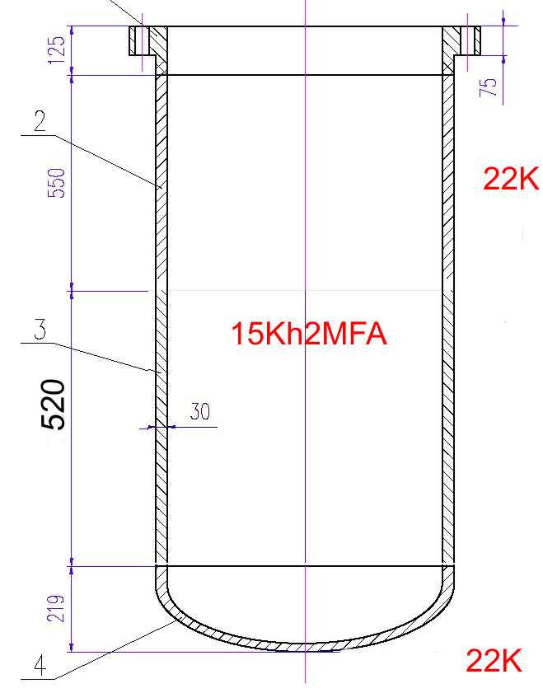
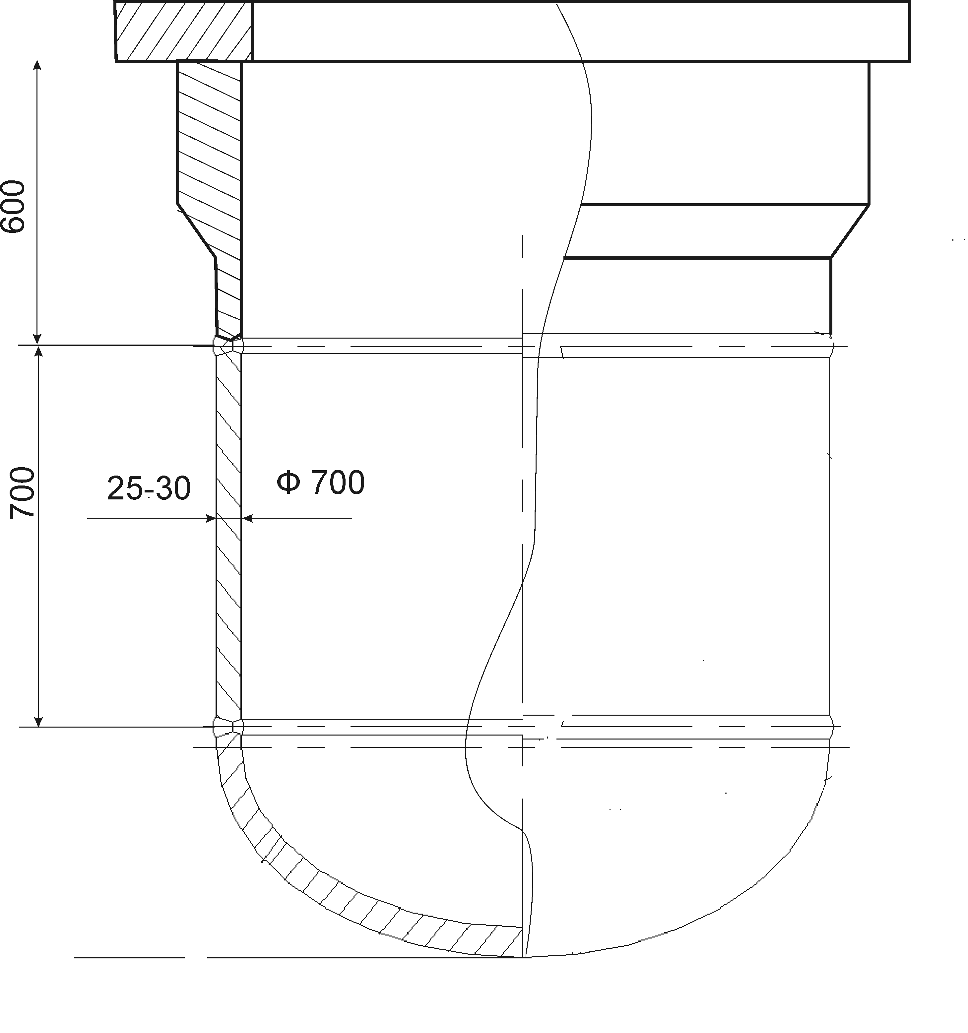
2. Task “B”: Experimental VVER-440 vessel scale model (2)
Fig.2.2 – Var. #2 of the vessel scale model design
Fig.2.3 – Var. #3 of the vessel scale model design
Fig.2.4 – Var. #4 of the vessel scale model design
The designs of the vessel scale model (Var. #2 … #4) are presented on fig. 2.2-2.4. These constructions of the vessel model are more simplified in comparison with a Var. #1.
Unlike a basic construction (fig. 2.1) in these constructions the VVER vessel steel is used only for those components of the construction (cylindrical course or the bottom) which will be investigated during tests.
Less critical components of the construction (the flange, etc.) are supposed to be made of a cheaper steel (Steel 20, 22K). Besides, the vertical sizes of the model variants #2 .. # 4 are much less than corresponding sizes of construction #1, that also reduces total weight of the VVER vessel steel in the model construction.
ISTC Project #3635. 17th CEG-SAM meeting, Madrid, CIEMAT, Spain, March 29-31, 2010

Slide 8
2. Task “B”: Experimental VVER-440 vessel scale model (3)
It was decided to start development and manufacturing of a simplified scale model construction the (Var. #4, fig. 2.5).
This decision is justified because it is planned in the scheduled experiment to study heating and deformation of the model cylindrical part. In this vessel model the VVER steel (15Kh2NMFA) is used for the cylindrical course of the vessel. The bottom of model is made of the Steel 20.
Features of the given vessel model design are the following:
there is a thermal insulation an internal surfaces of the bottom and cover. It will lead to decreasing of the thermal action from the heater to model construction.
presence of water cooling of a cover and the top part of the model.
Fig.2.5 – Var. #4 of the vessel scale model design
ISTC Project #3635. 17th CEG-SAM meeting, Madrid, CIEMAT, Spain, March 29-31, 2010

Slide 9
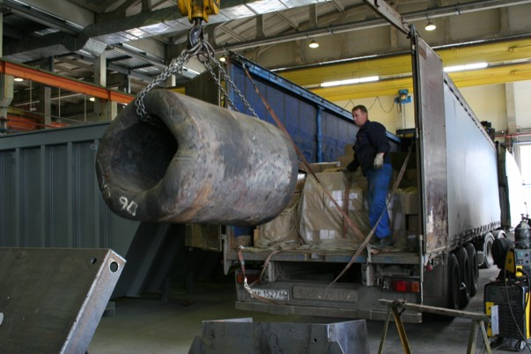
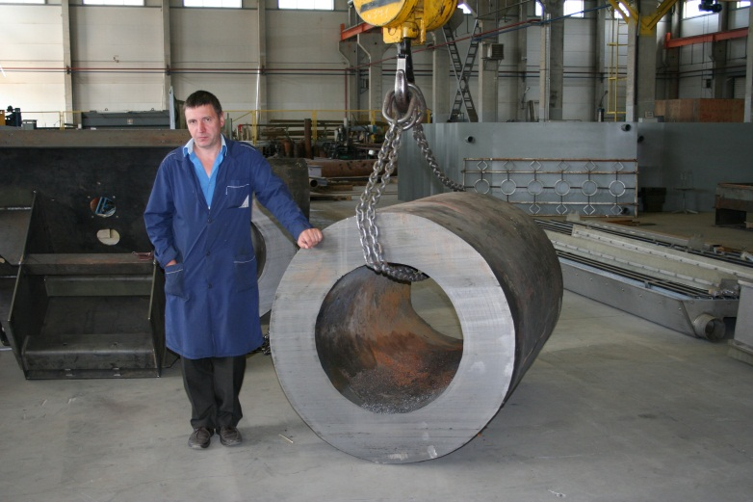
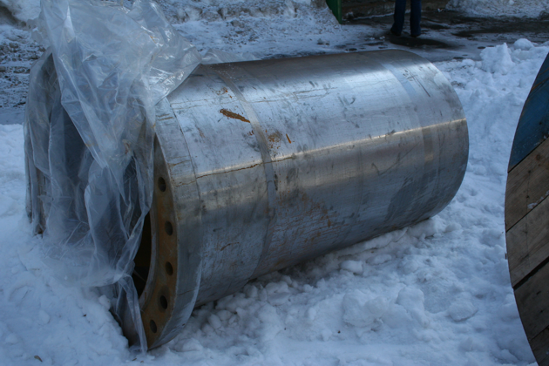
2. Task “B”: Experimental VVER-440 vessel scale model (4).
The main stages of the vessel model manufacturing
The billet from 15Kh2NMFA steel is used for the manufacturing of the vessel model (fig. 2.6).
After thermal treatment and of the vessel model, the final mechanical treatments will be carried out.
Planned date of the model manufacturing completion: 10-th quarter (the April-May, 2010).
Fig.2.6 – Preparation and machining of the
vessel models from the billet
ISTC Project #3635. 17th CEG-SAM meeting, Madrid, CIEMAT, Spain, March 29-31, 2010

Slide 10
3. Task “C”: Pre-test calculations. Expected thermal and deformation behaviour of the vessel model during the scale test (0)
Selection of conditions of the VVER-440 reactor vessel scale model testing
Main point:
In connection with the developed situation, testing of 1 vessel model is scheduled instead of 3 planned experiments.
In this connection, obtaining of maximum information on deformation and destruction features of the vessel model in the conditions of vessel steel high-temperature creep is extremely actual.
How can we realize it?
One of the ways is choosing of a step-by-step mode of heating and load change (owing to change of internal pressure in the vessel).
Duration of retention at each intermediate step of test will be determined proceeding from the value of the vessel model deformation which would allow to estimate speed of creep at each test step with sufficient accuracy.
Choosing of such test mode presuppose carrying out of justified pre-test calculations.
Fig.3.0 – Thermal/structural model for pre-test calculations
ISTC Project #3635. 17th CEG-SAM meeting, Madrid, CIEMAT, Spain, March 29-31, 2010

Slide 11
3. Task “C”: Pre-test calculations. Expected thermal and deformation behaviour of the vessel model during the scale test (1)
a=aconv+aradiation
T∞= 330 K
e= 0.7
Analytical studies include:
- the choosing of the accident scenarios and test conditions of the scale experiments;
- carrying out of the pre- and post-tests of the scale experiments
Expected Results:
Expected thermal and deformation behaviour of the vessel models (as a result of the pre-test calculations) during the scale tests, and the post-test calculation results of the performed experiments on the VVER vessel scale models
Heat flux distribution
Fig.3.1 – Thermal/structural model for pre-test calculations
ISTC Project #3635. 17th CEG-SAM meeting, Madrid, CIEMAT, Spain, March 29-31, 2010

Slide 12
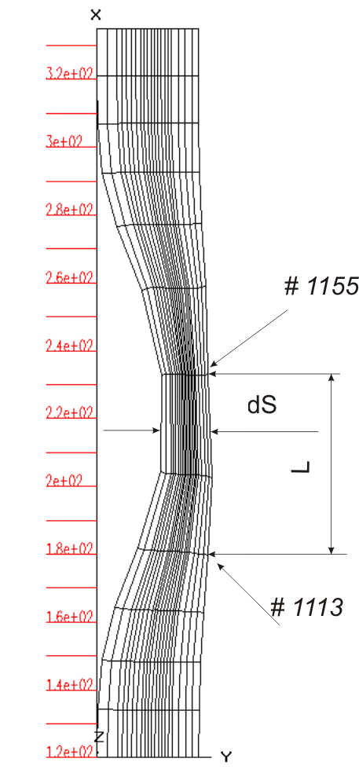
3. Task “C”: Pre-test calculations. Expected thermal and deformation behaviour of the vessel model during the scale test (2)
Z
Z
Deformation:
εz= (L/L0)
εr= (dS/dS0)
Fig.3.2 – Thermal/structural model for pre-test calculations
ISTC Project #3635. 17th CEG-SAM meeting, Madrid, CIEMAT, Spain, March 29-31, 2010

Slide 13
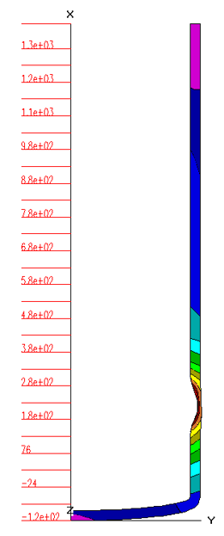
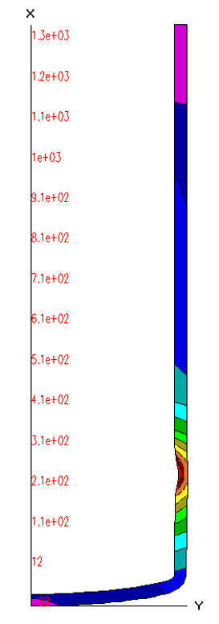
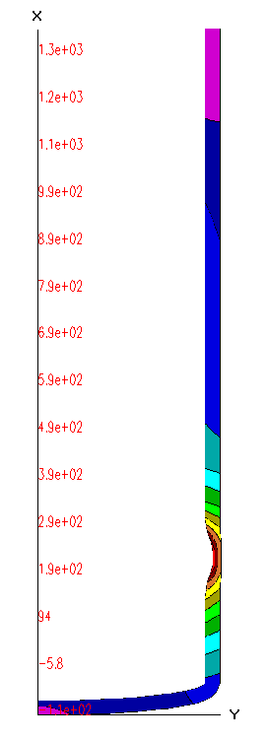
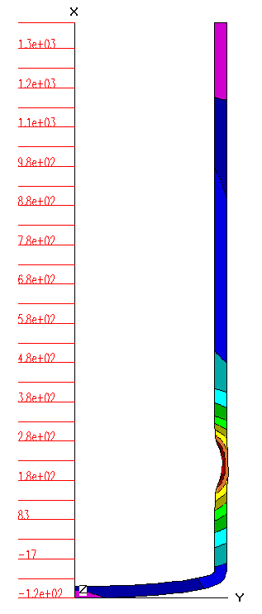
3. Task “C”: Pre-test calculations. Expected thermal and deformation behaviour of the vessel model during the scale test (3)
Var#1
Var#2
Var#3
Var#4
Var1: Time= 4.5 h; ε_{z} ~ 1 Var2:Time= 3.9 h; ε_{z} ~ 0.72 Var3:Time= 15 h; ε_{z} ~ 1.1 Var4:Time= 187 h; ε_{z} ~ 0.28
Fig.3.3 – Numerical results of the pre-test calculations. Scenarios Var.#1-Var.#4
ISTC Project #3635. 17th CEG-SAM meeting, Madrid, CIEMAT, Spain, March 29-31, 2010

Slide 14
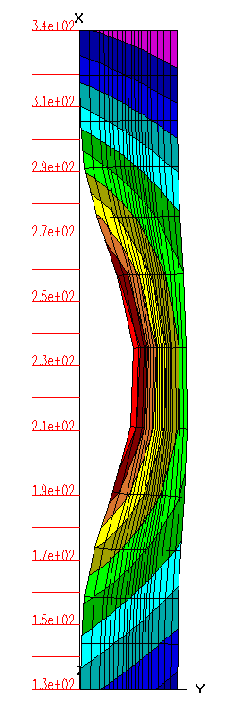
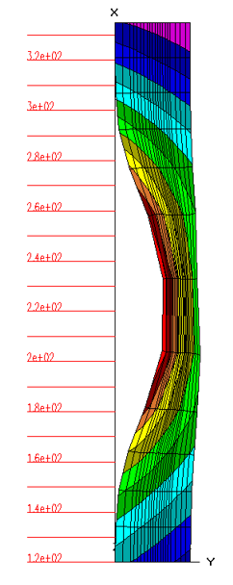
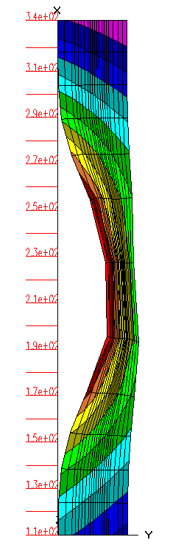
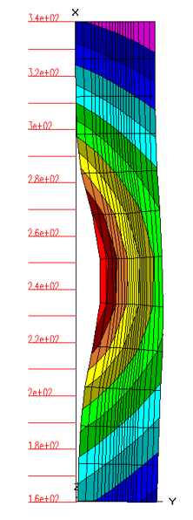
3. Task “C”: Pre-test calculations. Expected thermal and deformation behaviour of the vessel model during the scale test (4)
Var #1: Time= 4.5 h
Var #2: Time= 3.9 h
Var #4: Time= 187 h
Var #3: Time= 15 h
Fig.3.4 – Numerical results. Scenarios Var.#1-Var.#4
ISTC Project #3635. 17th CEG-SAM meeting, Madrid, CIEMAT, Spain, March 29-31, 2010

Slide 15
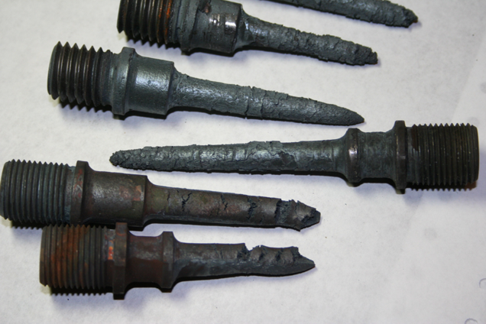
3. Task “C”: Pre-test calculations. Expected thermal and deformation behaviour of the vessel model during the scale test (5)
One of the main Problems during the scale test: oxidation of the outer vessel surface
Fig.3.5 – Samples from the 15Kh2NMFA steel after tests at 1000-1100 C (air). The duration of the tests: up to 3 h.
ISTC Project #3635. 17th CEG-SAM meeting, Madrid, CIEMAT, Spain, March 29-31, 2010

Slide 16
4. The Task “D”: The manufacturing and material creep testing of the samples from VVER vessel steel and material property creep testing of the samples cut from the tested VVER vessel models (1)
A vessel steel 15Kh2NMFA (TS 108-765-78) of which the lower course of the VVER vessel No. 1152.02.70.000 (number of fusion 107210), number of forgings 5015 has been made was the material which mechanical properties were subject to definition in process of material property studies.
The specimens fabricated for the tests had circular cross-section of 8 mm diameter and working length of 45 mm. The specimens were made in two variants: without a thread part and with a thread part for fastening in pinchers of the testing machine).
Main results:
1) Creep experiments were carried out in the temperature range from 750 to 1050 C and on the time base up to 50 hours at constant load;
2) Tests were carried out, as a rule, in the protective medium of argon, but some modes of tests were carried out in the air medium;
3) absence of protective medium leads to considerable hardening of material and slowing-down of deformation process at creep of this steel. It is connected, first of all, with formation of hard oxide film on the tested specimens surface;
4) with increase of the process duration, deformation at the moment of the specimens destruction considerably increases.
ISTC Project #3635. 17th CEG-SAM meeting, Madrid, CIEMAT, Spain, March 29-31, 2010

Slide 17
4. The Task “D”: The manufacturing and material creep testing of the samples from VVER vessel steel and material property creep testing of the samples cut from the tested VVER vessel models (2)
Determination of the stress exponent parameter (n) at minimum creep rate equation
n =4,17
n= 4,837
n = 4,319
n = 4,826
T= 900 C
(argon)
Fig. 4.1
ISTC Project #3635. 17th CEG-SAM meeting, Madrid, CIEMAT, Spain, March 29-31, 2010

Slide 18
4. The Task “D”: The manufacturing and material creep testing of the samples from VVER vessel steel and material property creep testing of the samples cut from the tested VVER vessel models (3)
n =4,476
n= 5,16
(argon)
n = 5,893
(argon)
Fig. 4.2
ISTC Project #3635. 17th CEG-SAM meeting, Madrid, CIEMAT, Spain, March 29-31, 2010

Slide 19
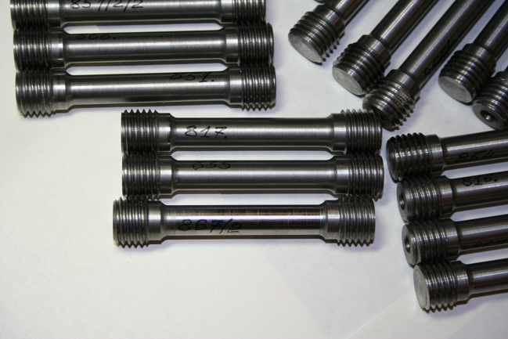
4. The Task “D”: The manufacturing and material creep testing of the samples from VVER vessel steel and material property creep testing of the samples cut from the tested VVER vessel models (4)
Tensile Tests and Creep testing of the 15Kh2NMFA Steel in vacuum
Now preparation of the additional series of creep tests at temperatures above 850 С in vacuum is performed.
The main results of these tests are presented in the below mentioned diagrams.
The specimens for testing in vacuum at temperature 900-1200 C
fabricated from 15Kh2NMFA vessel steel and have circular cross-section of 10 mm diameter and working length of 45 mm.
Fig. 4.3- Specimens for mechanical tests of the VVER vessel steel in vacuum
ISTC Project #3635. 17th CEG-SAM meeting, Madrid, CIEMAT, Spain, March 29-31, 2010

Slide 20
4. The Task “D”: The manufacturing and material creep testing of the samples from VVER vessel steel and material property creep testing of the samples cut from the tested VVER vessel models (4)
Tensile Tests and Creep testing of the 15Kh2NMFA Steel in vacuum. T= 900-1200 C. Strain rate ~ 0.004 s⁻¹
Total Elongation
Yield Stress
Ultimate Strength
Fig. 4.4- Tensile tests of the VVER vessel steel in vacuum vs temperature
ISTC Project #3635. 17th CEG-SAM meeting, Madrid, CIEMAT, Spain, March 29-31, 2010

Slide 21
CONCLUSION
1) the 1-st test of the scale model is planned to lead during June-Sept. 2010 г;
2) For successful carrying out of experiment it is necessary:
- to develop and coordinate the test scenarios by with all interested parties (collaborators and participants of the project).
- to carry out the pre-test calculations of the test scenarios by various settlement codes and the programs which are available at collaborators and participants of the project. It will allow to lower a risk of the negative result (premature failure of the model, etc.) at carrying out of the scale experiment.
ISTC Project #3635. 17th CEG-SAM meeting, Madrid, CIEMAT, Spain, March 29-31, 2010

Slide 22
Queries to ISTC and collaborators of the given Project:
At present the fabrication of the 2nd and 3rd models of the vessel seems to be not feasible without the appropriate financial support from EC countries and Rosatom.
Therefore, performing of the 2nd and 3rd experiments in the terms set forth in the Work plan (ending in September, 2010), is not feasible.
In this connection there are following queries:
Issue No.1:
- Is it expedient to go on with the subsequent studies on the Project matter after the test of the 1-st vessel model?
Issue No.2 (if the reply to issue No.1 is positive):
- Is an additional financial support from EU possible? Here we mean that the support is necessary both for manufacturing the vessel models (or for performing the tests of these models).
The replies to the given issues are extremely necessary for the proper understanding of our further actions after performing the 1-st test of the vessel scale model.
Issue No.3:
- Is the prolongation is reasonable without additional financing from ISTC?
By the present moment a positive interest in extending the activities on the subject matter of studies under the given Project has been expressed by the leading organizations of Rosatom. In case of support of the given studies by Rosatom there is a real possibility to extend these activities. Negotiations are under way as well as the appropriate work with the interested organizations of Rosatom concerning the given direction of studies.
ISTC Project #3635. 17th CEG-SAM meeting, Madrid, CIEMAT, Spain, March 29-31, 2010

Slide 23
Thank You!
End
ISTC Project #3635. 17th CEG-SAM meeting, Madrid, CIEMAT, Spain, March 29-31, 2010

