Slide 1
FSUE SRI SIA “LUCH”
IBRAE RAS
OKB “GIDROPRESS”
I S T C
Final report on the ISTC project #3690 on the “Fuel assemblies behaviour under severe accident top quenching conditions in the PARAMETER-SF test series”
(PARAMETER-SF3 and PARAMETER-SF4 experiments)
Presented by D. Ignatiev
CEG-SAM – 17, Madrid, Spain, March 29-31, 2010.
Notes:
Dear coleegs!!! I’d like to introduse you Final report on the ISTC project #3690 “Fuel assemblies behaviour under severe accident top quenching conditions in the PARAMETER-SF test series”

Slide 2
Research activities at SIA LUCH
Department
of technical diagnostic and material investigation
Laboratory of thermal physics research
PARAMETER
facility
Laboratory of
Material investigation
Notes:
But first of all, as secretary of ceg-sam mr. Peter Hofmann acked, I wan to say a few words about my Research activities at SIA LUCH
I represent the Department of technical diagnostic and material investigation, which consist of three laboratories….. These three parts a single whole allow to solve very difficult scientific problem includin the studuing of model fuel assemblies in severe accident conditions

Slide 3
The Structure of Project #3690
1. The basic participants:
FSUE SRI SIA “LUCH”
IBRAE RAS
FSUE EDO “GIDROPRESS”
2. Another participants:
A.A. Bochvar FSUE VNIINM,
A. I. Leipunsky SSC RF-IPPE,
RSC “Kurchatov Institute”
3. Foreign collaborators: FZK, GRS, EdF, INRNE, ITU, PSI, AEKI, CEA
Objective of Project #3690
The study of two 19-fuel rod model FAs of VVER-1000 behaviour, completed with standard reactor structural materials (fuel rod claddings of alloy Zr+1%Nb, fuel pellets of uranium dioxide, spaсing grids and shroud of alloy Zr+1%Nb), under the initial stage of severe accident with top quenching.
Notes:
As you know The Project was executed jointly by three organizations: SIA “LUCH”, IBRAE, “GIDROPRESS” with participation of the leading specialists from “VNIINM”, “Kurchatov Institute”, RF - IPPE and very impotant methodical support of foreign collaborators
The Objective of Project was The study of two VVER model FAs behaviour under the initial stage of severe accident with top quenching.
And also Within the framework of the this Project were conducted material studies of the model assembly tested in SF2 experiment under the preceding ISTC Project No. 3194.

Slide 4
Work Plan of Project #3690
Task 1. The post-test material analysis of VVER-1000 model FA,
subjected to tests in experiment PARAMETER-SF2 under severe
accident with top and bottom quenching.
Task 2. The study of cooling behavior and change in the
structure of VVER-1000 FA materials under severe accident
during top quenching of the assembly heated to the temperature
below 1600°С (PARAMETER-SF3).
Task 3. The study of VVER-1000 FA behaviour under severe
accident during bottom quenching of the assembly heated up to the
temperature 1750°C in the environment of air (PARAMETER-SF4).
Notes:
According to the Work Plan of Project the following tasks were completed:
Task 1 – Post-test material analysis of fuel assembly, subjected to tests in experiment PARAMETER-SF2;
Task 2 – The study of cooling behavior and change in the structure of VVER FA materials under severe accident
during top quenching of the assembly heated to the temperaturebelow 1600°С (PARAMETER-SF3).
Task 3 – The study of VVER FA behaviour under severe accident during bottom quenching of the assembly heated up to the
temperature 1800°C in the environment of air (PARAMETER-SF4).

Slide 5
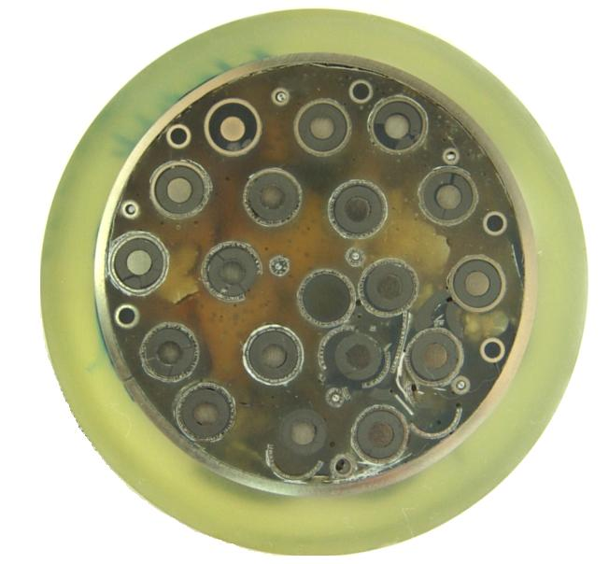
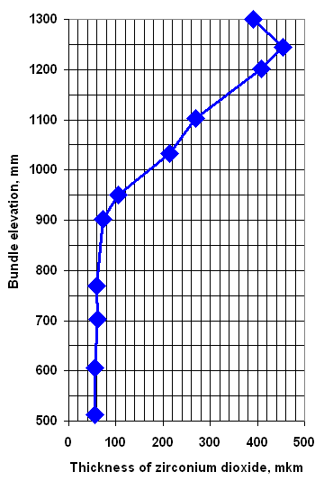
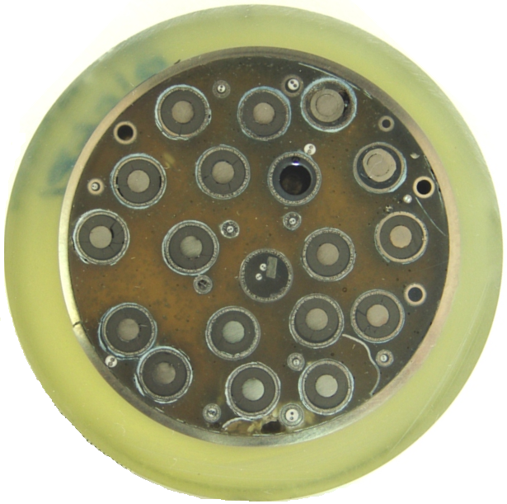
Post-test Analysis of SF2 Fuel Assembly
Material Investigation
Task 1.
Z = 1100 mm elevation (top view)
Z = 1200 mm elevation (top view)
Distribution of the averaged thickness of calculated oxide scale on cladding surfaces
Notes:
Experiment PARAMETER-SF2 was performed with the aim of studying the behaviour of a 19-rod VVER model FA under simulated severe accident condition with heating-up to ∼ 1500°C and top and bottom water quenching.
According to the results of temperature measurements, the hottest zone was observed in the assembly upper part at the elevations of 900…1300 mm and, consequently, the highest degree of oxidation of the shroud and claddings corresponded to this zone. Therefore, the metallographic measurements of layer thickness in this area were done with more details
By the results of metal layers thickness measurements we receive Distribution of the averaged thickness of calculated oxide scale on cladding surfaces

Slide 6
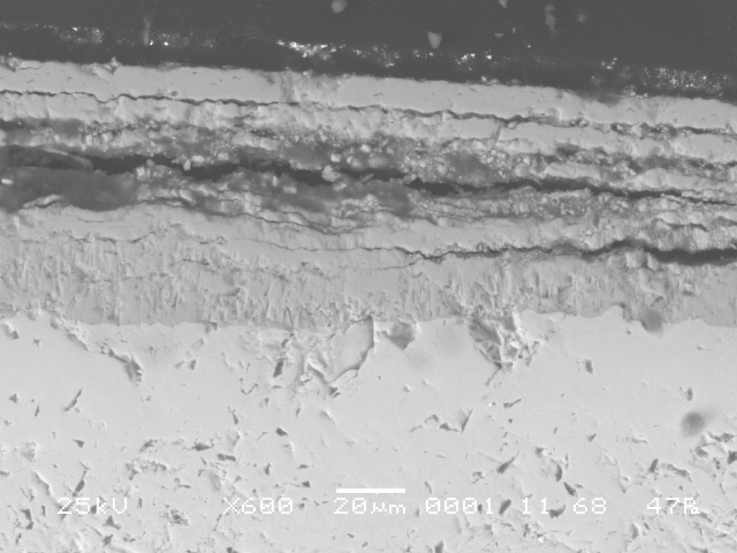
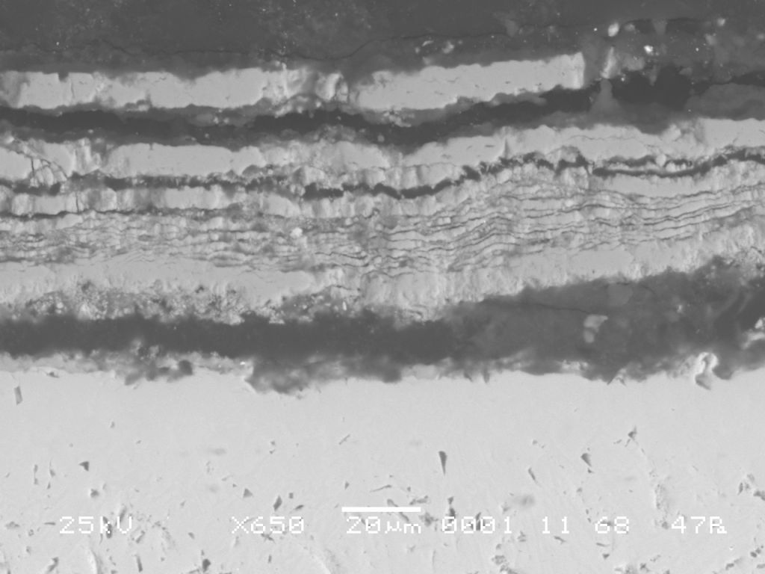
Task 1.
Post-test Analysis of SF2 Fuel Assembly
Material Investigation
- The state of the lower part of heated zone (Z = 0…400 mm) does not practically differ from the original state, and oxide thickness on the external surface does not exceed 5…10 μm.
- In the middle part of heated zone (Z = 500…800 mm) claddings are covered with multilayered zirconium dioxide, separating from metal surface, but its thickness does not exceed ~ 100 μm.
rod 2.1, Z = 513 mm
rod 2.3, Z = 513 mm
Notes:
Analysis of the post-test material studies results showed that irregularity of the assembly axial temperature profile distribution caused different degree of its damages.
The state of the assembly lower part does not differ from the original state
In the middle part of the assembly cladding surface is covered with multilayered zirconium dioxide, and its thickness does not exceed ~ 100 μm.

Slide 7
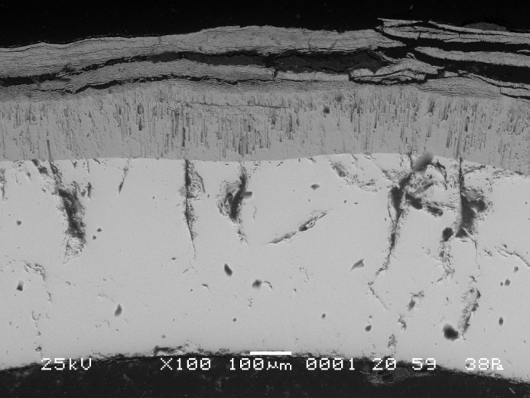
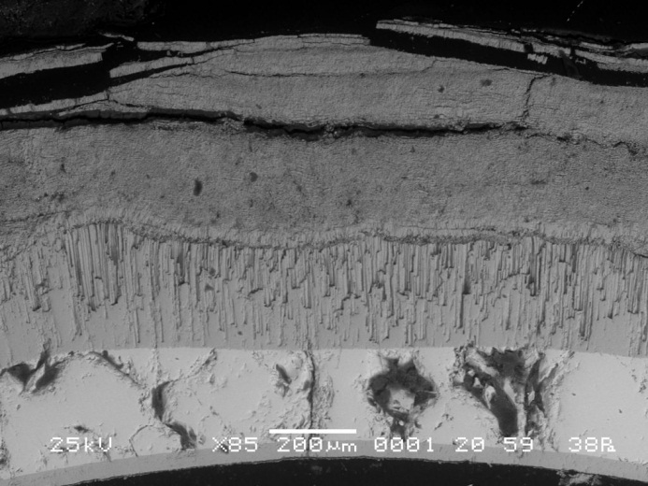
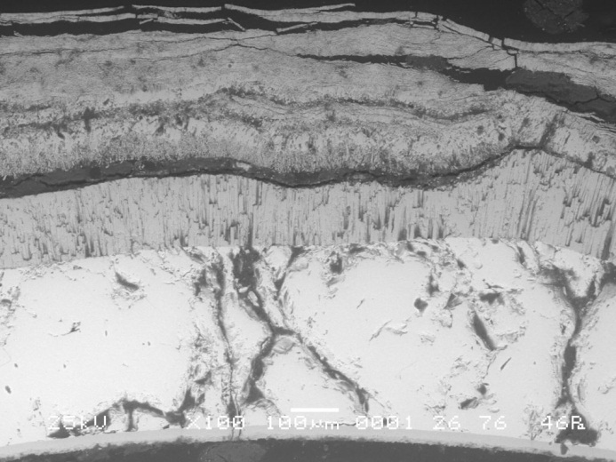
Task 1.
Post-test Analysis of SF2 Fuel Assembly
Material Investigation
- In the upper part of heated zone (Z = 900…1300 mm) claddings are oxidized both on the external (to 650 μm), and on the internal (to 50 μm) surfaces. The fuel rod claddings are embrittled, i.e. have through wall cracks, however fragmentation of fuel rods is limited. No fuel relacation and fuel-clad interaction are revealed in the assembly.
rod 2.2, Z = 1103 mm
rod 2.5, Z = 1103 mm
rod 2.1, Z = 1250 mm
- Taking into account the results of measurement of hydrogen content in the shroud, the upper limits of total hydrogen mass in the steam-gas environment can be estimated to be 31 g. The assessed value is in a good agreement with the results of measurements (∼ 28 g).
Notes:
In the upper part of the assembly claddings are oxidized both on the outer and on the inner surfaces. Zirconium dioxide has different morphology. The metal part of the claddings presents the oxygen-stabilized α phase (α - Zr (О)). The fuel rod claddings are embrittled, and have through-wall cracks, however fragmentation of fuel rods is limited. No fuel flaking and fuel-clad interaction are revealed in the assembly.
On the basis of the metallographic studies results the evaluation was done for the maximum possible hydrogen mass that could release into steam-gas environment during the experiment. Taking into account the results of measurements of hydrogen content in the shroud the hydrogen mass in the steam-gas environment shall not exceed 31 g. The obtained value is in a good agreement with the results of measurements (∼ 28 g)

Slide 8
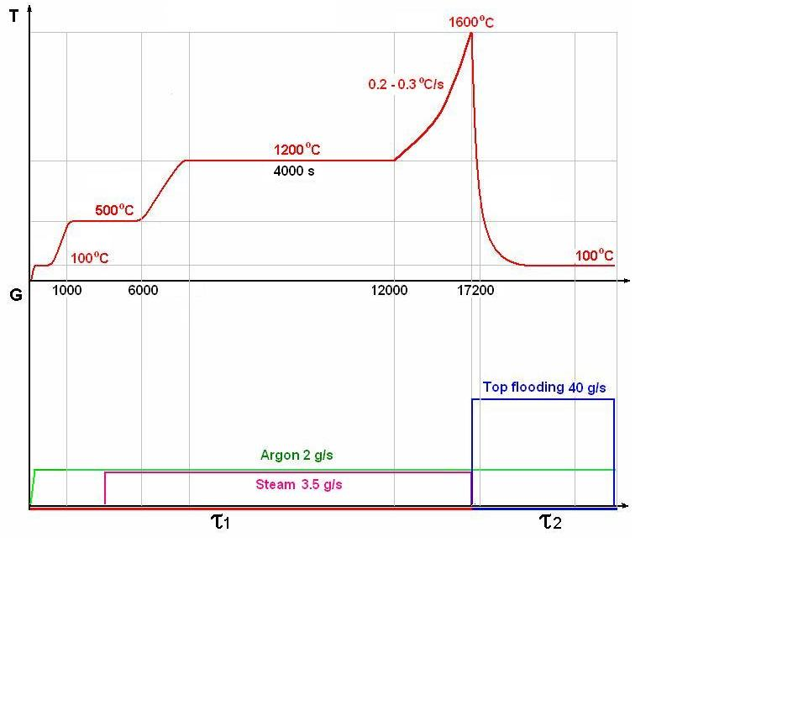
Task 2.
The PARAMETER-SF3 Test Scenario
Main parameters of the experiment
Sequence diagram of the experiment
Coolant | Steam/ argon
Flow rate of coolant, g/s | 3.5/2
Temperature of coolant, °C | ∼500
Heating rate of cladding, °C /s | 0.2- 0.3
Temperature of cladding at the pre-oxidation phase, °C | ∼1200
Duration of the pre-oxidation phase, s | ∼ 4000
Maximal temperature of cladding, °C | 1600
Quenching phase | Top flooding
Flow rate of top flooding, g/s | ∼ 40
Notes:
SF3 experiment was performed with the aim of studying the behaviour of a 19-rod VVERmodel FA under simulated severe accident conditions including its heating-up to ∼ 1600°C and low rate top flooding.
The experiment consisted of five stages:
- preparation stage;
- assembly heating-up to temperature of ≈ 1200°С (4506 – 9760 s);
- pre-oxidation (9760 – 13725 s);
- assembly heating-up to maximum temperature in the hottest section to 1600°С;
- flooding (14486 – 14960 s) – top flooding of the assembly

Slide 9
Task 2.
The PARAMETER-SF3 Test Results
1. The main parameters of experiment:
- the steam flow rate ~ 3.5 g/s at temperature ~ 500 °С;
- the argon flow rate ~ 2.0 g/s at temperature ~ 400 °С;
- the duration of the pre-oxidation stage ~ 3970 s at temperature ~ 1200 °С;
- the maximal temperature of the bundle - 1600°С at maximal heating rate ~ 0.5 °С/с.
2. The total of hydrogen measured by continuous monitoring systems of hydrogen (SOV-3), has not exceeded ~34 g, and maximum rate of hydrogen generation was ∼ 0,02 g/s
3. The cooling overheated up to ~ 1600°C of the bundle has been achieved for ~ 470 s at the water flooding from top with flow rate ~ 40 g/s.
Notes:
experiment SF3was conducted on 31 October, 2008
In PARAMETER-SF3 experiment, on the whole, the stages of heating and pre-oxidation of the model assembly were realized successfully.
The top flooding was successful.
the maximal temperature of the bundle - 1600°С at maximal heating rate ~ 0.5 °С/с.
Analysis of the hydrogen measurement results showed that during the experiment ∼ 34 g of hydrogen was generated.
The cooling overheated up to ~ 1600°C of the bundle has been achieved for ~ 470 s at the water flooding from top with flow rate ~ 40 g/s.

Slide 10
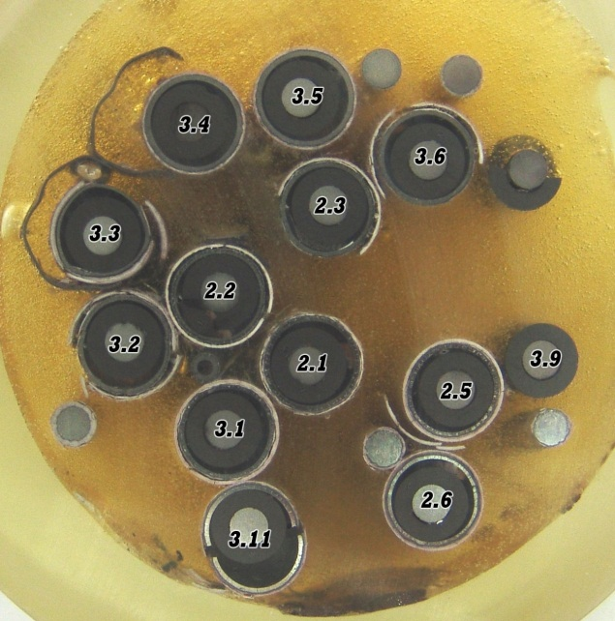
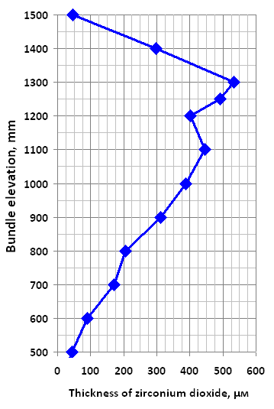
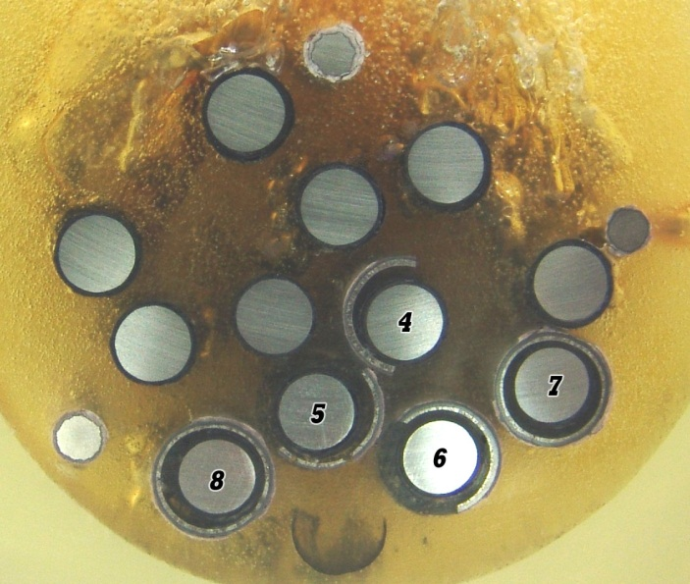
Main results of SF3 fuel assembly post-test
material Investigation
Task 2.
Z = 1000 mm elevation (top view)
Z = 1300 mm elevation (top view)
Distribution of the averaged thickness of calculated oxide scale on cladding surfaces
Notes:
Using the expirience of SF2 FA studying, the main attention in post-test studies was directed to the FA middle (500 – 800 mm) and upper (900 – 1500 mm) parts. For metallographic studies, 12 cross section slabs were chosen.
According to the results of temperature measurements, the hottest zone location was observed in the assembly upper part at 1250-1300 mm and so, the highest degree of oxidation of the shroud and claddings would corresponds to this zone. Metallographic measurements of layers thickness at the upper part of the bundle were done with more detail.
By the results of measurements we receive Distribution of the averaged thickness of calculated oxide scale on cladding surfaces.

Slide 11
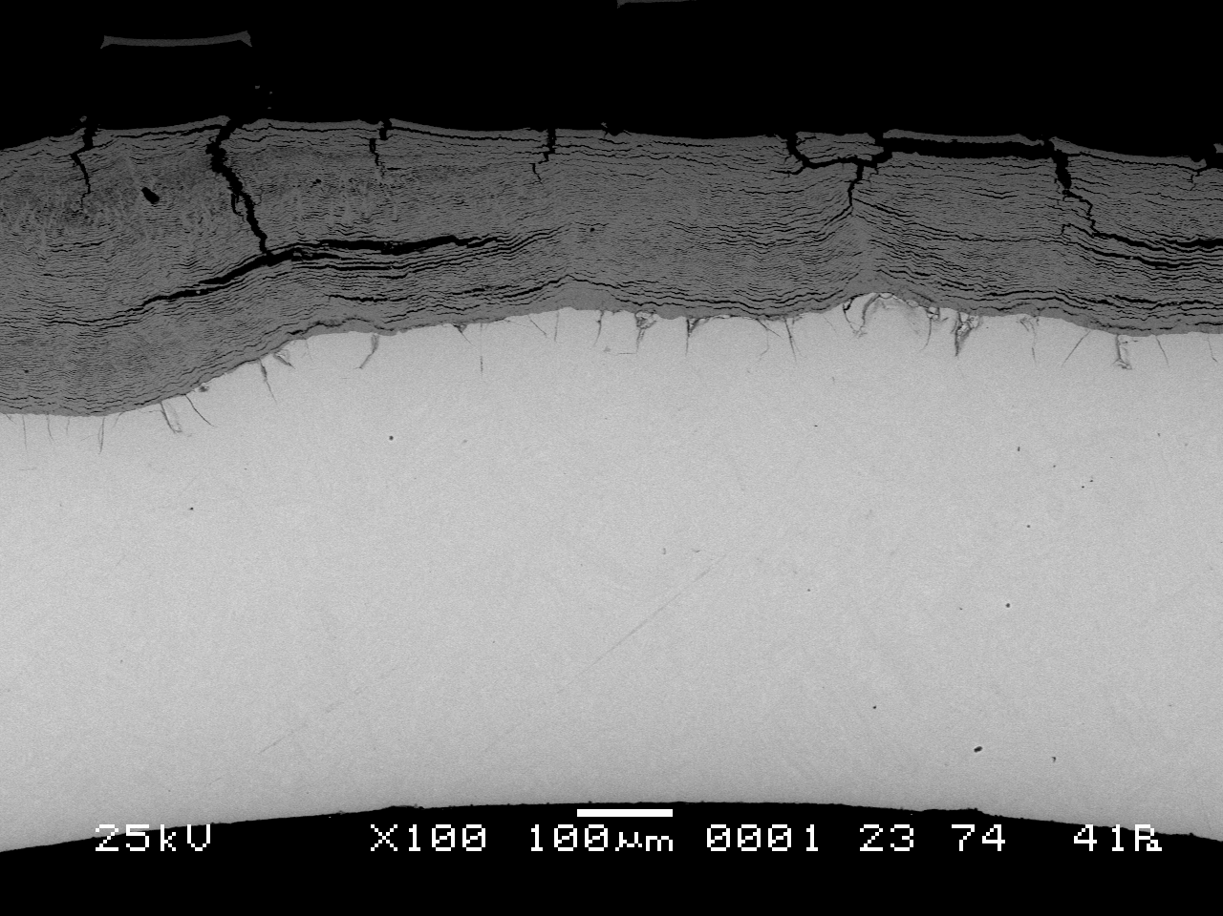
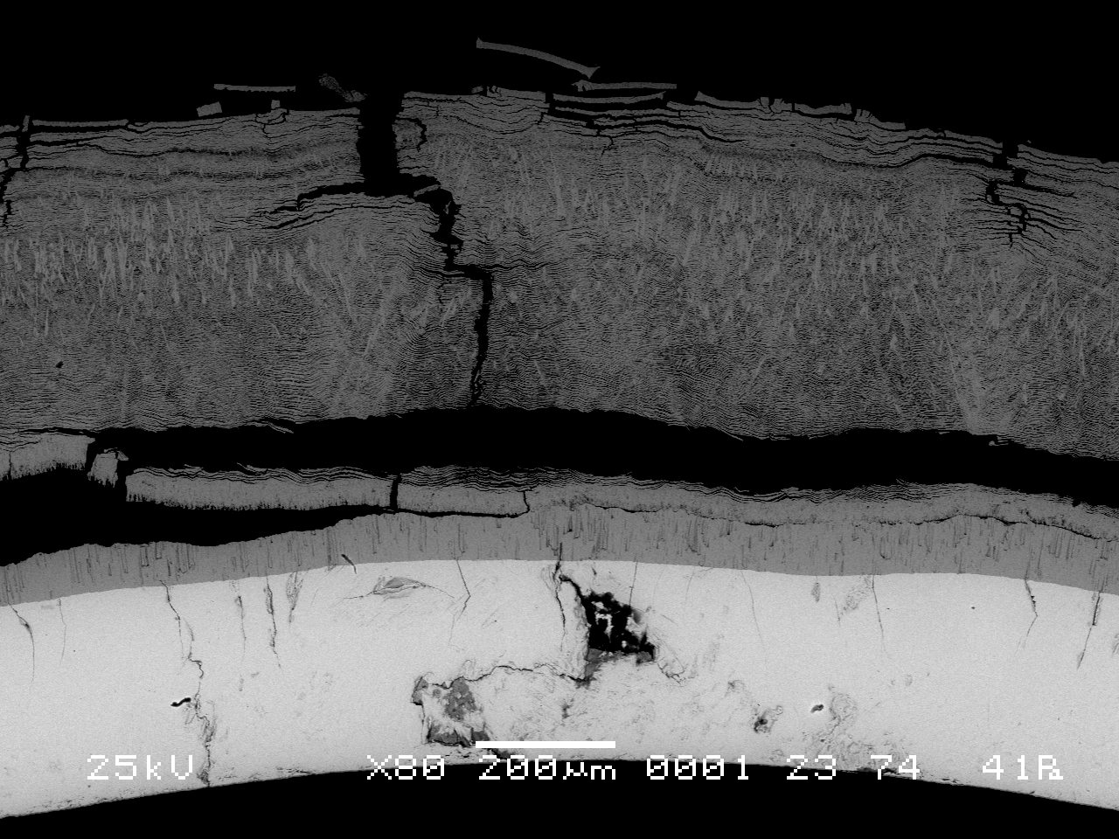
Task 2.
Main results of SF3 fuel assembly post-test
material Investigation
- The state of the assembly lower part (0…400 mm) does not differ practically from the initial state, and the oxide thickness on the outer surface does not exceed 2-10 μm; - In the middle part of heated zone (500…1300) mm there is a multi-layer separating zirconium dioxide on fuel rod claddings and its thickness on some fuel rods (at 800 mm elevation) reaches ~ 400 μm. ;
rod 2.2, Z = 800 mm
rod 2.5, Z = 800 mm
Notes:
Analysis of post-test material studies showed that:
- the state of the assembly lower part does not practically differ from the original state,
- within the middle elevation range there is a multilayered zirconium dioxide spalling off the fuel rod claddings, and its thickness on some fuel rods (at 800 mm elevation) reaches ~ 400 μm.

Slide 12
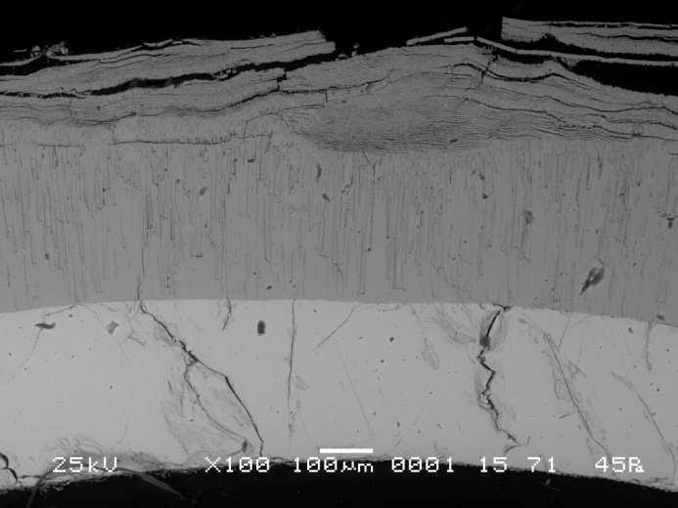
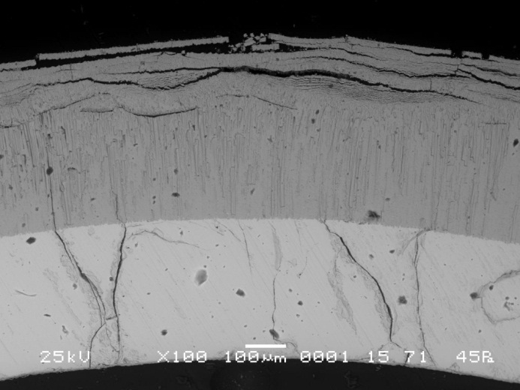
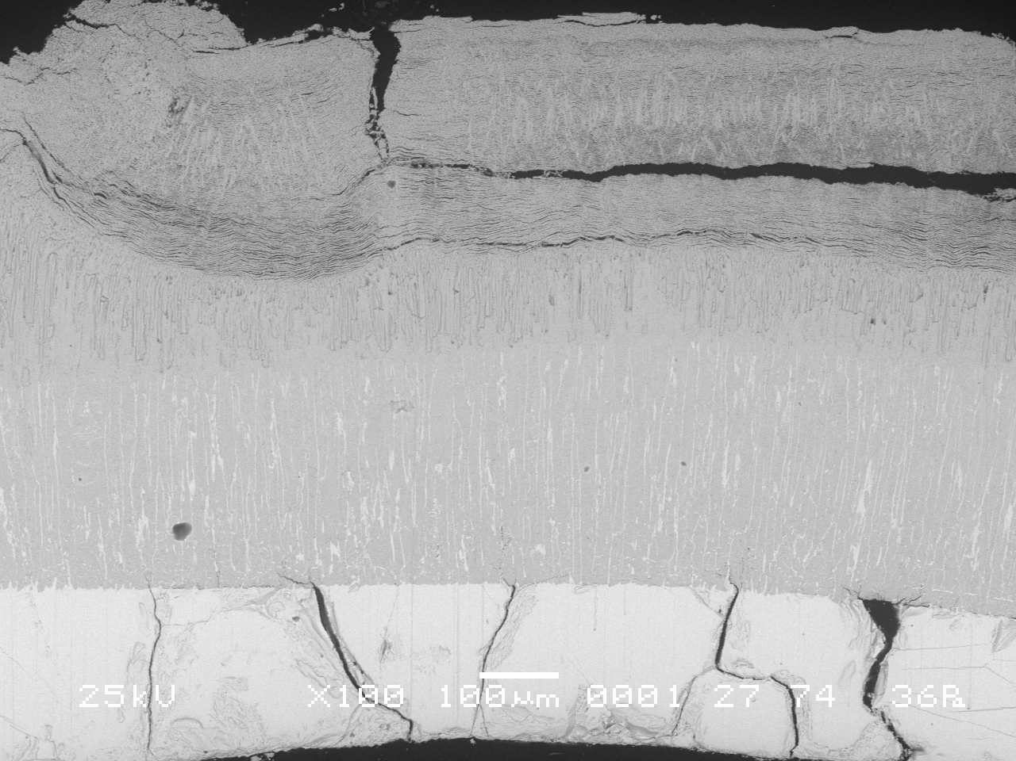
Task 2.
Main results of SF3 fuel assembly post-test
material Investigation
- In the upper part of heated zone (Z = 900…1300 mm) the rods arrangement is greatly distorted. The claddings are oxidized both on the external (to 550 μm), and on the internal (to 50 μm) surfaces.
rod 2.2, Z = 1200 mm
rod 3.11, Z = 1200 mm
Z = 1300 mm
- The mass of generated hydrogen, estimated “from above”, corresponds to the value of ∼42 g. For comparability with the mass measured in the experiment it is necessary to consider additionally the mass of hydrogen absorbed by FA components, at least due to the shroud hydrogenation.
Notes:
In the upper part (Z = 900…1300 mm) claddings oxidized both on the outside and on the inside surfaces. Zirconium dioxide has different morphology. The inside part of the oxide scale is a dense, well-bound with the metal part, zirconium dioxide of columnar structure that was formed, evidently, at the stage of heating-up to maximum temperature. Outside the dense dioxide there is the zirconium dioxide of multiplayer structure, separating from cladding. The metal part of claddings presents the oxygen-stabilized α phase (α - Zr (О)). The fuel rod claddings are embrittled, i.e. have the through cracks, and fragmented. No fuel-clad interaction is revealed in the assembly.
The mass of hydrogen generated due to oxidation and calculated “from above” corresponds to the value of ∼42 g. To make a comparison with the experimentally measured mass it is necessary to consider additionally the mass of hydrogen absorbed by FA components, at least, due to the shroud hydrogenation.
Post-test calculations of the experiment were carried out by computer codes SOCRAT, RELAP/SCDAPSIM MOD3.2, ICARE/CATHARE, PARAM-TG, ATHLET-CD. Comparative analysis of the results enable to conclude that all of them give a satisfactory description of temperature behaviour and of the processes occurring in the FA

Slide 13
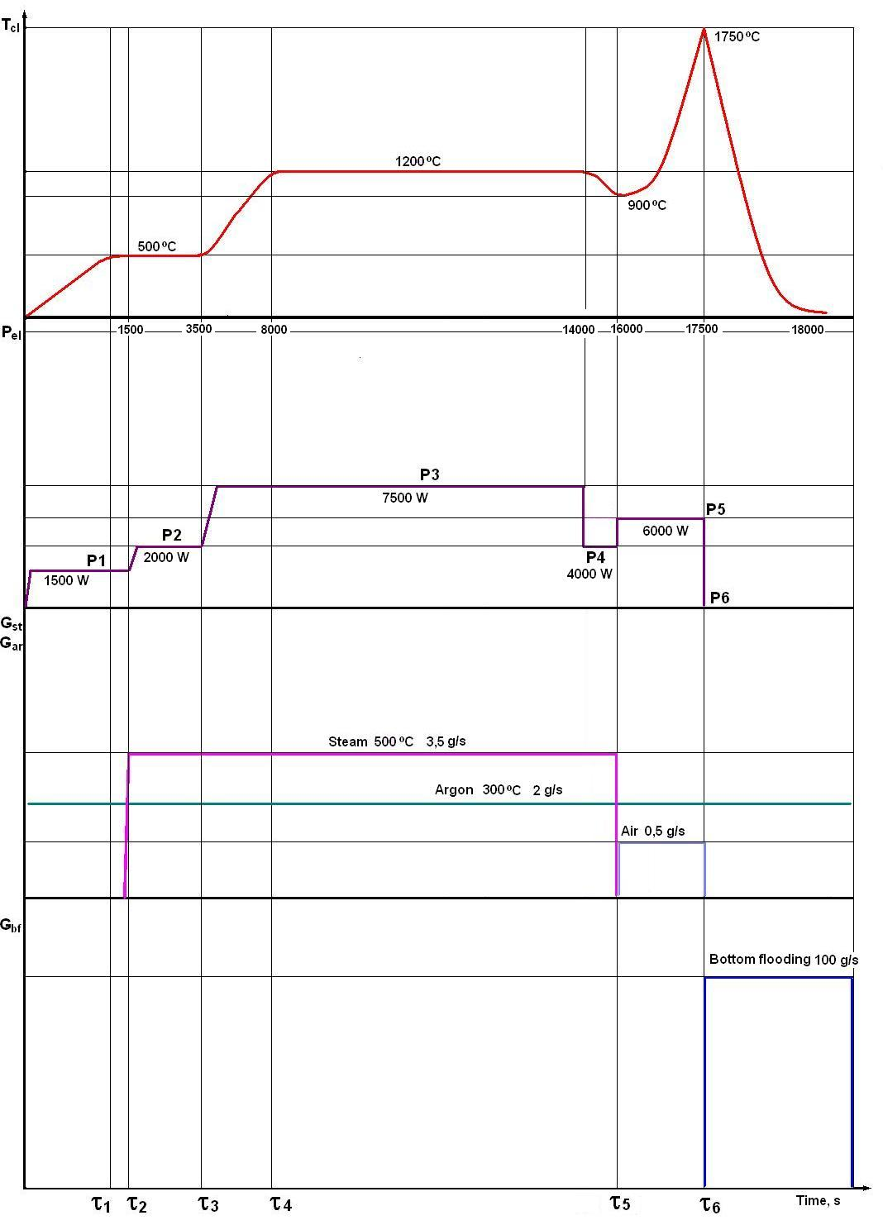
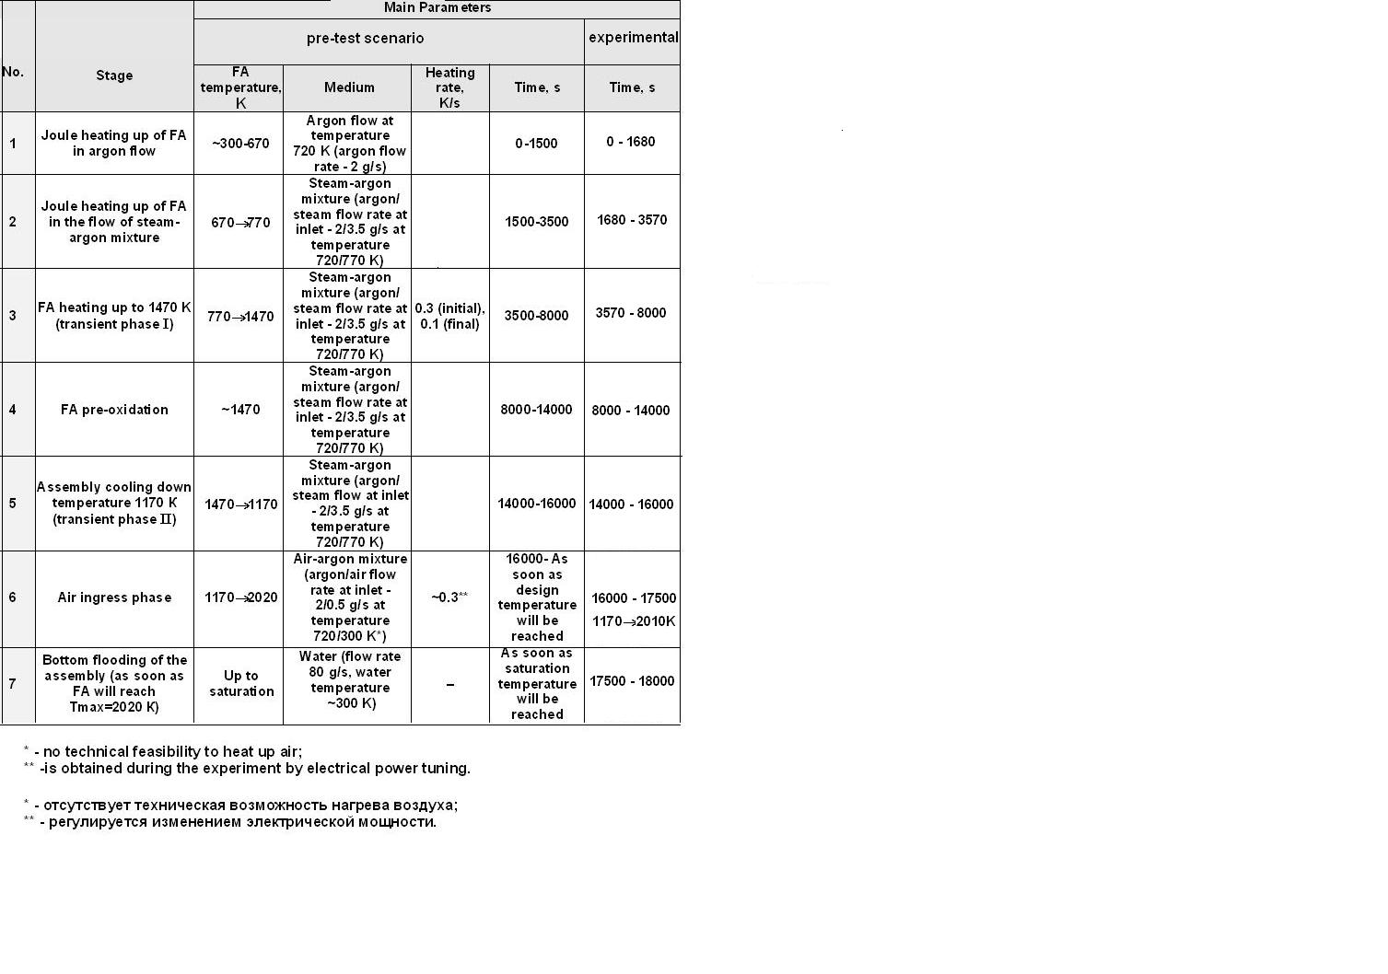
Task 3.
The PARAMETER-SF4 Test Scenario
Notes:
The purpose of PARAMETER-SF4 experiment was studying of the pre-oxidized assembly behaviour in the conditions of air ingress with a small flow rate and subsequent bottom flooding.
The proposed temperature scenario corresponded, on the whole, to the scenario of QUENCH-10 experiment. Specific features of SF4 experiment were the following:
1. Temperature of the assembly pre-oxidation in steam flow – 1200ºС;
2. Oxidation degree of the assembly – to 300 (400) μm;
Maximum temperature before flooding was 1750ºС to avoid temperature escalation and damage of the assembly.
The experiment consisted of six stages:
- preparation stage (0 – 4506 s);
- assembly heating-up to temperature of ≈ 1200оС ;
- pre-oxidation ;
- decrease in the assembly temperature to ТFA мах ≈ 900оС (from 13886 to 16355 s);
- air supply into FA with subsequent assembly heating-up to FA maximum temperature of  1740оС in the hottest section;
- assembly bottom flooding by water.

Slide 14
Task 3.
The PARAMETER-SF4 Test Results
1. The main parameters of experiment:
- the steam flow rate ~ 3.5 g/s at temperature ~ 500 °С;
- the argon flow rate ~ 2.0 g/s at temperature ~ 300 °С;
- the air flow rate ∼ 0,5 g/s;
- the duration of the pre-oxidation stage ~ 6000 s at temperature
~ 1200 °С;
- the temperature of bundle at the moment of switching on the system of the bottom flooding – 1740 °С.
2. The total of hydrogen measured by continuous monitoring systems of hydrogen (SOV-3), has not exceeded ~110 g. The hydrogen measured the duration of the pre-oxidation stage has not exceeded ~21 g.
3. The cooling overheated up to ~ 1740°C of the bundle has been achieved for ~ 1000 s at the water flooding from bottom with flow rate ~ 80 g/s.
Notes:
The PARAMETER-SF4 experiment was performed on 21 July, 2009, with analytical support of the teams executing the pre-test calculations
the temperature of bundle at the moment of switching on the system of the bottom flooding – 1740 °С.
Analysis of the hydrogen measurement results showed that in the experiment at the pre-oxidation stage the hydrogen was generated in the amount of ∼ 21 g, and at the stage of flooding – ∼ 86 g. Maximum rate of hydrogen generation at the stage of flooding was ∼ 0,6 g/s .
The cooling overheated up to ~ 1740°C of the bundle has been achieved for ~ 1000 s at the water flooding from bottom with flow rate ~ 80 g/s.

Slide 15
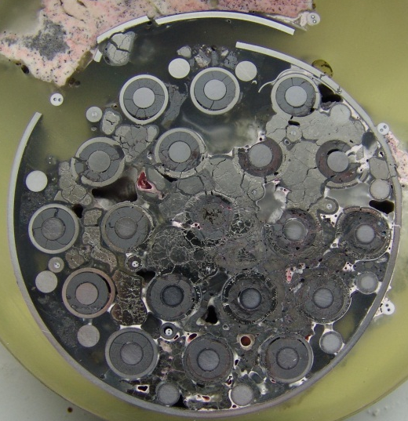
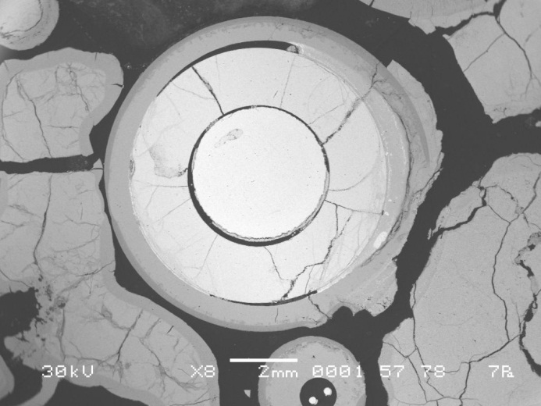
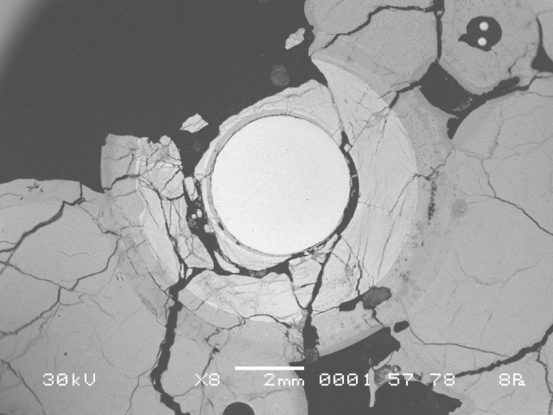
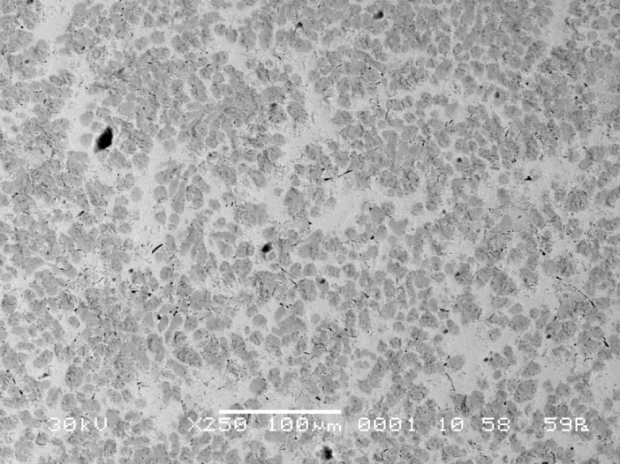
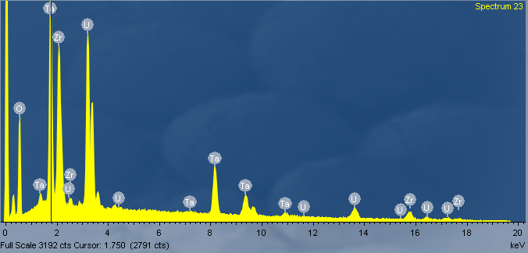
Task 3.
Main results of SF4 fuel assembly post-test
material Investigation
Z = 260 mm
Rod 2.2
Rod 2.4
Z = 300mm
(U,Zr,Ta,O) melt
EDX spectra of (U,Zr,Ta,O) melt
Notes:
The preliminary analysis was made for the four cross-sections from the assembly upper and lower parts. The analysis of structure of the cross-sections showed the following:
At the elevation Z = 130 mm the assembly has no any visible damages practically
At the elevation Z = 260 mm was observed
- large amount of melt in the inter-rod space that melted the fuel rod claddings (Figures 76, 77). - oxidation of zirconium structural components and melt;
- presence of melt in fuel-clad gaps in some fuel rods;
- interaction of some claddings of fuel rod with UO2 pellets.
At the elevation Z = 300 mm there are no structural components (including heaters) of the model FA practically Results of EDX analysis show that alongside with uranium, zirconium and oxygen there is a considerable amount of tantalum (Figure 79).
At the elevation Z = 1200 mm the state of the assembly is characterized by complete absence of zirconium structural components (that is indicative of considerable exceeding the zirconium melting temperature Integrity of the remained fuel rods is kept only at the expense of tantalum heaters.
At PARAMETER-SF4 experiment the data were obtained on flooding the experimental assembly after the stage of oxidation in the air environment. The material obtained in the course of the experiment will enable to broaden the base of knowledge on mechanical and physical-chemical behaviour of claddings of the overheated fuel rods.

Slide 16
CONCLUSIONS
The performed experiments enabled to:
obtain the information on the behaviour of structural components of 19 rod model FA of VVER-1000, overheated to ∼ 1600°C, during top quenching;
study the temperature behaviour of the model FA of VVER-1000 under the conditions of oxidation in air and subsequent bottom quenching;
obtain the information on the degree of oxidation of structural components of the model FA of VVER-1000 and structural-phase changes in claddings of the model FA of VVER-1000 by the results of post-test studies;
study the time history of oxygen absorption and hydrogen release.
Results of tests are intended for better understanding of the phenomenology of the processes occurring during water flooding of the core overheated under severe LOCA at NPP with VVER and under similar situations at PWR, and can be used for verification of computer codes.

