Slide 1
FSUE SRI SIA “LUCH”
IBRAE RAS
FSUE EDO “GIDROPRESS”
I S T C
Study of fuel assemblies under severe accident top quenching conditions
in the PARAMETER-SF test series.
(PARAMETER-SF3 and –SF4 experiments)
(Presentation of the work plan. ISTC project # 3690)
Presented by W. Nalivaev
12th CEG-SAM Meeting
Saint Petersburg, 11 -13 September 2007

Slide 2
Objective:
The studying of behaviour of simulators fuel assembly WWER-1000 completed with standard constructional materials under severe accident conditions at the top flooding
Implementation:
FSUE SRI SIA “LUCH”– rig experiments and post test analysis
IBRAE RAS – pre and post test analyses
FSUE EDO “GIDROPRESS” – justification of an experimental scenario, pre and post test analyses
Foreign collaborators: FZK: IMF- J. Stuckert, ITU - D. Bottomley,
PNS - W. Tromm

Slide 3
The project # 3690 is continuation of the Project # 3194
The primary goals of the project have been considered on:
1. CEG – SAM, 10th Meeting, Kurchatov-City, Republic of Kazakhstan, September 5-8, 2006.
2. 12th International QUENCH Workshop, Forschungszentrum Karlsruhe, October 24-26, 2006.
3. CEG – SAM, 11th Meeting, Dresden, 7 -9 March 2007

Slide 4
Realization of the top flooding at SA
1. WWER - 1000
Cooling of a core it is determined by two
processes:
1. Rise of a water level from the bottom
chamber at a bottom flooding.
2. Passage of water through a core from
the top chamber at a top flooding.
Water delivery from ECCS
simultaneously from top and bottom
allows to avoid a situation, when all
submitted water is carried away in a leak.
Water delivery from top allows
to organize cooling earlier, than at water
delivery from bottom.
The scheme of a flooding of core of WWER-1000 by two pumps of low pressure.

Slide 5
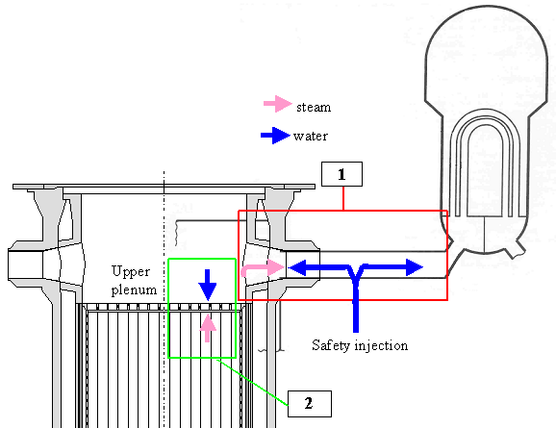
2. PWR
There are two possibilities for top quenching occurrence:
1. In case of severe accident, the steam in steam generator tubes can condensate and water thus produced can return to the core via the hot leg.
2. When the injection point of safety injection system is located on the hot leg, one can expect that a part of the injected water rate can directly go to the core through the nozzle of the hot leg.
The scheme of a flooding of core of PWR in case of severe accident.
(Top Flooding Modeling With MAAP4 Code. Estelle Brunet-Thibault, Serge Marguet, EDF Electricite, de France. International Conference Nuclear Energy for New Europe 2006,
Portorož, Slovenia, September 18-21, 2006)

Slide 6
Some conclusions by results of the analysis
of PARAMETER SF1, SF2 experiments
1. Difficult character of movement of front of cooling of test bundles in experiments SF1 and SF2 at a top flooding was observed.
2. Process of degradation of constructional elements of bundle happened in experiment SF1 and absence of zones of destruction (debris) pellets are caused by presence of a skeleton of heaters of rods.
3. The received results have shown on necessity of carrying out of the additional researches, allowing to estimate character of cooling of assembly at a top flooding before its degradation (SF3 experiment) and in conditions of formation of zones of destruction pellets (debris, SF4 experiment).

Slide 7
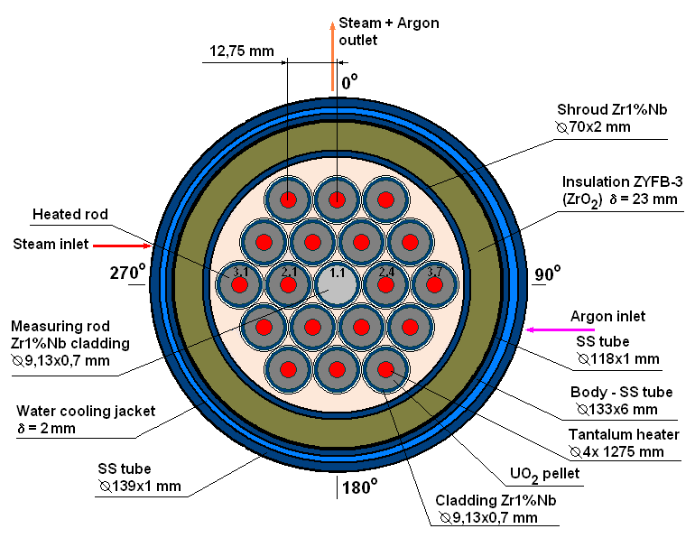
Scope of Activities
The activities of the Project include preparation and performing of two
experiments at PARAMETER test facility on studying the two fuel
assemblies (FA) of WWER-1000:
with 18 heated fuel rods and central unheated rod
(PARAMETER-SF3 experiment);
In experiment SF3 the FA maximum
temperature before flooding is no more
than 1600 °C, water flow rate of top
flooding is 40 g/s, all the rest of time
and temperature parameters are similar
to those in the experiment QUENCH-06.

Slide 8
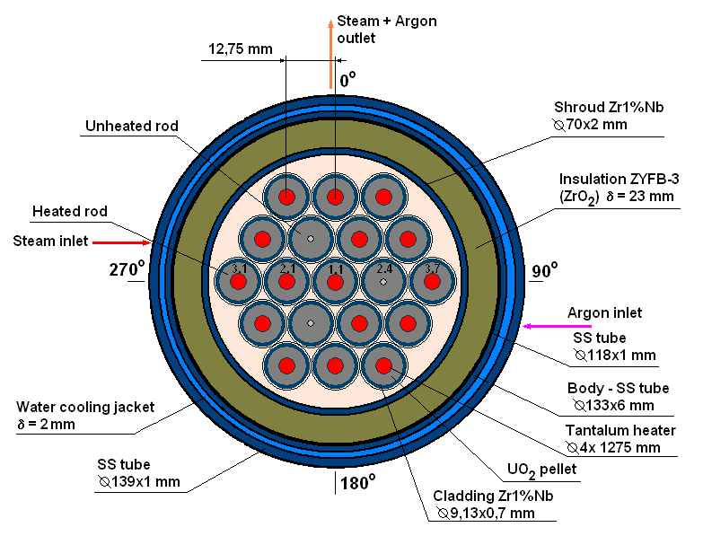
Scope of Activities
The activities of the Project include preparation and performing of two
experiments at PARAMETER test facility on studying the two fuel
assemblies (FA) of WWER-1000:
2. with 16 heated fuel rods and 3 central unheated rods arranged
in the 2-nd row (PARAMETER-SF4 experiment).
In experiment SF4 the FA maximum
temperature before flooding is ∼ 1800 °C,
water flow rate of top flooding is 40 g/s,
all the rest of time and temperature
parameters are similar to those in the
experiment SF1.

Slide 9
The main parameters of the PARAMETER-SF
and QUENCH-06 Experiments
Test | Test parameters
 | Input parameters | Pre-oxidation phase |  | Transient phase |  | Quench phase |  | Hydro-gen genera-tion
 | Steam/ argon flow rate, g/s | Tcl max, °C | τ, s | δTcl/δτ, °C/s | Tcl max, °C | Top flooding, g/s | Bottom flooding, g/s | M(H2), g
SF3 | 3/3 | 1200 | 3000 | 0.3 | 1600 | 40 | - | -
QU-06 | 3/3 | 1200 | 4000 | 0.3 | 1730 | - | 40 | ∼25
SF4 | 3/2 | 1200 | 3000 | ∼ 0.3 | ∼1800 | 40 | - | -
SF1 | 3.3/2 | 1200 | 3000 | 0.3-0.5 | ∼2000 | 40 | - | ∼92

Slide 10
The Work Plan of the Project
Task 1. Post-test material analysis of WWER-1000 model FA,
subjected to test in experiment PARAMETER-SF2 under severe
accident with top and bottom flooding. (IV quarter 2007).
- Fragmenting of model FA, subjected to tests in the experiment,
and preparing of templates;
- Metallography and measurement of microhardness;
- Electronic microscopy;
- X-ray structural analysis.
Task 2. Study of peculiarities of cooling and change in the structure
of materials of FA of WWER-1000 under severe accident during top
quenching of assembly heated to temperature below 1600 °C
(PARAMETER-SF3). (I-III quarters 2008):
- Carrying out the calculation of the test conditions and parameters of
the experiment on the basis of computer codes RELAP/SCADSIM, ТВЭЛ-3,
РАТЕГ/СВЕЧА, MELCOR, ICARE-CATHARE, РАПТА-5, PARAM-TG.
Preparation and conduction of PARAMETER-SF3 experiment.
- Post-test material analysis.
- Processing of the results of PARAMETER-SF3 experiment.

Slide 11
The Work Plan of the Project
Task 3. Study of debris formation during top quenching of
WWER-1000 FA heated to ∼ 1800 °C (PARAMETER-SF4).
(IV quarter 2008 - III quarter 2009):
- Carrying out the calculation of the test conditions and parameters of
the experiment on the basis of computer codes RELAP/SCADSIM, ТВЭЛ-3,
РАТЕГ/СВЕЧА, MELCOR, ICARE-CATHARE, РАПТА-5, PARAM-TG.
Preparation and conduction of PARAMETER-SF4 experiment.
- Post-test material analysis.
- Processing of the results of PARAMETER-SF4 experiment.
- Scientific and Research Final Report.

Slide 12
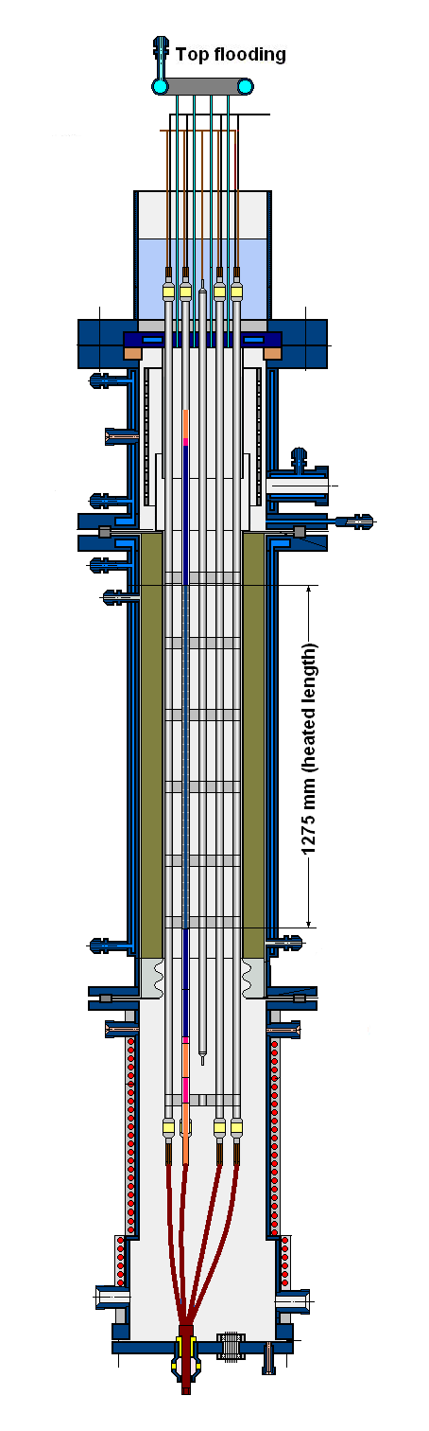
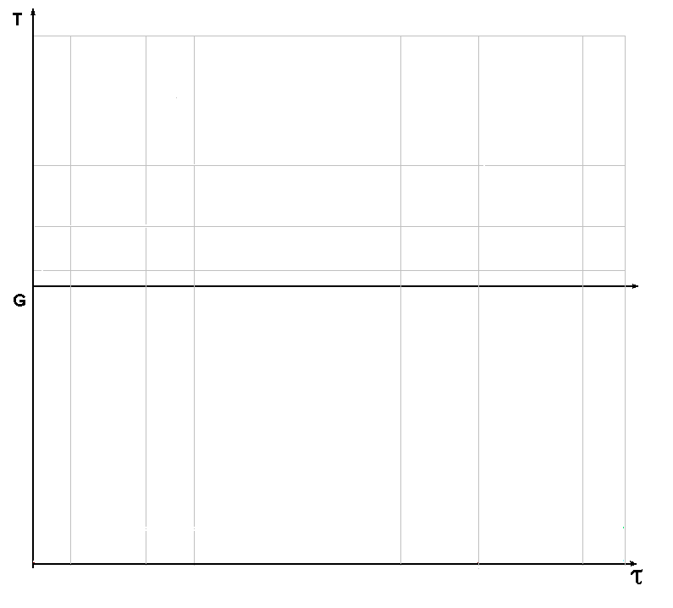
The prospective scenario of experiments

Slide 13
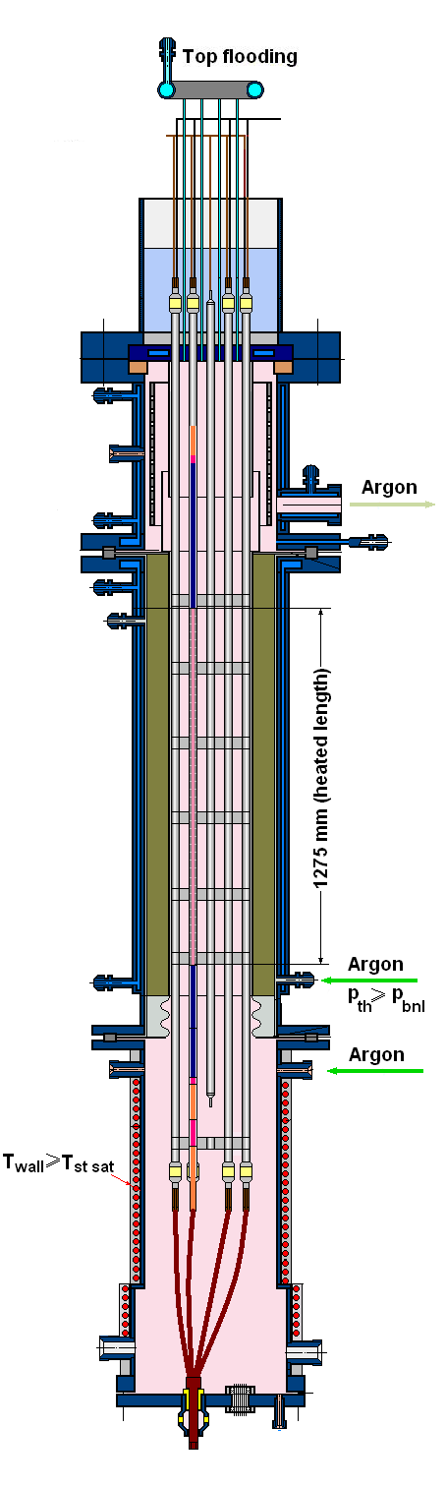
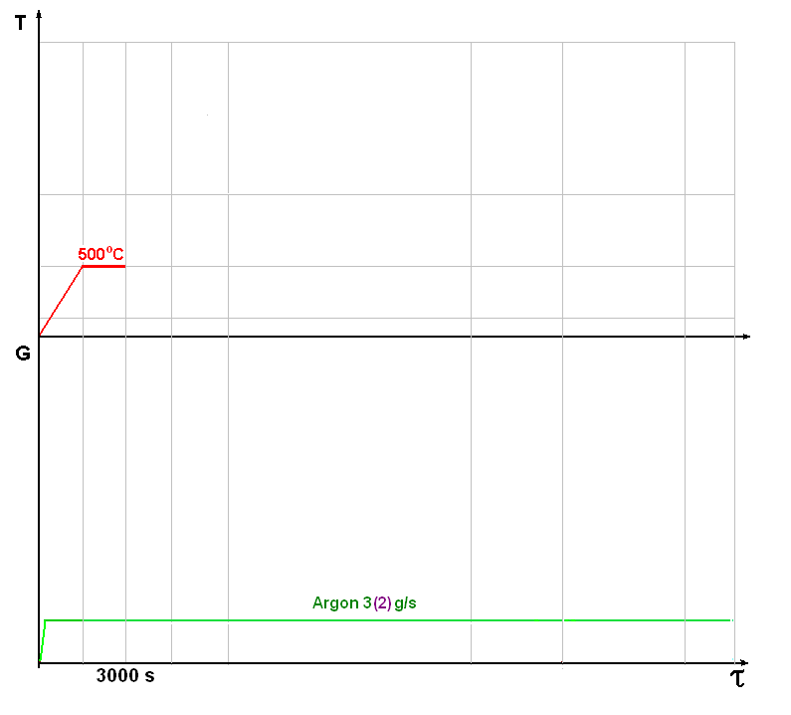
The prospective scenario of experiments
Preparatory stage 1
SF3
(SF4)

Slide 14
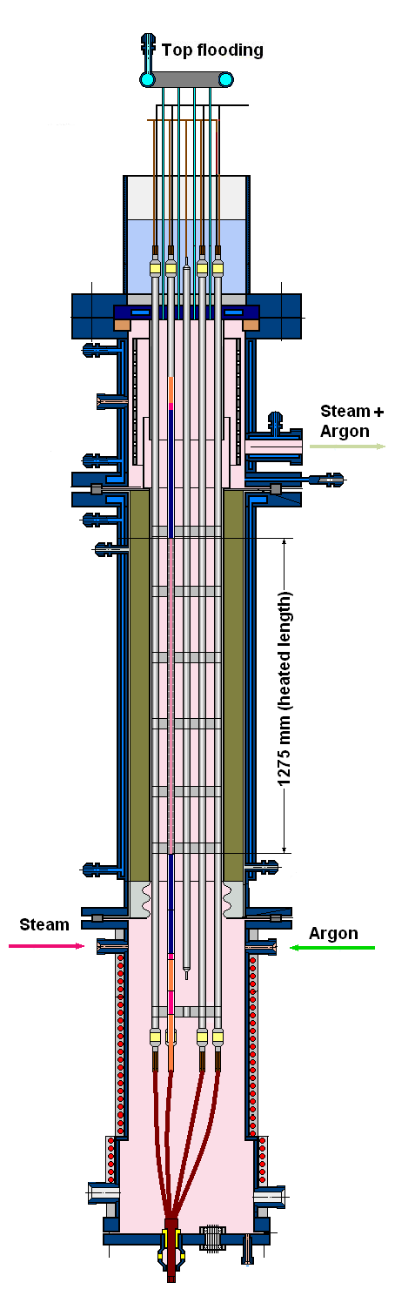
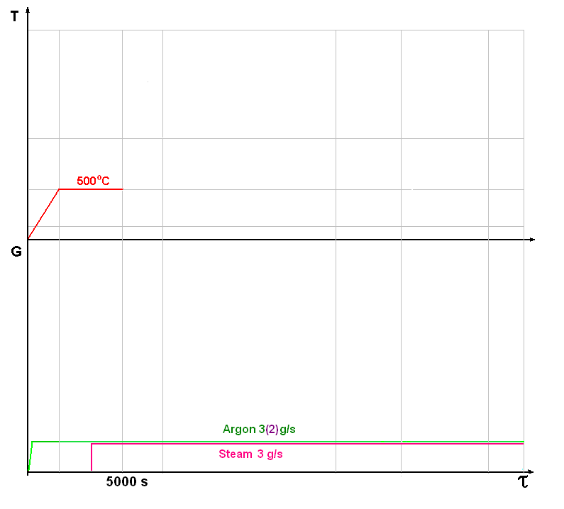
The prospective scenario of experiments
Preparatory stage 2
SF3
(SF4)

Slide 15
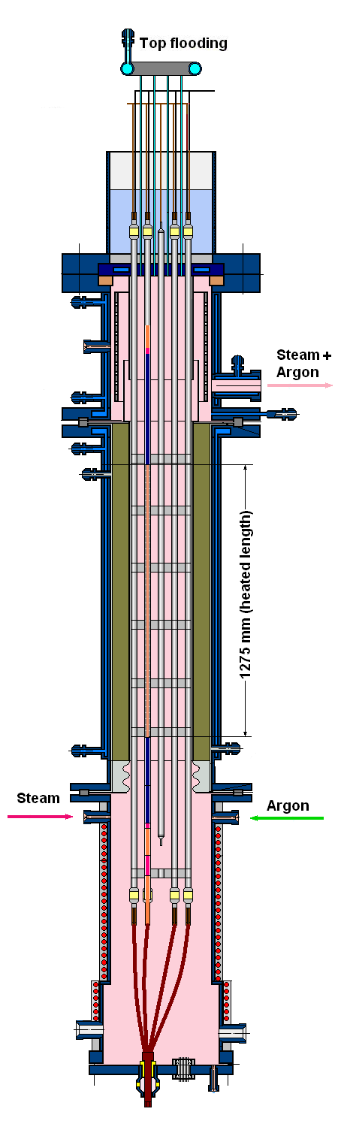
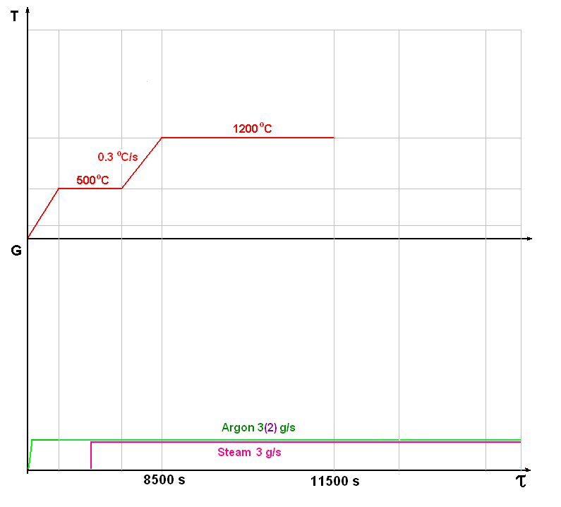
The prospective scenario of experiments
Stage of preoxidizing
SF3
(SF4)

Slide 16
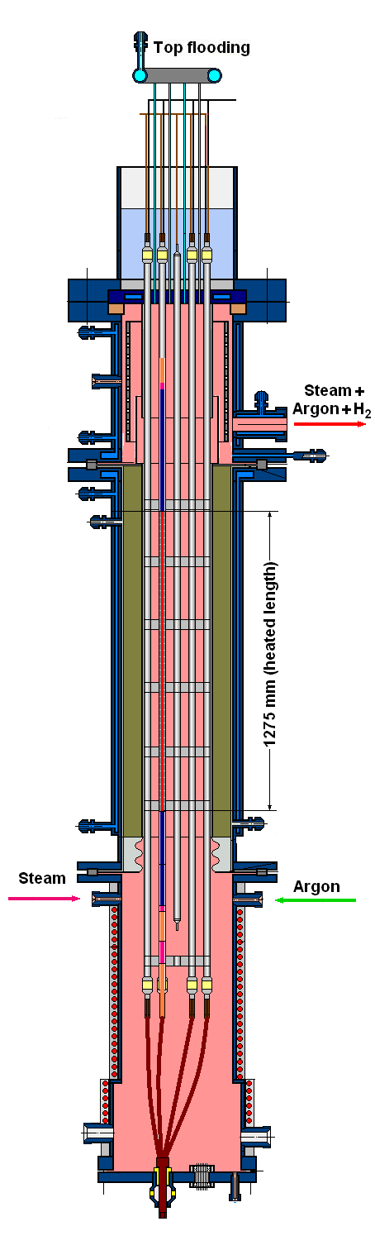
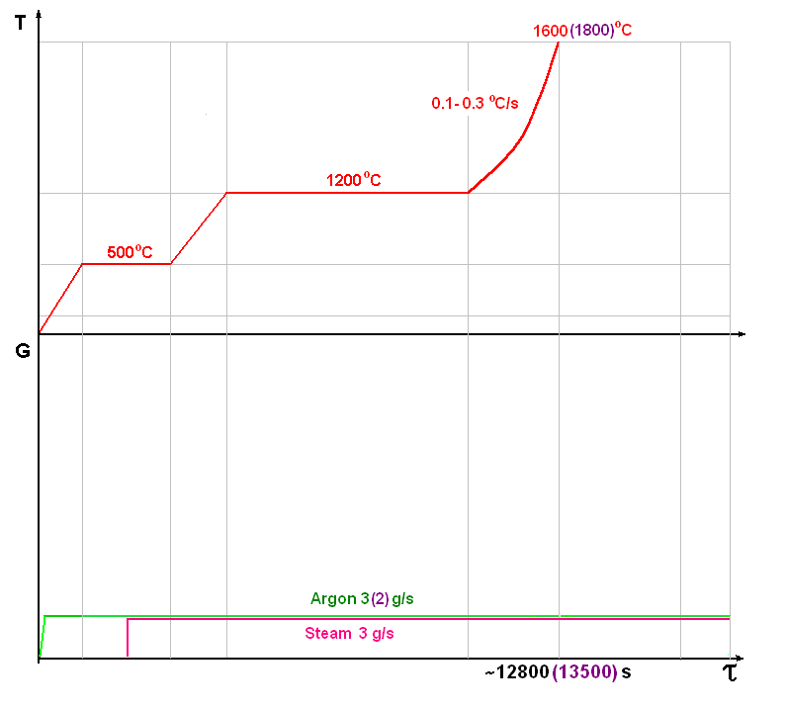
The prospective scenario of experiments
Transient stage
SF3
(SF4)

Slide 17
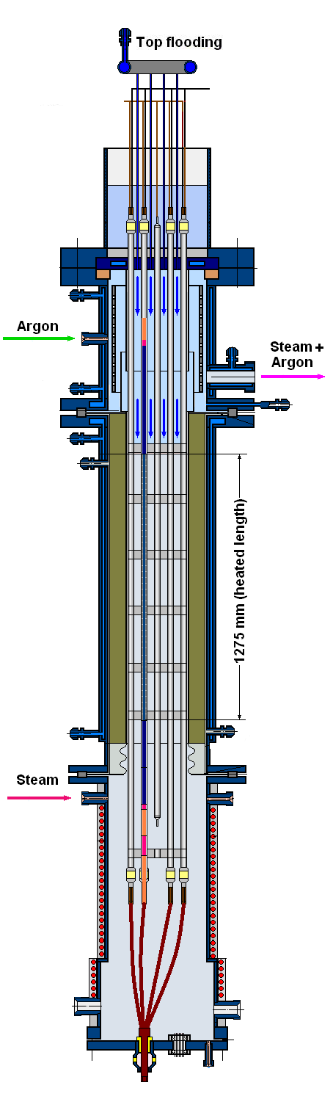
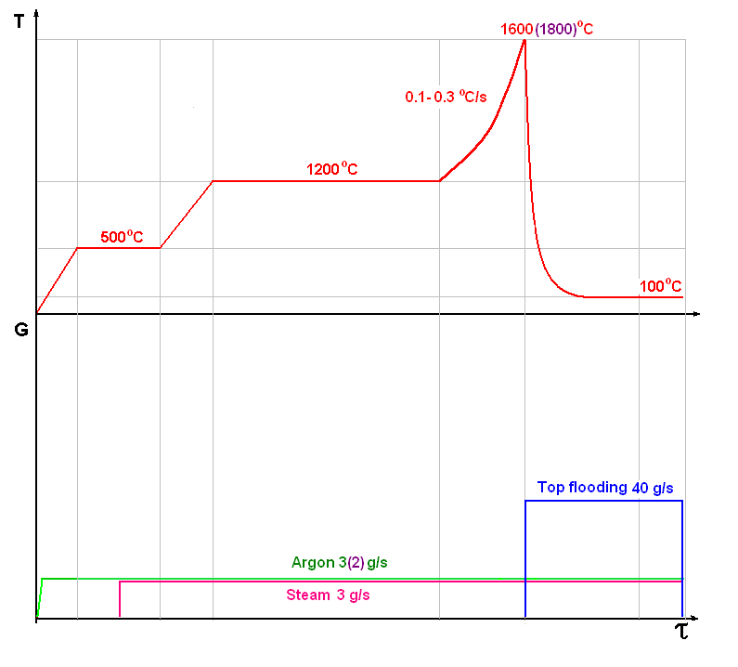
The prospective scenario of experiments
Quench stage
SF3
(SF4)

Slide 18
Expected results of works under the Project
- Information will be obtained and systematized on behaviour of model FA under severe accident during top quenching;
- Database for verification severe accident codes
(SOCRAT/B1, ATHLET, ICARE-CATHARE etc.) will be broadened;
- Moving of cooling front of the assembly, heated below 1800 °C will be studied;
- The obtained results can be used for safety justification of WWER (PWR) type reactors, as well as for development of the methods and means of control and protection system, capable to fulfill their function under accident conditions.

