Slide 1
FSUE SRI SIA “LUCH”
IBRAE RAS
FSUE EDO “GIDROPRESS”
Status of the ISTC project #3690 (continued)
Specification for numerical simulation of PARAMETER facility: Tests SF3 and SF4.
PARAMETER-SF3 test scenario and results of SF3 pre-test numerical modeling
V. NALIVAEV, A.KISELEV, T.YUDINA
Budapest, 5-7 March 2008

Slide 2
Content
Results of post-test examination of the PARAMETER-SF2 fuel bundle
Presentation of Specification for simulation of PARAMETER-SF3 test
Pretest calculation results of the PARAMETER-SF3 experiment

Slide 3
1. Post-test appearance of the shroud
Z = 850-1050 mm
Z=1100-1300 mm
Shroud kept its integrity
Thin oxide scale on the outer surface

Slide 4
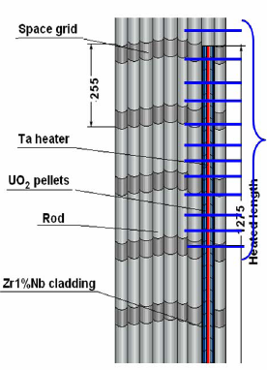
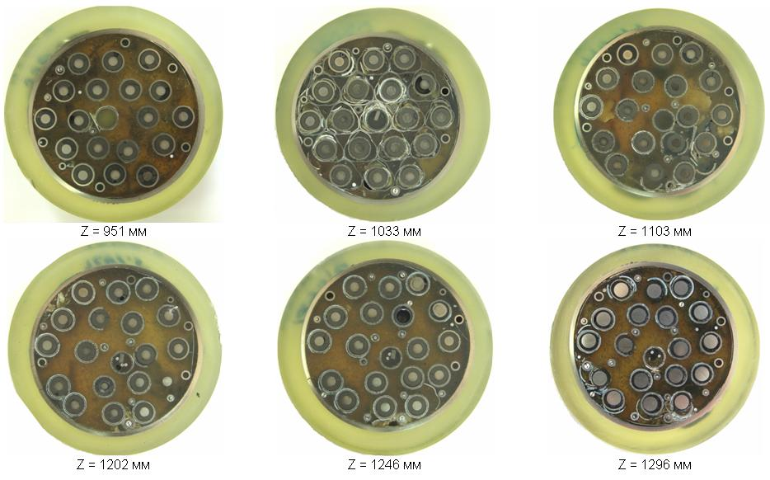
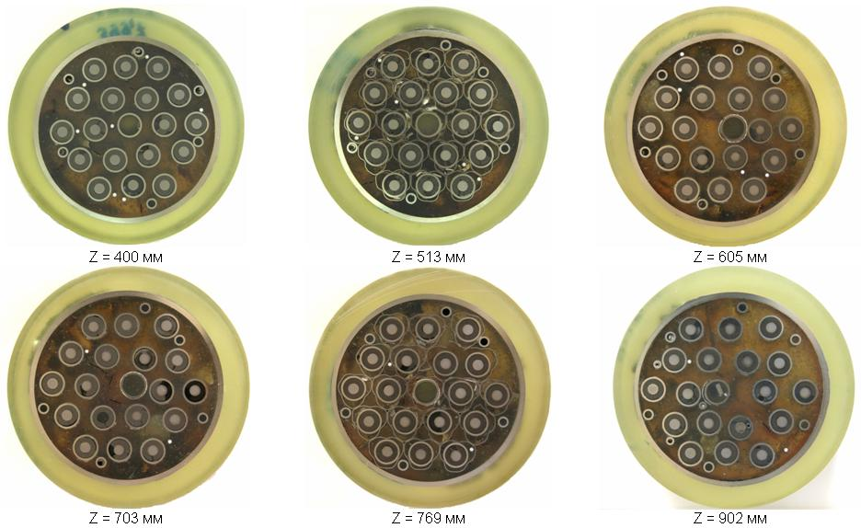
Overview of sectioning map for metallografic examination
At 400-1300 mm
30 crosscuts were
made
12 cross-sections
were chosen for
studies
5 selected cross
section are considered
in detail
in the presentation

Slide 5
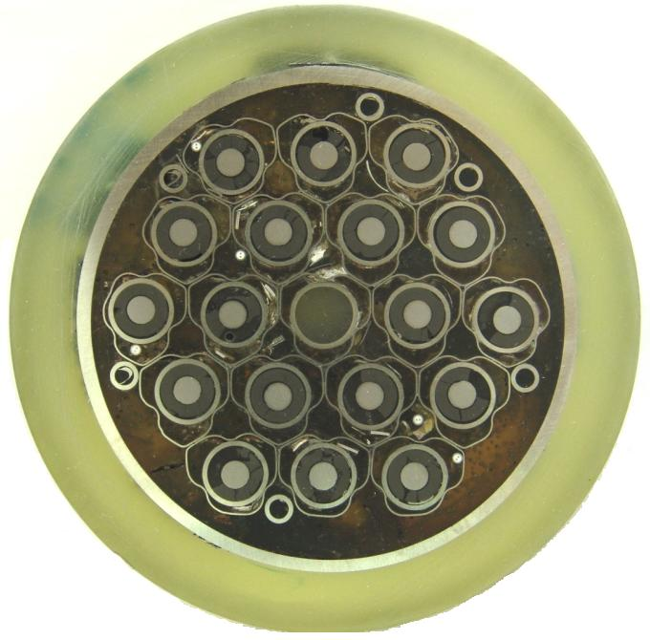
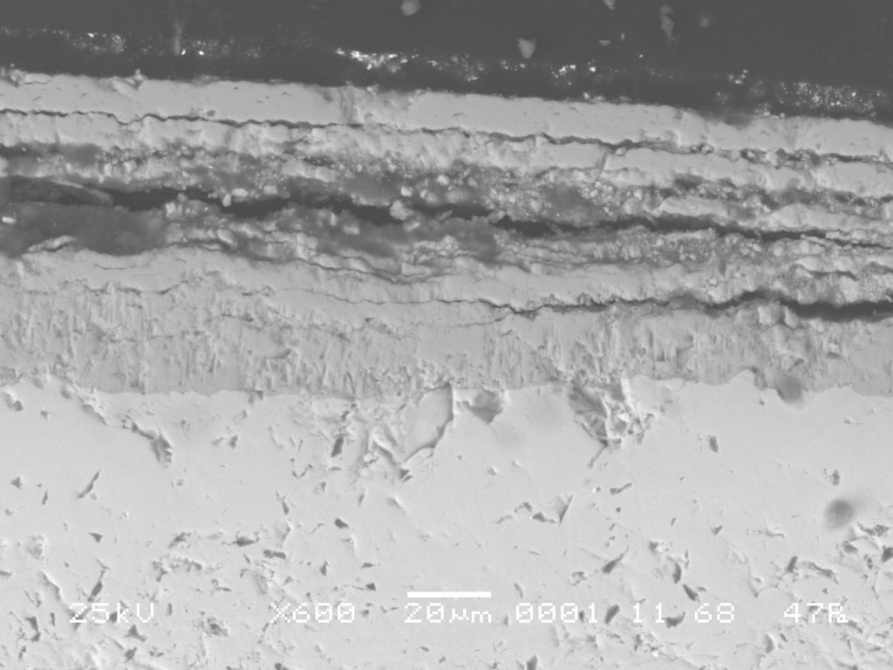
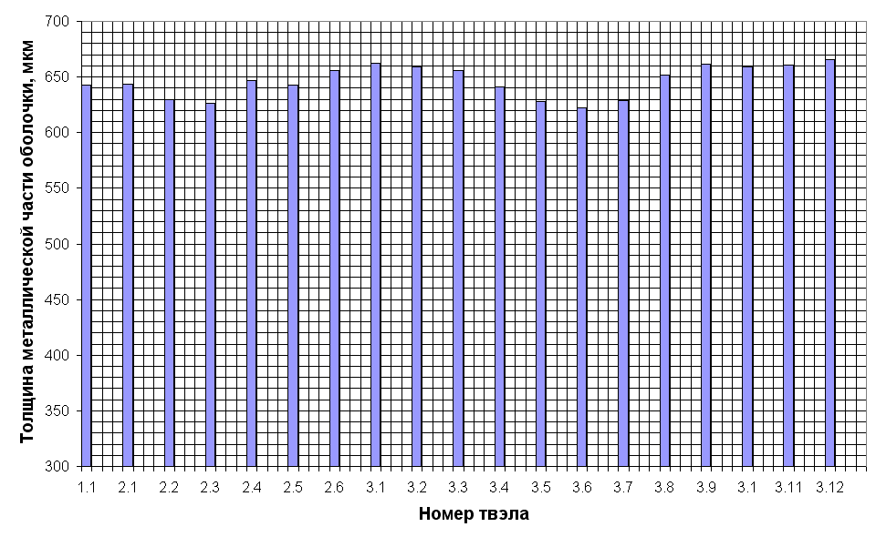
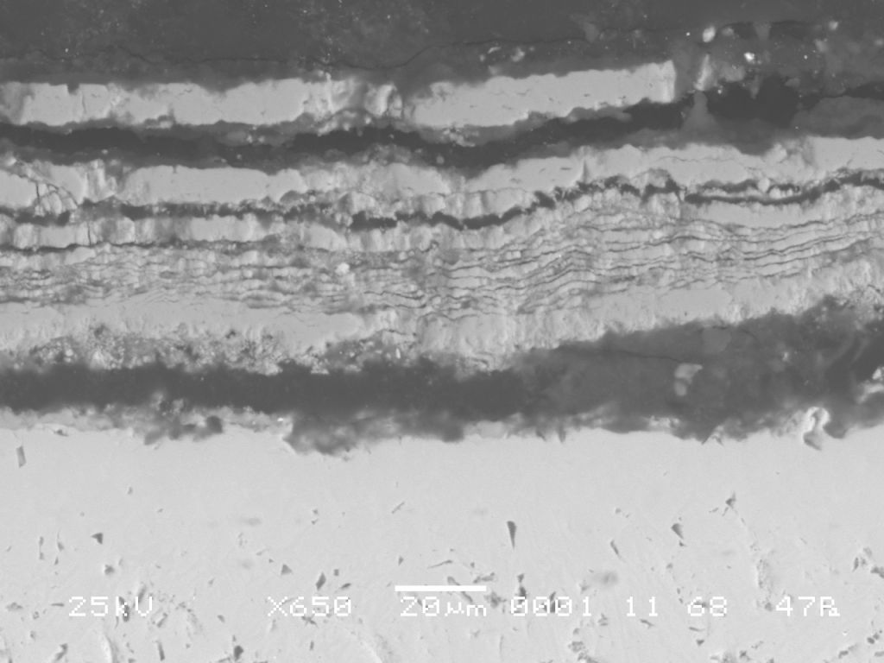
Metallographic examination of the cross section at Z=513 mm
Rod 2.1
Rod 2.3

Slide 6
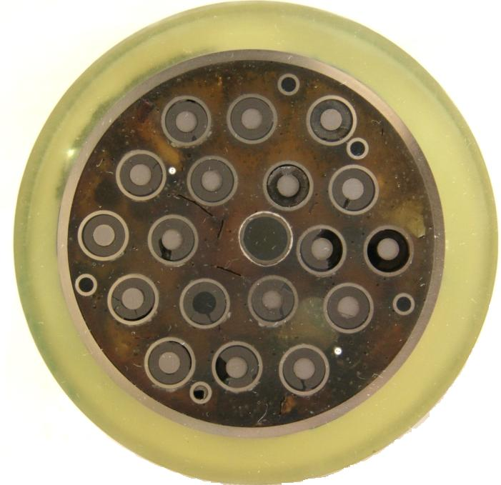
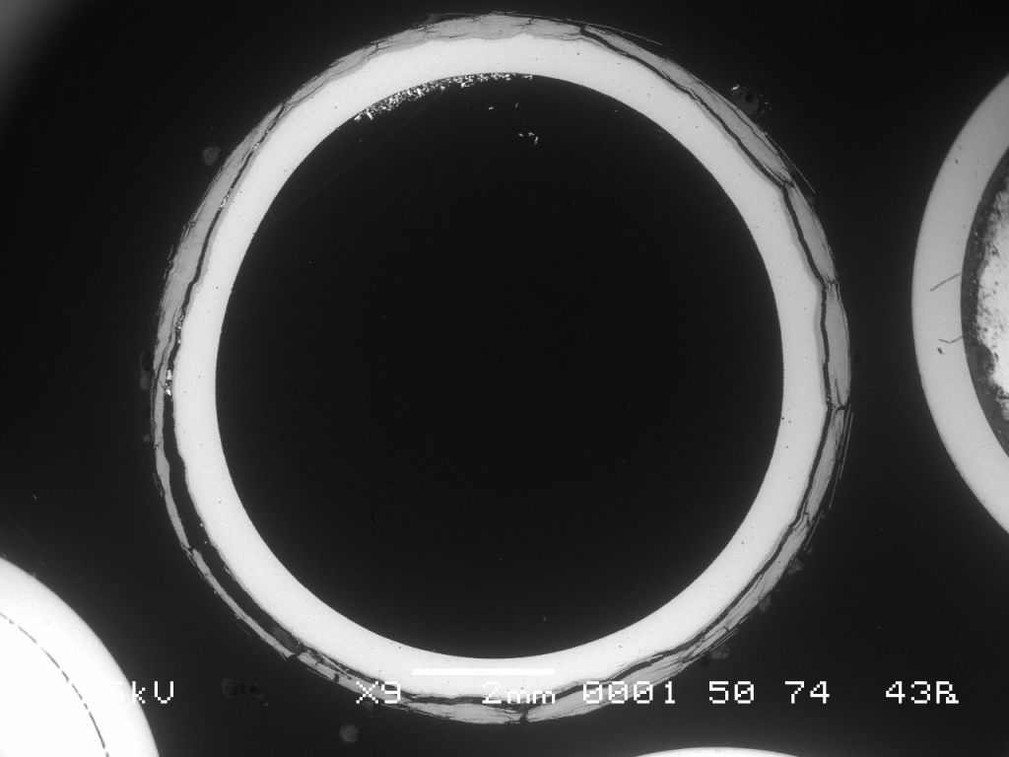
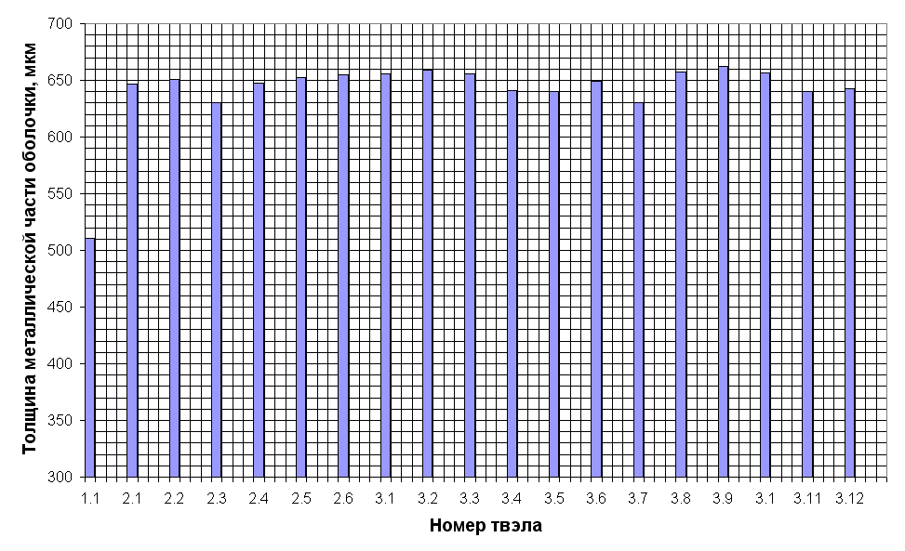
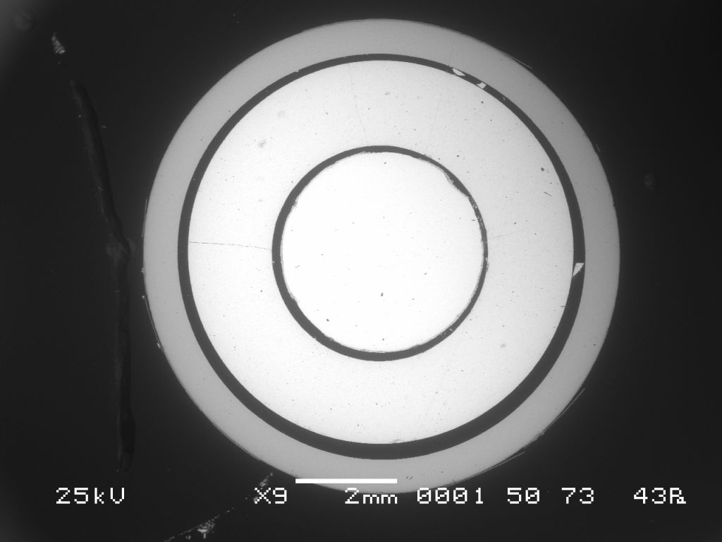
Metallographic examination of the cross section at Z=702 mm
Rod 1.1
Rod 2.1

Slide 7
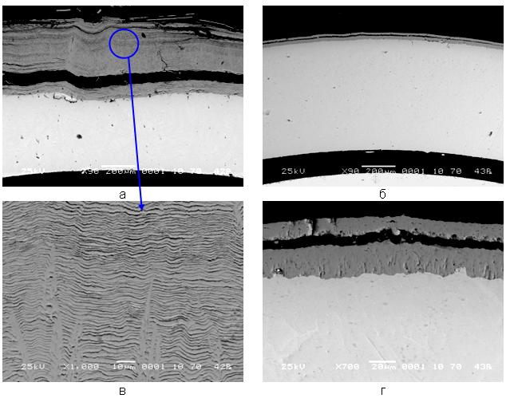
Layers structure at Z=702 mm
Rod 1.1
Rod 2.1

Slide 8
Metallographic examination of the cross section at Z=1033 mm
Through wall cracks on the claddings
A lot of oxide scale remnants between rods

Slide 9
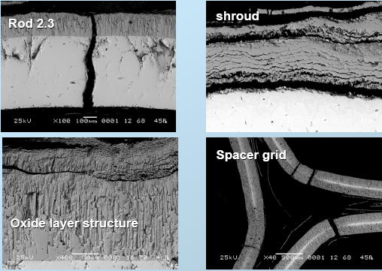
Layers structure at Z=1033 mm
Tmax ~1350C
Internal oxide of columnar
structure with multi-layer
spalling-off films
No oxidation of cracks

Slide 10
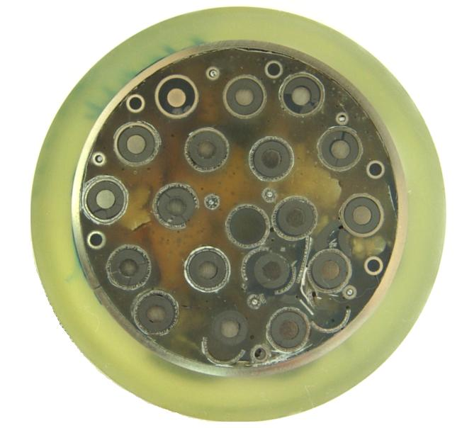
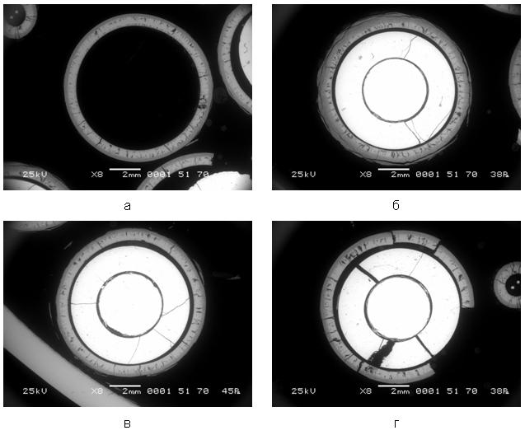
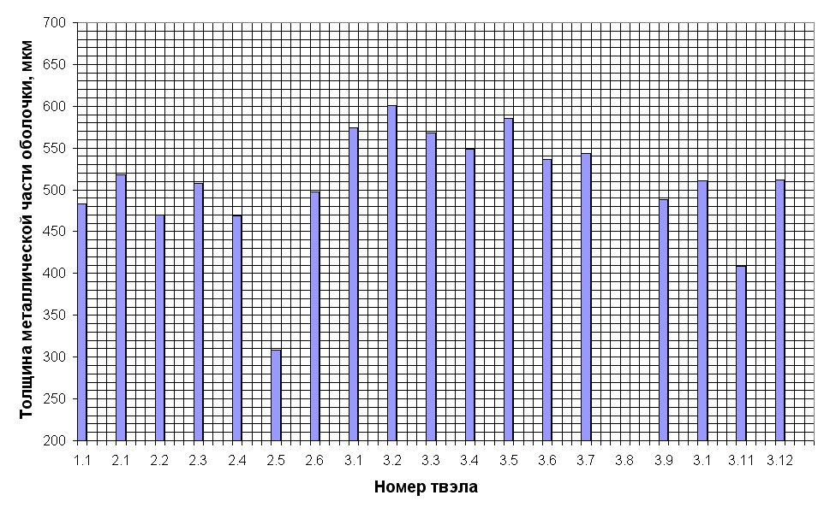
Metallographic examination of the cross section at Z=1103 mm
Rod 1.1
Rod 2.5
Rod 3.9
Rod 2.6

Slide 11
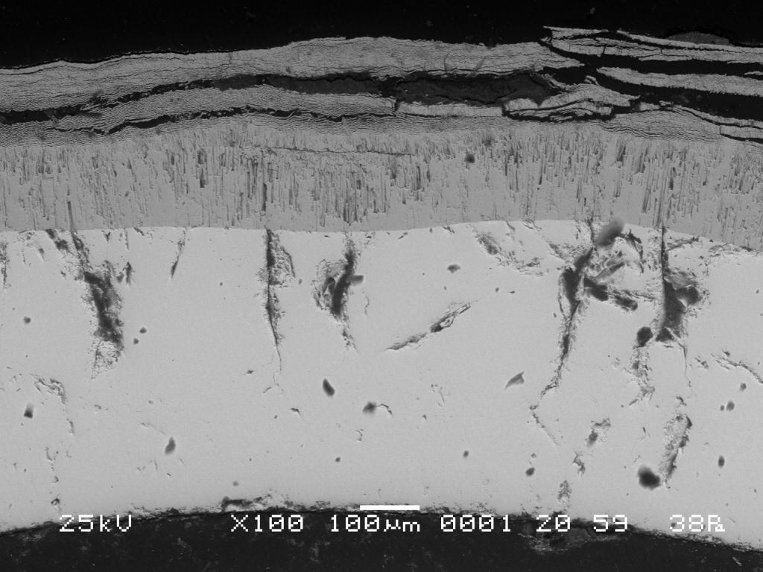
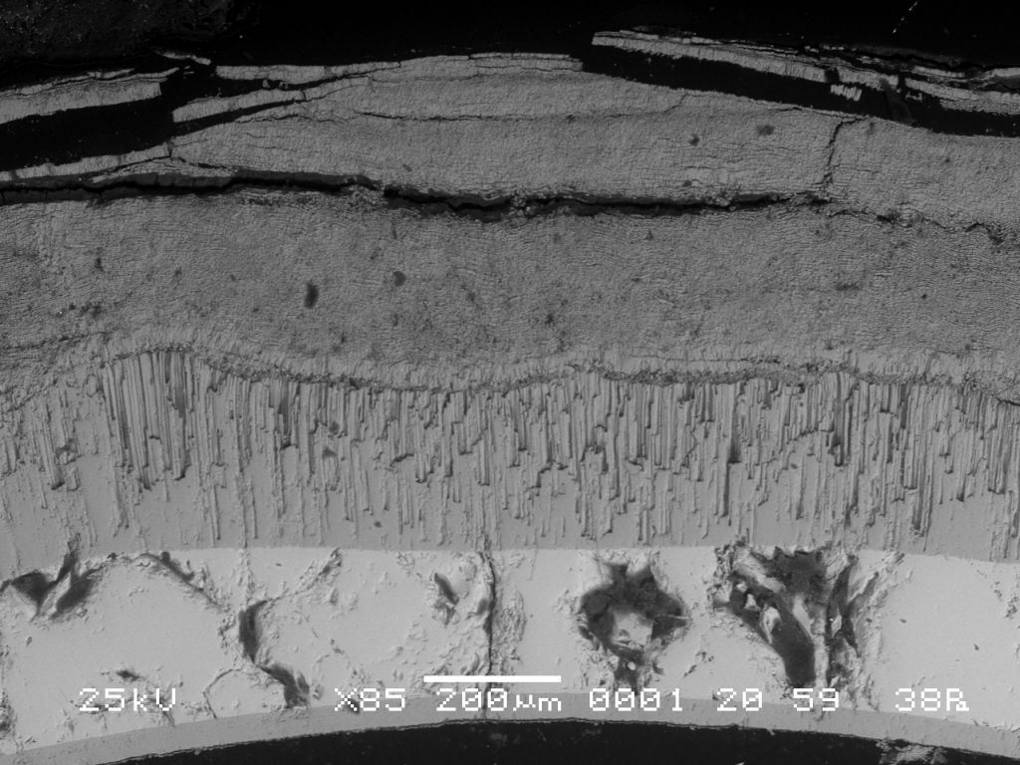
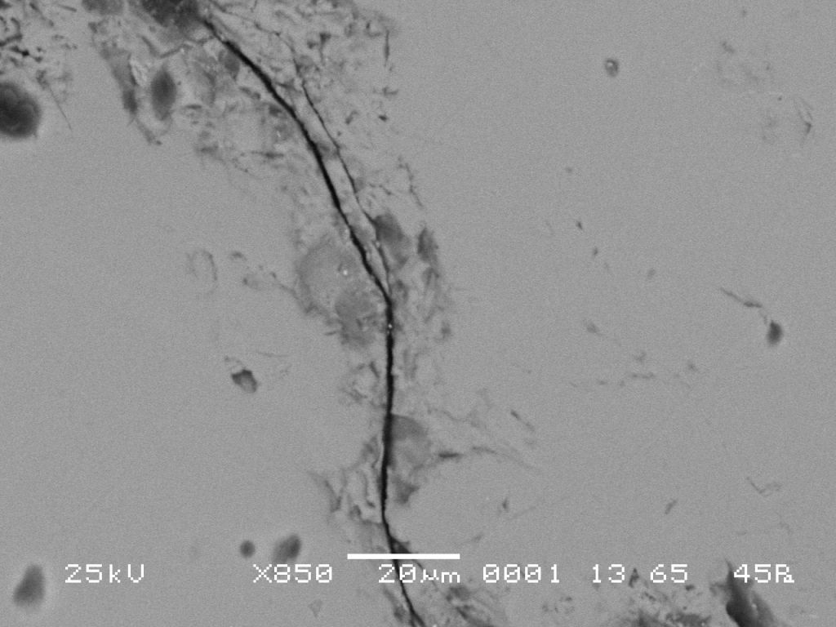
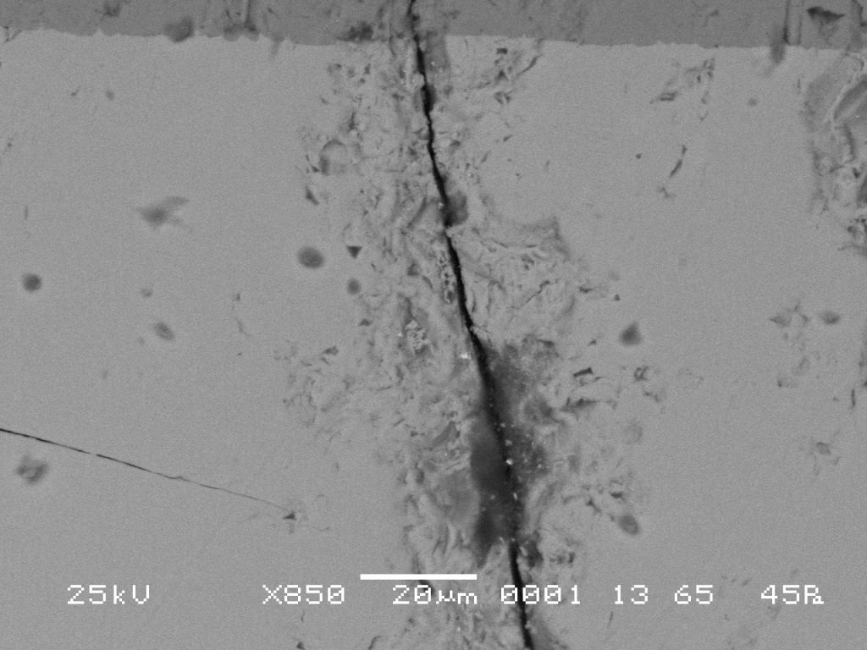
Layers structure at Z=1103 mm
Rod 2.2
Rod 2.5
Rod 2.4
Rod 3.5

Slide 12
Metallographic examination of the cross section at Z=1250 mm

Slide 13
Layers structure at Z=1250 mm
Tmax ~1500C
Columnar structure of inner
oxide and spalling-off
multi-layers
on the external surface
No oxidation of cracks

Slide 14
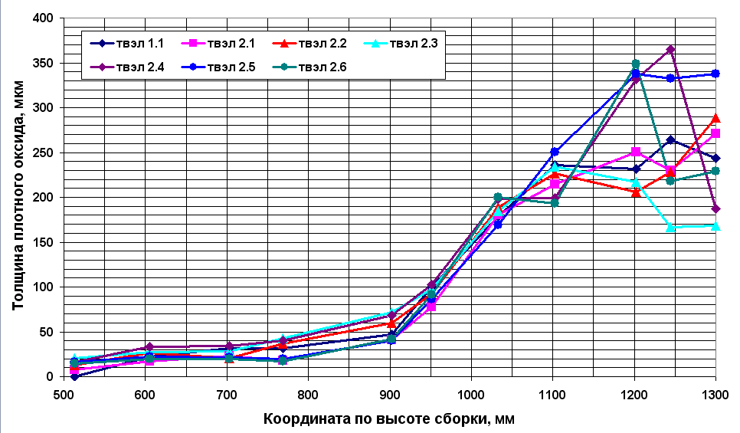
Distribution of the compact dioxide zirconium thickness along heated zone

Slide 15
Some outcomes from SF2 material investigations
Material investigations of the PARAMETER-SF2 bundle are in progress.
  The fuel assembly was filled with epoxy and cut on the cross-section
  12 cross section were chosen for metallographic measurements
  5 cross section have been investigated and described in detail (Z=513, 702, 1033, 1103, 1250 mm)
There is no fuel relocation.
Pronounced oxidation of the claddings at Z=1000-1300 mm elevations have been revealed. No oxidation of through wall cracks.
ZrO₂ oxide on the claddings surface includes inner compact one-layer dioxide zirconium with columnar structure on the metallic layer and external multi-layer spalling-off films.
Metallic layer thickness of the fuel rod claddings together with compact dioxide zirconium thickness were measured.

Slide 16
2. Specification for simulation of PARAMETER-SF3 test
Goal – to provide code users with technical information on PARAMETER-SF3 test
Draft version was issued 06.02.08
Content:
  Introduction
  Objectives and tasks of the investigation
  Design
      PARAMETER facility
      test section
      bundle
      fuel rod
      electric heating system
  List of instrumentation
  Scenario of the PARAMETER-SF3 test
      table of main phases
      initial and boundary conditions
  Material properties
  Proposal for calculation results comparison

Slide 17
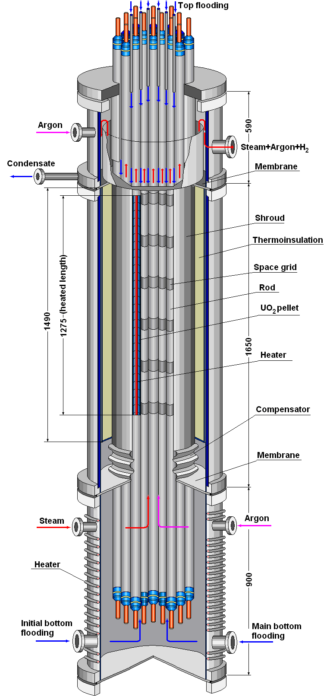
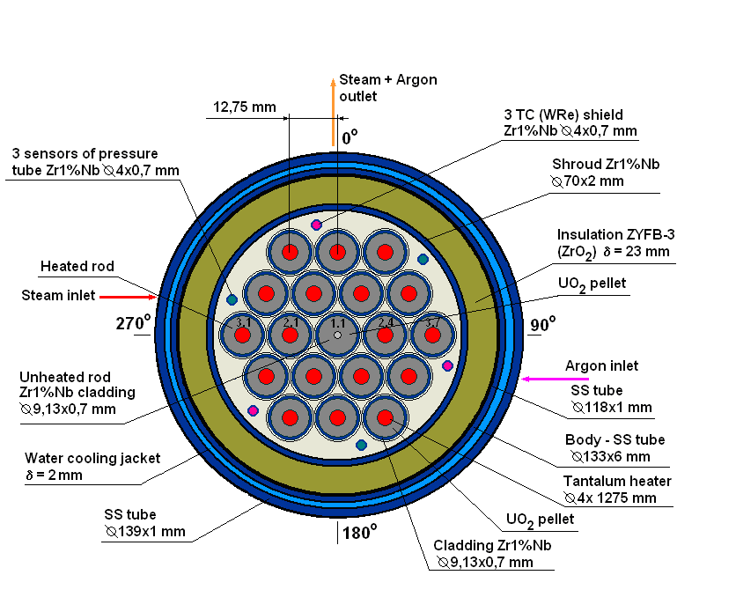
The test section and the bundle
Number of rods – 19 (central rod is unheated)
Material – typical for WWER
claddings spacer grids, shroud – Zr1%Nb
pellets – UO₂
Dimension – cladding diameter 9.13/7.73
fuel pellet - 7.6/4.2/11 for heated rods
fuel pellet - 7.6/1.6/11 for central rod
Heated zone – 1275 mm
Fiber ZrO₂ is used as an insulator material

Slide 18
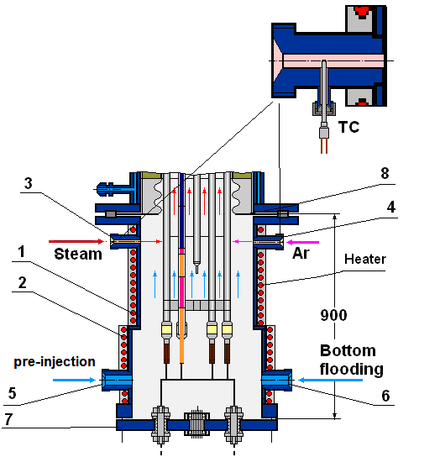
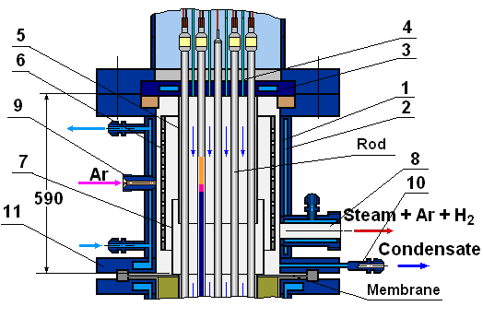
Top and bottom parts of the test section

Slide 19
Water supply tubes arrangement

Slide 20
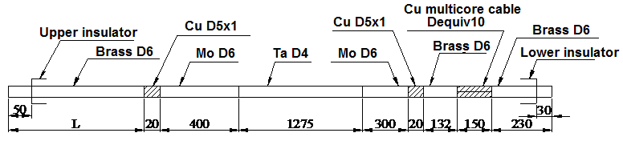
Design characteristics of electrodes
Rod number | 2.1 | 2.2 | 2.3 | 2.4 | 2.5 | 2.6 | 3.1 | 3.2 | 3.3 | 3.4 | 3.5 | 3.6 | 3.7 | 3.8 | 3.9 | 3.10 | 3.11 | 3.12
L, mm | 755 | 840 | 755 | 840 | 755 | 840 | 585 | 670 | 755 | 670 | 585 | 670 | 755 | 670 | 585 | 670 | 755 | 670

Slide 21
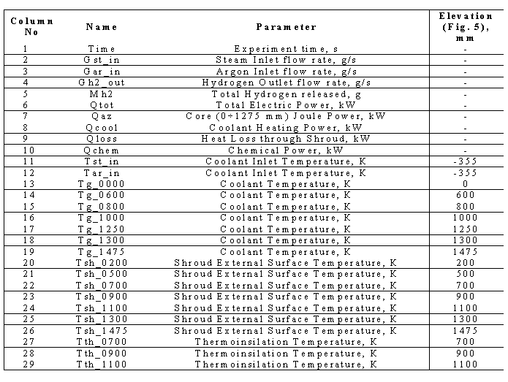
Proposal for calculation results comparison

Slide 22
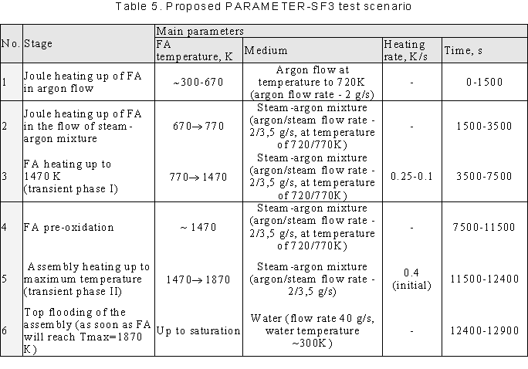
Proposed PARAMETER-SF3 test scenario

Slide 23
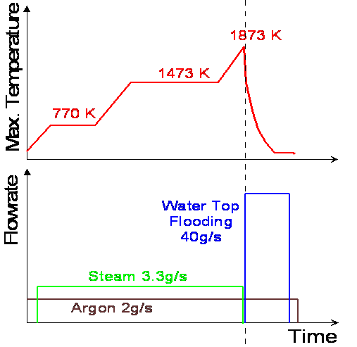
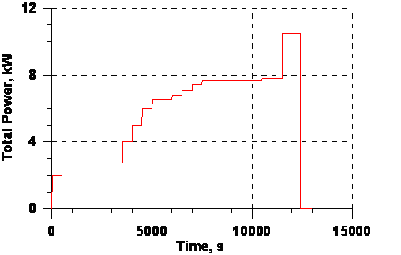
Initial and Boundary conditions

Slide 24
3. Results of SF3 pre-test numerical modeling
Used codes - SOCRAT, ICARE/CATHARE, RELAP, PARAM TG
Participants - IBRAE, NPO LUCH, RRC KI, OKB GIDROPRESS
Goal – scenario (and the Specification) justification and development of requirements for measuring and control systems and recommendations

Slide 25
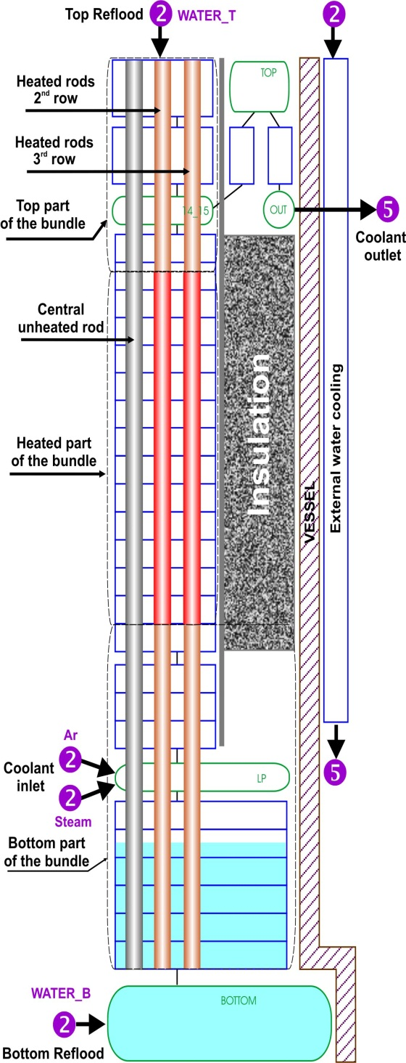
SOCRAT ICARE

Slide 26
Test section heat balance
Pre-oxidation stage
Total power ~7.5 kW
Core power ~6.5 kW
Transient phase
Total power ~10.5 kW
Core power ~9 kW
Heat loss to shroud
~15-20% of core power at 0-1275 mm

Slide 27
Claddings temperature and ZrO2 thickness at 1250 mm elevation (6 thermocouples)
1250 mm
1250 mm

Slide 28
ZrO₂ thickness (SOCRAT calculation)
11500s
end of pre-oxidation phase
12400s before flooding
13000s
final distribution

Slide 29
Hydrogen generation
Total hydrogen
release is ~ 22 g

Slide 30
Flooding Phase (SOCRAT calculations)
Well predicted cooling front propagation

Slide 31
Conclusions
Material investigations of SF2 bundle are in progress. Correspondent report expected to be issued in November 2008
Specification for SF3 test was issued. We are expecting the contribution from foreign collaborators.
Pre-test runs have been performed by SOCRAT, ICARE/CATHARE, RELAP, PARAM-TG (LUCH, GIDROPRESS, IBRAE, RRC KI)
Scenario for SF3 test was numerically justified. Now SF3 test section is under assembling. The test will be performed in September 2008.

